Slide 1

Abraham and Lot
Genesis 13-14
Is not the whole land before thee? separate thyself, I pray thee, from me: if thou wilt take the left hand, then I will go to the right; or if thou depart to the right hand, then I will go to the left.
Genesis 13:9

Slide 2

Lot
He was the son of Haran and nephew of Abraham
His name means “covering”
He joined Abraham’s family and left Ur to the land of Canaan
His estate and Abraham’s estate were so abundant that they had a disagreement and split the land
Abraham gave him a choice land, where he ‘pitched his tent toward Sodom’
The King of Elam, Chedorlaomer, and 3 princes of Babylon defeated the kings of Sodom and during this battle they took Sodom and Gomorrah along with Lot and his goods
Abraham rescued him and his family with his 318 men; however, he and his family dwelt in the wicked city by choice
Messengers were sent to warn Lot that he and his family were in the midst of evil and that the city was to be destroyed…Lot resisted, and the messengers came to force him to leave
One messenger urged him to escape to the mountains and not look back…they escaped to Zoar, and as the sun arose Sodom and Gomorrah was destroyed by the Lord
Lot’s wife looked back and was turned to ‘a pillar of salt’
He dwelt on the mountains and fathered two sons: Moab and Ammon
(1)

Slide 3
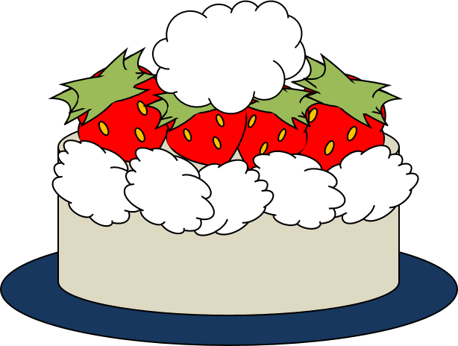
Equal Parts
Abram and Lot left Egypt with all their flocks and possessions and journeyed back to the land of Canaan, where they settled together.
The servants of Lot quarreled with the servants of Abram over land and water for their flocks and herds.
Is not the whole land before thee?
Being a peacemaker may require us to place others’ interests above our own
Genesis 13:1-9

Slide 4
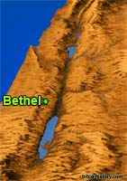
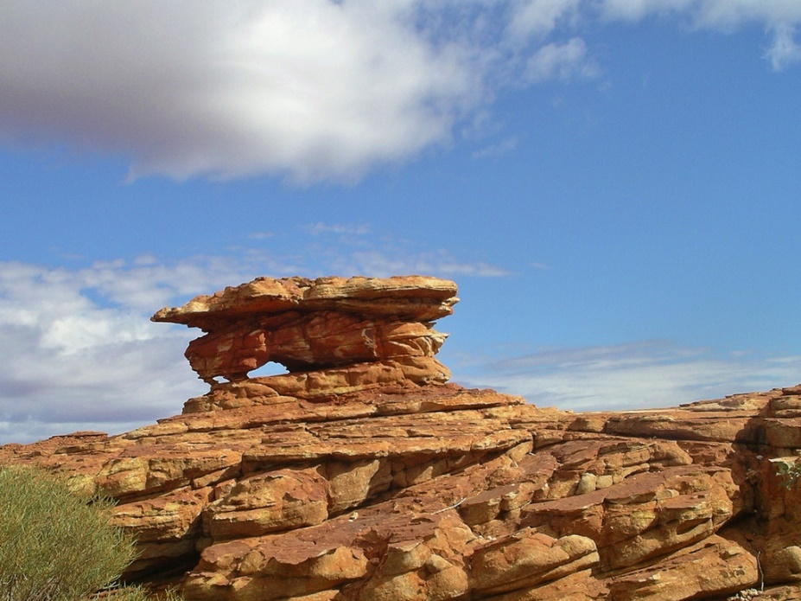
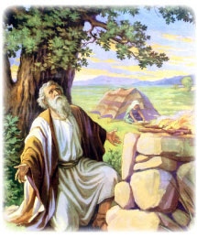
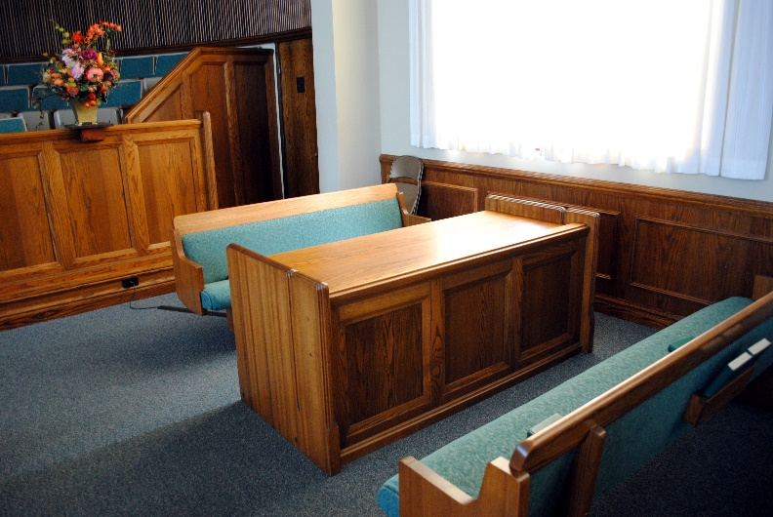
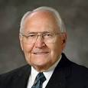
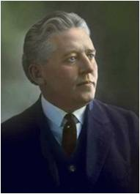
Abraham Builds an Alter
Between Beth-el and Hai—then Hebron
Alters of Today
Hebron
“After Adam and Eve entered mortality, they were commanded to “worship the Lord their God, and … offer the firstlings of their flocks [as] an offering unto the Lord … [in] similitude of the sacrifice of the Only Begotten of the Father.” The sacrifice of animals reminded Adam’s posterity that
one day the Lamb of God, Jesus
Christ, would make a sacrifice of
His own life for us.”
(Moses 5:5,7)
“We want every Latter-day Saint to come to the sacrament table because it is the place for self-investigation, for self-inspection, where we may learn to rectify our course and to make right our own lives,
bringing ourselves into harmony
with the teachings of the Church
and with our brethren and
sisters.”
Genesis 13:4, 18
(2)

Slide 5
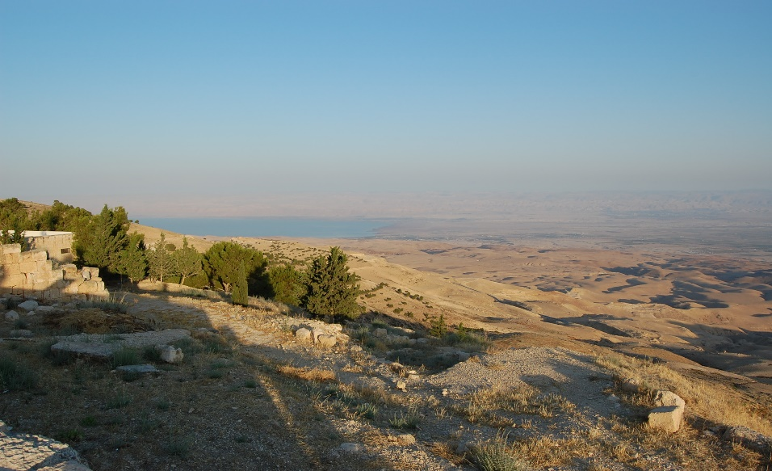
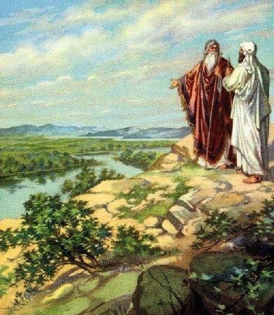
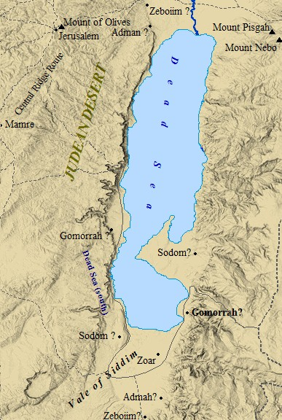
The Plain of Jordan
Sodom from Mt. Nebo
Land of Canaan
At first Lot “lived in the cities of the plain,” outside Sodom, but he “pitched his tent toward Sodom”
Plain of Jordan
Toward is “by” or “near.”
Later he lived in the city of Sodom itself
Genesis 13:10-13

Slide 6
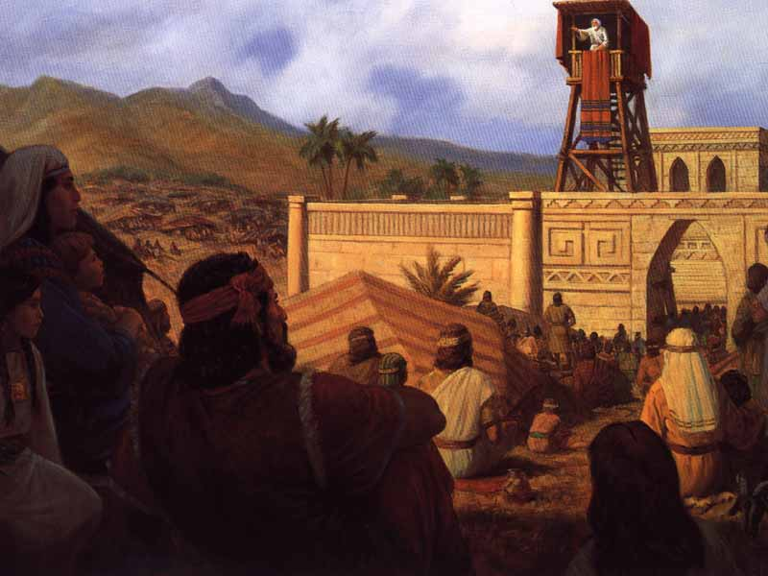
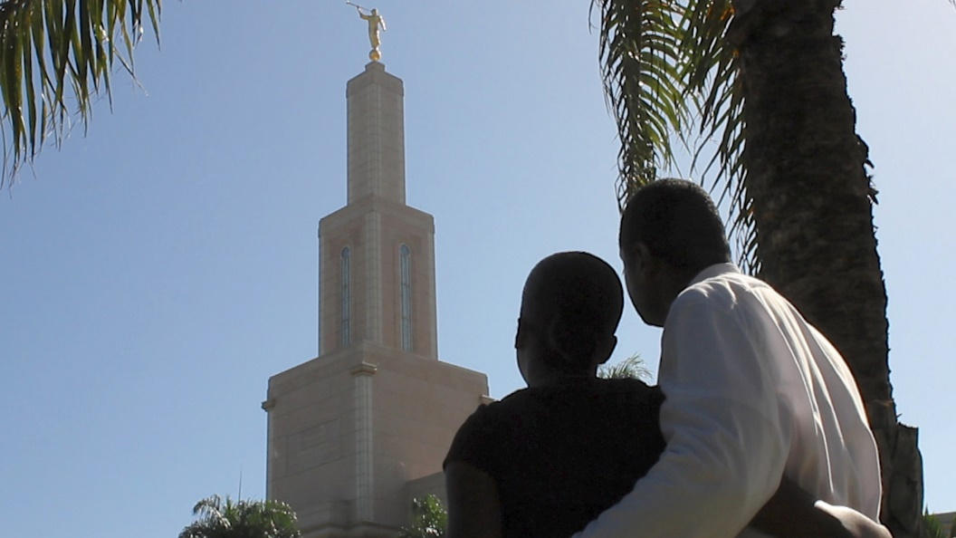
Pitching Our Tents
What things might we do that are the spiritual equivalent of pitching our tents toward Sodom?
We may associate with evil things instead of shunning them, or we may allow ourselves to commit small sins without thinking that they may lead to bigger ones.
How can we point our homes more toward the temple instead of worldly places?
Like Lot, the people of King Benjamin in the Book of Mormon also pitched their tents facing a specific direction. What did their tents face? (See Mosiah 2:6.)
Genesis 13:10-13

Slide 7
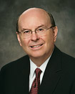
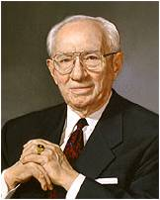
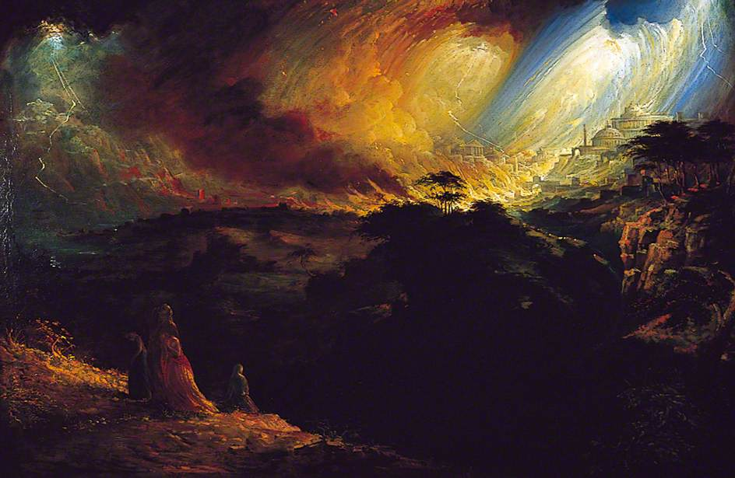

Sodom and Gomorrah
An actual and symbolic significance representing wickedness in the world.
“Their sinfulness was so great, and those who were righteous so few, that God destroyed these two cities of the plain…”
“All of the sins of Sodom and Gomorrah haunt our society. Our young people have never faced a greater challenge. We have never seen more clearly the lecherous face of evil.”
“Separating evil from our lives has become even more essential since our homes are wired to bring much of what the Lord has condemned into our own living rooms if we are not vigilant. One of the most difficult challenges in our lives is to be in the world but not of the world.” (see John 15:19)
Genesis 13:10-13
(3)

Slide 8
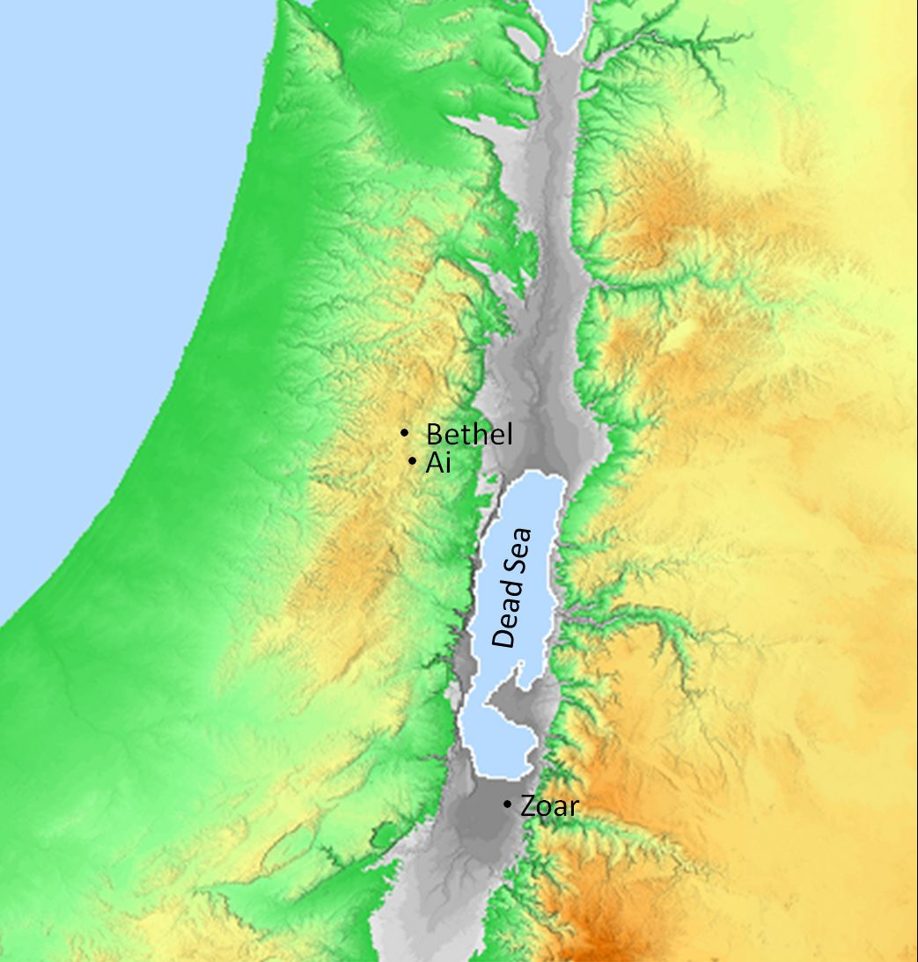
4 Local Kings
United their forces, attacked several cities (including Sodom and Gomorrah), and took their inhabitants captive
* Not accurate locations
Sodom—King Bera
Gomorrah—King Birsha
Admah—King Shinab
Zeboiim—King Shemeber
Zoar—King Bela
Elam
They rebelled against Elam—King Chedorlaomer, in which they were under the rule of Elamites
Sodom
Gomorrah
Vale of Siddim
Zoar
Admah
They waged war in the Vale of Siddim
Zeboiim
Kings of Sodom and Gomorrah fled to mountains and seized all the goods and took captive Lot and his family and returned to their cities.
Genesis 14:1-12

Slide 9
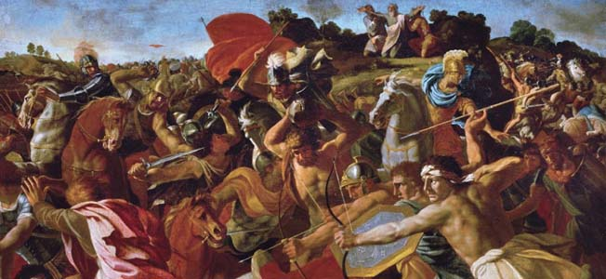
Abraham and His Forces
Abraham gathered and armed his servants (318 trained men) and pursued the armies. He caught up with them, and during the ensuing battle, Abram and his allies freed the captives.
“Abraham finds the Mesopotamian army at Dan and makes a surprise attack at night and from several directions. This scares them and they flee north to Damascus.
Abraham’s objective was not to destroy the Mesopotamian army, but to rescue Lot.”
Genesis 14:15-16
(4)

Slide 10
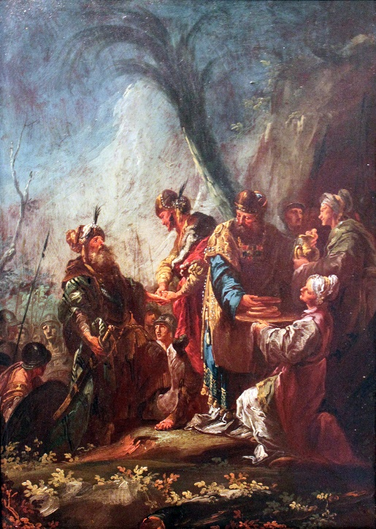
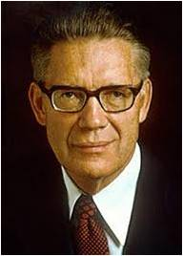
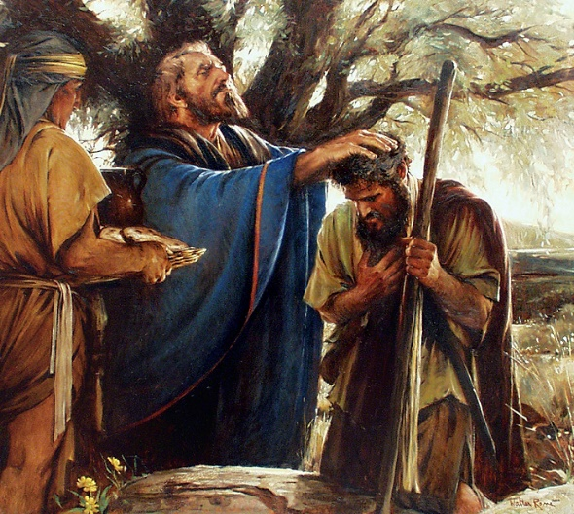
A Visit From 2 Kings
King of Sodom—King Bera
* Not accurate locations
King of Salem—Melchizedek
“brake bread and blest it; and he blest the wine, he being the priest of the most high God”
Valley of Shaveh
“may well have … prefigured [the sacrament of the Lord’s Supper], some two thousand years before its formal institution among men … when Jesus and his apostolic witnesses celebrated the feast of the Passover during the week [of the Atonement and Crucifixion]”
Salem
Sodom
The King of Sodom offered Abraham all the goods or spoils of the people of Sodom that had been taken by their enemies.
The King of Salem offered Abraham a blessing
Genesis 14:18-22
(5)

Slide 11
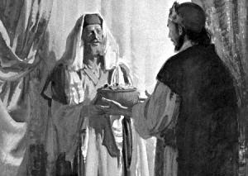
Abraham’s Response to King of Sodom
Why do you think Abram would not accept even a “thread” (or small reward) from the king of Sodom?
How might accepting a thread from the wicked king be like giving in to small temptations?
Resisting evil influences, regardless of how small, helps us stay true to God and free from sin
“Of the property belonging to the king of Sodom, which he had taken from the enemy, Abram would not keep the smallest part, because he would not have anything in common with Sodom.”
Genesis 13:22-23
(6)

Slide 12
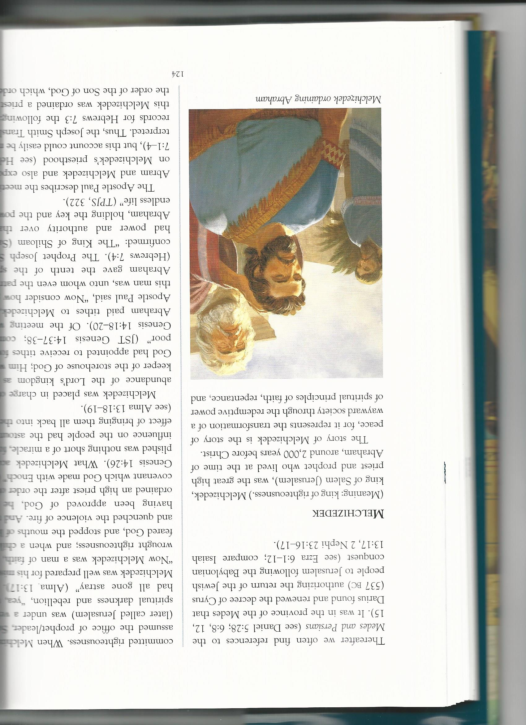
Abraham’s Response to Melchizedek
“He [Abraham] accepted from Salem’s priest and king, Melchizedek, not only bread and wine for the invigoration of the exhausted warriors,
but a priestly blessing also and gave him in return the tenth of all his booty [possessions], as a sign that he acknowledged this king as a priest of the living God, and submitted to his royal priesthood.
In this self-subordination of Abram to Melchizedek there was the practical prediction of a royal priesthood which is higher than the priesthood entrusted to Abram’s descendants, the sons of Levi, and foreshadowed in the noble form of Melchizedek, who blessed as king and priest the patriarch whom God had called to be a blessing to all the families of the earth.”
Genesis 13:22-23
(6)

Slide 13
Melchizedek
He was the great high priest and prophet who lived at the time of Abraham
His name means “king of righteousness”. He is also called the King of Peace
He lived 2,000 years before Christ
He lived in Salem, later called Jerusalem
He was a man of faith and magnified his holy office
As a child he “stopped the mouths of lions and quenched the violence of fire.”
He ordained a high priest after the order of the covenant which God made with Enoch. (JST Genesis 14:26)
He was placed in charge of the Lord’s kingdom as “the keeper of the storehouse of god; Him whom God had appointed to receive tithes for the poor.” (JST Genesis 14:37-38)
Abraham paid tithes to Melchizedek, and he also gave Abraham the Melchizedek Priesthood
The Melchizedek priesthood is named after him
(1)

Slide 14
Sources:
Video: Stay Within the Lines (5:10)
Old Testament Who’s Who by Ed J. Pinegar and Richard J. Allen pg.118-119, 124-125
2. L. Tom Perry The Sabbath and the Sacrament April 2011 Gen. Conf. (Melvin J. Ballard quote)
Presentation by ©http://fashionsbylynda.com/blog/
3. Lessons from the Old Testament: In the World but Not of the World by Elder Quentin L. Cook February 2006 Ensign
President Gordon B. Hinckley “Living in the Fulness of Times,” Liahona, Jan. 2002, 6; Ensign, Nov. 2001, 6.
4. Dr. Ralph F. Wilson http://www.jesuswalk.com/abraham/3_rescue.htm
5. Elder Bruce R. McConkie (The Promised Messiah: The First Coming of Christ [1978], 384).
6. (C. F. Keil and F. Delitzsch, Biblical Commentary on the Old Testament, 10 vols. [n.d.; repr., 1975], 1:1:208).

Slide 15
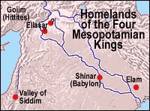
Abraham’s Wealth and Character:
Abraham provides an example of one who had great wealth (see Genesis 13:2) and yet was a man of great faith and righteousness. The incident between him and Lot provides an excellent insight into Abraham’s Christlike nature. By all rights Lot should have insisted that Abraham choose first. Lot had been nurtured and protected by Abraham, and Abraham was the patriarch of the clan. Abraham could have taken his rights and given Lot what was left. Instead, his concern was only that “there be no strife” between them, so he gave Lot first choice (v. 8; see also vv. 9–10). Lot seems to have chosen the best land—the well-watered plains of Jordan—and yet there is not a trace of resentment in Abraham. In fact, in the next few chapters is recorded Abraham’s intervention to save Lot’s life. Here was a man for whom principles came first and material things second. It is not surprising that the Lord should renew the ancient covenant with him and make him father of the faithful.
Institute Manual Old Testament Genesis 12-17
Interesting Read:
"At this time Amraphel king of Shinar, Arioch king of Ellasar, Kedorlaomer king of Elam and Tidal king of Goiim went to war against Bera king of Sodom, Birsha king of Gomorrah, Shinab king of Admah, Shemeber king of Zeboiim, and the king of Bela (that is, Zoar). All these latter kings joined forces in the Valley of Siddim (the Salt Sea). For twelve years they had been subject to Kedorlaomer, but in the thirteenth year they rebelled." (14:1-4)
"In the fourteenth year, Kedorlaomer and the kings allied with him went out and defeated the Rephaites in Ashteroth Karnaim, the Zuzites in Ham, the Emites in Shaveh Kiriathaim and the Horites in the hill country of Seir, as far as El Paran near the desert. Then they turned back and went to En Mishpat (that is, Kadesh), and they conquered the whole territory of the Amalekites, as well as the Amorites who were living in Hazazon Tamar." (14:5-7)
"Then the king of Sodom, the king of Gomorrah, the king of Admah, the king of Zeboiim and the king of Bela (that is, Zoar) marched out and drew up their battle lines in the Valley of Siddim against Kedorlaomer king of Elam, Tidal king of Goiim, Amraphel king of Shinar and Arioch king of Ellasar -- four kings against five. Now the Valley of Siddim was full of tar pits, and when the kings of Sodom and Gomorrah fled, some of the men fell into them and the rest fled to the hills." (14:8-10)[10]
"The four kings seized all the goods of Sodom and Gomorrah and all their food; then they went away. They also carried off Abram's nephew Lot and his possessions, since he was living in Sodom." (14:11-12)
http://www.jesuswalk.com/abraham/3_rescue.htm
Blessing on the Bread:
Elder Bruce R. McConkie of the Quorum of the Twelve Apostles explained what was likely taking place on this occasion:
“The sacrament of the Lord’s supper is an ordinance of salvation in which all the faithful must participate if they are to live and reign with him. It may well have been prefigured, some two thousand years before its formal institution among men, when ‘Melchizedek, king of Salem, brought forth bread and wine; and he brake bread and blest it, and he blest the wine, he being the priest of the most high God. And he gave to Abram.’ (JST, Gen. 14:17–18). … [The sacrament] had its beginning as an authorized ordinance and as a required rite when Jesus and his apostolic witnesses celebrated the feast of the Passover during the week of our Lord’s passion” (The Promised Messiah: The First Coming of Christ [1978], 384).

Slide 16
Melchizedek:
In ancient Jewish traditions Melchizedek is often thought to be Shem, the son of Noah. Melchizedek is a title meaning “king of righteousness,” even though it is also used as a proper name. A modern writer examined the question of whether Shem and Melchizedek could be the same person and concluded that, while we cannot say for sure, the possibility is clearly there. He said:
“Let us examine first what we know about Shem. Although the Bible names Shem as the eldest son of Noah (Gen. 5:32), modern-day revelation places Japheth as the eldest (Moses 8:12). Both reports, however, are harmonious in naming Shem as the progenitor of Israel and in the fact that the priesthood descended through Shem to all the great patriarchs after Noah. (1 Chron. 1:24–27.) In this patriarchal order of priesthood, Shem stands next to Noah. He held the keys to the priesthood and was the great high priest of his day.
“Living contemporary with Shem was a man known as Melchizedek, who was also known as the great high priest. The scriptures give us the details of Shem’s birth and ancestry but are silent as to his ministry and later life. Of Melchizedek, however, the opposite is true. Nothing is recorded about his birth or ancestry, even though the Book of Mormon states that he did have a father. (Al. 13:17–18.) Concerning his ministry and life we have several interesting and important facts. (Gen. 14:18–20; Heb. 7:1–4; Al. 13:17–18.)
“All of this provokes some questions and calls for answers. Were there two high priests presiding at the same time? Why is the record silent concerning Shem’s ministry? Why is nothing known concerning Melchizedek’s ancestry?
“Because of this state of knowledge on our part, many Saints and gospel scholars have wondered if these men were the same person. The truth is, we do not know the answer. But an examination of the scriptures is fascinating, because it seems to indicate that these men may have been one and the same. For example, here is the case for their oneness: Old Testament Institute Manual
1. The inheritance given to Shem included the land of Salem. Melchizedek appears in scripture as the king of Salem, who reigns over this area.
2. Shem, according to later revelation, reigned in righteousness and the priesthood came through him. Melchizedek appears on the scene with a title that means ‘king of righteousness.
3. Shem was the great high priest of his day. Abraham honored the high priest Melchizedek by seeking a blessing at his hands and paying him tithes.
4. Abraham stands next to Shem in the patriarchal order of the priesthood and would surely have received the priesthood from Shem; but D&C 84:5–17 says Abraham received the priesthood from Melchizedek.
5. Jewish tradition identifies Shem as Melchizedek.
6. President Joseph F. Smith’s remarkable vision names Shem among the great patriarchs, but no mention is made of Melchizedek.
7. Times and Seasons [15 Dec. 1844, p. 746] speaks of ‘Shem, who was Melchizedek. … ’
On the other hand, there is a case for their being two distinct personalities. Many persons believe D&C 84:14 is proof that there are perhaps several generations between Melchizedek and Noah. The scripture says, ‘Which Abraham received the priesthood from Melchizedek, who received it through the lineage of his fathers, even till Noah.’
“If it does turn out that Shem and Melchizedek are the same person, this scripture should prove no stumbling block, because it could be interpreted to mean that priesthood authority commenced with Adam and came through the fathers, even till Noah, and then to Shem.” (Alma E. Gygi, “Is It Possible That Shem and Melchizedek Are the Same Person?” Ensign, Nov. 1973, pp. 15–16.)
In the Joseph Smith Translation of Genesis 14, several verses are added about Melchizedek that greatly increase the available knowledge of this great high priest (see JST, Genesis 14:25–40)
Old Testament Institute Manual.

Slide 17
