Slide 1

Abraham, Sarah, and Hagar
Genesis 15-17
And I will make thy seed as the dust of the earth: so that if a man can number the dust of the earth, then shall thy seed also be numbered.
Genesis 13:6

Slide 2




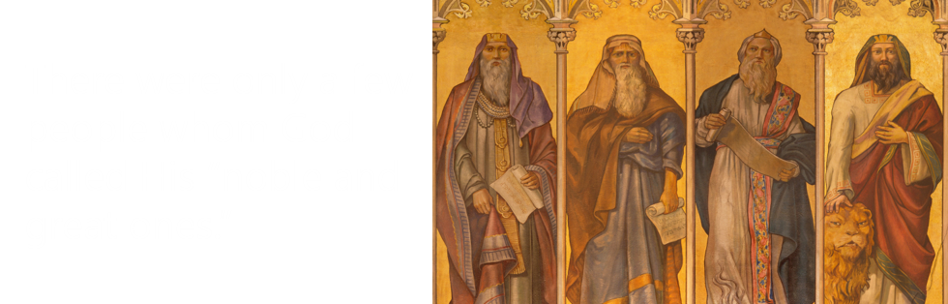
Review
Doctrinal Mastery- Abraham 3:22-23

Slide 3

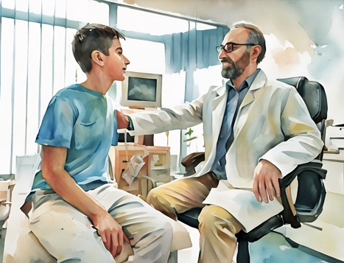

The Lord’s Promise Scenarios
A young woman has chosen to be honest in her schoolwork, believing the Lord will bless her. She notices her grades are worse than other students who are cheating.
A young man received his patriarchal blessing, which states that he will serve a full-time mission. During a medical exam, doctors discover he has physical complications that will not allow him to serve.
  What are some questions these young people might have about God and His promises?
  It is difficult to see how the Lord can fulfill promised blessings.
A young woman has put Moroni’s promise to the test by reading the Book of Mormon and praying to know that it is true. She feels she has not received an answer.

Slide 4
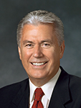
Concerns For the Future
God’s promises are not always fulfilled as quickly as or in the way we might hope; they come according to His timing and in His ways. (3)
What should I choose as a career?
Will I find the right person to marry?
Will I find the right person to marry?
Will I have children?
Will I be able to serve a mission?
Will I be able to serve a mission?
Will I have children?
Should I choose a career or stay home?
The Lord fulfills His promises in His time and in His way.

Slide 5
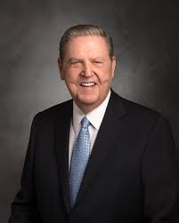
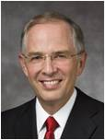
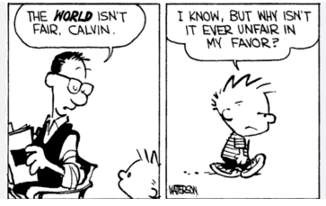
Life is Unfair
Some blessings come soon, some come late, and some don’t come until heaven; but for those who embrace the gospel of Jesus Christ, they come. (7)
Sometimes life seems very unfair—especially when our greatest desire is to do exactly what the Lord has commanded. As the Lord’s servant, I assure you that this promise is certain:
“Faithful members whose circumstances do not allow them to receive the blessings of eternal marriage and parenthood in this life will receive all promised blessings in the eternities, [as] they keep the covenants they have made with God” (8)

Slide 6
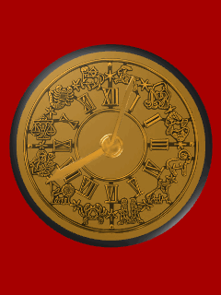
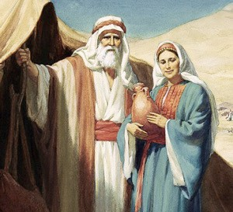
The Lord’s Promise To Abraham and Sarah
Earlier in Abram’s life, the Lord had promised him that his posterity would be as numerous as the “dust of the earth” (Genesis 13:16)
Abram was 75 years old and had waited for many years and still did not have any children.
What was Abram’s concern?
That he was childless and therefore had no heir. Also, Abram wondered if Eliezer would become his heir
What was the Lord’s response?
Abram and Sarai would have their own child, and their posterity would be innumerable
Genesis 15:1-6

Slide 7
Eliezer of Damascus
He was the man whom Abram identified as “steward of my house”
His name means “God of Help”
He apparently is the same steward who later acted as emissary in the quest to obtain a wife for Isaac (Genesis 24:2)
He was the eldest steward that ruled over all that Abraham had
He was commissioned to go to the city of Nabor where Abraham’s kin were and arrange for Rebekah, daughter of Bethuel, to be betrothed to Isaac (Gen. 24: 11-15)
Genesis 15:2
(1)

Slide 8

JST Genesis 15:
9 And Abram said, Lord God, how wilt thou give me this land for an everlasting inheritance?
10 And the Lord said, Though thou wast dead, yet am I not able to give it thee?
11 And if thou shalt die, yet thou shalt possess it, for the day cometh, that the Son of Man shall live; but how can he live if he be not dead? he must first be quickened.
12 And it came to pass, that Abram looked forth and saw the days of the Son of Man, and was glad, and his soul found rest, and he believed in the Lord; and the Lord counted it unto him for righteousness.
Son of Man—Jesus Christ
Abram was reminded that he would live again after his mortal life was completed because of the Savior’s Atonement and Resurrection.
JST Genesis 15:9-12

Slide 9
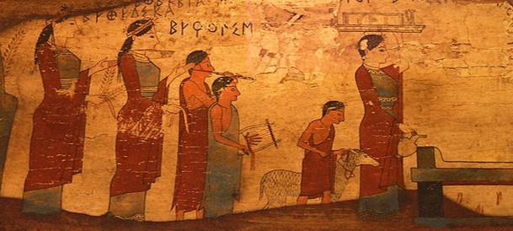
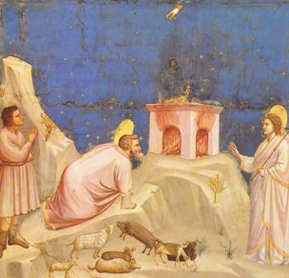
The Agreement
God commanded Abram to take various animals, cut their carcasses into two pieces, and set them apart from each other.
A “smoking furnace, and a burning lamp” representing the Lord’s presence then “passed between those pieces” (see verse 17).
In ancient times, when such a covenant was made, the individual passing between the carcasses was essentially saying, “May I also be cut in two if I do not keep my part of this covenant.”
Abram was assured that the Lord would fulfill His promises to him.
He did not know how the promises of the Lord would be fulfilled.
Genesis 15:9-18

Slide 10
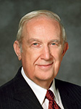

The Trust
We can trust that the Lord will fulfill His promises even if we do not know how He will do so
“This life is an experience in profound trust. … To trust means to obey willingly without knowing the end from the beginning (see Prov. 3:5–7). …
“To exercise faith is to trust that the Lord knows what He is doing with you and that He can accomplish it for your eternal good even though you cannot understand how He can possibly do it.”
Genesis 15:9-18
(2)

Slide 11
The Handmaid
Sarai could not have any children, so she gave her handmaid Hagar to Abram as a plural wife.
According to the custom of the time, Sarah’s giving her handmaid, Hagar, to be a wife to Abraham was an expected and logical act
God commanded Abraham, and Sarah gave Hagar to Abraham to wife. And why did she do it? Because this was the law; and from Hagar sprang many people. This, therefore, was fulfilling, among other things, the promises.
D7C 132:34
Sarai could obtain children by her servant Hagar, thus fulfilling the Lord’s promise that Abram would have children.
Genesis 16:1-3

Slide 12
Hagar
She was an Egyptian handmaiden to Sarai also spelled “Agar”
She was the mother of Abraham's son, Ishmael
She is mentioned in the D&C each time in connection with the principle of plural marriage
(1)

Slide 13
Jealousy
Sarai responded by dealing “hardly” with Hagar, who fled into the wilderness.
Hagar conceived a child but began to feel jealousy and bitterness toward Sarai.
Genesis 16:4-6

Slide 14
Galatians 4:21–31
The Allegory of Sarah and Hagar
Hagar | Sarah
Bondwoman | Free Born
Son Ismael—after the flesh | Son Isaac—Child of Promise
Old Covenant—Law of Moses—subject to bondage of the flesh | New Covenant—Gospel—men are made free
 | Heirs of Promise
“Those born after the flesh war against those born of the Spirit.”
(McConkie, DNTC, 2:477–78.)

Slide 15
An Angel is Sent
I will multiply thy seed exceedingly, that it shall not be numbered for multitude
And the angel of the Lord found her by a fountain of water in the wilderness
Return to Sarah and do as she wishes
You will have a son, and his name will be Ismael
The Lord hears and sees us in our trials and can help us through them
Genesis 16:7-11

Slide 16
Ishmael
He was the oldest son of Abram, being born of Hagar, the Egyptian handmaid of Sarai
Ishmael means “God hears” and the name Beer-lahai-roi means “the well of Him who liveth and seeth me.”
He and his mother were separated from the household of Abraham because of “mocking”
When Abraham died, he and Isaac, son of Sarai and Abraham, came together to bury their father
He passed away at age 137
His descendants seem to become a ‘wandering people’ who intermingled with the nations of Canaan
Joseph was sold by his brethren into the hands of the ‘Ishmeelites’ who took him to Egypt
(Gen. 37:25-28, 39:1)
(Note: Hagar and her son Ishmael are revered in the Islamic faith as ancestors of Muhammad, the founder of Islam. Muslims [followers of Islam] also honor Abraham as a prophet.)
Old Testament Seminary Manual Lesson 24
(1)

Slide 17
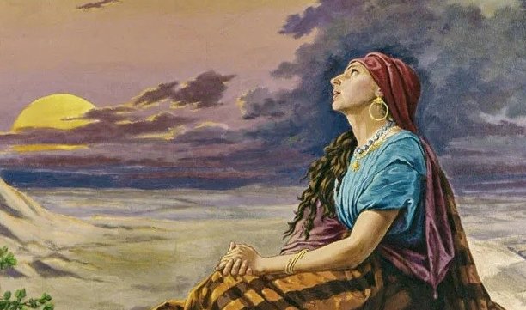
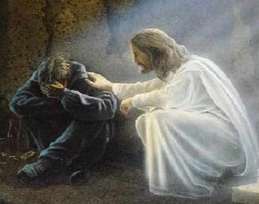
“You are not alone on this journey. Your Heavenly Father knows you. Even when no one else hears you, He hears you. When you rejoice in righteousness, He rejoices with you. When you are beset with trial, He grieves with you.”
Arise, lift up the lad, and hold him in thine hand; for I will make him a great nation. (Genesis 21:18)
…and, lo, I am with you alway, even unto the end of the world
Matthew 28:20
(3)

Slide 18
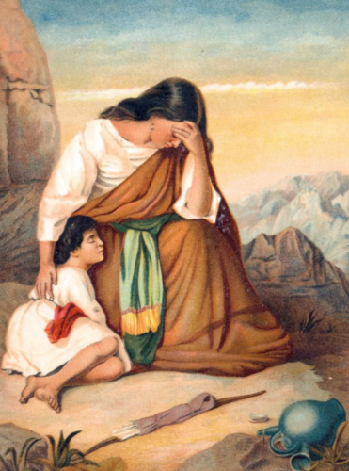
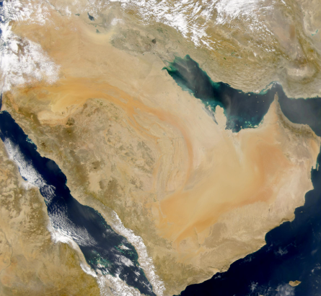
Descendants of Ishael
According to Islamic tradition, Abraham brought Ishmael and his mother to Arabia and settled them near what was to become the great city of Mecca.
Eventually the descendants of Ishmael’s 12 sons began to fill the Arabian Peninsula.
Hagar and her son Ishmael are revered in the Islamic faith as ancestors of Muhammad, the founder of Islam. Muslims (followers of Islam) also honor Abraham as a prophet. (9)
And also of the son of the bondwoman will I make a nation, because he is thy seed. Genesis 15:13
Genesis 17:20

Slide 19

Abraham and The Covenant
Genesis 17
Hearken to me, ye that follow after righteousness, ye that seek the Lord: look unto the rock whence ye are hewn, and to the hole of the pit whence ye are digged.
Look unto Abraham your father, and unto Sarah that bare you: for I called him alone, and blessed him, and increased him.
Isaiah 51:1-2

Slide 20

What do you want to do when you are an adult?
What do you want to be when you are an adult?
Abraham was told to walk in
His ways and be perfect
Genesis 17:1

Slide 21
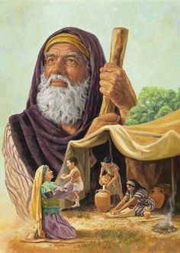
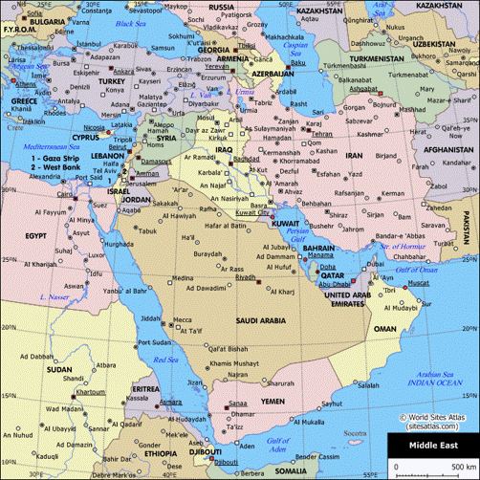
Abram to Abraham
Father of All Nations
In Hebrew the name Abram means “exalted father” and Abraham means “father of a multitude”
Abraham is always regarded in the Old Testament as founder of the covenant race, which is personified in the house of Israel.
Genesis 17:1-5
(4)

Slide 22
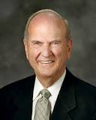
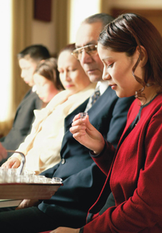
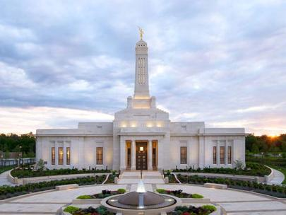
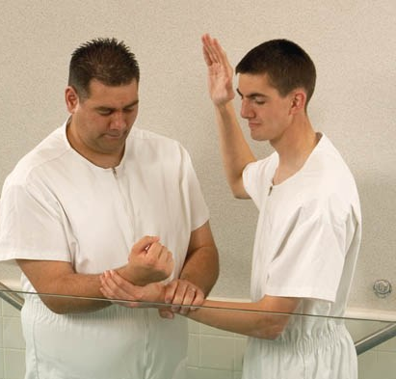
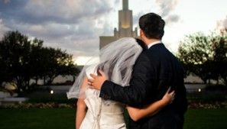
Children of the Covenant
When we partake of the sacrament, we renew those covenants.
Indianapolis Indiana Temple
August 23, 2015
“At baptism, we covenant to serve the Lord and keep his commandments.
We may receive covenants of the priesthood and the crowning blessings of the endowment, the doctrine, and the covenants unique to the holy temple.
“The new and everlasting covenant of the gospel allows us to qualify for marriage in the temple and be blessed to ‘come forth in the first resurrection’ and ‘inherit thrones, kingdoms, principalities, and powers, dominions, … to [our] exaltation and glory in all things’ [D&C 132:19].
Genesis 17:7
(5)

Slide 23
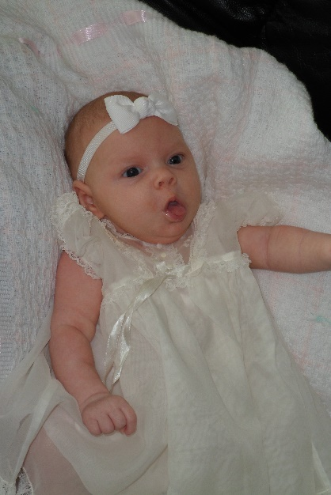
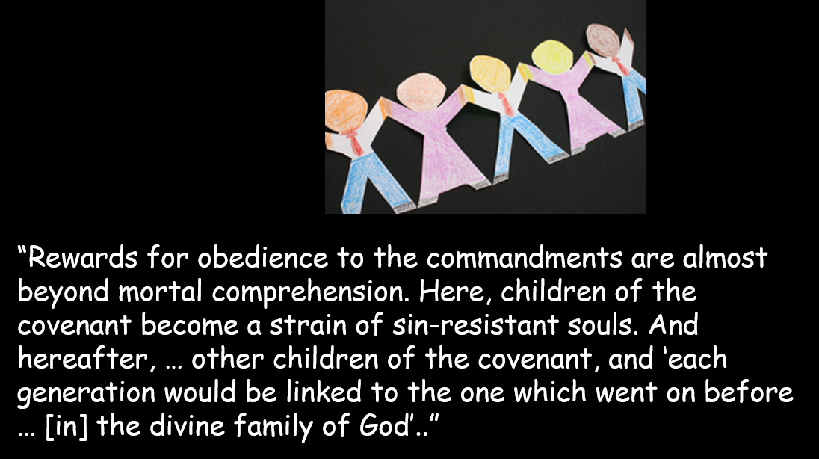
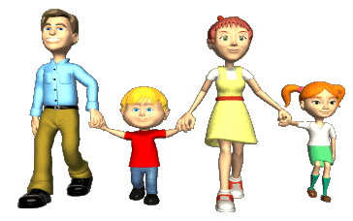
Children of the Covenant
“Children born to parents thus married are natural heirs to the blessings of the priesthood. They are born in the covenant. Hence, ‘they require no rite of adoption or sealing to insure their place in the posterity of promise’
Great comfort comes from the knowledge that our loved ones are secured to us through the covenants.”
Genesis 17:7
(5)

Slide 24
The Arm of Mercy
Throughout the history of the Old Testament, it is evident that the Lord extended His arm of mercy to Abraham’s seed. Even when they strayed from the truth, the Lord made every attempt to bring them back, honoring the covenant He made with Abraham.
As we make and keep covenants with the Lord, we become heirs to the responsibilities and blessings given to Abraham.
What does the Lord want you to do?
What does the Lord want you to be?
Genesis 17:7

Slide 25
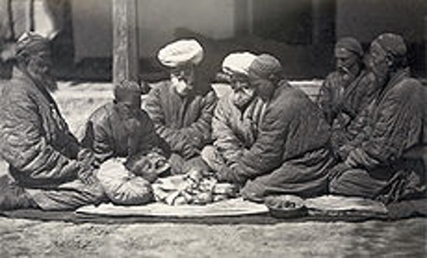
Circumcision
A token or reminder of the covenant God made with Abraham
The Lord commanded that Abraham and all male members of his household be circumcised. This symbol would act as a reminder of the responsibilities and blessings of the Abrahamic covenant, which includes the promise of eternal increase, dedication to God, and separation from sin and the world.
Those who were subject to circumcision:
1. Male Israelites, properly when 8 days old, but sometimes at a later age
2. Slaves born in the house or bought with money
3. Strangers who wished to eat the Passover
With circumcision was connected the giving of a name; but there is no express mention of this custom until New Testament times.
It would follow naturally from the fact that Abram’s name was changed at the institution of the ordinance.
And it came to pass, that on the eighth day they came to circumcise the child; and they called him Zacharias, after the name of his father.
Luke 1:59—John the Baptist
Genesis 17:9-14
(6)

Slide 26
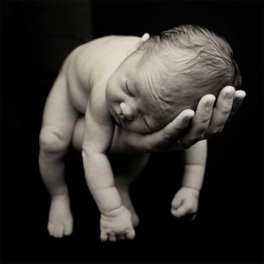
8 Days old
The people of Abraham’s day had gone astray from God’s ordinances and turned away from the proper performance of baptism, even participating in a form of infant baptism.
Circumcision of a male child when he was eight days old was to be a reminder to parents that children need to be baptized when they are accountable at eight years of age.
(JST Genesis 17:3-7, 11-12)
Circumcision as a token of the Abrahamic covenant was no longer required after Jesus Christ’s mortal ministry.
Listen to the words of Christ, your Redeemer, your Lord and your God. Behold, I came into the world not to call the righteous but sinners to repentance; the whole need no physician, but they that are sick; wherefore, little children are whole, for they are not capable of committing sin; wherefore the curse of Adam is taken from them in me, that it hath no power over them; and the law of circumcision is done away in me.
Moroni 8:8
Genesis 17:9-14

Slide 27
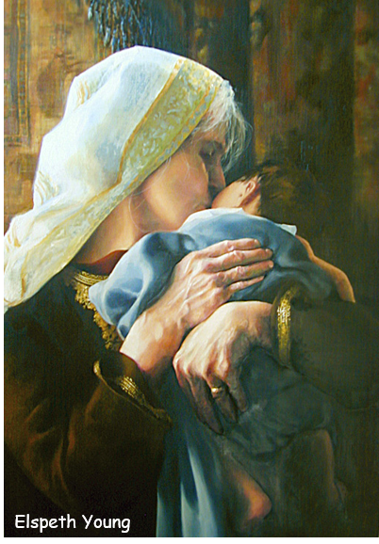
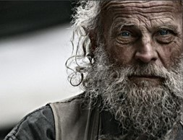
The Promise to Sarah
Sarai name was changed to Sarah
Abraham may have considered Ishmael to be the answer to his prayers for children, but the Lord planned to fulfill His covenant with Abraham in an additional way.
The Lord promised Abraham that Sarah would have a son and that he should be named Isaac
Sarah would be the mother of nations and Kings (David)
Jesus would be born through Sarah and Abraham
Abraham Laughed--Rejoiced
God will fulfill His promises, though it may not be in the way or at the time we might expect.
Genesis 17:15-22

Slide 28
Sources:
Videos
“Continue in Patience” (2:41), from time code 1:07 to 1:55.
“Good Things to Come” (4:55)
1. Old Testament Who’s Who by Ed J. Pinegar and Richard J. Allen pg. 46-47, 66, 80
2. Richard G. Scott (“Trust in the Lord,” Ensign, Nov. 1995, 17).
Presentation by ©http://fashionsbylynda.com/blog/
3. President Dieter F. Uchtdorf (“Your Wonderful Journey Home,” Ensign or Liahona, May 2013, 127–28); (“Continue in Patience,” Ensign or Liahona, May 2010, 58).
4. Bible Dictionary (Abraham)
5. Elder Russell M. Nelson (“Children of the Covenant,” Ensign, May 1995, 33–34).
[James E. Talmage, The Articles of Faith (1977), 446].
[Joseph Fielding Smith, in Conference Report, Oct. 1950, 13–14].
6. Bible Dictionary (Circumcision)
7. President Jeffrey R. Holland (“An High Priest of Good Things to Come,” Ensign, Nov. 1999, 38)
8. [Handbook 2: Administering the Church (2010), 1.3.3].Elder Neil L. Anderson (“Children,” Ensign or Liahona, Nov. 2011, 30)
9. “Ishmael, Our Brother,” James B. Mayfield, Ensign, June 1979, 24–32

Slide 29
Covenants and the Temples:
Elder Russell M. Nelson of the Quorum of the Twelve Apostles testified: “The ultimate blessings of the Abrahamic covenant are conferred in holy temples. These blessings allow us to come forth in the First Resurrection and inherit thrones, kingdoms, powers, principalities, and dominions, to our ‘exaltation and glory in all things’ (D&C 132:19)” (in “Special Witnesses of Christ,” Ensign or Liahona, Apr. 2001, 7).
Circumcision:
The token of the Abrahamic covenant during Old Testament dispensations. Those who received it thenceforth enjoyed the privileges and undertook the responsibilities of the covenant. It symbolized some aspects of separation or dedication (1) to God, to whom Israel belonged; (2) from the world, the uncircumcised with whom Israel might not mix; (3) from sin.
The subjects of circumcision were (1) male Israelites, properly when eight days old (Gen. 17:12), but sometimes at a later age (Ex. 4:25; Josh. 5:2–9); (2) slaves born in the house or bought with money (Gen. 17:13); (3) strangers who wished to eat the Passover (Ex. 12:48).
Circumcision was not peculiar to Israel. It was practiced in Egypt and also by nations with whom Israel had not come in contact. The significance of circumcision was that it was the manifest token of the covenant that the Lord had made with Abraham and his seed. It does not matter that other nations also practiced circumcision for to them it did not have the same meaning or purpose. The various Canaanite tribes appear to have been uncircumcised (Gen. 34:14–17; Judg. 14:3; 1 Sam. 31:4; 2 Sam. 1:20).
There was much controversy in the early church with regard to the obligation of circumcision (Acts 15:1–31). The Church under direction of Peter and the Twelve, and acting under the guidance of the Spirit, declared that circumcision was not obligatory for gentile converts. However, it apparently did not settle the matter of whether or not Jewish members of the Church should have their children circumcised. As one reads the scriptures on the matter, it becomes evident that the real issue was not circumcision only but also the larger question as to continued observance of the law of Moses by members of the Church. The word circumcision seems to have been representative of the law in these instances. The controversy was renewed later on in Galatia, as we read in Gal. 2:1–15; 5:2–6, 11; 6:12–16. These passages, along with Rom. 2:25–29; 3:1–2; Philip. 3:3; and Col. 2:11, contain Paul’s teaching on the subject.
The Jewish part of the church membership, especially in Jerusalem, appears to have been very reluctant to cease from the rituals and ceremony of the law of Moses (Acts 21:17–25). This is a marked contrast to the Church among the Nephites, in which there seems to have been a cessation of the law immediately upon their awareness of the death and resurrection of Jesus Christ. (3 Ne. 15:1–4; Moro. 8:8).
Bible Dictionary
Abraham was 99 when he was circumcised and Ismael was 13…this was on the same day
Temple Marriage:
Elder Bruce R. McConkie said, “When he [or she] is married in the temple for time and for all eternity, each worthy member of the Church enters personally into the same covenant the Lord made with Abraham. This is the occasion when the promises of eternal increase are made, and it is then specified that those who keep the covenants made there shall be inheritors of all the blessings of Abraham, Isaac, and Jacob” (A New Witness for the Articles of Faith [1985], 508).
Circumcision is the surgical removal of the skin covering the tip of the penis. In a typical procedure, the foreskin is opened and then separated from the glans after inspection. The circumcision device (if used) is placed, and then the foreskin is removed. Topical or locally injected anesthesia is occasionally used to reduce pain and physiologic stress.
An estimated one-third of males worldwide are circumcised. The procedure is most prevalent in the Muslim world and Israel (where it is near-universal), the United States and parts of Southeast Asia and Africa; it is relatively rare in Europe, Latin America, parts of Southern Africa and most of Asia. The origin of circumcision is not known with certainty; the oldest documentary evidence for it comes from ancient Egypt. Various theories have been proposed as to its origin, including as a religious sacrifice and as a rite of passage marking a boy's entrance into adulthood. It is part of religious law in Judaism and is an established practice in Islam, Coptic Christianity and the Ethiopian Orthodox Church--Wikipedia
Who are the Seed of Abraham? “We go to the promise made to Abraham, which was that in him and in his seed all the families of the earth should be blessed. Moses, as I have said was of his seed, and he was the deliverer of the whole of that nation. And who were the prophets that existed among ancient Israel? They were descendants of Abraham; and to them came the word of God and the light of revelation. Who was Jesus? After the flesh of the seed of Abraham. Who were his Twelve Apostles? Of the seed of Abraham. Who were the people that came to this continent—Lehi and his family, about 600 years B.C.? Of the seed of Abraham. Who were the Apostles they had among them that spread forth among the millions that then lived upon this continent? Of the seed of Abraham. Who was Joseph Smith? Of the seed of Abraham.” (John Taylor, in Journal of Discourses, 20:224.)

Slide 30
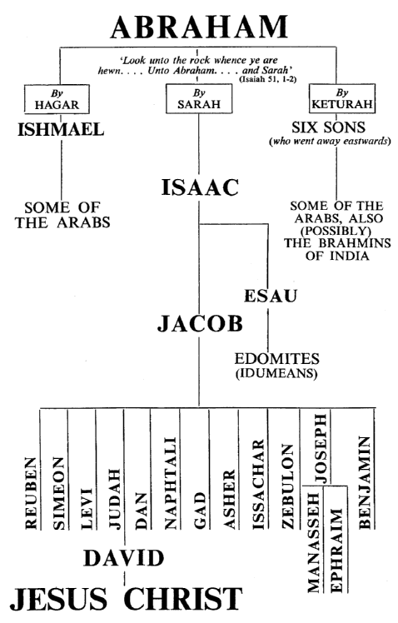
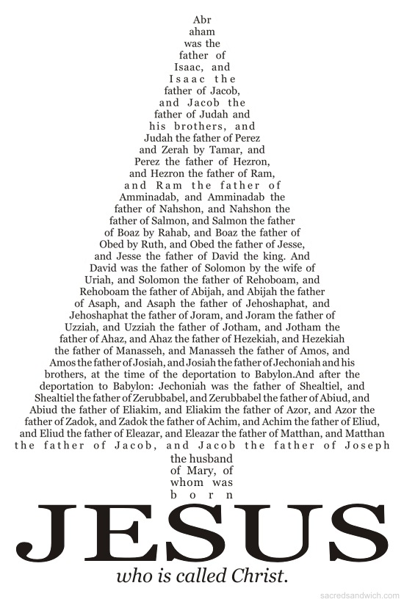

Slide 31
Plural Marriage:
At certain times in the history of the world, the Lord has commanded His people to practice plural marriage. Plural marriage was practiced by Abram and Sarai and by their grandson Jacob, and it was practiced for a time during the early days of the restored Church, beginning with Joseph Smith.
See More about -- Ishmael, Our Brother
By James B. Mayfield June 1979 Ensign
Galatians 4:21–31. The Allegory of Sarah and Hagar
“Paul here uses the life of Abraham as an allegory to dramatize the superiority of the gospel over the law of Moses—a mode of teaching designed to drive his doctrine home anew each time his hearers think of Abraham and his life.
“Hagar, the bondwoman, bore Ishmael; and Sarah, the free-woman, brought forth Isaac. Ishmael was born after the flesh, while Isaac, as a child of promise, came forth after the Spirit. Hagar is thus made to represent the old covenant, the law of Moses, the covenant under which men were subject to the bondage of sin; while Sarah symbolizes the new covenant, the gospel, the covenant under which men are made free, free from bondage and sin through Christ.
“Mt. Sinai, from whence the law came, and Jerusalem, from whence it is now administered, symbolize the law, and their children are in bondage. But the spiritual Jerusalem, the heavenly city of which the saints shall be citizens, is symbolized by Sarah, and she is the mother of freemen. Sarah, who was so long barren, as our spiritual mother, has now made us all, like Isaac, heirs of promise.
“But it is now, as it was then, those born after the flesh war against those born of the Spirit. And as God rejected Ishmael and accepted Isaac, so does he now reject those who cleave to the law of Moses and accept those who turn to Christ.” (McConkie, DNTC, 2:477–78.)
How plural marriage in the Old Testament connects to plural marriage in the last dispensation
“While working on the translation of the Bible in the early 1830s, the Prophet Joseph Smith became troubled by the fact that Abraham, Jacob, David, and other Old Testament leaders had more than one wife. The Prophet prayed for understanding and learned that at certain times, for specific purposes, following divinely given laws, plural marriage was approved and directed by God. Joseph Smith also learned that with divine approval, some Latter-day Saints would soon be chosen by priesthood authority to marry more than one wife. A number of Latter-day Saints practiced plural marriage in Nauvoo, but a public announcement of this doctrine and practice was not made until the August 1852 general conference in Salt Lake City. At that conference, Elder Orson Pratt, as directed by President Brigham Young, announced that the practice of a man having more than one wife was part of the Lord’s restitution of all things (see Acts 3:19–21)” (Our Heritage: A Brief History of The Church of Jesus Christ of Latter-Day Saints [1996], 97; see also Jacob 2:27–30).

Slide 32
Hagar:
And God opened her eyes Genesis 21:19
Hagar’s status is unequivocally displayed: she is a slave, and she belongs to Sarai. Sarai gives her to Abram, as she is Sarai’s property. Hagar does not belong to Abram.
If the union proves to be childless, the wife is required to provide a concubine, but would then have all the legal rights to the offspring. This may also act as evidence against a common reading of these verses that Sarai was, through her own intellect, attempting to force the fulfillment of promises Abram had already received. Significantly, this will also play into the next section with Hagar as a freed slave (by virtue of her marriage to Abraham).
Hagar does important things and receives important promises and visits. She is the first freed slave in the Bible. She becomes one of the elect few to directly receive the promise of innumerable posterity as well as an annunciation of the birth of a son by an angel. She is the first and only woman in scripture to name God. “And she called the name of the Lord God who spoke to her, Thou art God who seest me; for she said, For I have openly seen him that appeared to me. Therefore she called the well, The well of him whom I have openly seen.”
Abram/Abraham and Sarai/Sarah never use Hagar’s name nor speak to her directly. Indeed, God and His messenger are the only ones in these stories who speak to her directly and use her name when doing so (Genesis 16:8, 21:17).
What is also clear is that Sarah witnesses something between Ishmael and Isaac that pushes her, on the basis of inheritance issues, to demand Abraham to send Hagar and her child elsewhere. The text does make clear that God commands Abraham to follow the will of his wife Sarah in dismissing Hagar, changing Abraham’s view. Hagar is dismissed into the wilderness, becomes the first character [Page 100]in the Bible to weep, and yet subsequently experiences another visit of a divine being and is saved by the actions of the deity.
Genesis 25:12 In this the final reference to Hagar in the Hebrew Bible, we see again the identification of her as Egyptian. This has been a constant theme and her constant identifier throughout her time on screen. With this theme comes a dramatic look forward in time to the Exodus of Israel out of Egypt yet set as a distinct reversal: an Egyptian slave leaving the oppression or affliction suffered in the home of Abraham and Sarah, rather than Israelite slaves leaving the oppression suffered in Egypt.
The figure of Hagar in the Abrahamic scriptural traditions (Judaism, Christianity, and Islam) is one human character who stands as a common thread between those religious approaches. However, the views of Hagar and how she is read and used by those respective religious communities is vastly different. While her story is largely similar, interpretation of her position varies exceedingly. Her position as the second wife of Abraham assures her a preeminent position in religious historiography.
In Judaism and Christianity, she is largely eclipsed by the preeminence given to Sarah and the inheritance due to Isaac, as the firstborn of the first wife. Within Judaism, she is generally set aside in exegetical works and largely disappears within the shadow of Sarah, becoming, as one academic put it, superficially seen as a “throw-away character.” Yet in some later Jewish traditions, Hagar is said to have later fully converted to the covenant religion of Abraham, and taken a new name, Keturah (which most consider to be Abraham’s third wife), and is reunited with Abraham after Sarah’s death.
Excerpts from: http://www.mormoninterpreter.com/hagar-in-lds-scripture-and-thought/

