Slide 1

Three Messengers
Genesis 18

Slide 2

The Visitors
The Plains of Mamre
And said, My Lord, if now I have found favour in thy sight, pass not away, I pray thee, from thy servant:
Holy Men—sent forth after the order of God
Jewish Custom:
The host would go out to meet the stranger on his way, and would ask no questions as to his name and condition until his first needs had been satisfied.
On entering the house, he was given water to wash his feet, and a meal was then put before him, his animals being meanwhile attended to.
On leaving, another repast was served, when a covenant was sometimes entered into by the guest and his host, and the latter again accompanied the stranger some distance on his way.
On his part, the guest blessed the host before takingleave andd asked him whether he stood in need of anything.
Genesis 18:1-8
(1)

Slide 3
The Holy Men
angels, (Gen. 19:1) was translated from the Hebrew word malakhim, which can also mean “messengers.”
“Although we do not know the identity of the three messengers, Abraham treated them as if they were presiding authorities of the Lord’s kingdom then on the earth, and their messages were directly from the Lord.”
Genesis 18:1-8
(2)

Slide 4
The Message
Where is Thy wife?
Why did she laugh?
In the tent
Because we are old
Is there anything the Lord cannot do?
She will have a baby
Sarah will have a son
Sarah laughs
I didn’t laugh…I was afraid
Yes, you did laugh
Genesis 18:9-15

Slide 5






His Own Time
Therefore, sanctify yourselves that your minds become single to God, and the days will come that you shall see him; for he will unveil his face unto you, and it shall be in his own time, and in his own way, and according to his own will.
D&C 88:68
Nothing is too hard for the Lord; the Lord is able to do all things
Genesis 18:1-14
(2)

Slide 6
Can Sodom and Gomorrah Be Saved?
The Lord revealed to Abraham what He would do with Sodom and Gomorrah
Genesis 18:16-22

Slide 7
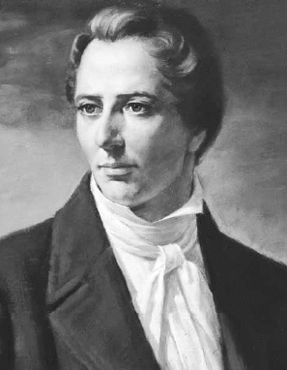
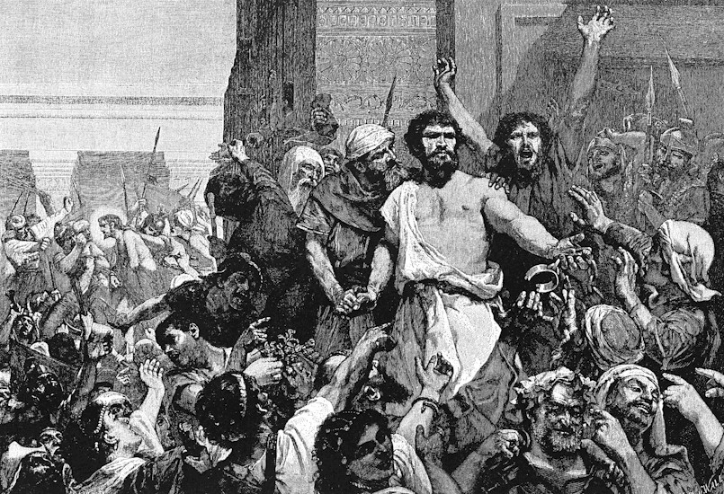
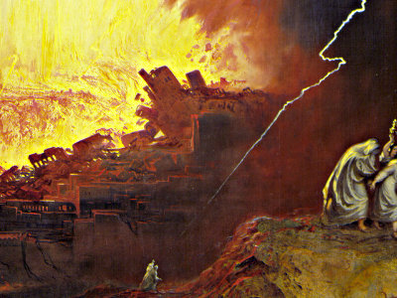
Joseph Smith’s Translation
“And the angel of the Lord said unto Abraham, The Lord said unto us, Because the cry of Sodom and Gomorrah is great, and because their sin is very grievous, I will destroy them.
“And I will send you, and ye shall go down now, and see that their iniquities are rewarded unto them.
“And ye shall have all things done whether they have done altogether according to the cry of it, which is come unto me.
“And if ye do it not, I will know it shall be upon your heads; for I will destroy them, and you shall know that I will do it, for it shall be before your eyes.
“And the angels which were holy men, and were sent forth after the order of God, turned their faces from thence and went toward Sodom.”
(3)

Slide 8
Grievous Sins
Homosexuality
Even as Sodom and Gomorrah, and the cities about them in like manner, giving themselves over to fornication, and going after strange flesh, are set forth for an example, suffering the vengeance of eternal fire.
Jude 1:7
Pride and Idleness
Behold, this was the iniquity of thy sister Sodom, pride, fulness of bread, and abundance of idleness was in her and in her daughters, neither did she strengthen the hand of the poor and needy.
And they were haughty, and committed abomination before me: therefore I took them away as I saw good.
Ezekiel 16:49-50
All violations of the law of chastity, or sexual sins, are very serious.
Genesis 18:16-22

Slide 9
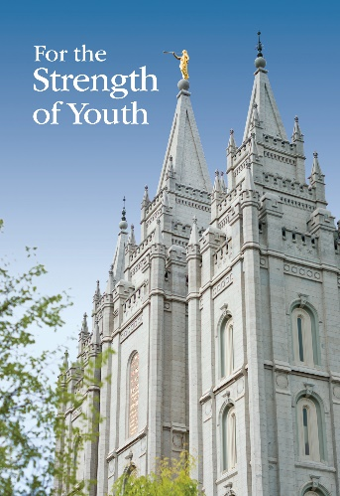

How to Keep it Virtuous
“Never do anything that could lead to sexual transgression.
Treat others with respect, not as objects used to satisfy lustful and selfish desires.
Before marriage, do not participate in passionate kissing, lie on top of another person, or touch the private, sacred parts of another person’s body, with or without clothing.
Do not do anything else that arouses sexual feelings.
Do not arouse those emotions in your own body.
Pay attention to the promptings of the Spirit so that you can be clean and virtuous.
The Spirit of the Lord will withdraw from one who is in sexual transgression.”
Genesis 18:16-22
(4)

Slide 10


Doctrines of Marriage
“We encourage all to bear in mind our Heavenly Father’s purposes in creating the earth and providing for our mortal birth and experience here as His children. ‘God created man in his own image, in the image of God created he him; male and female created he them. And God blessed them, and God said unto them, Be fruitful, and multiply, and replenish the earth’ (Genesis 1:27–28).
‘Therefore shall a man leave his father and his mother, and shall cleave unto his wife: and they shall be one flesh’ (Genesis 2:24).
Marriage between a man and a woman was instituted by God and is central to His plan for His children and for the well-being of society. Strong families, guided by a loving mother and father, serve as the fundamental institution for nurturing children, instilling faith, and transmitting to future generations the moral strengths and values that are important to civilization and crucial to eternal salvation.
(Family Proclamation)

Slide 11
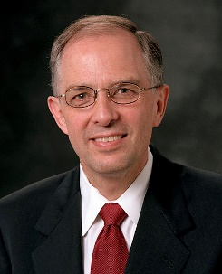
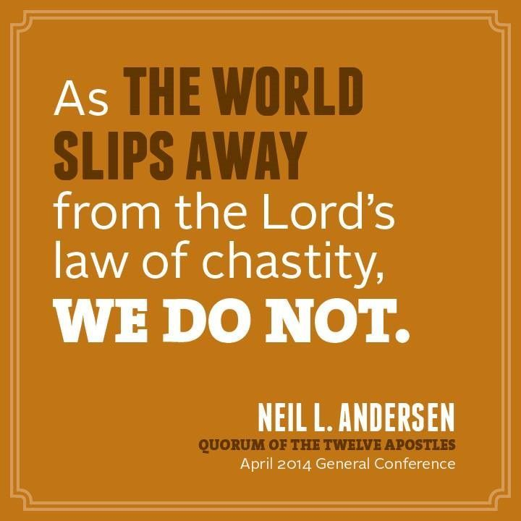
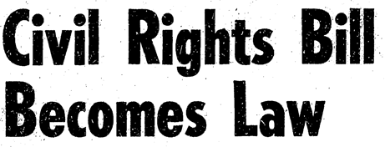

Moral law of God
“Changes in the civil law do not, indeed cannot, change the moral law that God has established. God expects us to uphold and keep His commandments regardless of divergent opinions or trends in society.
His law of chastity is clear: sexual relations are proper only between a man and a woman who are legally and lawfully wedded as husband and wife.
We urge you to review and teach Church members the doctrine contained in ‘The Family: A Proclamation to the World.’
“Just as those who promote same-sex marriage are entitled to civility, the same is true for those who oppose it.”
(5)

Slide 12
Same Sex Attraction
Those who experience same-sex attraction can enjoy all the blessings of the gospel as they keep the covenants they have made with God.
As they choose to live the law of chastity, they can have pure and virtuous thoughts and avoid lusting.
They can counsel with trusted family members and their bishops or branch presidents about how to remain sexually pure.
Any member of the Church who breaks the law of chastity must repent, which includes confession to a bishop or branch president, who will lovingly help him or her obtain forgiveness from the Lord.
The Lord loves all His children and wants them to repent and to be clean from sin.
(6)

Slide 13

What About the Righteous?
What did Abraham ask of the Lord?
Will you destroy everyone?
Genesis 18:22-26
(6)

Slide 14
Peradventure
50
And the Lord said, If I find in Sodom fifty righteous within the city, then I will spare all the place for their sakes
45
40
30
20
10
The Lord listens to our righteous pleas for others.
I will not destroy
I will not destroy
I will not destroy
I will not destroy
I will not destroy
Genesis 18:27-33
(6)

Slide 15
Sources:
Jewish Encyclopedia.com Genesis 24:33, Judges 19:21, Genesis 26:31, 2 Kings 4:13
Bruce R. McConkie, Doctrinal New Testament Commentary, 3 vols. [1965–73], 3:235; Sidney B. Sperry, “Abraham’s Three Visitors,” Improvement Era, Aug. 1931, 583, 585.
Joseph Smith Translation, Genesis 18:19–23; bold, italics, and strike through added
(For the Strength of Youth [booklet, 2011], 36).
Presentation by ©http://fashionsbylynda.com/blog/
(“Church Instructs Leaders on Same-Sex Marriage,” Jan. 10, 2014,mormonnewsroom.org).
Church of Jesus Christ of Latter-day Saints Seminary Teacher Manual Old Testament Lesson 25

Slide 16
Spare the Place:
President Spencer W. Kimball commented on the exchange between Abraham and the Lord as they discussed the destruction of Sodom:
“Abraham knew that the cities of the plains—Sodom and Gomorrah and other places—were wicked cities, housing wicked, godless people, saying with Cain, ‘Who is the Lord that I should know him?’ (Moses 5:16.) He was aware that destruction of those cities was imminent; but in his compassion for his fellowman, he begged and pleaded with the Lord, ‘Peradventure there be fifty righteous within the city,’ will you spare the others of the city? (See Gen. 18:24.) That pleading being granted, came Abraham again and prayed that the cities would be saved if 45 were found, or 40 or 30 or 20 or down to ten, but apparently there could not be found even ten, in those vicious cities, who were righteous. (See Gen. 18:24–32.)
“The evil continued. The sin was too well entrenched. They had laughed and joked about a destruction. The transgressions for which Sodom had apparently been renowned continued on. In fact, the people wanted to take advantage of the pure angel men they had seen come into the city. The vicious men pressed and would have broken down the doors to get to them. (See Gen. 19:4–1.)
“Everything was done that could be done by Abraham to save the city, but it had become so depraved and wanton that to save it was impossible” (“Why Do We Continue to Tolerate Sin?” Ensign, May 1975, 109).
The Family and Gender Roles:
Elder Dallin H. Oaks of the Quorum of the Twelve Apostles explained the assumptions upon which the Church bases its views concerning marriage and gender roles:
“We reject the modern idea that marriage is a relationship that exists primarily for the fulfillment of the individuals who enter into it, with either one of them being able to terminate it at will. We focus on the well-being of children, not just ourselves.
“Our Church handbook explains: ‘By divine design, both a man and a woman are essential for bringing children into mortality and providing the best setting for the rearing and nurturing of children’ [Handbook 2: Administering the Church (2010), 1.3.2].
“Our family proclamation declares: ‘Children are entitled to birth within the bonds of matrimony, and to be reared by a father and a mother who honor marital vows with complete fidelity’ [“The Family: A Proclamation to the World,” Ensign or Liahona, Nov. 2010, 129].
“Our belief that we are commanded to ‘honor marital vows with complete fidelity’ introduces the next fundamental premise stated in the family proclamation: ‘God has commanded that the sacred powers of procreation are to be employed only between man and woman, lawfully wedded as husband and wife’ [“The Family,” 129].
“This declaration is not politically correct, but it is true, and we are responsible to teach and practice its truth. That obviously sets us against many assumptions and practices in today’s world—the birth of millions of innocent children to unwed mothers being only one illustration. …
“Men and women spirits ‘complete each other’ because they are different, and they ‘progress together toward exaltation’ by, among other things, honoring those eternal, created differences. Thus, the family proclamation states: ‘By divine design, fathers are to preside over their families in love and righteousness and are responsible to provide the necessities of life and protection for their families. Mothers are primarily responsible for the nurture of their children. In these sacred responsibilities, fathers and mothers are obligated to help one another as equal partners’ [“The Family,” 129].
“We rejoice in the distinctive and mutually supportive roles of men and women in God’s plan. Men and women are to be different, yet they are inseparably bound together in a mutually supportive relationship to accomplish God’s plan” (“As He Thinketh in His Heart” [evening with Elder Dallin H. Oaks, Feb. 8, 2013]; si.lds.org).
Those Who Challenge Church Teachings and Standards:
Elder Dallin H. Oaks of the Quorum of the Twelve Apostles suggested how young people can respond when confronted with arguments that advocate ideas and practices that are contrary to God’s plan of salvation:
“I suggest that it may be preferable for our young people to refrain from arguing with their associates about such assertions or proposals. They will often be better off to respond by identifying the worldly premises or assumptions in the assertions they face and then by identifying the different assumptions or premises that guide the thinking of Latter-day Saints. This won’t elicit agreement from persons who don’t share our faith, but it can move the discussion away from arguing over conclusions to identifying the real source of disagreement” (“As He Thinketh in His Heart” [evening with a General Authority, Feb. 8, 2013]; si.lds.org; see also the Seek Truth resources on the S&I Priorities page at si.lds.org).

Slide 17
Those Who Struggle with Same-sex attraction:
President Gordon B. Hinckley emphasized that while we cannot condone sinful behavior, we love those who struggle with same-sex attraction:
“There are those who would have us believe in the validity of what they choose to call same-sex marriage. Our hearts reach out to those who struggle with feelings of affinity for the same gender. We remember you before the Lord, we sympathize with you, we regard you as our brothers and our sisters. However, we cannot condone immoral practices on your part any more than we can condone immoral practices on the part of others” (“Stand Strong against the Wiles of the World,” Ensign, Nov. 1995, 99).
Same Sex Attraction:
Elder Dallin H. Oaks of the Quorum of the Twelve Apostles taught the following about same-sex attraction and homosexual behavior:
“The distinction between feelings or inclinations on the one hand, and behavior on the other hand, is very clear. It’s no sin to have inclinations that if yielded to would produce behavior that would be a transgression. The sin is in yielding to temptation. Temptation is not unique. Even the Savior was tempted. …
“I think it’s important for you to understand that [homosexual] … is not a noun that describes a condition. It’s an adjective that describes feelings or behavior. …
“Everyone has some challenges they have to struggle with. [Same-sex attraction is] a particular kind of challenge that is very vexing. It is common in our society and it has also become politicized. But it’s only one of a host of challenges men and women have to struggle with, and I just encourage you to seek the help of the Savior to resist temptation and to refrain from behavior that would cause you to have to repent or to have your Church membership called into question. …
“… Homosexual feelings are controllable. Perhaps there is an inclination or susceptibility to such feelings that is a reality for some and not a reality for others. But out of such susceptibilities come feelings, and feelings are controllable. If we cater to the feelings, they increase the power of the temptation. If we yield to the temptation, we have committed sinful behavior. That pattern is the same for a person that covets someone else’s property and has a strong temptation to steal. It’s the same for a person that develops a taste for alcohol. It’s the same for a person that is born with a ‘short fuse,’ as we would say of a susceptibility to anger. If they let that susceptibility remain uncontrolled, it becomes a feeling of anger, and a feeling of anger can yield to behavior that is sinful and illegal.
“We’re not talking about a unique challenge here. We’re talking about a common condition of mortality. We don’t understand exactly the ‘why,’ or the extent to which there are inclinations or susceptibilities and so on. But what we do know is that feelings can be controlled and behavior can be controlled. The line of sin is between the feelings and the behavior. The line of prudence is between the susceptibility and the feelings. We need to lay hold on the feelings and try to control them to keep us from getting into a circumstance that leads to sinful behavior” (“Interview with Elder Dallin H. Oaks and Elder Lance B. Wickman: ‘Same-Gender Attraction,’” Dec. 12, 2012, mormonnewsroom.org).
Other information as suggested in Manual
The Church Instructs Leaders on same sex marriage
http://www.mormonnewsroom.org/article/church-instructs-leaders-on-same-sex-marriage
The Divine institution of marriage
http://www.mormonnewsroom.org/article/the-divine-institution-of-marriage
Love One Another: A Discussion on
Same-Sex Attraction
http://mormonsandgays.org/

