Slide 1

Don’t Look Back
Genesis 19
And he looked toward Sodom and Gomorrah, and toward all the land of the plain, and beheld, and, lo, the smoke of the country went up as the smoke of a furnace.
Genesis 19:28

Slide 2







Small Choices---Big Consequences
The decisions we make every day may seem small, but they always have real implications and big consequences, for good or bad. (5)
Choice of Friends
What you eat and drink
Where you go for entertainment
How you relate with your family

Slide 3
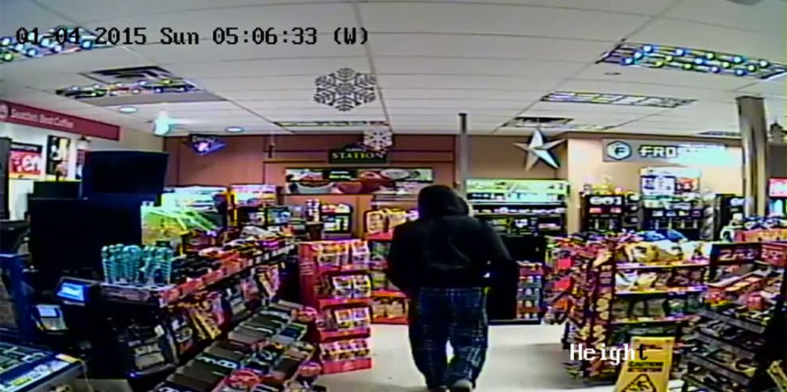


The Wrong Place At The Wrong Time
Two 18 year old friends stop at a convenient store. One of them gets out of the car and goes in to the store to buy a soda.
While in the store, unbeknownst to the friend in the car, he proceeds to rob the store.
The store manager quickly notifies the police and the police arrests both teens.
The men both receive a sentence of 20 years because a gun was involved in the robbery.
The innocent man had served his time, but because of other offences while in jail, he served many more years.
His cycle of in and out of jail persists to this day because he was in the wrong place at the wrong time.

Slide 4
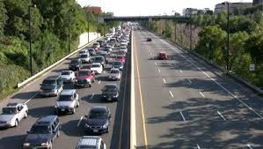
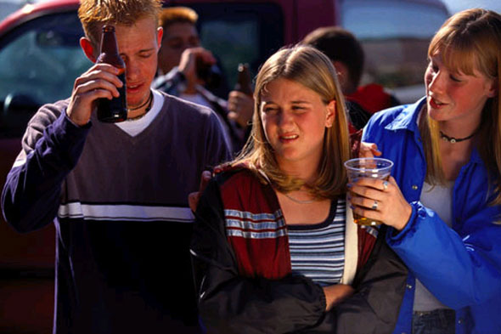
Do You Find Yourself in Situations That Could Change the Rest of Your Life?
Getting too close to sin; stopping in the wrong place or failing to stop at all; obeying or disregarding moral laws or the laws of the land—any or all of these choices may eternally affect the course of our existence
It is relatively easy to stay on the strait and narrow path while traffic is light and the road is marked. But frequently along the way we meet others exercising their own free agency; and, without wanting it to be so, we find their demands and expectations influencing our behavior and coloring our choices.
The tests come when friends say, “Come on. Don’t be a spoilsport,” or “It’s okay, everybody does it,” or “No one will know.”
(1)

Slide 5




Your Choices
What are the choices you are currently making that are leading you toward Heavenly Father and Jesus Christ.
What are the choices that may be leading you away from Heavenly Father and Jesus Christ.

Slide 6
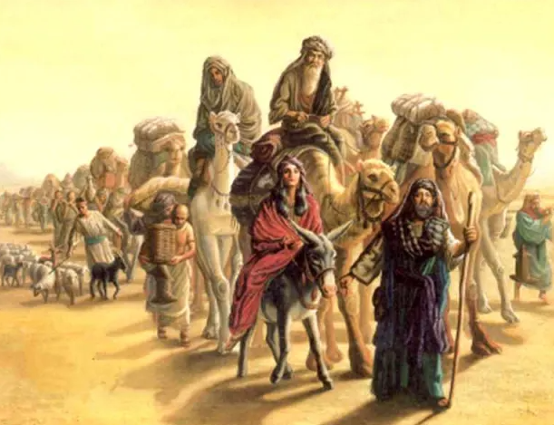
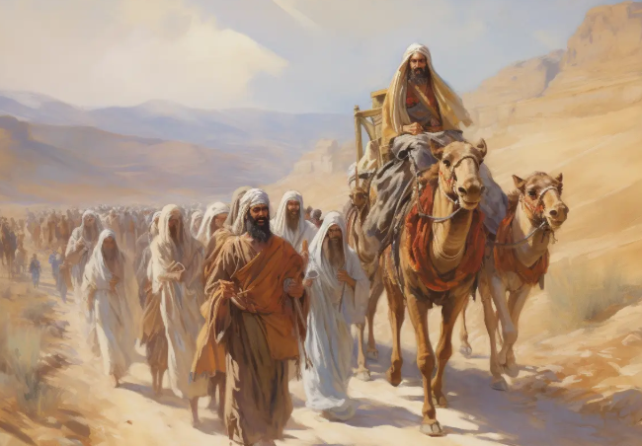
Abraham and Lot
After Abraham, Lot, and their families moved from Egypt to the land of Canaan, there was a disagreement between Abraham’s herdsmen and Lot’s herdsmen over their grazing land.
To help avoid further conflict, Abraham and Lot separated their families, and each decided where they would live.
Abram dwelled in the land of Canaan, and Lot dwelled in the cities of the plain, and pitched his tent toward Sodom. Genesis 13:12
Genesis 13:18-19

Slide 7
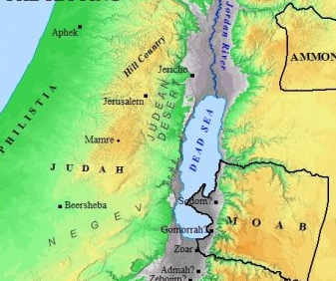
Lot and His Family Move to Sodom
Lot and his family did not remain with their tent pitched toward Sodom. Eventually, they moved to and “dwelt in Sodom”
The inhabitants of Sodom and the nearby city of Gomorrah rejected the prophets the Lord sent to warn them.
In His mercy, the Lord sent messengers to Sodom to warn Lot and his family to leave before the city was destroyed.
Genesis 19:12-13

Slide 8
Three Messengers in the City of Sodom
Genesis 19:1 And there came two angels to Sodom
JST footnote: three
Lot invited the three messengers to stay at his home for the night so they would not have to remain in the streets of Sodom.
Genesis 19:1-3

Slide 9
Men of Sodom
“that we may know them” means they wanted to participate in sexual activities with Lot’s visitors
The men of Sodom became angry with Lot when he refused their evil intentions toward his guests.
The men of Sodom then threatened to take by force not only Lot’s visitors (the holy men) but also his daughters for immoral purposes.
When Lot tried to reason with the men of Sodom, they attempted to force their way into his house.
The holy messengers miraculously protected Lot and his family by smiting the men with blindness.
Genesis 19:9-11

Slide 10
Lot’s Family
The Holy Men instructed Lot to get his family and leave Sodom because the Lord was going to destroy the city
Lot’s sons-in-law desired not to go
The holy men told Lot to take his wife and two unmarried daughters…
Lot “lingered” and the men told hold of them and forced Lot, his wife, and two daughters out of the city.
The Men told Lot: Escape for thy life; look not behind thee, neither stay thou in all the plain; escape to the mountain, lest thou be consumed.
Genesis 19:12-17

Slide 11
Lot’s Wife
She was the wife of Lot.
Jewish tradition called her “Edith” But the Bible does not mention her name
She was with Lot when they resided in Sodom
We don’t know how many children she had, but the Bible mentions at least a son, 4 daughters…2 unmarried, and at least 2 sons-in-law (men…Genesis 19:8, 12)
She reluctantly left with Lot and her 2 unmarried daughters with the messengers
The messengers told the family not to look back while the Lord was destroying the city
She looked back and became a ‘pillar of salt’
Her body had moved out of Sodom, but her heart was still in Sodom

Slide 12
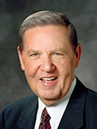
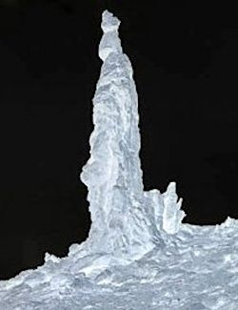
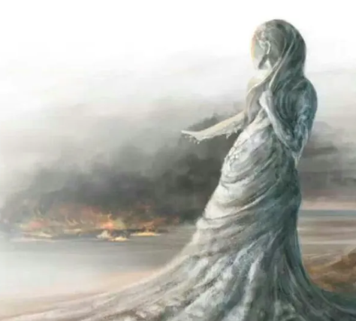
Looking Back
“Apparently what was wrong with Lot’s wife was that she wasn’t just looking back; in her heart she wanted to go back. …
“It is possible that Lot’s wife looked back with resentment toward the Lord for what He was asking her to leave behind.”
It is also possible that Lot’s wife may not have merely looked back but may have returned to Sodom (see Luke 17:28–32)
Genesis 19:24-26
(2)

Slide 13

Learned From But Not Lived In
“I plead with you not to dwell on days now gone, nor to yearn vainly for yesterdays, however good those yesterdays may have been.
The past is to be learned from but not lived in. We look back to claim the embers from glowing experiences but not the ashes.
And when we have learned what we need to learn and have brought with us the best that we have experienced, then we look ahead, we remember that faith is always pointed toward the future.
Faith always has to do with blessings and truths and events that will yet be efficacious in our lives.
So, a more theological way to talk about Lot’s wife is to say that she did not have faith.
She doubted the Lord’s ability to give her something better than she already had. Apparently, she thought—fatally, as it turned out—that nothing that lay ahead could possibly be as good as those moments she was leaving behind.”
Genesis 19:24-26
(2)

Slide 14
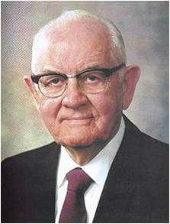


Fleeing Wickedness
“To know where the danger is and to be able to recognize it in all of its manifestations provides protection.”
As disciples of Jesus Christ, we should flee wickedness and not look back.
“Regardless of who is getting the adversary’s special attention at any given time, he seeks to make all people “miserable like unto himself.”
“He who has greater strength than Lucifer, he who is our fortress and our strength, can sustain us in times of great temptation.”
Even small sins—can lead us away from Jesus Christ.
(3)

Slide 15
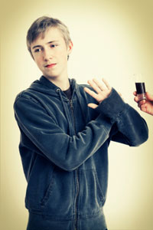

Keeping the Door Closed
“Serious sin enters into our lives as we yield first to little temptations. Seldom does one enter into deeper transgression without first yielding to lesser ones, which open the door to the greater.”
“If we would prevent sin rather than be faced with the much more difficult task of curing it.”
“It is extremely difficult, if not impossible, for the devil to enter a door that is closed. He seems to have no keys for locked doors. But if a door is slightly ajar, he gets his toe in, and soon this is followed by his foot, then by his leg and his body and his head, and finally he is in all the way.”
(3)

Slide 16


The Right Choices
Right decisions are easiest to make when we make them well in advance, having ultimate objectives in mind
Develop discipline of self so that, more and more, you do not have to decide and redecide what you will do when you are confronted with the same temptation time and time again. You only need to decide some things once!
(3)

Slide 17
Lot’s Daughters
Lot and his two daughters went to a nearby mountain to live in a cave.
In an effort to preserve the seed of their father, the firstborn daughter proposed a wicked and deceptive plan to intoxicate their father and lie with him so they could each become pregnant.
Thus were both the daughters of Lot with child by their father.
The eldest daughter bore a son, Moab
The same is the father of the Moabites
The younger daughter bore a son, Ben-ammi:
the same is the father of the children of Ammon
Genesis 19:30-38

Slide 18
The Unrighteous Decisions
There is no justification for Lot’s daughters’ choice to break the law of chastity.
The actions of Lot’s daughters may provide another example of how the wickedness in Sodom had negatively influenced members of Lot’s family.
Although Lot was not a wicked man, his decision to bring his family to live among evil influences resulted in serious consequences.
If we choose to associate with unrighteous influences, then we may experience consequences we will regret. Our choices may affect not only ourselves but others as well
Genesis 19:30-38

Slide 19


“Leave the Party
“Some years ago, John was accepted at a prestigious Japanese university. …
“Soon after John’s arrival, word of a party to be held on the rooftop of a private residence spread among the foreign student population.
That evening, John and two friends made their way to the advertised address.
(4)

Slide 20
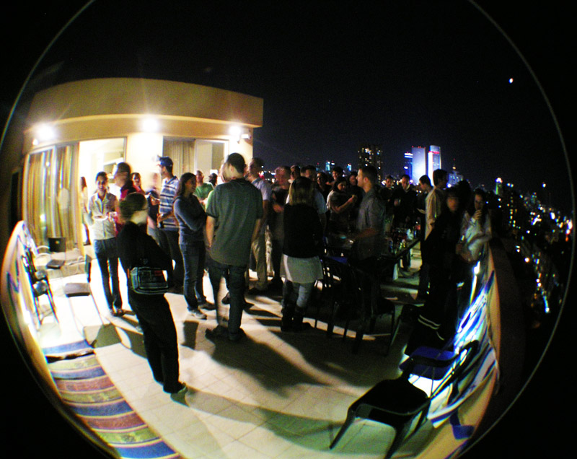
“Following an elevator ride to the top floor of the building, John and his friends … began mingling with the others. As the night wore on, the atmosphere changed.
The noise, music volume, and alcohol amplified, as did John’s uneasiness. Then suddenly someone began organizing the students into a large circle with the intent of sharing marijuana cigarettes.
John grimaced and quickly informed his two friends that it was time to leave.

Slide 21

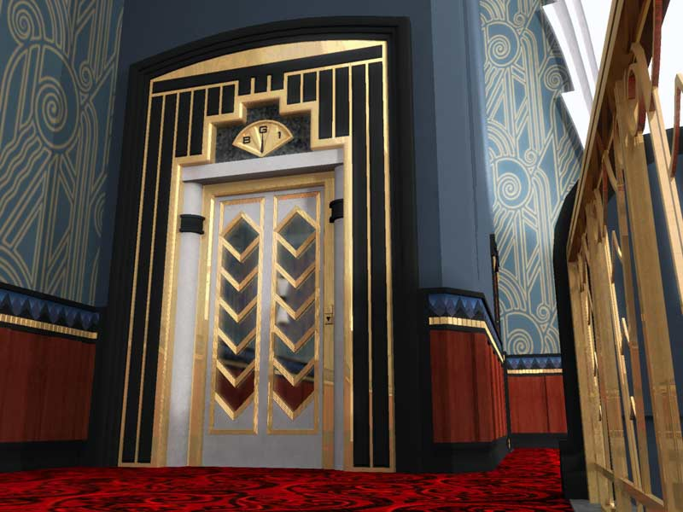
Almost in ridicule, one of them replied, ‘John, this is easy—we’ll just stand in the circle, and when it is our turn, we’ll just pass it along rather than smoke it. That way we won’t have to embarrass ourselves in front of everyone by leaving.’
This sounded easy to John, but it did not sound right. He knew he had to announce his intention and act. In a moment he mustered his courage and told them that they could do as they wished, but he was leaving.
One friend decided to stay and joined the circle; the other reluctantly followed John down the stairs to board the elevator.
Much to their surprise, when the elevator doors opened, Japanese police officers poured out and hurried to ascend the stairs to the rooftop. John and his friend boarded the elevator and departed.
(4)

Slide 22

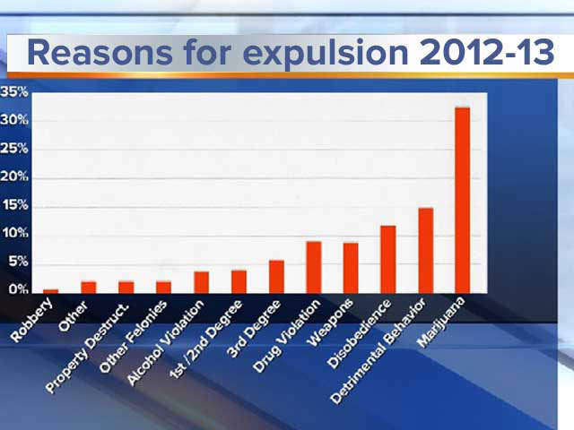
“When the police appeared at the top of the stairs, the students quickly threw the illegal drugs off the roof so they wouldn’t be caught.
After securing the stairway, however, the officers lined up everyone on the roof and asked each student to extend both hands.
The officers then walked down the line, carefully smelling each student’s thumbs and index fingers.
All who had held the marijuana, whether they had smoked it or not, were presumed guilty, and there were huge consequences.
Almost without exception, the students who had remained on the rooftop were expelled from their respective universities. …
(4)

Slide 23

“… As for John, the consequences in his life have been immeasurable. His time in Japan that year led him to a happy marriage and the subsequent birth of two sons.
He has been a very successful businessman and recently became a professor at a Japanese university. Imagine how different his life would have been had he not had the courage to leave the party on that important evening in Japan. …
“… There will be times when you, like John, will have to demonstrate your righteous courage in plain view of your peers, the consequence of which may be ridicule and embarrassment. … Be courageous! Be strong!”
(4)

Slide 24
Sources:
Videos: “Leave the Party” (6:26)
“Stay within the Lines” (5:10)
“New Year’s: Look Not behind Thee” (3:09).
Elder F. Burton Howard The Gift of Knowing September 1983 Ensign
Presentation by ©http://fashionsbylynda.com/blog/
2. Elder Jeffrey R. Holland (“Remember Lot’s Wife” [Brigham Young University devotional address, Jan. 13, 2009], 2; speeches.byu.edu).
3. Teachings of Presidents of the Church: Spencer W. Kimball, (2006), 102–13 Chapter 10: Fortifying Ourselves against Evil Influences
4. Bishop Gary E. Stevenson (“Be Valiant in Courage, Strength, and Activity,” Ensign or Liahona, Nov. 2012, 51–52).
5. Elder Massimo De Feo (“Small Choices, Big Consequences,” Ensign, Aug. 2019, 34)

Slide 25
Pillar of Salt
An Article Too Good to Pass Up
Right decisions now can help us withstand temptations later.
One of the basic tasks for each individual is the making of decisions. A dozen times a day we come to a fork in the road and must decide which way we will go. Some alternatives are long and hard, but they take us in the right direction toward our ultimate goal; others are short, wide, and pleasant, but they go off in the wrong direction. It is important to get our ultimate objectives clearly in mind so that we do not become distracted at each fork in the road by the irrelevant questions: Which is the easier or more pleasant way? or, Which way are others going?
Right decisions are easiest to make when we make them well in advance, having ultimate objectives in mind; this saves a lot of anguish at the fork, when we’re tired and sorely tempted.
When I was young, I made up my mind unalterably that I would never taste tea, coffee, tobacco, or liquor. I found that this rigid determination saved me many times throughout my varied experiences. There were many occasions when I could have sipped or touched or sampled, but the unalterable determination firmly established gave me good reason and good strength to resist.
… The time to decide that we will settle for nothing less than an opportunity to live eternally with our Father is now, so that every choice we make will be affected by our determination to let nothing interfere with attaining that ultimate goal.
Develop discipline of self so that, more and more, you do not have to decide and redecide what you will do when you are confronted with the same temptation time and time again. You only need to decide some things once!
How great a blessing it is to be free of agonizing over and over again regarding a temptation. To do such is time-consuming and very risky.
We can push some things away from us once and have done with them! We can make a single decision about certain things that we will incorporate in our lives and then make them ours—without having to brood and redecide a hundred times what it is we will do and what we will not do.
Indecision and discouragement are climates in which the Adversary lives to function, for he can inflict so many casualties among mankind in those settings. … If you have not done so yet, decide to decide!
How wonderful it would be if we could just get every Latter-day Saint boy and girl to make up his mind or her mind during childhood to say, “I will never yield to Satan or to anybody who would want me to destroy myself.”
The time to quit evil ways is before they start. The secret of the good life is in protection and prevention. Those who yield to evil are usually those who have placed themselves in a vulnerable position.
Teachings of Presidents of the Church: Spencer W. Kimball, (2006), 102–13
In Judaism, one common view of Lot's wife turning to salt was as punishment for disobeying the angels' warning. By looking back at the "evil cities" she betrayed her secret longing for that way of life. She was deemed unworthy to be saved and thus turned to a pillar of salt. Scharfstein, Sol (2008). Torah and commentary : the five books of Moses : translation, rabbinic and contemporary commentary. Jersey City, NJ: KTAV Publishing. p. 71, #26
Another accepted view in the Jewish exegesis of Genesis 19:26, is that when Lot's wife looked back, she turned to a pillar of salt upon the sight of God who was descending down to rain destruction upon Sodom and Gomorrah.
A Jewish legend gives one reason for Lot's wife looking back, and that was to check if her daughters, who were married to men of Sodom, were coming or not. Instead, she saw God descending in order to rain fire and brimstone upon Sodom and Gomorrah. Thus, the sight of God turned her into a pillar of salt.
Another Jewish legend says that because Lot's wife sinned with salt, she was punished with salt. On the night the two angels visited Lot, he requested of his wife to prepare a feast for them. Not having any salt, Lot's wife asked of her neighbors for salt which so happened to alert them of the presence of their guests, resulting in the mob action that endangered Lot's family
In the Midrash (a method in interpreting stories), Lot's wife is given the name Edith. . Schwartz, Howard (2004). "two angels Sodom". Tree of Souls:The Mythology of Judais---Wikipedia
Most scholars agree that the most probable site of Sodom is now covered by the southern part of the Dead Sea, a body of water with a high salt content. If Lot’s wife returned to Sodom, she would have been caught in the destruction. Her becoming a pillar of salt could be a figurative way of expressing this outcome. Whatever it was that happened to Lot’s wife, it is clear that she perished. Teacher’s Manual Old Testament 2026
Sins of those in Sodom and Gomorrah: The inhabitants of Sodom and Gomorrah engaged in many wicked practices that were grievous to the Lord. The prophet Ezekiel declared that the people were full of pride and idleness and that although they had a “fulness of bread,” they rejected “the poor and needy” (see Ezekiel 16:49–50). Sexual immorality was widely accepted and practiced among the inhabitants of Sodom and nearby cities (see Genesis 19:1–11; Joseph Smith Translation, Genesis 19:9–12 [in the Bible appendix]; Jude 1:7).

Slide 26
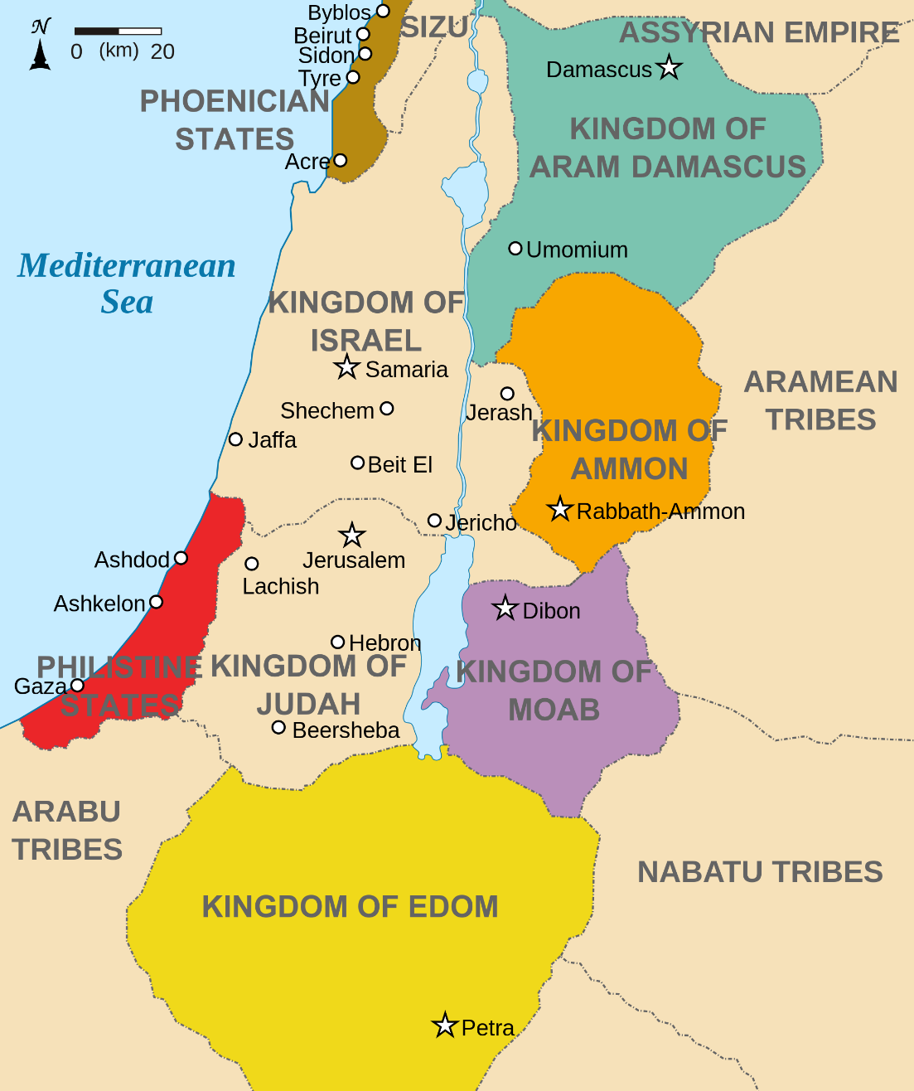
Moab was the son of Lot by his oldest daughter, the child being conceived by an incestuous union unbeknownst to the sedated and sleeping Lot.
The Moabites were a people who frequently warred with the Israelites.
The most often-cited episode concerning conflict with the Moabites is the campaign of Balak, king of the Moabites, to bring down a curse upon the Israelites, perceived as a distinct threat to the Moabites and their confederate associates, the Midianites. When the hosts of Israel were encamped on the plains of Moab east of the Jordan River near Jericho, Balak took action to retain the services of Balaam—who apparently had the reputation of divine influence—for the purpose of cursing Israel (Numbers 22:6). Balaam agreed to approach the Lord on their behalf—but the message from the Lord was consistently in favor of blessing, rather than cursing Israel.
As the Israelites had intimate contact with the Moabites, they began to assimilate their pagan practices and immoral ways. Thus the Lord commanded Moses to strike out against the indigenous peoples and eliminate the evil influence of the Moabites and Midianites (Numbers 31:8)
Over time, the Moabites and Israelites repeatedly confronted one another, but eventually, the Moabites came under the yoke of Assyria and Chaldea according to the judgements of the Lord (Zephaniah 2:8-11, 2 Kings 24:2, Ezekiel 25)
Old Testament Who’s Who by Ed J. Pinegar and Richard J. Allen pg. 130
Ammon/Ammonites:
Benammi was the son of Lot by his younger daughter, the child being conceived by an incestuous union unbeknownst to the sedated and sleeping Lot.
The name Ammon in the Old Testament is usually mentioned in the expression “children of Ammon,” meaning the tribal people of that name who were descended from lot, the nephew of Abraham.
The “children of Ammon” were generally at odds with the Israelites. It was against the Ammonites that David’s army was fighting when he became involved with Bathsheba and orchestrated the death of her husband, Uriah (2 Samuel 12:7-9). Later, Solomon took an Ammonitess as one of his wives (1 Kings 14:31; 2 Chronicles 12:13) and offended the Lord by choosing to adopt the idolatrous practices of Ammonite worship (1 Kings 11:5-7). Eventually the Ammonites came under the yoke of Assyria and Chaldea, according to the judgments of the Lord (Zephaniah 2:8-11; Amos 1; 2 Kings 24:2; Ezekiel 25)
Old Testament Who’s Who by Ed J. Pinegar and Richard J. Allen pg. 15

Slide 27
Genesis 19:8-10
Joseph Smith Translation Genesis 19:9-15
8. Behold now, I have two daughters which have not known man; let me, I pray you, bring them out unto you, and do ye to them as is good in your eyes: only unto these men do nothing; for therefore came they under the shadow of my roof.
9. And they said, Stand back. And they said again, This one fellow came in to sojourn, and he will needs be a judge: now will we deal worse with thee, than with them. And they pressed sore upon the man, even Lot, and came near to break the door.
10. But the men put forth their hand, and pulled Lot into the house to them, and shut to the door.
9. And they said unto him, Stand back. And they were angry with him.
10 And they said among themselves, This one man came in to sojourn among us, and he will needs now make himself to be a judge; now we will deal worse with him than with them.
11 Wherefore they said unto the man, We will have the men, and thy daughters also; and we will do with them as seemeth us good.
12 Now this was after the wickedness of Sodom.
13 And Lot said, Behold now, I have two daughters which have not known man; let me, I pray you, plead with my brethren that I may not bring them out unto you; and ye shall not do unto them as seemeth good in your eyes;
14 For God will not justify his servant in this thing; wherefore, let me plead with my brethren, this once only, that unto these men ye do nothing, that they may have peace in my house; for therefore came they under the shadow of my roof.
15 And they were angry with Lot and came near to break the door, but the angels of God, which were holy men, put forth their hand and pulled Lot into the house unto them, and shut the door.

