Slide 1
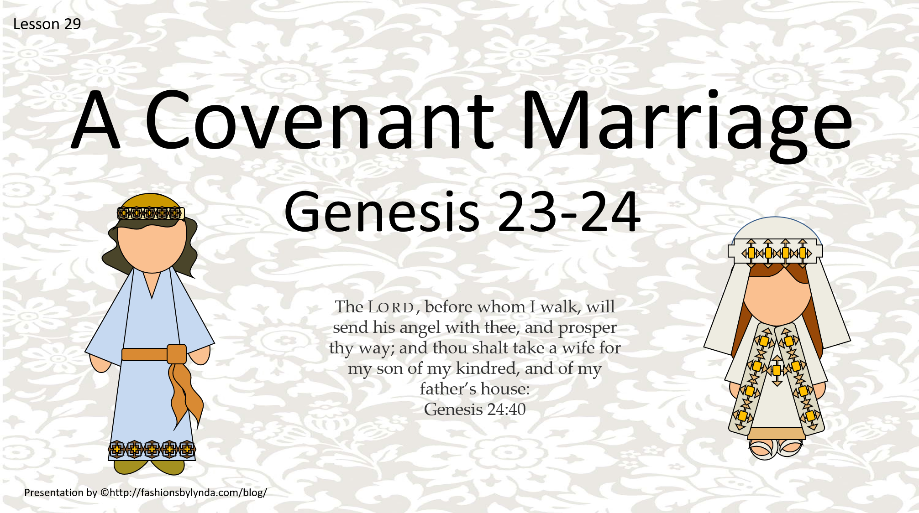

Slide 2

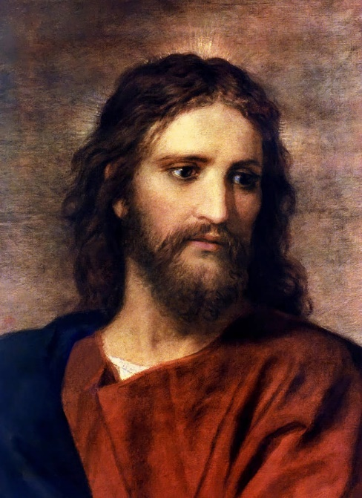
Review- Doctrinal Mastery
we will serve the Lord
Choose you this day
whom ye will serve
but as for me and my house
Push enter to unscramble

Slide 3

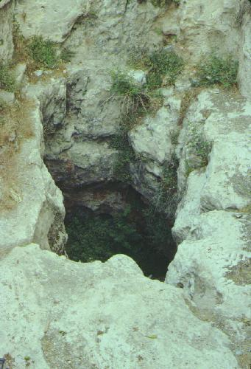
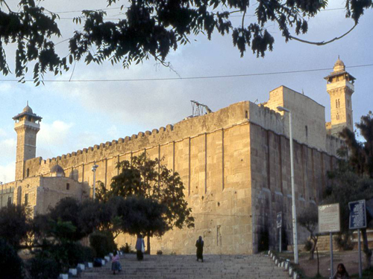
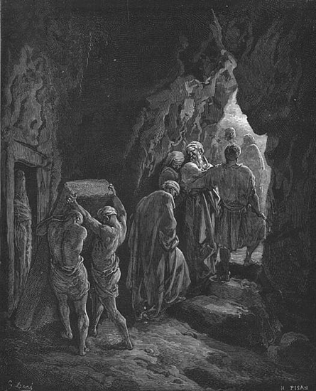
Sarah Is Buried
Sarah died in Kirjath-arba; the same is Hebron in the land of Canaan and Abraham came to mourn for Sarah, and to weep for her.
Heth (Bible) Heth is, the second son of Canaan, who is son of Ham, son of Noah. Heth is the ancestor of the Hittites, second of the twelve Canaanite nations descended from his sons, who lived near Hebron (Genesis 10:15)
Abraham purchased land from Ephron, the
Hittite, as a burial place for his wife Sarah;
subsequently Abraham, Isaac, Rebecca,
Jacob and Leah were also buried there.
She was buried in the field of Machpelah
before Mamre
Genesis 23:17-20
Today, Hebron is regarded as one of the four Jewish holy cities, second to Jerusalem
Genesis 23:1-20

Slide 4
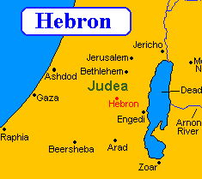
A Wife For Isaac
Abraham sent a servant to his former homeland to find a wife for Isaac from among Abraham’s kindred, who were covenant people.
The land of Canaan to Mesopotamia where his relatives lived was a distance of approximately 1,200 miles (1,931 kilometers) round-trip.
Genesis 24:1-6

Slide 5
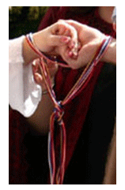
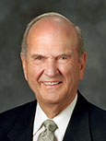
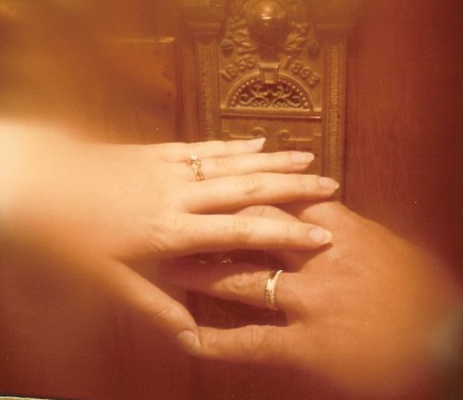
Why did Abraham want Isaac’s wife to be from his homeland?
A Covenant Marriage
“A couple in love can choose a marriage of the highest quality or a lesser type that will not endure. Or they can choose neither. …
“The best choice is a celestial marriage” (1)
Why is celestial marriage in the temple—or eternal marriage—the best kind of marriage?
In eternal marriages, righteous couples are sealed forever by the power of the priesthood and the family unit continues eternally.

Slide 6
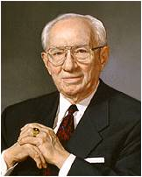
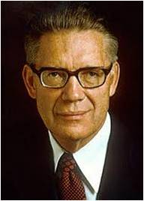
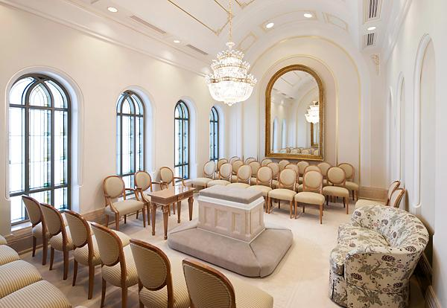

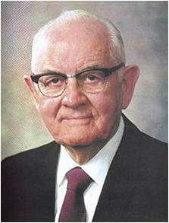
The Blessings of a Covenant Marriage
“There is no substitute for marrying in the temple. It is the only place under the heavens where marriage can be solemnized for eternity. Don’t cheat yourself. Don’t cheat your companion. Don’t shortchange your lives. Marry the right person in the right place at the right time.” (2)
“The most important single thing that any Latter-day Saint ever does in this world … is to marry the right person in the right place by the right authority.” (3)
Kansas City, Missouri Sealing Room
“Clearly, right marriage begins with right dating. A person generally marries someone from among those with whom he associates, with whom he goes to school, with whom he goes to church, with whom he socializes. Therefore, this warning comes with great emphasis. Do not take the chance of dating nonmembers, or members who are untrained and faithless” (4)
Genesis 24:1-6

Slide 7
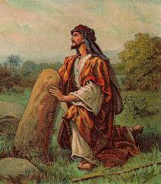
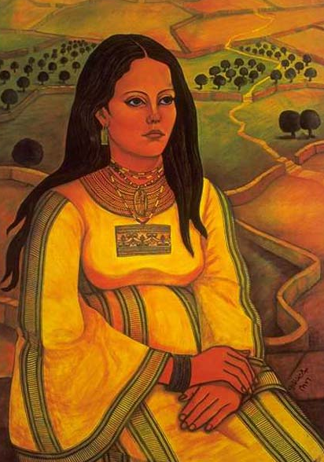
Isaac’s Choice
Abraham and his family lived in Canaan among people who worshipped idols and engaged in other sinful practices. Abraham had relatives that lived in Haran, where Abraham previously lived.
Isaac needed to fulfill the promise given to him by entering into a covenant marriage
The Canaanites did not believe in the Lord, no Canaanite woman would have been prepared to receive the responsibilities and blessings of the Abrahamic covenant and eternal marriage.
The decision Isaac faced concerning whether or not to marry in the covenant is just like our choice today of whether to receive the marriage sealing ordinance in the temple.
Genesis 24:1-6
Artist: Abdel Rahman Al Muzain

Slide 8
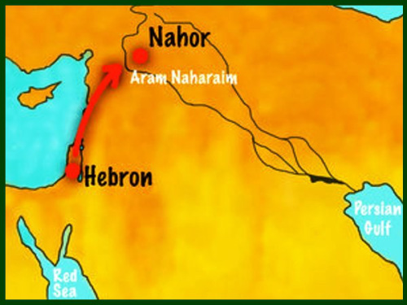
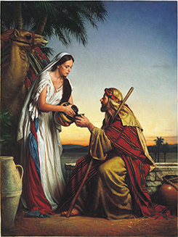
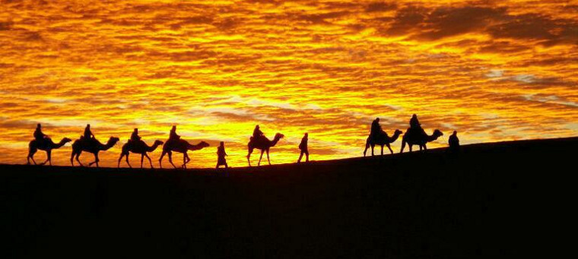
The Servant Meets Rebekah
Abraham’s servant traveled the long distance to Haran to find a wife for Isaac. While waiting by a well, he prayed and asked God for the ability to know whom the Lord would have him find.
We do not know why Abraham sent his servant to find Isaac a wife, rather than sending Isaac. Regardless of the reason, it is evident that the Lord guided Abraham’s servant in identifying a suitable wife for Isaac
Mesopotamia, unto the city of Nahor.
And the damsel was very fair to look upon, a virgin, neither had any man known her: and she went down to the well, and filled her pitcher, and came up.
Genesis 24:10-22

Slide 9
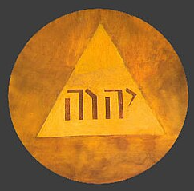
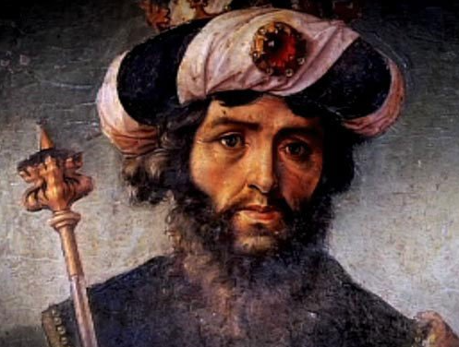
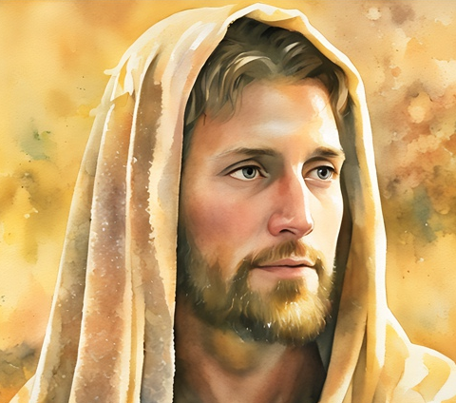
LORD vs Lord/lord
The name “Jehovah” in the King James Version of the Bible is generally indicated by LORD in all capital letters. The words “Lord” or “lord”, on the other hand, may simply refer to someone holding power, authority, or influence, such as a master or ruler.
The original pronunciation of this name has possibly been lost, as the Jews, in reading, never mentioned it but substituted one of the other names of God, usually Adonai. Probably it was pronounced Jahveh, or Yahveh.
In the (King James Version) KJV, the Jewish custom has been followed, and the name is generally denoted by Lord or God, printed in small capitals.
Jehovah is the premortal Jesus Christ and came to earth being born of Mary…
Genesis 24:12-27 Bible Dictionary, “Jehovah”

Slide 10
Rebekah
She was daughter of Bethuel, and granddaughter of Nahor, Abraham’s brother (Gen. 22:23) and she was the sister of Laban
A servant of Abraham went seeking a wife for Abraham’s son, Isaac and prayed for guidance
After Eliezer’s prayer at a well, she approached the servant with a pitcher of water
Laban extended a hand to the servant and hospitality and soon an arranged marriage was agreed upon
She readily agreed upon the union and went with the servant and Isaac and her were married
After a lengthy period of time, she became the mother of twins, Esau and Jacob
During her pregnancy she received and answer to her prayer concerning her children, and was told that her first child, Esau, would serve her second born, Jacob, however, Isaac favored Esau
She also, like Sarah, dealt with a secret as Isaac’s sister in Philistine because of her beauty
Close to the death of her husband, she arranged for Jacob to play the role of Esau to receive the birthright
She was buried “in the cave that is in the field of Machpelah—the same resting place of Abraham, Sarah, Isaac, and Leah
(5)

Slide 11
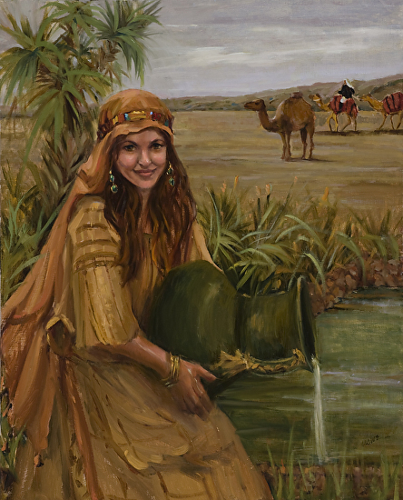
“Whose Daughter Art Thou”
Terah
Sarah
Abraham
Nahor
Milcah
Isaac
Rebekah
Bethuel
Rebekah was the granddaughter of Abraham’s brother Nahor.
Artist--Judy Crowe
(3)
Genesis 24:23-25

Slide 12
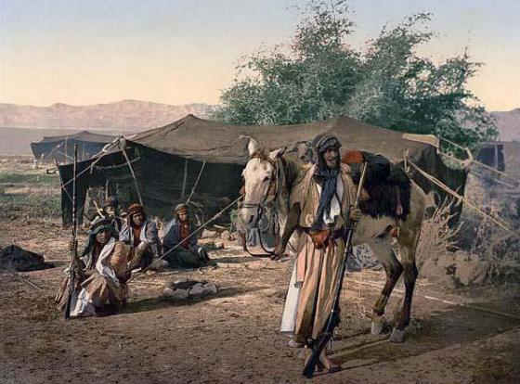
Brother Laban
He was the youngest son of Bethuel
He and the servant of Abraham arranged for Rebekah and Isaac’s marriage
Later Isaac sent his son, Jacob to seek a wife in Laban’s household
Terah
Sarah
Abraham
Nahor
Milcah
Isaac
Rebekah
Bethuel
Laban
(3)
Genesis 24:29-52

Slide 13
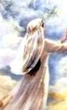
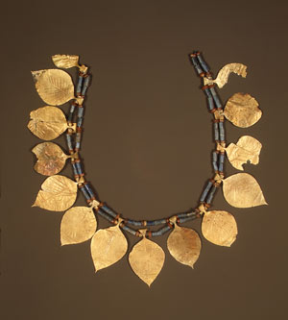
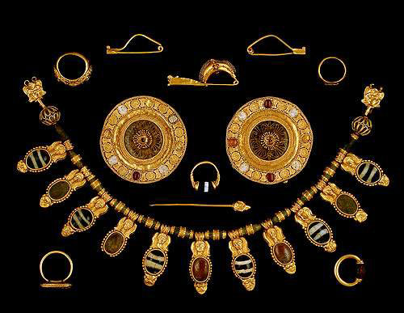
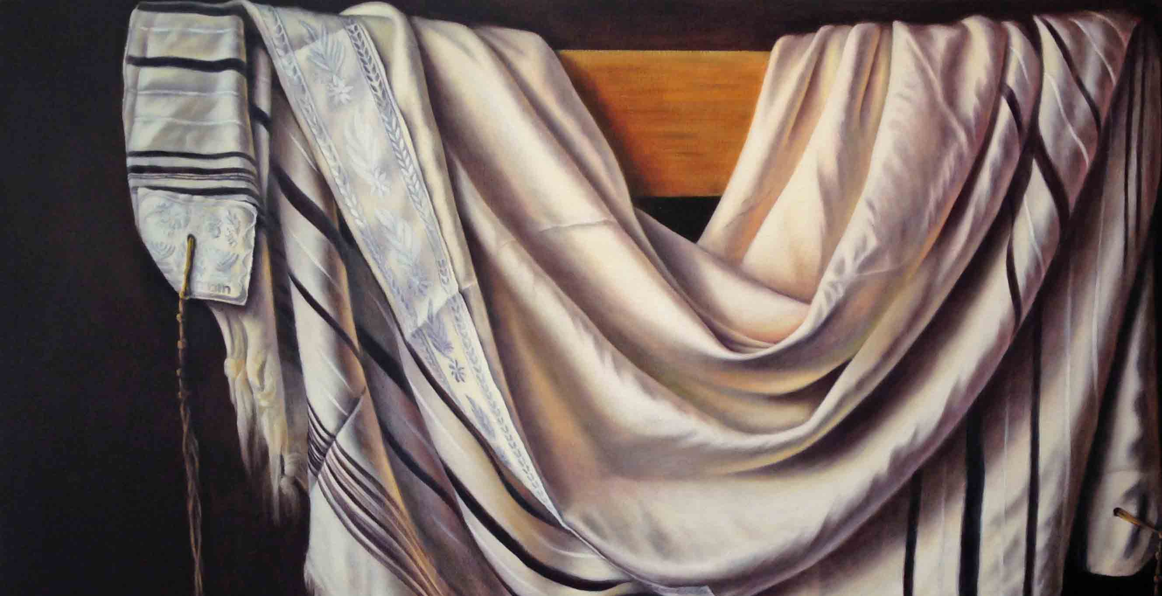
Bride Price
And the servant brought forth jewels of silver, and jewels of gold, and raiment, and gave them to Rebekah: he gave also to her brother and to her mother precious things
Bride price, also known as bride token, is an amount of money, property or other form of wealth paid by a groom or his family to the parents of the woman he has just married or is just about to marry. Bride price can be compare to dowry, which is paid to the groom, or used by the bride to help establish the new household; and dower, which is property settled on the bride herself by the groom at the time of marriage. The bride price agreed may or may not be intended to reflect the perceived value of the woman. Wikipedia
Raiment
(3)
Genesis 24:53

Slide 14
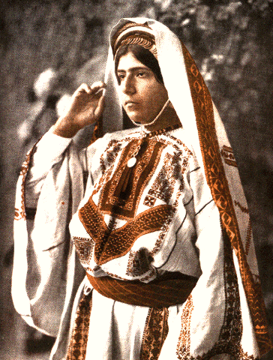
Betrothed
The acceptance of gifts by Rebekah and her family confirmed the betrothal and commitment to the proposed union.
Betrothed couples then entered an engagement period, when they were to demonstrate a commitment to their betrothal covenant through honesty and self-control.
Similarly, the proven ability of a potential marriage partner today to keep baptismal, priesthood, or temple covenants shows that that person is honorable before God and others. (8)
(3)
Genesis 24:53

Slide 15
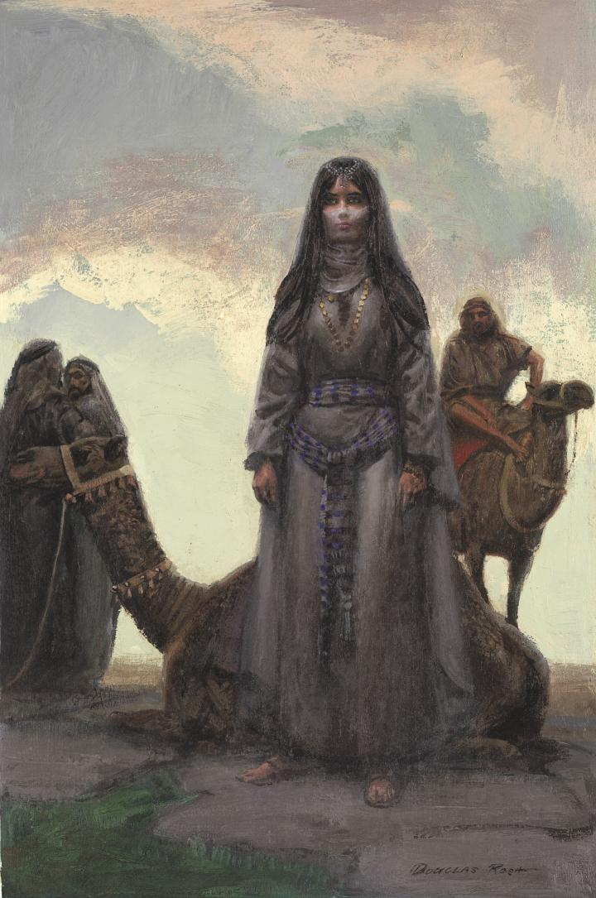
“I Will Go”
For a young woman to leave her home, travel to a new country completely foreign to her, and marry a man she had never met would present a tremendous challenge.
One would expect that she would have wanted to stay with her family as long as possible, but when given her choice, she said simply, “I will go.” (6)
“be thou the mother of thousands of millions”
Rebekah and her family understood that she would play a pivotal role in helping to accomplish the divine promise that Abraham’s descendants would be numbered as the stars in the heaven and the sand upon the seashore.
Artist—William Douglas Rosa
(3)
Genesis 24:58-60

Slide 16
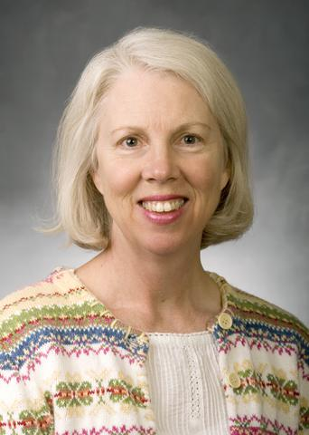
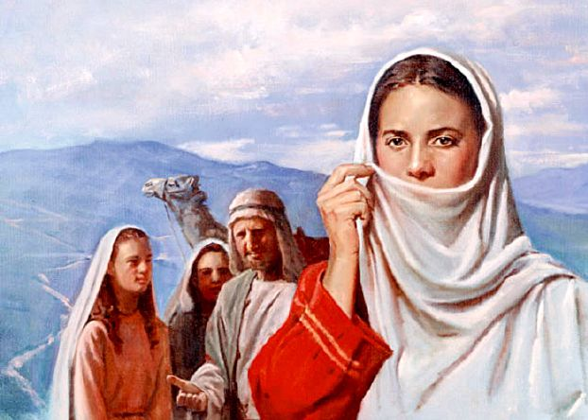
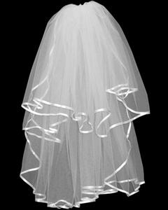
“Took A Vail”
Modesty and Respect
“After a long journey, Eliezer, Rebekah, and those who traveled with them arrived in the land of Canaan to meet Isaac. Rebekah had a character trait that showed her readiness for a covenant marriage,”
“It was common for unmarried women in Rebekah’s day to go about in public with their faces unveiled. So when Rebekah put on a veil, it was a sign of her virtue, reverence, humility, and modesty and showed respect for her future spouse.
Similarly, those who enter marriage today—both men and women—need the qualities of character Rebekah showed in this simple but dignified act.” (8)
(3)
Genesis 24:64-65

Slide 17

Developing A Righteous Character
The Lord will help us as we strive to enter into the covenant of eternal marriage
“If you hope to have an eternal companion who has certain spiritual qualities, then you must strive to develop those spiritual qualities in yourself. Then someone who has those qualities will be attracted to you” (7)
(3)
Genesis 24:58-60

Slide 18

The Eternal Marriage
“Now, there are those among you fine young members of the Church who might never marry. Although they are worthy in every way, they may never find someone to whom they will be sealed in the temple of the Lord in this life. …
“… I cannot tell you why one individual’s prayers are answered one way while someone else’s are answered differently. But this I can tell you: the righteous desires of your hearts will be fulfilled.
“… The brief span of this life is nothing in comparison with eternity. And if only we can hope and exercise faith and joyfully endure to the end …
there, in that great heavenly future, we will have the fulfillment of the righteous desires of our hearts and so very much more that we can scarcely comprehend now” (9)
It is worth great effort and sacrifice to obtain the blessings of eternal marriage
(3)
Genesis 24:61-67

Slide 19

Why is eternal marriage important?
What blessings can I obtain by being married in the temple and then striving to honor those covenants?
How can the Lord help me someday obtain the blessings of eternal marriage?

Slide 20
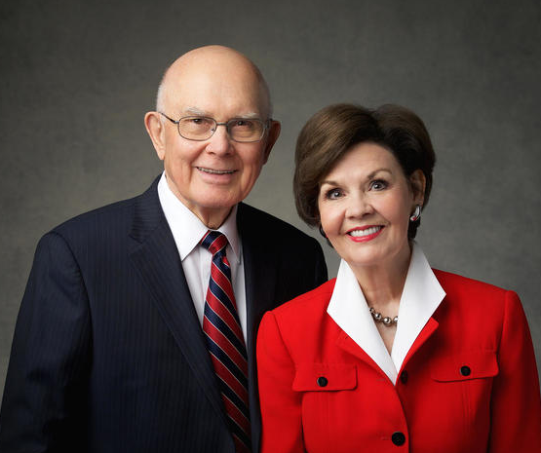
Marriage is a gift. Not only does marriage give us the opportunity for children, it gives us the opportunity and incentive to begin a journey of growing with one another.
We learn to sacrifice and serve as we can in few other ways. … I learn how to better love and help my husband; I have a friend to laugh with and cry with.
I have an advocate, teacher, and cheerleader who in turn helps me. Marriage is a built-in opportunity to learn communication and perspective.
Life becomes better as our marriage becomes connected to something greater than ourselves and closer to our Savior. We want that for you. (12)

Slide 21
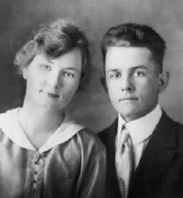
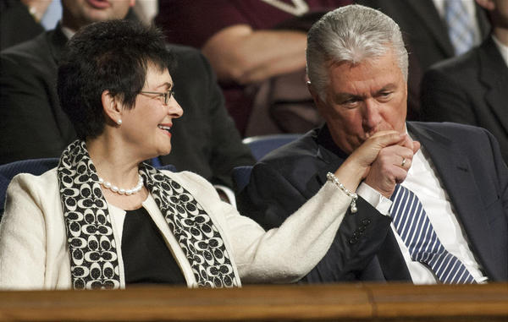
Eternal Companion
“‘Soul mates’ are fiction and an illusion; and while every young man and young woman will seek with all diligence and prayerfulness to find a mate with whom life can be most compatible and beautiful, yet it is certain that almost any good man and any good woman can have happiness and a successful marriage if both are willing to pay the price.” (10)
(guess who?)
“I know this may be a disappointment for some of you, but I don’t believe there is only one right person for you.
I think I fell in love with my wife, Harriet, from the first moment I saw her.
Nevertheless, had she decided to marry someone else, I believe I would have met and fallen in love with someone else. I am eternally grateful that this didn’t happen, but I don’t believe she was my one chance at happiness in this life, nor was I hers” (11)
(3)

Slide 22
Sources:
Video: “What Is a Temple Wedding Like?” (1:22).
Elder Russell M. Nelson (“Celestial Marriage,” Ensign or Liahona, Nov. 2008, 92, 94).
” President Gordon B. Hinckley (“Life’s Obligations,” Ensign, Feb. 1999, 2).
Elder Bruce R. McConkie (“Celestial Marriage” [Brigham Young University devotional, Nov. 15, 1955], 6).
President Spencer W. Kimball (Miracle of Forgiveness [1969], 241; see also Deuteronomy 7:3–4;2 Corinthians 6:14).
Who’s Who in the Old Testament by Ed J. Pinegar and Richard J. Allen pgs. 157-158
Presentation by ©http://fashionsbylynda.com/blog/
Institute Student Manual Old Testament Genesis Chapter 24
Elder David A. Bednar(in “Understanding Heavenly Father’s Plan”; lds.org/prophets-and-apostles/unto-all-the-world/understanding-heavenly-fathers-plan.
8. Cynthia L. Hallen Rebekah January 2002 Ensign
9. President Dieter F. Uchtdorf (“The Reflection in the Water” [Church Educational System devotional, Nov. 1, 2009]; LDS.org).
10. President Spencer W. Kimball (“Marriage and Divorce” [Brigham Young University devotional, Sept. 7, 1976], 4; speeches.byu.edu).
President Dieter F. Uchtdorf(“The Reflection in the Water” [Church Educational System devotional, Nov. 1, 2009]; LDS.org).
President Dallin H. Oaks and Sister Kristen M. Oaks, (“Stand for Truth” [worldwide devotional for young adults, May 21, 2023], Gospel Library)

Slide 23
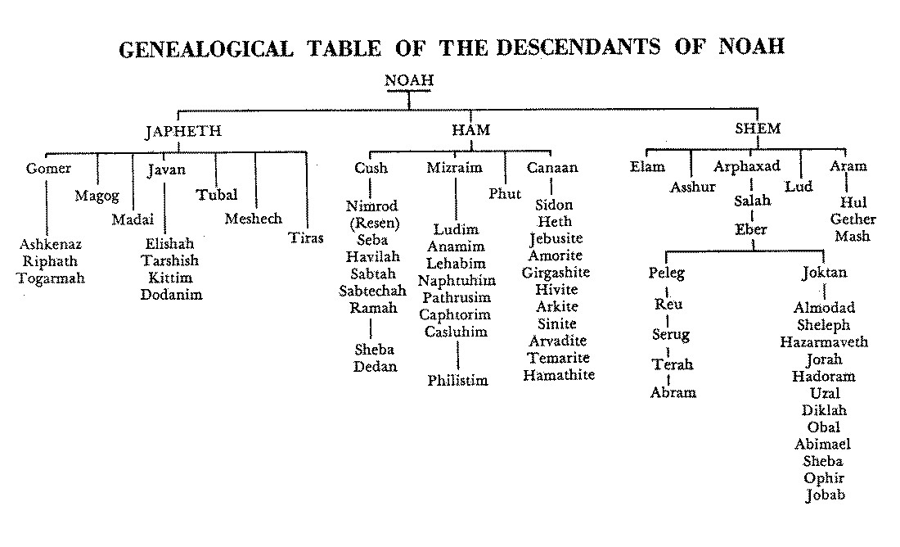

Slide 24
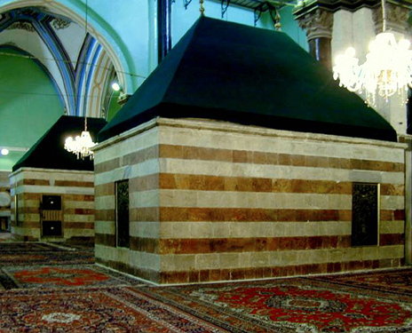
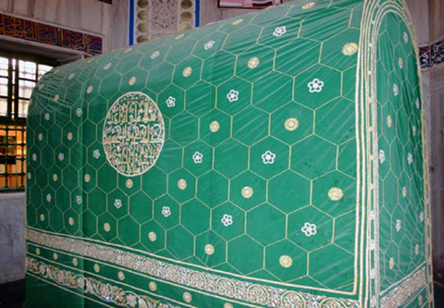
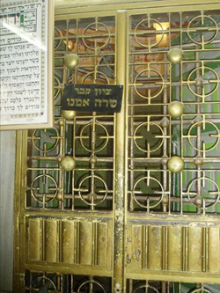
The enclosure of the Cave of the Patriarchs (Hebrew Me'arat HaMachpela; Arabic Al Magharah or Ibrahimi Mosque). After thousands of years the uniquely impressive building still fulfills its original function as a memorial to the patriarchs and matriarchs thought to be buried in the complex of caves beneath.
Herod the Great surrounded it with massive walls (the only fully intact Herodian structure), Byzantines and Crusaders transformed it into a church, Muslims turned it into a mosque.
Today, the Ibrahimi Mosque/Cave of Machpelah is divided into three rooms. Ohel Yitzhak (Isaac Hall) is a mosque; Ohel Avraham (Abraham Hall) and Ohel Ya'akov (Jacob Hall) serve as a Jewish synagogue. Jews have access to Ohel Yitzhak, the largest room, only ten days a year.
The Isaac Hall with its two cenotaphs ("a tomb or monument erected in honor of a person or persons whose remains are elsewhere") dedicated to Isaac and Rebekah. The other three fifths of the great structure contains six cenotaphs, each housed in individual octagonal rooms separated by corridors, and dedicated to Jacob and Leah, Abraham and Sarah.
Cave of the Patriarchs
Isaac Hall
The natural opening of the Cave of Macpelah at Hebron. Abraham, Isaac, Jacob, and their wives were buried here.
Dedicated to Jacob and Leah, and Abraham
http://www.wingsofeaglesct.com/LIFE_OF_JESUS/009_FlightToEgypt-2.htm
Dedicated to Sarah

Slide 25
Hittites: The ancient people descended from Heth (Gen. 10:15). They were a branch of the Canaanites, and in the Bible the name denotes all the Canaanite (as distinguished from the Aramean or Syrian) nations that lived north of Palestine from the Orontes to the Euphrates (1 Kgs. 10:29; 2 Kgs. 7:6). Their empire extended to the extreme northwest of Asia Minor, and they were strong enough to contend on equal terms with the kings of Egypt and Assyria. Their love of literature may be traced in the name of the Hittite Kirjath-Sepher (“city of books”); their art is evident by the curious sculptures found at Carchemish, one of their capitals, and elsewhere. Bible Dictionary
Isaac:
According to the information that has come down to modern times, Isaac spent his whole life in an area that could be encompassed by a circle approximately one hundred miles in diameter. On the northern edge of this circle would be Jerusalem, where Abraham took his son. Most of the circle would be in that part of southern Israel known as the Negev.
It appears that Isaac, a herdsman, and his large household found sufficient pasture and other means of subsistence there. They had to move about, however, because of famines that occurred. Centuries of conflict, neglect, and natural causes have since turned the Negev into a barren area that covers nearly half of modern Israel. In recent years the Israelis have been turning the Negev into a productive area once again.
Chiefly, Isaac lived in three areas of the Negev: Beer-lahai-roi, Gerar, and Beersheba. Like his father, Isaac dug many wells. His tribe and flocks often went where the water was to be found. Isaac was a peaceful man, according to the record, choosing to move on and dig new wells rather than fight for the ones he had already dug. The Lord prospered him exceedingly. Institute Student Manual Old Testament (ISMOT)
Hope For Eternal Family:
A prophet of God once offered me counsel that gives me peace. I was worried that the choices of others might make it impossible for our family to be together forever. He said, “You are worrying about the wrong problem. You just live worthy of the celestial kingdom, and the family arrangements will be more wonderful than you can imagine.”
… With the power of the Atonement of Jesus Christ working and with the Holy Spirit guiding, you can feel now and will feel in the world to come the family love your Father and His Beloved Son want so much for you to receive.
I testify that as you live worthy of the celestial kingdom, the prophetic promise that “family arrangements will be more wonderful than you can imagine” will be yours. President Henry B. Eyring (“The Hope of Eternal Family Love,” Ensign or Liahona, Aug. 2016, 5)
Rebekah:
The King James Version suggests that Rebekah was very beautiful, but the Joseph Smith Translation says that she was the most beautiful woman the servant had ever seen. The Joseph Smith Translation reads, “And the damsel being a virgin, very fair to look upon, such as the servant of Abraham had not seen, neither had any man known the like unto her …” (JST, Genesis 24:16).
Considering the capacity of a thirsty camel, one can well imagine how much effort it took for Rebekah to draw water by hand for ten camels. Not only was she beautiful but she was a willing worker and was quick to serve.
For a young woman to leave her home, travel to a new country completely foreign to her, and marry a man she had never met would present a tremendous challenge. One would expect that she would have wanted to stay with her family as long as possible, but when given her choice, she said simply, “I will go.” ISMOT
The Story of Isaac and Rebekah:
Sister Julie B. Beck, who served as general president of the Relief Society, explained that the experience of Isaac and Rebekah provides a pattern for the youth of the Church today:
“The story of Isaac and Rebekah is an example of the man, who has the keys, and the woman, who has the influence, working together to ensure the fulfillment of their blessings. Their story is pivotal. The blessings of the house of Israel depended on a man and a woman who understood their place in the plan and their responsibilities to form an eternal family, to bear children, and to teach them.
“… Every young man and young woman should understand his or her role in this great partnership—that they are each an ‘Isaac’ or a ‘Rebekah.’ Then they will know with clarity what they have to do” (“Teaching the Doctrine of the Family,” Ensign, Mar. 2011, 16).
Genesis 24:67 --When one contemplates the faith and beauty of Rebekah and how the servant of Abraham was led to her by the hand of the Lord, the comment “and he loved her” is not surprising. ISMOT

Slide 26
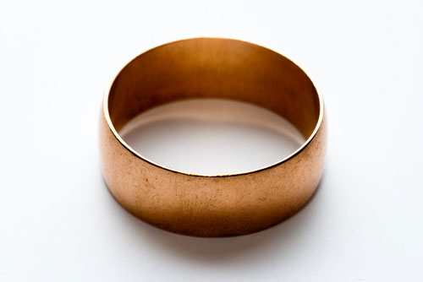
Ancient Jewish Marriage
In biblical times, people were married in early youth, and marriages were usually contracted within the narrow circle of the clan and the family. It was undesirable to marry a woman from a foreign clan, lest she introduce foreign beliefs and practices.
As a rule, the fathers arranged the match. The girl was consulted, but the “calling of the damsel and inquiring at her mouth” after the conclusion of all negotiations was merely a formality.
In those days a father was more concerned about the marriage of his sons than about the marriage of his daughters. No expense was involved in marrying off a daughter. The father received a dowry for his daughter whereas he had to give a dowry to the prospective father-in-law of his son when marrying him off.
The price paid by the father of the groom to the father of the bride was called mohar. In the stories of Genesis, Shekhem [Dina’s suitor] said to Dinah’s father and her brothers: “Let me find favor in your eyes, and what ye shall say unto me I will give. Ask me never so much mohar and mattan, and I will give according as ye shall say unto me; but give me the damsel to wife.” “Mattan” was the Hebrew word for the gifts given by the groom to the bride in addition to the mohar.
The mohar was not always paid in cash. Sometimes it was paid in kind, or in service. The book of Genesis relates the story of the servant of Abraham, who, after his request for Rebekah [to marry Isaac] was granted, “brought forth jewels of silver, and jewels of gold, and raiment, and gave them to Rebekah; he gave also to her brother and to her mother precious things.” The servant thus gave mattan to Rebekah, and mohar to her brother and mother.
The Bible does not specify what was to be done with the mohar in case the marriage agreement was broken by either of the two parties.
The mohar was originally the purchase price of the bride, and it is therefore understandable why it was paid by the father of the groom to the father of the bride. In ancient days, marriage was not an agreement between two individuals, but between two families.
http://www.myjewishlearning.com/article/ancient-jewish-marriage/

Slide 27
The qualities of an ideal husband
The qualities that a Jewish woman looked for in a husband were:
someone a few years older than herself, and of the same social standing
a student of the Hebrew Scriptures, for scholarship meant that a man was intelligent, prepared to work, and able to reason and think
someone possessing enough money and goods to be able to give her status, comfort and security
someone whose family was reputable, with no scandal or bad blood associated with his family
someone physically attractive, because Jews believed that a happy sex life was one of the greatest gifts God gave to a married couple.
The qualities of an ideal wife
The qualities that a Jewish man looked for in a wife were:
Jewish descent, because transmission of ‘Jewishness’ was through the Jewish mother
someone from a respectable family, since family characteristics could be transmitted to succeeding generations
the daughter of a man who was learned and had studied
a girl about the same age as the man or younger
someone known for her good sense, good behavior and kindliness
if possible, someone who was physically beautiful, but an intelligent mind and a cheerful personality were in the long run even more important.
http://www.womeninthebible.net/3.2.Major_Events.htm

Slide 28
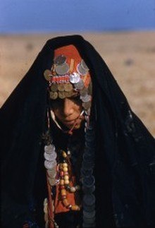
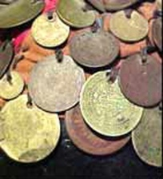
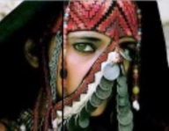
The Veil:
There exists very often among Christians the error of confusing Muslim customs with the customs of Biblical times. Many believe, including some scholars and professors of seminaries that women in Biblical times lived with their faces covered by a veil like the Muslim women of today. There is no such thing. As a nuptial custom, a woman used a veil to present herself before the man who she was going to marry, but that was only for that purpose, the rest of her activities and life, she walked around with her face uncovered. Nowadays a bride also uses a veil during the marriage ceremony.
Decent women did not have to cover their faces, the ones that covered their faces were the prostitutes, as we can see in the passage I present below, in which Judah upon seeing his daughter in law Thamar, thought she was a prostitute because she had a veil covering her face. Even it says that the reason why he thought she was a prostitute was because she was covered. If all the women of that time would have been used to wearing a veil over their faces, Judah would not have thought that a woman who he saw with a veil covering her face was a prostitute.
“14 And she put her widow's garments off from her, and covered her with a vail, and wrapped herself, and sat in an open place, which is by the way to Timnath; for she saw that Shelah was grown, and she was not given unto him to wife. 15 When Judah saw her, he thought her to be an harlot, because she had covered her face.” (Genesis 38:14-15)
The Bedouin headdress combines a rectangular scarf of black silk Georgette with a diagonally folded band. The thin scarf is draped around the head and under the chin so that the throat is covered. The folded band is tied squarely on the head so that it covers most of the forehead. The Bedouin woman pulls her hair out from under the veil to frame her face. She sews her gold and silver dowry coins on her headdress and likes gold or silver anklets and bracelets. In the Middle East, it is a common custom that the woman is entitled to all her wearing apparel, therefore, any wedding dowry she receives she will normally wear. This quite often consists of coins, jewelry, bracelets and the like.
Something of Interest
Makes you think twice about the Parable of the lost coin
Luke 15:8-10
The Bedouin Veil
You might spot a Bedouin Girl with a row of coins missing from her head dress, this would indicate that the family may have needed to pay for something such as for a doctor or a debt. The woman was the keeper of the family wealth. Just as the mother or in Hebrew the "em" was "the one that binds the family together”. The Husband would entrust this Wife to guard the Family finances!
After this thorough investigation into the Bedouin custom of wearing the Bridal dowry ,you can better understand how its origin is based on biblical wedding practices and customs. This had been done long before it was adopted by pagan groups who added amulets and talismans to ward off evil spirits.
Married women from Bethlehem and some other villages wore a specially padded hat with coins sewed on, displaying their family wealth for all to see. The more coins on the hat, the wealthier the family. The coins were part of bride wealth from the woman’s husband at the time of their marriage.
http://www.biblicalrootswebcentral.com/research-study-on-veils-by-mh.html

Slide 29
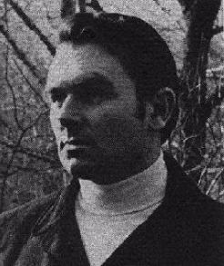
William Douglas Rosa—artist
He was born in New York City in 1942. He was encouraged by his father, art director for Life magazine, to seek a career in art. Rosa’s formal training was completed at the Art Student’s League and the School for Visual Arts in New York. By age 19, he began his career as a freelance illustration artist.
Rosa’s dramatic Bible paintings were commissioned by Prentice Hall to illustrate and complement the powerful writing style of renowned cleric Walter Russell Bowie in The Living Stories of the Old Testament and The Living Stories of the New Testament.
In addition to his incredible Bible illustrations, he is perhaps best known for his depictions of the Vietnam War where he was among several artists given a temporary commission by the Marine Corps’ fine arts program to spend seven weeks sketching battlefield scenes.
Death: 1976
Eliezer:
Abraham entrusted this matter to Eliezer, the “eldest servant of his house” (Gen. 15:2; Gen. 24:2). Even when his servant questioned how this might be accomplished (see Gen. 24:5), Abraham assured him the Lord would guide him to success (see Gen. 24:7, 40).
As Eliezer approached the city of Nahor in Haran, he prayerfully submitted a plan to the Lord for identifying an appropriate young woman (see Gen. 24:12–14, 42–44). He proposed that whoever would kindly agree to get water from the well for himself and his animals would be the right person for Isaac. Rebekah came “with her pitcher upon her shoulder”
Abraham’s servant had prayed for a maiden who would bring a dowry of kindness to the Abrahamic family (see Gen. 24:14). At the well he met a personification of Christlike charity and consideration.
The Well:
Most of the ancient wells of the Holy Land are really cisterns, large cavities in the rock into which one must descend. Many have steps carved into the stone along the wall. The steps are narrow and slippery, and women descended them with heavy pitchers on their shoulders. It appears that Rebekah did this over and over in order to water the servant’s camels.
Rebekah followed the promptings of the Holy Spirit and displayed her great faith through her willingness to go with Abraham’s servant, leaving her family and security behind. It was certainly a leap of faith. When the Holy Ghost arranges marriages, they are surely marriages “made in heaven,” and Isaac and Rebekah loved each other.
http://mormonbible.org/old-testament/isaac-and-jacob

