Slide 1

The Birthright
Genesis 25-27
And behold, ye are the children of the prophets; and ye are of the house of Israel; and ye are of the covenant which the Father made with your fathers, saying unto Abraham: And in thy seed shall all the kindreds of the earth be blessed.
3 Nephi 20:25

Slide 2
Now
Tomorrow
OR
Which would you choose?
Why?

Slide 3
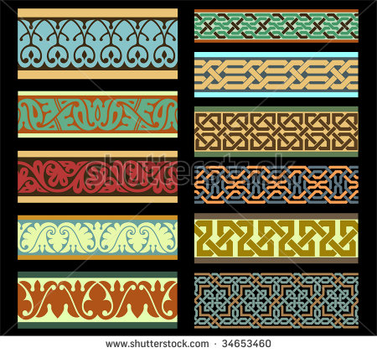
Abraham’s Family Grows
After the passing of Sarah Abraham married a woman named Keturah, who bore six sons. Keturah is referred to in the scriptures as a concubine.
(1 Chronicles 1:32)
Hagar
Sarah
Abraham
Keturah
Ishmael
Rebekah
Isaac
Zimran
Jokshan
Sheba
Medan
Dedan
Asshurim
Ephah
Midian
Letushim
Epher
Ishbak
Leummim
Hanoch
Shuah
Abida
Concubine:
Women in the Old Testament who, in the time and culture in which they lived, were legally married to a man but had a lower social status than a wife.
Eldaah
Genesis 25:1-4
Midianites

Slide 4
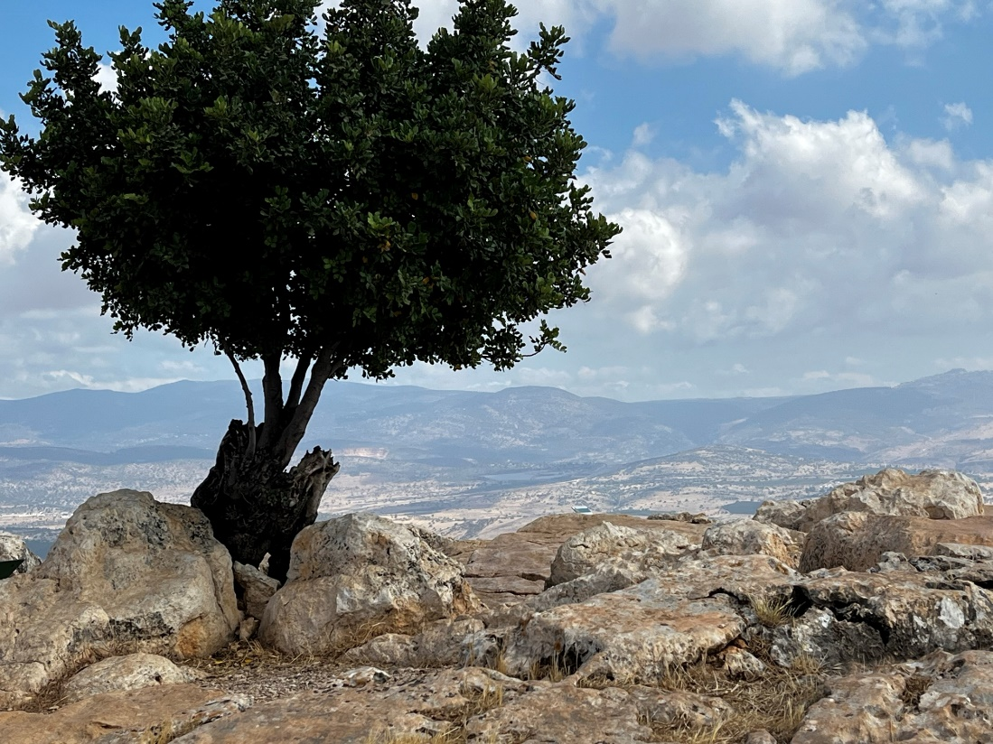
Giving All to Isaac
Isaac received more than Abraham’s other children because of Isaac’s birthright.
A son who held the birthright inherited not only his father’s lands and possessions, but also his father’s position as the spiritual leader of the family and the “authority to preside”.
Under the patriarchal order, the right or inheritance of the firstborn is known as birthright.
This generally included a land inheritance as well as the authority to preside.
The firstborn of flocks and of human families was considered as belonging to the Lord and was expected to be dedicated to Him.
This dedication could be either literal or by the payment of redemption money (Ex. 13:11–16).
Bible Dictionary
Genesis 25:5-6

Slide 5
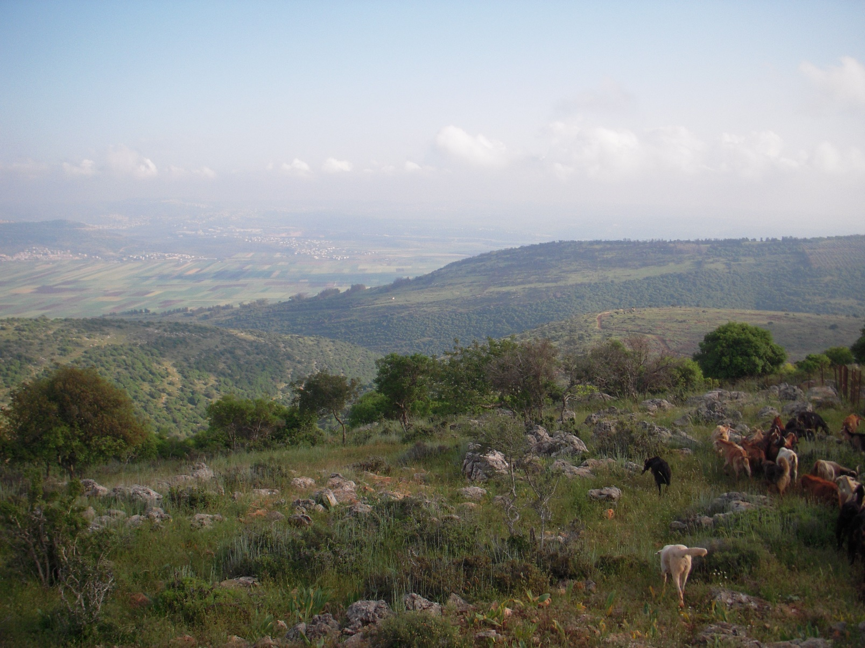
Birthright
The son was then responsible to use these resources to provide for the family’s needs.
The birthright was often passed from a father to his eldest son.
However, righteousness was more important than being the firstborn.
The birthright Isaac received from Abraham also included all the blessings and responsibilities of the Abrahamic covenant.
Genesis 25:5-6

Slide 6

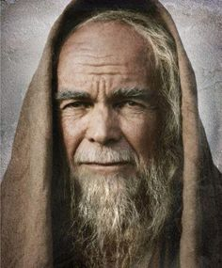
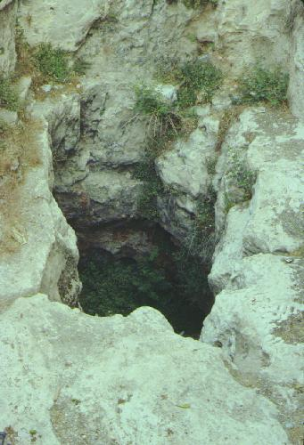
Death of Abraham
Abraham was 175 years old when he passed away
Ishmael and Isaac reunited to bury their father
Abraham is buried in the cave of Machpelah, in the field of Ephron the son of Zohar the Hittite, which is before Mamre;
The natural opening of the Cave of Macpelah at Hebron. Abraham, Isaac, Jacob, and their wives were buried here.
Genesis 25:7-10

Slide 7
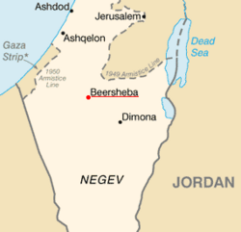
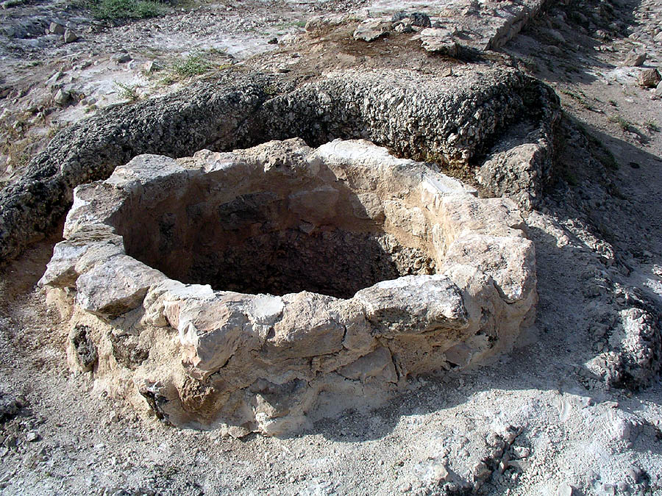

Building Wells
Beer- Lahai-roi
Chiefly, Isaac lived in three areas of the Negev: Beer-Lahai-roi, Gerar, and Beersheba. Like his father, Isaac dug many wells. His tribe and flocks often went where the water was to be found. Isaac was a peaceful man, according to the record, choosing to move on and dig new wells rather than fight for the ones he had already dug.
Beersheba is fifty miles south of Jerusalem and in Old Testament times marked the southern border of the Judean kingdom.
The Lord prospered him exceedingly. Isaac’s clan established Beersheba, and the community since then has always been associated with his name.
Genesis 25:11
(1)

Slide 8
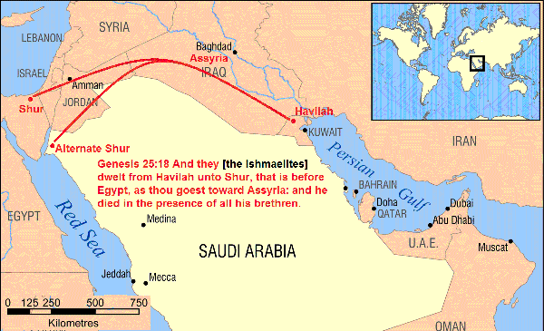
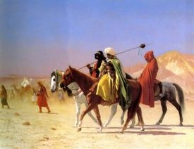
Ishmael’s Sons
Twelve princes according to their nations.
Hagar
Abraham
Sarah
Ishmael
Nebaioth
Massa
Kedar
Hadad
Adbeel
Temur
Mibsam
Jetur
Mishma
Naphish
Dumah
Kedemah
Ishmael dies at age 137
Ishmaelites
NOTE: Joseph is sold to the Ishmeelites
Genesis 37:27
Genesis 25:12-18

Slide 9
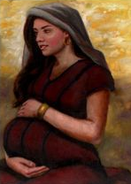
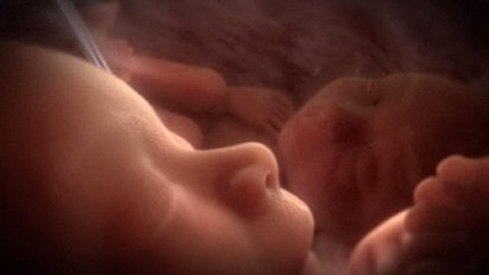
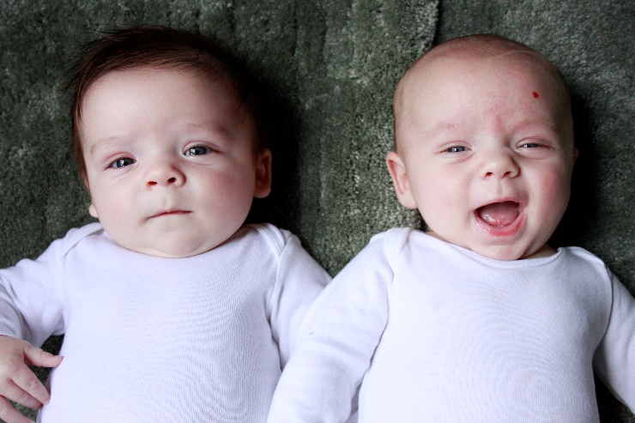
Two Nations--Twins
“The children struggled together within her”
Rebekah goes to the Lord
“the elder shall serve the younger”
Genesis 25:21-23

Slide 10
Esau
He was the older of two twin sons born to Isaac and Rebekah
His name means “hairy”
His father favored him
He was a hunter and a man of the field
He traded his birthright by trading a bowl of ‘pottage’, in which later he regretted
He married non-lsraelite women, Judith
When his father was old and frail, Isaac, wanted to bless the firstborn, however his mother counseled Jacob to manage to receive the blessing instead
He was enraged and wanted to kill Jacob, for which Jacob was sent away to relatives until Esau ‘’cooled down”
Eventually Esau and Jacob reconciled, and their descendants constituted two rival nations, the Israelite and the Edomites
(2)

Slide 11
Jacob
He was the younger of two twin sons born to Isaac and Rebekah
His name means supplanter (governments and rulers of countries)
He was a ‘plain man’ and dwelt in tents
The Covenant promise was granted to his seed through Abraham and Isaac
He exchanges ‘pottage’ for Esau’s birthright (Genesis 25:32-34)
He is sent away after Esau learns of the blessing their father gave to him.
His name is changed to Israel
He is valiant during his lifetime
He has 12 sons in whom Joseph is given the Covenant blessings
He is the father of the 12 tribes of Israel
The Lord refers him to the House of Israel
The Doctrine and Covenants confirms that he was one of the patriarchs whose descendants carried forth the work of the Abrahamic covenant to spread the blessing of the gospel of salvation and the priesthood of God to the world
(2)

Slide 12
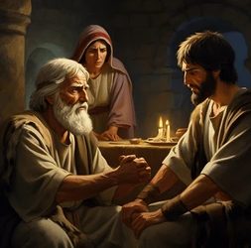
Birthright
In Old Testament times, the oldest son typically received the birthright.
The birthright inheritance included a double portion of land and wealth.
It also included greater responsibility to care for the mother and the rest of the family following the death of the father.
In addition to the temporal inheritance, the father would give a birthright blessing to confer priesthood authority upon the oldest son.
This blessing established the son’s position in the family as teacher and leader.

Slide 13
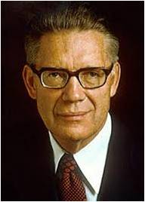
“It appears that anciently under the Patriarchal Order certain special blessings, rights, powers, and privileges—collectively called the birthright—passed from the father to his firstborn son.
In later ages special blessings and prerogatives have been poured out upon all the worthy descendants of some who gained special blessings and birthrights anciently. (3 Ne. 20:25–27.)
Justification for this system, in large part, lies in the pre-existent preparation and training of those born in the lines destined to inherit preferential endowments.”

Slide 14
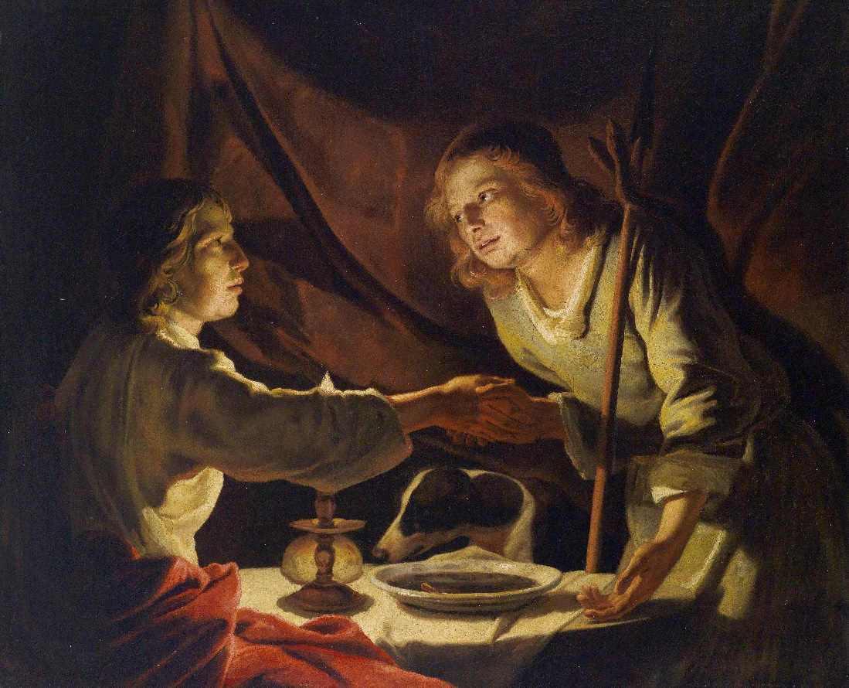
Pottage--Soup
Lest there be any fornicator, or profane person, as Esau, who for one morsel of meat sold his birthright.
Hebrews 12:16
Pottage is a thick soup or stew made by boiling vegetables, grains, and, if available, meat or fish
Esau’s choice, because he was famished, was to eat today, and then later miss out on the blessings of the future
Esau treated his birthright as though it had very little meaning or value
Artist: Matthias Stom
Genesis 25:29-34

Slide 15


Temporal vs Eternal
In the busyness of our daily lives and in the commotion of the contemporary world in which we live, we may be distracted from the eternal things that matter the most by making pleasure, prosperity, popularity, and prominence our primary priorities.
Our short-term preoccupation with “the things of this world” and “the honors of men” may lead us to forfeit our spiritual birthright for far less than a mess of pottage. …
Each of us should evaluate our temporal and spiritual priorities sincerely and prayerfully to identify the things in our lives that may impede the bounteous blessings that Heavenly Father and the Savior are willing to bestow upon us. (7)
Choosing immediate or worldly desires over God’s eternal blessings can lead to sorrow and regret.

Slide 16
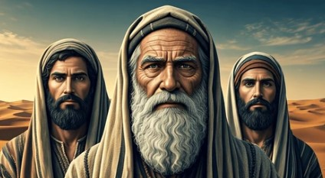
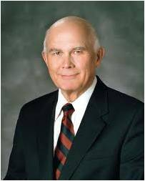
Blessings Given VS Blessings Lost
Blessings:
Position of head of family
Priesthood authority
Double portion of parents’ estate
Loss:
Birthright
Priesthood authority
Inheritance
Honor from his parents by marrying outside the covenant
“The firstborn, Esau, ‘despised his birthright.’ (Gen. 25:34.) Jacob, the second twin, desired it.
Jacob valued the spiritual, while Esau sought the things of this world. … Many Esaus have given up something of eternal value in order to satisfy a momentary hunger for the things of the world” (5)
Genesis 27

Slide 17
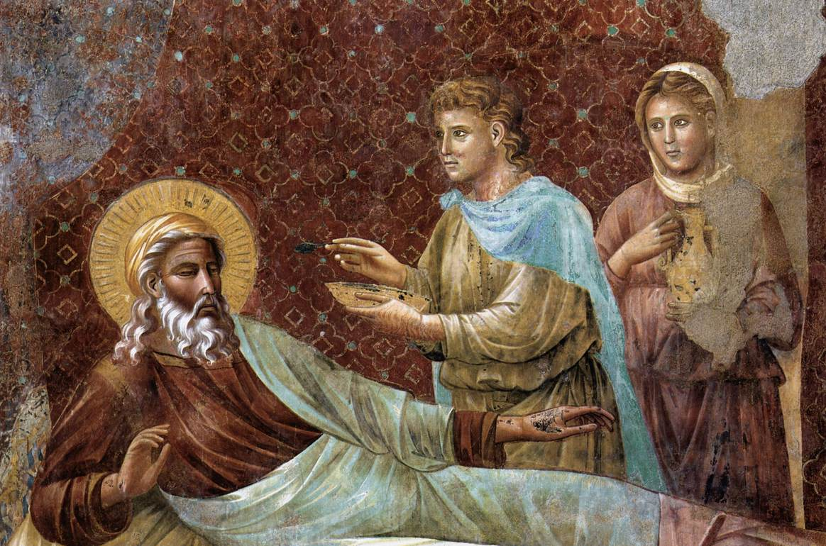
A Father’s Blessing
Rebekah had previously learned by revelation that Jacob was to receive the birthright (Genesis 25:23).
Rebekah instructed Jacob to approach Isaac, who was physically blind, and present himself as though he were Esau so that Jacob could receive the birthright blessing.
Jacob reluctantly carried out this plan and received the blessing.
Genesis 27:6-29

Slide 18
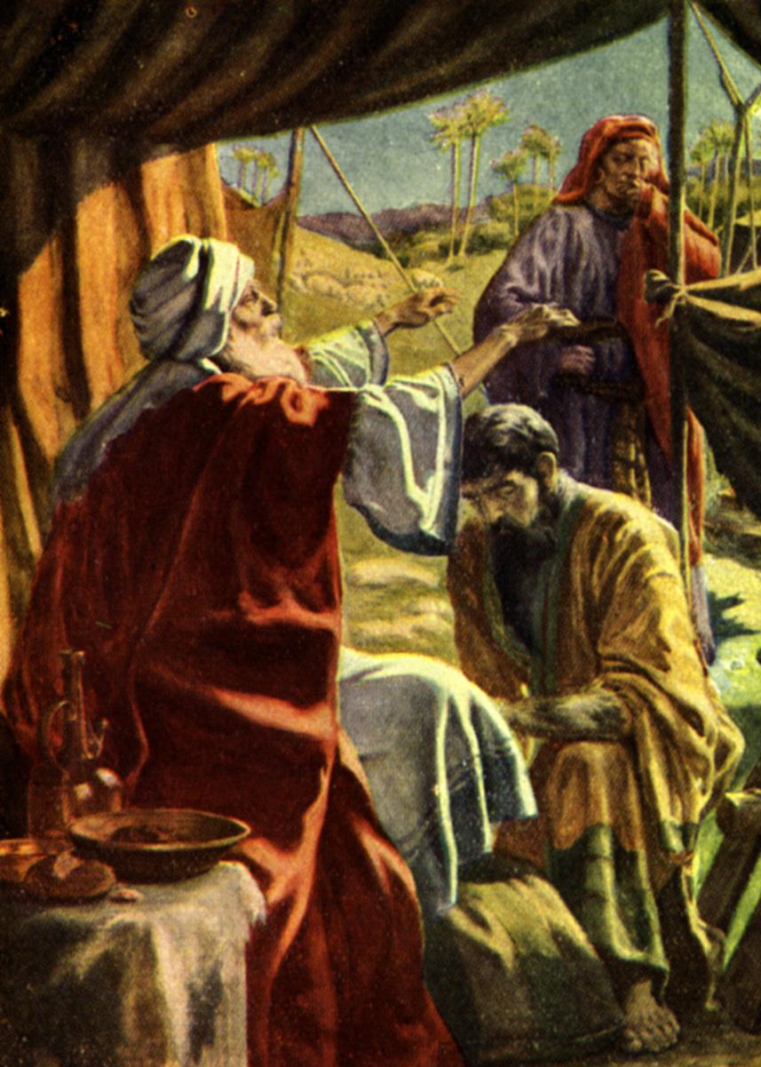
Was This The Right Way?
Some may be troubled by the account in Genesis 27:1–33 because it seems to indicate that righteous individuals made errors as they sought to control who would receive the birthright blessing.
After Isaac learned that he had unknowingly bestowed the birthright blessing on Jacob, he could have revoked the blessing and cursed Jacob.
However, instead of revoking the birthright blessings from Jacob and bestowing them upon Esau, Isaac confirmed that the birthright blessing was given to the person the Lord intended to have it.
Because the Spirit of the Lord was directing him, Isaac knew that he had given the blessing to the right son.
Genesis 27:6-29

Slide 19
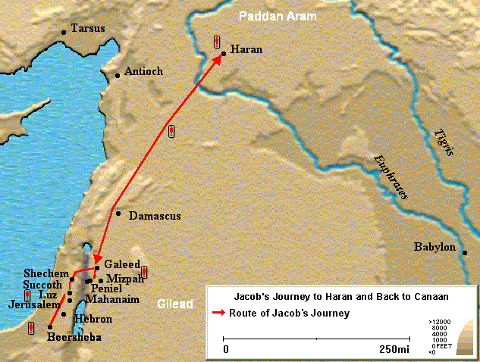
The Wrath
Behold, thy dwelling shall be the fatness of the earth, and of the dew of heaven from above;
Esau did receive a blessing from Isaac. However, angry about losing the birthright blessing,
Esau decided to kill Jacob.
Rebekah directed Jacob to travel to Haran, where he could be safe from Esau.
Genesis 27:41-46

Slide 20
Esau’s Fate
And Esau was forty years old when he took to wife Judith the daughter of Beeri the Hittite, and Bashemath the daughter of Elon the Hittite:
Eventually Esau and Jacob reconciled and their descendants constituted two rival nations, the Israelite and the Edomites
Genesis 25:34

Slide 21
Esau’s Descendants
This is my own interpretation of Genesis 26, 28, and 36.
Needless to say that Esau had many descendants
Hivite
Hittites
Zibeon
Isaac
Beeril
Ishmael or Elon ?
Ishmael
Horite
Elon
Anah
Esau
Judith
Bashemath
Mahalath
Aholibamah
Adah
Seir
Speculation that Mahalath and Bashemeth are the same person
Jeush
Eliphaz
Timna
Reuel
Jaalam
Amalek
Teman
Nahath
Korah
Omar
Ramesis I
Zerah
Zepho
Dukes
Shammah
Gatam
Mizzah
Edomites
They dwelt in Mt Seir and intermarriages took place between the sons and daughter of Esau and the sons and daughters of Seir, the Horite
Kenaz
See How Confussing Genealogy can get?

Slide 22
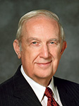
…But what is Important?
“Think of the long view of life, not just what’s going to happen today or tomorrow.
Don’t give up what you most want in life for something you think you want now.”
(6)

Slide 23
Sources:
Video: Many Esaus (0:26)
“Jacob and Esau” (2:06)
“The Soul’s Sincere Desire” (3:28)
http://mormonbible.org/old-testament/isaac-and-jacob
Old Testament Who’s Who by Ed J. Pinegar and Richard J. Allen pgs. 53-54, 83-84
Old Testament Institute Student Manual
Elder Bruce R. McConkie (Mormon Doctrine, p. 87.)
Elder Dallin H. Oaks (“Spirituality,” Ensign, Nov. 1985, 61).
Presentation by ©http://fashionsbylynda.com/blog/
6. (Richard G. Scott, “Jesus Christ, Our Redeemer,” Ensign, May 1997, 54).
7. Elder David A. Bednar (“Put On Thy Strength, O Zion,” Liahona, Nov. 2022, 94

Slide 24
Concubine, a word commonly used in the Old Testament, was defined by Elder Bruce R. McConkie as follows: “Anciently they were considered to be secondary wives, that is, wives who did not have the same standing in the caste system then prevailing as did those wives who were not called concubines...” (Mormon Doctrine, pp. 154–55.)
A female slave who functioned as a secondary wife and surrogate mother.
Multiplying children through concubines would not normally complicate the inheritance lines, but would increase the available family workforce and the family wealth. Bible Study Tools Dictionary
The Blessing:
When Isaac became about 130 years old, and his sons more than 70, the time was right for the bestowal of the birthright blessing. Rebekah felt the blessing should not go to Esau, that he would not perform in it as he should, and, remembering God’s word that “the elder shall serve the younger,” implemented a plan to ensure that her worthy son, Jacob, would receive it (see Gen. 27:6–10). Yet Jacob was hesitant to participate in the plan, so his mother replied, “Upon me be thy curse, my son: only obey my voice” (Gen. 27:13). Thus, by pretending to be his brother, Jacob received the birthright blessing from his father that his brother had promised him years earlier. Isaac affirmed that the blessing rightfully belonged to Jacob when he told Esau, “Yea, and he shall be blessed” (Gen. 27:33). Further, Isaac indicated in Esau’s blessing that Esau would serve Jacob (see Gen. 27:40).
When Esau learned that Isaac had given the blessing to Jacob, he “lifted up his voice, and wept” (Gen. 27:38), suggesting he had no intention of keeping his earlier promise. The scripture says that Esau “hated” his brother and vowed to “slay” him (Gen. 27:41). Any rift that may have existed between them was now a chasm. As a consequence, Rebekah counseled Jacob to leave the area, feeling that with the passage of time Esau’s anger might subside. Isaac and Rebekah also wanted Jacob to marry righteously (see Gen. 27:46; Gen. 28:1). So at about age 77 (see note 1), Jacob and Esau parted, a separation that lasted about 20 years (see Gen. 31:41).
Jacob and Esau January 2002 Ensign
By David H. Madsen
From time to time certain prerogatives, opportunities, and blessings have attended those who were born of a particular lineage. Thus the office of high priest (of the Aaronic order) and the office of the patriarch to the Church (in the Melchizedek Priesthood) are hereditary in nature. Lineage alone does not guarantee the blessings or spiritual power of the office, but the opportunities are offered to the firstborn of the selected lineage. There are several instances in the scriptures of the one who was the firstborn losing his birthright because of unrighteousness and his office being given to another; such is the case with Esau (Gen. 25:24–34; 27) and Reuben (1 Chr. 5:1–2; Jer. 31:9).
Matthias Stom or Matthias Stomer (c. 1600 – after 1652) was a Dutch golden age painter considered one of the masters of Utrecht Caravaggism. Other variants of his name are Matthias Stohom or Stomma,Matheo Schem and Matteo Tomar. Stom spent most of his artistic life in Italy, and 200 of his works have been preserved.
It is conjectured that Stom was born at Amersfoort or in the Utrecht area, but many details of his life are vague. An early mention of Stom was around 1630, when he lived in the same location as Paulus Bor had lived a few years earlier. He was a pupil of Gerard van Honthorst in Rome after 1615.
He remained in Rome until 1632, after which he traveled to Naples, where he stayed until 1640. He then moved to Palermo, and delivered paintings for churches in Caccamo and Monreale. He sold three paintings to Antonio Ruffo, duke of Messina. It is speculated that he died in Sicily, or alternatively in Northern Italy, where in 1652 he painted an altar piece for the church in Chiuduno.
His son or grandson, Mattia (il giovane) Stomer (1649–1702), also was a painter.
Wikipedia

Slide 25
A Deception?
As the record in Genesis now reads, there is little option but to conclude that Rebekah and Jacob deliberately deceived Isaac and that Jacob explicitly lied to his father (see Gen. 27: 24). Rebekah and Jacob believed the deception was necessary because Isaac obviously favored Esau. Joseph Smith, however, taught that certain errors had crept into the Bible through “ignorant translators, careless transcribers, or designing and corrupt priests” (Teachings, p. 327). For example, a comparison of the early chapters of Genesis with the fuller accounts revealed to the Prophet (now found in the books of Moses and Abraham) shows how much has been lost. It is possible that the story of Jacob’s obtaining the birthright has also lost much or been changed by unbelievers. These changes could then explain the contradictions.
Rebekah knew by personal revelation that Jacob was to be the son of the covenant (see Genesis 25:22–23). Jacob reluctantly gave in to his mother’s wishes after she told him that she would take the responsibility for what they were about to do.
Although the early patriarchs and their wives were great and righteous men and women who eventually were exalted and perfected (see D&C 132:37), this fact does not mean that they were perfect in every respect while in mortality. If the story is correct as found in Genesis, Isaac may have been temporarily shortsighted in favoring Esau. Or Rebekah may have had insufficient faith in the Lord to let Him work His will and therefore undertook a plan of her own to ensure that the promised blessings would come to pass. These shortcomings do not lessen their later greatness and their eventual perfection.
Whatever the explanation for the circumstances surrounding the reception of the blessing, one thing is perfectly clear. Priesthood holders are given the keys to bind and loose on earth and have that action validated in heaven (see Matthew 16:19). Once Isaac learned of the deception, he could have revoked the blessing and given it to Esau. Instead, he told Esau, “Yea, and he shall be blessed” (Genesis 27:33). Later, when Jacob was preparing to leave for Padan-aram to escape Esau’s wrath, Isaac clearly gave him the blessing of Abraham (see Genesis 28:3–4), an additional proof that Jacob received the blessing meant for him and that Isaac confirmed it upon him. Thus, if the Genesis record is correct as it now is, Jacob, like others, received a call and a promise of eventual blessings because of his potential and in spite of his weaknesses. Like anyone, he had then to live worthily in order to obtain the promised blessings.
Old Testament Institute Student Manual

Slide 26
Inheritance was the gift of honor and support given by a patriarch to his sons (and sometimes daughters). It was meant for the provision and status of the family. Most of the occurrences of inheritance in the first half of the Old Testament refer to God bestowing the Promised Land on the Israelites—the Heavenly Father providing for His sons and daughters. Because the land was given by God to the individual families, the people were not allowed to dispose of their land permanently. If they needed to sell it, it was to be returned during the year of Jubilee (Leviticus 25:23-38).
The Bible laid out specific guidelines for inheriting family property: the eldest son was to inherit a double portion (Deuteronomy 21:15-17); if there were no sons, daughters were allowed to inherit their father's land (Numbers 27:8); in the absence of direct heirs, a favored servant or a more distant kinsman could inherit the land (Genesis 15:2; Numbers 27:9-11). At no time could the land pass to another tribe. The point of passing on the land was to ensure the extended family had a means of support and survival. Inheritance was assumed, and only Proverbs 13:22 speaks of it as a particular virtue.
The New Testament does not speak of a physical inheritance but rather a spiritual inheritance. In fact, in Luke 12:13-21, Jesus downplays the importance of an earthly inheritance, explaining that it can lead to greed and an obsession with wealth. It is far better to store up treasures in heaven. Our inheritance, like the Israelites’, is from God (Acts 20:32; Ephesians 1:11, 14, 18). And, like Abraham (Hebrews 11:8, 13), we will not receive our inheritance in this lifetime (1 Peter 1:4). What is this inheritance? Psalm 37:11 and Matthew 5:5 say it’s the whole earth. James 2:5 says it’s the kingdom of God, and Hebrews 11:16 calls it a heavenly country. 1 Corinthians 2:9 says it is so wonderful, that "eye has not seen and ear has not heard, and which have not entered the heart of man, all that God has prepared for those who love Him." And Revelation 21 describes a new heaven and new earth where God will dwell among His people and take away tears, mourning, pain, and death.
As believers, we are not bound to the Old Testament Law. Instead, we are to follow the two greatest commandments—love God and love others (Matthew 22:34-36). The Old Testament offers practical examples as to how to fulfill the greatest commandments. In regards to inheritance, it's the example of parents ensuring their family is cared for after their death. In modern times, this doesn't necessarily mean land, or even material possessions. It can include imparting a good character, ensuring children have an education, or training them in a profession. But, when most people think of parents leaving an inheritance for their children, it is in regards to material possessions. The Bible definitely supports the idea of parents leaving their material possessions/wealth/property to their children. At the same time, parents should not feel obligated to save up everything for their children’s inheritance, neglecting themselves in the process. It should never be a matter of guilt or obligation. Rather, it should be an act of love, a final way of expressing your love and appreciation to children. Most important, however, is the parents’ responsibility to make sure children are aware of the inheritance they will receive if they follow Christ. Parents are to teach their children about God's expectations (Deuteronomy 6:6-7; Ephesians 6:4) and bring their children to Christ (Mark 10:14). In this way, parents can provide for their children in the greatest way possible.
http://www.gotquestions.org/Bible-inheritance.html
Something of Interest
From chronological information in Genesis and the book of Moses it is estimated that Isaac was born approximately 1900 B.C. Isaac was forty years of age when he married Rebekah. Esau and Jacob were born twenty years later, or about 1840 B.C. Jacob’s flight to Padan-aram, or Haran, likely occurred about 1800 B.C. , which means the twelve sons would have been born between 1800 B.C. and 1780 B.C. In the line of Adam’s royal generations Abraham was the twentieth, Isaac the twenty-first, and Jacob the twenty-second.
It appears that Isaac spent his life in the Negev desert, not travelling farther north than Jerusalem, or Mt. Moriah. The Negev responds to agricultural pursuits that harmonize with its arid character. It appears that Isaac, a herdsman, and his large household found sufficient pasture and other means of subsistence there. They had to move about, however, because of famines that occurred. Centuries of conflict, neglect, and natural causes have since turned the Negev into a barren area that covers nearly half of modern Israel. In recent years the Israelis have been turning the Negev into a productive area once again.
Chiefly, Isaac lived in three areas of the Negev: Beer-lahai-roi, Gerar, and Beersheba. Like his father, Isaac dug many wells. His tribe and flocks often went where the water was to be found. Isaac was a peaceful man, according to the record, choosing to move on and dig new wells rather than fight for the ones he had already dug. The Lord prospered him exceedingly. Isaac’s clan established Beersheba, and the community since then has always been associated with his name. Beersheba is fifty miles south of Jerusalem and in Old Testament times marked the southern border of the Judean kingdom. Old Testament Institute Manual

