Slide 1

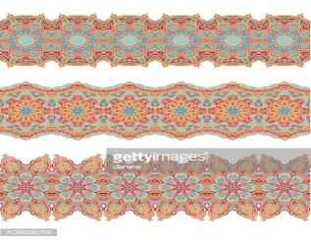

A Suitable Companion
Genesis 28-30
Now to Abraham and his seed were the promises made. He saith not, And to seeds, as of many; but as of one, And to thy seed, which is Christ.
Galatians 3:16

Slide 2

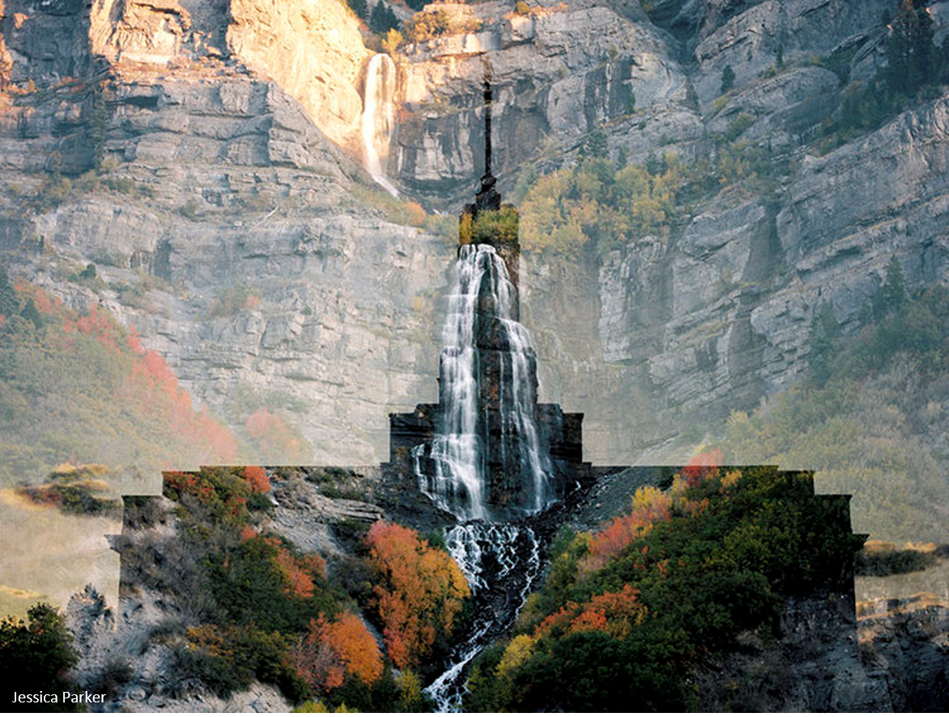
What are some of the blessings that come to those who choose to be sealed for eternity in the temple?

Slide 3
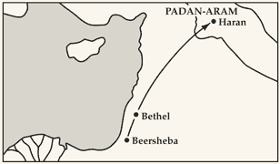
Search For a Wife
The Canaanites worshipped idols and engaged in other practices that were offensive to God. A daughter of Canaan would not be worthy to join Jacob in entering into a marriage covenant with the Lord. Marrying a daughter of Canaan would mean marrying out of the covenant.
Terah
Sarah
Abraham
Nahor
Milcah
Isaac
Rebekah
Bethuel
If we marry in the covenant and remain faithful, then we will receive the blessings of Abraham
Laban
Jacob
To protect Jacob and ensure he had the opportunity to marry in the covenant, Jacob’s parents instructed him to leave home and journey several hundred miles to his mother’s homeland.
This journey would take Jacob far away from Canaan, the land the birthright promised him.
Genesis 27:42-46; 28:1-2

Slide 4
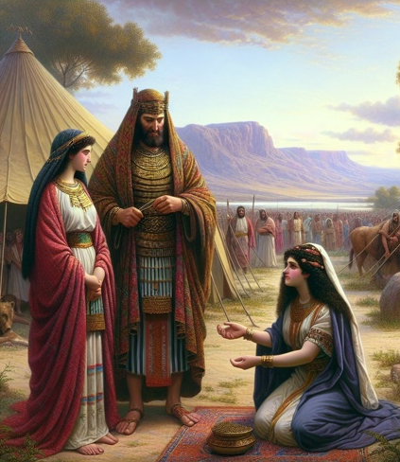
Esau’s Descendants
Review
Hivite
Hittites
Zibeon
Isaac
Beeril
Ishmael or Elon ?
Ishmael
Horite
Elon
Anah
Esau
Judith
Bashemath
Mahalath
Aholibamah
Adah
Seir
Speculation that Mahalath and Bashemeth are the same person
Jeush
Eliphaz
Timna
Reuel
Jaalam
Amalek
Teman
Nahath
Korah
Omar
Ramesis I
Zerah
Zepho
Dukes
Shammah
Gatam
Edomites
They dwelt in Mt Seir and intermarriages took place between the sons and daughter of Esau and the sons and daughters of Seir, the Horite
Mizzah
Kenaz

Slide 5
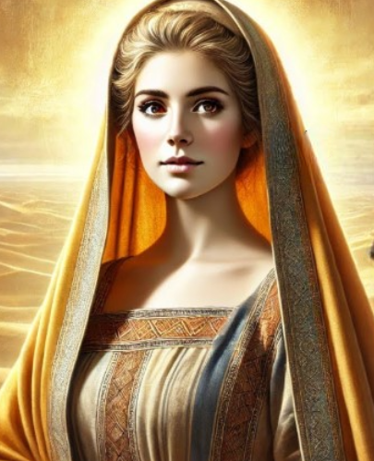
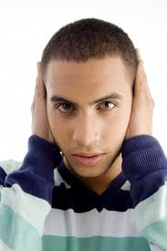

A Rebellious Soul
When Esau saw that Jacob had been blessed, he went among the Ishmaelites and married a daughter of Ishmael, Mahalath. He also married a Hittite woman named Judith (Gen 26:34)
Children who have been loved and taught may still be rebellious. These children deliberately disobey important family rules or gospel principles, they continue rebellious behavior for a long period of time, and they often show no sorrow for their actions.
Because our children are free to make choices, they sometimes make the wrong choice. Although we cannot force anyone into righteousness, we can teach them by precept and example and then pray that they will feel the influence of the Holy Ghost to choose the right.
Genesis 28:6-9
(1)

Slide 6
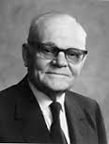
Jacob’s Dream
Heaven=presence of the Lord
“Jacob realized that the covenants he made with the Lord there were the rungs on the ladder that he himself would have to climb in order to obtain the promised blessings—blessings that would entitle him to enter heaven and associate with the Lord.”
How far did the ladder extend?
We must receive the saving ordinances of the gospel and keep their associated covenants in order to return to the presence of the Lord
Earth
(2)
Genesis 28:10-15

Slide 7
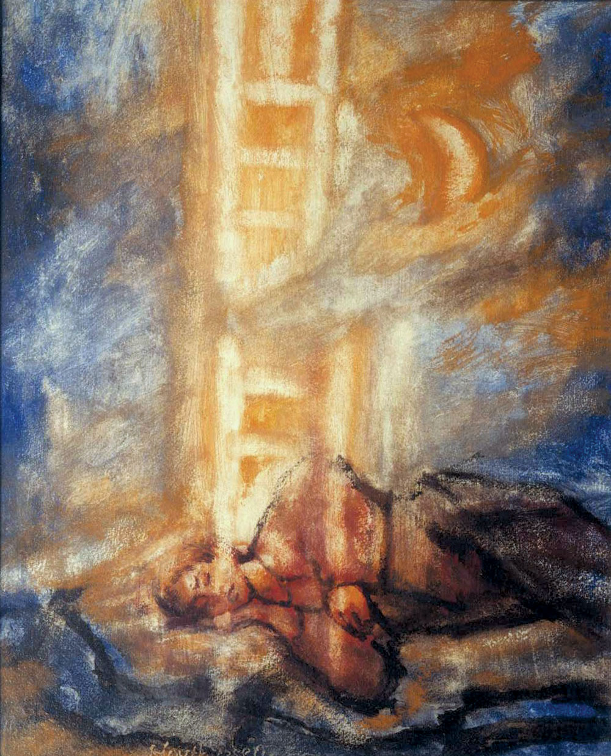
Jacob’s Ladder
“When Jacob traveled from Beersheba toward Haran, he had a dream in which he saw himself on the earth at the foot of a ladder that reached to heaven where the Lord stood above it.
He beheld angels ascending and descending thereon, and Jacob realized that the covenants he made with the Lord there were the rungs on the ladder that he himself would have to climb in order to obtain the promised blessings—blessings that would entitle him to enter heaven and associate with the Lord.
Artist-Albert Huthusen
The Lord’s Promise:
To be with us, to protect and care for us, to not leave us.
Genesis 28:10-15
(2)

Slide 8
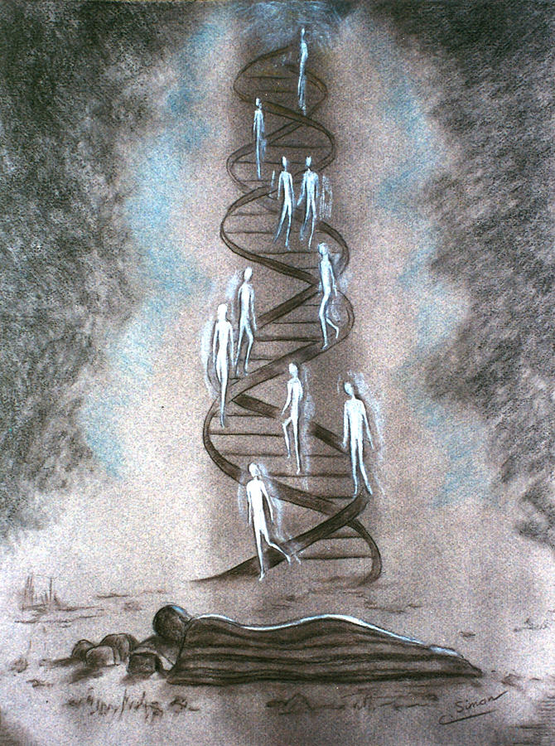
Bethel
“Because he had met the Lord and entered into covenants with him there, Jacob considered the site so sacred that he named the place Bethel, a contraction of Beth-Elohim, which means literally ‘the House of the Lord.’ He said of it: ‘… this is none other but the house of God, and this is the gate of heaven.’
“Jacob not only passed through the gate of heaven, but by living up to every covenant he also went all the way in. Of him and his forebears Abraham and Isaac, the Lord has said: ‘… because they did none other things than that which they were commanded, they have entered into their exaltation, according to the promises, and sit upon thrones, and are not angels but are gods.’
Genesis 28:10-15
(2)

Slide 9
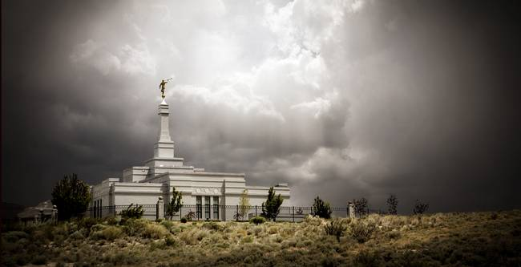
The Gates of Heaven
“Temples are to us all what Bethel was to Jacob. Even more, they are also the gates to heaven for all of our unendowed kindred dead. We should all do our duty in bringing our loved ones through them.”
The temple is the house of God and the gate to eternal life
Reno, Nevada
Genesis 28:10-17
(2)

Slide 10

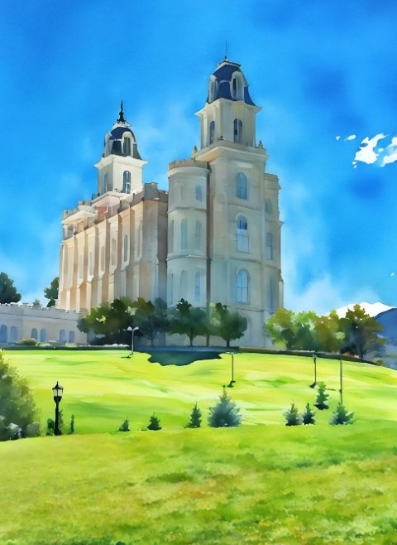

Walking the Covenant Path
As you walk the covenant path, from baptism to the temple and throughout life, I promise you power to go against the natural worldly flow—power to learn, power to repent and be sanctified, and power to find hope, comfort, and even joy as you face life’s challenges.
I promise you and your family protection against the influence of the adversary, especially when you make the temple a major focus in your life.
(7)

Slide 11
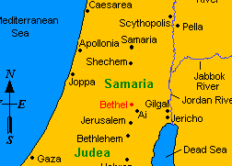
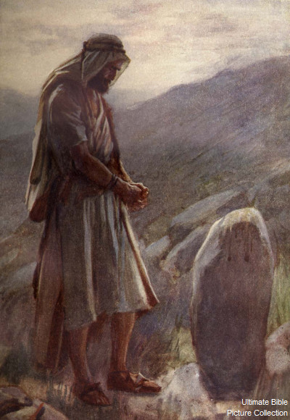
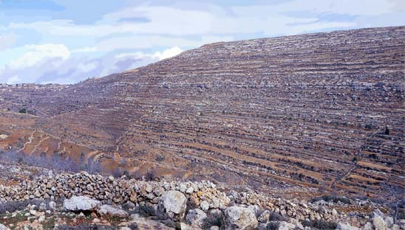
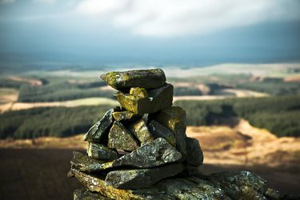
Blessing Bethel
The city was called Luz
If God will be with me, and will keep me in this way that I go, and will give me bread to eat, and raiment to put on,
And this stone, which I have set for a pillar, shall be God’s house: and of all that thou shalt give me I will surely give the tenth unto thee.
Genesis 28:17-22

Slide 12
Meeting Rachel
Jacob arrived in Haran he met Rachel, one of Laban’s daughters, at a well. Laban welcomed Jacob to stay at his house.
When Jacob said that he was Laban’s brother this was another way of saying, “We are all family.” More specifically, Laban was Jacob’s uncle.
Genesis 29:1-14

Slide 13
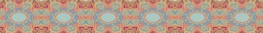


Leah and Rachel’s Genealogy
Terah
Sarah
Abraham
Nahor
Milcah
Isaac
Rebekah
Bethuel
Laban
Jacob
Leah
Rachel
The Hebrew word translated as “tender” means “soft, delicate, or lovely.” The fact that this trait is emphasized for Leah, while Rachel is described as “beautiful and well-favoured,” that is, beautiful in every respect, seems to suggest that Leah’s eyes were her most attractive feature.
(4)
Genesis 29:17

Slide 14
Rachel
She was the youngest daughter of Laban, and the granddaughter of Bethuel, great granddaughter of Nahor, who was brother to Abraham
She met Jacob when he brought her father’s sheep to the well
Jacob loved her and agreed to serve her father, Laban, for 7 years in exchange for her hand in marriage
Her older sister, Leah, was eligible for marriage, and though Laban promised Rachel’s hand to Jacob, Laban deceived Jacob by sending the veiled Leah to wed Jacob instead of Rachel
Jacob agreed to serve Laban another 7 years for Rachel’s hand in marriage
After Jacob and Rachel wed, they seemed to have a difficult time in conceiving children
Eventually she was blessed with a son, Joseph, and later a son, Benjamin (Benoni)
She died after the birth of Benjamin and was buried in the way to Ephrath, which is Bethlehem
It is through Joseph that the power and blessings of the Abrahamic Covenant would be made to all the quarters of the earth in the latter days
(3)

Slide 15
Leah
She was the oldest daughter of Laban, and the granddaughter of Bethuel, great granddaughter of Nahor, who was brother to Abraham
Her name means “weary”
After Jacob served 7 years for the hand of her younger sister, Rachel, Laban veiled Leah on the wedding night and deceived Jacob into marrying her
Jacob agreed to serve Laban 7 more years for Rachel’s hand in marriage
During this time Leah bore unto Jacob six sons: Reuben, Simeon, Levi, Judah, and later Issachar, Zebulon
She also bore a daughter, Dianah
Leah was buried in the cave of Machpelah, the resting place of Abrahm, Sarah, Isaac, and Rebekah
(3)

Slide 16
Love and Commitment
What was Jacob willing to do so he could marry Rachel?
Jacob worked seven years to marry Rachel, Laban tricked him into marrying his older daughter, Leah, instead.
Laban justified his actions by claiming that the oldest daughter should be married first.
Laban told Jacob he could still marry Rachel after the weeklong wedding feast for Leah, but Jacob would have to agree to work for him another seven years.
Jacob agreed to these conditions.
Jacob served a total of 20 years before returning to Canaan
We must work diligently and be patient as we seek to obtain the blessings the Lord has promised us
Genesis 29:21-29

Slide 17


Children Are Born
hated -- translated from the Hebrew word sahnay, which means “loved less
Bilhah
Rueben
She was the maidservant of Laban whom he gave to his daughter Rachel
She was given to Jacob by Rachel as his wife to bare children
She bore two sons, Dan and Naphtali
Simeon
Dan
Levi
Naphtali
Judah
Genesis 29:30-35, Genesis 30:1-8
(3)

Slide 18
More Children Are Born
Lehi gives her maidservant to Jacob
Zilpah
She was the maidservant of Laban whom he gave to his daughter Leah upon the marriage of Leah and Jacob
She was given to Jacob by Leah as his wife to bare children
She bore two sons, Gad and Asher, and Leah names the children
According to Jewish tradition she is believed to be buried in the Tomb of the Matriarchs in Tiberias (Wikipedia)
Gad
Asher
Genesis 30:9-13
(3)

Slide 19
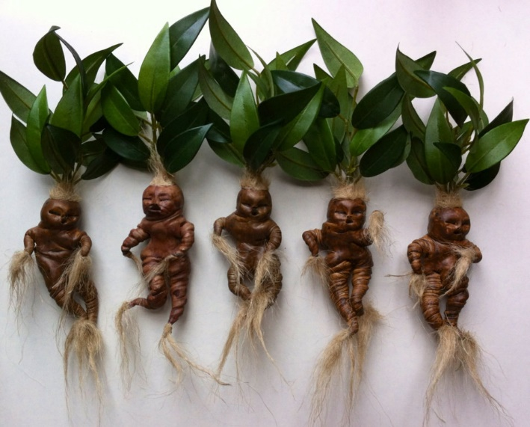
The Love Fruit
Mandrakes
The fruit had a pleasant taste and odor, and was supposed to ensure conception
The mandrakes were thought to enhance a woman’s fertility and ability to have children
Although not stated specifically, the record implies that the mandrakes did nothing for Rachel.
Finally, Rachel did conceive, but it was not because of mandrakes. Rather, ‘God hearkened to her, and opened her womb’
Genesis 30:14-22
(6)

Slide 20


Jacob’s Family Grows
And God remembered Rachel, and God hearkened to her, and opened her womb.
Issachar
Joseph
Zebulon
Benjamin
Dinah—
a daughter
When we experience challenges, we should realize that God does not forget us.
After Rachel had Benjamin she died and was buried in the way to Ephrath, which is Beth-lehem.
Genesis 30:16-24; Genesis 35:18
(3)

Slide 21
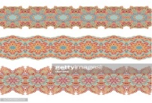


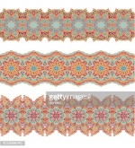

Why Was Motherhood So Important?
Motherhood was perhaps the deepest desire of women in the Old Testament.
One scholar wrote, “For ancient Israelites the most important contribution a woman could make to a household was to present her husband with children. . . .
Indeed, the noblest contribution a woman could make to a household in general and her husband in particular was to bear a son for him.
Through childbearing a woman earned her place in life and her share in the household.
Conversely, failure to deliver on this obligation was viewed as a curse and a shameful disgrace.”
(5)

Slide 22
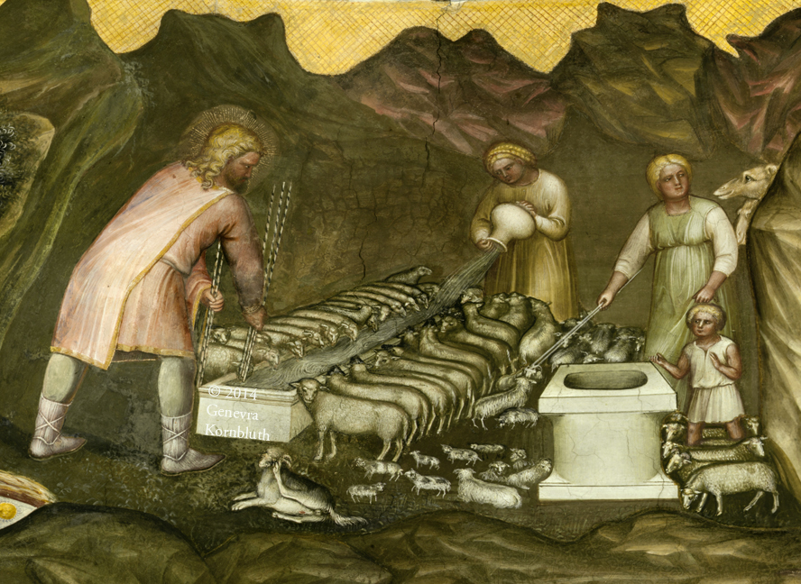
Peeling of Rods
“Jacob’s peeling of branches and placing them before the animals so that when they conceived they would bear multicolored offspring seems to be a reflection of a common superstition that the conception of offspring is influenced by what the mother experiences or sees at the time of conception.
Nothing is known by modern science to explain any relationship between what Jacob did and what happened in the hereditary patterns of the animals. Perhaps something is missing from the text. Perhaps the Lord was just taking advantage of the virility of crossbred animals. Divine intervention certainly played a part. In any event, Jacob’s herds grew and the Lord blessed him.
Also, Jacob’s separation of the flocks follows principles of good animal husbandry and would have increased the likelihood of having multi-colored animals.”
Genesis 30:37-43
(6)

Slide 23
Sources:
When Children Rebel (Handbook) Liahona October 1985
President Marion G. Romney (“Temples—The Gates to Heaven,” Ensign, Mar. 1971, p. 16.)
Old Testament Who’s Who by Ed J. Pinegar and Richard J. Allen pgs. 29, 117, 155-156
Old Testament Institute Manual
Presentation by ©http://fashionsbylynda.com/blog/
5. BYU Studies Motherhood in the Old Testament https://rsc.byu.edu/archived/gospel-jesus-christ-old-testament/3-motherhood-old-testament
6. (Old Testament Student Manual: Genesis–2 Samuel, 3rd ed. [Church Educational System manual, 2003], 88).
7. Elder Dale G. Renlund (“Accessing God’s Power through Covenants,” Liahona, May 2023, 37)

Slide 24
Rebellious behavior often results when a child has a need that is not met. If we do not have a loving, respectful atmosphere at home, our children may not want to follow our teachings. Children need freedom to grow, develop, make decisions, and learn from their use of this freedom. If we smother them with rules or are too harsh and demanding, our children may rebel just to embarrass us. On the other hand, if we are too permissive or do not spend enough time with our children, they may feel they are being ignored. Then they may be rebellious to get our attention.
Mandrakes:
“Although Bible scholars are not sure exactly what plant is meant by the word mandrake, the significance of this plant to Rachel and Leah is clear. ‘The Hebrew name denotes love fruit. The fruit had a pleasant taste and odor, and was supposed to ensure conception.’ (Bible Dictionary, s.v. ‘mandrakes.’) In other words, the mandrakes were thought to enhance a woman’s fertility and ability to have children. Knowledge of this belief helps explain the interchange between Rachel and Leah. Rachel desired the mandrakes so that she could at last bear children of her own. As has already been seen, there was a fierce competition between the sisters in this regard. Leah’s response was, therefore, equally natural. She indicated that Rachel had already taken her husband, which probably meant only that Rachel had the first place in his affections. (Some scholars, however, believe that this passage means that Jacob actually lived in Rachel’s tent rather than in Leah’s tent.) The one advantage Leah had was her ability to bear children, while Rachel could not. In essence she told Rachel that it would be foolish for her to give Rachel her mandrakes and help her have children, for this would only lessen Leah’s one advantage (v. 15). So Rachel made a counter offer. She promised that she would encourage Jacob to go to Leah that night if she, Rachel, could have the mandrakes (v. 15). Leah agreed and told Jacob. Out of the agreement Leah conceived and bore Jacob a fifth son (vv. 17–18). She later bore another son and Jacob’s daughter Dinah (vv. 19–21).
“Although not stated specifically, the record implies that the mandrakes did nothing for Rachel. Finally, Rachel did conceive, but it was not because of mandrakes. Rather, ‘God hearkened to her, and opened her womb’ (v. 22)” (Old Testament Student Manual: Genesis–2 Samuel, 3rd ed. [Church Educational System manual, 2003], 88).
There are at least six significant things to ponder about Jacob’s vision:
First, as the Prophet Joseph Smith indicated, this vision was Jacob’s opportunity to begin to comprehend for himself “the mysteries of Godliness” that lead men and women to the kingdom of God (see D&C 63:23, D&C 76:5–9). From this comment we also know that Jacob was a righteous Melchizedek Priesthood holder, because the Doctrine and Covenants teaches that “this greater priesthood administereth the gospel and holdeth the key of the mysteries of the kingdom, even the key of the knowledge of God” (D&C 84:19). Jacob would, during the course of his life, come to know God in a profound way.
Second, Jacob’s status as a prophet was confirmed. He heard the voice of the Lord Jehovah, the premortal Christ, and, as the Apostle John later recorded, “the testimony of Jesus is the spirit of prophecy” (Rev. 19:10).
Third, Jacob learned that in his seed, or through his own lineage, all the other families of the earth would be blessed. That promise was literally fulfilled in the mortal advent of the Savior, Jesus Christ (see Gal. 3:16), and it is not impossible that Jacob glimpsed that fulfillment. Moreover, this promise has also been fulfilled as Jacob’s seed—all latter-day peoples who accept the restored gospel—have become missionaries of the name and gospel of the Son of God. This gospel will ultimately bring salvation, even eternal life, to everyone who receives it (see Abr. 2:10–11).
Fourth, Jacob learned that if he kept the covenant, God would be with him everywhere he went, that God would fulfill everything he promised to do for him, and that God would bring him back to the land of his inheritance.
Fifth, Jacob learned that sanctity and place can be, and often are, linked together. “Surely the Lord is in this place; and I knew it not. … this is none other but the house of God,” Jacob said (Gen. 28:16–17).
Sixth—and this point ties the other five points together—Jacob had a temple like experience on the occasion of this vision.
Andrew C. Skinner Jacob: Keeper of Covenants March 1998 Ensign

Slide 25
The Marriage of Jacob to Leah and Rachel:
Here is given the first glimpse of Laban’s crafty nature. After promising Rachel to Jacob for seven years of service, Laban sent Leah to Jacob’s tent to consummate the marriage. The modern reader may find it hard to believe that Jacob did not discover the switch until it was morning; however, the following possibilities could explain the success of Laban’s ruse. As sisters, Rachel and Leah may have been quite similar in height, weight, and general appearance. Second, the women of Haran sometimes veiled themselves (see Genesis 24:65). Third, Laban was a shepherd. If he was a typical shepherd of ancient times, he dwelt in tents instead of in permanent dwellings. The inside of a tent at night can be very dark. And finally, knowing what the reaction of Jacob would be if he discovered the substitution early, Laban may have told Leah to speak as little as possible so as not to give the deception away before it was too late to change it.
Though Laban demanded another seven years for Rachel’s hand, he allowed Jacob to marry her once the seven days of wedding feasts for Leah were finished and to fulfill his indebtedness after the marriage. The gift of the handmaidens to each daughter made the servants the direct property of each wife, not of Jacob. Thus, later, when the handmaids had children, the children were viewed legally as the children of Rachel and Leah. Old Testament Institute Manual
Mother | Name | Meaning | Reason for Name
Leah | Reuben | See a son | Joy for having a son (Genesis 29:32).
Leah | Simeon | Hearing | Because the Lord heard that she was hated (Genesis 29:33).
Leah | Levi | Joined | “This time will my husband be joined unto me” (Genesis 29:34).
Leah | Judah | Praise | “Now I will praise the Lord” (Genesis 29:35).
Bilhah | Dan | Judging | “God hath judged me” (Genesis 30:6).
Bilhah | Naphtali | Wrestling | “With great wrestlings have I wrestled with my sister” (Genesis 30:8).
Zilpah | Gad | Troop | “Leah said, A troop cometh” (Genesis 30:11).
Zilpah | Asher | My happiness | “Leah said, Happy am I” (Genesis 30:13).
Leah | Issachar | A reward | God hath given me my reward (Genesis 30:18).
Leah | Zebulun | Dwelling | “Now will my husband dwell with me” (Genesis 30:20).
Rachel | Joseph | Adding | “The Lord shall add to me another son” (Genesis 30:24).
Rachel | Benjamin | Son of my right hand | “You are the son of my right hand” (Genesis 35:18).
Names Given
The scriptures in this chapter indicate that each child born to Jacob was given a name which reflected the feelings of his parents. There was a tremendous competitive spirit between the wives. Being able to bear a male child for their husband was a great honor. Rachel apparently was very sad that she did not have a child until later in her life. When she finally bore a son the name she gave him indicated her feeling for him and the hope she had in the future. The twelve sons of Jacob are listed below.

