Slide 1

Return to Canaan
Genesis 31-32
We are troubled on every side, yet not distressed; we are perplexed, but not in despair;
Persecuted, but not forsaken; cast down, but not destroyed;
2 Corinthians 4:6-8

Slide 2

Doctrinal Mastery Review
God showed Abraham only “the intelligences that were organized” after the Creation.
God prepared Abraham in the premortal world so he could do great things here on the earth.
There were only a few people whom God called His “noble and great ones.”
We lived in the presence of God as His spirit children before we were born.
Abraham 3:22-23

Slide 3
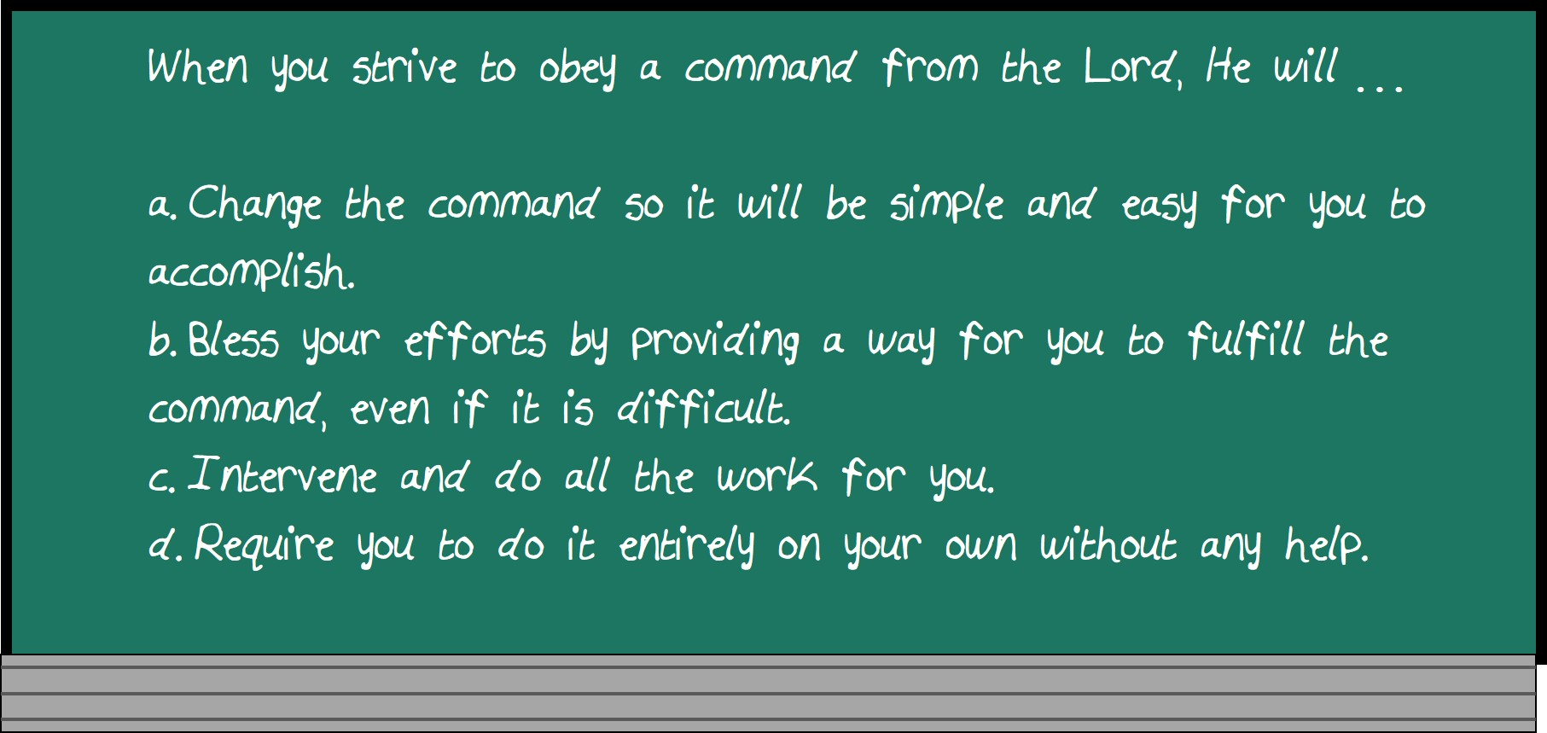

Slide 4
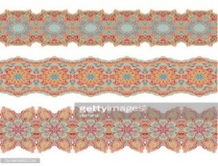



The Secret Exit
A difficult decision
Esau lived in the land of Jacob’s fathers and when they were last together Esau wanted to kill Jacob
And Jacob was afraid of what Laban might do to them if he found them gone
It is significant to note that Jacob counseled with his wives on the important move he was contemplating. Often modern scholars claim that woman in the Old Testament were of low status and were treated as property by their husbands. But this example, and others like it, show that such was not the case. (1)
Genesis 31:1-14

Slide 5
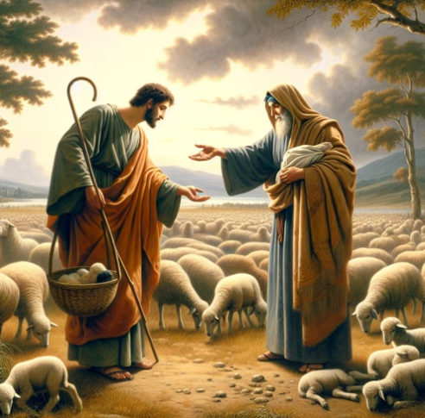
Wages
And your father hath deceived me, and changed my wages ten times; but God suffered him not to hurt me.
Jacob had good reason therefore to be suspicious when Laban tried to persuade him to stay and work for him further…
Jacob’s comment that Laban changed his wages ten times cannot be documented in the record—that is, ten times cannot be counted.
But the nature of Laban makes it not unlikely that once Jacob began to prosper, Laban kept changing the terms of their agreement. Nevertheless, the Lord continued to bless Jacob temporally. (1)
Genesis 31:1-13

Slide 6
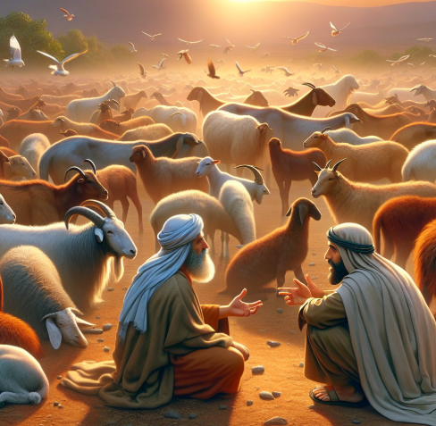
The Agreement Gone Sour
Jacob had worked for Laban for 14 years and all he had to show for it was 4 wives, 11 sons, and 1 daughter.
Jacob agreed to work for Laban in payment of cattle, goats, and sheep.
“Jacob does not cheat Laban. He carries through exactly the terms of an agreement which he had proposed to Laban, and which Laban explicitly accepted…
When he had proposed to Laban that all he asked in the way of wages was that little fraction of the flock which might be odd in color, that seemed to Laban a highly desirable bargain, especially since he, Laban, took the opportunity then and there to remove from the flock all the sheep and goats that might breed the type that would belong to Jacob.
The trouble was that he did not foresee the extraordinary device by which Jacob would be able to make the flock breed according to his interest—a device not ruled out by the bargain. (2)
“let God between me and thee, and reward thee according to thy deeds” (D&C 64:11).
Genesis 30:25-43

Slide 7
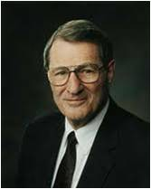
Faith and Patience
Faith also includes trust in God’s timing, for He has said, “All things must come to pass in their time.”
(D&C 64:32.)
Ironically, some who acknowledge God are tried by His timing, globally and personally!
Faith likewise includes faith in God’s developmental purposes, for “the Lord seeth fit to chasten his people; yea, he trieth their patience and their faith.” (Mosiah 23:21.)
Still, some of us have trouble when God’s tutoring is applied to us! (3)
Genesis 31:13

Slide 8
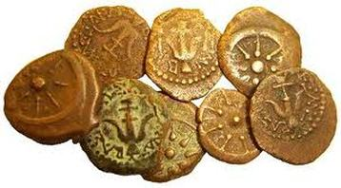
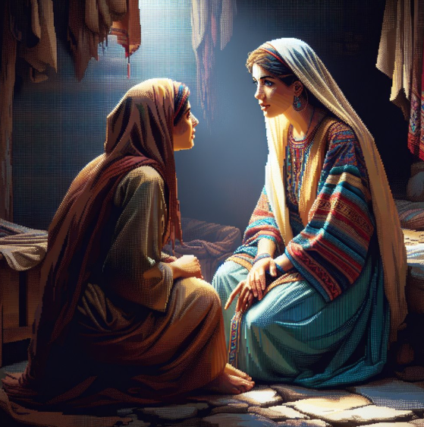
Inheritance For Us?
According to ancient custom, the groom would pay the bride’s father a “bride-price.” Jacob knew this well, having paid 20 years of devoted labor—a huge payment, much more than ancient custom normally required.
Conversely, the bride’s father was to provide his daughter with a dowry, a sum of money or property often approximating a tenth of the father’s wealth, which would support the new couple and was to be returned to the wife in case of divorce. Often the dowry included the original bride-price. This is what Rachel and Leah are asking about, “is there yet any portion or inheritance for us?”
Genesis 31:14
(4)

Slide 9
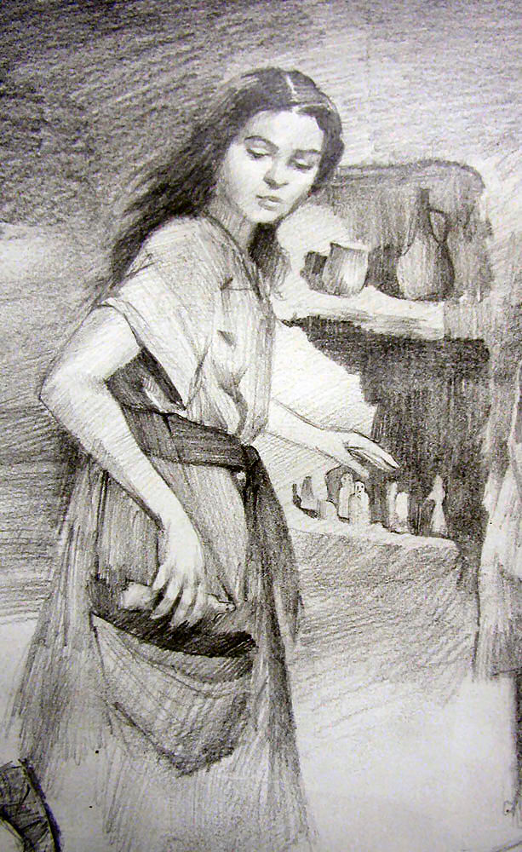
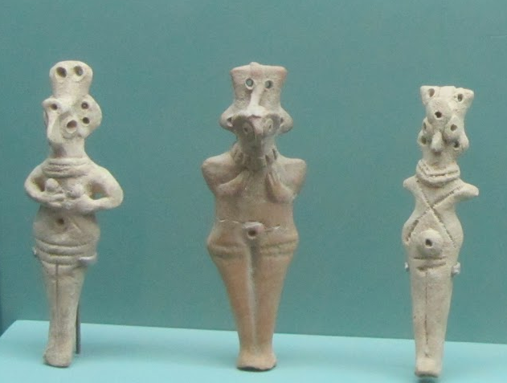
Rachel Takes An Image
They began their journey to the land of Canaan while Laban was away shearing his sheep. As they left, Rachel took some of Laban’s “images”
Images could refer to household idols and that some believe the images could represent Rachel’s dowry.
The debate:
The Hebrew word which is sometimes used for small images of false gods is teraphim. Some translators render the word as “household gods.”
Others believe they were astrological devices used for telling the future.
One scholar theorized that these images were somehow tied in with the legal rights of inheritance (5)
If this theory is correct, the possessor of the teraphim had the right to inherit the father’s property (1)
We do not know why Rachel took the images or why Laban later referred to them as “my gods”
Genesis 31:19

Slide 10
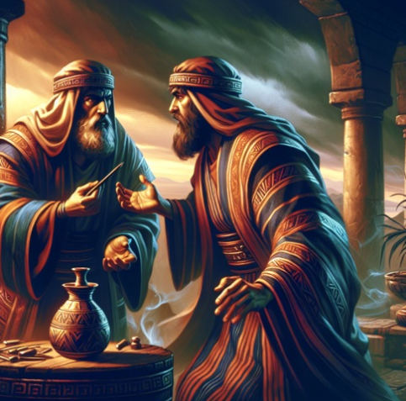
Laban Pursues Jacob
Laban admitted to Jacob “it is in the power of my hand to do you hurt”.
Laban was angry enough to either kill Jacob or take back his daughters with all his goods and leave him destitute.
Divine intervention was the only thing that would protect Jacob and so Laban is given instruction in a dream.(4)
Laban searched Jacob’s camp for his images but did not find them because Rachel hid them under the cushion she used to sit on a camel. After Laban finished searching for the images, Jacob recounted how Laban had mistreated him numerous times during the preceding 20 years. (1)
What hast thou done, that thou hast stolen away unawares to me, and carried away my daughters, as captives taken with the sword?
Genesis 31:23-30

Slide 11
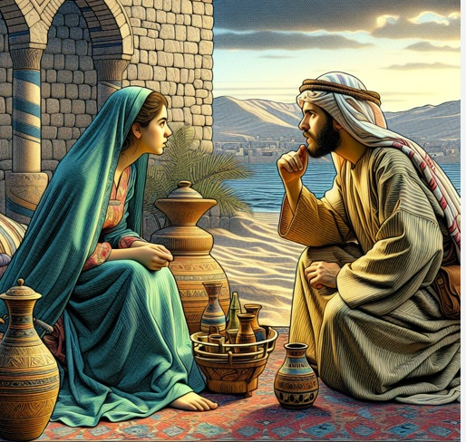
Rachel’s Actions
"And she said to her father, Let it not displease my lord that I cannot rise up before thee; for the custom of women is upon me. And he searched, but found not the images."
Rachel's actions and words reveal her loyalty and commitment to her husband, Jacob. Despite the potential consequences of her actions, she is willing to deceive her father in order to protect her husband and his household.
Additionally, her claim about the "custom of women" refers to menstruation, which could be seen as a reminder of the inherent differences between men and women and the societal expectations placed upon them. (10)
Genesis 31:35

Slide 12
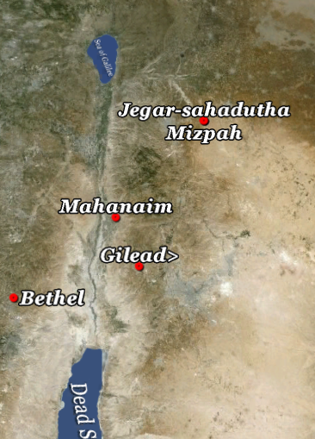
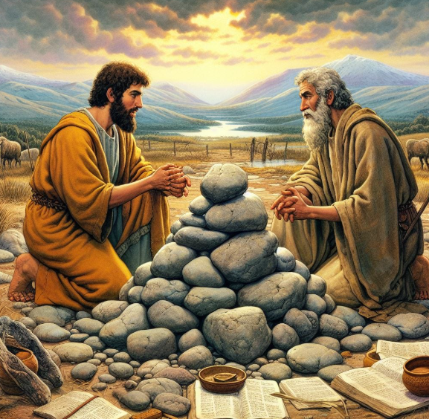
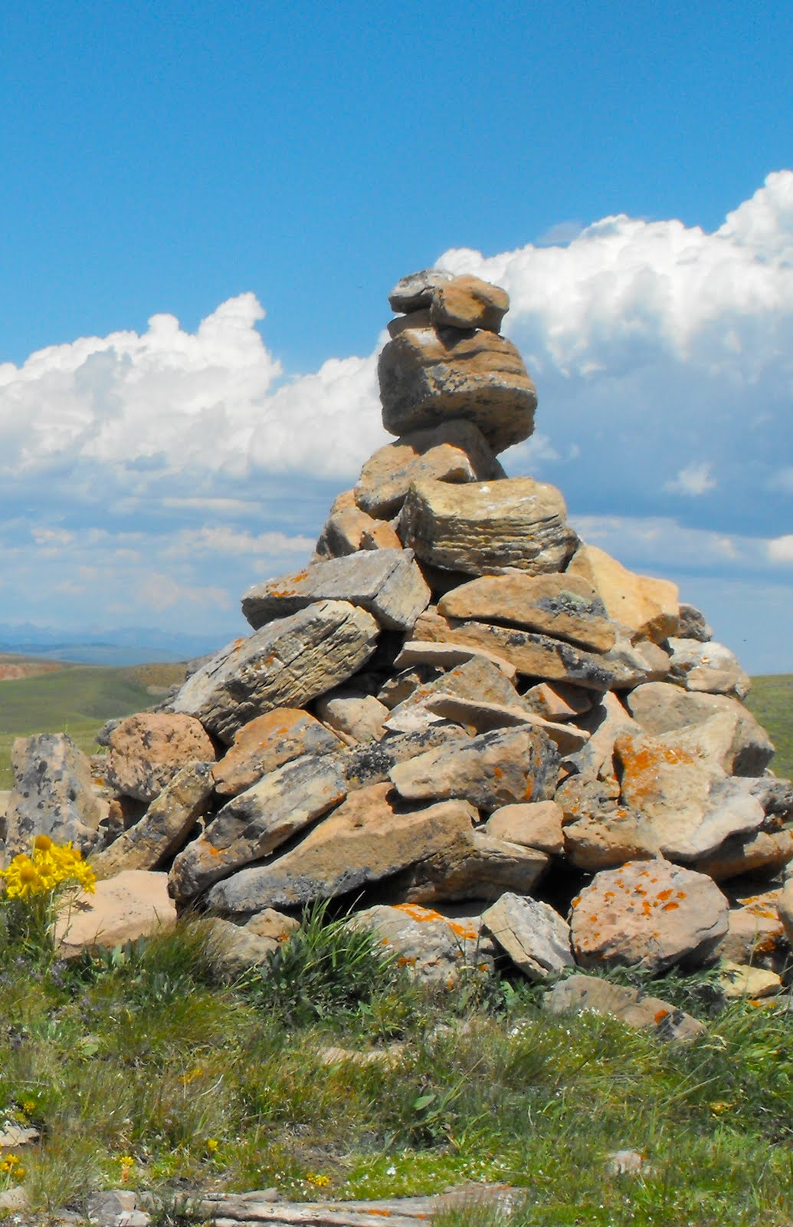
Laban and Jacob Make a Covenant
Ultimately, Jacob and Laban came to a respectful parting of the ways and established a boundary covenant which would long divide the territory of the Israelites from the northern Aramaeans. (1)
Genesis 31:44-55

Slide 13
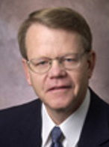
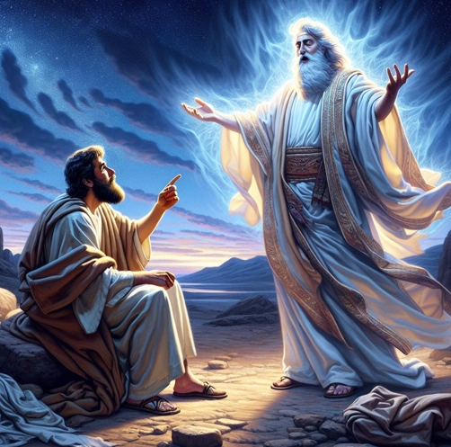
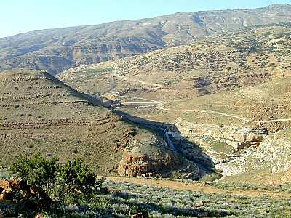
Angels Sent to Strengthen
“Jacob’s journey home was remarkable for its divine manifestations. En route, the patriarch was met by “God’s host”, angels of the Lord, who strengthened him.
It is also likely these angels reminded Jacob of his powerful, life-changing vision of the ascending ladder at Bethel when he was leaving the promised land 20 years earlier.
Now Jacob was returning to face a seemingly inevitable, possibly mortal conflict with Esau—a conflict which had been partially responsible for Jacob’s flight from Canaan in the first place.
The angelic ministration during Jacob’s return trip appears to have been a sign and a reminder of divine protection and assistance.” (6)
Mahanaim
Genesis 32:1-2

Slide 14
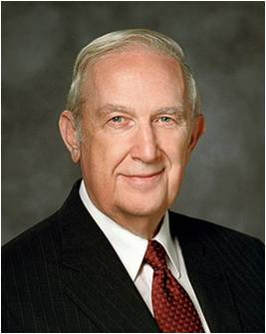
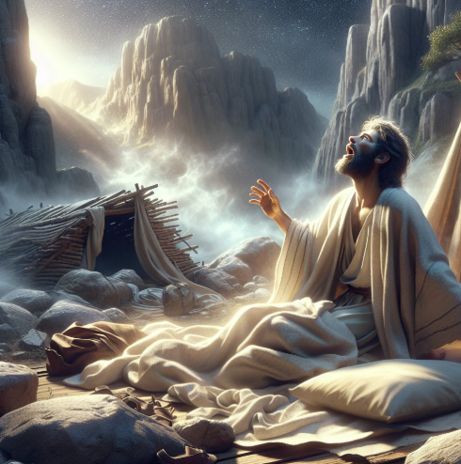
Jacob’s Prayer
“When He answers yes, it is to give us confidence.
“When he answers no, it is to prevent error.
“When He withholds an answer, it is to have us grow through faith in Him, obedience to His commandments, and a willingness to act on truth.
We are expected to assume accountability by acting on a decision that is consistent with His teachings without prior confirmation.
We are not to sit passively waiting or to murmur because the Lord has not spoken.
We are to act.” (7)

Slide 15
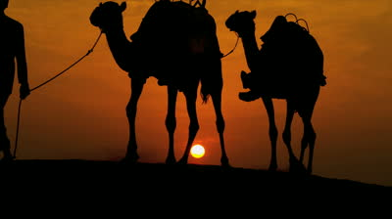
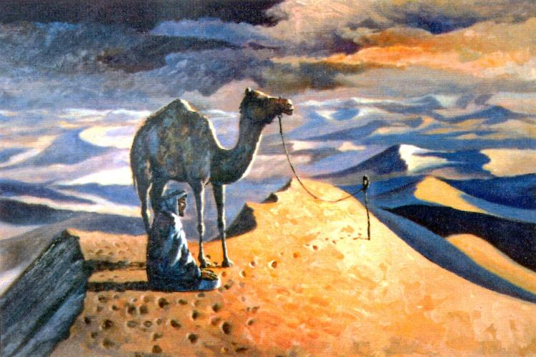
Messengers Sent to Esau
“That the looming conflict weighed heavily on Jacob’s mind seems beyond question, because immediately after his encounter with the angels, Jacob sent messengers to Esau’s territory in hopes of laying the groundwork for a peaceful reunion with his brother.”
Josephus says that “these messengers told him this message. Upon which Esau was very glad.” (8)
Apparently, Esau’s joy was not apparent to the messengers because they return with a message that strikes fear into their master.
“The messengers returned with gravely distressing news: Esau was coming to meet him with 400 men. Jacob became exceedingly fearful and divided his entourage into two groups, intending to preserve at least part of his family should Esau attack (see Gen. 32:6–8).” (6)
Ramzi Kayello
Genesis 32:6-8

Slide 16
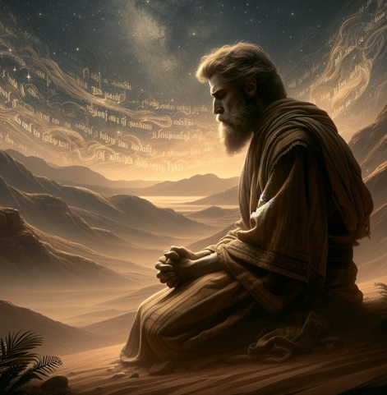
At the River Jabbok
“We do not know how long Jacob prayed that day at the river Jabbok, but surely his prayer was intense. In it, he acknowledged the Lord’s goodness as well as his own heartfelt unworthiness.
He pleaded for deliverance from the impending catastrophe, reminding God that He had told Jacob to leave Padan-aram and that He had also promised Jacob that his posterity would be as innumerable as the sands of the sea.
How could this promise come to pass if Jacob and his family were annihilated?” (6)
Genesis 32:9-23

Slide 17
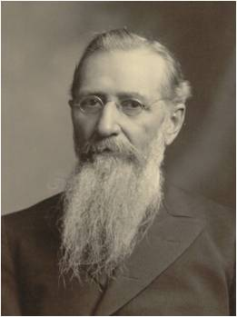
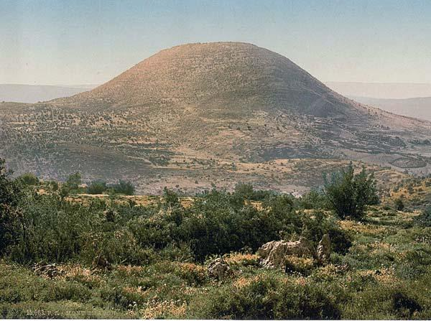
Wrestled With a Man
“Most scholars believe Jacob wrestled with an angel, but President Joseph Fielding Smith explained why this explanation could not be true:
“‘Who wrestled with Jacob on Mount Peniel? The scriptures say it was a man.
The Bible interpreters say it was an angel. More than likely it was a messenger sent to Jacob to give him the blessing. To think he wrestled and held an angel who couldn’t get away, is out of the question. The term angel as used in the scriptures, at times, refers to messengers who are sent with some important instruction.’ (8)
Genesis 32:24-30
Mount Tabor

Slide 18
Jacob’s Name Changed To Israel
A prince hast thou power with God and with men
While much of what happened at Peniel (also spelled Penuel is unclear, the scriptures indicate that a sacred experience took place there.
Spiritual struggles often precede powerful revelations. For example, when Enos, Alma, and Joseph Smith each earnestly sought blessings of the Lord, they experienced such “wrestlings”
The wrestle Jacob experienced may have been a similar spiritual struggle.
Nevertheless Alma labored much in the spirit, wrestling with God in mighty prayer, that he would pour out his Spirit upon the people who were in the city; that he would also grant that he might baptize them unto repentance.
Alma 8:10
See Enos 1:1-5 and Joseph Smith—History 1:13-17
Genesis 32:28

Slide 19
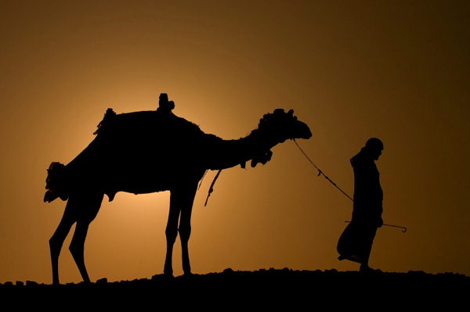
And as he passed over Penuel the sun rose upon him, and he halted upon his thigh.
Therefore the children of Israel eat not of the sinew which shrank, which is upon the hollow of the thigh, unto this day: because he touched the hollow of Jacob’s thigh in the sinew that shrank.
Genesis 32:24-30

Slide 20
Sources:
Suggested Hymn: #123 Oh, May My Soul Commune with Thee
Old Testament Institute Manual
Presentation by ©http://fashionsbylynda.com/blog/
2. Gospel Doctrine.com (The Interpreter’s Bible, ed. by G. A. Buttrick et al [New York, Abingdon Press, 1952] vol. 1, 707-709)
3. Elder Neal A. Maxwell (“Lest Ye Be Wearied and Faint in Your Minds,” Ensign, May 1991, 90)
4. Gospel Doctrine.com
5. Guthrie, New Bible Commentary, p. 104).
6. (Andrew C. Skinner, “Jacob: Keeper of Covenants,” Ensign, Mar. 1998, 53–54)
7. Elder Richard G. Scott (“Learning to Recognize Answers to Prayer,” Ensign, Nov. 1989, 32).
8. (Josephus, Antiquities of the Jews, Book I, 20:1)
9. (Doctrines of Salvation, comp. Bruce R. McConkie, 3 vols. [1954–56], 1:17)” (Old Testament Student Manual: Genesis–2 Samuel, 3rd ed. [Church Educational System manual, 2003], 89).
10. https://bible.art/meaning/genesis-31%3A35

Slide 21
The God of Bethel:
“Beth-el” means literally “the house of God”: beth, house of, el, God (short for Elohim). Jehovah is saying to Jacob, “I am the God of the House of God.” He could have said, “I am the God of your fathers, Abraham and Isaac,” but Jehovah was Jacob’s God in a very personal way. 20 years prior, when Jacob was on his way to Haran, the Lord gave him the promise of the Abrahamic covenant and declared, “I will bring thee again into this land” (Gen. 28:15). It was a promise that Jacob was ready to see fulfilled. First, he thought it was going to be seven years, but then the deal changed. He could have blamed God for the switch but he didn’t. After 14 years, when he had served for both daughters, the game changed again. At that point, Jacob could have murmured to God, “I thought you were going to bring me back to the land of my inheritance! How is it that Laban is keeping me longer?” After 20 years, he still hasn’t blamed God. He has been patient. He has waited on the Lord understanding that the promises of the Lord are fulfilled even if it is not according to a mortal schedule. It is sometimes easier to trust in the Lord than to trust in his timing.
Interesting Ideas from Bible Hub.com about not eating the sinew of the shrank
Jamieson-Fausset-Brown Bible Commentary
The sinew which shrank—the nerve that fastens the thigh bone in its socket. The practice of the Jews in abstaining from eating this in the flesh of animals, is not founded on the law of Moses, but is merely a traditional usage. The sinew is carefully extracted; and where there are no persons skilled enough for that operation, they do not make use of the hind legs at all.
Gill's Exposition of the Entire Bible
Therefore the children of Israel eat not of the sinew which shrank,.... Which was contracted by the touch of the angel, and by which it was weakened and benumbed; or the sinew of the part that was out of joint, the sinew or tendon that keeps the thigh bone in the socket, together with the flesh that covered it, or the muscle in which it is; or that sinew, others, that contracts itself and gives motion to the thigh bone to work itself: of this the Israelites eat not: which is upon the hollow of the thigh; or the cap of it:
unto this day; when Moses wrote this history:
because he the angel touched the hollow of Jacob's thigh, in the sinew that shrank; and very superstitiously do they abstain from it unto this day: they have a whole chapter in one of their treatises in the Misnah (l), giving rules concerning it; where it is forbidden to eat of it, whether in the land of Israel or out of it; whether in common food or sacrifices, even in burnt offerings it was to be taken out; and whether in cattle of the house or of the field; and both in the right and left thigh, but not in fowls, because they have no hollow, and butchers are not to be trusted; and whoever eats of it to the quantity of an olive is to be beaten with forty stripes; and because the Jews are more ignorant of this nerve, as Mercer observes, therefore they abstain from all nerves in the posteriors of animals.
An Image:
“Teraphim were small, portable figurines in human shapes. Anciently, they were consulted as oracles for purposes of divination and represented the family’s prosperity and divine protection.” (Camille Fronk Olson, Women of the Old Testament, [SLC: Deseret Book, 2009], 76)
“Josephus reported that even in his day (first century C.E.) it was the custom ‘among all the people in that country to have objects of worship in their house and to take them along when going abroad’… Nuzi records indicate that teraphim were often symbols of property rights and family status. Their possession could indicate that certain privileges had been confirmed by transmitting the ownership of the teraphim (cf. The symbolism of the scepter or of keys to a house).
Thus, Jacob’s possession of the teraphim might prove that he was no longer Laban’s servant and that he was, therefore entitled to a part of the latter’s estate. If Jacob had not in law attained this position, Rachel by her theft meant to assure it for him.
Biblical tradition viewed Rachel as a resolute woman who did not hesitate to take the law—or what she believed to be the law—into her own hands. She knew he husband’s rights and she had ample reason to doubt that Laban would voluntarily and formally transfer [them].” (The Torah: A Modern Commentary, ed. by W. Gunther Plaut [New York, The Union of American Hebrew Congregations, 1981], 214)
Ellicott's Commentary for English Readers
Jewish commentators notice that this was the second special ordinance imposed upon the race of Abraham, circumcision having been enjoined upon them by God, while this grew out of an historical event in the life of their progenitor, to the reality of which it bears remarkable testimony.

