Slide 1

To Forgive
Genesis 33-34
And Esau ran to meet him, and embraced him, and fell on his neck, and kissed him: and they wept.
Genesis 33:4

Slide 2

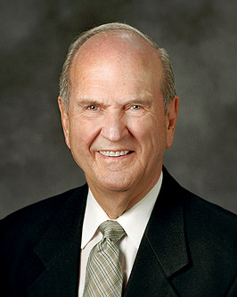
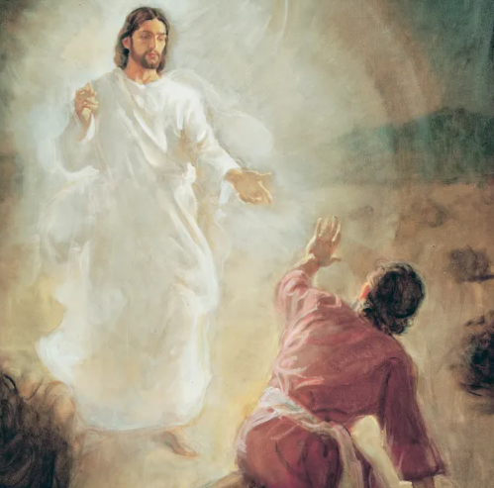
Previously…
And he said, Thy name shall be called no more Jacob, but Israel: for as a prince hast thou power with God and with men, and hast prevailed
At a crucial moment in his life, “Jacob wrestled with a serious challenge. His agency was tested. Through this wrestle, Jacob proved what was most important to him.
He demonstrated that he was willing to let God prevail in his life. In response, God changed Jacob’s name to Israel, meaning ‘let God prevail.’ God then promised Israel that all the blessings that had been pronounced upon Abraham’s head would also be his”
Taking this new name was a sign of receiving the covenant his father and grandfather had received. (8)
Keith Larsen
As we are willing to let God prevail in our lives, He will bless us in all things.
Genesis 32:28

Slide 3
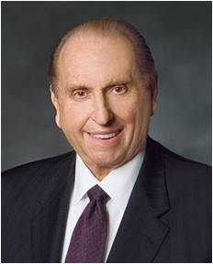

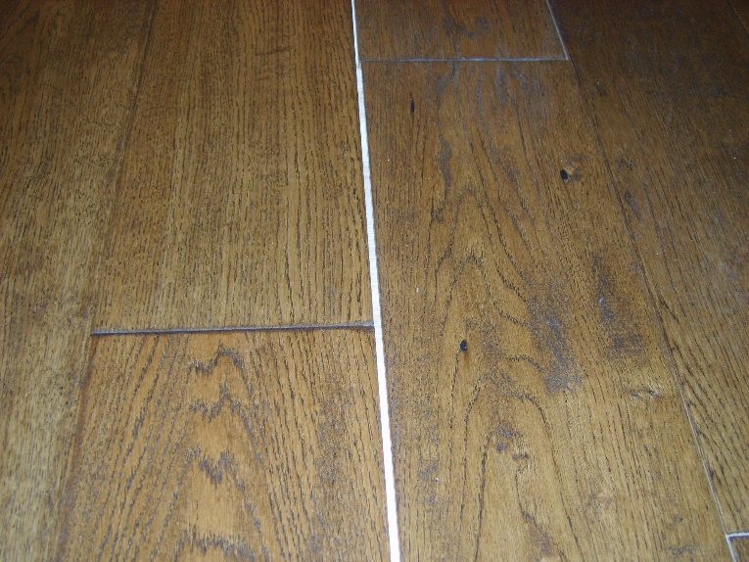

Divided
“Many years ago I read the following Associated Press dispatch which appeared in the newspaper:
An elderly man disclosed at the funeral of his brother, with whom he had shared, from early manhood, a small, one-room cabin near Canisteo, New York, that following a quarrel, they had divided the room in half with a chalk line, and neither had crossed the line or spoken a word to the other since that day—62 years before.
Just think of the consequence of that anger. What a tragedy!” (1)

Slide 4
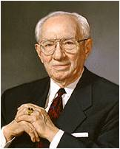


To Forgive
How difficult it is for any of us to forgive those who have injured us. We are all prone to brood on the evil done us. That brooding becomes as a gnawing and destructive canker.
Is there a virtue more in need of application in our time than the virtue of forgiving and forgetting?
There are those who would look upon this as a sign of weakness.
Is it? I submit that it takes neither strength nor intelligence to brood in anger over wrongs suffered, to go through life with a spirit of vindictiveness, to dissipate one's abilities in planning retribution.
There is no peace in the nursing of a grudge. There is no happiness in living for the day when you can "get even." (2)

Slide 5
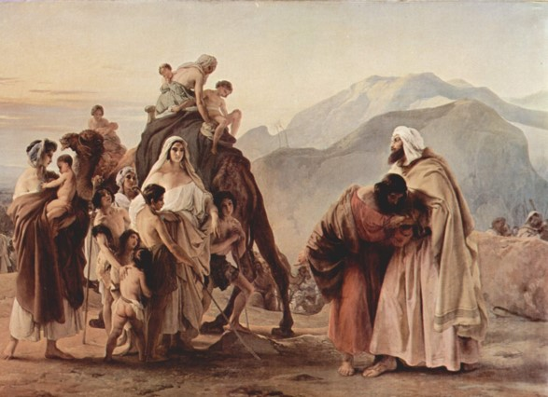
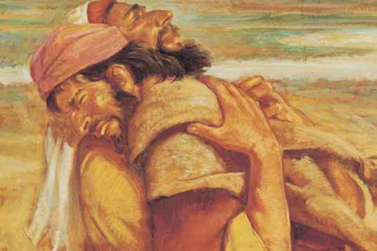
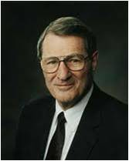
Reunited
What did Jacob do to restore peace to his relationship with Esau?
Jacob addressed him as my lord Esau—showing respect and honor
Jacob showed humility and courtesy
Artist: Francesco Hayez
Jacob offered generous gifts to Esau
If we make the effort to settle conflicts in the Lord’s way, then we can help restore peace to troubled relationships
“…how gracious Esau grew to be, as evidenced when his and Jacob's caravans met in the desert many years later!
(4)
Genesis 33:1-11

Slide 6
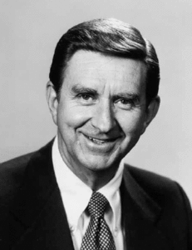


If we overcome hatred and forgive others, then we can help restore peace to troubled relationships
“What is our response when we are offended, misunderstood, unfairly or unkindly treated, or sinned against, made an offender for a word, falsely accused, passed over, hurt by those we love, our offerings rejected?
Do we resent, become bitter, hold a grudge?
Or do we resolve the problem if we can, forgive, and rid ourselves of the burden?
“The nature of our response to such situations may well determine the nature and quality of our lives, here and eternally. …
“… Even if it appears that another may be deserving of our resentment or hatred, none of us can afford to pay the price of resenting or hating, because of what it does to us.” (3)

Slide 7

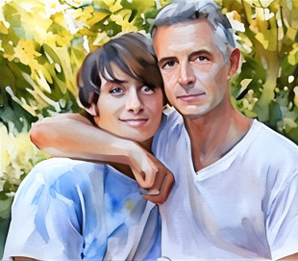
The Value of Forgiving One Another
Wherefore, I say unto you, that ye ought to forgive one another; for he that forgiveth not his brother his trespasses standeth condemned before the Lord; for there remaineth in him the greater sin.
I, the Lord, will forgive whom I will forgive, but of you it is required to forgive all men.
And ye ought to say in your hearts—let God judge between me and thee, and reward thee according to thy deeds.
D&C 64:9-11

Slide 8
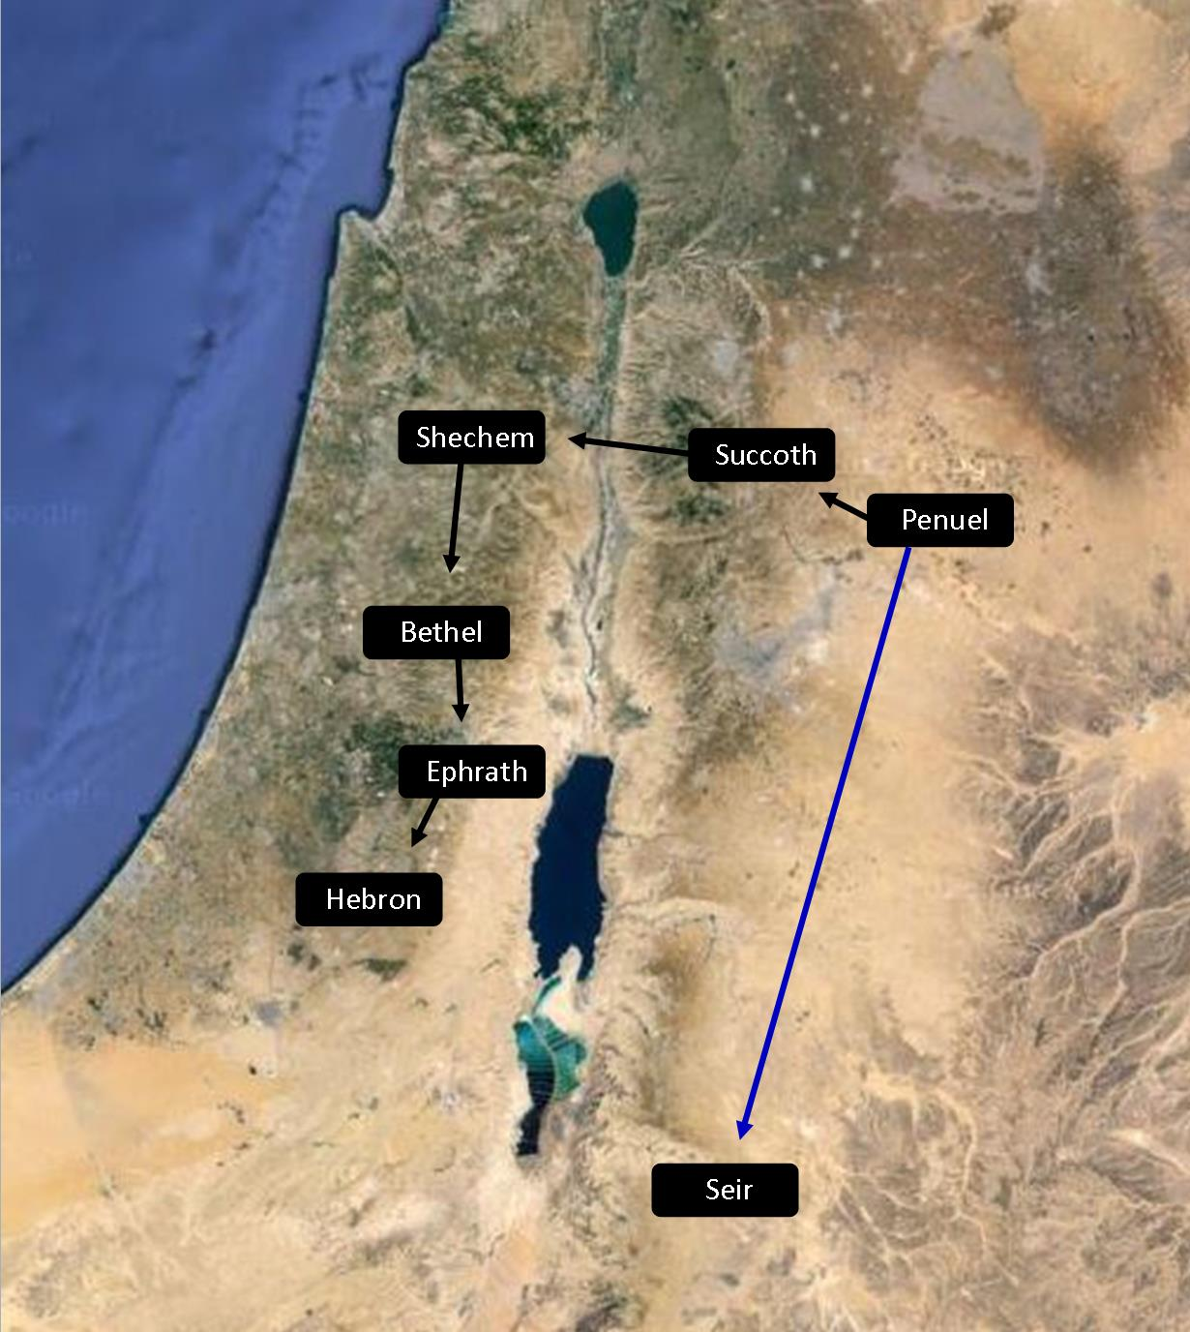
Seir and Canaan
Canaan
Seir
Genesis 33:12-20

Slide 9
Shechem
He was the son of Hamor, who was a Hivite
He fell in love with Dinah, the daughter of Jacob and Leah
Dinah was defiled and Levi and Simeon (sons of Jacob) removed her and initiated a campaign of vengeance agast the Hivite community by killing all the males and despoiling the city
He died at the hands of Levi and Simeon along with his father Hamor
When Jacob heard of his son’s actions he was distressed and gathered his family and moved away to Bethel at the command of God
(5)

Slide 10
Dinah
She was the daughter of Jacob and Leah
Her name means judged and vindicated
Shechem, the son of Hamor the Hivite, fell in love with her and defiled her
Her brothers, Levi and Simeon, was angered with Shechem and pretended to accept the peace overtures of Hamor by requiring the males of the Hivites to be circumcised in exchange for the hand of Dinah
However, the sons fell upon the Hivite community and killed all of the males and took Dinah
She later journeyed to Egypt with Jacob’s family circle
(5)

Slide 11
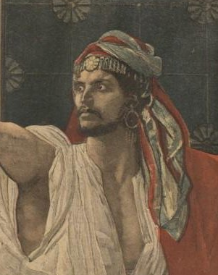
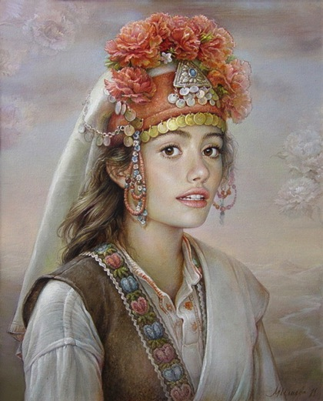
Shechem and Dinah
The Hivites were one group of descendants of Canaan, son of Ham
Even though Shechem claimed that he loved Dinah, what did he do that showed that he lusted after her rather than truly loved her?
He took her, and lay with her, and defiled her”, which means that Shechem violated and dishonored Dinah by forcing her to engage in sexual relations with him
Genesis 34:1-2

Slide 12

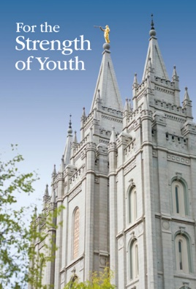
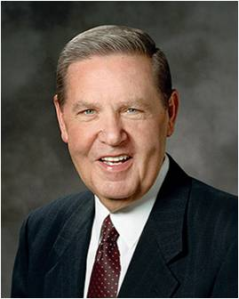
Love VS Lust
“Never do anything that could lead to sexual transgression. Treat others with respect, not as objects used to satisfy lustful and selfish desires. … Do not participate in discussions or any media that arouse sexual feelings. Do not participate in any type of pornography.” (6)
Lusting after others shows a lack of love and respect for them
“Love makes us instinctively reach out to God and other people. Lust, on the other hand, is anything but godly and celebrates self-indulgence. Love comes with open hands and open heart; lust comes with only an open appetite” (7)
Genesis 34:1-2

Slide 13
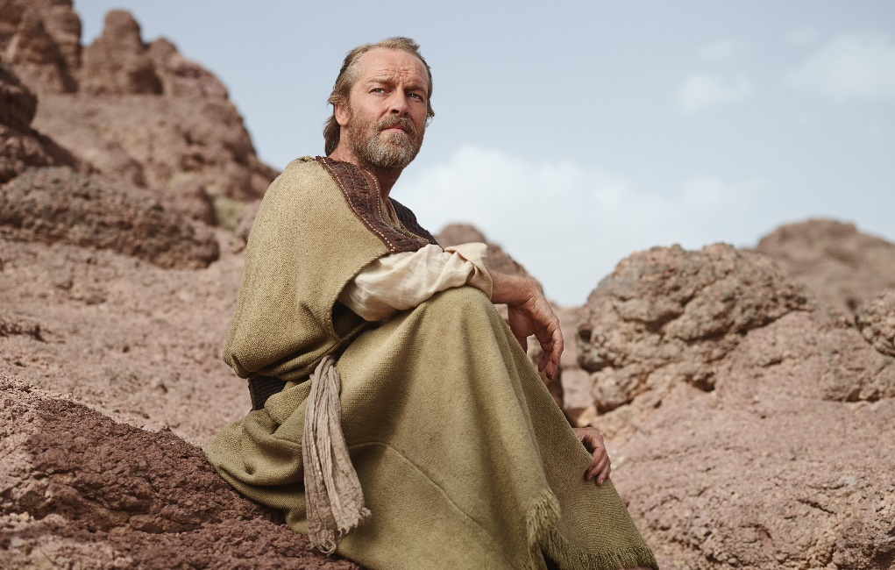
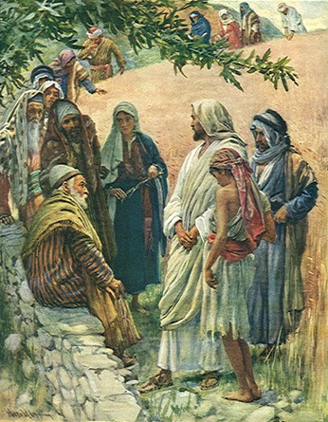
Desires
After Shechem took Dinah and defiled her, Shechem desired to marry her.
Shechem’s father approached Jacob and proposed that Dinah be allowed to marry Shechem.
He also suggested that their people engage in trade relations with each other and further intermarry.
The sons of Jacob were angry about what Shechem had done and deceitfully suggested that they should agree to the proposed arrangement only if all of the men in Shechem’s city agreed to be circumcised, which was symbolic of entering into the Abrahamic covenant.
Genesis 34:5-24

Slide 14
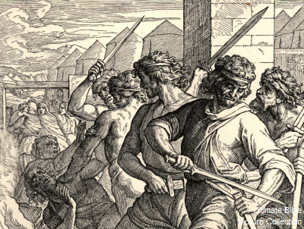
Destruction On the City
The men agreed to this proposal, and all were circumcised.
While the men of the city were recovering from being circumcised, Simeon and Levi entered the city, killed all of the males, and rescued their sister Dinah from Shechem’s house.
Jacob was greatly distressed by what Simeon and Levi had done and worried that surrounding tribes would gather together to destroy his household.
Possible Consequences of Simeon and Levi’s Actions:
Simeon wasn’t given land of their own, rather they got some area inside of Judah (and were later spread out all over as a nomadic tribe) and the Levites were also not given any land of their own and were spread all over Israel. See Comment
Genesis 34:25-31

Slide 15
Sources:
Video: Two Brothers Apart (6:12)
1. President Thomas S. Monson (“School Thy Feelings, O My Brother,” Ensign or Liahona, Nov. 2009, 68–69).
2. Teachings of Gordon B. Hinckley [Salt Lake City: Deseret Book Co., 1997], 229
3. Elder Marion D. Hanks (“Forgiveness: The Ultimate Form of Love,” Ensign, Jan. 1974, 20, 21).
4. Elder Neal A. Maxwell (Sermons Not Spoken [Salt Lake City: Bookcraft, 1985], 12)
Presentation by ©http://fashionsbylynda.com/blog/
5. Old Testament Who’s Who by Ed J. Pinegar and Richard J. Allen pgs. 40-41, 172
6. For the Strength of Youth[booklet, 2011], 36.
7. Jeffrey R. Holland, “Place No More for the Enemy of My Soul,” Ensign or Liahona, May 2010, 45.
8. Russell M. Nelson, “Let God Prevail,” Oct. 2020 general conference [Ensign or Liahona, Nov. 2020, 92]).

Slide 16
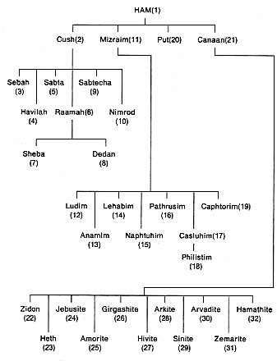
The Gifts:
Jacob is anxious and assembles many gifts, but he had no reason to fear, for “Esau ran to meet him, and embraced him, and fell on his neck, and kissed him: and they wept” (Gen. 33:4).
The gifts were offered, but “Esau said, I have enough, my brother; keep that thou hast unto thyself” (Gen. 33:9).
Notice how not only Jacob but Esau has grown. Though Jacob’s anxiety was understandable, generous Esau soon relieved him of his concern. Neal A. Maxwell (Ensign, Apr. 1981, 59)
And the Wealth:
Esau and Jacob are both wealthy but they are not greedy. Esau declares, “I have enough, my brother” (v. 9). Jacob also says, “I have enough” (v. 11). Ironically, it is the wealthy that sometimes have a hard time admitting that they “have enough.” Wealth breeds a love of wealth. Comfort seeks to be more comfortable. Rich is good, but more is better. Is happiness having everything you want or being happy with everything you have? Neither Esau nor Jacob made the mistake of falling into Satan’s greed trap. They were smart enough to say, “I have enough.”
“My wife and I learned a valuable lesson about this several years ago when we had the opportunity finally to build a new home. During the months of planning and building, an interesting phenomenon occurred. Even though we were blessed to have a nicer home with more comforts than we had ever had before, rather than being content, we began looking for ways to acquire more. We had to have new furniture for the upstairs family room so that we could put the old furniture downstairs. But the old entertainment center, a large piece of furniture that held our stereo and TV equipment, didn’t go well with the new furniture, so we had to have a new one. And instead of our antiquated stereo system, we now needed a new CD player with the latest technology. Then we had to accumulate a whole new library of expensive CDs to go with it. Whether it was the desire for new furniture, draperies, or landscaping for the house, we easily rationalized our covetousness by saying they were legitimate needs or ‘just wants.’
“Finally, we came to a stark realization about two things that we previously felt would never be a source of temptation for us: first, Satan can help us rationalize any desire for worldly gain so that it appears justifiable, even noble; and second, striving to acquire the things of the world not only does not bring lasting happiness and peace, but it drives us to seek more. When “all we’ve ever wanted” is grounded in the temporal trappings of this world, it is never enough!” (Brent L. Top, “Thou Shalt Not Covet,” Ensign, Dec. 1994, 25)
Possible Consequences of Simeon’s and Levi’s Actions:
Levi—was given no land inheritance per se. Instead, the Levites were allotted cities throughout all of the various tribes, in order that they might serve the nation through the Aaronic Priesthood which they held.
Jacob had prophesied of the people of Simeon (and Levi as well) that the Lord would “scatter them in Israel.” (Gen. 49:7.) Moses, too, when he blessed the tribes of Israel (Deut. 33), omitted the name of Simeon; and after the time of the initial settlement of the promised land, there are no further historical records concerning the land group of Simeon…Simeon was the only tribe of Israel to be completely surrounded by one other tribe—by Judah.
The “Other Tribes”: Which Are They? January 1982 Ensign
By John A. Tvedtnes

Slide 17
“Victims of sexual abuse are not guilty of sin and do not need to repent. If you have been a victim of abuse, know that you are innocent and that God loves you. Talk to your parents or another trusted adult, and seek your bishop’s counsel immediately. They can support you spiritually and assist you in getting the protection and help you need. The process of healing may take time. Trust in the Savior. He will heal you and give you peace” (For the Strength of Youth [booklet, 2011], 36–37).
Lust
Elder Jeffrey R. Holland of the Quorum of the Twelve Apostles explained why lust is a sin:
“Why is lust such a deadly sin? Well, in addition to the completely Spirit-destroying impact it has upon our souls, I think it is a sin because it defiles the highest and holiest relationship God gives us in mortality—the love that a man and a woman have for each other and the desire that couple has to bring children into a family intended to be forever. Someone said once that true love must include the idea of permanence. True love endures. But lust changes as quickly as it can turn a pornographic page or glance at yet another potential object for gratification walking by, male or female. True love we are absolutely giddy about—as I am about Sister Holland; we shout it from the housetops. But lust is characterized by shame and stealth and is almost pathologically clandestine—the later and darker the hour the better, with a double-bolted door just in case” (“Place No More for the Enemy of My Soul,” Ensign or Liahona, May 2010, 44–45).

