Slide 1


Joseph Sold Into Egypt
Genesis 35-37

Slide 2

Review -- Doctrinal Master
Genesis 1:26-27
All human beings—male and female—are created in the image of God

Slide 3

When Should You Prepare?
In what ways might your preparation for this event affect your experience?
A test
Athletic event
Sacrament Meeting
Music Recital
(1)

Slide 4
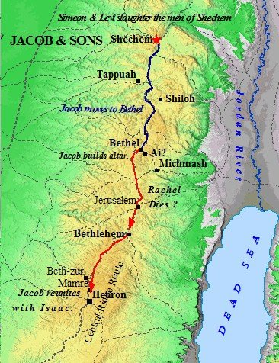
Arise and Go
Previously:
Because of Levi and Simeon’s massacre of the men in Shechem the family was in trouble with the neighboring lands.
In those days, such an outrage was dealt with by surrounding cities banding together to punish the offenders.
God protected Jacob and his family by first commanding them to move before they were attacked, and second by protecting them once on their journey, “and the terror of God was upon the cities that were round about them, and they did not pursue after the sons of Jacob”
Genesis 35:1
(1)

Slide 5
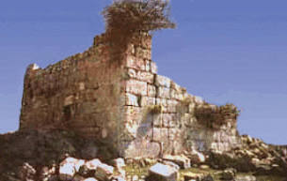
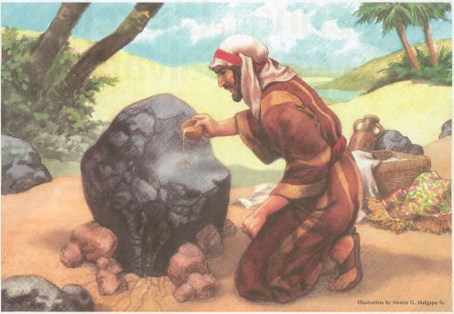
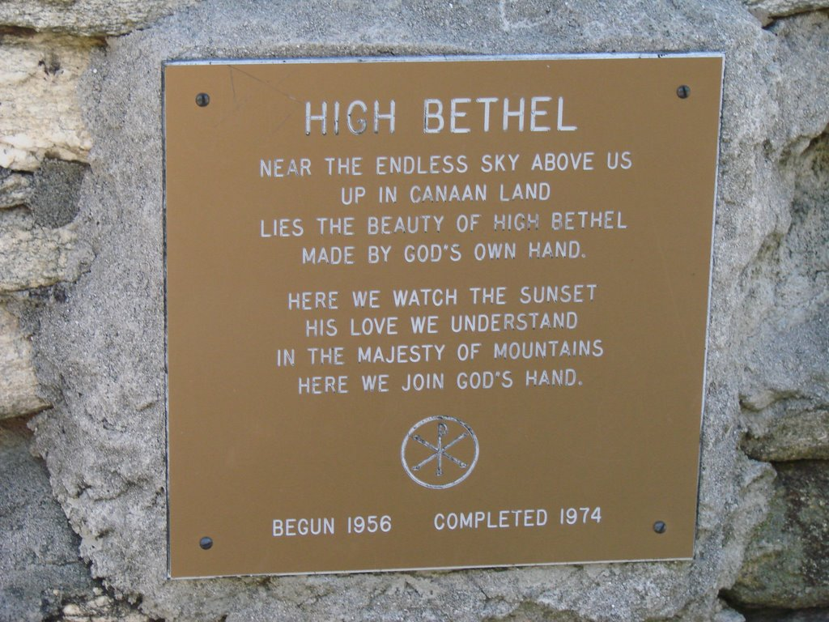
Bethel—House of God
Beth-el means literally “house of God.”
El means “God” and Beth is a prefix that means “house of”
Bethlehem House of bread
Bethphage House of figs
Bethsaida House of fish
Bethshemesh House of the sun
“One of the most sacred sites of the Old Testament was a placed called Bethel. It was at Bethel that Abraham built his altar on his first arrival in Canaan. (See Gen. 12:8, 13.)
And it was at Bethel that Jacob saw in vision a ladder reaching up into heaven, after which he built a pillar.
Until that time, the place was called Luz. Jacob renamed it Bethel, which means "house of God."
(2)

Slide 6
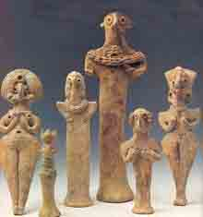



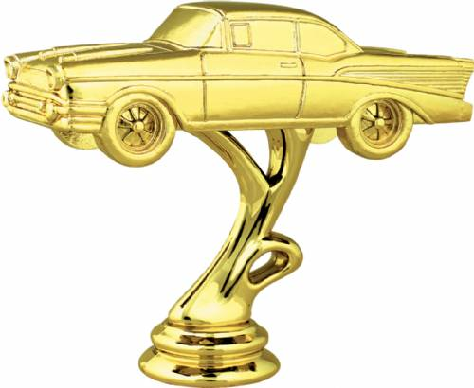
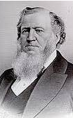
Put Away Your Gods
Jacob lived in a time when idolatry was the cultural norm. While Jacob was never an idol worshipper, some of his household still held to idolatrous practices.
“What is commonly termed idolatry has arisen from a few sincere men, full of faith and having a little knowledge, urging upon a backsliding people to preserve some customs—to cling to some fashions or figures, to put them in mind of that God with whom their fathers were acquainted, without designing or wishing the people to worship an idol—to worship stocks, stones, beasts, and birds. Idols have been introduced, which are now worshipped, and have been for centuries and thousands of years.” (3)
What are our idols?
Genesis 35:2-5
(1)

Slide 7
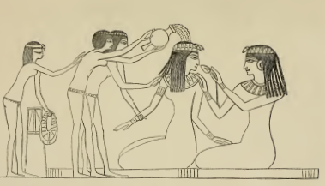
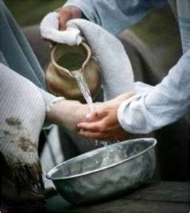
Prepare To Worship
As we approach the temple, we too should repent before we are washed, anointed, and clothed in the garments of the temple.
The cleansing of one's garments was ritually important in ancient Israel as a necessary preparation for appearing before God.
And the Lord said unto Moses, Go unto the people, and sanctify them to day and to morrow, and let them wash their clothes, and be ready against the third day: for the third day the Lord will come down in the sight of all the people upon mount Sinai. . . . And Moses went down from the mount unto the people, and sanctified the people; and they washed their clothes (Exodus 19:10-11, 14).
“This washing was to prepare the people for meeting the Lord and becoming a ‘kingdom of priests’.
“In ancient Israel, garments were cleansed before the performance of sacred functions.
A ritually unclean person was required to wash himself and his clothes, sometimes following this practice by sacrifice.” (4)
Genesis 35:7
(1)

Slide 8

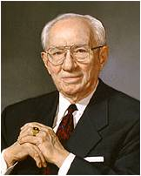
Repentant and Become Clean
Everything looks better when there is cleanliness.
As we prepare ourselves to worship the Lord, we invite His revelation
“Be ye clean that bear the vessels of the Lord” (D&C 133:5).
Thus has He spoken to us in modern revelation:
Be clean in body.
Be clean in mind.
Be clean in language.
Be clean in dress and manner.
Wash you, make you clean; put away the evil of your doings from before mine eyes; cease to do evil;
Learn to do well; seek judgment, relieve the oppressed, judge the fatherless, plead for the widow.
Come now, and let us reason together, saith the Lord: though your sins be as scarlet, they shall be as white as snow; though they be red like crimson, they shall be as wool.
Isaiah 1:16-18
Genesis 35:6-10
(5)

Slide 9
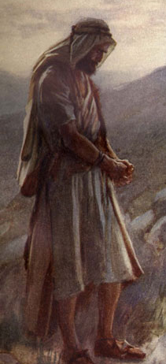
Jacob No More
Jacob was to be called “Israel” at that point
“Critics have attempted to distinguish between an ‘Israel tradition’ and a ‘Jacob tradition… [one author] has attempted, however, to show that each particular usage has a purpose.
His analysis covers the forty-five times ‘Jacob’ is used and the thirty-four times ‘Israel’ is written from here to the end of Genesis.
‘Israel’ is said to be used whenever the spiritual side of the Patriarch is emphasized, ‘Jacob’ when material and physical aspects are involved.”
Genesis 35:10
(6)

Slide 10
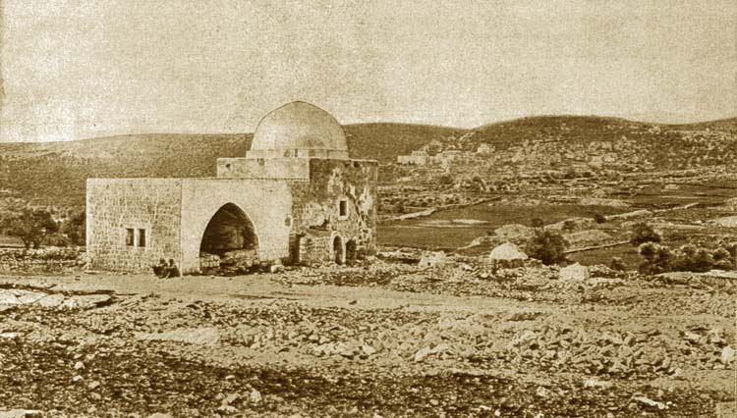
Trials of the Faithful
Benjamin was born on the road between Bethlehem and Bethel, the only of Jacob's sons to be born in what is today Israel.
Tragically, Rachel died in giving him birth.
Her last words were to name the infant Benoni, meaning son of my sorrow, which was changed by Jacob to Benjamin, meaning son of my right hand.
Rachel's tomb near Bethlehem
Even those who are faithful to the Lord experience trials and sorrow
Genesis 35:16-20
(6)

Slide 11
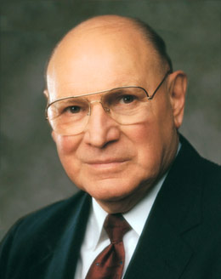
“I love the scriptures because they show examples of great and noble men and women such as Abraham, Sarah, Enoch, Moses, Joseph, Emma, and Brigham. Each of them experienced adversity and sorrow that tried, fortified, and refined their characters.”
Genesis 35:16-20
(7)

Slide 12
Esau’s Descendants-Recap
This is my own interpretation of Genesis 26, 28, and 36.
Needless to say that Esau had many descendants
Hivite
Hittites
Zibeon
Isaac
Beeril
Ishmael or Elon ?
Ishmael
Horite
Elon
Anah
Esau
Judith
Bashemath
Mahalath
Aholibamah
Adah
Seir
Speculation that Mahalath and Bashemeth are the same person
Jeush
Eliphaz
Timna
Reuel
Jaalam
Amalek
Teman
Nahath
Korah
Omar
Ramesis I
Zerah
Zepho
Dukes
Shammah
Gatam
Mizzah
Edomites
They dwelt in Mt Seir and intermarriages took place between the sons and daughter of Esau and the sons and daughters of Seir, the Horite
Kenaz
Genesis 36

Slide 13
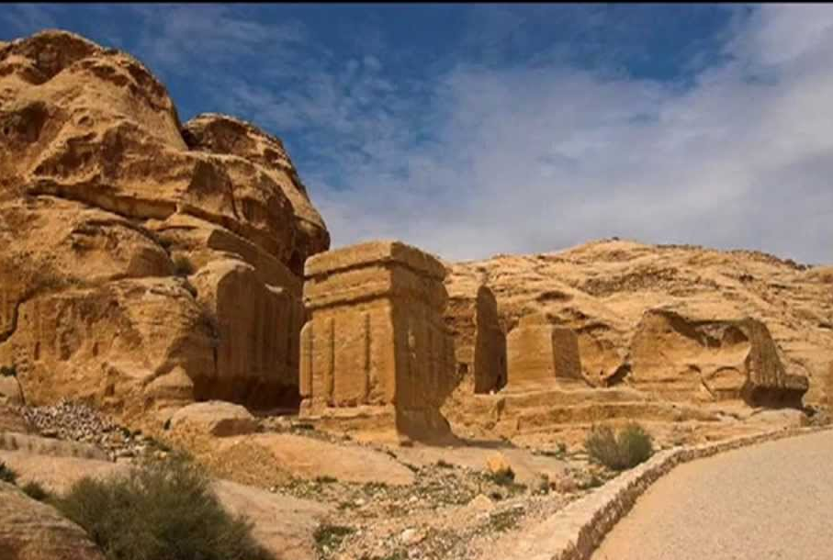
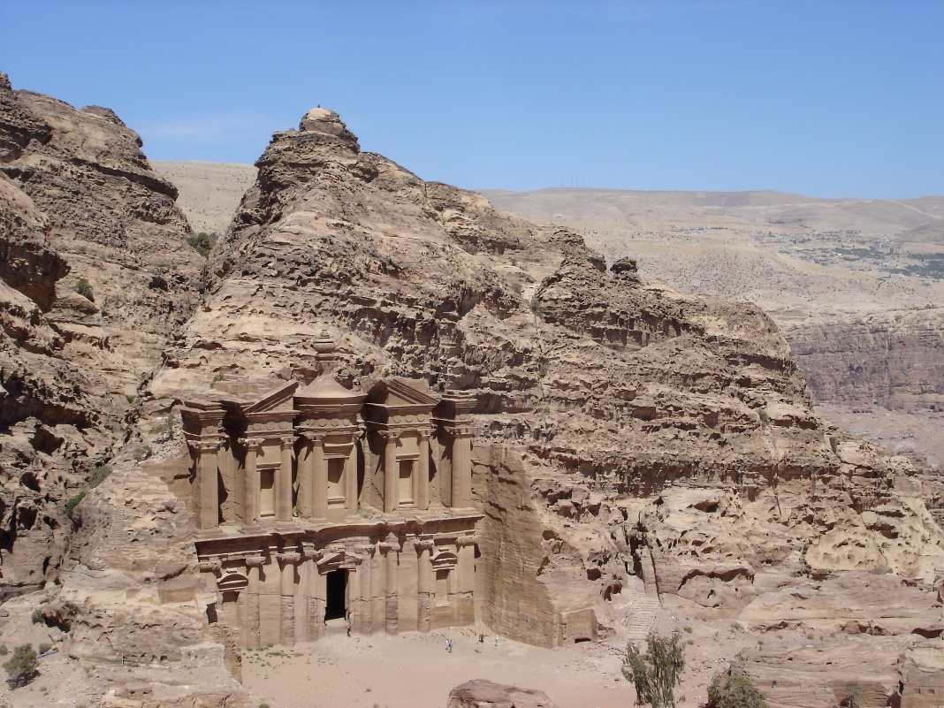
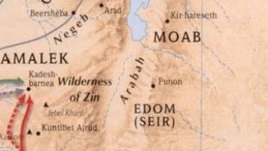
Lost
While it is important to understand the relationship of the Edomites to the Israelites, both geographically and spiritually, the historical significance of nearly all of these Edomite names has been lost.
Petra/Mount Seir
Genesis 36

Slide 14

Good Fortune
What are some ways a person might feel about someone else’s good fortune?
What is the danger of feeling envious or jealous of others who experience good fortune?

Slide 15
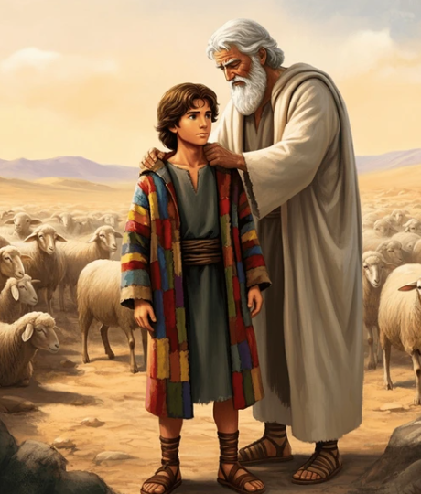
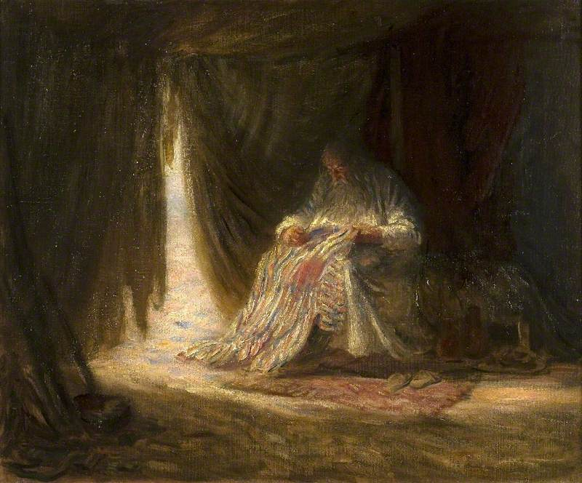
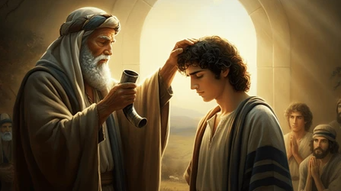
Favored Son
Joseph was 17 years old.
Joseph’s age in this story is important. He lacks the maturity to see how his actions are perceived by his brothers. He is the messenger boy, sent back and forth to his brothers tending the flocks. It seems that he had bad news to tell his father. The report likely reflected negatively on his older brothers who began to see Joseph as a tattler.
Obviously, Joseph was the firstborn son of his beloved Rachel. He loved Rachel more than Leah or his concubines; it is natural, therefore, for him to favor Joseph and later Rachel’s second son Benjamin over the others. Parental purists might find fault, but the scripture is painting the picture of real people, not perfect people, made great by the promises given them by God and the covenants they kept.
Joseph’s Brothers: could not speak peaceably unto him” means they could not be friendly or desire any happiness for him
Genesis 37:1-4
(1)

Slide 16
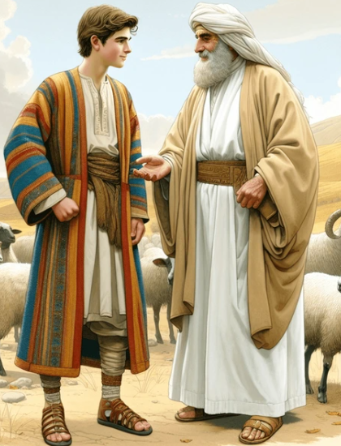
Coat of Many Colors
“There is some question as to what Joseph’s coat actually was. The Hebrew word denotes ‘a long coat with sleeves … i.e. an upper coat reaching to the wrists and ankles, such as noblemen and kings’ daughters wore.
The coat may have been of different colors, but its significance seems to have been far more than its brightness and beauty.
One noted scholar suggested that it was ‘a tunic reaching to the palms of the hands and soles of the feet; the long tunic with sleeves worn by young men and maidens of the better class; in the case of Joseph, supposed by Bush … to have been the badge of the birthright which has been forfeited by Reuben and transferred to Joseph’ (9)
Whatever this coat looked like or represented, it was a source of jealousy and contention among Joseph’s brothers.
The Daughters of King David:
And she had a garment of divers colours upon her: for with such robes were the king’s daughters that were virgins apparelled.
2 Samuel 13:18
Genesis 37:3
(8)

Slide 17
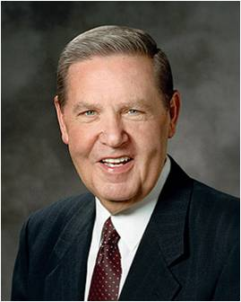


Envy In Our Lives
“Brothers and sisters, there are going to be times in our lives when someone else gets an unexpected blessing or receives some special recognition. May I plead with us not to be hurt—and certainly not to feel envious—when good fortune comes to another person? We are not diminished when someone else is added upon. …
“Furthermore, envy is a mistake that just keeps on giving. Obviously we suffer a little when some misfortune befalls us, but envy requires us to suffer all good fortune that befalls everyone we know!
What a bright prospect that is—downing another quart of pickle juice every time anyone around you has a happy moment!”
Genesis 37:3
(10)

Slide 18
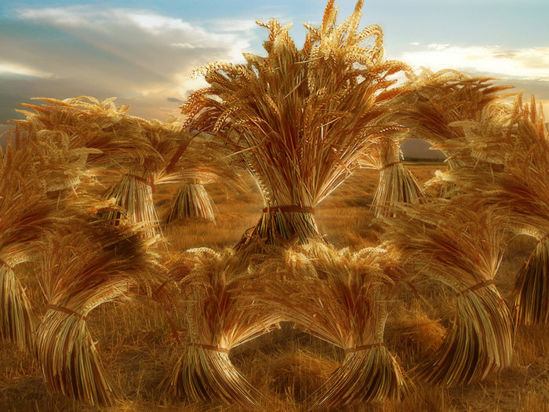
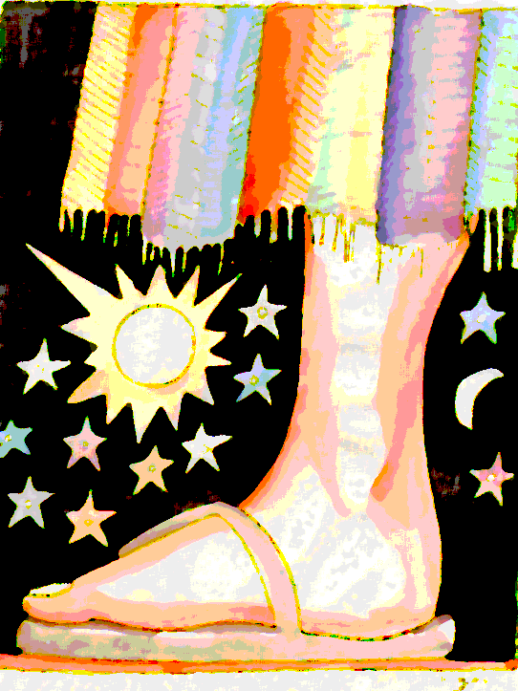
The Dreams
make obeisance=
to bow
Choosing to hate or envy others can lead us to commit additional sins.
Genesis 37:5-11

Slide 19



The Plot
Shed no blood, but cast him into this pit that is in the wilderness
…let us slay him, and cast him into some pit, and we will say, Some evil beast hath devoured him: and we shall see what will become of his dreams.
And they took him, and cast him into a pit: and the pit was empty, there was no water in it.
Genesis 37:18

Slide 20
The Sale
and they brought Joseph into Egypt
What profit is it if we slay our brother, and conceal his blood?
let us sell him to the Ishmeelites, and let not our hand be upon him;
…lifted up Joseph out of the pit, and sold Joseph to the Ishmeelites for twenty pieces of silver:
The child is not; and I, whither shall I go?
Genesis 37:18-30

Slide 21
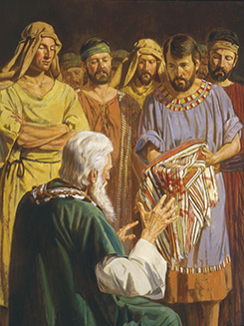
The Lie
Despite the grief Reuben felt, however, Reuben and his brothers dipped Joseph’s coat in animal blood and gave it to their father.
Jacob assumed that Joseph had been killed by a wild animal.
He mourned deeply, putting on sackcloth, which was clothing worn in times of sorrow.
Genesis 37:31-35

Slide 22
Potiphar
Once in Egypt, Joseph was sold to Potiphar, one of Pharaoh’s officers.
The Hebrew phrase which is translated as “captain of the guards” literally means “chief of the butchers or slaughterers.”
From this meaning some scholars have thought that he was the chief cook or steward in the house of the pharaoh, but other scholars believe that butcher or slaughterer is used in the sense of executioner, and thus Potiphar was the “commanding officer of the royal body-guard, who executed the capital sentences ordered by the king.”
Either way, Potiphar was an important man, but the latter position especially would give him great power and status in Egypt. (11)
Genesis 37:36

Slide 23
Sources:
gospeldoctrine.com
LDS Church News, 1998, 02/21/98) Illustration (Jacob’s alter) by Nestor G. Malgapo
Discourses of Brigham Young, selected and arranged by John A. Widtsoe [Salt Lake City: Deseret Book Co., 1954], 21
Donald W. Parry, ed., Temples of the Ancient World: Ritual and Symbolism [Salt Lake City and Provo: Deseret Book Co., Foundation for Ancient Research and Mormon Studies, 1994], 688
5. President Gordon B. Hinckley “Be Ye Clean” April 1996 General Conf.
6. The Torah: A Modern Commentary, ed. by W. Gunther Plaut [New York, The Union of American Hebrew Congregations, 1981], 233
7. Elder Joseph B. Wirthlin “Come What May, and Love It,” Ensignor Liahona, Nov. 2008, 27).
8. Keil and Delitzsch, Commentary,1:1:335
Presentation by ©http://fashionsbylynda.com/blog/
9. Wilson, Old Testament Word Studies, s.v. “colour,” p. 82)” (Old Testament Student Manual: Genesis–2 Samuel, 3rd ed. [Church Educational System manual, 2003], 93
10. Elder Jeffrey R. Holland (“The Laborers in the Vineyard,” Ensign, May 2012, 31–32).
11. Old Testament Institute Manual and (Keil and Delitzsch, Commentary, 1:1:338).

Slide 24
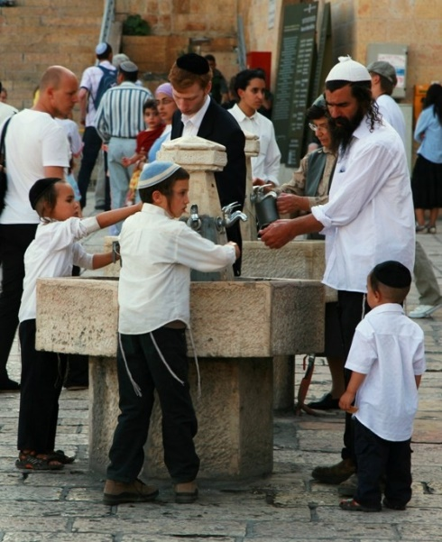
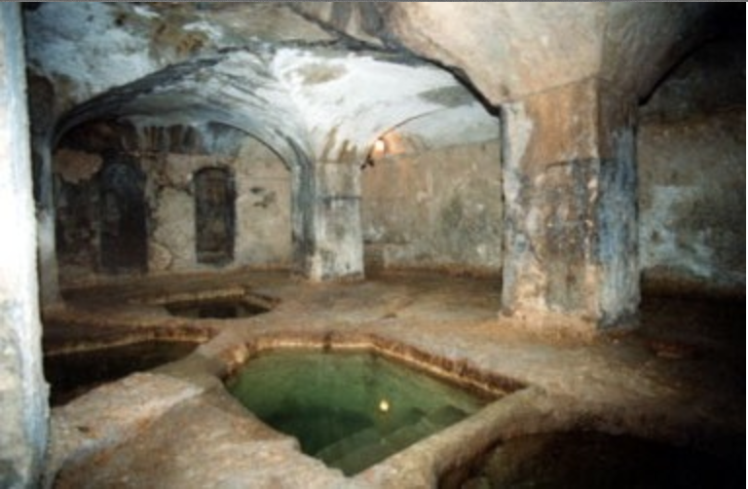
Bethel is located in central Palestine, on the border between Ephraim and Benjamin, on the great north-south watershed road of Palestine, about 12 miles north of Jerusalem, 9 miles south of Shiloh, and just west of Ai.
There were excellent springs of water near the top of a ridge of hills there which made Bethel an idea place for inhabitation from the beginning.
Bethel was also on a key west-east route between the Mediterranean Sea and Eastern Jordan (Trans-jordania) through Jericho. From Bethel, one would travel either through the valley of Avalon or by Gophna through the Plain of Sharon to the sea.
Bethel is probably located mostly under the modern city of Beitin. http://kukis.org/Doctrines/Bethel.htm
Washing, especially of the hands (and sometimes feet) has long had symbolic significance in the Middle East. Such washing has often been less for ablution (or cleaning) than as a symbol of an inner cleansing. A careful, intentional and ritual washing of the hands prior to prayer can have a powerful psychological effect. For some people, bathing (or showering) prior to prayer, or washing the face and rinsing out the mouth, will also be useful. Whatever form the ritual washing may take, the words of Psalm 26:6-12 (KJV—in the Septuagint it is Psalm 25), can appropriately be recited:
I will wash my hands in innocency and I will compass Thine altar, O Lord, that I may hear the voice of Thy praise and tell of all Thy wondrous works. O Lord, I have loved the beauty of Thy house, and the place where Thy glory dwelleth.
The tradition of Israel required ritual washing before prayers and meals, and on other specific occasions.
https://citydesert.wordpress.com/2014/03/24/aids-to-prayer-1-washing/
A mikvah (also miqvah or mikveh; mikvot, pl.) is a specially designed pool of water used for purification purposes.
Immersion in the ritual bath is an important part of Jewish tradition, especially for women who used the mikvah following menstruation, childbirth and before marriage. Men use the ritual bath less frequently.
For either gender, the purpose of the immersion was (and still is) not for the purpose of a physical cleansing, but for achieving spiritual renewal. The mikvah ritual was the precedent for the baptism practices of Christianity and the ghusl rites of Islam.
How old is the Jewish tradition of absolution? The only place “mikveh” is specifically mentioned in the Hebrew Bible is Lev. 11:36. Mikveh literally means gathering [of water] without mention of an accompanying ritual. The Hebrew Bible records the tradition of washing in preparation for the Sinai theophany in the 10th century BCE. By the time the story of Bathsheba’s famous rooftop bath is recorded in the 5th century BCE, scholars speculate that ritual washing had become more than a one-time event in a person’s life.
http://robincohn.net/biblical-women-and-the-use-of-mikvot-jewish-ritual-baths/

Slide 25
“Rachel's Tomb (Hebrew: קבר רחל‎ translit. Kever Rakhel), also known since the 1990s as the Bilal bin Rabah mosque (Arabic: مسجد بلال بن رباح‎) to Muslims and UNESCO is the name given to a small religious building encased in concrete revered by Jews, Christians and Muslims.
The tomb is located within a Muslim cemetery in a walled enclave biting into the outskirts of Bethlehem, 460 meters south of Jerusalem’s municipal boundary, in the West Bank. The burial place of the matriarch Rachel as mentioned in the Jewish and Christian Old Testament, and in Muslim literature is contested between this site and several others to the north. The earliest extra-biblical records describing this tomb as Rachel's burial place date to the first decades of the 4th century AD. The domed structure containing the tomb dates from the Muslim Ottoman period and when Sir Moses Montefiore renovated the site in 1841 after obtaining the key for the Jewish community, he added a antechamber which included a mihrab for Muslim prayer. According to the 1947 United Nations Partition Plan for Palestine, the tomb was to be part of the internationally administered zone of Jerusalem, but the area was occupied by Jordan, which prohibited Israelis from entering the area. Though not initially falling within Area C, the site has come under the control of the Israeli Ministry of Religious Affairs. Rachel's tomb is the third holiest site in Judaism. Jews have made pilgrimage to the tomb since ancient times, and it has become one of the cornerstones of Jewish-Israeli identity.”
(http://en.wikipedia.org/wiki/Rachel's_Tomb(link is external))
The name Edom was given to Esau, the first-born son of Isaac and twin brother of Jacob, when he sold his birthright to the latter for a meal of lentil pottage. The country which the Lord subsequently gave to Esau was hence called ‘the country of Edom,’ Genesis 32:3; and his descendants were called Edomites. Edom was called Mount Seir and Idumea also. Edom was wholly a mountainous country. It embraced the narrow mountainous tract (about 100 miles long by 20 broad) extending along the eastern side of the Arabah from the northern end of the Gulf of Elath to near the southern end of the Dead Sea. The ancient capital of Edom was Bozrah (Buseireh). Sela (Petra) appears to have been the principal stronghold in the days of Amaziah (B.C. 838). 2 Kings 14:7; Elath and Ezion-geber were the seaports. 2 Samuel 8:14; 1 Kings 9:26; History.—Esau's bitter hatred to his brother Jacob for fraudulently obtaining his blessing appears to have been inherited by his latest posterity. The Edomites peremptorily refused to permit the Israelites to pass through their land. Numbers 20:18-21; For a period of 400 years we hear no more of the Edomites. They were then attacked and defeated by Saul, 1 Samuel 14:47; and some forty years later by David. 2 Samuel 8:13, 14; In the reign of Jehoshaphat (B.C. 914) the Edomites attempted to invade Israel, but failed. 2 Chronicles 20:22; They joined Nebuchadnezzar when that king besieged Jerusalem. For their cruelty at this time they were fearfully denounced by the later prophets. Isaiah 34:5-8; Isaiah 63:1-4; Jeremiah 49:17; After this they settled in southern Palestine, and for more than four centuries continued to prosper. But during the warlike rule of the Maccabees they were again completely subdued, and even forced to conform to Jewish laws and rites, and submit to the government of Jewish prefects. The Edomites were now incorporated with the Jewish nation. They were idolaters. 2 Chronicles 25:14, 15, 20; Their habits were singular. The Horites, their predecessors in Mount Seir, were, as their name implies, troglodytes, or dwellers in caves; and the Edomites seem to have adopted their dwellings as well as their country. Everywhere we meet with caves and grottos hewn in the soft sandstone strata.” (Dictionary of the Bible, William Smith, “Edom”)
Mount Seir
“[Seir] is the original name of the mountain range extending along the east side of the valley of Arabah, from the Dead Sea to the [gulf]. The Horites appear to have been the chief of the aboriginal inhabitants, Genesis 36:20; but it was ever afterward the possession of the Edomites, the descendants of Esau. The Mount Seir of the Bible extended much farther south than the modern province, as is shown by the words of Deuteronomy 2:1-8; It had the Arabah on the west, vs. 1 and 8; it extended as far south as the head of the Gulf of Akabah, ver. 8; its eastern border ran along the base of the mountain range where the plateau of Arabia begins. Its northern, order is not so accurately determined. There is a line of ‘naked’ white hills or cliffs which run across the great valley about eight miles south of the Dead Sea, the highest eminence being Mount Hor, which is 4800 feet high.” (Dictionary of the Bible, William Smith, “Seir”)

Slide 26
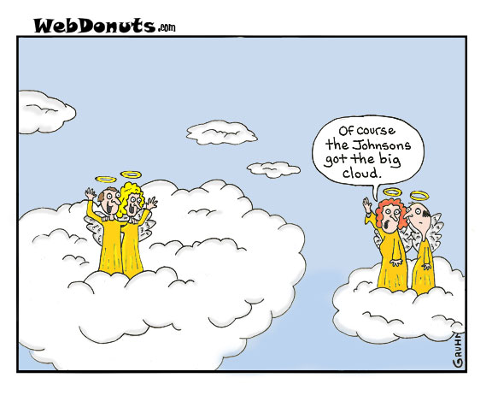
Coat of many Colors: Hugh Nibley
Here the survival of Joseph's garment guarantees and typifies the survival of Joseph (Alma 46:24).
In the tenth century of our era the greatest antiquarian of the Moslem world, Muhammad ibn-Ibrahim ath-Tha'labi, collected in Persia a great many old tales and legends about the prophets of Israel…Among other things, Tha'labi tells a number of stories, which we have not found anywhere else, about Jacob and the garment of Joseph. In one… there were in the garment of Joseph three marks or tokens when they brought it to his father… According to ad-Dahak that garment was of the weave [pattern, design] of Paradise, and the breath [spirit, odor] of Paradise was in it, so that it never decayed or in any way deteriorated [and that was] a sign [omen]. And Joseph gave them that garment, and it was the very one that had belonged to Abraham, having already had a long history…
Note here that there were two remnants of Joseph's garment, one sent by Joseph to his father as a sign that he was still alive (since the garment had not decayed), and the other, torn and smeared with blood, brought by Judah to his father as a sign that Joseph was dead. Moroni actually quotes Jacob (“Now behold, this was the language of Jacob”) as saying: “Now behold, this giveth my soul sorrow; nevertheless, my soul hath joy in my son” (Alma 46:25-26)…
“These interesting little details are typical apocryphal variations on a single theme, and the theme is the one Moroni mentions; the rent garment of Joseph is the symbol both of his suffering and his deliverance, misfortune and preservation.” (An Approach to the Book of Mormon, p. 218-20)
20 Pieces of Silver:
The price received for Joseph, twenty pieces of silver, is the same price specified later in the Mosaic law for a slave between the ages of five and twenty (see Leviticus 27:5). Typically, the price for a slave was thirty pieces of silver (see Exodus 21:32).
The Right to the coat:
If indeed this coat signaled that Joseph held the birthright, which may have been in question among the brothers because there were four firstborn sons in Jacob’s family, this fact would explain the intense hostility and jealousy the coat provoked among the other sons of Jacob. The following brothers could easily have thought that they should have had the birthright.
Reuben. He was the firstborn of all the sons. Although he had lost the right, he may not have accepted that fact.
Simeon. Since he was the second son of Leah and next in line following Reuben, he could have assumed the birthright would come to him after Reuben lost his right to it.
Judah. He could have argued that not only Reuben had lost the right, but so had Simeon and Levi, through the massacre of the Shechemites (see Genesis 34). The disqualification of these sons would make him the rightful legal heir.
Dan. Because his mother, Bilhah, was considered Rachel’s property, he could argue that he was Rachel’s firstborn, not Joseph, and therefore should have received the birthright when Reuben lost it.
Gad. He was the firstborn son of Zilpah and therefore could easily have thought he should have taken the birthright after Reuben forfeited it.
Old Testament Institute Manual
Potiphar: “The Hebrew phrase which is translated as ‘captain of the guards’ literally means ‘chief of the butchers or slaughterers.’ From this meaning some scholars have thought that he was the chief cook or steward in the house of the pharaoh, but other scholars believe that butcher or slaughterer is used in the sense of executioner, and thus Potiphar was the ‘commanding officer of the royal body-guard, who executed the capital sentences ordered by the king’ (Keil and Delitzsch, Commentary, 1:1:338). Either way, Potiphar was an important man, but the latter position especially would give him great power and status in Egypt” (Old Testament Student Manual: Genesis–2 Samuel, 3rd ed. [Church Educational System manual, 2003], 94).

