Slide 1

Joseph in Egypt
Story of Judah
Genesis 38-39
A man’s pride shall bring him low: but honour shall uphold the humble in spirit. Proverbs 29:23

Slide 2

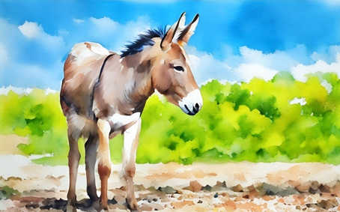

The Fable
The fable has been told of a donkey that fell into a pit. Scared and trapped, the donkey whined and brayed. After searching for a way to rescue the donkey, the owner began to shovel dirt into the pit. Each shovel full of dirt landed on the donkey’s back, making it whine more.
The donkey would shake the dirt off its back, causing mounds of dirt to pile underneath. Over and over, the donkey repeated the actions of shaking the dirt off and stepping onto the growing mound, until eventually the donkey rose high enough on the dirt to escape from the pit.
https://www.youtube.com/watch?v=wj2MnA5oGpk

Slide 3
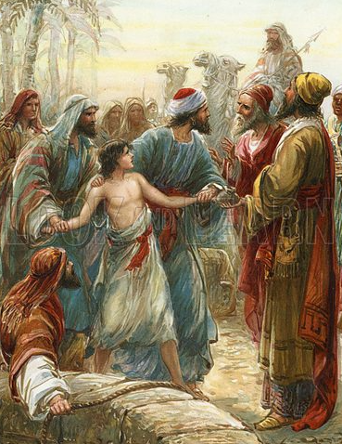
Previously…
When Joseph was 17 years old, his older brothers envied his favored status with their father, Jacob. They hated Joseph for sharing dreams he had about them bowing before him in the future. In time, they sold Joseph as a slave.
Joseph was lifted out of the pit by Midianites merchantmen then was sold to the Ishmeelites who came from Gilead while traveling to Egypt. Joseph was sold for twenty pieces of silver.
Ishmaelites and Midianites, while distinct groups, were closely related and sometimes even used interchangeably in the Bible, particularly in narratives like the story of Joseph. Both were descendants of Abraham, with Ishmaelites tracing back to Abraham's son Ishmael and Midianites tracing back to Abraham's son Midian. They were often nomadic traders and pastoralists, leading to their paths crossing and sometimes being conflated, especially when they were traveling together or when describing general groups of desert traders,
Genesis 37

Slide 4
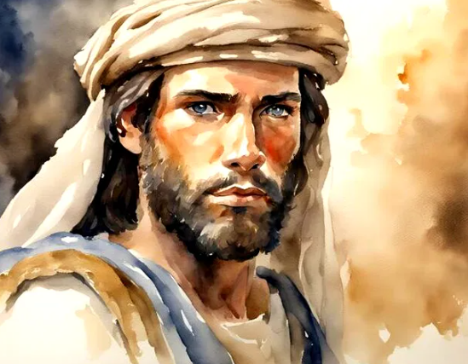
Taking a Detour
Genesis 38 takes a historical detour from the story of Joseph sold into Egypt.
Judah has three sons by a Canaanite woman—Er and Onan are slain by the Lord—Tamar, disguised as a harlot, bears twins by Judah.
Genesis 38

Slide 5
Judah
Canaanite
Canaanite
Shuah
Judah, married a Canaanite woman (a daughter of Shuah).
Judah and his wife had three sons together: Er, Onan, and Shelah.
The oldest son, Er, married a woman named Tamar, but he died before they had children.
Shuah
Judah
Judah
Tamar
Er
Er
Onan
Tamar
Onan
Shelah
Shelah
According to the customary law at that time, a widow who had no children had claim on her husband’s next oldest brother or his closest living male relative.
This man, if asked by the widow, was obligated to marry her and raise up seed, or produce children, on behalf of his deceased brother.
Genesis 38:1-11

Slide 6
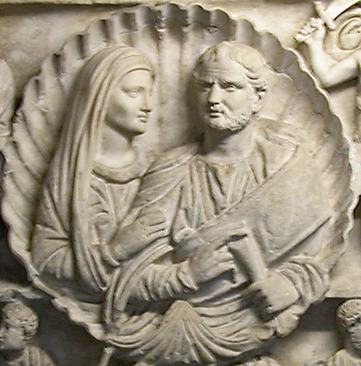
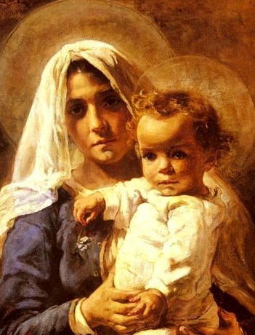
Levirate Marriage—Deut. 25:5-10
The custom of a widow marrying her deceased husband’s brother or sometimes a near heir.
5 ¶If brethren dwell together, and one of them die, and have no child, the wife of the dead shall not marry without unto a stranger: her husband’s brother shall go in unto her, and take her to him to wife, and perform the duty of an husband’s brother unto her.
6 And it shall be, that the firstborn which she beareth shall succeed in the name of his brother which is dead, that his
name be not put out of Israel.
7 And if the man like not to take his brother’s wife, then let his brother’s wife go up to the gate unto the elders, and say, My husband’s brother refuseth to raise up unto his brother a name in Israel, he will not perform the duty of my husband’s brother.
8 Then the elders of his city shall call him, and speak unto him: and if he stand to it, and say, I like not to take her;
9 Then shall his brother’s wife come unto him in the presence of the elders, and loose his shoe from off his foot, and spit in his face, and shall answer and say, So shall it be done unto that man that will not build up his brother’s house.
10 And his name shall be called in Israel, The house of him that hath his shoe loosed.
Genesis 38:8
Elizabeth Nourse

Slide 7
Deception
Canaanite
Shuah
However, when Shelah was old enough, Judah did not keep his promise to Tamar.
Tamar then resorted to deception in order to bear children by Judah, who had the responsibility to provide a husband and children for her.
Tamar
Judah
Er
Onan
Shelah
Had Judah faithfully kept his promise to Tamar, the seduction would never have taken place. Likewise, had Judah been faithful to the laws of morality, he never would have sinned with Tamar. (1)
Genesis 38:12-19

Slide 8
Secrets Exposed
Tamar’s choice to pretend to be a harlot so she could become pregnant by Judah violated the law of chastity.
Tamar knew that her actions might have serious consequences, such as being sentenced to death.
Judah sent his friend with a kid (a young goat) to pay the harlot and retrieve his signet, bracelets, and staff, but his friend could not find her.
Judah still did not realize that the woman he believed was a harlot was actually his daughter-in-law, Tamar.
By requesting Judah’s signet, bracelets, and staff, Tamar gathered evidence to show who the father of her child was.
Judah had no qualms about sending Tamar home with unfulfilled promises nor of picking up a harlot along the road.
But when he heard that Tamar was pregnant he was so incensed that he ordered her put to death.
Genesis 38:13-24

Slide 9

“The Church of Jesus Christ of Latter-day Saints has a single, undeviating standard of sexual morality: intimate relations are proper only between a man and a woman in the marriage relationship prescribed in God’s plan.
Such relations are not merely a curiosity to be explored, an appetite to be satisfied, or a type of recreation or entertainment to be pursued selfishly.
They are not a conquest to be achieved or simply an act to be performed.
Rather, they are in mortality one of the ultimate expressions of our divine nature and potential and a way of strengthening emotional and spiritual bonds between husband and wife.
We are agents blessed with moral agency and are defined by our divine heritage as children of God—and not by sexual behaviors, contemporary attitudes, or secular philosophies” (2)

Slide 10
Twins Are Born
Shuah
…that the one put out his hand: and the midwife took and bound upon his hand a scarlet thread, saying, This came out first.
Tamar
Judah
Zarah
Er
Pharez
Onan
And it came to pass, as he drew back his hand, that, behold, his brother came out: and she said, How hast thou broken forth? this breach be upon thee: therefore his name was called Pharez.
Shelah
Through the lineage of Pharez, Jesus Christ was born
And afterward came out his brother, that had the scarlet thread upon his hand: and his name was called Zarah.
Genesis 38:27-30

Slide 11
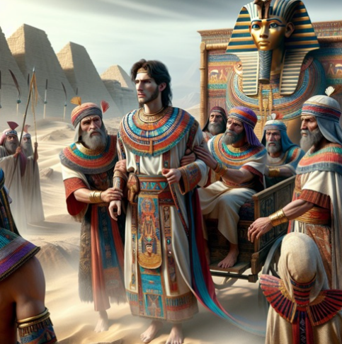
Joseph’s Journey Continues
An act of betrayal and cruelty sets the stage for Joseph's journey to Egypt, where he is sold as a slave to Potiphar, an officer of Pharaoh and the captain of the guard.
It is important to note the significance of Joseph's descent to Egypt, as it symbolizes a descent into darkness and hardship and loss of freedom.
The luxurious and comfortable life that Joseph had known as his father's favored son is now replaced by the harsh reality of slavery and servitude.
Joseph eventually became the overseer of Potiphar’s house
Genesis 39

Slide 12
Potiphar
His name means: he whom Ra (the sun-god)
He was a captain of the bodyguard of the pharaoh and benefactor of Joseph when he was sold into slavery
He was a wealthy man
He saw everything Joseph did and knew Joseph was blessed by the Lord and flourished
He made Joseph overseer of his house
His wife made multiple attempts to persuade Joseph to lie with her
Joseph resisted honorably
His wife accused Joseph falsely of licentious behavior
Potiphar became angry and put Joseph in the king’s prison
Genesis 39
(3)

Slide 13
Joseph’s Character
Joseph found grace in his (Potiphar’s) sight, and he served him: and he made him overseer over his house
Joseph was a goodly person, and well favoured
Joseph did not succumb to Potiphar’s wife’s temptations
Genesis 39:1-7

Slide 14
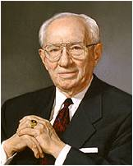

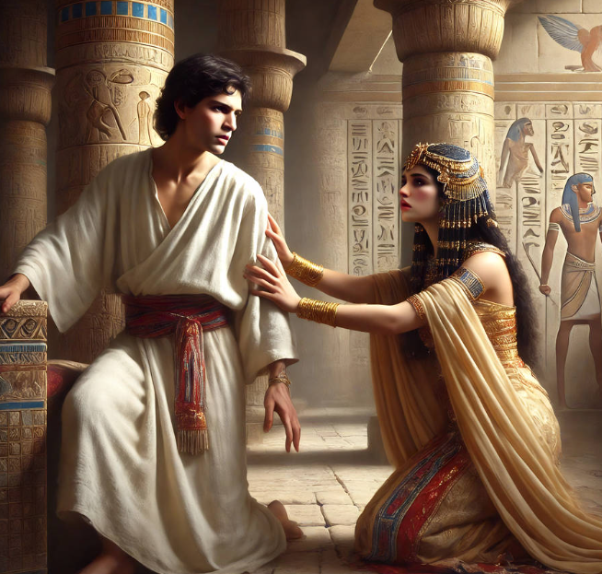
Joseph’s Choice
Potiphar’s wife lusted after Joseph, but Joseph refused to break the law of chastity and fled from her.
Potiphar’s wife falsely accused Joseph of mistreating her, and he was cast into prison
“You face tremendous temptation. It comes at you in the halls of popular entertainment, on the Internet, in the movies, on television, in cheap literature, and in other ways—subtle, titillating, and difficult to resist. Peer pressure may be almost overpowering. But … you must not give in. You must be strong. You must take the long look ahead rather than succumbing to the present seductive temptation.” (4)

Slide 15
The influences today may be more apparent and more seductive, but they are no more compelling. You cannot be shielded entirely from these influences. They are all about us. Our culture is saturated with them. But the same kind of self-discipline exercised by Joseph will yield the same beneficial result.
Notwithstanding the so-called "new morality," notwithstanding the much-discussed changes in our moral standard, there is no adequate substitute for virtue. The old standard is challenged on every campus in America as it is in Europe. But God has not abrogated his commandments.
The violation of these commandments in this, as in any other age, brings only regret, sorrow, loss of self-respect, and in many cases tragedy. Rationalization and equivocation will not erase the cankering scar that blights the self-respect of a young man who takes that virtue which he can never replace. Self-justification will never mend the heart of a young woman who has drifted into moral tragedy.
(4)

Slide 16
Doctrinal Mastery
Genesis 39:9
There is none greater in this house than I; neither hath he kept back any thing from me but thee, because thou art his wife: how then can I do this great wickedness, and sin against God?

Slide 17

The Law of Chastity
Our devotion to God can give us strength to resist the temptation to break the law of chastity
Why do you think Heavenly Father has given us the law of chastity?
The law of chastity states that God approves of sexual activity only between a man and a woman who are married. …
Outside of marriage between a man and a woman, it is wrong to touch the private, sacred parts of another person’s body even if clothed.
In your choices about what you do, look at, read, listen to, think about, post, or text, avoid anything that purposely arouses lustful emotions in others or yourself. This includes pornography in any form.
(For the Strength of Youth: A Guide for Making Choices, 23, 25)

Slide 18


The Law of Chastity
Sexual feelings are an important part of God’s plan to create happy marriages and eternal families. These feelings are not sinful—they are sacred.
Because sexual feelings are so sacred and so powerful, God has given you His law of chastity to prepare you to use these feelings as He intends.
… Obeying this law will make it possible for you to progress eternally and become more like your Heavenly Father. Your confidence will grow as you live as a disciple of Jesus Christ.
(For the Strength of Youth: A Guide for Making Choices, 23, 26)

Slide 19


Satan’s Temptations
What are some ways Satan tempts youth to break the law of chastity?
Some Answers May Include:
Taking or sending inappropriate pictures,
Viewing or listening to media that is sexually suggestive or explicit,
Not keeping sex or sexual feelings sacred.

Slide 20
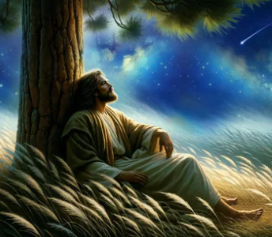

No matter how long we have been off the path or how far away we have wandered, the moment we decide to change, God helps us return.
From God’s perspective, through sincere repentance and pressing forward with a steadfastness in Christ, once back on the path, it will be as if we were never off.
The Savior pays for our sins and frees us from the looming decrease in happiness and blessings. (7)

Slide 21
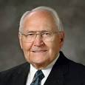
The Lord Was With Him
“We learn a great lesson from Joseph. When he was presented with a temptation, he immediately separated himself from even the appearance of evil.”
“Even making the right choices did not free Joseph from the challenges he faced in life.”
(5)

Slide 22
What Can We Learn From the Choices That Joseph Made?
Our devotion to God gives us strength to resist temptation
If we remove ourselves from tempting situations, then we will have greater ability to resist temptation
If we are faithful, God can use our trials to bless our lives and others.
(5)

Slide 23
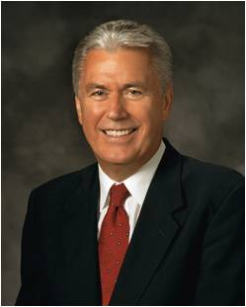


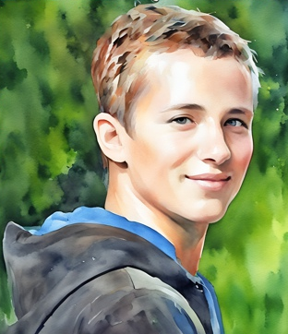

Buried By Trials
It is my witness that though at times we may feel buried by the trials of life or surrounded by emotional darkness, the love of God and the blessings of the restored gospel of Jesus Christ will bring something unimaginable to spring forth. (6)
Search diligently, pray always, and be believing, and all things shall work together for your good, if ye walk uprightly and remember the covenant wherewith ye have covenanted one with another. Doctrine and Covenants 90:24
(5)

Slide 24
Sources:
Video:
Faith Murray’s Story: Overcoming Adversity through Service” (4:52)
“Wheelz: Overcoming Is Possible” (7:13)
“Temptation Fades as We Seek Christ in Every Thought” (2:57)
“I Choose to Be Pure” (4:19).
1. Old Testament Institute Manual
2. Elder David A. Bednar Ensign or Liahona, May 2013, 42).
Presentation by ©http://fashionsbylynda.com/blog/
3. Who’s Who in the Old Testament by Ed J. Pinegar and Richard J. Allen pg. 152
4. Gordon B. Hinckley (Conference Report, October 1964, pp. 116-119); “An Ensign to the Nations, a Light to the World,” Ensign, Nov. 2003, 83.
5. Elder L. Tom Perry Becoming Men in Whom the Spirit of God Is April 2002 Gen. Conf.
6. Elder Dieter F. Uchtdorf (“God Will Do Something Unimaginable,” Ensign or Liahona, Nov. 2020, 52)
7. . Elder Dale G. Renlund (“Choose You This Day,” Ensign or Liahona, Nov. 2018, 106)

Slide 25
Levirate:
The word has nothing to do with the name Levi or the biblical Levites but is so called because of the Latin levir, meaning “husband’s brother,” connected with the English suffix -ate, thus constituting levirate.
Bible Dictionary
Scarlet Thread: something of interest
One reference to the scarlet thread in the Bible occurs during the birth of the twin sons of Judah and Tamar (Genesis 38:27–30). As Tamar was giving birth, the arm of one twin, Zerah, reached out of the birth canal, and immediately the midwife tied a scarlet thread to the baby’s wrist to designate Zerah as the firstborn. As it turned out, however, Zerah was not the firstborn; the arm was withdrawn into the womb, and the other twin, Perez, was born first. In the case of Perez and Zerah, the scarlet thread was to indicate who was to have the designation and privileges of the firstborn. To all appearances, Zerah seemed to be the one, but God had different plans, and Perez was the firstborn. In God’s providence, it was through Perez that the line of the Lord Jesus Christ proceeded (Matthew 1:3).
The Bible also mentions scarlet thread or scarlet yarn as part of the tabernacle’s curtains (Exodus 26:1) and the high priest’s ephod (Exodus 28:6), along with threads of gold, blue, and purple. Scripture does not comment on the significance of those colors in the curtains or ephod, but some commentators surmise that the gold, blue, and purple foreshadow Christ’s glory, heavenly origin, and kingly position, while the scarlet thread represents Christ’s atoning work on the cross through the shedding of His blood.
Theologians and Bible students sometimes refer to “the scarlet thread running through the Bible.” By this they mean that the Bible’s theme is Jesus Christ and His sacrifice for the redemption of mankind. The blood of Christ runs throughout the entire Bible, symbolically.
gotquestions.org
The purpose of such a marriage was to produce a male heir for the dead man and thus perpetuate his name and memory. It was regarded as a great calamity to die without a son, for then the man’s lineage did not continue and also the man’s property reverted to someone else’s family (through daughters, if he had any, or through other relatives). It may be that Onan, who by virtue of the death of his older brother would have been next in line for the inheritance of Judah, refused to raise up seed through Tamar because the inheritance would have stayed with the elder son’s family. He went through the outward show of taking Tamar to wife but refused to let her have children. Thus when Judah failed to keep his promise to send the youngest son to her, Tamar resorted to deception in order to bear children.
Old Testament Institute Manual
The Actions of Tamar and Judah:
Tamar’s actions show why Satan’s temptations are at times so compelling. In the ancient world, not having children would have meant embarrassment and even humiliation, perhaps resulting in a poorer quality of life for Tamar. Tamar feared the long-term consequences of remaining childless, and she viewed the risk of remaining childless as being greater than the risk of physical and spiritual death. Tamar took matters into her own hands instead of trusting in God.
We must also recognize that despite the double standard of Judah and Tamar’s situation, the Lord holds men and woman equally accountable in keeping the law of chastity. Although because of their culture Judah was not in as much physical danger as Tamar, the spiritual consequences of his violating the law of chastity were the same as they were for Tamar.
Seminary Teacher Manual

Slide 26
Joseph’s life continues to be a type of Christ
Joseph of Egypt | Old Testament | New Testament | Jesus Christ
Deeply loved by his father | Genesis 37:3 | Matthew 3:17 | This is my beloved Son, in whom I am well pleased.
Hated by some of his brothers | Genesis 37:4 | Isaiah 53:3; John 1:11 | He is despised and rejected of men… He came unto his own, and his own received him not.
He knew that one day his family would bow down before him | Genesis 37:6-7 | Romans 14:11 | As I live, saith the Lord, every knee shall bow to me,
Betrayed by those closest to him for money | Genesis 37:26-28 | Matthew 26:14–16 | And they covenanted with him for thirty pieces of silver. And from that time he sought opportunity to betray him.

Slide 27

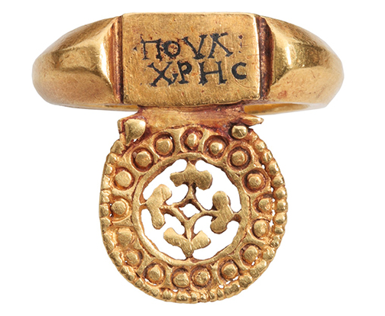
Something of Interest
The practice of exchanging wedding rings is thought to have originated in ancient Egypt around 3000 years ago. Ancient Egyptians exchanged rings made of reeds or hemp, symbolizing eternity due to their circular shape with no beginning or end. This practice later spread to other cultures, including the Greeks and Romans, with variations in materials and symbolism.
The Egyptian pharaohs who first used rings to represent eternity. That’s because a circle has no beginning and no end, and reflects the shape of the sun and the moon, which the Egyptians worshipped. The Egyptians also thought that the open space in the middle of a ring represented a gateway to the unknown. The Egyptian ouroboros (oor-uh-boor-ros) rings portrayed a serpent swallowing its tail, representing the eternal cycle of things. The ouroboros is one of the oldest symbols in the world, and its name means “tail devourer” in Greek.
When Alexander the Great conquered the Egyptians, the Greeks adopted the tradition of giving rings to their lovers to represent devotion. Many of these rings depicted Eros or Cupid, the god of love. When the Romans conquered Greece, they picked up on this tradition and began using iron and copper rings in marriage ceremonies. The iron rings sometimes had key motifs to symbolize that the wife now had control of the household goods. By 2nd century CE, however, most rings were gold.
Ancient Egyptians believed that the ring finger, or the fourth finger of the left hand, contained a “vena amoris” or “vein of love” that led directly to the heart. The Romans adopted this belief and wore wedding rings on their ring finger. Although their belief isn’t anatomically correct, the tradition of wearing rings on the ring finger continues to this day.
The first diamond wedding ring was recorded in the will of a widow who passed in 1417.
Dates back to 4th century
https://4cs.gia.edu/en-us/blog/origin-of-wedding-rings/

