Slide 1
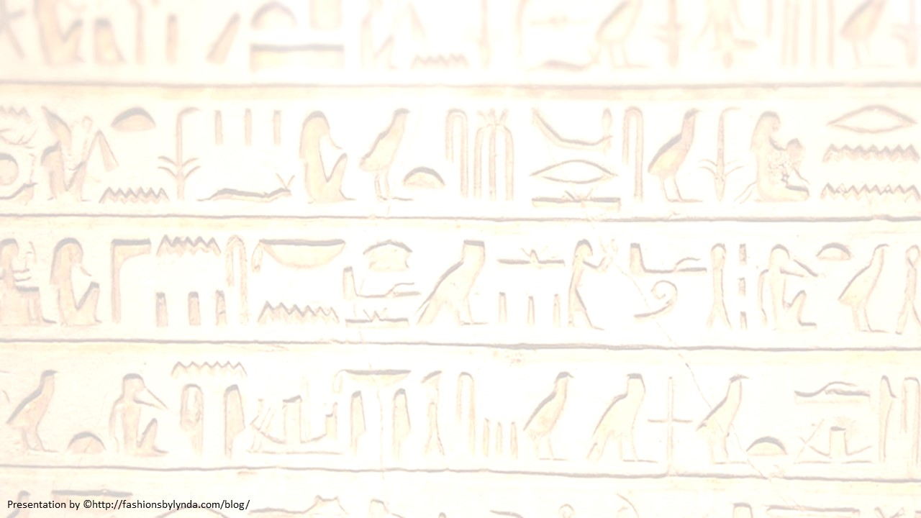
Joseph Interprets Dreams
Genesis 40-41

Slide 2
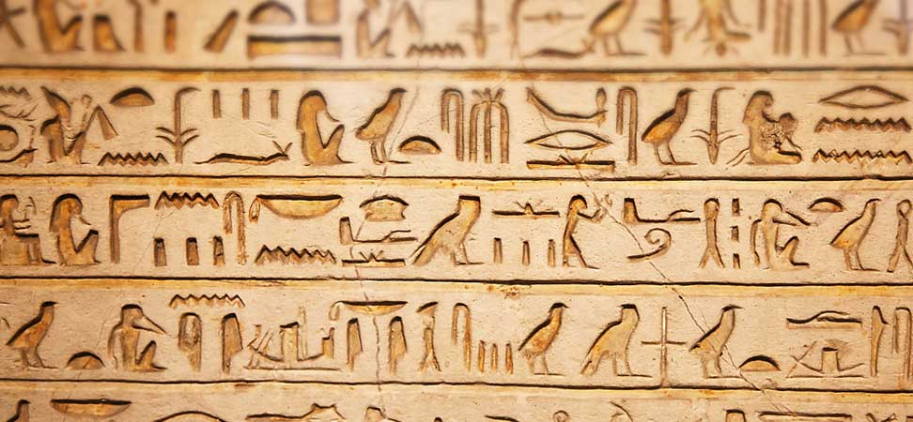
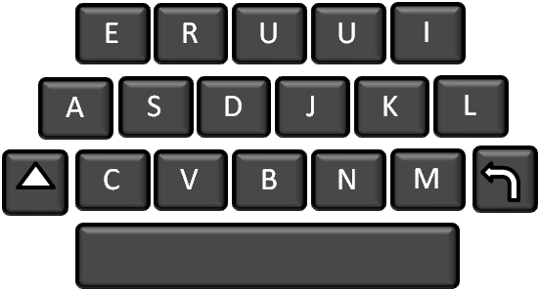
How Does God Communicate With Us?

Slide 3
Sometime after Joseph was placed in prison, Pharaoh became upset with his chief butler and chief baker and placed them in prison. Joseph was assigned to be their servant. One night both the butler and the baker had troubling dreams. In the morning Joseph noticed that they were sad.
Do not interpretations belong to God? Tell me them, I pray you.
And the chief butler told his dream to Joseph
In my dream… (Read Gen. 40:9-11)
Wherefore look ye so sadly today?
This is the interpretation…(Read Gen.40:12-15)
We have dreamed a dream …
When the chief baker saw that the interpretation of the butler’s dream was good, he told Joseph his dream
and there is no interpreter of it.

Slide 4
I also was in my dream... (Read Gen. 40:16-17)
This is the interpretation…(Read Gen. 40:18-19)
"'Now Joseph, commending all his affairs to God, did not betake himself to make his defense, nor to give an account of the exact circumstances of the fact, but silently underwent the bonds and the distress he was in, firmly believing that God, who knew the cause of his affliction and the truth of the fact, would be more powerful than those that inflicted the punishments upon him‘
(1)
And it came to pass the third day, which was Pharaoh’s birthday, that he made a feast unto all his servants: and he lifted up the head of the chief butler and of the chief baker among his servants.
And he restored the chief butler unto his butlership again; and he gave the cup into Pharaoh’s hand:
But he hanged the chief baker: as Joseph had interpreted to them.
Yet did not the chief butler remember Joseph, but forgat him.

Slide 5
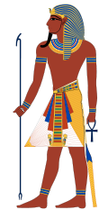
Pharaoh
Pharaoh: meaning great house
Pharaoh was the title of the kings of Egypt, many of whom are identified in the Old Testament by that title alone.
Pharaoh Dynasty:
The Early Dynastic Period before 3100 BC through to the end of the Ptolemaic Dynasty, when Egypt became a province of Rome under Augustus Caesar in 30 BC.
The first monarch: Narmaer (a.k.a. Menes)
The last monarch: Nectanebo II (last native)
Cleopatra and Caesarion (last actual
Started in 3100 BC and Abolished in 343 BC (last native paraoh) but 30 BC (last Greek pharaohs
Wikipedia and Bible Dictionary

Slide 6
The Pharaoh told them his dream; because he had been troubled by them; but there was none that could interpret them unto Pharaoh.
Then spake the chief butler unto Pharaoh …”
In my dream…Read Gen. 41:17-24
The dream of Pharaoh is one: God has shown Pharaoh what He is about to do. The seven good cows and seven good ears of corn represent seven years of great plenty throughout all the land of Egypt. The seven lean, ill cows and seven thin ears of corn represent seven years of famine that will consume the land after the seven years of plenty.
“I do remember … read Gen. 41:9-13
Then Pharaoh sent and called Joseph, and they brought him hastily out of the dungeon: and he shaved himself, and changed his raiment, and came in unto Pharaoh.
I have dreamed a dream, and there is none that can interpret it: and I have heard say of thee, that thou canst understand a dream to interpret it.
After interpreting Pharaoh’s dreams, Joseph offered Pharaoh some counsel.
It is not in me: God shall give Pharaoh an answer of peace.
Read Gen. 41:33-36

Slide 7
And the thing was good in the eyes of Pharaoh, and in the eyes of all his servants.
And Pharaoh said unto his servants,
What did Pharaoh do for Joseph because he helped him understand the dreams?
Pharaoh made him second in command over all of Egypt. He also appointed Joseph to oversee storing grain and other food to prepare for the famine.
Can we find such a one as this is, a man in whom the Spirit of God is?
Can we find such a one as this is, a man in whom the Spirit of God is? Forasmuch as God hath shewed thee all this, there is none so discreet and wise as thou art. Thou shalt be over my house, and according unto thy word shall all my people be ruled: only in the throne will I be greater than thou. See, I have set thee over all the land of Egypt.
When we help others recognize God’s involvement in their lives, it can inspire them to act in faith
Pharaoh gave Joseph his ring, and he clothed him in fine linen. Joseph became a ruler over all the land of Egypt and was married to Asenath, the daughter of the priest of On.

Slide 8
Why is it sometimes difficult to recognize God’s hand in our lives?
When have you helped someone else recognize the Lord’s hand in his or her life?
If you could see perfectly how much Heavenly Father is involved in your life, how do you think it would influence your faith in Him?
When has someone helped you see how the Lord is influencing your life?

Slide 9
Joseph Gathers Grain
For seven years Joseph went throughout all of Egypt gathering food until there was more grain in storage than could be measured
Also during those years he married and Joseph and Asenath had two sons.
v
Genesis 41:46-51
Ephraim
Manasseh.

Slide 10
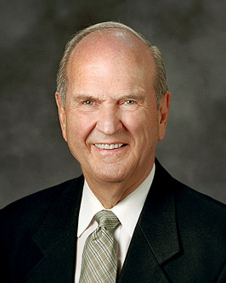
The Preparation
What was the result of Pharaoh’s decision to follow Joseph’s counsel?
In what ways have prophets in our day asked us to prepare for future physical or temporal challenges?
How have latter-day prophets asked us to prepare for future spiritual difficulties or trials of our faith?
If we follow the counsel of the prophets and inspired leaders, then we will be better prepared to face difficulties
Genesis 41:53-57

Slide 11
Sources:
Josephus (Antiquities of the Jews, Book II, v:1)." (Arthur R. Bassett, "Joseph, Model of Excellence," Ensign, Sept. 1980, 13)
Presentation by http://fashionsbylynda.com/blog/

Slide 12
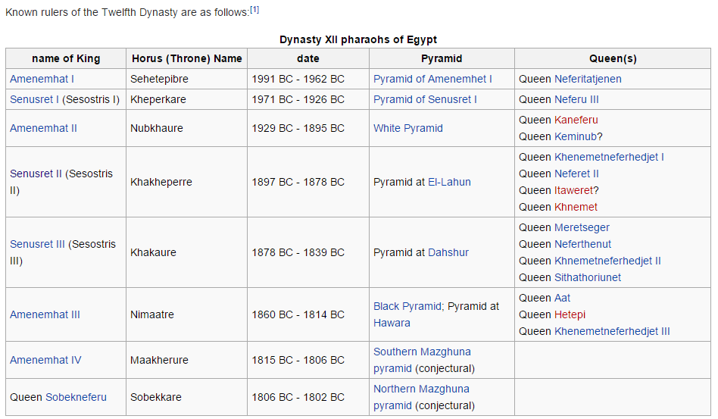
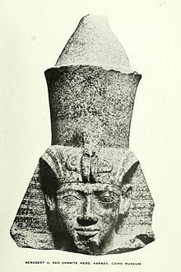
Eugene H. Merrill has suggested that Senusret II (reigned from 1897 to 1878 BC), the fourth pharaoh of the Twelfth Dynasty, may be the unnamed Pharaoh mentioned in the biblical story of Joseph. Eugene H. Merrill, Kingdom of Priests, Grand Rapids: Baker Academic, 2008, 66-68.
Pharaoh Sesostris I is identified as the pharaoh who appointed Joseph over Egypt, with Joseph himself possibly being identified as Mentuhotep, Sesostris’ vizier or prime minister. answersingenesis.org
We do not know which Pharaoh was in power during Joseph’s time
The Twelfth Dynasty of ancient Egypt (Dynasty XII), is often combined with the Eleventh, Thirteenth and Fourteenth Dynasties under the group title Middle Kingdom

Slide 13
Nine or ten different Pharaohs are mentioned in the Old Testament, belonging to several different dynasties. (1) The Pharaoh (probably one of the Hyksos or Shepherd kings) visited by Abram (Gen. 12:15–20).
(2) Pharaoh (also one of the Hyksos) and Joseph (Gen. 39–50).
(3) The Pharaohs of oppression, Seti Ⅰ and Ramses Ⅱ, belonging to the 19th dynasty (Ex. 1; 2); it is generally believed that the Pharaoh of the Exodus was Mer-ne-ptah, but the discovery of the Tell el-Amarna tablets has thrown doubt on this.
(4) The Pharaoh whose daughter Solomon married, perhaps Pi-netchem of the 21st dynasty (1 Kgs. 3:1; 7:8; 9:16, 24).
(5) Shishak or Sheshonk, of the 22nd dynasty, who befriended Jeroboam.
(6) So (Shabakah) with whom Hoshea makes alliance (2 Kgs. 17:4).
(7) Pharaoh Necho, who defeated Josiah at Megiddo (2 Kgs. 23:29–35; Jer. 25:19; 46:17, 25;47:1).
(8) Pharaoh Hophra, who sent an army to the assistance of Zedekiah (Jer. 37:5–11; 43:9; Ezek. 17:17; 29:2–3; 30:21–25; 31:2, 18; 32:2, 31–32). See also Abr. 1.
Bible Dictionary
Joseph’s Devotion to God:
“The spiritual greatness of Joseph is a remarkable thing. How many people have become bitter over some real or imagined slight, or blamed the Lord for some personal tragedy? In the very midst of being faithful and holding true to that which is right, Joseph was falsely accused and thrown into prison. How easy it would have been for him to give up, to say, ‘What’s the use of trying to serve God? All He does is punish me.’ But there was not a trace of bitterness, no blaming the Lord. Joseph just continued being righteous and faithful. Unselfishly he offered to interpret the dreams of his two fellow prisoners, telling them that the knowledge came from God (see Genesis 40:8). He still trusted in the Lord, although he must have felt doomed to spend his life in prison. If any person had cause for discouragement and bitterness, it was Joseph, but he never faltered in his faith. Truly, Joseph is a model to be emulated” (Old Testament Student Manual: Genesis–2 Samuel, 3rd ed. [Church Educational System manual, 2003], 95).
The Lord Was With Joseph:
“You will notice in each situation in which Joseph found himself that the Lord was with him. It was easy to recognize the special spirit in him because of the way he lived and heeded the voice of the Lord to direct him.
“That same recognition will surely be with each of us as we are led and directed by His Holy Spirit” Elder L. Tom Perry (“Becoming Men in Whom the Spirit of God Is,” Ensign, May 2002, 41).

