Slide 1





Jacob and Family
in Goshen
Genesis 47-49
v

Slide 2

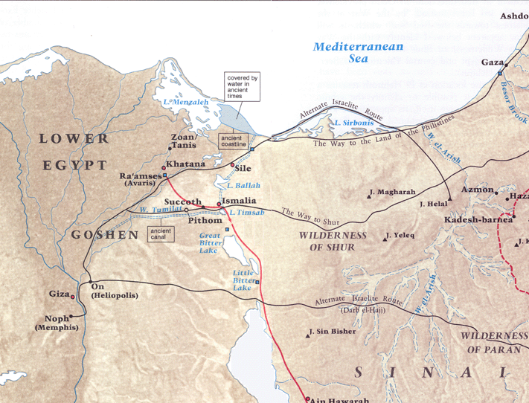
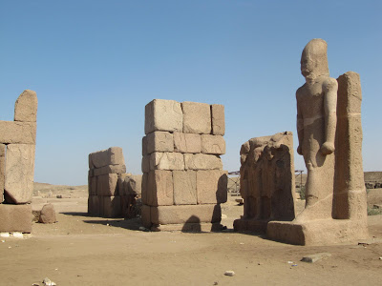
The Land of Goshen
Because Joseph lived worthily, the Lord directed his life in a way that would allow Joseph to do much good and even save the lives of his family.
Pharaoh invited Joseph’s father, Jacob, and his family to dwell in Egypt in the land of Goshen. When Joseph introduced his father to Pharaoh, Jacob blessed Pharaoh. Joseph wisely administered the affairs of Egypt during the famine, saving the lives of the people and gathering great wealth for Pharaoh.
Tanis
Genesis 47:1-9

Slide 3
My Life
Education
Occupation
Achievements
Family
Church
If you were to choose between your plan for your life and what Heavenly Father might have planned for your life, which would you choose?

Slide 4
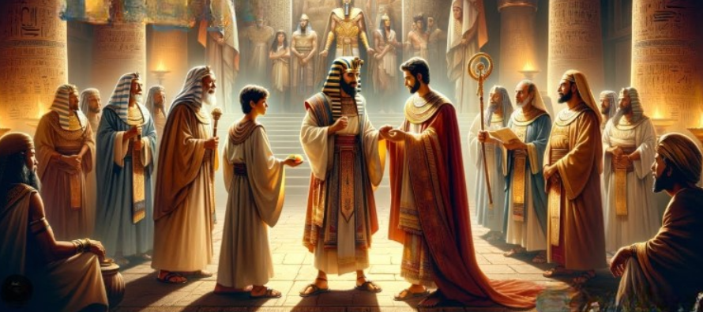
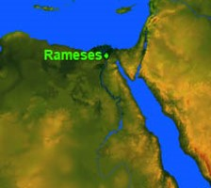
Jacob Blesses Pharaoh
And Joseph placed his father and his brethren, and gave them a possession in the land of Egypt, in the best of the land, in the land of Rameses, as Pharaoh had commanded. And Joseph nourished his father, and his brethren, and all his father’s household, with bread, according to their families.
Genesis 47:10-11

Slide 5
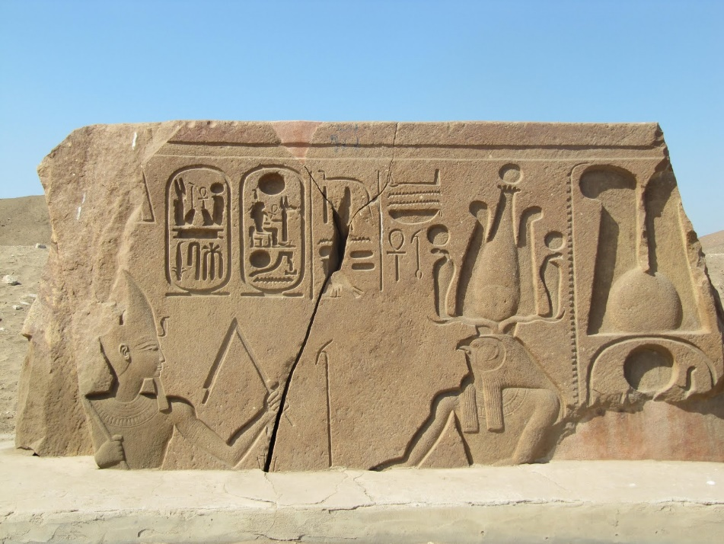
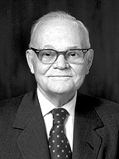
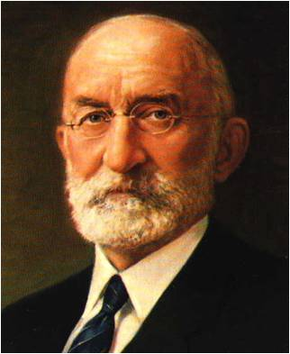
During Times of Famine
The Egyptians, instead of exercising their agency to provide for themselves against a day of need, depended upon the government.
As a result, when the famine came, they were forced to purchase food from the government. First, they used their money. When that was gone, they gave their livestock, then their lands; and finally, they were compelled to sell themselves into slavery, that they might eat. (1)
As it was, those who did not obey Joseph's counsel were under the necessity of selling all their property, and ultimately themselves, for slaves to the king, in order to obtain that bread which they could have laid
up during the seven years of plenty, if they
had obeyed Joseph's counsel. (2)
Genesis 47:13-26

Slide 6
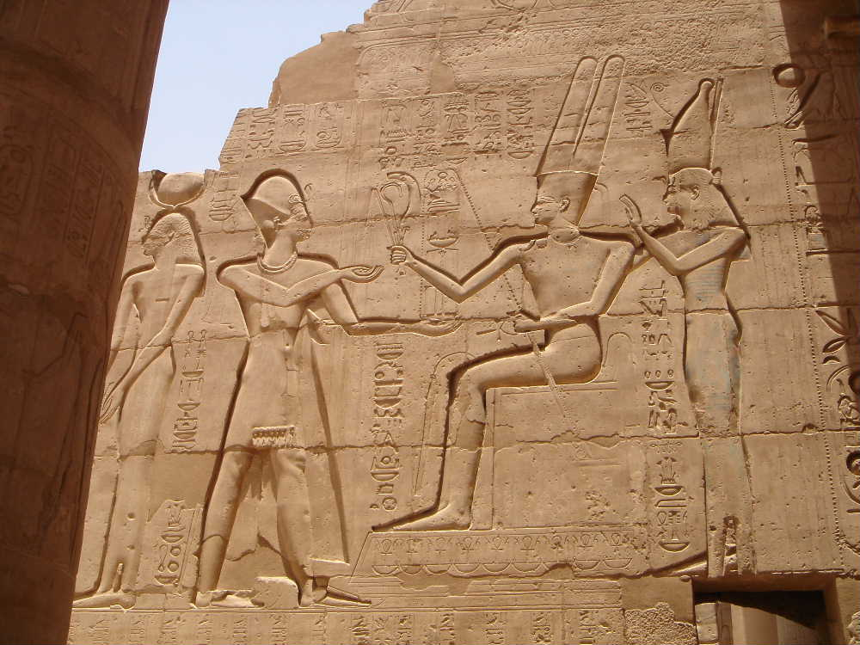
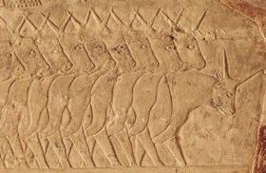
Pharaoh’s Fifth
Pharaoh claimed title to their possessions but that the people could use them as their own. (vs.22-23)
The cattle became government property, but we expect that the people kept them, delivering meat and milk to state agents but keeping what they needed as well.
And Joseph made it a law over the land of Egypt unto this day, that Pharaoh should have the fifth part; except the land of the priests only, which became not Pharaoh’s.
Genesis 47:24-26

Slide 7
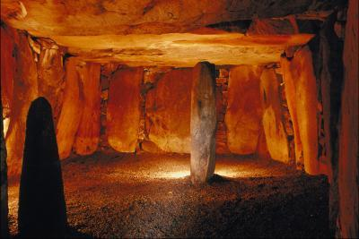
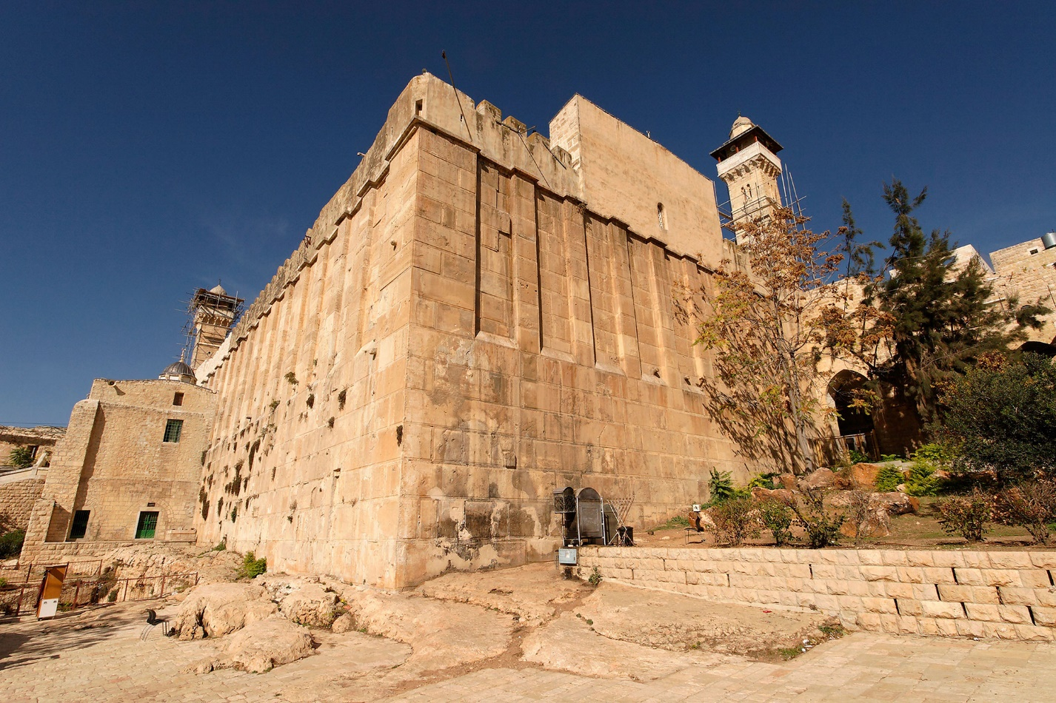
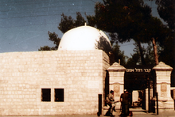
Israel’s Burying Place
The Tombs of the Patriarchs in Hebron, West Bank, is a shrine complex built mainly under Herod (1st cent. BC) with additions by the Crusaders (12th century AD). It centers around the Cave of Machpelah..
Tombs of the Patriarchs:
Abraham and Sarah, Isaac and Rebecca, Jacob and Leah
Rachel was buried "on the way to Ephrath, which is Bethlehem, border of Benjamin at Zelzah(1 Sam. 10-2)
Genesis 47:27-31

Slide 8
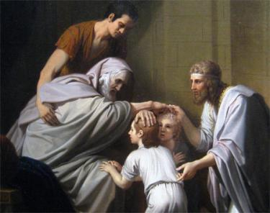
Jacob Blesses Joseph’s Sons
The blessings Jacob desired to give Manasseh and Ephraim were similar to patriarchal blessings because they described Manasseh and Ephraim’s future possibilities.
“…Joseph brought up his two sons to Jacob to receive his last blessing. Jacob was blind, and when Ephraim and Manasseh were brought before him, Manasseh being the oldest was brought before the old Patriarch in such a way that the old man would place his right hand upon the firstborn, and his left hand upon the younger, that the firstborn might receive the prophetic blessing.
Being guided by the spirit of inspiration, the old Patriarch crossed his hands and laid his right hand upon the head of the younger and his left hand upon the head of Manasseh and pronounced his blessing. (3)
And Israel beheld Joseph’s sons, and said, Who are these?
And Joseph said unto his father, They are my sons, whom God hath given me in this place. And he said, Bring them, I pray thee, unto me, and I will bless them. JTS Genesis 48:8-9
Genesis 48:1-22

Slide 9


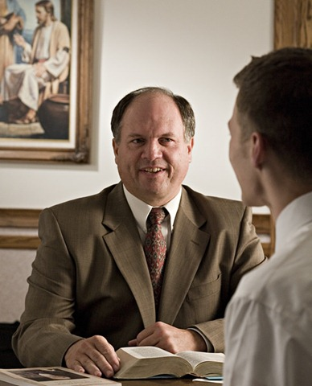
A Patriarchal Blessing
A father’s blessing given by the patriarch of a family and a patriarchal blessing given by an ordained patriarch. A father who holds the Melchizedek Priesthood may give his children healing blessings or blessings of comfort and counsel at any time.
Patriarchal blessings are given through the inspiration of God
A patriarchal blessing may be given to any worthy member of the Church by a patriarch who has been called and ordained under the direction of the Quorum of the Twelve Apostles.
A patriarchal blessing contains a declaration of the recipient’s lineage in the house of Israel as well as guidance to help direct his or her life according to Heavenly Father’s will.
Those who wish to receive a patriarchal blessing must be interviewed by their bishop or branch president and receive a recommend.

Slide 10
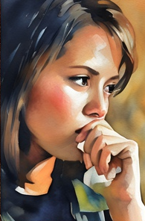
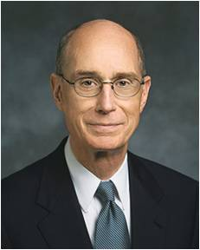
“Once, long ago, when I was serving as a bishop, a young woman in my ward came for an interview. We somehow got around to her telling me her feelings about her patriarchal blessing.
She said that it depressed her rather than helped her. I must have looked surprised, because she explained her feelings by telling me this: She said that her blessing warned her about sexual immorality. And, at least by her report, it did little else.
It apparently warned her by describing a situation in which she might find herself, and in which, if she yielded to temptation, she would come to great harm and sorrow.
She said something about how that hurt her doubly, not only by being about something so depressing when she needed encouragement, but her social life then was so barren that such a situation could never arise. …
“I remember better the interview I had with her less than a year later. She sobbed for a while, sitting in a chair on the other side of my desk in the bishop’s office.
And then she blurted out her tragedy
and how it happened, exactly as she
had told me the patriarch so long
before had described. In her little
season of doubt that a patriarch
could see with inspiration, she had
made choices that led to years of
sorrow” (4)

Slide 11
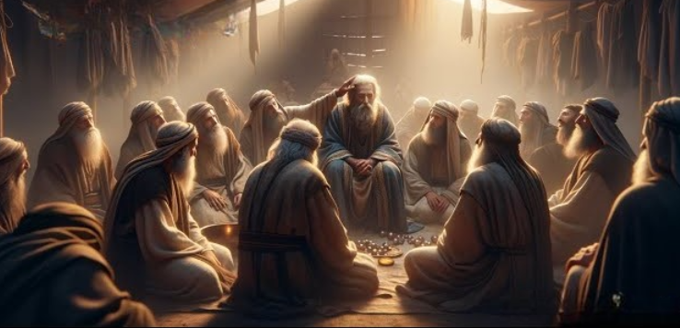
Jacob Blesses His Sons
Rueben (firstborn)—unstable as water
“shalt not excel”
Dan…judge and serpent…practiced idolatry
Gad- “he shall trump at last”—this tribe provided troops for David
Simeon and Levi—dishonored their father’s name
“I will divide them in Jacob, and scatter them Israel”
Asher—”Asher is most blessed of sons; let him be favored by his brothers, and let him dip his foot in oil.”
Judah (lion)—will be praised
“unto him shall the gathering of the people be.” Kings will come through his lineage
Naphtali– land was in a key position where there was much teaching and ministry
Joseph—fruitful bough—priesthood lineage and rightful heir
Zebulun ‘haven of seas and be for an haven of ships
Benjamin—ravenous wolf--fierceness
Issachar ‘strong as a couching down between two burdens’, a donkey…a large tribe...but became a band of slaves
Each son and each tribe that would come from them had their own calling and destiny. Yet the remarkable promise remained – that they each would survive and grow into significant tribes, without one perishing during the centuries to come in Egypt.
Genesis 49:3-27

Slide 12
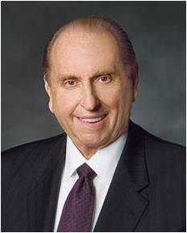
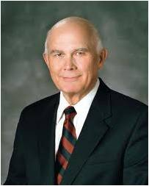
The Importance of Priesthood Blessings
“A patriarchal blessing literally contains chapters from your book of eternal possibilities.
I say eternal, for just as life is eternal, so is a patriarchal blessing.
What may not come to fulfillment in this life may occur in the next.
We do not govern God’s timetable” (5)
Fathers should also cultivate loving family relationships so that family members will want to ask their fathers for blessings.
And parents should encourage more priesthood blessings in the family. (6)

Slide 13
Sources:
President Marion G. Romney The Perfect Law of Liberty 1981 April Ensign
Elder George A. Smith, delivered in the Tabernacle, Salt Lake City, October 9, 1867.
3. The Blessings of Joseph—The American Indians;
Discourse by Elder Orson Pratt, delivered in the Tabernacle, Salt Lake City, Feb. 19, 1871.
4. (“‘And Thus We See’: Helping a Student in a Moment of Doubt” [evening with Elder Henry B. Eyring, Feb. 5, 1993], 1–2; si.lds.org).
Presentation by http://fashionsbylynda.com/blog/
5. President Thomas S. Monson (“Your Patriarchal Blessing: A Liahona of Light,” Ensign, Nov. 1986, 66).
6. President Dallin H. Oaks (“The Powers of the Priesthood,” Ensign or Liahona, May 2018, 67).
Presentation by http://fashionsbylynda.com/blog/

Slide 14
Cattle:
The Egyptians considered cow’s milk to be healing and a key element which helped the dead to be reborn. On the wall of tombs the dead are portrayed drinking from bowls of milk, if not nursing from the Great Cow herself, Hathor. Vessels of milk were buried with the dead, and in Predynastic times (3500-3100 BC) skulls of cows were displayed at temple entrances, fastened to poles.
Hathor was a very old goddess of Egypt, worshiped as a cow-deity from the earliest times (about 2700 B.C.E.) Wikispaces
Death in Ancient Times:
Preparing the Body
After death, the body was laid out, either on the ground or over sand and salt. The eyes and mouth were securely closed and the body was washed. The hair and nails were trimmed, and then the deceased was anointed with oils and ointment. Finally, the body was dressed. Sometimes the body was wrapped in linen with spices enclosed, while other times the body was dressed in fine clothes. Soldiers were usually buried in full uniform.
Burial
The ideal of a decent burial was important in most ancient cultures, as the idea of being left unburied and vulnerable to animals and birds of prey was shameful. It was especially desirable to be buried in one’s native land and, if possible, with one’s ancestors. Because cremation was believed to be a pagan practice, the Jews did not cremate their dead. There was also a superstition that the soul could feel what was done to the body, and this was further discouragement against cremation. Mosaic law dictated that Jews bury their dead, not burn the dead bodies, as such burning was reserved for punishment or judgment. Jacob and his son, Joseph, were embalmed in Egypt upon their deaths, but embalming was not generally practiced among the Jews. This was an Egyptian practice.
Tombs
In Biblical times, tombs were often caves or hollowed-out hovels in the earth that were meant to house eight bodies or more. The entrance to a tomb was usually sealed with a door or large stone. Many times, where a body was buried depended greatly on who the deceased’s family was. For example, at the time of his wife’s death, Abraham purchased the cave of Machpelah at Hebron to be her burial site. When Abraham died, he was buried in the same tomb. Later, Isaac, Abraham’s son, was also buried there, and Jacob, Isaac’s son, was laid to rest there. There are references in Scripture to individuals who were buried alone, but this was often due to the fact that they died suddenly and in a place that was far away from their ancestral tomb. Bodies that were not placed in tombs were buried in shallow graves that were covered with heaps of rocks, which marked the grave and prevented the body from being disturbed.
Rituals
Burial places were often located outside a city’s boundary, so the deceased had to be carried from their home to the burial site. Often, the dead were carried on a bier, which may have been a wooden slab. Much like modern day pallbearers, it was family members and friends who carried the bier. Women led the funeral procession, and often hired mourners and musicians accompanied the procession and made a demonstrative presentation of grief. At the tomb, an oration would be delivered, and the body would be laid to rest.
http://people.opposingviews.com/old-testament-burial-customs-3257.html
Why did Ephraim receive birthright?
“Joseph, son of Jacob, because of his faithfulness and integrity to the purposes of the Lord, was rewarded with the birthright in Israel. It was the custom in early times to bestow upon the firstborn son special privileges and blessings, and these were looked upon as belonging to him by right of birth. Reuben, the first of Jacob’s sons, lost the birthright through transgression, and it was bestowed upon Joseph, who was the most worthy of all the sons of Jacob [1 Chronicles 5:1–2].
“When Jacob blessed Joseph, he gave him a double portion, or an inheritance among his brethren in Palestine and also the blessing of the land of Zion—‘the utmost bound of the everlasting hills.’ He also blessed him with the blessings of heaven above, of the deep which lieth under, and of posterity [Genesis 49:22–26]. Jacob also blessed the two sons of Joseph with the blessings of their father, which they inherited, and he placed Ephraim, the younger, before Manasseh, the elder, and by inspiration of the Lord conferred upon Ephraim the birthright in Israel” (Joseph Fielding Smith, Doctrines of Salvation, comp. Bruce R. McConkie, 3 vols. [1954–56], 3:250–51).

Slide 15
Joseph’s Blessing:
“There are several things to be understood in the prophecy. First, he should become a multitude of nations. We understand what this means. In the second place, his branches should run over the wall. Now what does this mean? The Lord in ancient times had a meaning for everything. It means that his tribe should become so numerous that they would take up more room than one small inheritance in Canaan, that they would spread out and go to some land at a great distance. …
“Joseph’s peculiar blessing, which I have just read to you, was that he should enjoy possessions above Jacob’s progenitors to the utmost bounds of the everlasting hills. This would seem to indicate a very distant land from Palestine.” (Orson Pratt, in Journal of Discourses, 14:9.)
The seed of Joseph came to the land of America at the time Lehi and his family departed from the Mediterranean world. The land of America is specifically designated by the Lord as the land reserved for “a remnant of the house of Joseph” (3 Nephi 15:12).
Old Testament Institute Manual
Importance in Knowing Your Lineage:
“In your [patriarchal] blessing, you are told about your ancestry in the house of Israel. That’s your family line and your family line is sometimes called a tribe. All of the tribes go back to the great patriarch Abraham. Your lineage is important. It means that you are included in the promises given to Abraham that through him all the nations of the world would be blessed [see Genesis 26:4;Abraham 2:9].
“Your lineage is a ‘blood relationship’ [Joseph Fielding Smith, Doctrines of Salvation, comp. Bruce R. McConkie, 3 vols. (1954–56), 3:248–49]. That makes you literally ‘children of the prophets’ [3 Nephi 20:25] with a noble birthright. That is why we often say that you are ‘youth of the noble birthright’ [“Carry On,” Hymns, no. 255] and belong to a royal, ‘chosen generation’ [1 Peter 2:9]” Julie B. Beck(“You Have a Noble Birthright,” Ensign or Liahona, May 2006, 106).

