Slide 1


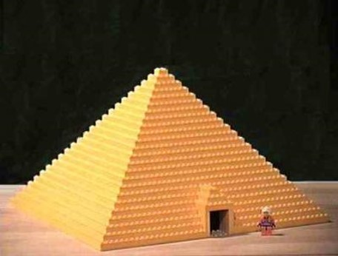
Joseph, The Final Chapter
A seer shall the Lord my God raise up, who shall be a choice seer unto the fruit of my loins. 2 Nephi 3:6

Slide 2

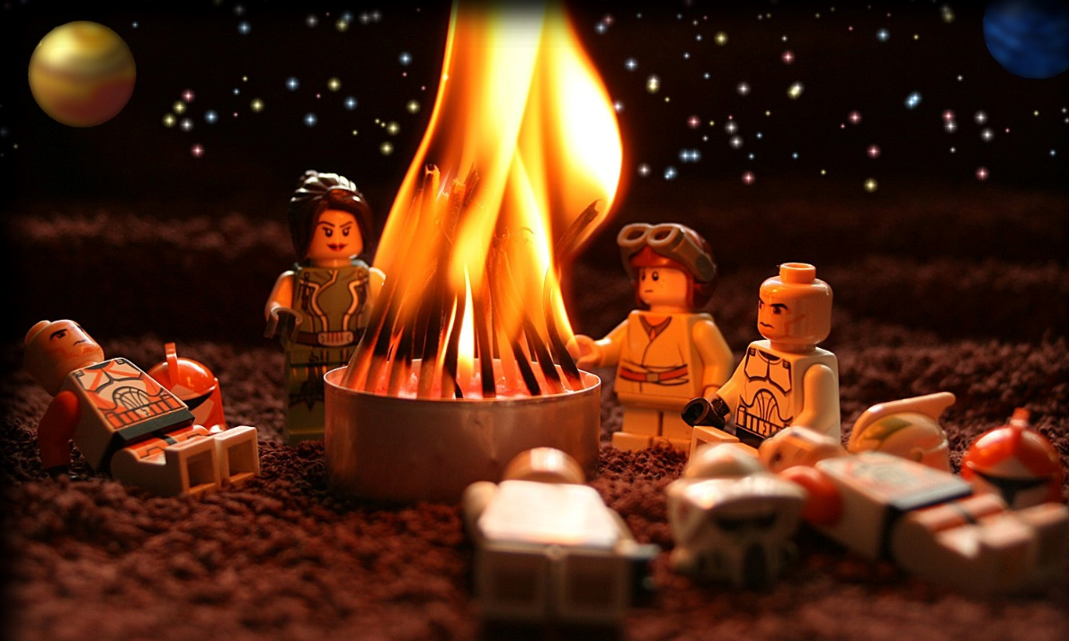
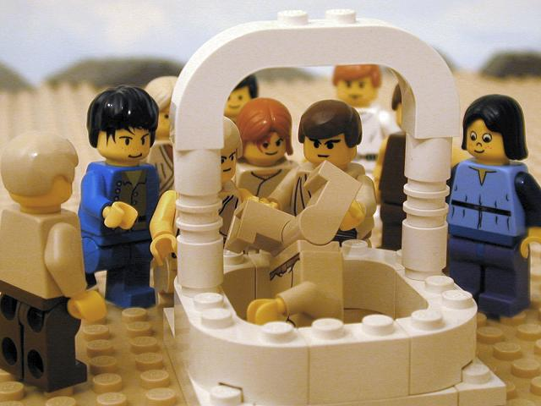
What might bring a family together?
What might divide a family?

Slide 3
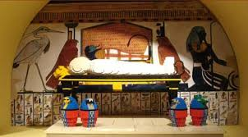
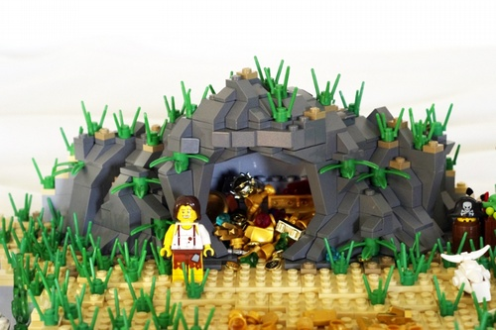
Jacob Dies
Embalm
To treat it with preservatives to protect it from decay.
Today:
Embalming is the art and science of preserving human remains by treating them (in its modern form with chemicals) to forestall decomposition.
The intention is to keep them suitable for public display at a funeral, for religious reasons, or for medical and scientific purposes such as their use as anatomical specimens.
Joseph and his brothers take their father’s body to the cave of cave of the field of Machpelah
Genesis 50:1-13

Slide 4
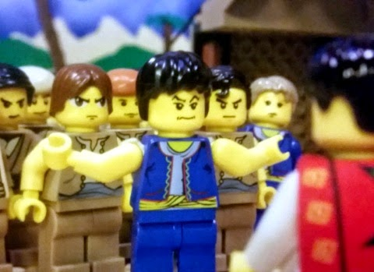
Requite
repay or retaliate
The Brothers thought that Joseph would hate them and seek revenge on them for mistreating him and selling him as a slave.
Genesis 50:14-21

Slide 5
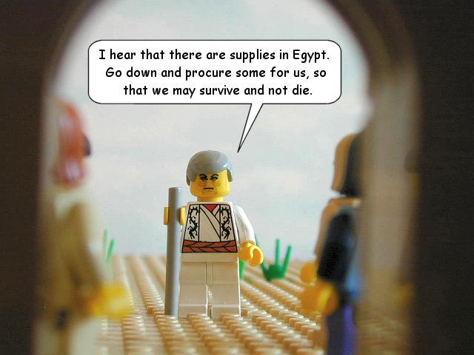
Forgiveness
When others sin against us, we should leave judgment to God. If we let go of past offenses, we can bring peace to ourselves and our families.
Genesis 50:14-21

Slide 6
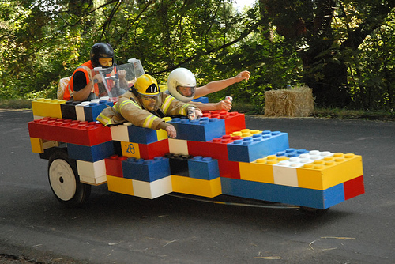
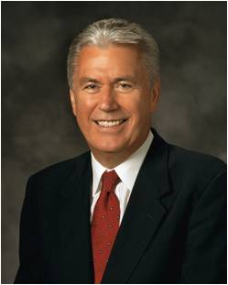
“I have discovered one thing that most [happy families] have in common: they have a way of forgiving and forgetting the imperfections of others and of looking for the good.
“Those in unhappy families, on the other hand, often find fault, hold grudges, and can’t seem to let go of past offenses. …
“It is through our Savior’s sacrifice that we can gain exaltation and eternal life. As we accept His ways and overcome our pride by softening our hearts, we can bring reconciliation and forgiveness into our families and our personal lives. God will help us to be more forgiving, to be more willing to walk the second mile, to be first to apologize even if something wasn’t our fault, to lay aside old grudges and nurture them no more” (1)
Genesis 50:14-21

Slide 7
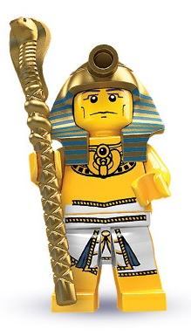
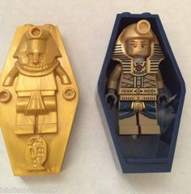
Joseph Dies at Age 110
And Joseph saw Ephraim’s children of the third generation: the children also of Machir the son of Manasseh were brought up upon Joseph’s knees.
Read JST 40:24-38
So Joseph died, being an hundred and ten years old: and they embalmed him, and he was put in a coffin in Egypt.
and he was kept from burial by the children of Israel, that he might be carried up and laid in the sepulchre with his father. And thus they remembered the oath which they sware unto him. JST 40:38
Genesis 50:22-26

Slide 8
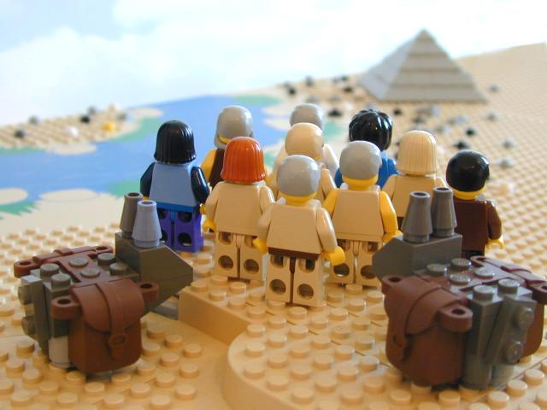
Fruit of the Loins of Judah
The Bible
Wherefore, the fruit of thy loins shall write; and the fruit of the loins of Judah shall write; and that which shall be written by the fruit of thy loins, and also that which shall be written by the fruit of the loins of Judah, shall grow together, unto the confounding of false doctrines and laying down of contentions, and establishing peace among the fruit of thy loins, and bringing them to the knowledge of their fathers in the latter days, and also to the knowledge of my covenants, saith the Lord.
2 Nephi 3:12

Slide 9
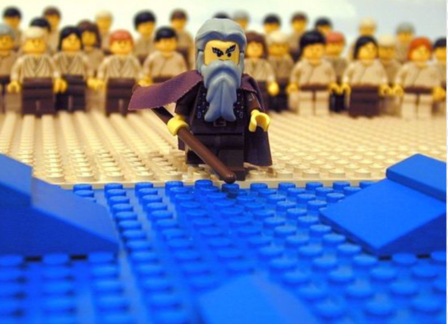
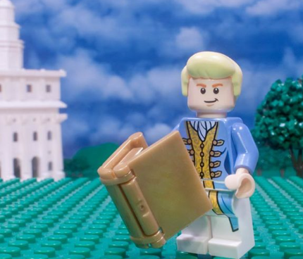
Joseph Prophesied
Shortly before his death, Joseph of Egypt prophesied that in the latter days the Lord would raise up Joseph Smith to do His work.
At the end of his life, Joseph of Egypt prophesied that the Lord would raise up two prophets, who are descended from Jacob, to help deliver His people out of bondage.
Moses would come to deliver the Israelites out of physical bondage in Egypt.
Then, in the latter days, the Lord would deliver His people from spiritual darkness through the Prophet Joseph Smith.
JST Genesis 50:24, 29

Slide 10
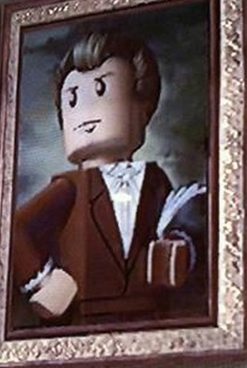
Promises to Joseph
In order to bring His people out of spiritual darkness and captivity, the Lord raised up a “choice seer”
A choice seer
The Lord chose and prepared Joseph Smith to bring forth the Book of Mormon.
A seer is “a person authorized of God to see with spiritual eyes things that God has hidden from the world.
(Moses 6:35-38)
JST 50:25-27

Slide 11
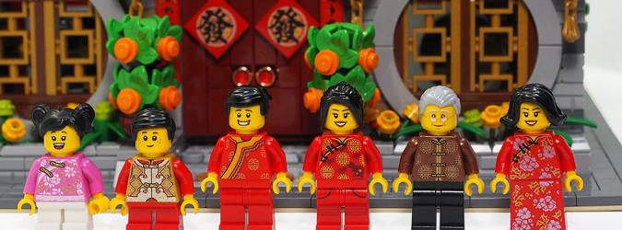
Each believer needs a spiritual confirmation of the divine mission and character of the Prophet Joseph Smith. This is true for every generation. (2)
JST 50:25-27

Slide 12
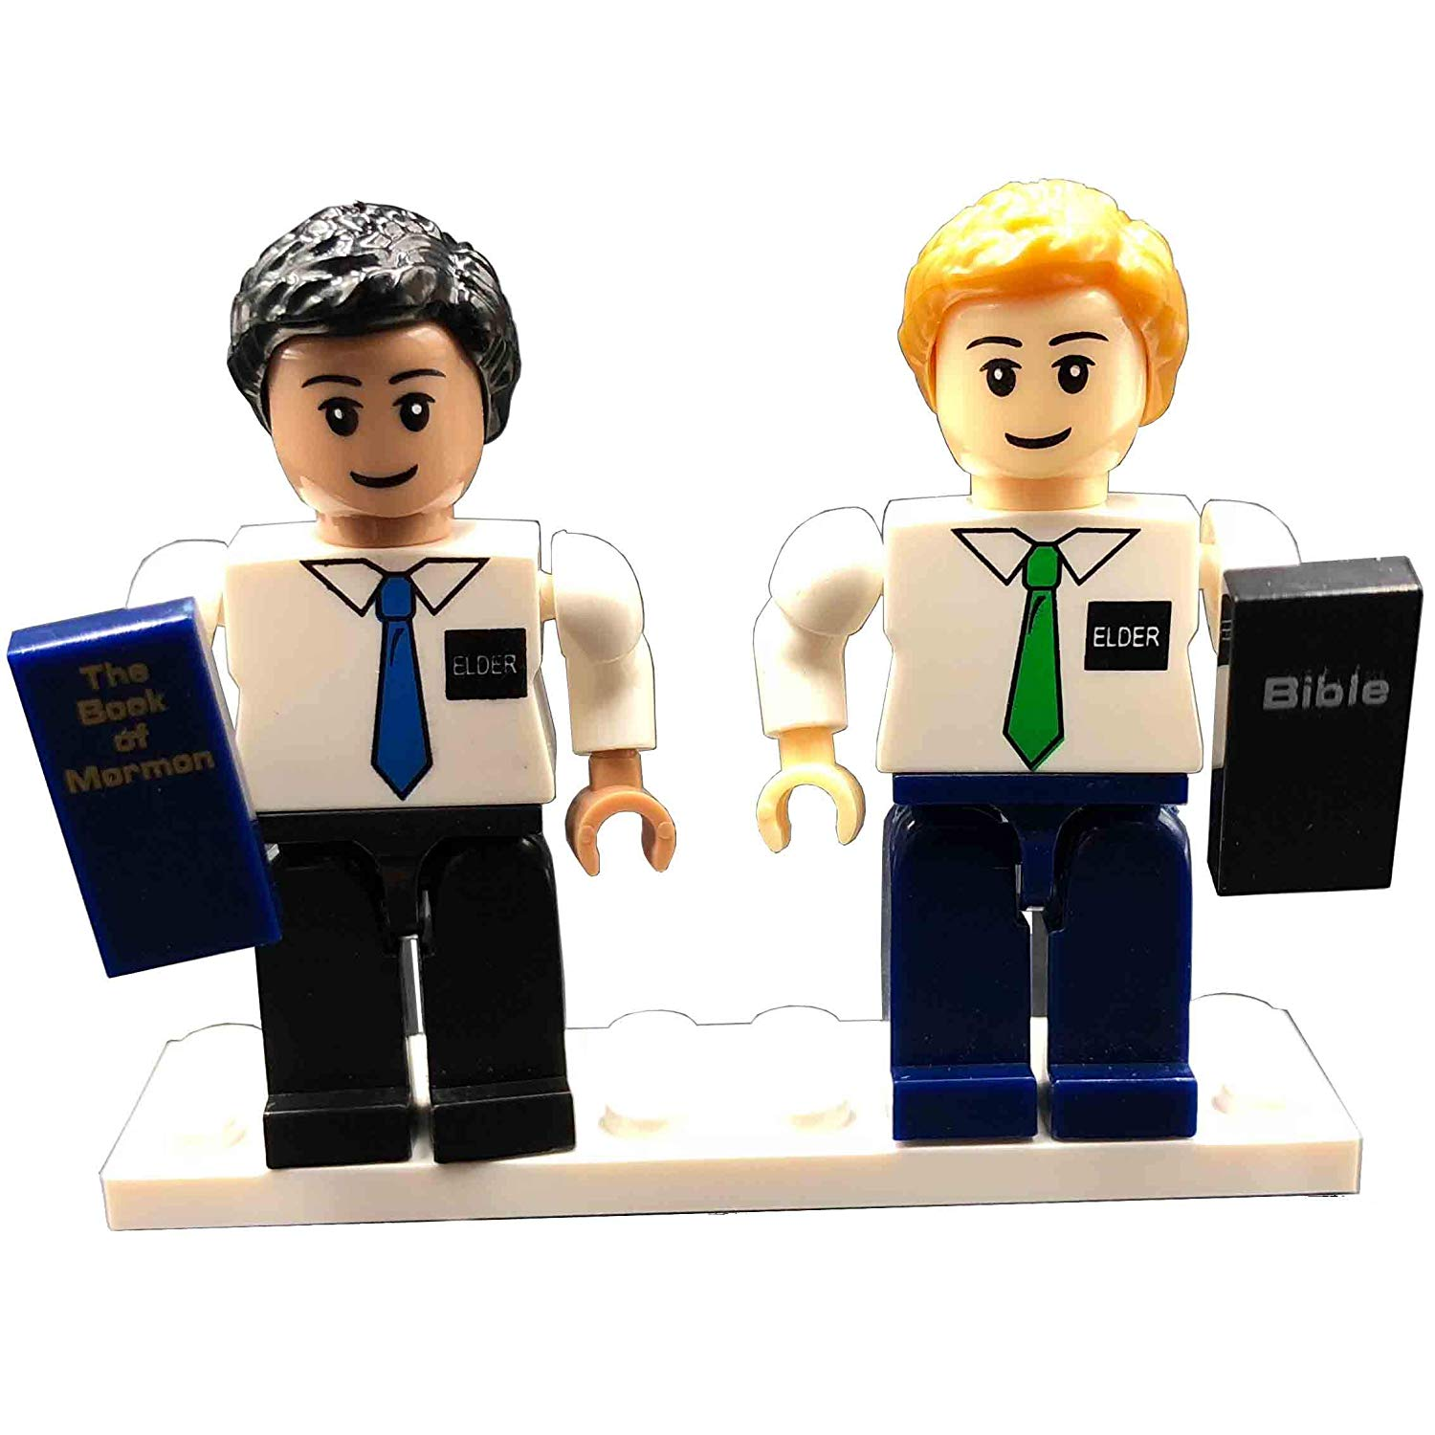
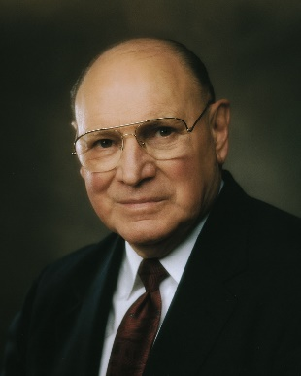
Knowledge of the Book of Mormon and Bible
…we must understand why this inspired book of scripture is the heart of missionary proselyting. Conversion to it is conversion to Christ, because this book contains the words of Christ.
The very title page of the Book of Mormon proclaims its purpose: “To the convincing of the Jew and Gentile that Jesus is the Christ.”
…conversion to the Book of Mormon is conversion to the divine, prophetic calling of the Prophet Joseph Smith.
It is the divine evidence of the truthfulness of Joseph Smith’s calling.
Either this is all true, or it is not.”
JST 50:31

Slide 13
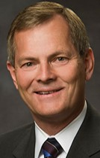

Key Elements of a Testimony
God is your Heavenly Father; you are His child. He loves you.
Jesus Christ lives. He is the Son of the living God and your Savior and Redeemer.
Joseph Smith is a prophet of God called to restore the Church of Jesus Christ.
The Church of Jesus Christ of Latter-day Saints is God’s restored Church on the earth.
The restored Church of Jesus Christ is led by a living prophet today. (3)
JST 50:31

Slide 14
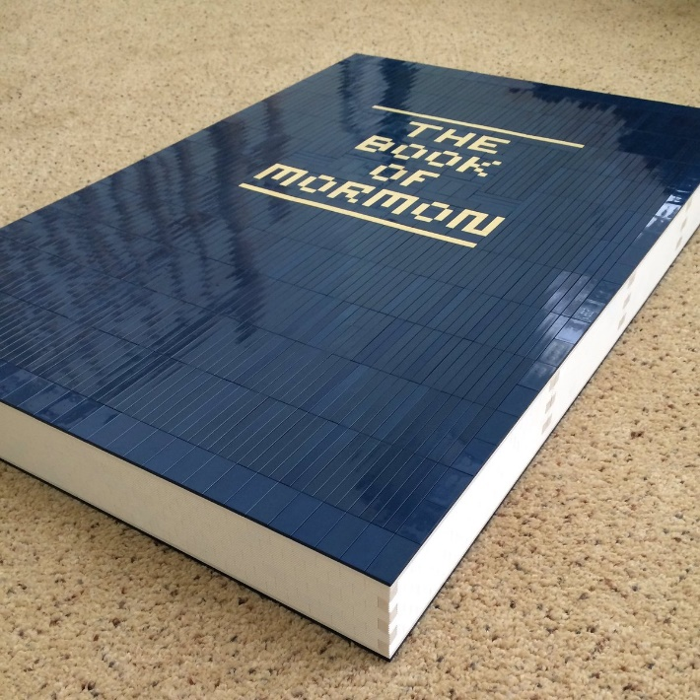
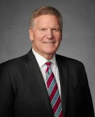

For many of us, a witness of the Prophet Joseph Smith begins as we read the Book of Mormon. I first read the Book of Mormon from cover to cover as a young early-morning seminary student. With my vivid boyish imagination, I decided to read as if I were Joseph Smith, discovering the truths in the Book of Mormon for the very first time. It had such an impact on my life that I continue to read the Book of Mormon in that way. I often find that doing so deepens my appreciation for the Prophet Joseph and for the truths restored in this precious book. …
Photo of young boy, not Craig
Perhaps the most stunning passage in the Book of Mormon to young Joseph may have been the third chapter of 2 Nephi. This chapter contains an ancient prophecy about a “choice seer” whom the Lord would raise up in the latter days—a seer named Joseph, named after his father. This future prophet would be “esteemed highly” and would do a work “of great worth” unto his people. He would “be great like unto Moses” and would be given “power to bring forth [God’s] word” (2 Nephi 3:6–15). Consider how Joseph Smith must have felt as he realized that this prophecy was about him! He was not just translating history; he was translating a vision of the last days, of the miraculous Restoration of the gospel of Jesus Christ—and Joseph himself would help fulfill it! (4)

Slide 15
Sources:
President Dieter F. Uchtdorf (“One Key to a Happy Family,” Ensign or Liahona, Oct. 2012, 5–6).
Presentation by ©http://fashionsbylynda.com/blog/
2. Elder Neil L. Andersen (“Joseph Smith,” Ensign or Liahona, Nov. 2014, 29–30)
3. Gary E. Stevenson(“Nourishing and Bearing Your Testimony,” Liahona, Nov. 2022, 112)
4. Elder Craig C. Christensen (“A Choice Seer Will I Raise Up,” Ensign or Liahona, Nov. 2016, 28–29)
5. Elder Joseph B. Wirthlin From an address to new mission presidents, Provo Missionary Training Center, 23 June 1999.

Slide 16
Joseph of Egypt linked to Joseph Smith:
“Unsurprisingly, the Prophet [Joseph Smith] was closely linked with previous prophets! … In a December 1834 blessing, [Joseph Smith Sr.] confirmed to his son that ancient Joseph in Egypt ‘looked after his posterity in the last days … [and] sought diligently to know … who should bring forth the word of the Lord [to them] and his eyes beheld thee, my son [Joseph Smith, Jr.]: [and] his heart rejoiced and his soul was satisfied.’ Elder Neal A. Maxwell (Patriarchal Blessings, 1:3.)” (“My Servant Joseph,” Ensign, May 1992, 39).
Descendant of Jacob:
“Nearly every member of the Church is a literal descendant of Jacob who gave patriarchal blessings to his 12 sons, predicting what would happen to them and their posterity after them. (Gen. 49; Teachings, p. 151.) As inheritors of the blessings of Jacob, it is the privilege of the gathered remnant of Jacob to receive their own patriarchal blessings and, by faith, to be blessed equally with the ancients. Patriarchal blessings may be given by natural patriarchs, that is by fathers in Israel who enjoy the blessings of the patriarchal order, or they may be given by ordained patriarchs, specially selected brethren who are appointed to bless worthy church members.
“The First Presidency (David O. McKay, Stephen L Richards, J. Reuben Clark, Jr.), in a letter to all stake presidents, dated June 28, 1957, gave the following definition and explanation: ‘Patriarchal blessings contemplate an inspired declaration of the lineage of the recipient, and also where so moved upon by the Spirit, an inspired and prophetic statement of the life mission of the recipient, together with such blessings, cautions, and admonitions as the patriarch may be prompted to give for the accomplishment of such life’s mission, it being always made clear that the realization of all promised blessings is conditioned upon faithfulness to the gospel of our Lord, whose servant the patriarch is. All such blessings are recorded and generally only one such blessing should be adequate for each person’s life. The sacred nature of the patriarchal blessing must of necessity urge all patriarchs to most earnest solicitation of divine guidance for their prophetic utterances and superior wisdom for cautions and admonitions.’” Bruce R. McConkie (Mormon Doctrine, p. 558.)
Fore-ordained:
“It was decreed in the counsels of eternity, long before the foundations of the earth were laid, that he, Joseph Smith, should be the man, in the last dispensation of this world, to bring forth the word of God to the people, and receive the fulness of the keys and power of the Priesthood of the Son of God. The Lord had his eyes upon him, and upon his father, and upon his father’s father, and upon their progenitors clear back to Abraham, and from Abraham to the flood, from the flood to Enoch, and from Enoch to Adam. He has watched that family and that blood as it has circulated from its fountain to the birth of that man. He was fore-ordained in eternity to preside over this last dispensation” President Brigham Young (Teachings of Presidents of the Church: Brigham Young [1997], 343).

Slide 17
JST Genesis 50:26-33
Prophecy about Joseph Smith (including the verse): | Possible ways this prophecy was fulfilled:
“He shall be esteemed highly” (verse 27) | Millions of believers consider Joseph Smith to be the Prophet of the Restoration.
“He shall bring them to the knowledge of the covenants which I have made with thy fathers” (verse 28) | Through the restored priesthood, we can make covenants with God through baptismal and other ordinances. One of the purposes of the Book of Mormon is to bring the House of Israel to a knowledge of the covenants of the Lord.
“Unto him will I give power to bring forth my word” (verse 30) | The Lord revealed the Book of Mormon, the Doctrine and Covenants, the Joseph Smith Translation, and other inspired writings through Joseph Smith.
“Out of weakness shall he be made strong” (verse 32) | From humble beginnings and little formal education, Joseph Smith became a mighty prophet.
“They that seek to destroy him shall be confounded” (verse 33) | Those who seek to discredit Joseph Smith and his work will be unsuccessful.

