Slide 1

The Book of Exodus
Exodus 1
Choosing rather to suffer affliction with the people of God, than to enjoy the pleasures of sin for a season;
Hebrews 11:25

Slide 2

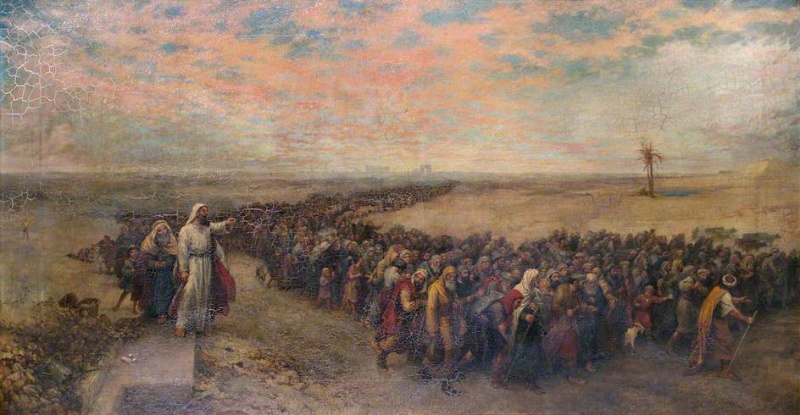
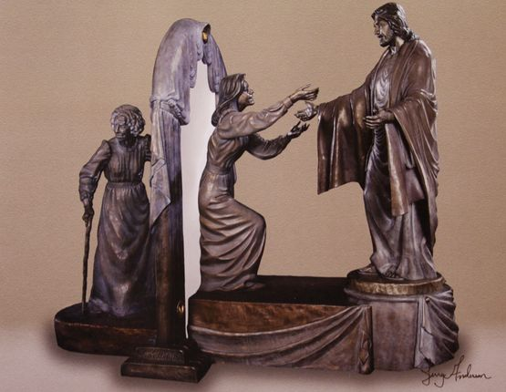
Exodus—Exit or Departure
An account of Israel’s departure from bondage in Egypt and their preparation to inherit the promised land as the Lord’s covenant people.
Israel’s departure from bondage and journey through the wilderness can symbolize our journey through a fallen world and back to the presence of God.
Jerry Anderson

Slide 3
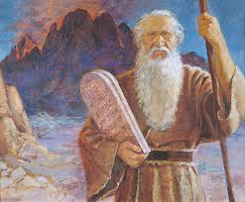
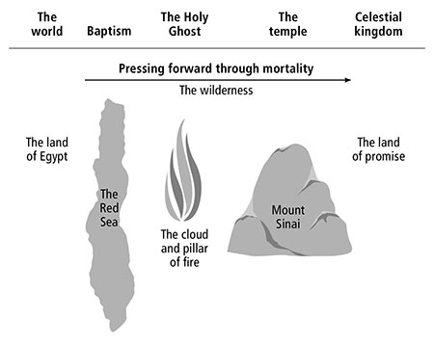
Moses—The Author
The events recorded in Exodus became an important part of Israel’s historical identity and have been cited by Jesus Christ and His prophets to teach a variety of gospel principles
The book of Exodus provides details about Moses’s upbringing and calling as a prophet, (Exodus 1–4),
the institution of the Passover, (Exodus 11–12)
and the Lord’s covenant with Israel at Sinai—including His declaration of the Ten Commandments (Exodus 19-24)

Slide 4

Egypt During Joseph’s Time
What were the circumstances that led Jacob’s children into Egypt?
How accepting was the Pharaoh towards Joseph’s family?
How did the pharaoh in Joseph’s day regard Joseph?

Slide 5
Children of Israel Increase
There were about 350 years between the time that Israel and his sons moved to Egypt and the birth of Moses (see Ex. 12:40).
Eventually Joseph and his generation died, and a new pharaoh rose to power
The Israelites (also called the Hebrews) grew in number in the land of Egypt.
Fearing that the Israelites could overpower the Egyptians, the new pharaoh enslaved them
The problem that occurred during that several century time span was an apostasy. There did not seem to be a continuance of the patriarchal, or Melchizedek Priesthood. There was a loss of the gospel, a loss of the traditions of the fathers, a loss of the covenants of Abraham, Isaac, and Jacob. How do we know this? It is evident looking at the Israelites in retrospect.
Exodus 1:1-8; 6-14
(1)

Slide 6
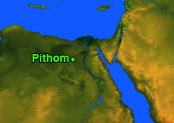
أخبار المصري
Page 1
Around BC 1300-1400
New King Rules Over Egypt
Exodus 1:9-10
The Children of Israel… Descendants of Jacob… have increased in number, causing Pharaoh to take action by “dealing with them wisely”
Bricks and Stones
Midwives Favored by God
Exodus 1:12-14
The more oppression grew for the Children of Israel, the more their families increased, causing Pharaoh to increase their hardships by making having them make bricks, and working in the fields.
Exodus 1:18-19
Because of the righteous midwives in refusing to kill the baby males, God blessed them ‘exceedingly’ and they had more children and ‘waxed strong.’
Midwives Ordered To Kill
Midwives Fear God
Pithom and Raamses
Exodus 1:11
Treasured cities are built by the Children of Israel under
the bondage of
Pharaoh.
Exodus 1:15-16
Hebrew midwives, Shiphrah and Puah were ordered by Pharaoh to kill all the male infants born under their care. However, if the infant should be a
female their lives
were spared.
Exodus 1:17
Hebrew midwives, Shiphrah and Puah who were ordered by Pharaoh to kill all the male infants born during childbirth feared God and secretly did not kill the babies and the babies were hid from Pharaoh and his guards.

Slide 7
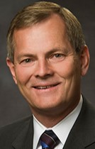
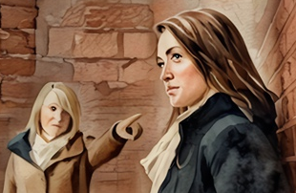

Times of Courage
“There will be times when you … will have to demonstrate your righteous courage in plain view of your peers, the consequence of which may be ridicule and embarrassment.
… He will reward you for your courage and righteous behavior—with happiness and joy.
Such courage will be a byproduct of your faith in Jesus Christ and His Atonement, your prayers, and your obedience to commandments.”
As we submit our will to God instead of bending to other pressures, He will bless us.
Exodus 1:17-19
(2)

Slide 8
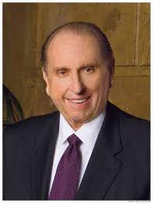
Courage=Facing Fear
We will all face fear, experience ridicule, and meet opposition. Let us—all of us—have the courage to defy the consensus, the courage to stand for principle.
Courage, not compromise, brings the smile of God’s approval.
Courage becomes a living and an attractive virtue when it is regarded not only as a willingness to die … but also as the determination to live decently.
As we move forward, striving to live as we should, we will surely receive help from the Lord and can find comfort in His words. (6)

Slide 9

Godly Fear
Proverbs 16:6
Hebrews 12:28
Wherefore we receiving a kingdom which cannot be moved, let us have grace, whereby we may serve God acceptably with reverence and godly fear:
By mercy and truth iniquity is purged: and by the fear of the Lord men depart from evil.
Job 28:28
Isaiah 11:2-3
And unto man he said, Behold, the fear of the Lord, that is wisdom; and to depart from evil is understanding.
…the spirit of knowledge and of the fear of the Lord;
And shall make him of quick understanding in the fear of the Lord:

Slide 10
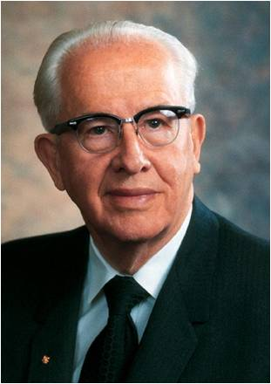
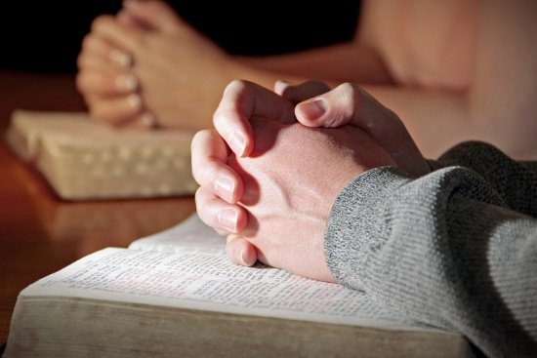

Putting the Lord First
The great test of life is obedience to God.
The great task of life is to learn the will of the Lord and then do it.
We must put God in the forefront of everything else in our lives. He must come first, just as He declares in the first of His Ten Commandments: “Thou shalt have no other gods before me”
(Ex. 20:3).
When we put God first, all other things fall into their proper place or drop out of our lives. Our love of the Lord will govern the claims for our affection, the demands on our time, the interests we pursue, and the order of our priorities.
As we revere God by putting His will above that of others, He will bless us
(3)

Slide 11




Rate of Your Willingness
Not at all true
Very true
1
2
3
4
5
I am willing to put the Lord first, even when I feel pressure from others to lower my standards.
I am unsure if God will bless me for striving to obey His commandments.
I am willing to stand up for what I know is right, even if it isn’t the popular choice.

Slide 12
Moses
He was the son of the house of Levi
He was hidden by his mother for three months
When his mother could not hide him anymore, she made an ark of bulrushes and set him in the ark on the river and his sister, Miriam, watched as the ark floated on the water
The daughter of Pharaoh found him, and Moses was raised in the royal court of Egypt, knowing he was a Hebrew child, she found Miriam as his nurse
Upon finding that he was Hebrew he left this place of privilege “to suffer affliction with the people of God”
He fled Egypt and traveled to the land of Midian, married Zipphorah, and received the Melchizedek Priesthood from his father-in-law, Jethro
He also received the keys of the gathering of Israel (see D&C 110:11).
Moses ushered in a dispensation of the gospel of Jesus Christ and served as a prophet and a revelator of God’s words
(4)

Slide 13
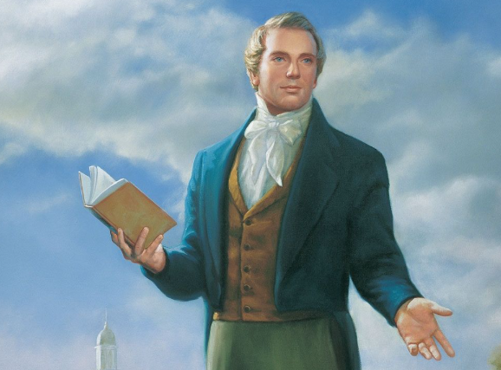
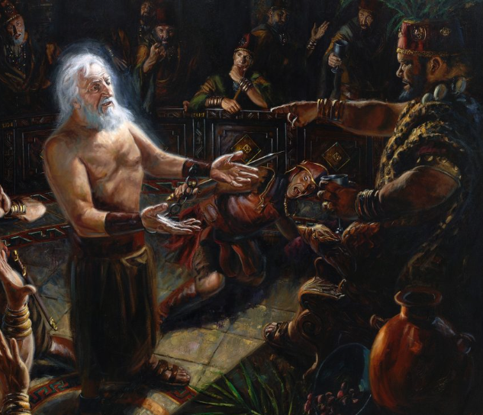
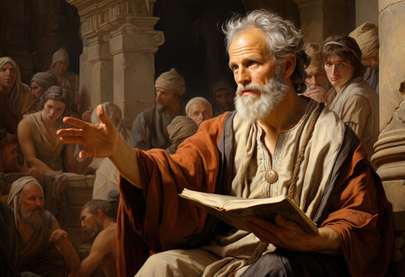
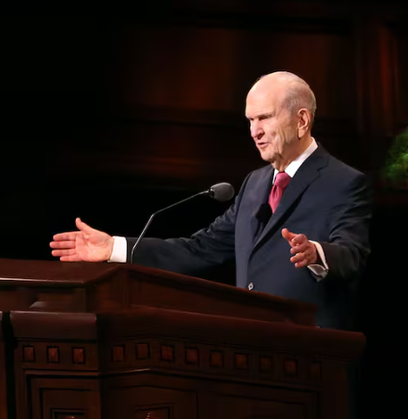
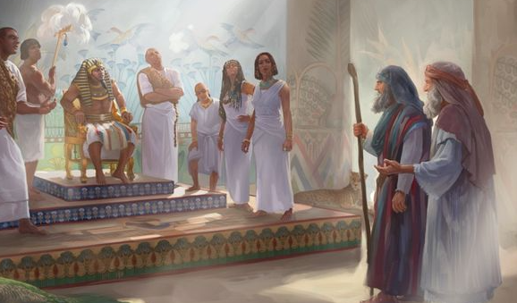
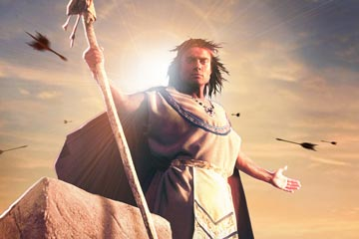
True disciples of Jesus Christ are willing to stand out, speak up, and be different from the people of the world. They are undaunted, devoted, and courageous. (5)

Slide 14
Sources:
Videos: Putting the Lord First (2:25) Howard W. Hunter
“Leave the Party” (6:26)
“Be Valiant in Courage, Strength, and Activity” from time code 1:20 to 5:13
Gospel Doctrine.com Exodus 1:1-22
Bishop Gary E. Stevenson, Presiding Bishop of the Church(“Be Valiant in Courage, Strength, and Activity,” Ensign or Liahona, Nov. 2012, 52).
President Ezra Taft Benson The Great Commandment—Love the Lord May 1988 Ensign Gen. Conf.
Presentation by ©http://fashionsbylynda.com/blog/
4. Old Testament Who’s Who by Ed J. Pinegar and Richard J. Allen pgs. 99-100
5. President Russell M. Nelson (“Drawing the Power of Jesus Christ into Our Lives, ” Ensign or Liahona, May 2017, 40–41)
6. President Thomas S. Monson (“Be Strong and of a Good Courage,” Ensign or Liahona, May 2014, 69)

Slide 15
Jerry Anderson Sculpture:
unveiled in 2000 as a life-sized bronze sculpture and is resides in the Spilsbury Mortuary in St George, Utah. It portrays the spiritual journey from mortality to immortality.
Spiritually Lost:
"The children of Israel had been in the land of Egypt 430 years by the time the Lord called Moses to lead them out of bondage. (See Ex. 12:40) During their long years under the Egyptian yoke, they became not only physically enslaved but also spiritually sick. Having gone for generations without a prophet to counsel and guide them, the greater part of the children of Israel drifted into apostasy.
"Before they were ready to enter the land of promise, they had a long way to go-not only in the geographical distance to be covered but also in spiritual progression to be accomplished. Some scholars and students of the Old Testament say, 'It was harder for Moses to get Egypt out of the children of Israel than to get the children of Israel out of Egypt.' At times, the children of Israel placed more trust in the gods of Egypt than in the God of Israel." (LDS Church News, 1994, 02/26/94)
Why Stay in Egypt?
“The fulfillment of God’s promises to Abraham required that Israel should become numerous. To accomplish this, the little family, numbering only 70 persons (Genesis 46:26–27), needed sufficient time and a peaceful place in which to grow. Egypt was that place. …
“… Palestine was a battleground for warring nations that moved back and forth in their conquests between the Nile and the Euphrates. Israel would have found no peace there. They required stable conditions for their eventual growth and development. …
“Their bondage certainly was not all on the negative side. It too served a good purpose. The cruelty of the taskmasters, the hatred that existed between the Hebrews and the Egyptians, and the length of their trying servitude fused Jacob’s children into a united people. …
“The hatred they felt toward the Egyptians prevented intermarriage between the Hebrews and their neighbors. To reap the benefits of the Abrahamic promises, Israel had to remain a pure race, and the Lord used this means to achieve it. …
“Yes, Egypt had her role in the Lord’s mighty drama, and she played it well.
“At the end of 430 years, the Lord now decreed that the time had arrived for Israel to occupy her own land and there become that ‘peculiar people’ who would await the coming of their Messiah.” (Petersen, Moses, pp. 27–30.)
Placed under Aaronic Priesthood:
For the next forty plus years Moses will have to lead the children of Israel. Their rebellion, faithlessness, reliance on signs, and hardened hearts are the product of a people who had lost the Spirit of God. The Aaronic Priesthood and Law of Moses that they would be placed under was not for a righteous people but for a wicked people-a people with little understanding, quick to forget God, oblivious to the difference between clean and unclean, holy and unholy. At this point, the children of Israel are the descendants of Abraham, Isaac, and Jacob in name but not in spirit.
Slaying:
“The historian Eusebius says that the slaying was the result of a court intrigue in which certain men plotted to assassinate Moses. In the encounter it is said that Moses successfully warded off the attacker and killed him. (Eusebius IX:27.)
“In the Midrash Rabbah, the traditional Jewish commentary on the Old Testament, it is asserted that Moses, with his bare fists, killed an Egyptian taskmaster who was in the act of seducing a Hebrew woman. This is confirmed in the Koran.
“Certainly there must have been good reason for Moses’ act, and most assuredly the Lord would not have called a murderer to the high office of prophet and liberator for his people Israel” (Mark E. Petersen, Moses: Man of Miracles [1977], 42).
أخبار المصري
Arabic—Egyptian News—goggle translate

Slide 16
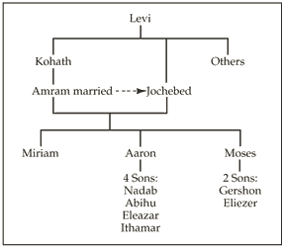
Jethro (Reuel):
According to the Hebrew Bible, the Kenites (/ˈkiːnaɪt/; Hebrew: קינים, Hebrew pronunciation: [qeˈnim]) were a nomadic clan in the ancient Levant. One of the most recognized Kenites is Jethro, a priest in the land of Midian.
They played an important role in the history of ancient Israel. The Kenites were coppersmiths and metalworkers.[Moses' father-in-law, Jethro, was a shepherd and a priest in the land of Midian. Judges 1:16 says that Moses had a father-in-law who was a Kenite, but it is not clear from the passage if this refers to Jethro. Certain groups of Kenites settled among the Israelite population, including the descendants of Moses' brother-in-law, although the Kenites descended from Rechab maintained a distinct, nomadic lifestyle for some time.
Moses’ father-in-law, Jethro, was a Kenite (Judges 1:16) resident in the land of Midian. Judges 1:16 says that his descendants "went up from the City of Palms [i.e. Jericho] with the men of Judah to live among the people of the Desert of Judah in the Negev near Arad.
However, in Exodus 3:1 Jethro is said to have been a "priest in the land of Midian" and a resident of Midian (Numbers 10:29
Wikipedia
Pharaoh:
Both the ancient Jewish historian Josephus and Jonathan ben Uzziel, another ancient Jewish writer, recorded that the pharaoh had a dream wherein he was shown that a man soon to be born would deliver Israel from bondage, and this dream motivated the royal decree to drown the male children (see Josephus, Antiquities of the Jews, bk. 2, chap. 9, par. 2; Clarke, Bible Commentary, 1:294).
Putting the Lord First: (Exodus 1:20-21)
“There will be times when you … will have to demonstrate your righteous courage in plain view of your peers, the consequence of which may be ridicule and embarrassment. …
“… He will reward you for your courage and righteous behavior—with happiness and joy. Such courage will be a byproduct of your faith in Jesus Christ and His Atonement, your prayers, and your obedience to commandments” (Gary E. Stevenson, “Be Valiant in Courage, Strength, and Activity,” Ensign or Liahona, Nov. 2012, 52).

Slide 17
Moses |  | Jesus
Moses was in danger of being killed in infancy and was preserved through the power of God | Exodus 1:22 | Jesus was in danger of being killed in infancy and was preserved through the power of God | Matthew 2:16 Matthew 2:20-21
The Lord promised to raise up a Prophet like Moses | Deuteronomy 18:15-18 | The multitude recognized that Jesus was “that prophet” | John 6:14
Moses overcame confrontations with Satan | Moses 1:12-22 | Jesus overcame confrontations with Satan | Matthew 4:3-11
The Lord saved the Israelites by parting the Red Sea; they walked through on dry ground. | Exodus 14 | Jesus walked across the Sea of Galilee and saved the disciples from the storm | John 6:16-21
The Lord instituted the Feast of the Passover | Exodus 12 | Jesus observes the Passover and introduces the sacrament | John 6:4 Mark 14
The Lord told the people to gather only what they needed each day so nothing was wasted and provided bread when needed and provided lifesaving water | Exodus 16:16-30 Exodus 17:5-6 | Jesus told the disciples to gather the fragments so that nothing was lost (gathering the Bread) He is the living water | John 6:5-35 John 4:10-14
God led the children of Israel through the wilderness by the Red Sea | Exodus 13:18 | A multitude followed Jesus across the Sea of Galilee | John 6:1-2
Moses controlled the winds and the sea | Exodus 14:21 | Jesus calmed the sea and walked on water | Mark 4:37-39
Moses “Came to the mountain of God” and shown the kingdoms of the world | Exodus 3:1, 12 Exodus 19:1-3 Moses 1:1, 8, 11 | Jesus went into a mountain and shown the kingdoms of the world | John 6:3, 15 (JST) Matthew 4:8
Moses was called to deliver Israel | Exodus 3:7-10 | Jesus was called to deliver Israel | 2 Nephi 6:17
Moses was a mediator between God and his people | Deuteronomy 9:16-20, 23-26 | Jesus is the mediator between us and God | 1 Timothy 2:5

Slide 18
EXODUS
Exodus 1-4 | The Lord answers Israel’s cries by raising up Moses to deliver them from bondage in Egypt
Exodus 5-12 | Moses and Aaron ask Pharaoh to set the children of Israel free. Pharaoh refuses, and the Lord sends plagues upon Egypt. The Feast of the Passover is established among Israel to commemorate the passing over of the houses of the Israelites when God smote the firstborn of the Egyptians.
Exodus 13-15 | The children of Israel leave Egypt. Pharaoh and his army pursue Israel. The Lord parts the Red Sea for Israel, and Pharaoh’s army is drowned. Israel praises the Lord for their deliverance.
Exodus 16-18 | Israel murmurs about the lack of food and water in the wilderness. The Lord sends manna and quail for Israel to eat and commands Moses to bring forth water from a rock. Israel defeats the armies of Amalek. Moses establishes rulers among Israel.
Exodus 19-24 | At Mount Sinai the Lord reveals the conditions of His covenant, and Israel covenants to obey the Lord.
Exodus 25-31 | Moses receives instructions concerning the construction of the tabernacle, the consecration of priests, and the performance of sacrifices. Moses is given two stone tables containing the Lord’s covenant with Israel.
Exodus 32-34 | Israel worships a golden calf. Moses breaks the stone tables and pleads with the Lord for Israel. After the people repent, the Lord makes another covenant with Israel and writes it on two new tables of stone.
Exodus 35-40 | Skilled workmen construct the tabernacle, and the glory of the Lord rests upon it.

