Slide 1

Sending a Prophet
Exodus 2-4
…have ye not read in the book of Moses, how in the bush God spake unto him, saying, I am the God of Abraham, and the God of Isaac, and the God of Jacob?
Mark 12:26

Slide 2

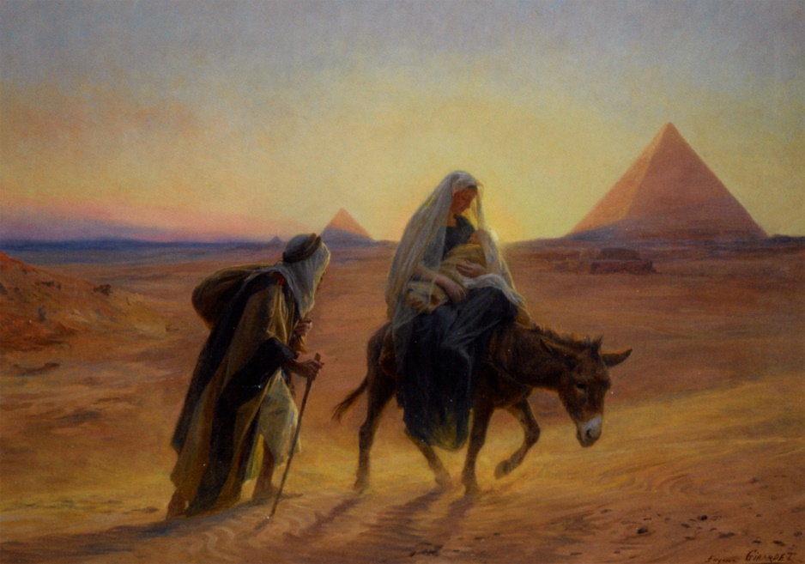
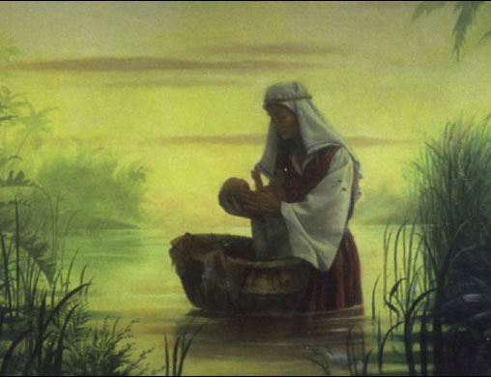
Similitude
Both Jesus Christ and Moses were in danger of being killed in infancy and were preserved through the power of God
Pharaoh’s decree to kill the newborn males and Moses’s miraculous survival foreshadowed (was a type of) Herod’s decree to kill the infant children in Bethlehem and surrounding areas and Jesus’s survival through divine intervention. (3)
Exodus 2:1-10

Slide 3
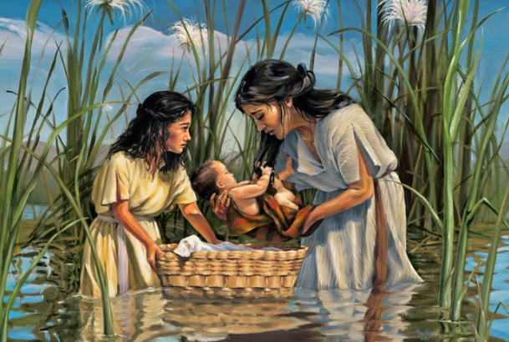
Preparing a Prophet
When Moses was an infant, Pharaoh commanded that all newborn Israelite boys should be killed.
To save Moses, his mother hid him in a basket and placed it next to a river. Moses was discovered by Pharaoh’s daughter, who raised him as her son.
Although Moses was an Israelite by birth, the prophet Moses was raised in the household of Pharaoh in Egypt.
In Egypt, Moses was well educated and “mighty in words and in deeds”.
Megan Rieker
Exodus 1:22; 2:1-10; Acts 7:22

Slide 4
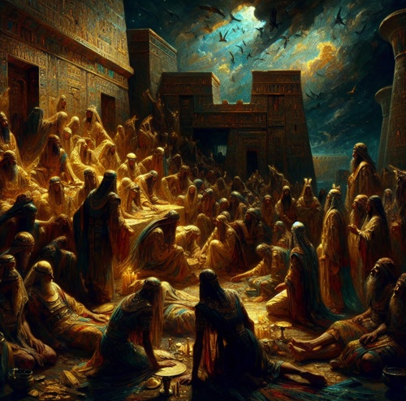
Sending a Prophet
Under Pharaoh’s reign, the children of Israel struggled in bondage and cried unto the Lord.
The Lord heard their cries and called Moses as a prophet to help them.

Slide 5
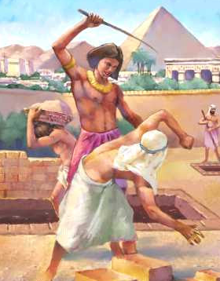
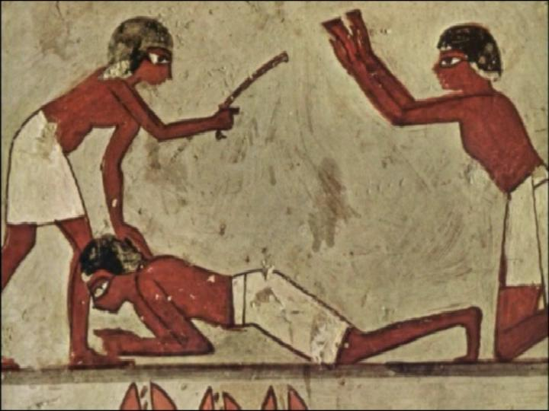
Smote—Beat Down
Hebrew nakhah
It is the word used in describing the action taken by soldiers in combat against each other.
As a grown man, Moses killed an Egyptian while defending one of the Israelite slaves.
and he spied an Egyptian smiting an Hebrew, one of his brethren.
And he looked this way and that way, and when he saw that there was no man, he slew the Egyptian, and hid him in the sand.
Exodus 2:11-14

Slide 6
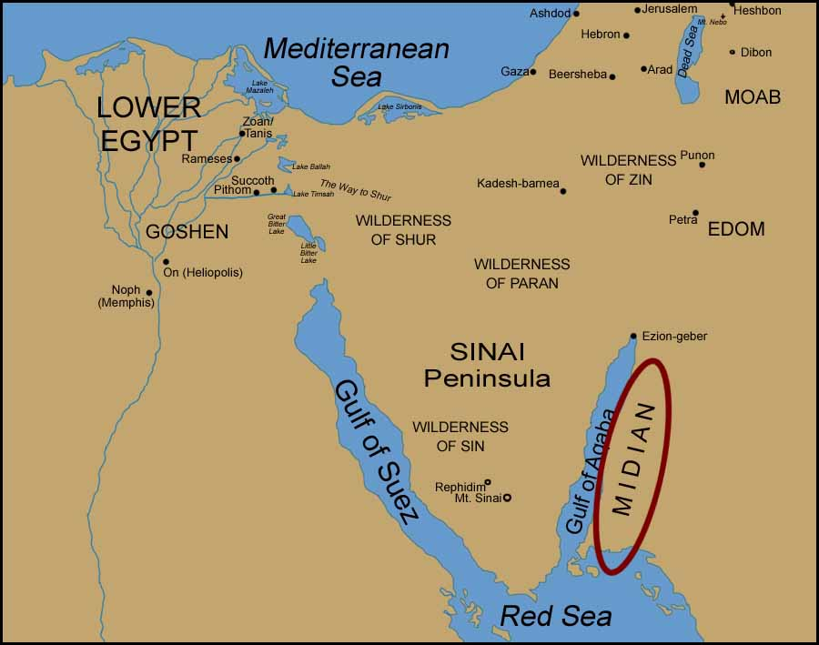
Fleeing to Midian
Pharaoh sought to slay Moses
Moses flees to the land of Midian
Hagar
Sarah
Abraham
Keturah
Ishmael
Rebekah
Isaac
Zimran
Jokshan
v
Medan
Ephah
Midian
Epher
Ishbak
Hanoch
Shuah
Abida
Moses marries Zipporah, one of seven daughters of Reuel (Jethro) and they had a son, Gershom
Eldaah
Midianites
Exodus 2:15-22

Slide 7
Reuel--Jethro
He was a descendant of Midian who was a son of Abraham and Keturah
His name means ‘his excellence’
He was a priest in the land of Midian (Exodus 3:1)
He had seven daughters and was a shepherd and later when Moses took his daughter, Zipporah, to marriage he turned over the responsibility of caring for the flock
He acted as counselor to Moses regarding how to manage the heavy administrative burden of acting as judge over the house of Israel
He taught Moses principles of delegation and leadership development
He gave Moses the Melchizedek Priesthood (D&C 84:6-7)
Exodus 2:15-22
(5)

Slide 8
Zipporah
She was the daughter of Jethro (Reuel)
Her father was the priest in the land of Midian
She and Moses were married and they had two sons, Geshon and Eliezer
She intervened when the Lord was angry with Moses for failing to circumcise his son as commanded and she accomplished the circumcision herself (JST Exodus 4:24-27)
v
Exodus 2:15-22
(5)

Slide 9


Children in Bondage
While Moses was in Midian, the children of Israel remained in bondage in Egypt
Meanwhile the king dies
God hears and answers our prayers, and God keeps His covenants with His people
While tending sheep in Midian, Moses had an experience with Jehovah.
Exodus 2:23-25

Slide 10
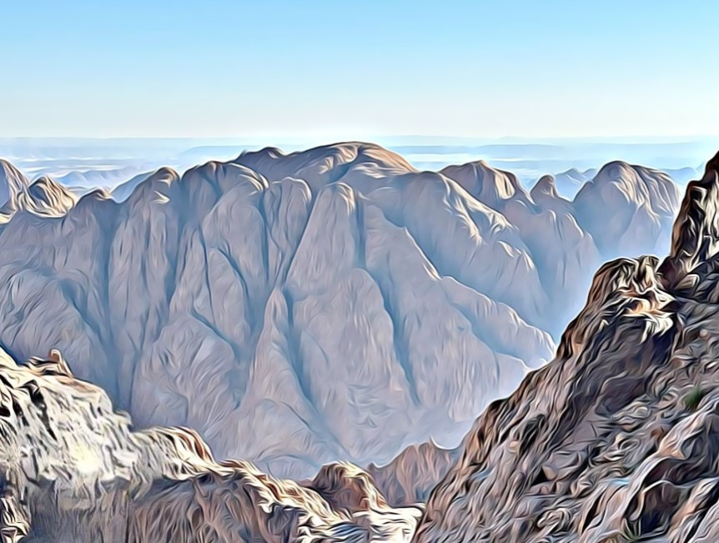
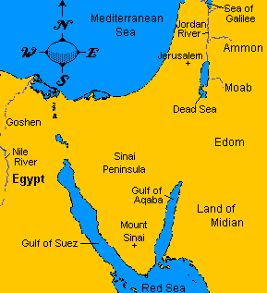
Horeb—Mountain of the Lord
Mount Sinai
Elijah Also Seeks Refuse
And he arose, and did eat and drink, and went in the strength of that meat forty days and forty nights unto Horeb the mount of God.
1 Kings 19:8
There are several possible sites for Mount Sinai. One of the traditional locations is Jebel Musa (Mountain of Moses)
Exodus 3:1

Slide 11
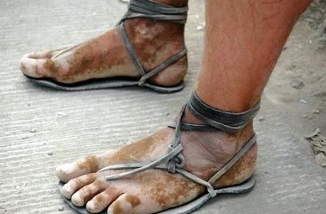
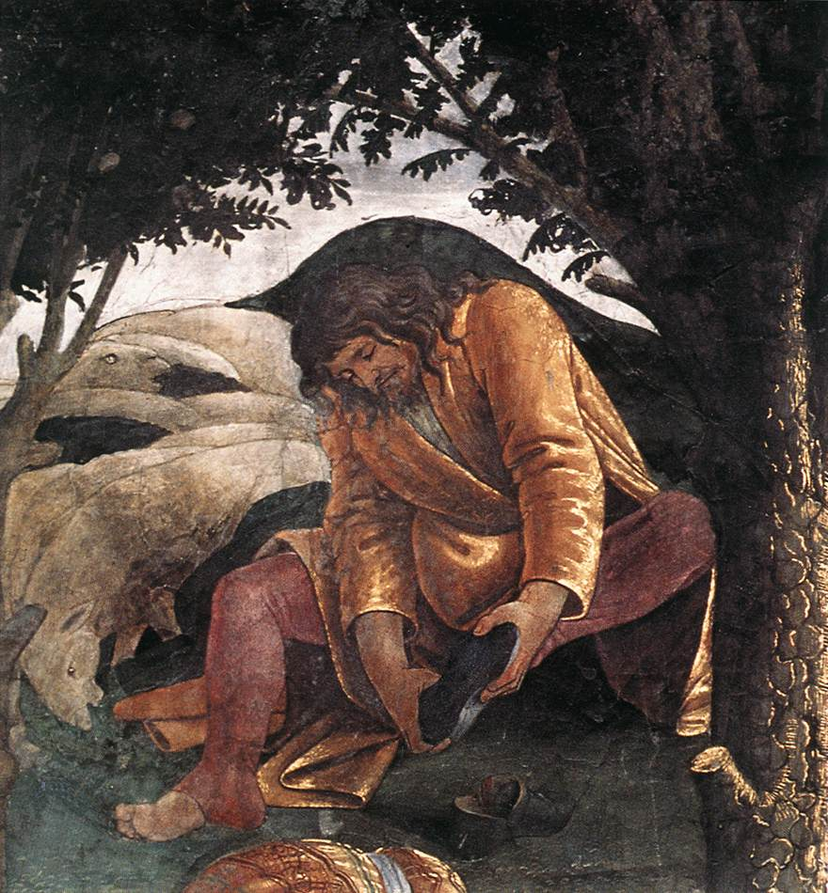
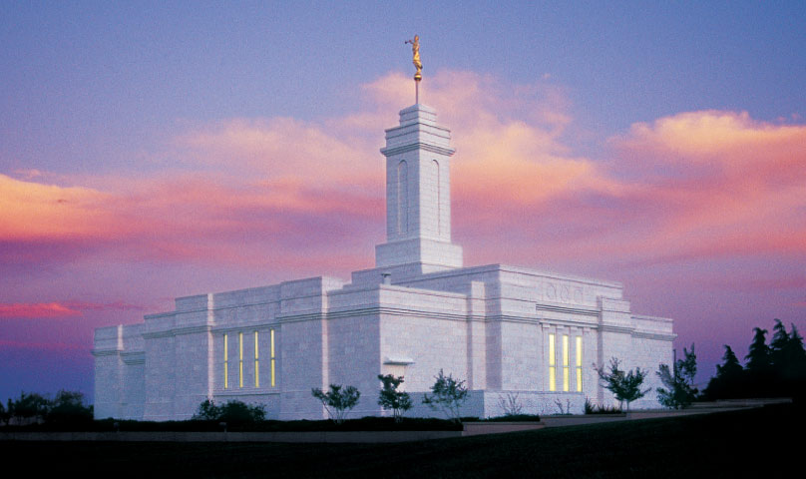
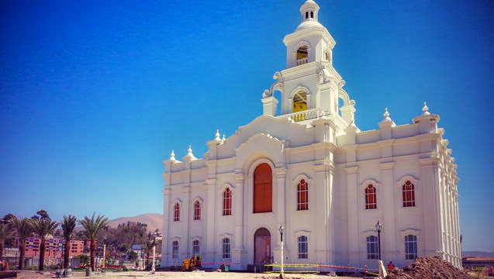
Put Off Thy Shoes
Holy Ground
We are to be reverent in sacred places; showing reverence to the Lord when we are in sacred places prepares us to draw near to Him.
Colonia Juarez Chihuahua Mexico Temple
Putting off our shoes at the door of the temple is letting go of worldly desires or pleasures that distract us from spiritual growth, setting aside those things which sidetrack our precious mortality, rising above contentious behavior, and seeking time to be holy.
Exodus 3:5
Tijuana Temple
Dedicated on 13 December 2015

Slide 12
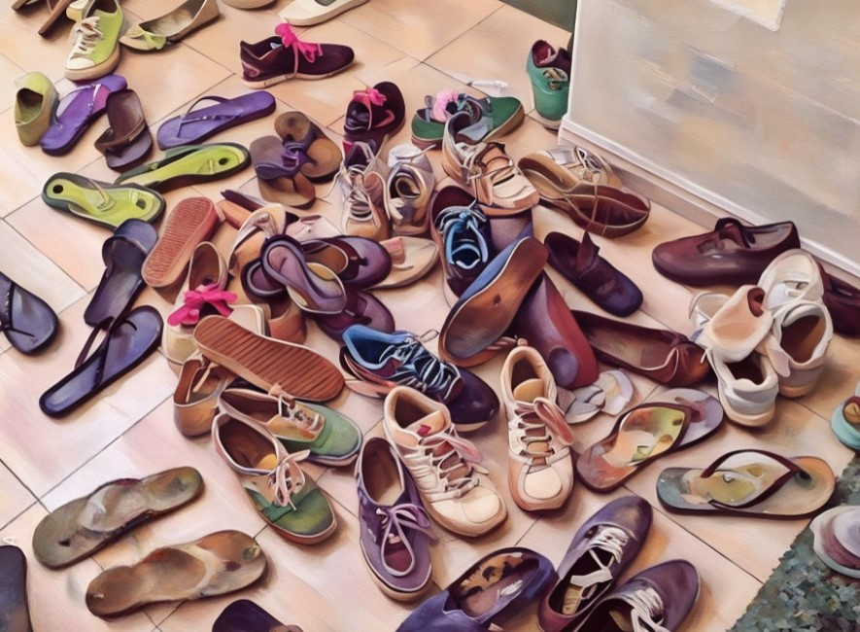
How does removing shoes show reverence, beyond obeying God?
We wear shoes at church.
We wear shoes when we pray.
We wear shoes in the house of the Lord, even if they're different shoes.
I could think of only one answer: The shoes were separating Moses from the holy ground.
Peter saith unto him, Thou shalt never wash my feet. Jesus answered him, If I wash thee not, thou hast no part with me. John 13:8
And whosoever shall not receive you, nor hear your words, when ye depart out of that house or city, shake off the dust of your feet. Matthew 10:14
https://addfaith.org/forums/topic/84900-why-put-off-his-shoes/

Slide 13
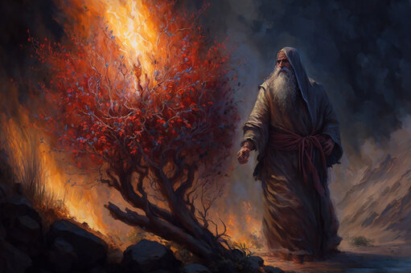
Who Am I?
Was it an angel?
What name should I call you before the children of Israel?
The answer is not Jehovah. The Lord is identified by another term. "Out of respect or reverence to the name of the Supreme Being, to avoid the too frequent repetition of his name," (D&C 107:4)
Jehovah declares his name as "I AM" to the children of Israel (Ex. 3:14). "I AM" is a proper name for the God of Abraham, Isaac, and Jacob. (1)
I AM
“I AM” comes from the same root word as Jehovah, which can be interpreted as “He is” or “He exists.” The name would have been easily recognized by the Israelites.
Exodus 3:2-14

Slide 14
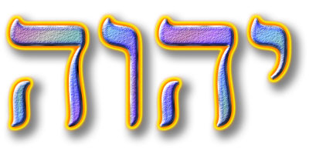
The Lord also wanted Moses to know him by the sacred name of Jehovah
Prophets like Abraham, Isaac, Jacob, Moses and many others certainly knew the Lord by the name of Jehovah.
The children of Israel were not to use this name; it was too sacred.
Jehovah
Seldom written, the name was never spoken for even the scribes who were aware of the name Jehovah would never say the word aloud (Bible Dictionary: Jehovah)
Moses could know it, but they were not to use it. To this command, they were faithful.
Under the Law of Moses, blasphemy of the name of the Lord, particularly Jehovah, was punishable by death (Lev. 24:16).
Old Testament
Accordingly, the name of Jehovah was treated with great care, appearing only 4 times in the Old Testament (Ex 6:3; Ps. 83:18; Isa 12:2; 26:4).
Exodus 3:4-6
(1)

Slide 15
The Lord Knows
Affliction
“God sees our ______________________,
hears our ____________________,
and knows our ___________________.”
Prayers
Sorrows
Exodus 3:7

Slide 16
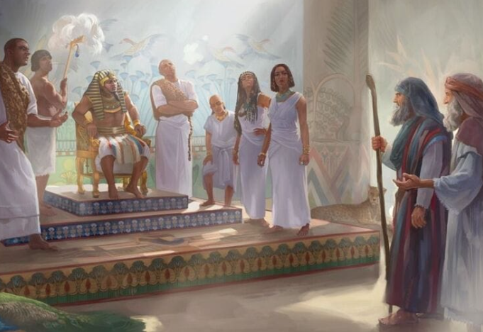
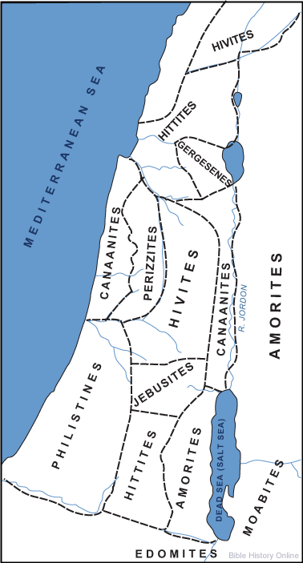
The Plan—to Deliver
Unto a land flowing with milk and honey;
unto the place of the Canaanites, and the Hittites, and the Amorites, and the Perizzites, and the Hivites, and the Jebusites.
Through Moses the children were to be rescued from the Egyptians
Moses was to go to the Pharaoh, ask for the people to be released and return to the mountain (Mt. Sinai)
The Lord often answers our prayers through other people.
Exodus 3:7-10

Slide 17
Who am I to be able to do what you have asked?
But they will not believe me or listen to me. They will say I am lying.
Perform the three sign that I will give you
Turn a rod into a snake
Display a hand bearing leprosy
Turn water into blood
I will be with you.
Who should I tell them sent me?
I have never been a good speaker. I am slow of speech.
Please, Lord, send someone else.
Tell them “I Am” sent you unto them.
I made your mouth, and I will be with you and teach you what to say.
I will make Aaron a spokesman for you and teach you what to do
Exodus 3:11-17, Exodus 4:1-17

Slide 18
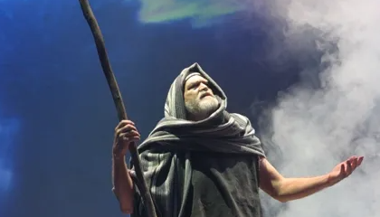
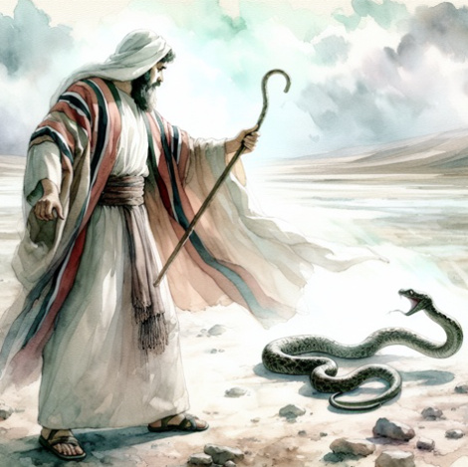
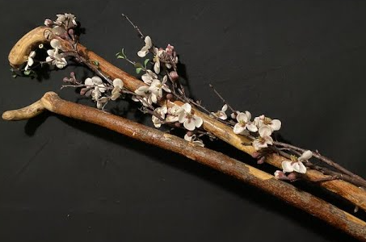
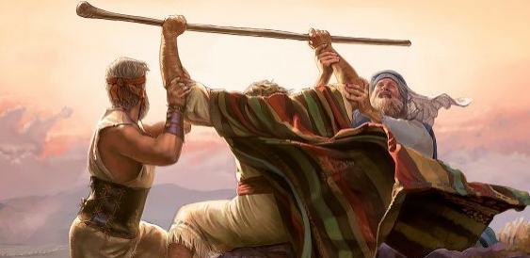
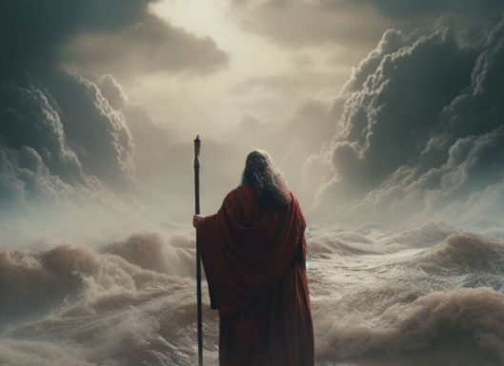
The Rod=God’s Power
Moses’ and Aaron’s rods represented authority
Ex. 4:1–5; 7:9–12, 17 Bible Dictionary; See Numbers 17:6-11

Slide 19

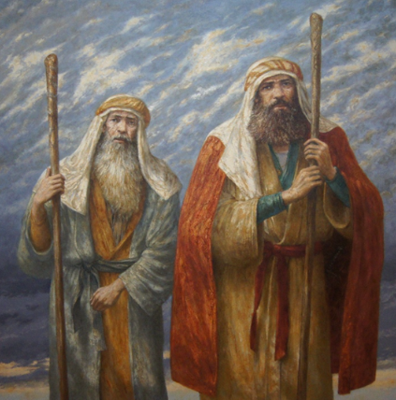
Moses left Midian, met Aaron, and traveled with him to Egypt.
Together they told the elders of Israel all that the Lord had commanded.
The children of Israel believed Moses and Aaron and worshipped the Lord.

Slide 20
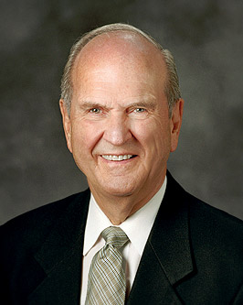
The Lord Jesus Christ, whose Church this is, appoints prophets and apostles to communicate His love and teach His laws. …
Ask your Heavenly Father if we truly are the Lord’s apostles and prophets.
Ask if we have received revelation on this and other matters. (2)

Slide 21
Sources:
Gospel Doctrine.com (Exodus 1-12)
Presentation by ©http://fashionsbylynda.com/blog/
2. President Russell M. Nelson (“The Love and Laws of God” [Brigham Young University devotional, Sep. 17, 2019], 3, 5, speeches.byu.edu) 3. Bruce R. McConkie, The Promised Messiah: The First Coming of Christ [1978], 446.
4. Elder Ronald A. Rasband (General Conference October 2020)

Slide 22
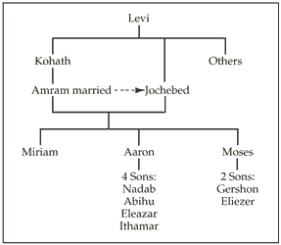
Jethro (Reuel):
According to the Hebrew Bible, the Kenites (/ˈkiːnaɪt/; Hebrew: קינים, Hebrew pronunciation: [qeˈnim]) were a nomadic clan in the ancient Levant. One of the most recognized Kenites is Jethro, a priest in the land of Midian.
They played an important role in the history of ancient Israel. The Kenites were coppersmiths and metalworkers.[Moses' father-in-law, Jethro, was a shepherd and a priest in the land of Midian. Judges 1:16 says that Moses had a father-in-law who was a Kenite, but it is not clear from the passage if this refers to Jethro. Certain groups of Kenites settled among the Israelite population, including the descendants of Moses' brother-in-law, although the Kenites descended from Rechab maintained a distinct, nomadic lifestyle for some time.
Moses’ father-in-law, Jethro, was a Kenite (Judges 1:16) resident in the land of Midian. Judges 1:16 says that his descendants "went up from the City of Palms [i.e. Jericho] with the men of Judah to live among the people of the Desert of Judah in the Negev near Arad.
However, in Exodus 3:1 Jethro is said to have been a "priest in the land of Midian" and a resident of Midian (Numbers 10:29
Wikipedia
The Rod: There are several meanings of rod in the scriptures. A shepherd’s rod was a club approximately three feet long, with a knob on one end. It was used to beat wolves away from the herd. A staff, sometimes called a rod, is longer; it was used for walking, resting, or for guiding the sheep, as in Lev. 27:32; Ps. 23:4.
Moses’ and Aaron’s rods represented authority, as in Ex. 4:1–5; 7:9–12, 17. A rod was also used for punishing a wayward child, as in Prov. 13:24; 22:15; or to whip a supposed offender, as in 2 Cor. 11:25 and Matt. 27:26. A measuring rod was about 10 feet, 10 inches (330 centimeters) long and was used to determine distances (see Ezek. 40:3). Isa. 11:1 speaks of a rod (Hebrew Khoter—a twig or shoot), which has been identified in latter-day revelation as a prophet of the Restoration (D&C 113). Bible Dictionary
The Rod…when Moses was leading the children of Israel in their battle against the Amalekites. Moses took the rod of God in his hands and went to the top of a sacred mount, where he held up his hands to God over the battle; and as long as Moses held up his hands, Israel prevailed. But when he let his hands down, the Amalekites prevailed. And as Moses’ arms became heavy with weariness, Aaron and Hur stood on either side of Moses and helped him to hold up his hands until the battle was won. (See Ex. 17:8–12.) Hold Up Your Hands
By Elder Sterling W. Sill April 1973 General Conference
Aaron’s rod that budded was a sign of God’s continued choice of Aaron as a priest, Numbers 17:5, but Aaron’s priesthood was interrupted by his death. The Lord Jesus Christ, though, has a priesthood that is constituted with an indestructible life, Hebrews 7:16. He is able to save to the uttermost those who come to God through Him, Hebrews 7:25.
Pharaoh:
Both the ancient Jewish historian Josephus and Jonathan ben Uzziel, another ancient Jewish writer, recorded that the pharaoh had a dream wherein he was shown that a man soon to be born would deliver Israel from bondage, and this dream motivated the royal decree to drown the male children (see Josephus, Antiquities of the Jews, bk. 2, chap. 9, par. 2; Clarke, Bible Commentary, 1:294).

Slide 23
“I AM”
The theology of the Judaism and the Jehovah's Witnesses denies the idea that Jesus Christ was the pre-mortal Jehovah. John the Revelator, declared this truth in terms that any careful student of the Old Testament should understand. The scribes and Pharisees taunted Jesus as follows:
Art thou greater than our father Abraham, which is dead? And the prophets are dead: whom makest thou thyself?
...Your father Abraham rejoiced to see my day: and he saw it, and was glad.
Then said the Jews unto him, Thou art not yet fifty years old, and hast thou seen Abraham?
Jesus said unto them, Verily, verily, I say unto you, Before Abraham was, I am. (John 8:53-58)
The text should read, "Before Abraham was I AM," using the term I AM as the proper name for the God who spoke to Moses. Indeed, this was the name by which the children of Israel were supposed to know God. Gospeldoctrine.com
“I Am” is a form of “Jehovah,” one of the names of Jesus Christ recognized by the prophets Abraham, Isaac, and Jacob (see Joseph Smith Translation, Exodus 6:3 [in Exodus 6:3, footnote c ). Moses and the Israelites understood the name to mean that God is eternal and not created by man, as were other gods of the day. This name was a way for the Lord to identify Himself as the all-powerful true and living God. The Israelites came to greatly reverence this name and declared that speaking it was blasphemy. The name was so sacred that once the Tabernacle was built, only the high priest was allowed to speak the name in the Holy of Holies, once a year, on the Day of Atonement.
Whenever the name I Am or Jehovah occurs in the Old Testament’s Hebrew text, it is almost always rendered as “LORD.” In the New Testament, a group of Jews sought to kill Jesus because He said, “Before Abraham was, I am” (John 8:58). This New Testament reference confirms that Jesus Christ is Jehovah, the God of the Old Testament.
Moses’s life and mission bear many similarities to the life and mission of Jesus Christ. In fact, Moses was told, “Thou art in the similitude of mine Only Begotten” (Moses 1:6). God raised up Moses to perform a divine mission that included not only physically delivering Israel but also teaching them how to be spiritually delivered. His ministry extended beyond the limits of his own mortal lifetime. Joseph Smith taught that, in company with Elias (Elijah), Moses came to the Mount of Transfiguration and bestowed priesthood keys upon Peter, James, and John (see Matthew 17:3–4; Mark 9:4–9; Luke 9:30; D&C 63:21). Moses appeared to Joseph Smith and Oliver Cowdery on April 3, 1836, in the temple in Kirtland, Ohio, and conferred on them the keys of the gathering of Israel (see D&C 110:11). (See Guide to the Scriptures, “Moses”; scriptures.lds.org; see also Bible Dictionary,“ Moses.”)
The significance of Moses as a prophet, lawgiver, and holy messenger places him as one of the noble and great sons of God. Moses is referred to in the scriptures as being like unto Jesus Christ (see Deuteronomy 18:15–19; 3 Nephi 20:23). Just as Moses helped deliver Israel from the bondage of Egypt, Jesus Christ delivers mankind from the bondage of sin and death. As Moses worked to prepare the children of Israel to enter the promised land, Jesus Christ works to bring the children of Israel to the celestial kingdom.
For a more detailed comparison of the similarities between Moses and Jesus Christ, you may want to refer to Bruce R. McConkie, The Promised Messiah: The First Coming of Christ (1978), 442–48.
Jehovah:
"Most scholars believe that the name Jehovah (this is the Anglicized form of the name Yahweh) is derived from an old form of the Hebrew verb meaning 'to be' or 'to become.' The word stresses existence, with the meaning being that expressed in Ex. 3:14: 'I AM.' This has been understood to emphasize the unchanging nature of God, particularly his changeless commitment to the faithful." (Joseph Fielding McConkie and Donald W. Parry, A Guide to Scriptural Symbols [Salt Lake City: Bookcraft, 1990], 137)
Franklin D. Richards
At different times He told Israel that He was Jehovah until He came and dwelt in the flesh. Then He was the Son of God-the Christ. It is said concerning Him by one of the ancient prophets, that "His name shall be called Wonderful, Counselor, the Mighty God, the Everlasting Father, the Prince of Peace" (Isaiah 9:6). These were a few of the names that were given to Him besides some that John saw-such as the Word of God, King of kings and Lord of lords. (Brian H. Stuy, ed., Collected Discourses, 5 vols. [Burbank, Calif., and Woodland Hills, Ut.: B.H.S. Publishing, 1987-1992], vol. 4, Oct. 7, 1984)

Slide 24
Moses |  | Jesus
Moses was in danger of being killed in infancy and was preserved through the power of God | Exodus 1:22 | Jesus was in danger of being killed in infancy and was preserved through the power of God | Matthew 2:16 Matthew 2:20-21
The Lord promised to raise up a Prophet like Moses | Deuteronomy 18:15-18 | The multitude recognized that Jesus was “that prophet” | John 6:14
Moses overcame confrontations with Satan | Moses 1:12-22 | Jesus overcame confrontations with Satan | Matthew 4:3-11
The Lord saved the Israelites by parting the Red Sea; they walked through on dry ground. | Exodus 14 | Jesus walked across the Sea of Galilee and saved the disciples from the storm | John 6:16-21
The Lord instituted the Feast of the Passover | Exodus 12 | Jesus observes the Passover and introduces the sacrament | John 6:4 Mark 14
The Lord told the people to gather only what they needed each day so nothing was wasted and provided bread when needed and provided lifesaving water | Exodus 16:16-30 Exodus 17:5-6 | Jesus told the disciples to gather the fragments so that nothing was lost (gathering the Bread) He is the living water | John 6:5-35 John 4:10-14
God led the children of Israel through the wilderness by the Red Sea | Exodus 13:18 | A multitude followed Jesus across the Sea of Galilee | John 6:1-2
Moses controlled the winds and the sea | Exodus 14:21 | Jesus calmed the sea and walked on water | Mark 4:37-39
Moses “Came to the mountain of God” and shown the kingdoms of the world | Exodus 3:1, 12 Exodus 19:1-3 Moses 1:1, 8, 11 | Jesus went into a mountain and shown the kingdoms of the world | John 6:3, 15 (JST) Matthew 4:8
Moses was called to deliver Israel | Exodus 3:7-10 | Jesus was called to deliver Israel | 2 Nephi 6:17
Moses was a mediator between God and his people | Deuteronomy 9:16-20, 23-26 | Jesus is the mediator between us and God | 1 Timothy 2:5

Slide 25
EXODUS
Exodus 1-4 | The Lord answers Israel’s cries by raising up Moses to deliver them from bondage in Egypt
Exodus 5-12 | Moses and Aaron ask Pharaoh to set the children of Israel free. Pharaoh refuses, and the Lord sends plagues upon Egypt. The Feast of the Passover is established among Israel to commemorate the passing over of the houses of the Israelites when God smote the firstborn of the Egyptians.
Exodus 13-15 | The children of Israel leave Egypt. Pharaoh and his army pursue Israel. The Lord parts the Red Sea for Israel, and Pharaoh’s army is drowned. Israel praises the Lord for their deliverance.
Exodus 16-18 | Israel murmurs about the lack of food and water in the wilderness. The Lord sends manna and quail for Israel to eat and commands Moses to bring forth water from a rock. Israel defeats the armies of Amalek. Moses establishes rulers among Israel.
Exodus 19-24 | At Mount Sinai the Lord reveals the conditions of His covenant, and Israel covenants to obey the Lord.
Exodus 25-31 | Moses receives instructions concerning the construction of the tabernacle, the consecration of priests, and the performance of sacrifices. Moses is given two stone tables containing the Lord’s covenant with Israel.
Exodus 32-34 | Israel worships a golden calf. Moses breaks the stone tables and pleads with the Lord for Israel. After the people repent, the Lord makes another covenant with Israel and writes it on two new tables of stone.
Exodus 35-40 | Skilled workmen construct the tabernacle, and the glory of the Lord rests upon it.

Slide 26
