Slide 1

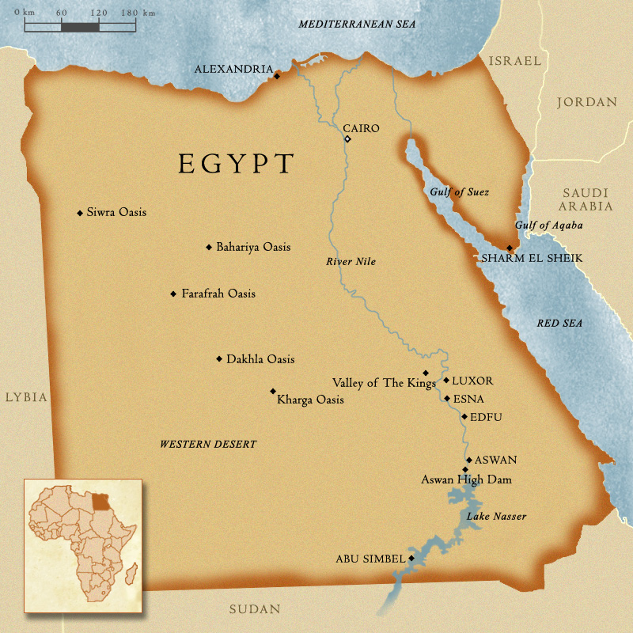
“Let My People Go”
Exodus 5-6
Goshen
And the Lord spake unto Moses, Go unto Pharaoh, and say unto him, Thus saith the Lord, Let my people go, that they may serve me.
Exodus 8:1

Slide 2
Aaron and Moses in Egypt
Goshen
Moses and Aaron obeyed the Lord by commanding Pharaoh to let the children of Israel go into the wilderness to worship the Lord
Exodus 5:1-2

Slide 3
Pharaoh's Refusal
God gave the pharaoh a chance to let Israel go, of his own free will, to worship God. Through his refusal the pharaoh could blame no one but himself for the consequences.
What happened after Moses and Aaron asked Pharaoh to let the Israelites go?
Even when we are following the Lord’s commands, we may experience opposition
Exodus 5:3-9

Slide 4
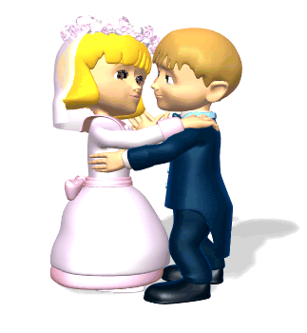

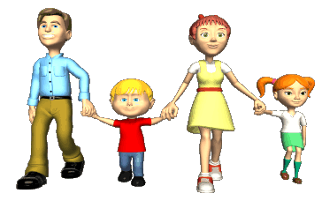
Facing Opposition
Although our opposition will not be like the opposition Moses and Aaron faced from Pharaoh, we all face possible resistance.
1. You choose to use clean language and ask others not to swear when they are around you.
3. You choose to support the roles of men and women as given in the proclamation on the family.
2. You choose to support traditional marriage.
Exodus 5:3-9

Slide 5
Opposition From Pharaoh
When the Israelites failed to make the same amount of bricks as before, the taskmasters beat them.
The Israelite officers complained to Pharaoh about their plight, but he was unsympathetic and rebuked them for being idle.
Exodus 5:10-19

Slide 6
Our Lives Are Harder
…because ye have made our savour to be abhorred in the eyes of Pharaoh, and in the eyes of his servants, to put a sword in their hand to slay us.
They were likely saying that their lives were now harder because of what Moses and Aaron had done
They blamed Moses for Pharaoh’s actions
Moses asked the Lord why he was sent to Pharaoh because the Israelites were now being treated so poorly
Exodus 5:20-24

Slide 7

The Name JEHOVAH
The covenant or proper name of the God of Israel
The King James Version of Exodus 6:3 suggests that the name Jehovah was unknown to Abraham, Isaac, and Jacob.
“And I appeared unto Abraham, unto Isaac, and unto Jacob. I am the Lord God Almighty; the Lord Jehovah. And was not my name known unto them?” (JST, Exodus 6:3.)
The original pronunciation of this name has possibly been lost, as the Jews, in reading, never mentioned it but substituted one of the other names of God, usually Adonai.
Probably it was pronounced Jahveh, or Yahveh.
In the KJV, the Jewish custom has been followed, and the name is generally denoted by Lord or God, printed in small capitals. (1)
Exodus 6:3

Slide 8
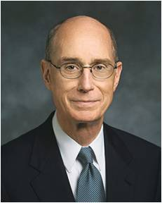
Keeping the Covenant
Why would the Lord deliver Israel out of the bonds of slavery?
The Lord remembers and fulfills His covenants
And whoso receiveth you, there I will be also, for I will go before your face. I will be on your right hand and on your left, and my Spirit shall be in your hearts, and mine angels round about you, to bear you up.
D&C 84:88
“Although His time is not always our time, we can be sure that the Lord keeps His promises.” (2)
Exodus 6:1-5

Slide 9
I Will…
I am the Lord
Give it you for an heritage
Bring you in unto the land
Which I gave to Abraham, Isaac, and Jacob
Take you to me for a people
Be to you a God
And ye shall know that I am the Lord your God
Bring you out from under the burdens of the Egyptians
Rid you out of their bondage
Redeem you with a stretched-out arm
…and with great judgements
Exodus 6:6-8

Slide 10
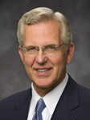


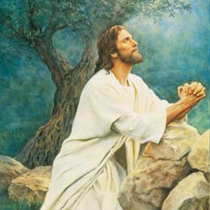
I Will Redeem You
“The word redeem means to pay off an obligation or a debt.
Redeem can also mean to rescue or set free as by paying a ransom. If someone commits a mistake and then corrects it or makes amends, we say he has redeemed himself.
Each of these meanings suggests different facets of the great Redemption accomplished by Jesus Christ through His Atonement, which includes, in the words of the dictionary, ‘to deliver from sin and its penalties, as by a sacrifice made for the sinner’”. (3)
Exodus 6:6

Slide 11

Free From Bondage
The Lord has power to redeem us from our bondage and to lighten or remove our burdens

Slide 12
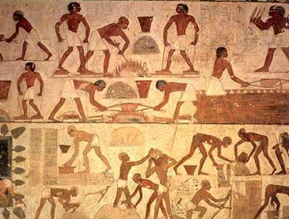
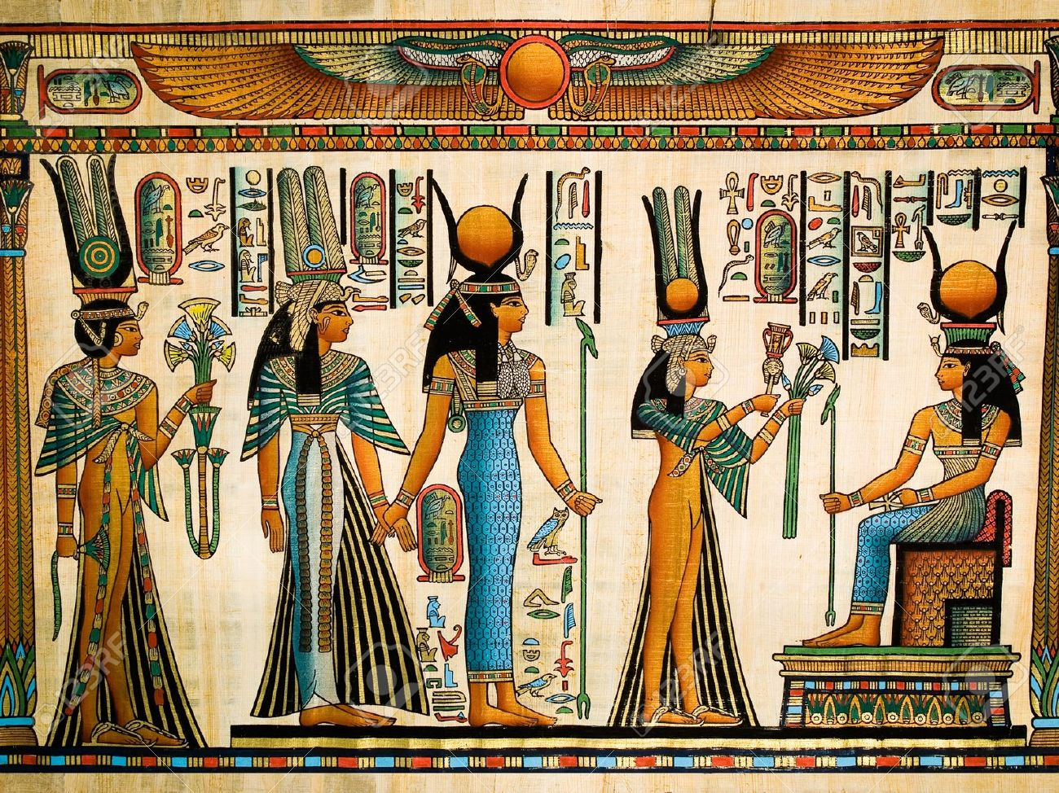
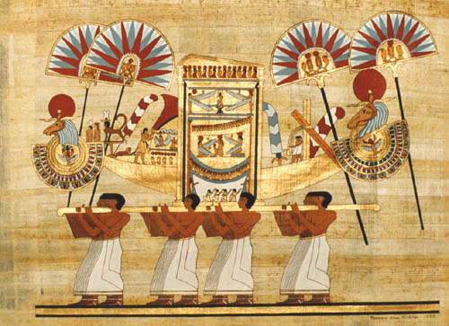
The Israelites
During that time, they were influenced by idol worship and beliefs about Egyptian gods.
The Israelites had been in bondage for 400 years
Acts 7:6
The Israelites responded negatively to Moses because they did not know the Lord and had been in bondage and suffering for a long time.
It was one thing to take the Israelites out of Egypt but quite another to get Egypt out of the Israelites.
Exodus 6:7-13

Slide 13
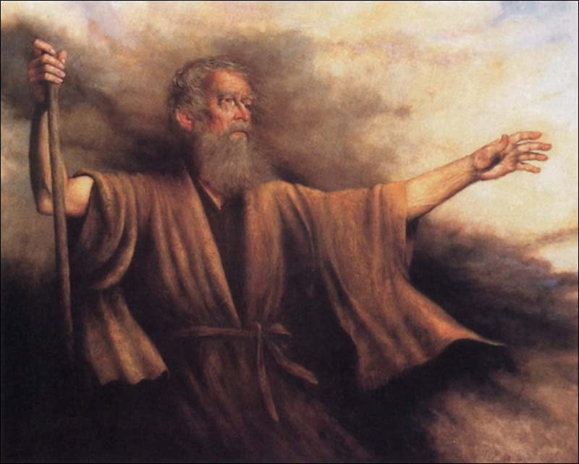
“Uncircumcised Lips”
The Joseph Smith Translation clarifies this statement by saying that Moses had “stammering lips” and was “slow of speech”
And Moses said unto the Lord, O my Lord, I am not eloquent, neither heretofore, nor since thou hast spoken unto thy servant: but I am slow of speech, and of a slow tongue.
Exodus 4:10
The Lord’s response required Moses to exercise faith in the promises the Lord had just made to him. As he followed the Lord’s commands, Moses would receive the Lord’s help.
Exodus 6:7-13, 28-30

Slide 14
Reuben, Simeon, and Levi
Reuben
Simeon
Levi
Lived 137 years
Hanoch
Jemuel
Gershon
Kohath
Merari
Lived 133 years
Pallu
Jamin
Ohad
Libni
Amram
Mahali
Hezron
Lived 137 years
Jachin
Shimi
Izhar
Mushi
Carmi
Zohar
Hebron
Korah
Shaul
Uzziel
Jochebed sister to Kohath
Nepheg
Son of a Canaanitish woman
Zichri
Aaron
Elsheba
Nadab
Assir
Moses
Abihu
Mishael
Zipporah
Korhites
Elkanah
Daughter of Putiel
Eleazar
Elzaphan
Gershom
Abiasaph
Exodus 6:14-30
Zithri
Eliezer
Head of Levites
Ithamar
Phinehas

Slide 15
Sources:
Bible Dictionary—Jehovah
President Henry B. Eyring Where Is the Pavilion? October 2012 Gen. Conf.
Presentation by ©http://fashionsbylynda.com/blog/
3. [Webster’s New World College Dictionary, 3rd ed. (1988), “redeem”] Elder D. Todd Christofferson (“Redemption,” Ensign or Liahona, May 2013, 109).

