Slide 1

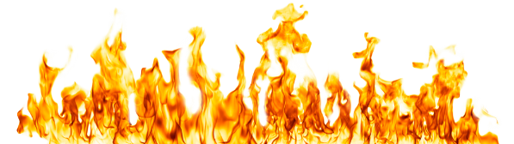
The Plagues
Exodus 7-11

Slide 2
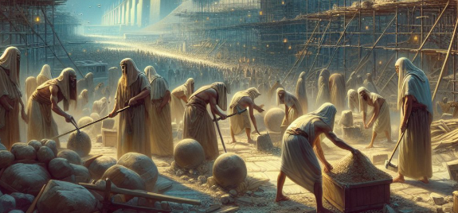
Previously…
The Lord promised Moses that He would bring the Israelites out of bondage. He declared that He would manifest His power to Pharaoh and the Egyptians and that they would have no choice but to set the Israelites free.
And I will take you to me for a people, and I will be to you a God: and ye shall know that I am the Lord your God, which bringeth you out from under the burdens of the Egyptians. Exodus 6:7
And the Egyptians shall know that I am the Lord, when I stretch forth mine hand upon Egypt, and bring out the children of Israel from among them. Exodus 7:5

Slide 3
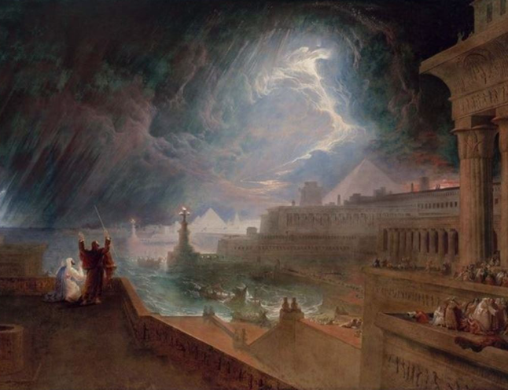
The Lord’s Power
The Lord selected Moses and Aaron to demonstrate His power before Pharaoh. Pharaoh dismissed the Lord’s power. This prompted additional demonstrations of the Lord’s power through plagues that came upon Egypt.

Slide 4
True or False
1. Pharaoh said he was willing to let the children of Israel go free, because he respected the Lord’s power. ________
2. After Moses and Aaron asked Pharaoh to let the children of Israel go, the Israelites were eager to listen to Moses and follow his leadership. _______
3. Moses was confident in his abilities and excited about his responsibility to free the children of Israel from bondage. _______
4. Moses was slow of speech and wondered why the Lord had sent him to free the children of Israel. _______
F
F
F
T
Exodus 5:1-2, 5:19-21, 3:11, 4:10; 5:22-23; 6:12,30

Slide 5
Harden Pharaoh’s Heart
The Prophet Joseph Smith corrected this verse to read that Moses was to be a prophet to the pharaoh rather than a god. (1)
We know that the Joseph Smith Translation changes the text every time it reads that the Lord hardened Pharaoh's heart.
Certainly God does not harden the hearts of men; it is men that harden their hearts toward God. (2)
Exodus 7:1-3; 13 (see footnote 3)

Slide 6
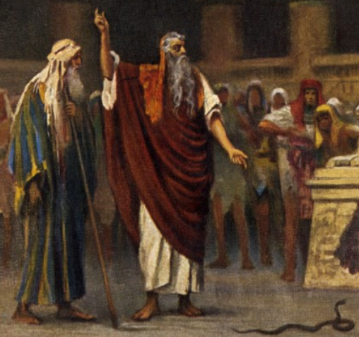
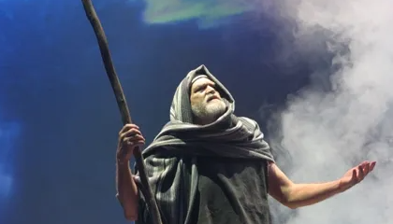
The Rod=God’s Power
In the culture of the Israelites, the rod would be a natural symbol of authority, as the tool used by the shepherd to correct and guide his flock.
Moses' rod is, in fact, carried by him while he tended his sheep; and later became his symbol of authority over the Israelites.
The rods of both Moses and Aaron were endowed with miraculous power during the Plagues of Egypt.
God commanded Moses to raise his rod over the Red Sea when it was to be parted and in prayer over Israel in battle.
Moses brings forth water from a stone using his rod.
Moses’ Rod
Aaron’s Rod
The Lord’s power is greater than the power of mankind, the devil, and the false gods mankind worships
(3)
Exodus 7:8-12

Slide 7
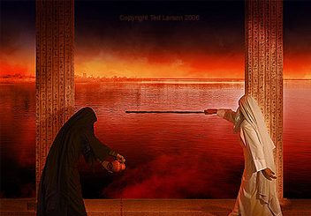
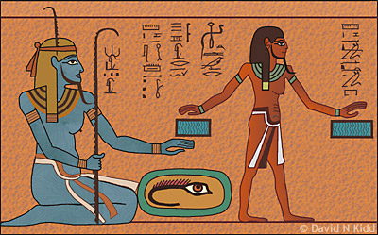
Plague 1
All the water turned to blood and the fish died and the river stank
Blood Dam דם
The Nile was worshiped as a deity
It made all water unusable for bathing or drinking and causes smell of dead fish; this would have robbed the Egyptians of peace and comfort
The Blue Nile god Hapi Hapi was sometimes depicted as a mother hippopotamus or with the head of a mother hippo
(4)
Exodus 7:19-25

Slide 8
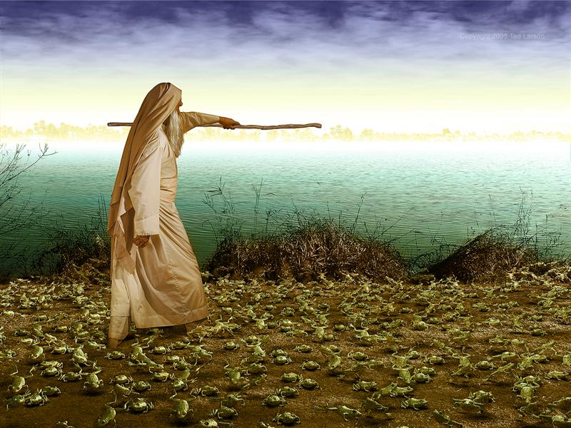
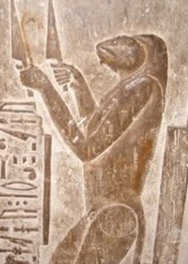
Plague 2
Frogs came up and covered the land of Egypt
Ted Larsen
Frogs Tsephardeda צפרדע
The land stank and made living uncomfortable; they could not sleep because their beds were also invaded
Heqet was most commonly shown with the head of a frog and body of a woman. Egyptian women wore amulets and scarabs with the image of Heqet to protect them during childbirth.
Frogs were so sacred in Egypt that even the involuntary slaughter
of one was often punishable by death
After the second plague, the magicians could no longer replicate the plagues and told Pharaoh, “This is the finger of God”.
(4)
Exodus 8:5-15, 18-19

Slide 9
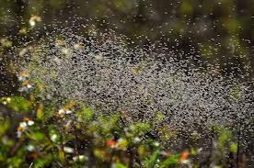
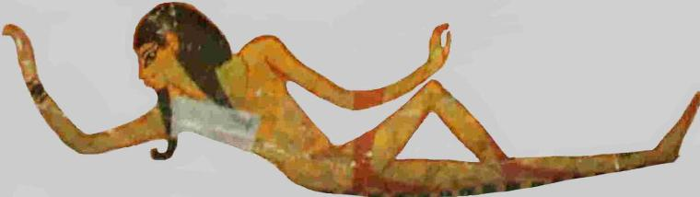
Plague 3
Lice
Gnats/Lice Kinim כינים
An irritating and carried diseases and bite constantly; bites would have caused itching/irritation of skin
The lice originated from the dust of the earth
The Egyptians worshiped Ged (or Geb), the earth god
(4)
Exodus 8:16-19

Slide 10
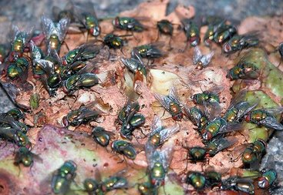
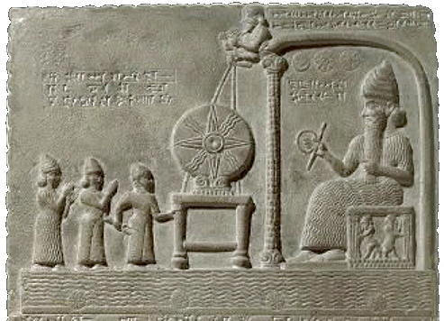
Plague 4
Flies swarm over Egypt
Swarms/Mixture Arov ערוב
They would have picked at food, laid eggs in food, and caused disease; again, allowing no rest for the Egyptians
This plague may have been targeting the Canaanite god “the lord of the flies” or “lord of the high place/high lord” baal zevuv which may have evolved later into Beelzebub
(4)
Exodus 8:20-25, 29-32

Slide 11
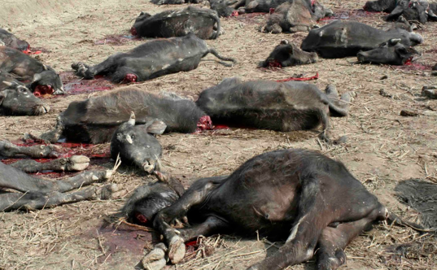
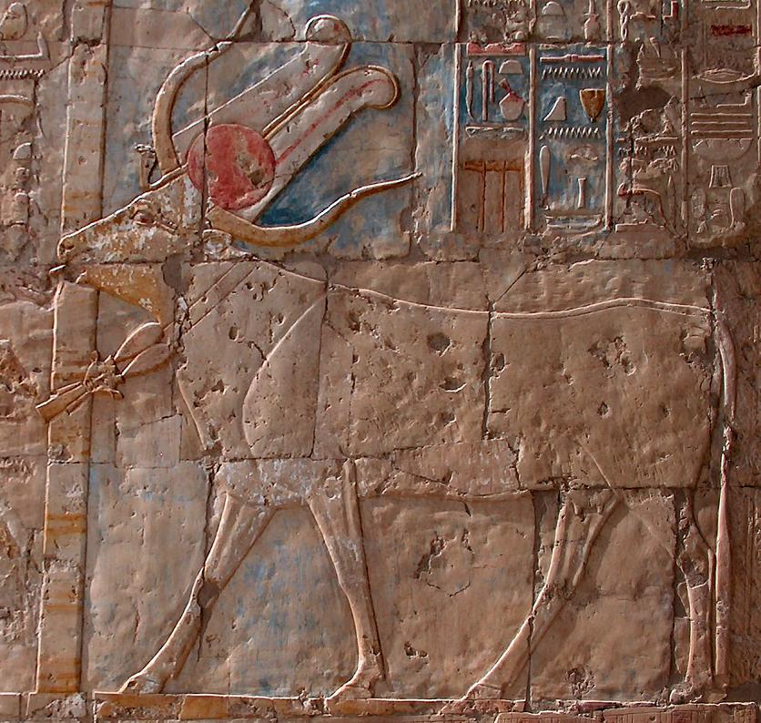
Plague 5
Infectious disease of livestock
Livestock Pestilence דבר
Flies and gnats carrying diseases from dead fish and frogs; killed sacred animals and food sources
The god Apis was represented as a bull
Apis was the most important of all the sacred animals worshiped in Egypt
In connection to crops, herds, fertility, resurrection, and Pharaoh’s strength and fertility
(4)
Exodus 9:1-7

Slide 12
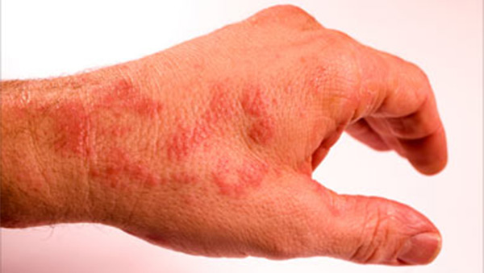
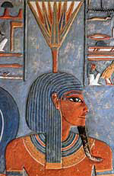
Plague 6
Boils afflict man and beast
Boils Shchin שחין
The first plague to harm the physical bodies of the Egyptians
Thoth, the Egyptian god credited with inventing medicine among many other arts and sciences, was unable to cure the boils; depicted with head of either an ibis (bird) or baboon
Nefertem god of healing and beauty; originally a water lily; son of the sky god and earth goddess; would mature to be Ra; Egyptians carried a small statue of him as a good luck charm
(4)
Exodus 9:8-12

Slide 13
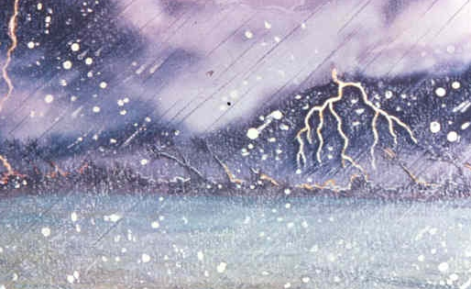
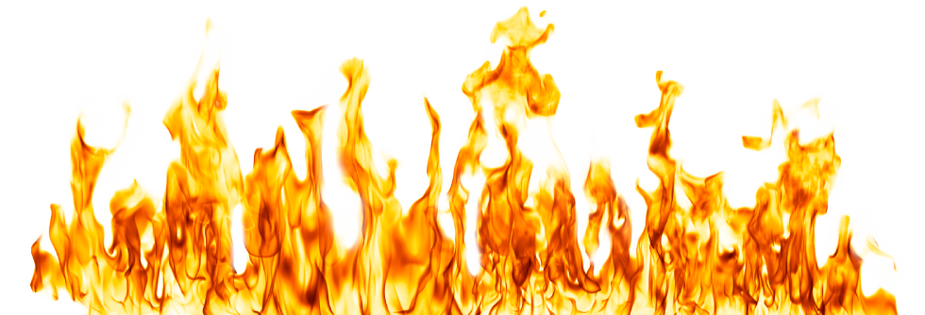
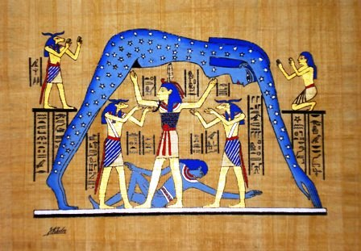
Plague 7
Thunder and Hail
Only in the land of Goshen, where the children of Israel were, was there no hail.
Hail Barad ברד
Destroys people, animals, crops, land and green things
Egyptian goddess Nut, goddess of the sky who covers the earth; she was called “she who bore all the gods” and “she who protects Ra” (the sun god) and “she who holds a thousand souls”
Tefnut, goddess of moisture and rain; mother of Nut (goddess of the sky); depicted many ways: a lioness with female body, female only, a serpent, or lion headed serpent
(4)
Exodus 9:22-29, 33-35

Slide 14
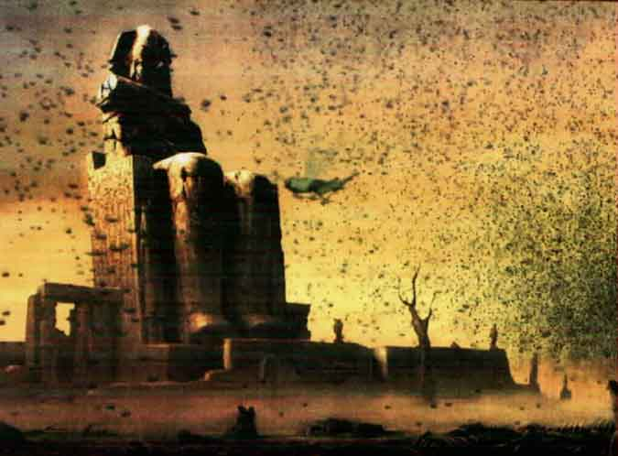
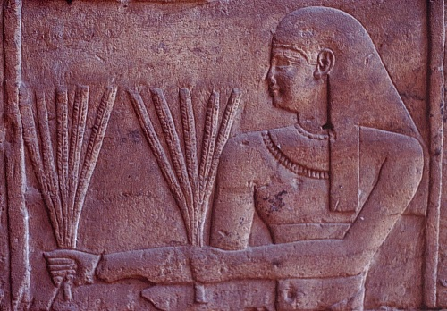
Plague 8
Locust destroy grain, herbs, and fruit
Locust (Many) Arbeh ארבה
Destroyed what the hail did not
Covered the land so no one could even see the land
Ate every green tree; filled houses of Egyptians
The god Nepri (god of grain)
(4)
Exodus 10:12-20

Slide 15
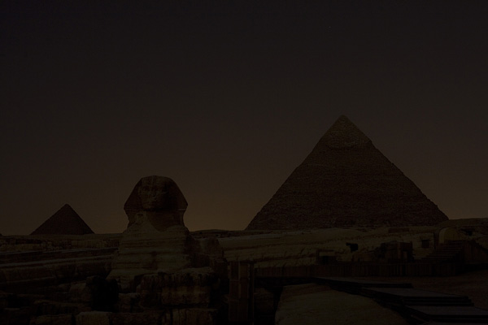
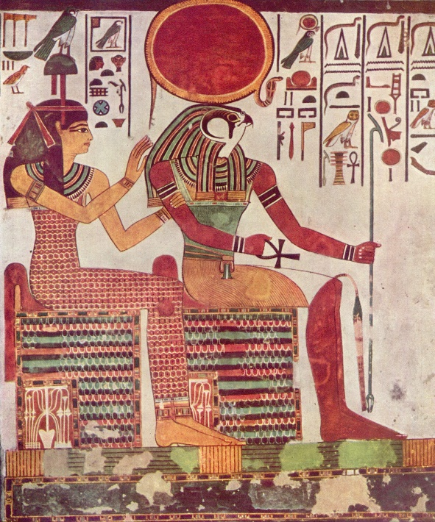
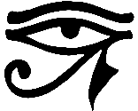
Plague 9
Thick darkness in all the land for 3 days
Darkness Hosek חושך
Ra, Egyptian sun god
Associated with hawk or falcon; thought to rule the sky, earth, and underworld
Ra sent his eye (the all-seeing eye) in the form of Sekhmet (lioness; warrior goddess of healing) to punish the humans
(4)
Exodus 10:21-27

Slide 16
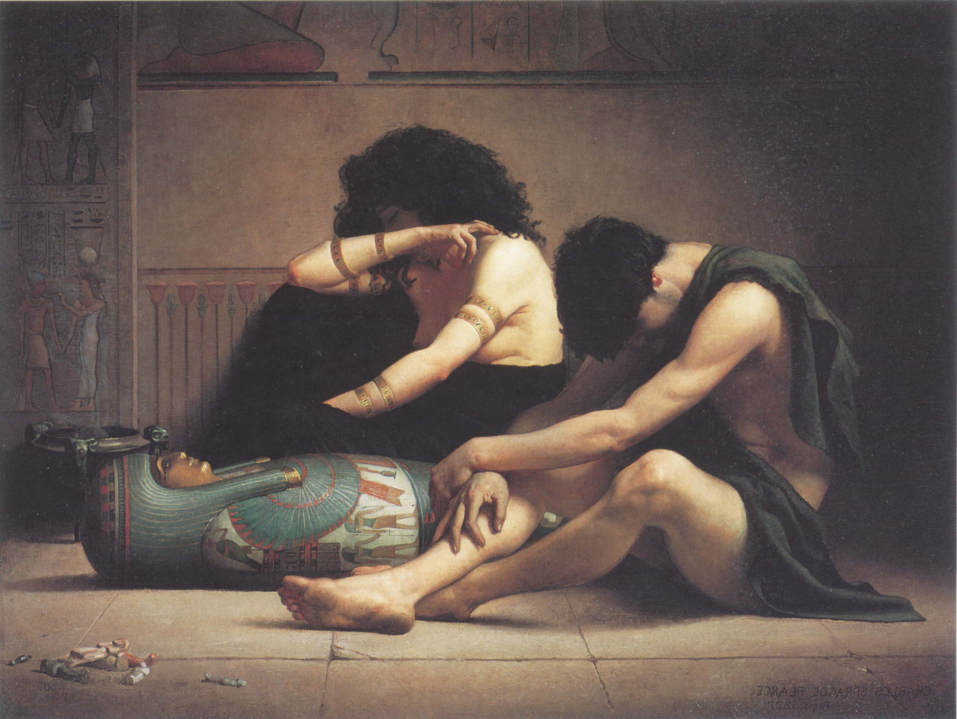

Plague 10
Death of Firstborn
Charles Sprague Pearce
Death of the Firstborn Bekor (Firstborn) Makot (Plague) מכת בכורות
Min: the god of procreation
Isis: the goddess of fertility
Selket: the guardian of life
Renenutet: cobra-goddess who was the guardian of Pharaoh
Bastet or Bast: protector of the pharaoh and solar goddess; depicted as a lioness or cat
(4)
Exodus 11:4-10, 12:29-33

Slide 17
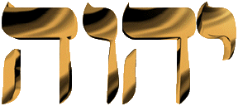
The Egyptian Gods Could Not Save Them
The Egyptians and the Israelites had been steeped in Egyptian culture for 400 years. The Israelites soon saw the Pharaoh (a self-proclaimed god) and the other Egyptian gods rendered helpless against YHVH. That made them more confident in trusting YHVH to lead them out and to make YHVH their only God.
In the Tanakh, YHVH is the personal name of God and his most frequent designation, occurring over 6,800 times. This is the Ineffable Name or Unutterable Name of the God of Israel. Because it is composed from the four Hebrew Letters Yod, Hey, Vav, and Hey, It is also referred to as the “Tetragrammaton,” which simply means “the four letters.” (Hebrew for Christians.com)
(4)

Slide 18
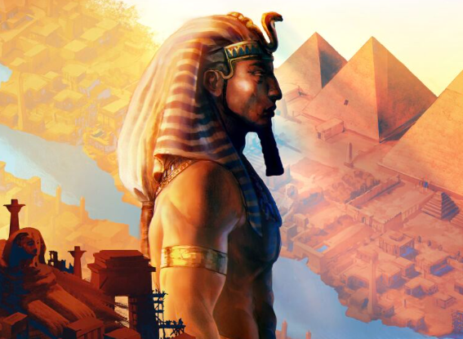
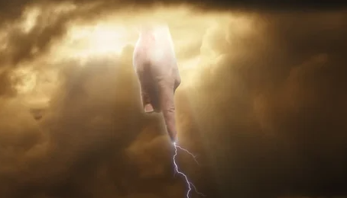
Why So Many Plagues?
The plagues served several purposes. One of those was to show Pharaoh, Egypt, and the Israelites that Jesus Christ (Jehovah) is more powerful than the false Egyptian gods.
Egypt had many false gods, including the pharaoh himself.
“[Some] interpreters suggest a symbolic correlation between each plague and an Egyptian deity, assuming they were each meant to demonstrate Jehovah’s superiority over a specific god. This explanation is difficult to confirm in every case. …
[However,] there is no doubt that the plagues as a whole were intended to demonstrate the power of Jehovah over the Egyptian pantheon, which included the divine Pharaoh himself”
(6)

Slide 19

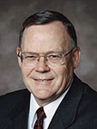
Pharaoh Had So Many Opportunities
“Individual agency is so sacred that Heavenly Father will never force the human heart, even with all His infinite power.
Man may try to do so, but God does not.
To put it another way, God allows us to be the guardians, or the gatekeepers, of our own hearts.
We must, of our own free will, open our hearts to the Spirit, for He will not force Himself upon us.” (5)
The Lord allows us opportunities to soften our hearts and repent, but He will not force us to repent.

Slide 20
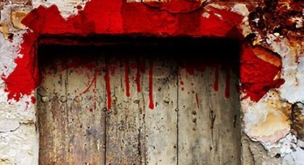
Sources:
1. Student Manual Institute Old Testament
2. Gospel Doctrine.com
Presentation by ©http://fashionsbylynda.com/blog/
3. Wikipedia
4. The 10 Plagues of Egypt Published by Voice in the Desert
Elder Gerald N. Lund (“Opening Our Hearts,” Ensign or Liahona, May 2008, 33).
Richard Neitzel Holzapfel, Dana M. Pike, and David Rolph Seely, Jehovah and the World of the Old Testament: An Illustrated Reference for Latter-day Saints [2009], 90.

Slide 21
Plague | Verses to study
1. Water turned to blood | Exodus 7:19–25
2. Frogs come upon the land | Exodus 8:5–15 (Note: “Respite” means rest or relief)
3. Lice | Exodus 8:16–19
4. Flies | Exodus 8:20–25, 29–32
5. Cattle die | Exodus 9:1–7
6. Boils | Exodus 9:8–12
7. Hail and fire from the sky | Exodus 9:22–29, 33–35
8. Locusts | Exodus 10:12–20
9. Darkness | Exodus 10:21–27
10. Death of Firstborn | Exodus 11:4-10, 12:29-33

Slide 22
Magicians?
“All down through the ages and in almost all countries, men have exercised great occult and mystical powers, even to the healing of the sick and the performing of miracles. Soothsayers, magicians, and astrologers were found in the courts of ancient kings. They had certain powers by which they divined and solved the monarch’s problems, dreams, etc. One of the most striking examples of this is recorded in Exodus, where Pharaoh called ‘the wise men and the sorcerers’ who duplicated some of the miracles the Lord had commanded Moses and Aaron to perform. When Aaron threw down his rod, it became a serpent. The Egyptian magicians threw down their rods, and they also became serpents. …
“… The Savior declared that Satan had the power to bind bodies of men and women and sorely afflict them [see Matthew 7:22–23; Luke 13:16]. If Satan has power to bind the bodies, he surely must have power to loose them. It should be remembered that Satan has great knowledge and thereby can exercise authority and to some extent control the elements, when some greater power does not intervene.” (Joseph Fielding Smith, Answers to Gospel Questions, 1:176, 178.)
Magicians: The devil is the father of lies, and he is ever anxious to frustrate the work of God by his clever imitations. President Dallin H. Oaks (“Two Lines of Communication, “ Ensign or Liahona, Nov. 2010, 84
The Bible generally prohibits "magic" in the sense of sorcery, divination, and consulting spirits or the dead, viewing these acts as an "abomination to the Lord" and works of the flesh that lead people away from God. Key passages like Deuteronomy 18 list various forms of these practices and condemn them, while the New Testament includes sorcery in its lists of sins. However, the Bible does not prohibit the modern art of stage magic or illusions that are clearly understood as tricks and do not involve supernatural powers or deception.
Old Testament Prohibitions
Deuteronomy 18:10-11: lists various forbidden practices, including divination, sorcery, omen interpretation, witchcraft, spells, mediumship, and necromancy (consulting the dead).
Exodus 22:18: states, "You shall not permit a sorceress to live," highlighting the severity of these offenses.
Leviticus 19:31: warns against turning to mediums or spiritists.
1 Samuel 28: details King Saul's downfall and death for consulting a medium.
New Testament Condemnations
Galatians 5:19-21: includes sorcery among the "works of the flesh" and states that those who practice them will not inherit God's kingdom.
Revelation 21:8: places sorcerers among those assigned to the lake of fire.
Distinguishing Biblical Magic from Stage Magic
Source of Power:
Biblical prohibitions are against practices that involve seeking supernatural power from sources other than God, such as evil spirits or the deceased.
Intent and Purpose:
The magic condemned in the Bible was often for manipulating events, harming enemies, or gaining forbidden knowledge, rather than entertainment.
Miracles vs. Magic:
Biblical miracles, like those performed by Moses or the apostles, originate from God's direct intervention, whereas magic relies on human effort or demonic forces. Modern stage magic is a form of illusion or trickery, not a supernatural power. AI
Attempting to Explain the Plagues:
There have been numerous attempts through the ages to explain the plagues described in these chapters of Exodus. Some have tried to show that the various plagues were the result of some natural phenomenon such as passing meteorites or the explosion of a volcanic island in the Mediterranean Sea. While there is some degree of logical progression in the plagues (the river’s pollution could have driven the frogs out of the marshes to die, and this situation would then have bred lice, flies, and disease), it is not possible at present to explain how the Lord brought about these miraculous events. The fact that the plagues were selective (that is, sent upon the Egyptians but not the Israelites) adds to their miraculous nature. God often works through natural means to bring about His purposes, but that fact does not lessen the miraculous nature of His work. In the plagues and eventual deliverance of Israel from the bondage of Egypt is a record of remarkable and miraculous intervention by God in behalf of His children. How He actually intervened is not nearly so significant as that He did intervene.

