Slide 1

The Red Sea
Exodus 14-15
Moreover, brethren, I would not that ye should be ignorant, how that all our fathers were under the cloud, and all passed through the sea;
And were all baptized unto Moses in the cloud and in the sea;
1 Corinthians 10:1-2

Slide 2

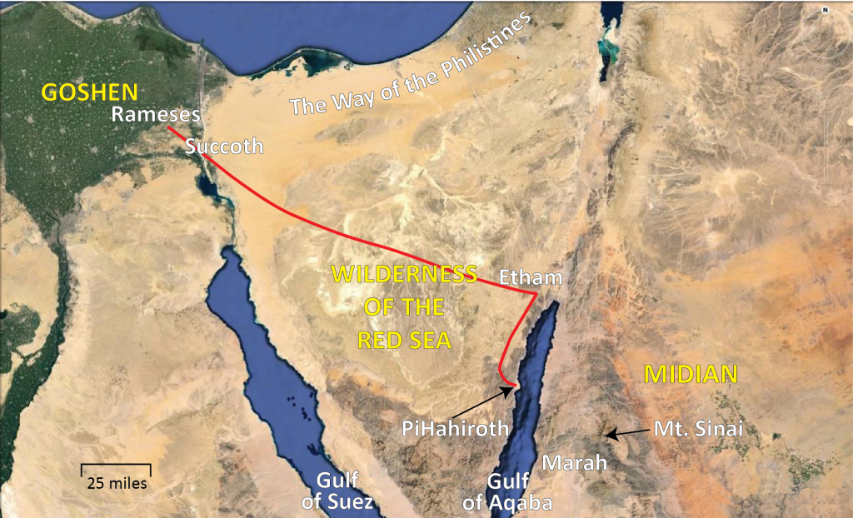
From Goshen to The Red Sea
They left Rameses and assembled in Succoth, which was very near, but at the same time, outside of the boundary of Egypt “proper.”
So this day shall be to you a memorial; and you shall keep it as a feast to the LORD throughout your generations. You shall keep it as a feast by an everlasting ordinance. Seven days you shall eat unleavened bread. On the first day you shall remove leaven from your houses. For whoever eats leavened bread from the first day until the seventh day, that person shall be cut off from Israel (Exodus 12:14-15).

Slide 3
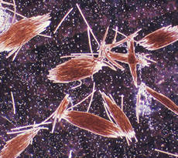
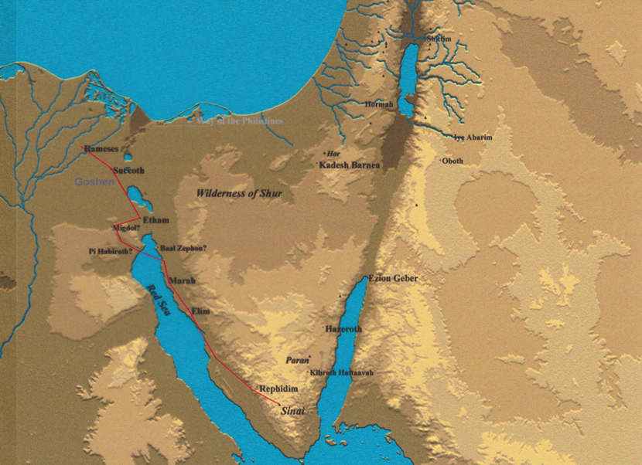
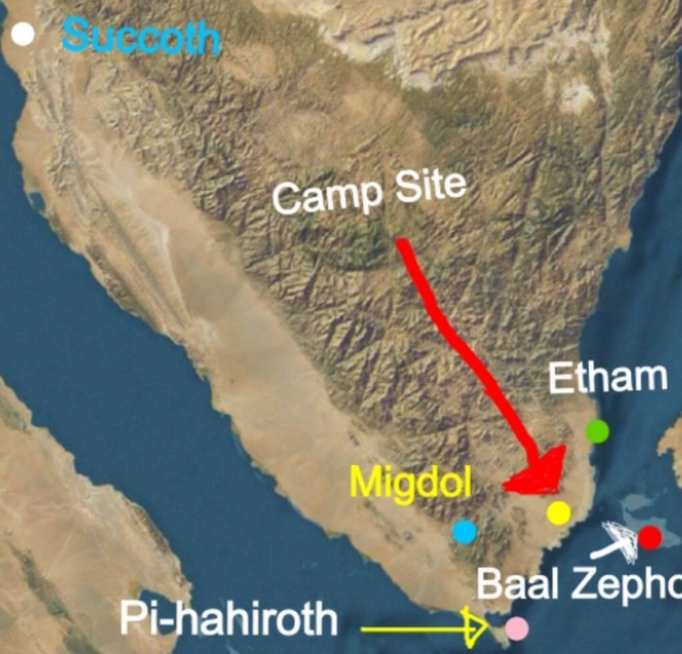
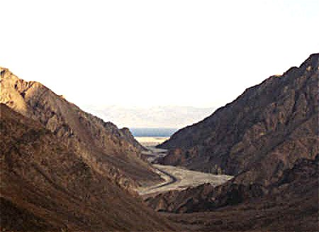
To Be Trapped
The name of the sea may signify the seasonal blooms of the red-coloured Trichodesmium erythraeum (sea sawdust) near the water's surface.
The Mountains are 300 Meters High
The beach is 4.25 miles long by 2 miles wide
The Red Sea is one of the saltiest bodies of water in the world.
The crossing is about 12 miles
Exodus 14:2

Slide 4
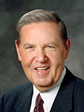
“The children of Israel [were in a] horrible predicament. … There were chariots behind them, sand dunes on every side, and just a lot of water immediately ahead. … In this case it was literally a matter of life and death” (1)

Slide 5
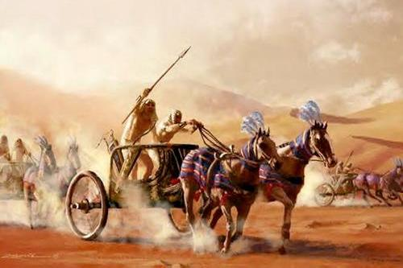
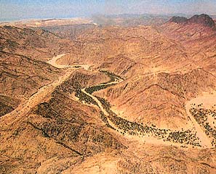
Pharaoh’s Army
" Now when the Egyptians had overtaken the Hebrews, they prepared to fight them, and by their multitude they drove them into a narrow place; for the number that pursued after them was six hundred chariots, with fifty thousand horsemen, and two hundred thousand footmen, all armed.
They also seized on the passages by which they imagined the Hebrews might fly, shutting them up between inaccessible precipices and the sea; for there was on each side mountains that terminated at the sea, which were impassable by reason of their roughness, and obstructed their flight; wherefore they there pressed upon the Hebrews with their army, where the ridges of the mountains were closed with the sea; which army they placed at the gaps of the mountains, that so they might deprive them of any passage into the plain ..."
Exodus 14:5-9
(2)

Slide 6
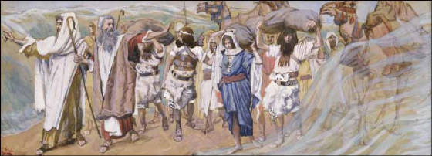
Israelites Fear Pharaoh
Having second thoughts?
Do the Israelites want to return to Egypt for fear of being killed?
Is this the easier way out of tough bind?
Exodus 14:10-12

Slide 7
How Do You Deal With Fear?
How the person deals with these feelings can make a big difference in the outcome of the situation.
Understand the Problem
Control
Maintain Balance
Avoid denial or justification for the problem
Focus attention and efforts on what you can change, not on what you can’t.
By:
Reading scriptures
Praying
Continuing to attend Church
The Lord shall fight for you, and ye shall hold your peace.
Trust in the Lord
Exodus 14:10-14
(3)

Slide 8
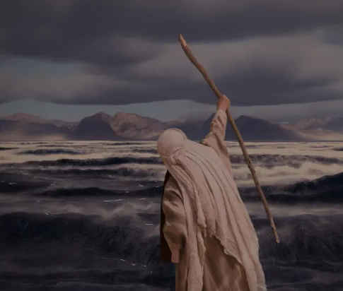
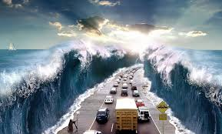
He Shall Fight For You
Moses was telling the Israelites not to be afraid and to stand firm and watch God do His work of salvation for them; they would no longer need to worry about the Egyptians.
Sometimes the Lord fights for us by solving our problems. Other times He fights for us by giving us the strength or knowledge we need to face the challenges of life.
As we trust in the Lord, He will fight for us.
Exodus 14:13-14

Slide 9
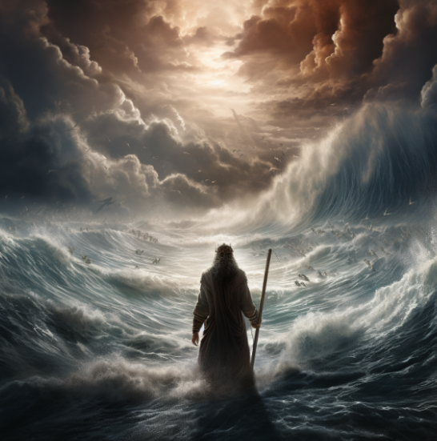
Why The Red Sea?
The Lord may have had at least two reasons for taking Israel through the Red Sea. First, the action displayed His awesome and great protective power. He was the only warrior in this battle against one of the most formidable armies in the world. Therefore, this event was the prelude and proof of His demand henceforth for trust and obedience.
Second, when that battle was over, the power of the Egyptian army was destroyed. The time necessary for rebuilding Egypt’s power left Israel unmenaced until she became established in the promised land.
Exodus 14:21-29
(4)

Slide 10
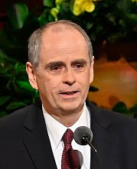
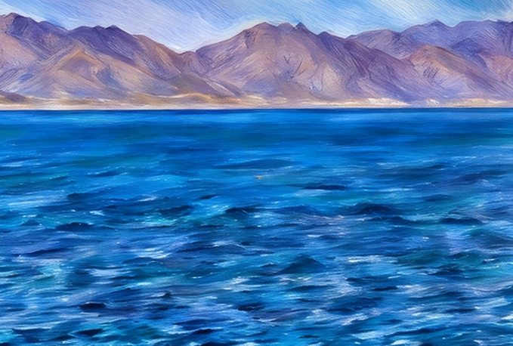
Challenges
My father used to tell me, “Don’t focus so intensely on your problems that you can’t see the solution.”
I testify that the Lord Jesus Christ is the solution to even our most difficult problems.
The Lord Jesus Christ lives today. He can be an active, daily presence in our lives. He is the solution to our problems, but we must lift our eyes and raise our sights to see Him. He has said, “Look unto me in every thought; doubt not, fear not” (8)
Focusing on Jesus Christ can increase our hope during challenges and trials.
Exodus 14:21-29
(4)

Slide 11
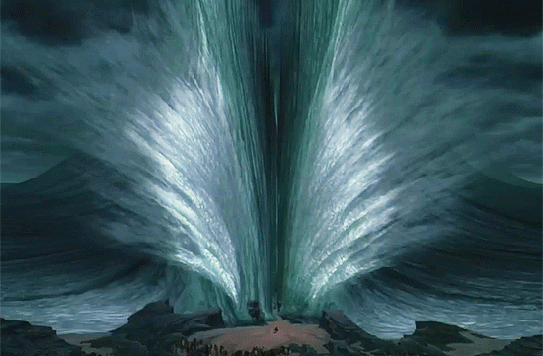

Songs of Praise
The Lord is my
strength and song, and he is become my salvation:
he is my God, and I will prepare him an habitation; my father’s God, and I will exalt him.
It is important to thank the Lord for what He has done for us
Exodus 15:1-19
(5)

Slide 12
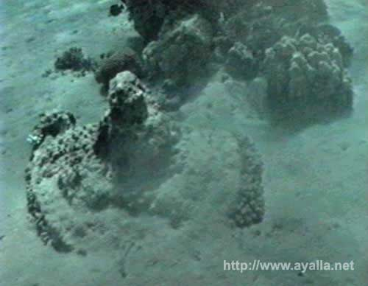
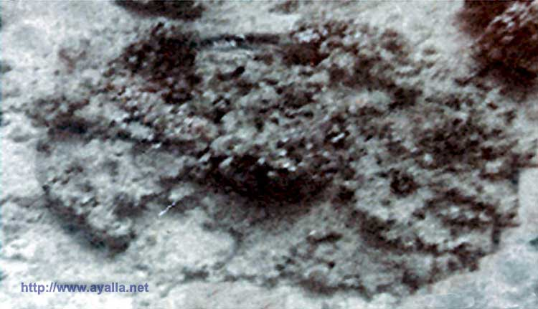
The Great Work of the Lord
In 1978, Ron Wyatt on his first dive at the site of Nuweiba , found chariot remains.
These were not in perfect condition and required careful examination to see exactly what they were.
They were covered in coral, which made it difficult to see them clearly,
but it appears that the coral was the agent the Lord used to preserve them.
Recognizing the works of the Lord in our lives can help increase our trust and faith in Him
Exodus 15:4-5
(5)

Slide 13
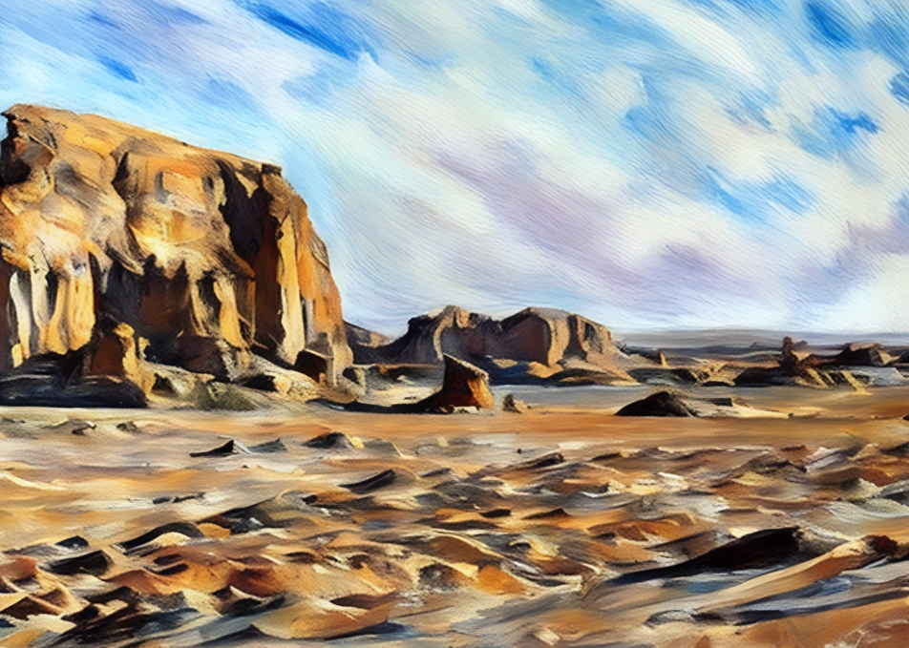
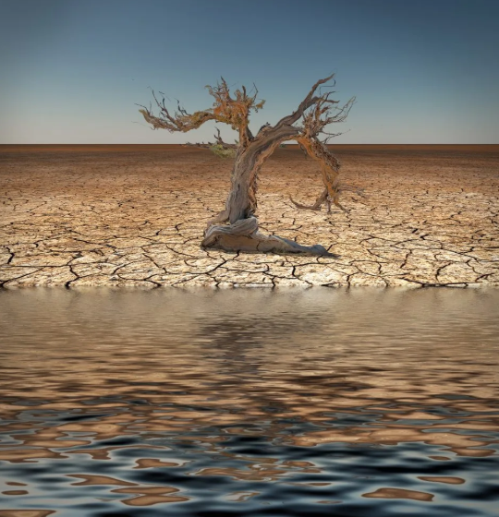
Healing Marah
Through the wilderness of Shur; and they went three days in the wilderness, and found no water.
Murmuring seems to have been a dominant part of their natures and a root of some of the problems they faced.
Murmuring is defined as “a half-suppressed or muttered complaint” (6)
Having just witnessed these great demonstrations of God's power, the children of Israel were quick to forget and quick to complain. Only three days journey from the Red Sea, the Israelites complain of thirst.
He shows Moses a tree, which when cast into the bitter waters of Marah, heals them (foreshadowing the Messiah healing the waters of the Dead Sea after the Second Coming)
Exodus 15:22-25
(7)

Slide 14
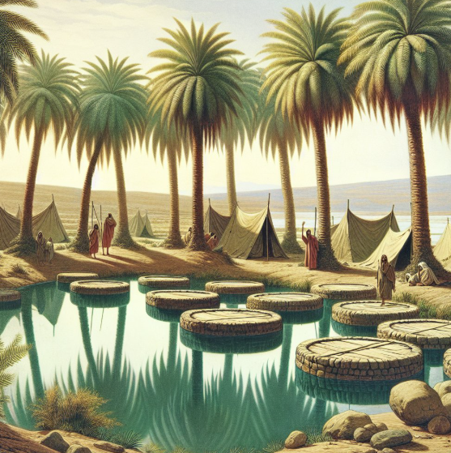
12 Wells of Water
And they came to Elim, where were twelve wells of water, and threescore and ten palm trees: and they encamped there by the waters..
This verse comes at the end of the song of Moses and the Israelites, celebrating their deliverance from the Egyptians and their subsequent journey through the Red Sea.
The twelve wells of water symbolize the ample supply of sustenance and refreshment, while the seventy palm trees represent prosperity, peace, and security. This imagery conveys the idea that God not only meets our basic needs but also provides abundantly, exceeding our expectations.
By resting near the abundant supply of water and palm trees, the Israelites found a place of refuge and nourishment.
Exodus 15:27

Slide 15

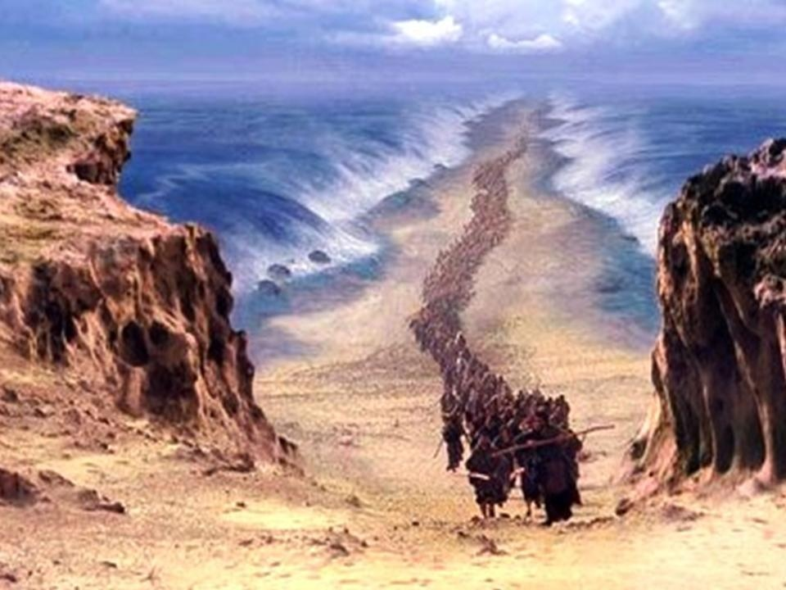
Sources:
“Finding Christ During Difficult Times” (4:35)
“Feeling the Lord’s Love and Goodness in Trials” (4:18)
1. Elder Jeffrey R. Holland (“Cast Not Away Therefore Your Confidence” [Brigham Young University devotional, Mar. 2, 1999], 4; speeches.byu.edu).
2. Josephus "Antiquities of the Jews" Book II, Chapter XV
3. Excerpts from: Hope, Healing, and Dealing with Addiction By Michael D. Gardner July 2008 Ensign
4. Old Testament Institute Manual
5.
Presentation by ©http://fashionsbylynda.com/blog/
6. Webster’s New Collegiate Dictionary, 1979 ed., s.v., “murmur”
7. Gospeldoctrine.com
8. Brother Camargo (“Focus on Jesus Christ,” Liahona, May 2023, 64)
http://www.ayalla.net/modules.php?name=News&file=article&sid=74

Slide 16
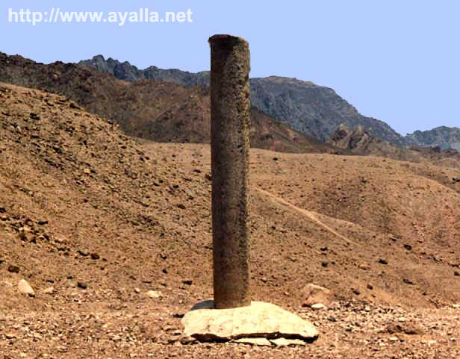
Name of the Red Sea Theory:
A theory favored by some modern scholars is that the name red is referring to the direction south, just as the Black Sea's name may refer to north. The basis of this theory is that some Asiatic languages used color words to refer to the cardinal directions. Herodotus on one occasion uses Red Sea and Southern Sea interchangeably.
Caution against Murmuring:
“I raise my voice on this matter to warn and counsel you to be on your guard against criticism. … It comes, in part, from those who hold, or have held, prominent positions. Ostensibly, they are in good standing in the Church. In expressing their feelings, they frequently say, ‘We are members of the Church, too, you know, and our feelings should be considered.’
“They assume that one can be in full harmony with the spirit of the gospel, enjoy full fellowship in the Church, and at the same time be out of harmony with the leaders of the Church and the counsel and directions they give. Such a position is wholly inconsistent, because the guidance of this Church comes, not alone from the written word, but also from continuous revelation, and the Lord gives that revelation to the Church through His chosen leaders and none else. It follows, therefore, that those who profess to accept the gospel and who at the same time criticize and refuse to follow the counsel of the leaders, are assuming an indefensible position.” (In Conference Report, Apr. 1942, pp. 17–18.)
In 1978, when Ron Wyatt the archeologist first visited the beach area with his two sons, they found a Phoenician-style column lying on the southern end of the beach. But in 1984, when he and his 2 sons, were imprisoned in Saudi Arabia, their captors, in an effort to verify their story that they believed Mt. Sinai was there and that "Musa" (Moses) led the people across the sea to their country, had them take the saudis to the beach where they arrived after passing through the sea and they directed them to the spot in a helicopter.
Landing there, they found another column - identical to the one on the opposite shore (Nuweiba) except this one had the inscriptions intact.
Noting carefully the Phoenician (Archaic Hebrew) letters, they were later able to have it translated.
It contained the words: Mizraim (Egypt); Solomon; Edom; death; pharaoh; Moses; and Yahweh.
From this, Ron knew that King Solomon had erected these columns in honor of god and dedicated them to the miracle of the crossing of the sea.
http://www.ayalla.net/modules.php?name=News&file=article&sid=74
The Wilderness of Shur:
The place where the Midianites, Kenites and Ishmaelites lived was in the wilderness of Shur. The Kenites are a sect of Midianites who descended from Jethro the Midianite (Moses father in law) and their traditional territory was near Midian: Judges 1:16. The Midianites and the Ishmaelites intermarried and became one sect that were indistinguishable at the time Joseph was sold into Egyptian slavery in 1893 BC.
1 Gal. 4:25 says that Mt. Sinai is in Arabia, where Ishmael lived and Ishmael lived in Shur.
Israel crossed the Red sea and spent a total of 5 days in the wilderness of Shur before they entered the wilderness of Sin. Three days en route to Marah, then one day at Elim and one day camped by the Red Sea.
http://www.bible.ca/archeology/bible-archeology-exodus-route-wilderness-of-shur-ishmaelites-midianites-amalekites.htm

Slide 17
Possible Calendar of the Exodus out of Egypt
Sun | Mon | Tues | Wed | Thurs | Fri | Sat
 |  |  |  | 1 Goshen Nissan 14 Passover begins at sundown. Depart Egypt starting midnight | 2 Nissan 15 Numbers 33:3 Left before sundown Ex 12:51 | 3 Pentecost Day 1 of Pentacost start counting 7 more Sabbaths
4 | 5 | 6 | 7 | 8 | 9 Succouth 160 km at 28 km per day (equals 6 days) | 10 Day 8 of Pentecost
11 | 12 | 13 | 14 | 15 Migdol | 16 Etham lyar 1 | 17 Camped at Red Sea
18 Camped at Red Sea | 19 Camped at Red Sea | 20 Camped at Red Sea | 21 Camped at Red Sea | 22 Camped at Red Sea | 23 Camped at Red Sea | 24 Camped at Red Sea
25 Crosed the Red Sea Shadow of the fulfillment of the day of First Fruits (Lev 23:10-12) which always fell on a Sunday. Israel was "saved" by coming through the Red Sea. | 26 Wilderness of Shur | 27 Wilderness of Shur | 28 Marah Bitter waters are turned into pure water | 29 | 30
---------------------Unleavened Bread---------------------------------------
http://www.bible.ca/archeology/bible-archeology-exodus-route-travel-times-distances-days.htm

