Slide 1

My People Are Not Ready
Exodus 17:8-16 and Exodus18-19
Now this Moses plainly taught to the children of Israel in the wilderness, and sought diligently to sanctify his people that they might behold the face of God;
Doctrine and Covenants 84:23

Slide 2

Amalekites
An ancient Arab tribe that existed at the time of Abraham (Gen. 14:7)
They may have been descendants of Esau (see Genesis 36:12, 16)
They were constantly at war with the Hebrews in connection with the Exodus and the return to the Holy Land and attacked the Israelites in a most cowardly way, killing first the feeble, the faint, and the weary at the rear of the marching nation (Deuteronomy 25:17–19)
For this lack of respect toward God, the Amalekites were cursed by the Lord. The Israelites were subsequently commanded to “utterly put out the remembrance of Amalek from under heaven”
The power of the band was eventually broken by
Saul and David
(1 and 2)

Slide 3
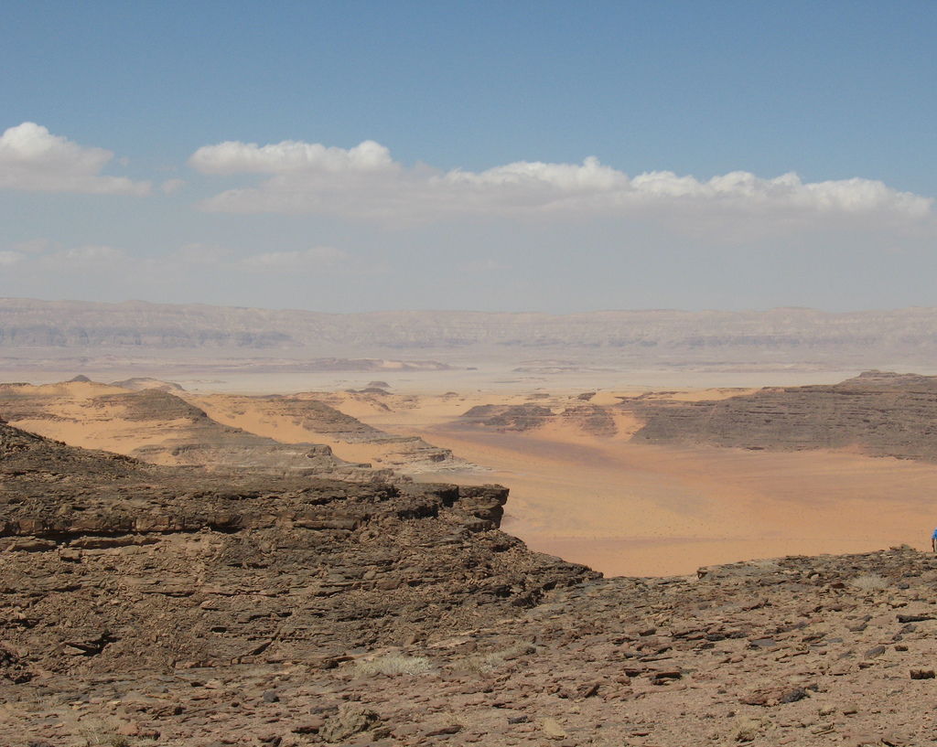
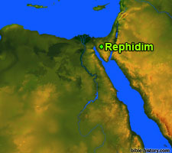
Amalekites Come to Fight
Valley of Rephidim
Exodus 17:8

Slide 4
Joshua
He was the son of Nun; his name meaning “God is help” was born in Egypt while the Israelites were still in bondage
He was chosen to soldier with the leadership of the House of Israel following the days of Moses and was ‘full of spirit of wisdom’
The first thing that the Lord commanded Joshua to do was to have the people cross the Jordan River with the ark of the covenant, which was to be carried by the Levites.
Later, the Lord instructed Joshua to conquer the city of Jericho.
He went into battle with the Ali, but lost because the Israelites had stolen from the spoils of war, but later, after repentance, the Lord helped them to win the battle with Ali
During the battle with the Amorites, the Lord sent hailstones killing more Amorites than Joshua’s army and He stopped the sun and the moon in their places while the army won the battle.
Before he died at the age of 110, he warned the people of worshipping false gods and said, “Choose you this day whom ye will serve; … but as for me and my house, we will serve the Lord.”
He was buried in his own city, Timnath-Serah.
His name has a number of variants in the Old Testament, including Jehoshua (Numbers 13:16, 1 Chronicles 7:27),
Hosea (Deuteronomy 32:44),
and Jeshua (Ezra 2:2, 3:2)
(1 and 3)

Slide 5
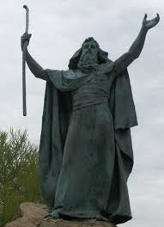
Moses Holds Rod
What happened when Moses held up his hands?
What happened when Moses let down his hands?
Washington Park in Albany, New York.
Exodus 17:8-11

Slide 6
Hur
He was a leading official in Israel who assisted Aaron in supporting the hands of Moses on the hill during the battle in which Joshua prevailed against the Amalekites
He also assisted Aaron in overseeing the people while Moses was on Mount Sinai
(1)

Slide 7
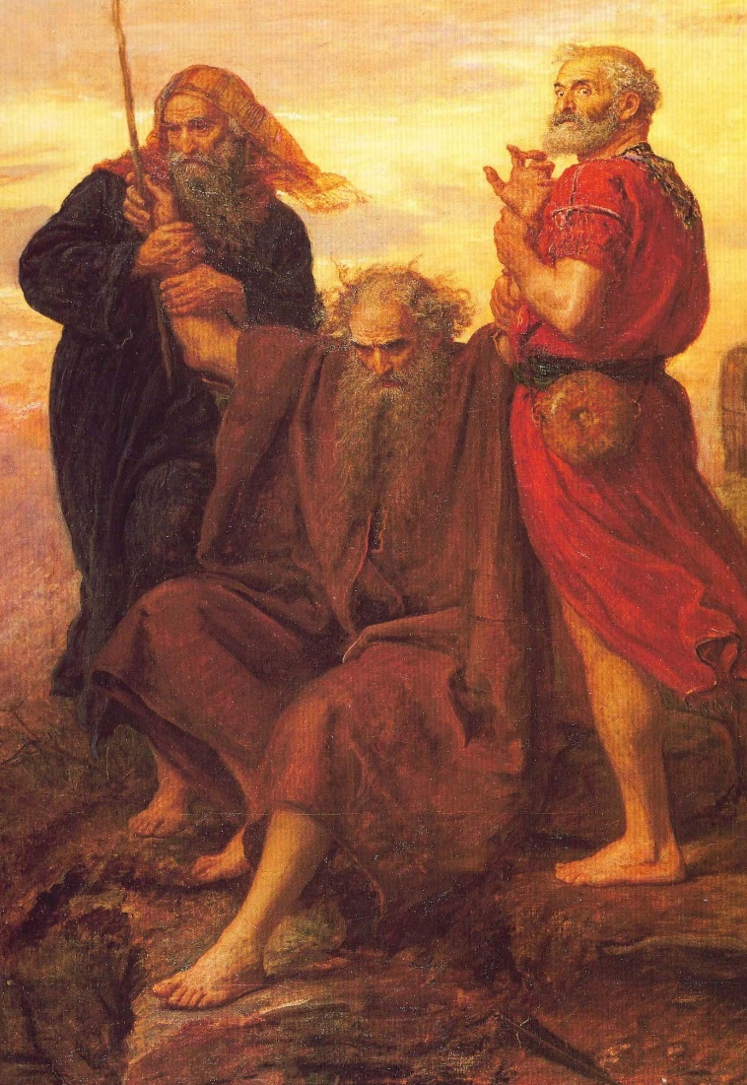
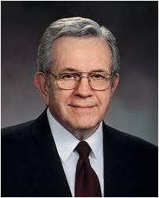
Stay Up His Hands
How long would you be able to hold your arms up if someone else supported them?
“The raising of the hands has been a custom since ancient times, symbolized when Moses was confronted by the Amalekite robbers, the destroyers of the wilderness.”
“The wicked who now oppose the work of the Lord, while different from, are no less terrible than the plundering Amalekites. The sustaining of the prophet is still an essential ongoing part of the safety of this people. Should age and infirmity cause his hands to grow heavy, they are held up by his counselors at his side. Both are prophets, seers, and revelators, as is each member of the Quorum of the Twelve.” (4)
J.E. Millais
Exodus 17:12-13

Slide 8
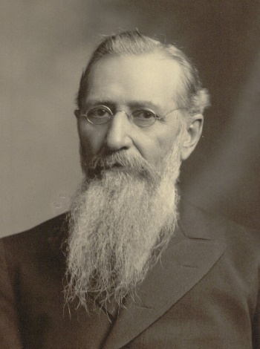
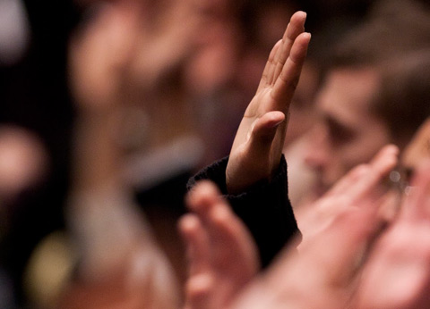
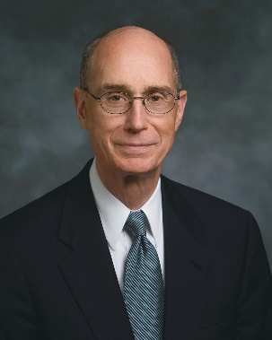
Lifting the Hand--Sustaining
How long would the prophets be able to counsel the saints if they sustained them?
As we sustain the Lord’s prophet and follow his words, we will eventually prevail in our conflict against Satan
“It is an important duty resting upon the Saints who … sustain the authorities of the Church, to do so not only by the lifting of the hand, the mere form, but in deed and in truth.” (5)
“Our sustaining of prophets is a personal commitment that we will do our utmost to uphold their prophetic priorities. Our sustaining is an oath-like indication that we recognize their calling as a prophet to be legitimate and binding upon us.” (6)
Exodus 17:12-13

Slide 9
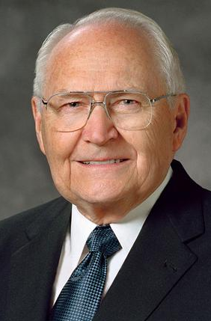
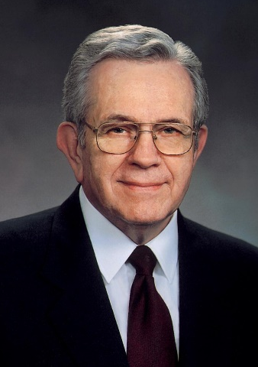
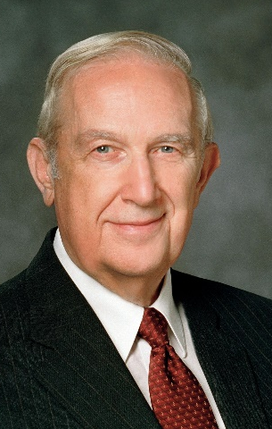
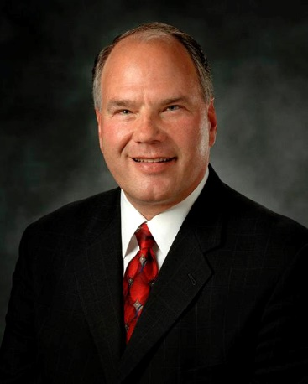
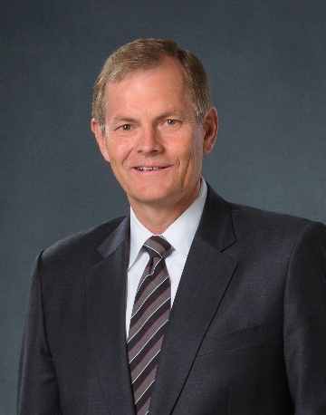
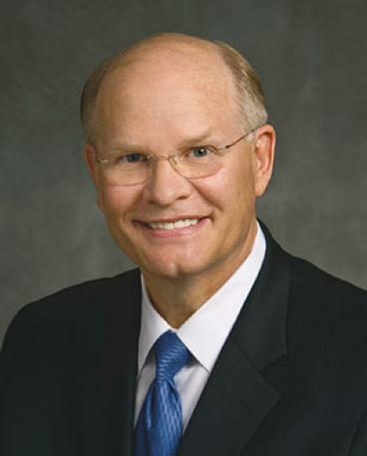
Sustaining
Beloved Departed:
Elder L. Tom Perry, President Boyd K. Packer and Elder Richard G. Scott.
Sustained October 3, 2015
Elder Ronald A. Rasband, Elder Gary E. Stevenson and Elder Dale G. Renlund were named to the Quorum of the Twelve Apostles of The Church of Jesus Christ of Latter-day

Slide 10
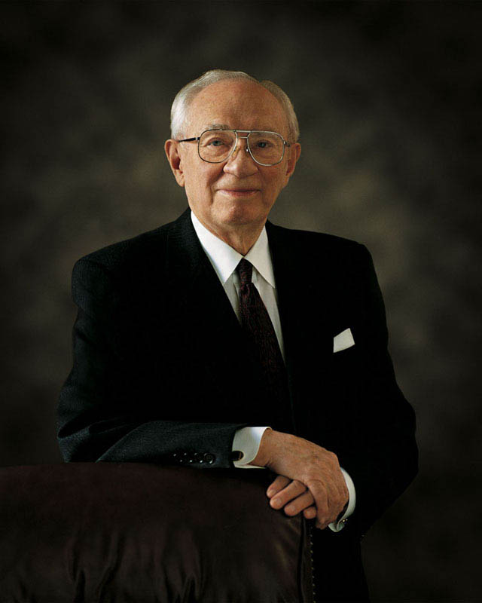
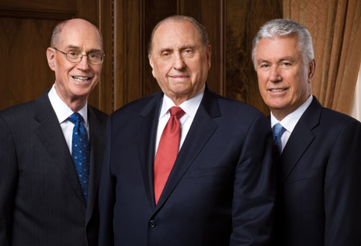
Not Able to Fully Function
“When the President is ill or not able to function fully in all of the duties of his office, his two Counselors together comprise a Quorum of the First Presidency. They carry on with the day-to-day work of the Presidency. …
“… But any major questions of policy, procedures, programs, or doctrine are considered deliberately and prayerfully by the First Presidency and the Twelve together.” (7)
“Despite any health challenges that may come to us, despite any weakness in body or mind, we serve to the best of our ability. I assure you that the Church is in good hands. The system set up for the Council of the First Presidency and Quorum of the Twelve [Apostles] assures [us] that it will always be in good hands and that, come what may, there is no need to worry or to fear. Our Savior, Jesus Christ, whom we follow, whom we worship, and whom we serve, is ever at the helm.” (8)
Exodus 17:12-13

Slide 11
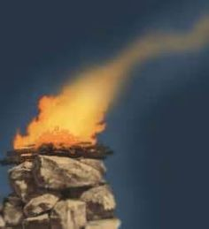
In Remembrance
Moses built an altar in the place where Israel defeated the Amalekites as a memorial for what God had done for them.
And Moses built an altar, and called the name of it Jehovah-nissi:
Exodus 17:15-16

Slide 12
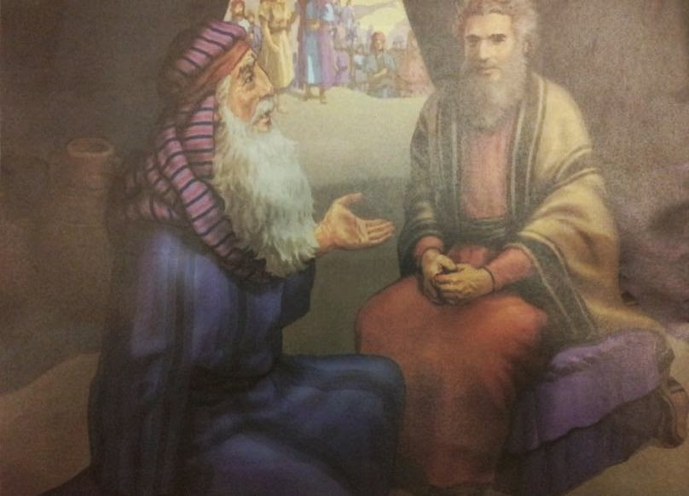
Delegating Responsibilities
What is this thing that thou doest to the people? why sittest thou thyself alone, and all the people stand by thee from morning unto even?
I will give thee counsel, and God shall be with thee:
Pray and Teach
Choose:
Men of ability: able men
Men of godliness: such as fear God
Men of God's Word: men of truth
Men of honor: hating covetousness
When they have a matter, they come unto me; and I judge between one and another, and I do make them know the statutes of God, and his laws.
The thing that thou doest is not good.
Thou wilt surely wear away, both thou, and this people that is with thee: for this thing is too heavy for thee; thou art not able to perform it thyself alone.
Jethro counseled Moses to seek the counsel of the Lord and to delegate responsibilities to honorable men.
Exodus 18:1-27

Slide 13
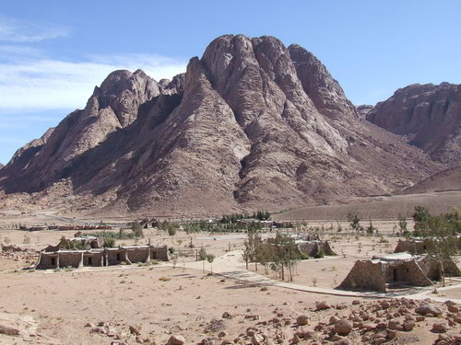
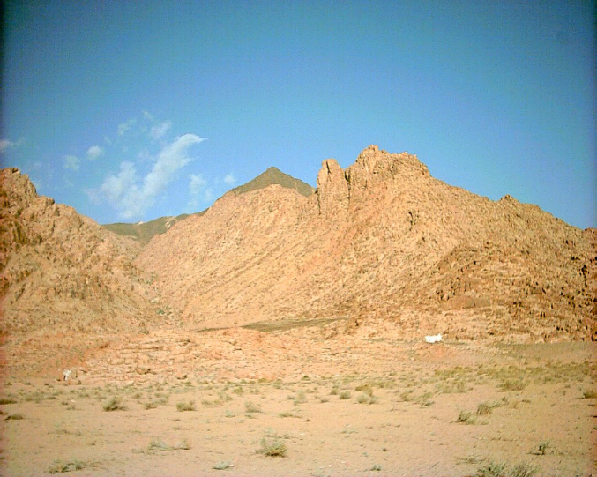
Mt. Sinai
Despite the importance of Mount Sinai, or Horeb, in the Old Testament narrative, biblical scholars are not in agreement regarding the mountain’s location. Much of the confusion is due to a lack of geographical information in the biblical text.
It is difficult to determine if Mount Sinai is, for example, in the north or south of the area we call the Sinai Peninsula or located in another region of the Middle East, such as Arabia. Thus, at least 20 different mountains in the Sinai Peninsula, Jordan, and Saudi Arabia have been identified as possible locations for the mount of God.
Religious and secular scholars typically refer to three specific geographical areas as probable locations for Mount Sinai: southeastern Sinai Peninsula, northwestern Sinai Peninsula, and northwestern Arabia.
Exodus 19:1-2
(9)

Slide 14
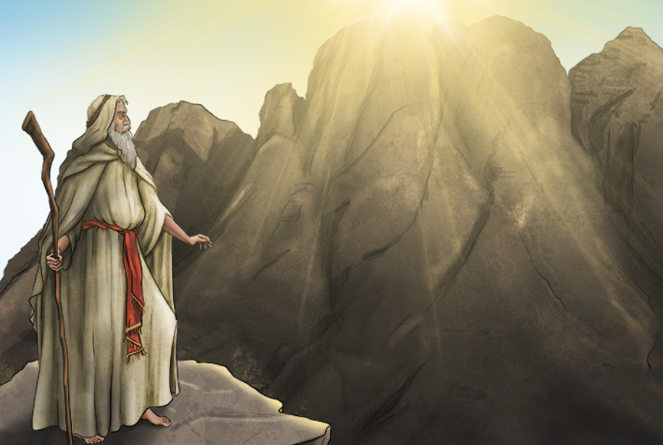
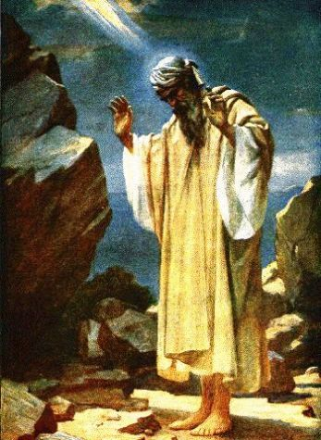
Preparing to Receive Covenants
For Moses and the children of Israel, Mount Sinai was like a temple. Today we go to temples to make covenants that help us become more like our Heavenly Father and prepare us to return to His presence. The Lord brought the children of Israel to Mount Sinai for this same purpose
To prepare the people to enter into a covenant with the Lord, Moses went up Mount Sinai multiple times. There the Lord revealed to him the terms of the covenant—including commandments, laws, and ordinances.
Exodus 19:1-9

Slide 15

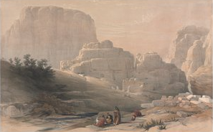
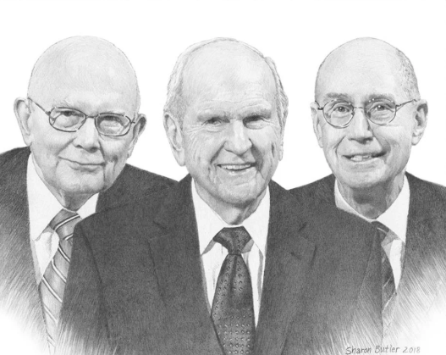
Peculiar = Segullah = Treasure
“valued property”
Now therefore, if ye will obey my voice indeed, and keep my covenant, then ye shall be a peculiar treasure unto me above all people: for all the earth is mine:
Thus, we see that the scriptural term peculiar signifies “valued treasure,” “made” or “selected by God.” For us to be identified by servants of the Lord as his peculiar people is a compliment of the highest order. (6)
Exodus 19:5

Slide 16

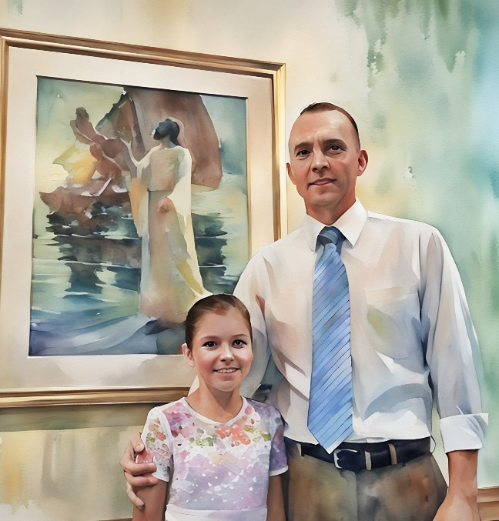
Once you and I have made a covenant with God, our relationship with Him becomes much closer than before our covenant.
Now we are bound together. Because of our covenant with God, He will never tire in His efforts to help us, and we will never exhaust His merciful patience with us.
Each of us has a special place in God’s heart. He has high hopes for us. (6)
Exodus 19:5-6

Slide 17
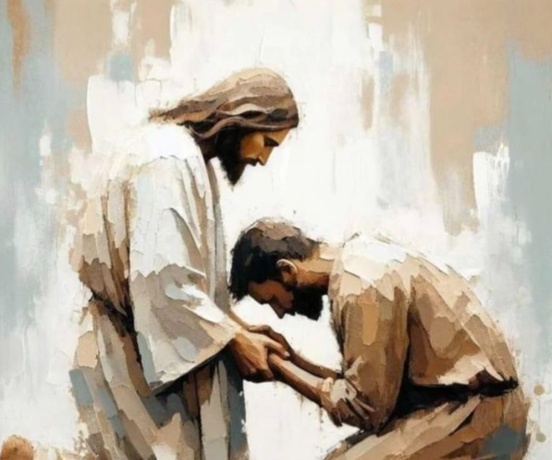
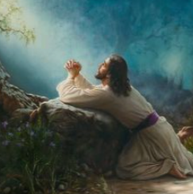
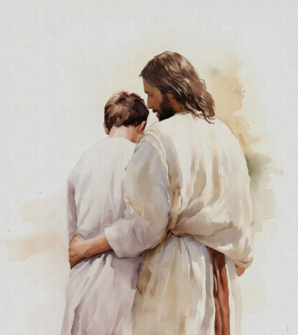
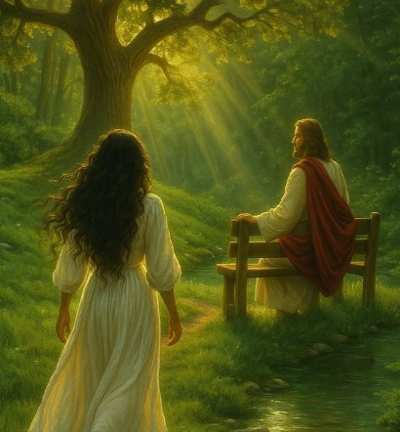
A Covenant Relationship With God
Matthew 11:28–30
1 Peter 1:15–16
The Savior invites us to come unto Him so He can help us and give us rest
We can be holy because the Savior is holy
Moroni 10:32–33
Titus 2:11–14
We are sanctified in Christ through His atonement which is a covenant of the Father for forgiveness of our sins
The Savior gave Himself to redeem and purify us as His peculiar people
Exodus 19:5-6

Slide 18
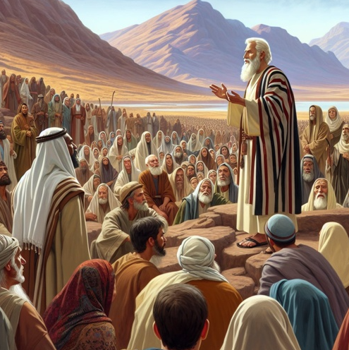
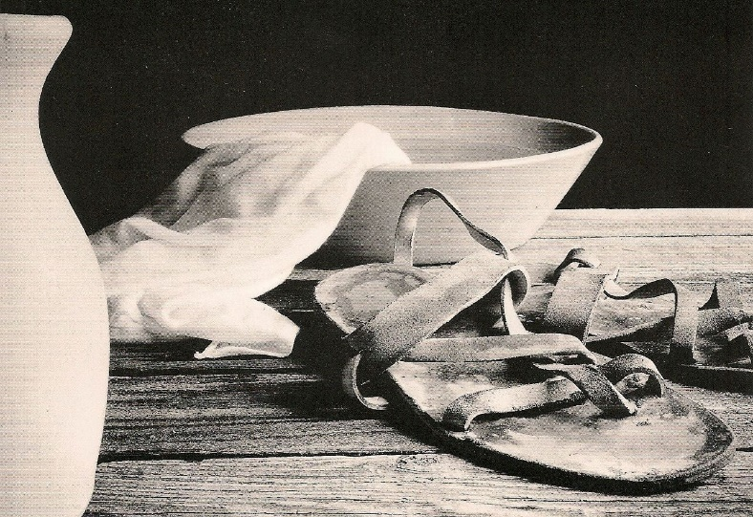
He Offered to Appear Unto Them
“If they had accepted all of the privileges offered them and followed the instructions which would have qualified them to receive the fulfillment of all God’s promises, they could have been accorded the grandest of all revelations:
He offered to come down in the sight of all the people and let them hear when He spoke to Moses that they might know for themselves about His will and His law, and believe in Moses’ future revelations from God, and revere the Lord evermore (cf. Deuteronomy 4:10).
repentance or spiritual cleansing
There was a need of cleanliness and spiritual dedication in their preparation for this great spiritual experience.
Exodus 19:10-24
(2)

Slide 19
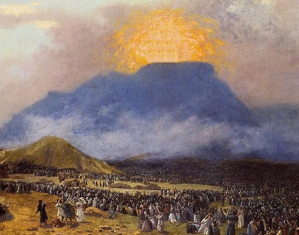
Reveal His Will
There, they saw evidence of the Lord’s presence on the mountain. The Lord called Moses up the mountain to speak with Him and to reveal His will for the people
Exodus 19:18-25

Slide 20
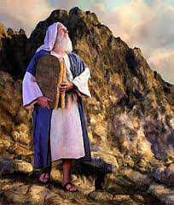
Not Fully Prepared
“At the prearranged signal, the sounding of the trumpet ‘exceeding long,’ the people trembled in anticipation and awe, but apparently they were not fully ready to come up ‘in the sight’ of the Lord on the mount where Moses was, for the Lord told him to go down and warn them not to come up.
But even though their hearts were not fully prepared to endure His presence, they did hear the voice and the words of God as the Ten Commandments were given.
If we obey the Lord’s voice and keep our covenants with Him, then we are His treasured possession and His holy people
Exodus 19:10-24
(2)

Slide 21
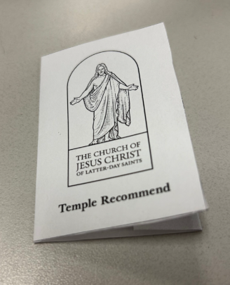
Those Who Are Willing and Prepared
Striving to be holy is an important part of preparing to attend the temple.
Receiving a limited-use temple recommend is an exciting time for many new members and youth in the Church.
During an interview with your bishop, he will ask you questions similar to those you were asked for your baptism.
These include questions about your observance of the commandments and your testimony of the gospel. When you receive your recommend, you can plan a trip to the temple with your family and ward friends.
The limited-use recommend allows you to serve in the baptistry of the temple and to perform baptismal and confirmation ordinances for your deceased family members and others who have died.
(10)

Slide 22
Sources:
Old Testament Who’s Who by Ed J. Pinegar and Richard J. Allen pg. 14, 76, 109-110
Old Testament Institute Manual
3. Scriptural Giants: Joshua, Devout General by Sherri Johnson (See Numbers 27:18; Joshua 1-24 and Bible Dictionary
January 1987 Ensign
Presentation by ©http://fashionsbylynda.com/blog/
4. President Boyd K. Packer “The Shield of Faith” April 1995 Gen. Conf.
5. Teachings of Presidents of the Church: Joseph F. Smith(1998), 211
6. Elder Russell M. Nelson Sustaining the Prophets October 2014 Gen. Conf. President Russell M. Nelson “Children of the Covenant,” Ensign, May 1995, 34; “The Everlasting Covenant,” Liahona, Oct. 2022, 6
7. Gordon B. Hinckley, “God Is at the Helm,” Ensign, May 1994, 54; see also Gordon B. Hinckley, “He Slumbers Not, nor Sleeps,” Ensign, May 1983, 6.
8. “Message from President Thomas S. Monson,” Church News, Feb. 3, 2013, 9.
9. April 1998 Ensign “I Have A Question” Do we know where Mount Sinai is?
Ray L. Huntington, assistant professor of ancient scripture, Brigham Young University.
10. Sister Joann Twitchel (Area Communications Missionary What to Expect When Receiving Your Limited-Use Recommend October 2021

Slide 23
Possible Calendar of the Israelites in the Wilderness
Sun | Mon | Tues | Wed | Thurs | Fri | Sat
 |  |  |  | 29 Elim | 30 Camped at Red Sea | 31 Wilderness of Sin Arrive lyar 15 (Exodus 16:1) Sabbath revealed in evening
32 Camp at Wilderness of Sin First Manna | 33 Camp at Wilderness of Sin | 34 Camp at Wilderness of Sin | 35 Camp at Wilderness of Sin | 36 Camp at Wilderness of Sin | 37 Camp at Wilderness of Sin | 38 Camp at Wilderness of Sin First Sabbath
39 Leave in morning to Dophkah | 40 Alush | 41 Evening at Rephidim (Meribah) Water from the Rock of Herob | 42 Rephidim (Meribah) | 43 Rephidim Amalek attacks | 44 Wilderness of Sin lyar 28 (Exodus 19:1) | 45 Rested on second Sabbath day 42 of Pentecost: Sivan 1
46 | 47 | 48 | 49 | 50 | 51 | 52 Day 49 of Pentecost, 7th Sabbath 3rd Sabbath kept by Israelites
53 Moses Ascends Mt. Sinai and returns with law (Ex 19:3-6) | 54 Moses ascends Mt. Sinai 2nd time. God says be ready today and tomorrow (Ex 19:7-14) | 55 Moses asks the people to become clean, to be ready for against the 3rd day (Ex. 19:14) | 56 Thunder and Lightening and thick clouds on Mt. Sinai on the morning of the third day. | 57 Moses descends a 4th time to warn people, ascends with Aaron. (Ex. 19:21-25)
http://www.bible.ca/archeology/bible-archeology-exodus-route-travel-times-distances-days.htm

Slide 24
Joshua, whose name means “God is help,” was born in Egypt while the Israelites were still in bondage. He had served as minister to Moses throughout the forty years of the Exodus and now, at eighty years of age, was being asked to do a difficult thing. But Joshua was faithful; he knew that the Lord would help him. Humbly he accepted this call to lead Israel in cleansing the promised land.
The first thing that the Lord commanded Joshua to do was to have the people cross the Jordan River with the ark of the covenant, which was to be carried by the Levites.
The ark of the covenant was a sacred chest that contained the Tables of the Law (scriptures). It was to be carried to the middle of the river, and the people were to follow it, pass it there, and continue to the other side of the river.
Joshua was not to worry about the Israelites doubting his leadership over them. “This day will I begin to magnify thee in the sight of all Israel,” the Lord told him, “that they may know that, as I was with Moses, so I will be with thee.”
When the priests started to carry the ark into the overflowing river, the water upstream stopped flowing and heaped up, leaving the riverbed dry for the people to cross. From the middle of the crossing, the priests watched as all the rest of the Israelites, about forty thousand people, crossed the Jordan River. After everyone had completely crossed, the priests finished carrying the ark across.
To help them remember this great miracle, Joshua commanded the people to erect a monument of twelve stones taken from the riverbed. He told them, “When your children shall ask their fathers in time to come, saying, What mean these stones?
“Then ye shall let your children know, saying, Israel came over this Jordan on dry land.”
Later the Lord instructed Joshua to conquer the city of Jericho. It was a small city but was completely encircled by a strong wall many feet thick. Instead of commanding the Israelite warriors to fight against Jericho, the Lord told Joshua to have them march around the city once each day for six days. The ark of the covenant was to be carried with them by Levite priests, and seven of the priests were to carry trumpets made of ram’s horns but not blow on them. On the seventh day the warriors were to circle the city seven times; then the seven priests were to sound their trumpets. At the sound, all the people were to give a great shout.
The men did as Joshua instructed, and when the trumpets sounded on the seventh day, Joshua ordered, “Shout; for the Lord hath given you the city.”
At the tremendous sound, the strong walls of Jericho tumbled to the ground, and the Israelite army charged in and captured Jericho.
Joshua next went to battle against the wicked people in the land of Ai. The Lord had promised that He would help the Israelites if they obeyed Him, but the people of Ai won the battle! Joshua, bewildered, asked God why He had not helped the Israelite armies.
The Lord answered, “Israel hath sinned.” He told Joshua that His commandment that no one should steal during the battle of Jericho had been broken. Because it had been broken, the Israelites had lost the battle with the people of Ai.
Joshua arose early the next morning and began a search of the people, tribe by tribe. Finally in one tribe, he found a man named Achan who had stolen silver and gold during the conquest of Jericho. According to the command of the Lord, Achan was punished for his sin. Once more the armies of Israel entered Ai. This time the Lord helped them, and they won the battle.
When the Israelite army battled the Amorites, they had to fight the armies of the kings of Hebron, Jarmuth, Lachish, and Eglon, too, because they had banded together. Joshua’s warriors fought valiantly, and the other armies began to flee. As they ran, the Lord cast down great hailstones that killed more of the Israelites’ enemies than were killed by Joshua’s men.
But the battle had not quite been won, and night was fast approaching. So Joshua, full of faith and the power of God, commanded the sun and moon to stop in their places. With the sun and moon stopped, the Israelites were able to win the battle, and everyone knew that the Lord was fighting for Israel.
Joshua was one hundred ten years old when he died. Before he did, he called the people together and reminded them that it was the Lord God who had freed them from Egypt, had led and fed them in the wilderness, and had driven their enemies out of the promised land. “Be ye therefore very courageous,” Joshua told his people, “to keep and to do all that is written in the book of the law of Moses.”
Joshua warned the people against worshiping false gods and then said, “Choose you this day whom ye will serve; … but as for me and my house, we will serve the Lord.”
The people answered, “The Lord our God will we serve, and his voice will we obey.”
Joshua had the people make a covenant that they would always remember this promise and obey God.
Joshua’s mission on earth was now finished. He had been a devout warrior, a worker of many miracles. When he died, this true servant of the Lord was buried in his own city, Timnath-Serah.
Scriptural Giants: Joshua, Devout General by Sherri Johnson (See Numbers 27:18; Joshua 1-24 and Bible Dictionary
January 1987 Friend

Slide 25
The King Memorial Fountain, also known as The Rufus H. King Fountain and The Moses Fountain, is a highlight of Washington Park in Albany, New York.
Erected by J. Massey Rhind in 1893, a huge bronze figure depicting Moses stands on a pile of rocks. His arms are raised up in the air and there is a stick in one of them.
Rhind was one of four sculptors who fashioned models of the fountain and his was selected and commissioned.
It's actually a memorial fountain in memory of Rufus H. King who was in the banking and insurance industries in Albany. His son, Col. Henry L. King left $10,000 in his will for construction of the fountain. A few years after construction began, the cost increased to $30,000, according to reports written on the fountain.
Jethro was very important in Moses’ life and work. The Old Testament calls him “the priest of Midian,” but modern revelation through Joseph Smith throws important light upon the priesthood of Jethro. According to the Doctrine and Covenants, section 84, Moses received the “Holy Priesthood … under the hand of his father-in-law, Jethro.” (D&C 84:6.) It is reasonable to believe that Jethro held the office of a high priest and may have presided over a branch of the church in Midian. (See JST, Ex. 18:1.)
It is interesting to note that Jethro’s priesthood is traced through Caleb and Elihu back to Melchizedek and Noah and thence to Adam. (D&C 84:7–16.) The fact that he held the Melchizedek Priesthood contributes to our believing that a branch of the church of Jesus Christ was in Midian. This is a surprising fact, since the Old Testament says nothing at this point about a church. But, thanks to the Prophet Joseph Smith, we may assume that Jethro had possession of the scriptures and taught Moses the gospel when he became a member of his household.
The Mission of Moses: Out of Bondage
By Sidney B. Sperry October 1973 Ensign
Moses’ overwhelming responsibility:
It wasn't that Moses was unfit to hear their disputes; it wasn't that he didn't care about their disputes; it wasn't that the job was beneath him, and it wasn't that the people didn't want Moses to hear their disputes. The problem was simply that the job was too big for Moses to do. His energies were spent unwisely, and justice was delayed for many in Israel.
(Moses) was teachable; when Jethro said the thing that you do is not good, Moses listened to Jethro. Moses knew how to not bow to the complaints of the children of Israel (Exodus 17:3), but also knew how to hear godly counsel from a man like Jethro.
Jethro advises Moses to pray and teach.
Jethro advises Moses t delegate the responsibilities of being the leader. Delegation fails if the job is not put into the hands of able, godly men. Only particular men were fit for this job.
For Moses to effectively delegate, he must still have oversight and leadership over those under him. Delegation is the exercise of leadership, not the abandonment of it.
http://www.enduringword.com/commentaries/0218.htm
Mount Sinai, or Horeb, is mentioned 14 times in the books of Exodus, Leviticus, and Numbers. Scripturally, Sinai was the mountain where the Lord gave a number of important revelations to Moses and then to the Israelites following their miraculous exodus from Egyptian bondage. Among the revelations delivered on Mount Sinai were Moses’ prophetic calling to deliver Israel from Egypt (see Ex. 3–4); the Lord’s appearance amid earthquakes, thunder, lightning, fire, and smoke (see Ex. 19); the Lord’s recitation of the Ten Commandments (see Ex. 20; Deut. 5:4–5; Deut. 9:10); the Lord’s appearance to Moses and the 70 elders of Israel (see Ex. 24); Moses’ reception of the stone tablets (see Ex. 24); and the Lord’s instructions for the tabernacle (see Ex. 25–31). Thus, Mount Sinai is regarded in biblical studies as the Mount of God and the place of divine theophany and revelation (Encyclopedia Judaica, s.v. “Sinai, Mount”).
https://www.lds.org/ensign/1998/04/i-have-a-question?lang=eng
Sustaining of Apostles: October 3, 2015
Elder Rasband was serving as the senior president in the Presidency of the Seventy at the time of his call to the Twelve. He became a General Authority of the Church in April of 2000.
Elder Stevenson was serving as the Presiding Bishop of the Church since March 2012 and previously served in the First Quorum of the Seventy, to which he was called in 2008. Elder Stevenson will continue in his position as Presiding Bishop for what is expected to be a short period until his replacement is named.
Elder Renlund had served in the First Quorum of the Seventy since April 2009 prior to being named to the Quorum of the Twelve.
Desert News

Slide 27
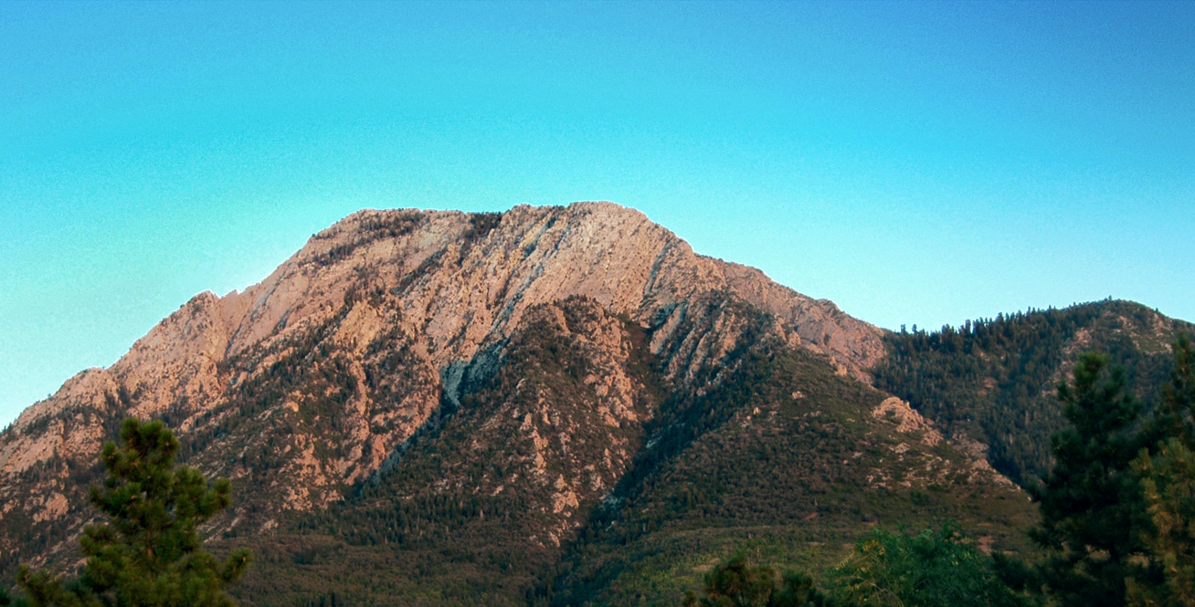
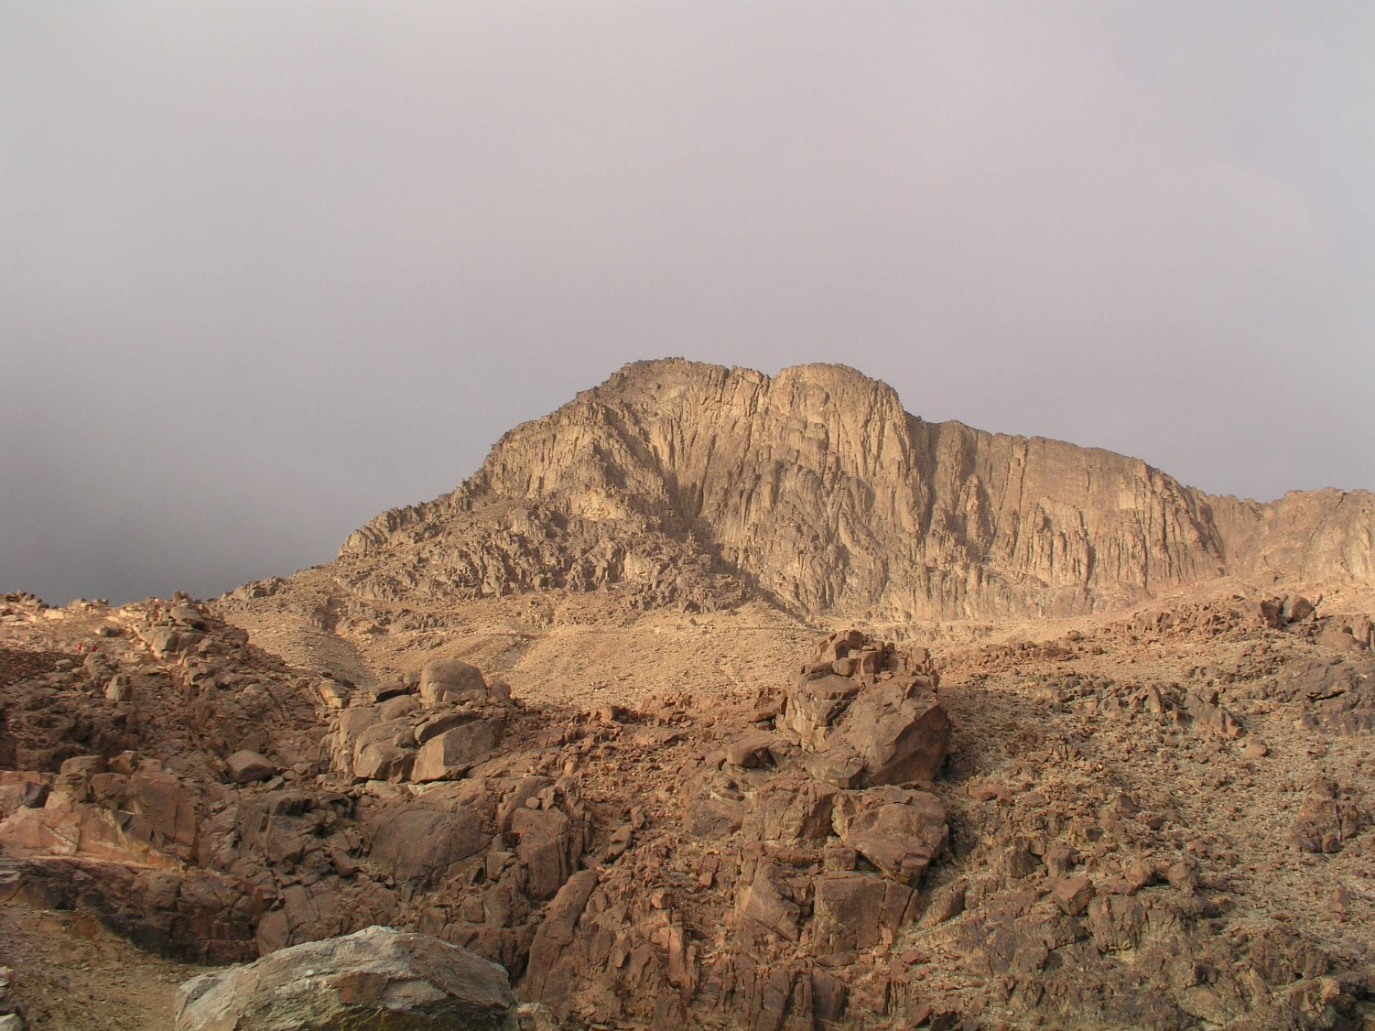
Cool!
Mt. Olympus—Salt Lake City
Mt. Sinai

