Slide 1

The Ten Commandments
Exodus 20:12-17
Part 2
And thou shalt observe to keep all my covenants wherein I covenanted with thy fathers; and thou shalt keep the commandments which I have given thee with mine own mouth, and I will be a God unto thee and thy seed after thee.
JST Genesis 17:12

Slide 2

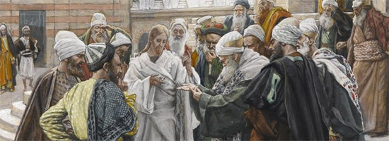
Previously…
Master, which is the great commandment in the law?
Thou shalt love the Lord thy God with all thy heart, and with all thy soul, and with all thy mind.
This is the first and great commandment.
By living the Ten Commandments, we can show love for God and our neighbor
And the second is like unto it, Thou shalt love thy neighbour as thyself.
On these two commandments hang all the law and the prophets.
Matthew 22:36-40

Slide 3
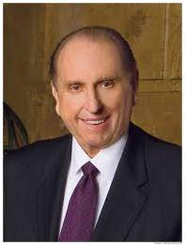
We cannot truly love God if we do not love our fellow travelers on this mortal journey. Likewise, we cannot fully love our fellowmen if we do not love God, the Father of us all. The Apostle John tells us,
“This commandment have we from him, That he who loveth God love his brother also” [1 John 4:21].
We are all spirit children of our Heavenly Father and, as such, are brothers and sisters. As we keep this truth in mind, loving all of God’s children will become easier. (5)
Matthew 22:36-40

Slide 4
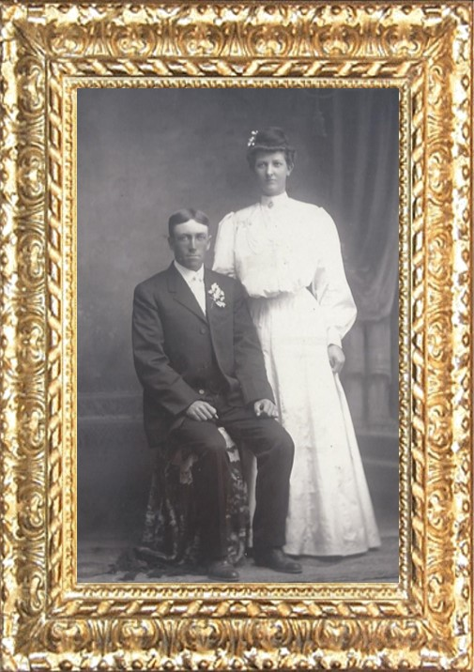
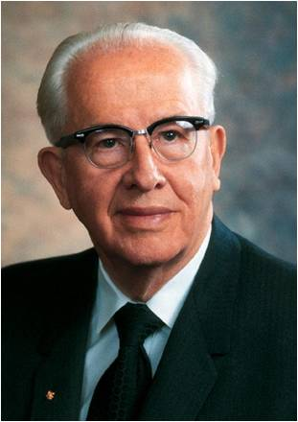
Honor Thy Father and Mother
To honor means to “bring honor to or to have an attitude of honoring.”
Obedience means “to follow direction or example.”
I counsel you to stay close to your parents. There are some things which come only with mature adulthood, and one of these is wisdom. Young people, you need the wisdom of age, just as some of us older ones need your enthusiasm for life...
…your parents, with their maturity of years and experience you have not had, can provide wisdom, knowledge, and blessings to help you over life’s pitfalls. (7)
Joseph and Agnes Tomina Anderson
Exodus 20:12
(2)

Slide 5



A Commandment
Honor Thy Father and Mother
How can a person honor a parent who is not living righteously or who teaches his or her children to do things that are contrary to Heavenly Father’s commandments?
We can show love and respect for our earthly parents even when they are not perfect.
“Do your part to develop real family unity and family solidarity.”
Exodus 20:12
(3)

Slide 6
“When we put God first, all other things fall into their proper place or drop out of our lives. Our love of the Lord will govern the claims for our affection, the demands on our time, the interests we pursue, and the order of our priorities.”
(3)

Slide 7
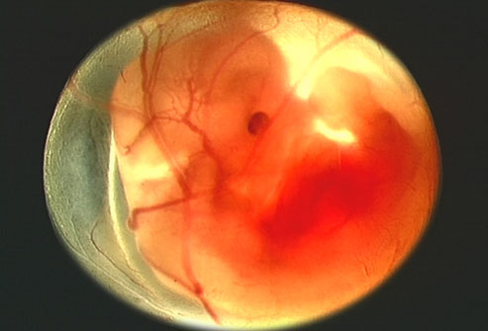


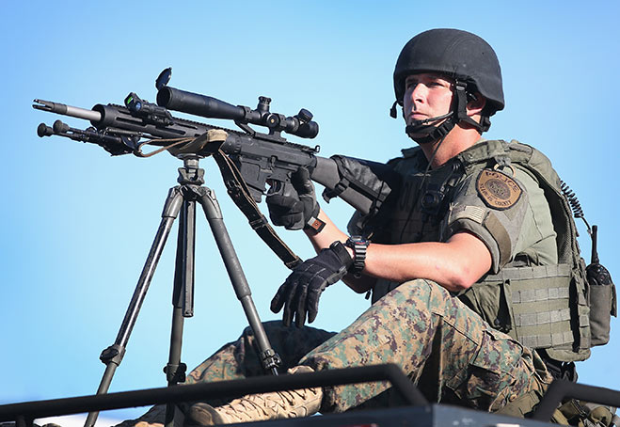
Kill was translated from a Hebrew word that means murder.
Murder means to intentionally and illegally end another person’s life. In the latter days, the Lord has expanded our understanding of this commandment by saying, “Thou shalt not … kill, nor do anything like unto it” D&C 59:6
Thou shalt Not Kill
Prophets have affirmed that human life is sacred and is to be respected.
While Latter-day prophets have not stated that abortion is murder, they have taught that abortion for personal or social convenience fits into the scriptural description of “anything like unto it.”
Murder does not include police or military action in the line of duty.
Entertainment and media that glorifies or presents as acceptable murder and other forms of violence should be avoided. Such entertainment and media influence our attitudes and thoughts and offend the Spirit.
Exodus 20:13
(1)

Slide 8


Adultery means sexual relations between a married individual and someone other than his or her spouse. Any sexual relations outside the bond of marriage between a man and a woman, including homosexual behavior, violate the Lord’s law of chastity.
Thou shalt Not Commit Adultery
“Physical intimacy between husband and wife is beautiful and sacred. It is ordained of God for the creation of children and for the expression of love between husband and wife. God has commanded that sexual intimacy be reserved for marriage.” (1)
To keep the law of chastity before and during marriage, prophets have also taught that we are not to share, view, read, or listen to anything that depicts or describes the physical body or sexual conduct in an immoral or pornographic way. We must keep our thoughts, desires, words, and actions pure.
Exodus 20:14

Slide 9


Stealing means taking something that rightfully belongs to someone else. Bearing false witness against your neighbor means to give or support an untrue statement about someone else.
Thou shalt Not Steal
“Be honest with yourself, others, and God at all times. Being honest means choosing not to lie, steal, cheat, or deceive in any way. …
Exodus 20:15

Slide 10

“Dishonesty harms you and harms others as well. If you lie, steal, shoplift, or cheat, you damage your spirit and your relationships with others. Being honest will enhance your future opportunities and your ability to be guided by the Holy Ghost” (1)
Thou shalt Not Bare False Witness
“To bear false witness is to testify to or to pass along reports, insinuations, speculations, or rumors as if they were true, to the hurt of a fellow human being. Sometimes the practice stems from a lack of correct information—sometimes from lack of understanding—sometimes from misunderstandings—sometimes from a vicious disposition to distort and misrepresent.
“Whereas murder involves the taking of human life, bearing false witness centers in the destruction of character or its defamation. It reaches to the ruin of reputation.” (4)
Exodus 20:16

Slide 11

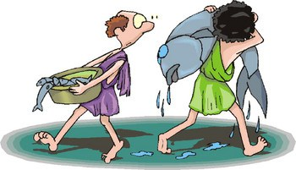
Coveting, in this context, means having a selfish, excessive desire for something that belongs to another person.
Coveting can cause feelings of jealousy, envy, pride, and greed.
Coveting can lead us to be ungrateful and never satisfied with what we have. We can admire what others have, and we can seek to improve our lives and circumstances, but we must do so with modest, humble desires and honest, appropriate efforts.
Thou shalt Not Covet
We can admire what others have, and we can seek to improve our lives and circumstances, but we must do so with modest, humble desires and honest, appropriate efforts.
Exodus 20:17

Slide 12

The Lord’s Voice
When the Israelites saw the thunderings and lightnings upon Mount Sinai and heard the Lord’s voice declare the Ten Commandments, they were afraid.
“fear not”
Moses’s words were meant to inspire their reverence and awe toward God and to motivate them to resist sin
Reverence for God helps us to resist sin
Exodus 20:18-26

Slide 13
Thou shalt have no other gods before me.
Thou shalt not make unto thee any graven image, or any likeness of any thing that is in heaven above, or that is in the earth beneath, or that is in the water under the earth:
Thou shalt not bow down thyself to them, nor serve them: for I the Lord thy God am a jealous God, visiting the iniquity of the fathers upon the children unto the third and fourth generation of them that hate me;
And shewing mercy unto thousands of them that love me, and keep my commandments.
Thou shalt not take the name of the Lord thy God in vain; for the Lord will not hold him guiltless that taketh his name in vain.
Remember the sabbath day, to keep it holy.
Six days shalt thou labour, and do all thy work:
But the seventh day is the sabbath of the Lord thy God: in it thou shalt not do any work, thou, nor thy son, nor thy daughter, thy manservant, nor thy maidservant, nor thy cattle, nor thy stranger that is within thy gates:
Exodus
20:3-17

Slide 14
For in six days the Lord made heaven and earth, the sea, and all that in them is, and rested the seventh day: wherefore the Lord blessed the sabbath day, and hallowed it.
Honour thy father and thy mother: that thy days may be long upon the land which the Lord thy God giveth thee.
Thou shalt not kill.
Thou shalt not commit adultery.
Thou shalt not steal.
Thou shalt not bear false witness against thy neighbour.
Thou shalt not covet thy neighbour’s house, thou shalt not covet thy neighbour’s wife, nor his manservant, nor his maidservant, nor his ox, nor his ass, nor any thing that is thy neighbour’s.
Exodus
20:3-17

Slide 15
Sources:
Video:
“Honesty: You Better Believe It!” (4:46).
1. For the Strength of Youth [booklet, 2011],11–13,19, 22–23, 35
2. Old Testament Institute Manual
Presentation by ©http://fashionsbylynda.com/blog/
3. President Ezra Taft Benson A Message to the Rising Generation Nov. 1977 Ensign
The Great Commandment—Love the Lord Ensign, May 1988, 4
4. Adam S. Bennion, in “The Ninth Commandment,” Part 1, The Ten Commandments Today, pp. 134–36.
5. President Thomas S. Monson (“Love—the Essence of the Gospel,” Ensign or Liahona, May 2014, 91).

Slide 16
Thou Shalt Not Kill
“One of the most serious of all sins and crimes against the Lord’s plan of salvation is the sin of murder or the destruction of human life. It seems clear that to be guilty of destroying life is the act of ‘rebellion’ against the plan of the Almighty by denying an individual … the privilege of a full experience in this earth-school of opportunity. It is in the same category as the rebellion of Satan and his hosts and therefore it would not be surprising if the penalties to be imposed upon a murderer were to be of similar character as the penalties meted out to those spirits which were cast out of heaven with Satan.” (Harold B. Lee, in “The Sixth Commandment,” Part 1, The Ten Commandments Today, p. 88.)
A message of the First Presidency to the Church during World War II and delivered at the general conference on April 6, 1942, this subject was fully discussed.“‘… the Church is and must be against war. The Church itself cannot wage war, unless and until the Lord shall issue new commands. It cannot regard war as a righteous means of settling international disputes; these should and could be settled—the nations agreeing—by peaceful negotiation and adjustment.
“‘But the Church membership are citizens or subjects of sovereignties over which the Church has no control. The Lord himself has told us [D&C 98:4–7].
“‘While by its terms this revealed word related more especially to this land of America, nevertheless the principles announced are world-wide in their application, and they are specifically addressed to “you” (Joseph Smith), “and your brethren of my church.” When, therefore, constitutional law, obedient to these principles, calls the manhood of the Church into the armed service of any country to which they owe allegiance, their highest civic duty requires that they meet that call. If, harkening to that call and obeying those in command over them, they shall take the lives of those who fight against them, that will not make of them murderers, nor subject them to the penalty that God has prescribed for those who kill. … For it would be a cruel God that would punish his children as moral sinners for acts done by them as the innocent instrumentalities of a sovereign whom he had told them to obey and whose will they were powerless to resist.
“‘The whole world is in the midst of a war that seems the worst of all time. This Church is a world-wide Church. Its devoted members are in both camps. They are the innocent war instrumentalities of their warring sovereignties. On each side they believe they are fighting for home, and country and freedom. On each side, our brethren pray to the same God, in the same name, for victory. Both sides cannot be wholly right; perhaps neither is without wrong. God will work out in his own sovereign way the justice and right of the conflict, but he will not hold the innocent instrumentalities of the war, our brethren in arms, responsible for the conflict. This is a major crisis in the world-life of man. God is at the helm.’
“There is, then, a vast difference in destroying life while acting under the mandate of a sovereign nation whom we are in duty bound to obey and wantonly killing on our own responsibility. It would be well for every young man called to military service to study carefully the above quoted statement of the First Presidency.” (Lee, in “The Sixth Commandment,” Part 2, The Ten Commandments Today, pp. 93–94.)
Found in Old Testament Institute Manual
Studies show that violence on television does have an adverse affect on children and the way they think and act. This is true not only for young children, but some recent studies indicate that watching violence on television can even impact adults.
We know that for the most part, children learn from both experience and social learning or role modeling. Therefore, when children, especially young children, see violence on television, they have a difficult time differentiating between what is real or what is make believe, and tend to emulate or copy what they are seeing. Furthermore, there is a chemical change in the brain, similar to that which is seen in post-traumatic stress disorder; if enough violence is viewed, the brain reacts as if the person doing the viewing has actually been abused…beforeitsnews.com

Slide 17
Thou shalt not commit adultery:
“Man must reproduce himself. Man was not of the vegetable kingdom to follow the rules of that form of life. Neither was he an animal to be led by mere instincts. As a child of God, man was given powers not granted to any other form of life. He was of the divine race, and therefore could have many of the privileges and powers related to divinity.
“The power of reproduction must be given to man as it had been given to lower forms of life to perpetuate his species. But whereas the Lord had set up safeguards for this power among the lower forms, barriers which the animals had no tendency to break down because of the manner in which they were made, man was in a different situation. With his right of choice, with his impulses, some for good and some for evil (even Satan had rebelled in the pre-existence), he could now use these divinely-given powers for either good or bad purposes. It was not a matter of instinct with him. It was a matter of choice. He possessed the right of choice before he came into the world. It was not taken from him when he became mortal. The animals would not corrupt their reproductive powers. Instinct took care of that.
But what would mortal man do? This question came to the very heart of the purpose for which man was sent here—to try him, and prove whether he was worthy to come back into God’s presence. With his right of choice, he would be at liberty to select his own course. He could do that which would be ennobling, or he could do that which would debase.
“Laws were the answer. How else could God deal with an intelligent person who had the right of choice and who was to be tested to see which he would choose?
“So God called before him the first man and the first woman. As male and female, they were to reproduce their species. But they were to do so under divinely prescribed conditions. …
“The covenant of marriage, this sacred thing which was to go on eternally, was the heavenly institution which God provided under which his mortal children on earth were to reproduce themselves. There should be no human sex relationship outside of marriage. Children born to man and woman under divinely appointed marriage were to remain as their children forever. Families would continue as a unit even into eternity. The ties of home established in earth life would last forever. It was part of the system of heaven transferred to earth. It must be kept sacred.” (Mark E. Petersen, in “The Seventh Commandment,” Part 1, The Ten Commandments Today, pp. 104–5.)
Thou shalt not steal:
“In public office and private lives, the word of the Lord thunders: ‘Thou shalt not steal: … nor do anything like unto it.’ (D&C 59:6.)
“We find ourselves rationalizing in all forms of dishonesty, including shoplifting, which is a mean, low act indulged in by millions who claim to be honorable, decent people.
“Dishonesty comes in many other forms: in hijacking, in playing upon private love and emotions for filthy lucre; in robbing money tills or stealing commodities of employers; in falsifying accounts; in taking advantage of other taxpaying people by misuse of food stamps and false claims; in taking unreal exemptions; in government or private loans without intent to repay; in unjust, improper bankruptcies to avoid repayment of loans; in robbing on the street or in the home money and other precious possessions; in stealing time, giving less than a full day of honest labor for a full day’s compensation; in riding without paying the fare; and in all forms of dishonesty in all places and in all conditions.
“To all thieveries and dishonest acts, the Lord says, ‘Thou shalt not steal.’ Four short common words He used. Perhaps He wearied of the long list He could have made of ways to steal, misrepresent, and take advantage, and He covered all methods of taking that which does not properly belong to one by saying, ‘Thou shalt not steal.’” (“A Report and a Challenge,” Ensign, Nov. 1976, p. 6.)
Intertwining of All the Commandments
“He who covets the mere material ‘things’ of life may have ‘other gods before him,’ and may ‘bow down before them,’ in thought and in spirit, if not in physical fact.
“He who covets may become coarse and careless in other things also, such as taking ‘the name of the Lord God in vain.’
“He who covets may desecrate the Sabbath day to get gain.
“He who covets may fail to sustain his father and his mother in their need.
“Some who have coveted have killed to get gain.
“Many who have coveted a ‘neighbour’s wife’ have committed the grievous sin of adultery.
“He who covets is more likely to steal (or to swindle or embezzle or engage in sharp practices).
“He who covets may bear false witness to get gain.
…and coveting could lead to infraction of all the others—
(Richard L. Evans, in “The Tenth Commandment,” Part 1, The Ten Commandments Today, p. 142–44.)

