Slide 1

A Formal Covenant With the Lord
Exodus 21-24
Exodus 24:3
And Moses came and told the people all the words of the Lord, and all the judgments: and all the people answered with one voice, and said, All the words which the Lord hath said will we do.
Presentation by ©http://fashionsbylynda.com/blog/

Slide 2
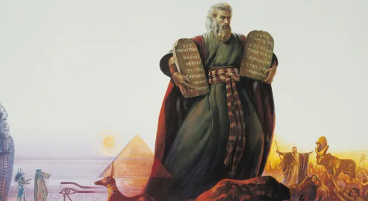
Broken Covenants
When Moses returned from the presence of the Lord, he found that the Israelites had broken the covenants they had made and were worshipping a golden calf.
The Israelites suffered the consequences of this sin, but the Lord demonstrates His justice, mercy, and long-suffering toward those who repent and return to Him.

Slide 3
You Be the Judge
A woman has been treated very poorly by her neighbors for several years. They often ridicule her and her family. One day she discovers a cow belonging to one of her neighbors wandering by itself in the road. What should the woman do?
Two men became angry at one another and began to fight. One of them was severely injured in the fight and will be confined to bed for several weeks. What responsibility does the other man have toward the injured man?
A boy borrowed a donkey, and then someone stole the donkey from him. Is the boy financially responsible for the donkey? Does the boy need to compensate the owner of the donkey for the loss?

Slide 4
Revealing the Laws
Exodus 22
Exodus 23
Exodus 21
Laws pertaining to stealing, destructions by fire, care of the property of others, borrowing, lascivious acts, sacrifices to false gods, afflicting widows, usury, reviling God, and the firstborn of men and of animals.
The men of Israel are commanded to be holy.
Laws pertaining to integrity and godly conduct.
The land is to rest during a sabbatical year.
The children of Israel are to keep three annual feasts.
Laws pertaining to servants, marriage, the death penalty for various offenses, the giving of an eye for an eye and a tooth for a tooth, and the damage done by oxen.
The laws recorded in these chapters would help the people keep the Ten Commandments and live peaceably with one another.
Exodus 21-23 Chapter Headings

Slide 5





The Verdict And the Punishment
Exodus 21:23-25
Exodus 21:18-19

Slide 6
Restitution
Exodus 22:1
Exodus 22:2-4
Exodus 22:5
Exodus 22:6
=
=
If a thief is taken in the act of forcing his way into a house, and his death is caused by a blow, the owner of the house is not responsible for his blood.
"If the sun be risen upon him, there shall be blood shed for him; for he should make full restitution; if he have nothing, then he shall be sold for his theft.
"If what he stole is actually found alive in his possession, whether an ox or a donkey or a sheep, he shall pay double.…
If we violate the laws of God, then He requires us to make restitution
Exodus 22:1-6

Slide 7
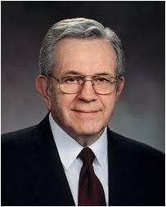
“Sometimes you cannot give back what you have taken because you don’t have it to give. If you have caused others to suffer unbearably—defiled someone’s virtue, for example—it is not within your power to give it back.
… Perhaps the damage was so severe that you cannot fix it no matter how desperately you want to. … Fixing that which you broke and you cannot fix is the very purpose of the atonement of Christ.
“When your desire is firm and you are willing to pay the ‘uttermost farthing’ [Matthew 5:25–26], the law of restitution is suspended.
Your obligation is transferred to the Lord.
He will settle your accounts” (1)

Slide 8
Entering Into A Covenant
What might you do to prepare to enter into the covenant of baptism?
Learning about and developing faith in Jesus Christ and His teachings
Repenting of sins
Making commitments to obey God’s commandments
At Mount Sinai the Lord gave the Israelites the opportunity to enter into a covenant with Him that would prepare them to return to His presence and receive eternal life.

Slide 9
Building An Alter
Moses descended Mount Sinai and taught God’s law to the people, and they committed to obey it. Moses then recorded “all the words of the Lord.”
Before the people formally entered into the covenant with God, Moses built an altar and instructed some young men to make burnt offerings and sacrifice oxen on it.
Exodus 24:4

Slide 10
Sprinkling of the Blood
God had commanded His children to participate in the ordinance of animal sacrifice, which taught them about the Atonement of Jesus Christ.
The blood of Jesus Christ, which He shed for us.
This act symbolized that the people could receive the blessings of the Atonement of Jesus Christ through the covenant they had made
Making and keeping covenants with the Lord helps us qualify to receive the blessings of the Atonement of Jesus Christ.
Exodus 24:6-8

Slide 11
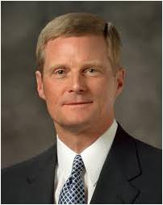
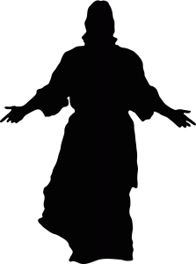
“Most of us clearly understand that the Atonement is for sinners. I am not so sure, however, that we know and understand that the Atonement is also for saints—for good men and women who are obedient, worthy, and conscientious and who are striving to become better and serve more faithfully. We may mistakenly believe we must make the journey from good to better and become a saint all by ourselves. …
“The gospel of the Savior is not simply about avoiding bad in our lives; it also is essentially about doing and becoming good. And the Atonement provides help for us to overcome and avoid bad and to do and become good. …
“The enabling power of the Atonement of Christ strengthens us to do things we could never do on our own.” (2)

Slide 12
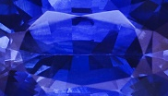
Moses, and Aaron, Nadab, and Abihu
And 70 elders of Israel
And they saw the God of Israel: and there was under his feet as it were a paved work of a sapphire stone, and as it were the body of heaven in his clearness.
And upon the nobles of the children of Israel he laid not his hand: also they saw God, and did eat and drink.
Exodus 24:9-11

Slide 13

Tables of Stones
Teach Them
לא יהיה לך אלוקים אחר על פני
And Moses went into the midst of the cloud, and gat him up into the mount: and Moses was in the mount forty days and forty nights.
Exodus 24:12-18

Slide 14
Sources:
President Boyd K. Packer (“The Brilliant Morning of Forgiveness,” Ensign, Nov. 1995, 19–20).
Presentation by ©http://fashionsbylynda.com/blog/
2. Elder David A. Bednar (“The Atonement and the Journey of Mortality,” Ensign, Apr. 2012, 42, 46).

Slide 15
Possible Calendar of the Israelites in the Wilderness
Sun | Mon | Tues | Wed | Thurs | Fri | Sat
 |  |  | 56 Thunder and Lightening and thick clouds on Mt. Sinai on the morning of the third day. | 57 Moses descend a 4th time to warn people with Aaron (Ex. 19:21-25) | 58 Moses descends 5th time with Aaron and ascends with Aaron, Nadab, Abihu, 70 elders (Ex. 24:9-11) | 59 4th Sabbath kept by Israel since in Wilderness of Sin
60 6th ascension Ex 24:18 Moses spends 40 days at summit | 61-100 Moses Reveals the 10 Commandments
Exodus 22:2 The Thief
Matthew 18:25
Since he was not able to pay, the master ordered that he and his wife and his children and all that he had be sold to repay the debt.
Exodus 21:2
If thou buy an Hebrew servant, six years he shall serve: and in the seventh he shall go out free for nothing.
http://www.bible.ca/archeology/bible-archeology-exodus-route-travel-times-distances-days.htm

Slide 16
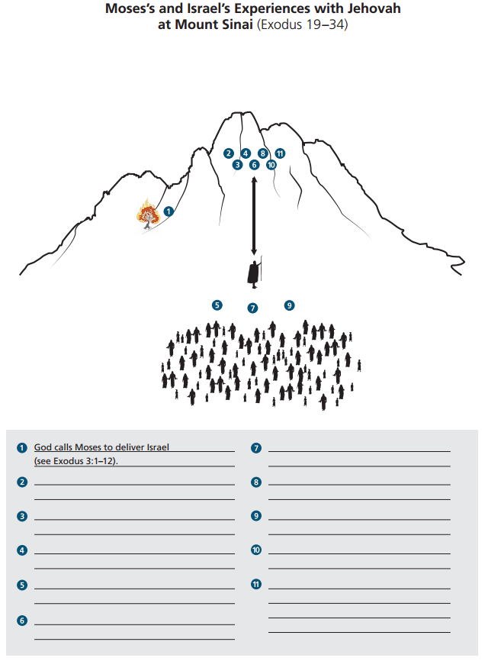
God invites Israel to be His covenant People (Exodus 19:3-6)
Moses reports Israel’s desire to enter God’s Covnant (Ex. 19:7-8)
God warns that the people are not yet prepared to enter His presence (Ex. 19:20-21, 25)
God Speaks the Ten Commandments to the Israelites (Ex. 19-20)
God give Israel additional laws (Ex. 21-23)

