Slide 1

The Golden Calf
Exodus 32
And the Lord plagued the people, because they made the calf, which Aaron made. Exodus 32:35

Slide 2

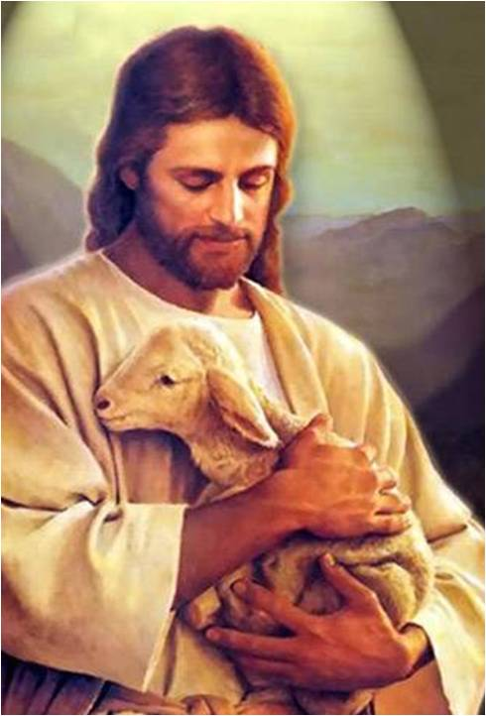
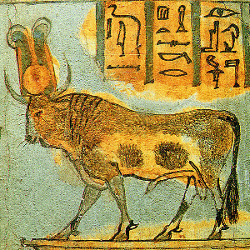
Who is the Protector?
From the plagues in the Egypt?
From drowning in the Red Sea and being captured by the Egyptians
From hunger and thirst in the desert?

Slide 3
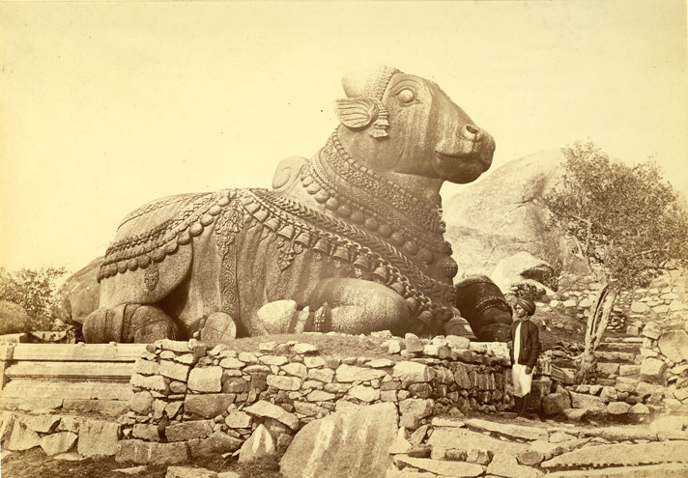
Where is Moses?
Moses was on Mt. Sinai for 40 days and nights
Which direction were the Israelites facing?
The wild bull, was widely worshipped, often as the Lunar Bull and as the creature of El.
"As has been observed before, it was one thing to get Israel out of Egypt, and another thing entirely to get Egypt out of Israel!” (1)
Exodus 32:1-6

Slide 4
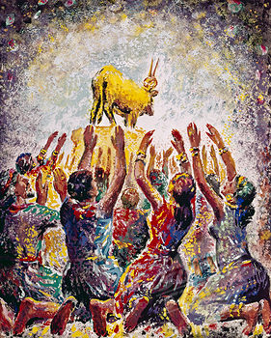
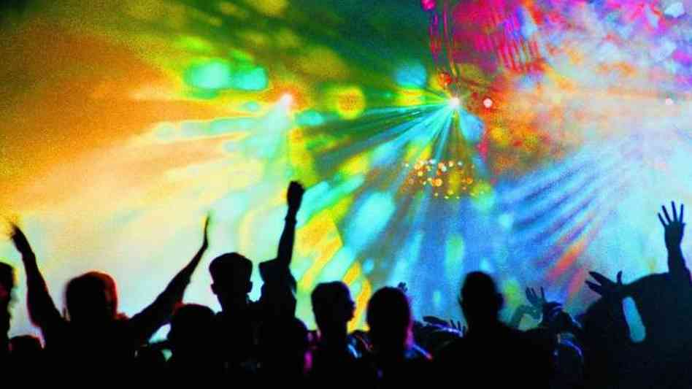
Rose Up to Play
Unruly, riotous, and immoral
Exodus 32:6

Slide 5
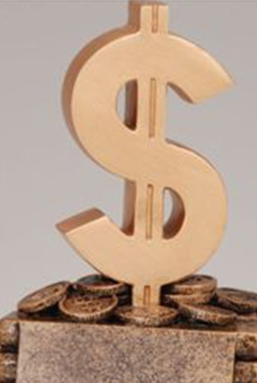
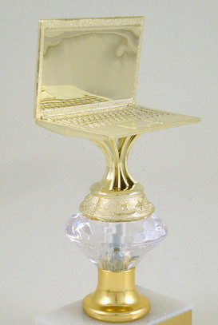


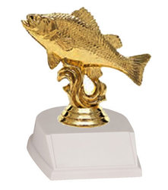
Today’s Golden Calves
"...Anything can become a 'golden calf.' When activities or material blessings become so important that by turning to them we turn from God, we are breaking the second commandment.
We are walking 'in [our] own way, and after the image of [our] own god, whose image is in the likeness of the world, and whose substance is that of an idol, which waxeth old and shall perish.'
The solution is to prioritize our loyalties and turn our affections back to God." (2)
Exodus 32:1-6

Slide 6
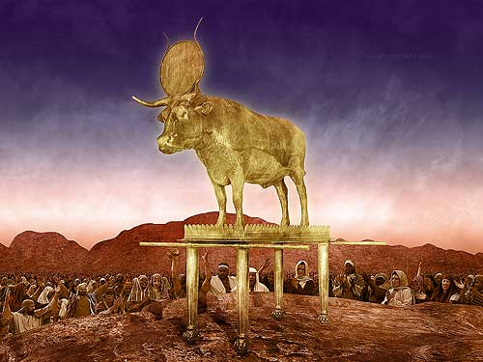
Corrupted Themselves
They had become unworthy
By turning aside from the Lord and His commandments, we corrupt ourselves
Exodus 32:7-8

Slide 7
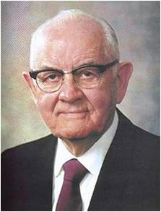
“Modern idols or false gods can take such forms as clothes, homes, businesses, machines, automobiles, pleasure boats, and numerous other material deflectors from the path to godhood.
What difference does it make that the item concerned is not shaped like an idol?” (3)
Exodus 32:7-8

Slide 8
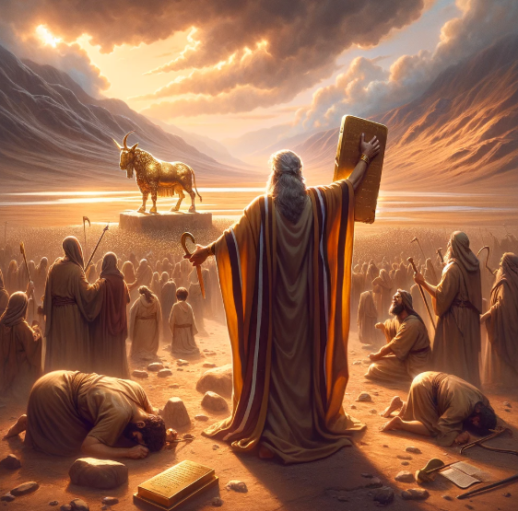
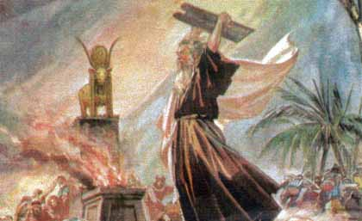
Israel Breaks Covenants
“And the Lord said unto Moses, if they will repent of the evil which they have done, I will spare them, and turn away my fierce wrath; but, behold, thou shalt execute judgment upon all that will not repent of this evil this day.
Therefore, see thou do this thing that I have commanded thee, or I will execute all that which I had thought to do unto my people.” (JST Exodus 32:14)
Exodus 32:9-14

Slide 9
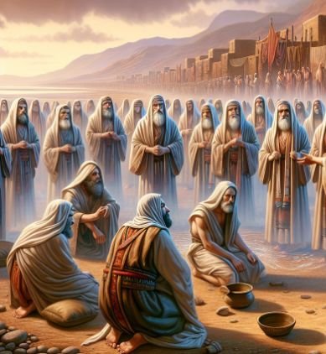
The Son’s of Levi
HOWEVER:
The first group to gather on the side of the Lord were the Sons of Levi
Moses instructed the Levites to kill everyone who would not repent of worshipping the golden calf. About 3,000 men fell that day. Moses acted as a mediator between the Lord and the people.
(8)
Wherefore then, the law was added because of transgressions, till the seed should come to whom the promise was made in the law given to Moses, who was ordained by the hand of angels to be a mediator of this first covenant, (the law.)
Now this mediator was not a mediator of the new covenant; but there is one mediator of the new covenant, who is Christ, as it is written in the law concerning the promises made to Abraham and his seed. Now Christ is the mediator of life; for this is the promise which God made unto Abraham.
Joseph Smith Translation; Galatians 3:19-20
Exodus 32:26-29

Slide 10
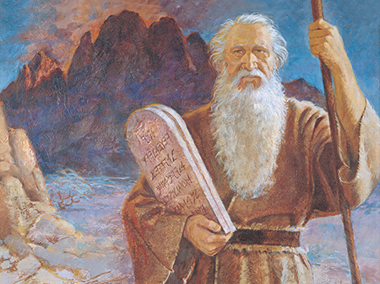
Moses, the Mediator
And I have a work for thee, Moses, my son; and thou art in the similitude of mine Only Begotten; and mine Only Begotten is and shall be the Savior, for he is full of grace and truth; but there is no God beside me, and all things are present with me, for I know them all.
Moses 1:6
Moses was a “prophetic symbol of the Christ who was to come”
As the people faced destruction because of their wickedness, Moses became their mediator with God. He pleaded their cause and even offered his own life to appease the divine justice
Exodus 32:31-32

Slide 11
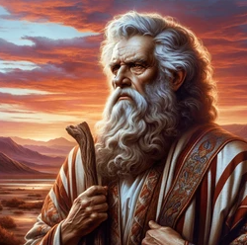
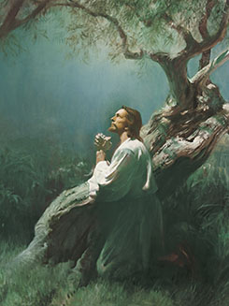
Make An Atonement
peradventure I shall make an atonement for your sin
Jesus Christ is our Mediator with the Father and Jesus Christ took our sins upon Him
if thou wilt forgive their sin—; and if not, blot me, I pray thee, out of thy book which thou hast written.
Exodus 32:30-32

Slide 12
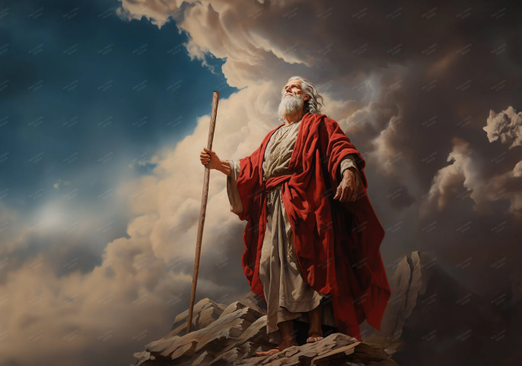
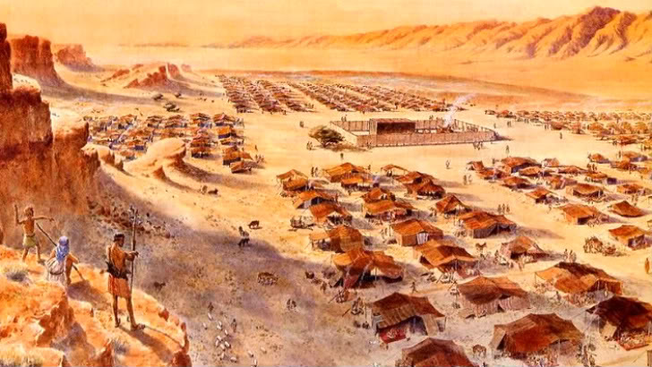
Punishment For the People
Moses returned a sixth time to the holy mountain, to plead for forgiveness of his people. He received the assurance that justice would be satisfied and that the people would still be permitted to go to the Promised Land.
While many of the people chose to repent and turn back to the Lord after worshipping the golden calf, they still had to endure many of the consequences of their sinful actions.
The Lord instructed Moses to move away from the people for a time. Outside the camp where he dwelt, further instruction was received relative to his leadership in Israel.
Exodus 32:34-35

Slide 13
Sources:
Kent P. Jackson and Robert L. Millet, eds., Studies in Scripture, Vol. 3: Genesis to 2 Samuel [Salt Lake City: Randall Book, 1985], 109
Dennis Largey, "Refusing to Worship Today's Graven Images," Ensign, Feb. 1994, 10-13
Presentation by ©http://fashionsbylynda.com/blog/
3. President Spencer W. Kimball The Miracle of Forgiveness [1969], 40).
4. Old Testament Seminary Teacher Manual 2018

Slide 14
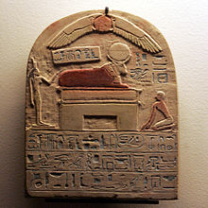
Aaron in Charge:
“The whole of this is a most strange and unaccountable transaction. Was it possible that the people could have so soon lost sight of the wonderful manifestations of God upon the mount? Was it possible that Aaron could have imagined that he could make any god that could help them? And yet it does not appear that he ever remonstrated with the people! Possibly he only intended to make them some symbolical representation of the Divine power and energy, that might be as evident to them as the pillar of cloud and fire had been, and to which God might attach an always present energy and influence; or in requiring them to sacrifice their ornaments, he might have supposed they would have desisted from urging their request: but all this is mere conjecture, with very little probability to support it. It must however be granted that Aaron does not appear to have even designed a worship that should supersede the worship of the Most High; hence we find him making proclamation, To-morrow is a feast to the Lord [Jehovah], and we find farther that some of the proper rites of the true worship were observed on this occasion, for they brought burnt-offerings and peace-offerings, ver. 6, 7: hence it is evident he intended that the true God should be the object of their worship, though he permitted and even encouraged them to offer this worship through an idolatrous medium, the molten calf.” (Clarke, Bible Commentary, 1:463–64.)
Aaron and the state of the Israelites:
“Moses sought out those who were ‘on the Lord’s side’ from those whom Aaron had made ‘naked.’ (The Hebrew word used here may mean either ‘bare, uncovered’ or ‘unruly, broken loose.’) ‘Naked’ can be understood in the same sense as when Adam was ashamed and hid himself from God because he was naked. The expression can also mean ‘exposed in guilt before God’s wrath.’ Compare the feeling of Alma as he described such exposure, in Alma 36:14–22. On the other hand, that Israel had ‘broken loose’ and become ‘unruly’ under Aaron’s lead was obviously true. Both conditions would be to the shame of a people who were supposed to be religious.” (Rasmussen, Introduction to the Old Testament, 1:93.)
Some have wondered why Aaron, who played a key role in the golden calf episode, came out with no condemnation. Though it is not recorded in Exodus, Moses later indicated that Aaron also was nearly destroyed and was saved only through Moses’ intercession in his behalf (see Deuteronomy 9:20).
Old Testament Institute Manual
“There are unfortunately millions today who prostrate themselves before images of gold and silver and wood and stone and clay. But the idolatry we are most concerned with here is the conscious worshipping of still other gods. Some are of metal and plush and chrome, of wood and stone and fabrics. They are not in the image of God or of man, but are developed to give man comfort and enjoyment, to satisfy his wants, ambitions, passions and desires. Some are in no physical form at all, but are intangible” President Spencer W. Kimball (The Miracle of Forgiveness [1969], 40).
The Bull:
Apis (deity)
Egyptian Mythology—
is a bull-deity that was worshipped in the Memphis region. "Apis served as an intermediary between humans and an all-powerful god (originally Ptah, later Osiris, then Atum)." [quote: Virtual Egyptian Museum]
Apis was the most important of all the sacred animals in Egypt.
The cult of the Apis bull started at the very beginning of Egyptian history, probably as a fertility god connected to grain and the herds. In a funerary context, the Apis was a protector of the deceased, and linked to the pharaoh. This animal was chosen because it symbolized the king’s courageous heart, great strength, virility, and fighting spirit. The Apis bull was considered to be a manifestation of the pharaoh, as bulls were symbols of strength and fertility, qualities which are closely linked with kingship ("strong bull of his mother Hathor" was a common title for gods and pharaohs). wikipedia

Slide 15
Sun | Mon | Tues | Wed | Thurs | Fri | Sat
 | 61-100 God reveals for the first time, the 10 Commandments and the plan for the tabernacle. The people party and build the Golden calf. from day 56 to day 96 when Moses returns. |  |  |  | 100 7th ascension Ex 32:30-35 God tells Moses is to take them into promised land. | 101 Sabbath

Slide 16
