Slide 1

Gifts and Sacrifices
Exodus 35-40
Which was a figure for the time then present, in which were offered both gifts and sacrifices, that could not make him that did the service perfect, as pertaining to the conscience;
Hebrews 9:9

Slide 2

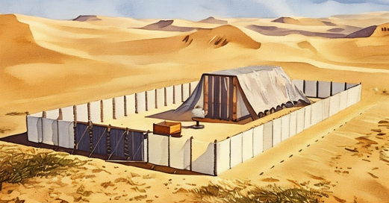
Building a Sanctuary
In obedience to the Lord’s command, the Israelites built a tabernacle, or temple, in the wilderness. This tabernacle was a portable sanctuary where the Lord could dwell among His people as they traveled.

Slide 3
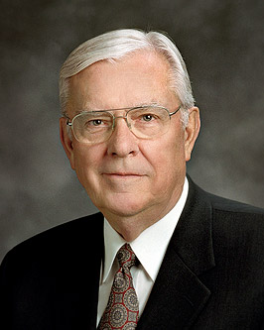
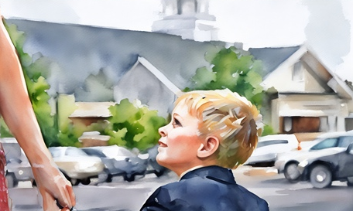
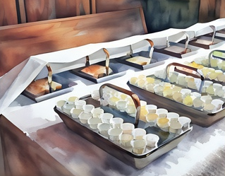
Sabbath Day
[An] important doctrine that we should cling to is to observe the Sabbath day. This helps us remain unspotted from the world, provides us with physical rest, and gives each of us the spiritual refreshment of worshipping the Father and the Son every Sunday.
When we delight in the Sabbath day, it is a sign of our love for Them.
The presentation of the ordinance of the sacrament is when we renew our covenants and reconfirm our love for the Savior and remember His sacrifice and His Atonement. (1)
Exodus 35:1-3

Slide 4
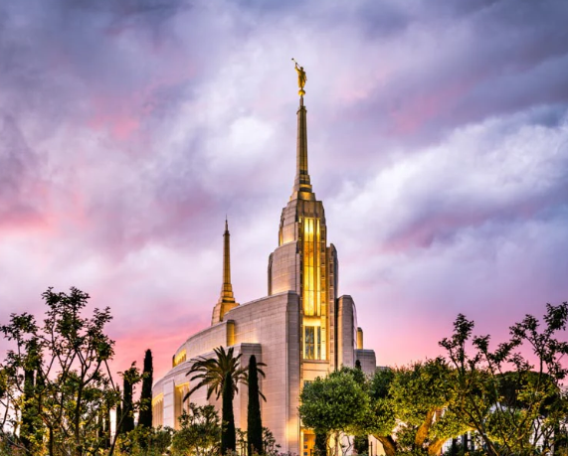
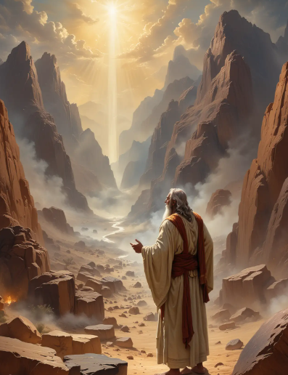
Gold and Silver/Service and Offerings
While speaking with Moses on Mount Sinai, the Lord asked that the Israelites offer their gold, silver, and other valuable materials to build a sanctuary, or tabernacle, for Him.
In our time, we have also been asked to build temples to serve as a sanctuary or a place of holiness.
Members of The Church of Jesus Christ of Latter-day Saints provide financial support to the Church through a 10% tithe and other offerings
Exodus 35:1-3

Slide 5
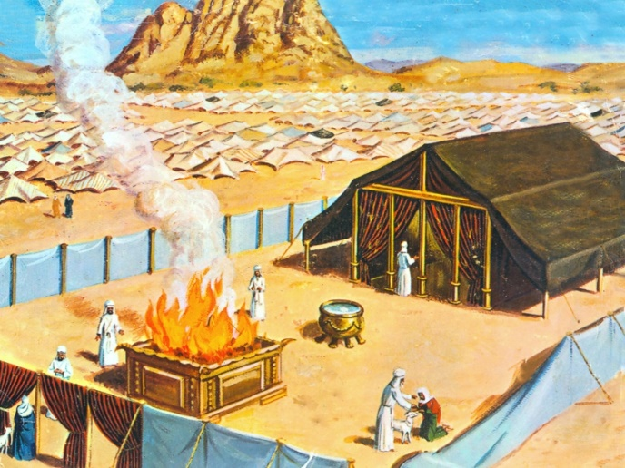
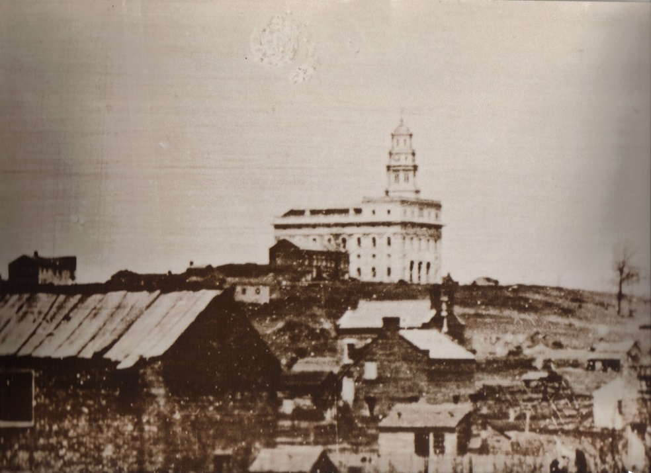
Give of Your Substance
Offerings to the Tabernacle
The Nauvoo Temple
“No effort was spared. No sacrifice was too great. Through the next five years men chiseled stone and laid footings and foundation, walls and ornamentation.
Hundreds went to the north, there to live for a time to cut lumber, vast quantities of it, and then bind it together to form rafts which were floated down the river to Nauvoo.
Beautiful moldings were cut from that lumber. Pennies were gathered to buy nails.
Unimaginable sacrifice was made to procure glass. They were building a temple to God, and it had to be the very best of which they were capable.” (2)
Exodus 35:4-5

Slide 6

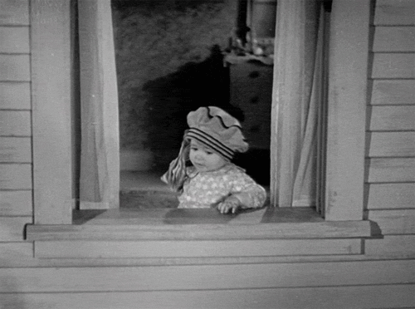

A Willing Heart
The Lord desires that we give our offerings to Him with a willing heart
What are some offerings we can give to the Lord?
Why do you think the Lord wants us to give these offerings willingly?
Exodus 35:20-22, 29

Slide 7
Bezaleel
Bezaleel was the son of Uri, who was the son of Hur, of the tribe of Judah
Bezaleel was one of the skilled craftsmen given by the Lord to Moses, along with Aholiab (Aholiab, the son of Ahisamach, of the tribe of Dan), to help prepare the Tabernacle under the inspiration of the Spirit of God
Bezaleel and Aholiab, through the Spirit, were given the gift of fine workmanship in metals and wood and stone.
Gifts of the Spirit come to us in the form of pure intelligence or knowledge, transferred “in the abstract” (that is, spirit to spirit) through the Holy Ghost to enlighten our minds, open the eyes of our understanding, and manifest themselves as special abilities, skills, or capacities for understanding. (3)
Exodus 35:30-35; 36:1-3

Slide 8
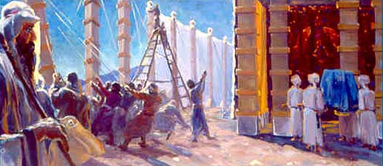
Sufficient
The Israelites were so willing to help that they had plenty of material to build the Tabernacle
Exodus 36:4-7

Slide 9
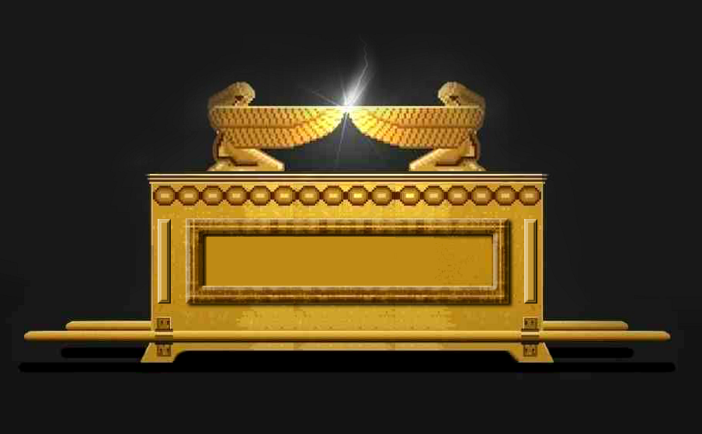
Making An Ark
2 cherubims
Mercy seat
Bezaleel makes an ark of shittim wood
Covered in Gold
Shittim wood to bare the ark
4 rings
Exodus 25: 16-22; 37:1-9; Hebrews 9:3-5

Slide 10
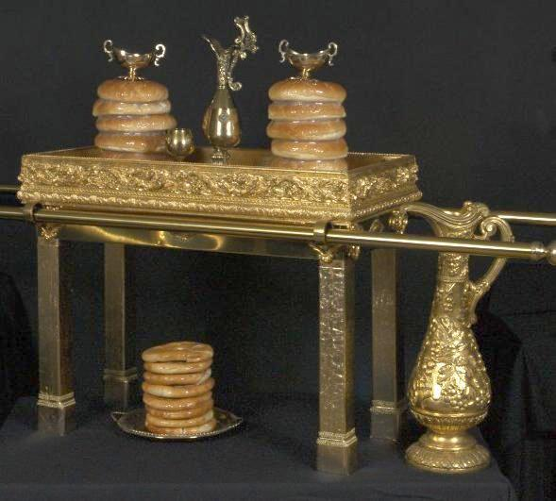
Making a Table
Made of Shittim wood covered in gold
Table of Shewbread
Dishes and spoons and Bowls
Vessels
Staves to bear the table
4 rings
Exodus 37:10-16; Leviticus 24:5–9; Luke 22:19; John 6:35

Slide 11
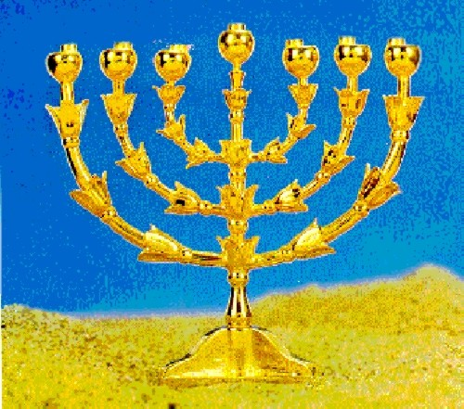
Making Candlesticks
candlestick of pure gold
Three bowls
6 branches going out of the sides—3 on one side and 3 on the other side
4th
3rd
Three flowers
2nd
1st Bowl or Knop
Exodus 37:17-24; Leviticus 24:2–4; Psalm 119:105; John 8:12

Slide 12
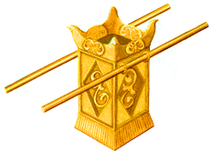
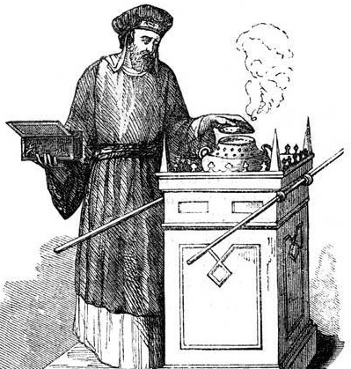
Making An Incense Alter
Shittim Wood with overlay of gold
Staves for carrying
Rings
Apothecary—”Perfumer” a person (priest) who was properly qualified to prepare the holy oils and ointments.
And he made the holy anointing oil, and the pure incense of sweet spices, according to the work of the apothecary.
The Holy Oil:
Myrrh
Sweet cinnamon
Sweet calamus
Olive oil
Incense:
Sweet spices:
Stacte
Onycha
Galbanums
Pure frankincense
Exodus 30:1, 6-8; 37:25-24; Psalm 141:2; Revelation 8:3–4

Slide 13
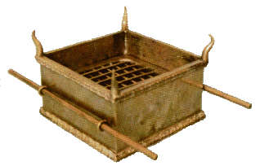
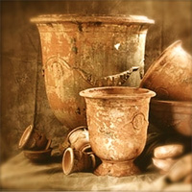
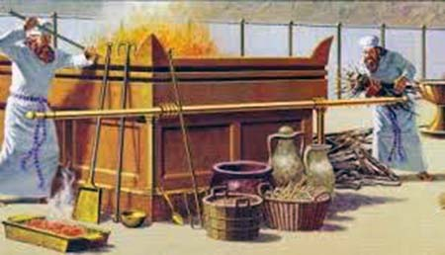
Making An Alter For Burnt Offerings
Shittim Wood with overlay of brass
Horns of brass
pots
Rings and stave
brasen grate of network
Exodus 38:1-7; Moses 5:4-7

Slide 14
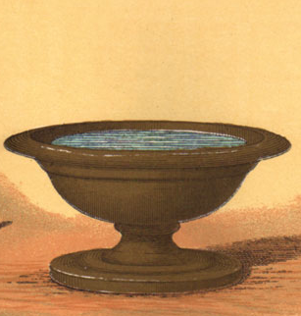
Making A Laver
A place of washing and cleansing
And he made the laver of brass, and the foot of it of brass, of the lookingglasses of the women assembling, which assembled at the door of the tabernacle of the congregation.
The laver was located in a convenient place for washing and stood as a reminder that people need cleansing before approaching God.
The priests atoned for their sins through a sacrifice at the brazen altar, but they cleansed themselves at the laver before serving in the Holy Place, so that they would be pure and not die before a holy God.
Exodus 30:17–21; 38:8; 40:7, 12–13

Slide 15
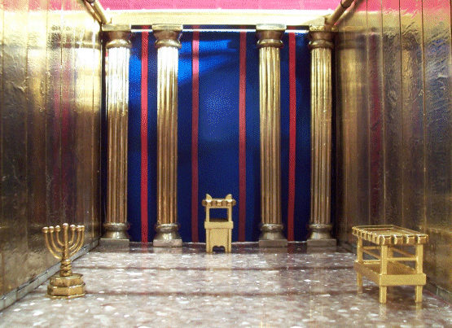
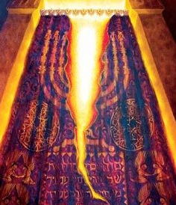
Making Veil
A thick, ornate curtain that separated the Holy Place from the Most Holy Place (or Holy of Holies) within the dwelling of God.
This sacred barrier concealed God's presence, and only the High Priest could pass through it once a year during the Day of Atonement to make a sacrifice for the sins of the people.
The veil, woven with blue, purple, scarlet, and fine linen, and embroidered with cherubim, symbolized the barrier of human sin separating humanity from a holy God.
It was torn in two at Jesus's death, signifying that through His sacrifice
And the veil of the temple was rent in twain from the top to the bottom. Mark 15:38
Exodus 26:31-33; 30:17–21; 38:8; 40:7, 12–13; Hebrews 10:19–20; John 14:6

Slide 16
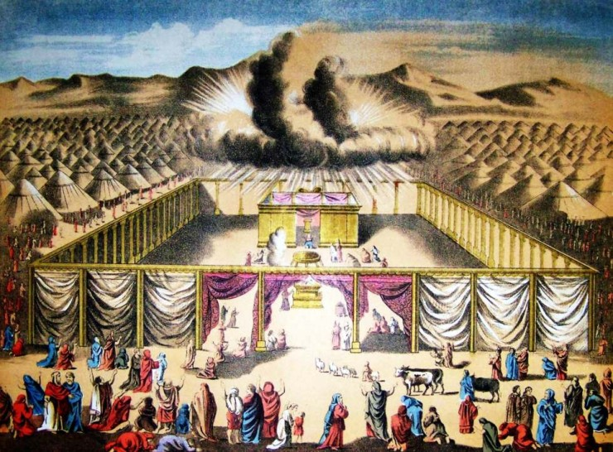
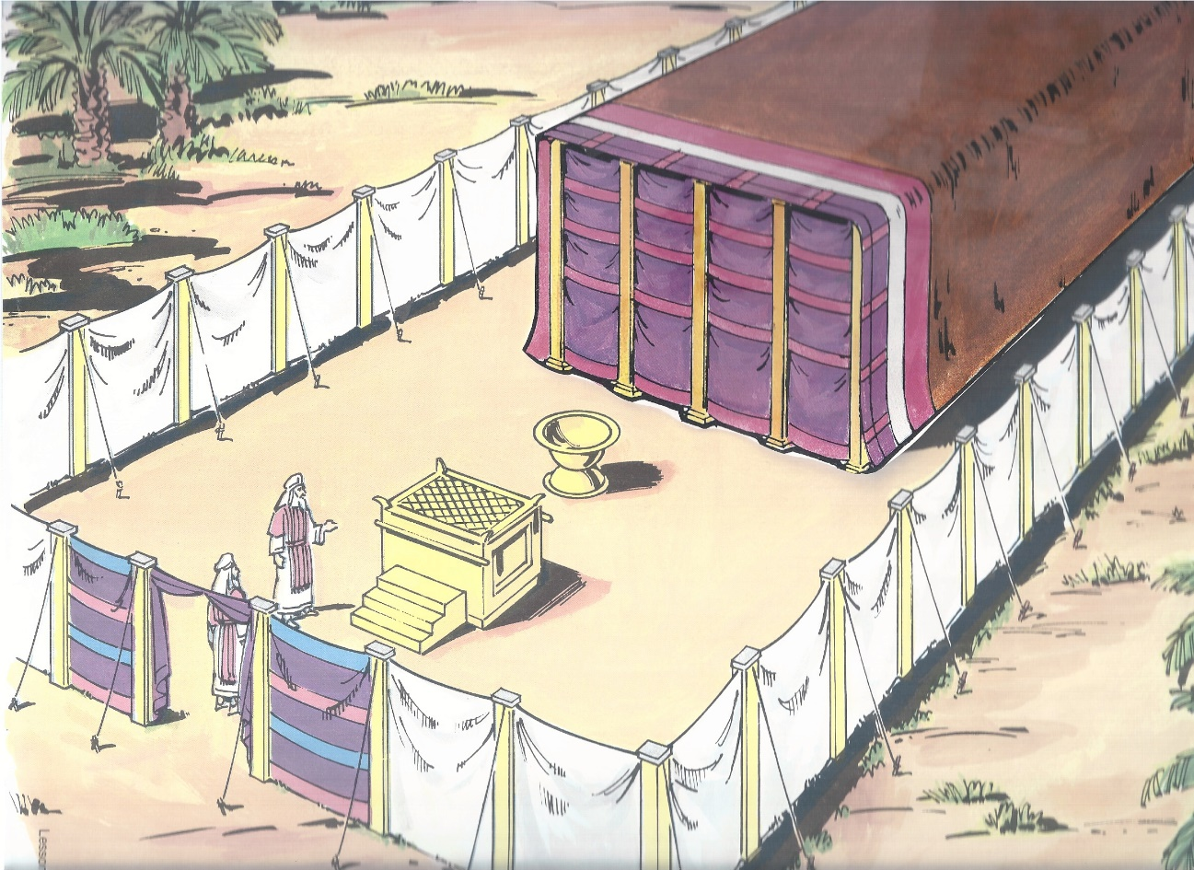
The Court
The tabernacle and its plan and the ordinances thereof illustrate the grand and glorious symbolism of mankind’s progress from a state of being alienated from God to one of full communion with Him. Old Testament Institute Manual
Exodus 38:9-20

Slide 17
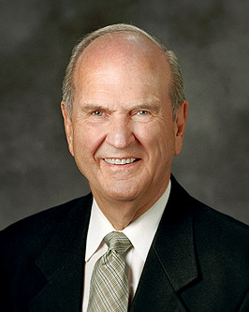
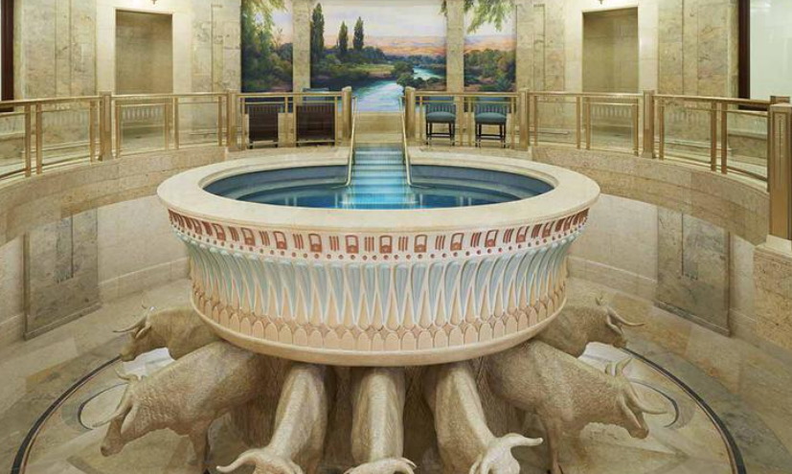
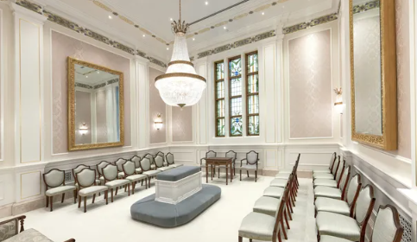
Symbols in Today’s Temples
"Each temple is a beacon of light and hope. The temple, the House of the Lord, stands as a symbol of our faith in life after death and as a stepping stone to eternal life for us and our families. The temple is a sacred and essential part of God’s plan for our happiness, now and forever."
If you don’t yet love to attend the temple, go more often—not less. Let the Lord, through His Spirit, teach and inspire you there. I promise you that over time, the temple will become a place of safety, solace, and revelation.
READ Article: https://www.churchofjesuschrist.org/temples/inside-temples?lang=eng
(4)

Slide 18
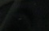
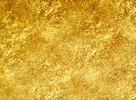







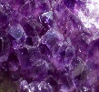




The Holy Garments
The golden diadem and the mitre—
Engraved on the band were the words “Holiness to the Lord”
(Ex. 28:36-38)
Onyx Stones--engraved with the names of the 12 sons of Israel as a ‘memorial’ as the priest served before the Lord (Ex. 28:9)
The Upper Robe (Blue)
The robe was] woven in one piece, which set forth the idea of wholeness or spiritual integrity; and the dark-blue colour indicated nothing more than the heavenly origin and character of the office with which the robe was associated. (Ex. 28:31)
Hidden in the breastplate—Urim and Thummim
The Undergarment
(White Tunic)
Ephod--This garment was fastened at each shoulder and had an intricately woven band with which it could be fastened around the waist.
(Ex. 28:12)
Breastplate--was made of fabric rather than of metal. It was twice as long as it was wide and when folded became a square pocket into which the Urim and Thummim was placed.
Stones inscribed with the names of each of the tribes of Israel.
(Ex. 28:13-29)
The Fringe— Pomegranate and gold
Every Israelite is directed to make a fringe in the border of his garment, of dark-blue purple thread, and when he looks at the fringe to remember the commandments of God and do them.
(Ex. 28:33-34)
Exodus 39:9-31

Slide 19
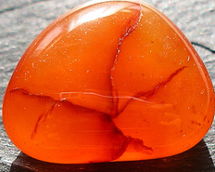
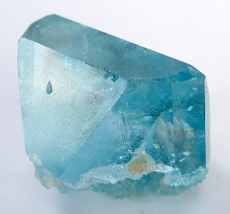
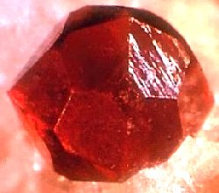
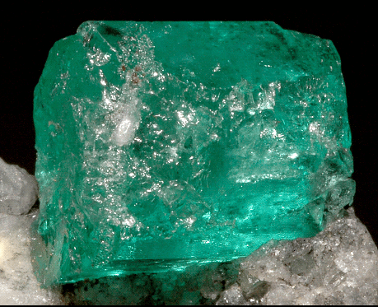
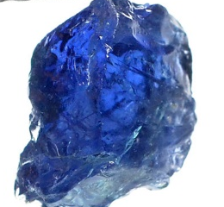
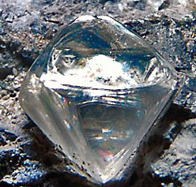
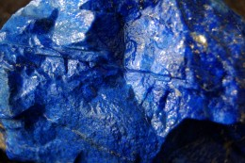
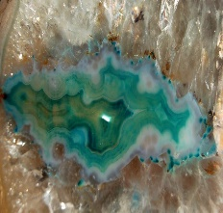
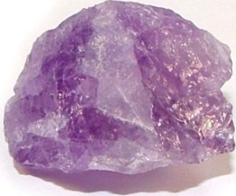
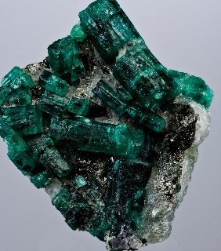
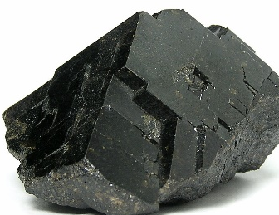
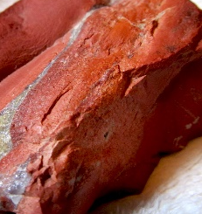
The Stones on the Breastplate
Reuben-Sardius; Simeon-Topaz; Levi-Carbuncle
And the stones were according to the names of the children of Israel, twelve, according to their names, like the engravings of a signet, everyone with his name, according to the twelve tribes.
Judah-Emerald; Issachar-Sapphire; Zebulon-Diamond
Dan-Ligure/Jacinth; Napthtali-Agate; Gad-Amethyst
Asher-Beryl; Joseph-Onyx; Benjamin-Jasper
Exodus 38:9-14

Slide 20
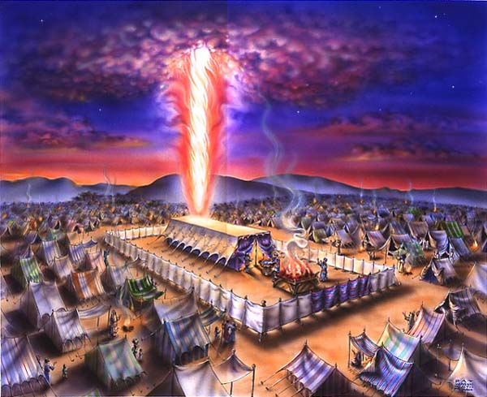
Moses Blesses The New Portable Temple
He also blessed those who participated in building the temple
Exodus 39:43

Slide 21
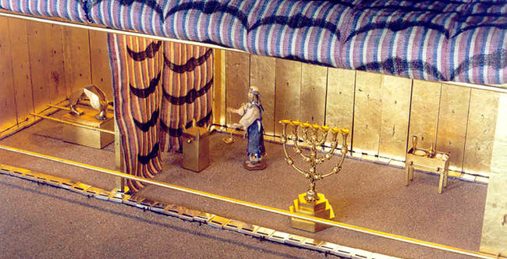
Set Up of the Tabernacle
Holy of Holies
Ark of the Covenant
Veil
Incense alter
Candlestick
Table of shewbread
W
N
Laver
S
Courtyard
Altar of burnt offering
E
Exodus 40:1-33
Entrance

Slide 22
The Cloud
Because of Israel’s obedience to the Lord…
Then a cloud covered the tent of the congregation, and the glory of the Lord filled the tabernacle.
For the cloud of the Lord was upon the tabernacle by day, and fire was on it by night, in the sight of all the house of Israel, throughout all their journeys.
Exodus 40:34-38

Slide 23
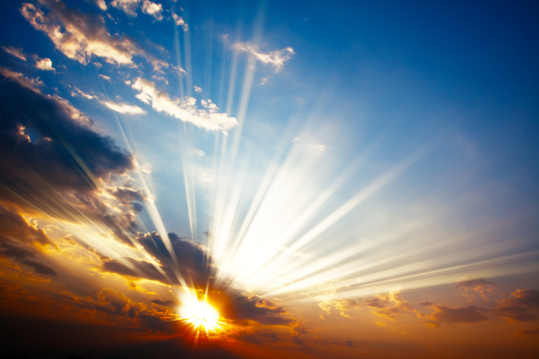
Shechinah—The Presence
A word used by the later Jews (and borrowed from them by the Christians) to denote the cloud of brightness and glory that marked the presence of the Lord.
The Prophet Joseph Smith described this phenomenon of Shechinah in connection with his First Vision, as a “light … above the brightness of the sun,” and said that he saw two Personages whose “brightness and glory defy all description,” standing “in the light” (JS—H 1:16–18).
Bible Dictionary
Exodus 40:34-38 as spoken of in Ex. 3:1–6; 24:16; 1 Kgs. 8:10; Isa. 6:1–3; Matt. 17:5;Acts 7:55.

Slide 24
Sources:
Videos: “The Tabernacle” (7:18) ChurchofJesusChrist.org
“Temples” (5:40)
“Latter-day Saint Temples” (1:40)
Elder M. Russell Ballard God Is at the Helm Oct 2015 Gen. Conf.
Presentation by ©http://fashionsbylynda.com/blog/
2. President Gordon B. Hinckley “O That I Were an Angel, and Could Have the Wish of Mine Heart” Oct 2002 Gen. Conf.
3. Joseph Smith (Teachings of the Prophet Joseph Smith, p. 355)
4. “Inside Temples” Russell M. Nelson, President of the Church of Jesus Christ of Latter-Day Saints https://www.churchofjesuschrist.org/temples/inside-temples?lang=eng ;“The Temple and Your Spiritual Foundation,” Liahona, Nov. 2021, 95)

Slide 25
Weighing My Willingness
Weighing My Willingness
 | Willingly | Somewhat willingly | Not very willingly
1. I attend and participate in my Church meetings and classes.
2. I do service for others.
3. I pay my tithing and fast offerings.
4. I participate in activities with my family.
5. I obey my parents.
 | Willingly | Somewhat willingly | Not very willingly
1. I attend and participate in my Church meetings and classes.
2. I do service for others.
3. I pay my tithing and fast offerings.
4. I participate in activities with my family.
5. I obey my parents.
Exodus 35:20-22, 29.
Exodus 35:20-22, 29.

Slide 26
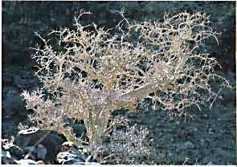
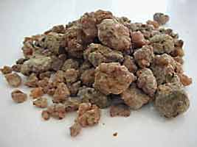
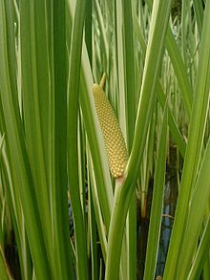
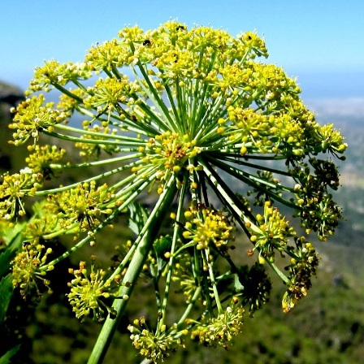
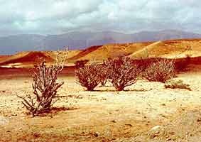
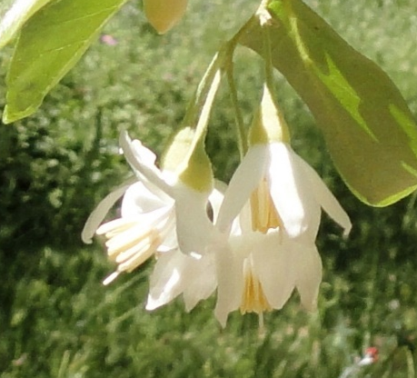

Art of the Apothecary
Apothecary is defined in today’s terms as a health professional trained in the art of preparing and dispensing drugs. Derived from the Greek word apotheke, it means a repository or storeroom and from the Hebrew word raqach, which means to perfume.
healwithoil.com
Sweet Calamas
Myrrh tree in Somalia
Myrrh globules
Frankincense Tree
MYRRH AND FRANKINCENSE
by Subhuti Dharmananda, Ph.D., Director, Institute for Traditional Medicine, Portland, Oregon
Most resin (whether myrrh or frankincense) is obtained by tapping: making deliberate incisions with a specially designed tool or ordinary axe, about 2 inches long, into the bark of the tree. The milky liquid that exudes hardens on exposure to air into droplets or "tears," which are then easily detached by the collector about two weeks later. New tappings are made at the same place as old ones after removing hardened resin from the previous cut. If the tapping interval is short, then a light scratching of the wood is usually sufficient to cause the resin to flow again. The particular details of the tapping-the time of year it is undertaken, its duration, and the interval between individual tappings-vary according to the species and the customs in the area of production. For example, in Somalia there are usually two periods when Boswellia is tapped, each lasting 3-4 months, involving successive tappings at approximately 15-day intervals, with the timing of the tapping periods dependent on the onset and extent of the rains. The resin is stored for about 12 weeks to harden. The only processing undertaken after collection is sorting and grading of the resin globules, usually done by the local merchant to whom it is sold rather than the collector.
Galbanum
Stacte
Myrrh and frankincense have had spiritual significance since ancient times, and they also were adopted as medicines for physical ailments.
Onycha

Slide 27
Just for Fun
Incredibly Embarrassing Funny Moments During Sacrament Meeting
“I Love Cookies”
“They were doing the Primary Program during Sacrament Meeting and one of the primary kids was giving the prayer. The teacher was right next to him whispering in his ear the prayer. She said “…and we love Thee Heavenly Father” and he repeated “…and we love Thee Heavenly Father.”
She then said “And we love Thy Son Jesus Christ” and he then said “and I loooove cookies.” The primary teacher quickly said “No, we love Jesus” to which he simply said “No! I love cookies, in the names of Jesus Christ Amen.”
Justin Bieber Song
“While the young men were passing the Sacrament, the High Councilman’s phone went off. All of a sudden you could hear the words ‘Baby, baby, baby ohhhh like baby, baby, baby.’ Yeah, he had a Justin Bieber song for his ringtone.”
Not enough
“My son yelled out as they brought the sacrament tray around, ‘I’m WAY thirstier than that!'”
Amen
“As I said ‘amen’ in giving the closing prayer, I could hear my little boy scream at the top of his lungs “Amen!” while waving his little arms in the air.”
Help Bishop!
“one time my 3yr old was being very noisy in sacrament and while I am taking him out, he yells ‘Help me Bishop'”
http://ldssmile.com/2014/08/31/sacrament-meeting/

