Slide 1

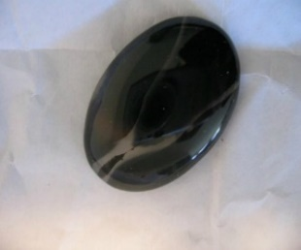













Laws For the Israelites
Leviticus 12-18
“Moses went no longer up to Mount Sinai, but went into the tabernacle, and learned of God what they were to do, and what laws should be made…”
Josephus

Slide 2

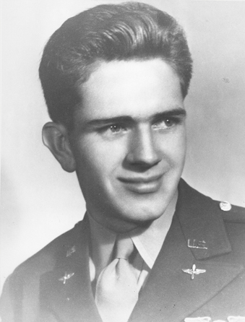
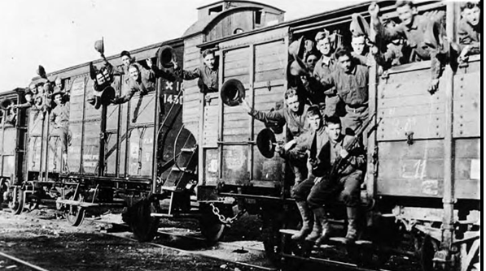
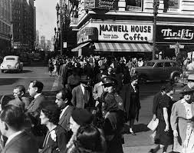
Elder Boyd K. Packer and other soldiers during World War II were transported across the United States in boxcars on a freight train:
“We had no change of clothing during the six-day trip. It was very hot. … Smoke and cinders from the engine made it very uncomfortable. There was no way to bathe or wash our uniforms. We rolled into Los Angeles one morning. …
“We thought first of food. The 10 of us in our crew pooled our money and headed for the best restaurant we could find.”

Slide 3
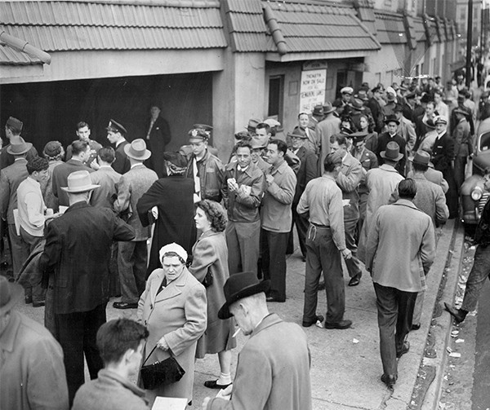
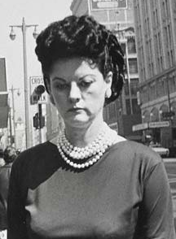
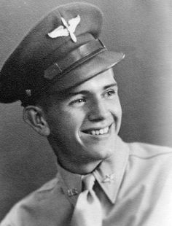
“It was crowded, and so we joined a long line waiting to be seated. I was first, just behind some well-dressed women. Even without turning around, the stately woman in front of me soon became aware that we were there.
“She turned and looked at us. Then she turned and looked me over from head to toe. There I stood in that sweaty, dirty, sooty, wrinkled uniform. She said in a tone of disgust, ‘My, what untidy men!’ All eyes turned to us.
“No doubt she wished we were not there; I shared her wish. I felt as dirty as I was, uncomfortable, and ashamed” (1)
Leviticus 12

Slide 4
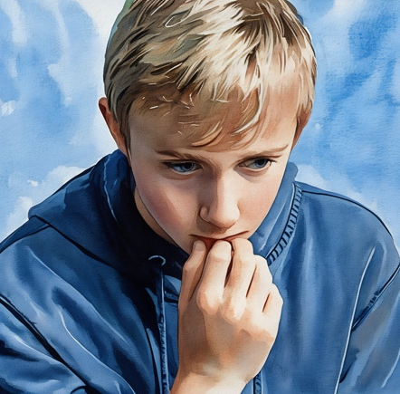
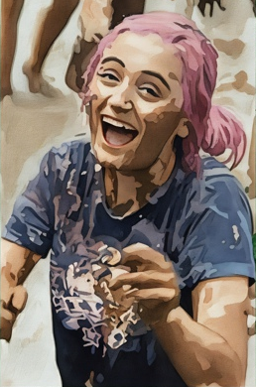
Spiritually Unclean VS Physically Unclean
How might the feelings we experience when we are spiritually unclean be similar to the feelings we have when we are physically unclean?
Even though we may feel ashamed by our sins, we can feel hope and know that the power of the Atonement can redeem us

Slide 5
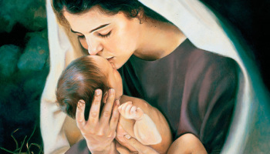
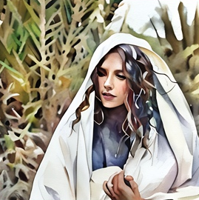
Spiritually Clean
If a woman have conceived seed, and born a man child: then she shall be unclean seven days; according to the days of the separation for her infirmity shall she be unclean.
And she shall then continue in the blood of her purifying three and thirty days; she shall touch no hallowed thing, nor come into the sanctuary, until the days of her purifying be fulfilled.
Liz Lemon Swindle
If she bear a maid child, then she shall be unclean two weeks, as in her separation: and she shall continue in the blood of her purifying threescore and six days.
Leviticus 12:2-5

Slide 6
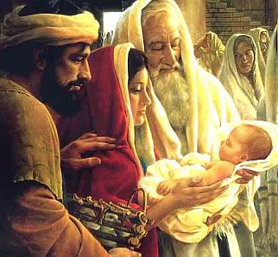
An Offering
And when the days of her purifying are fulfilled, for a son, or for a daughter, she shall bring a lamb of the first year for a burnt offering, and a young pigeon, or a turtledove, for a sin offering, unto the door of the tabernacle of the congregation, unto the priest:
Who shall offer it before the Lord, and make an atonement for her; and she shall be cleansed from the issue of her blood. This is the law for her that hath born a male or a female.
And if she be not able to bring a lamb, then she shall bring two turtles, or two young pigeons; the one for the burnt offering, and the other for a sin offering: and the priest shall make an atonement for her, and she shall be clean.
Leviticus 12:6-8

Slide 7
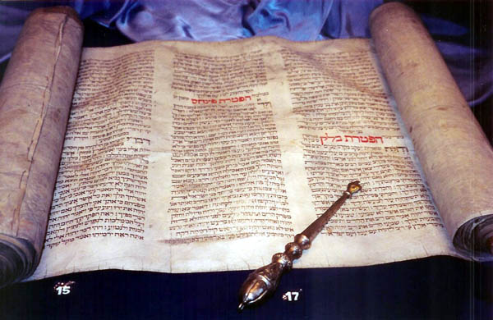
A Strict Law
As with the other laws, you must try to look beyond the outward commandments and rituals for what they were meant to teach about spiritual realities.
And now I say unto you that it was expedient that there should be a law given to the children of Israel, yea, even a very strict law; for they were a stiffnecked people, quick to do iniquity, and slow to remember the Lord their God;
Therefore there was a law given them, yea, a law of performances and of ordinances, a law which they were to observe strictly from day to day, to keep them in remembrance of God and their duty towards him.
Mosiah 13:29-30
Leviticus 12-15

Slide 8
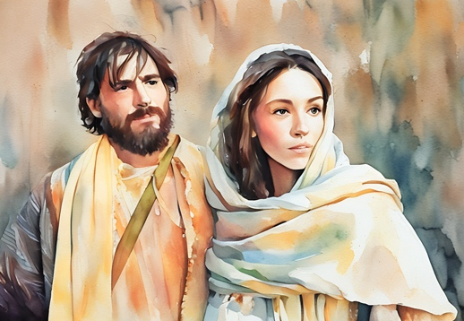
Unclean
“The term unclean in this and the following cases, is generally understood in a mere legal sense, the rendering a person unfit for sacred ordinances” (3)
The ordinances of the Mosaic law were all designed to symbolize spiritual truths. The more nearly one approached perfection in the performance of the law, the more closely one approached the true symbolic meaning of the ordinance. (2)
Leviticus 12-15

Slide 9
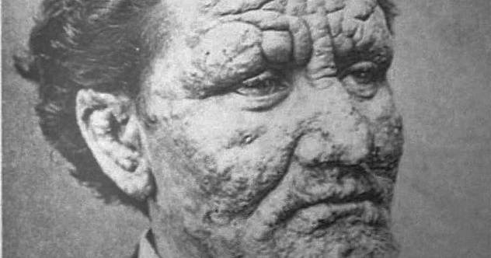
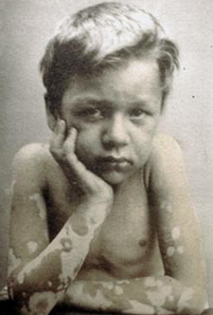
Leprosy
The Hebrew root tzarah, which is translated into the English words leper and leprosy, means “to smite heavily, to strike,” because a leprous person was thought to have been “smitten, scourged of God” (7)
Although it included modern leprosy (Hansen’s disease), leprosy also seems to have designated a wide range of diseases and even such physical decay as mildew or dry rot. The common characteristic seems to be decay and putrefaction, and thus leprosy became a type or a symbol of sin or the sinful man.
Classical leprosy was a dreaded disease that required exile from society and isolation (13:45)
Leviticus 13

Slide 10
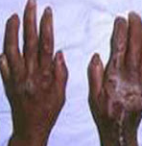
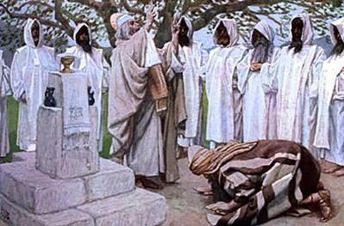
Two Types of Leprosy
The tubercular form manifests itself first by reddish patches in which dark tubercles are later found; as the disease develops there occurs a swelling and distortion of the face and limbs.
Anesthetic leprosy affects primarily the nerve trunks, particularly of the extremities. They become numb and ultimately lose their vitality.
“Certainly the priests were using sound scientific measures in isolating adults who developed chronic skin diseases that might be transmitted to others. Isolation was the very best method for prevention of the spread of contagion.
Furthermore, it is clear that if the individual recovered later—and thus had had some mild recoverable skin disease—then he could be declared cured, and in due time could return to his family and friends.” (4)
Leviticus 13

Slide 11
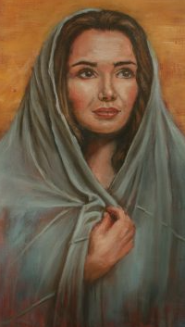
Aaron Pleads For Miriam
Miriam is plague for a week of Leprosy
“…and behold, Miriam became leprous, white as snow; and Aaron looked upon Miriam, and behold, she was leprous.
“Let her (Miriam) not be as one dead, of whom the flesh is half consumed…”
Leviticus 13 Numbers 12:10-15

Slide 12
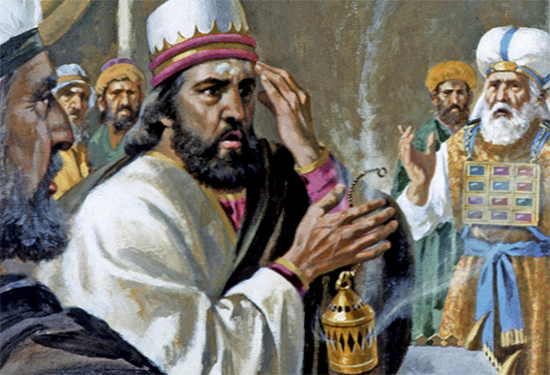
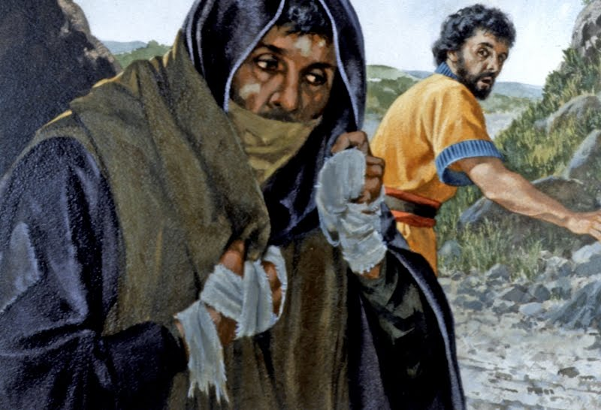
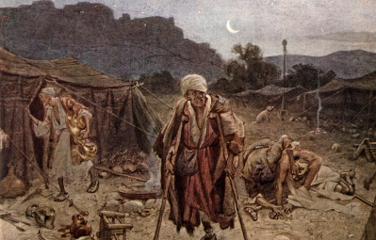
Laws of Leprosy
Those who have the appearance of a skin disorder
Brought to a Priest (Aaron)
Pronounce unclean
White, not deep…shut up for 7 days
If not cleared up then shut up for 7 more days
If plague does not spread, the priest pronounces clean
If plague is spread Priest pronounces him unclean.
His clothes are burned.
He head is shaved.
He puts a covering upon his upper lip, and cries, “unclean, unclean.”
He dwells alone; outside of the camp.
Leviticus 13

Slide 13
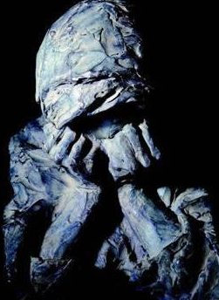
Cleansing the Leper
Many of the skin diseases and conditions described as leprosy would heal with time.
However, before a leper could be considered clean under the law of Moses, he or she needed to participate in two rituals.
One reason these rituals were given was to teach about the Savior’s Atonement and to help them understand principles of repentance.
Leviticus 14

Slide 14
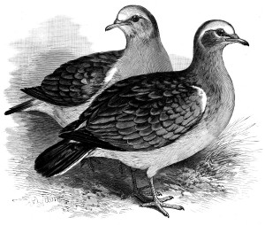
The Ritual
God's law for lepers
If a leper person is healed of his infectious disease, he must go and show himself to the priest.
The person is to bring two birds, some cedar wood, scarlet yarn, and hyssop.
One of the birds will be killed over freshwater.
The priest will dip the live bird and cedar wood, scarlet yarn, and hyssop into the blood of the dead bird in the clay pot and sprinkle it against the person for 7 times.
Then, the priest is to pronounce him clean.
The priest is to release the live bird in the open fields.
Leviticus 14:3-7

Slide 15
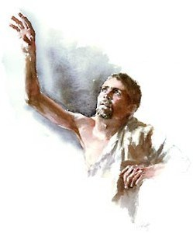
Washing
The person then will wash his clothes and shave off all his hair.
He will wash himself in water.
He will tarry abroad out of his tent 7 days.
On the 7th day he will again shall all his hair, beard, and eyebrows.
He will again wash his clothes and himself in water.
Leviticus 14:8

Slide 16
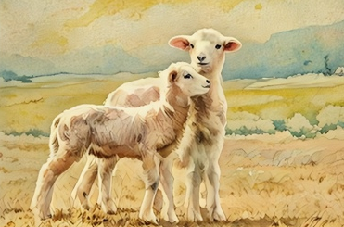
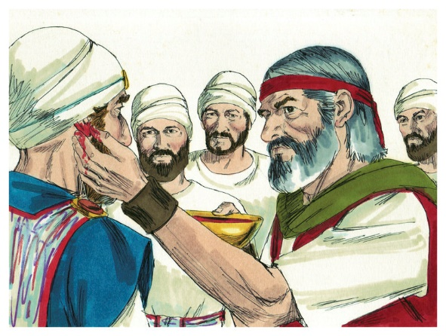
2 Male Lambs
On the 8th day the person is to bring 2 male lambs (without blemish) and one ewe lamb a year old as sacrifices to make atonement for his uncleanness.
One of the male lambs will be used as guilt offering.
The other male lamb will be used as sin offering and the ewe lamb will be used as burnt offering.
They will also bring 3/10th deals of fine flour for a meat offering, mingled with oil, and one log of oil.
The priest performs the offering before the Lord.
One lamb is killed for the trespass offering, and is waved for a wave offering for the priest.
The priest takes some of the blood and puts on right ear, right thumb, and right great toe of person.
Leviticus 14:9-14

Slide 17

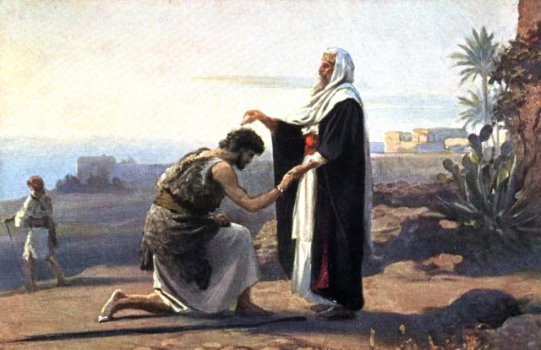
Log of Oil –A Jar, Kad
The priest will take some of the log of oil and pour it into his left palm.
He will dip his right finger in the oil and sprinkle the oil with his finger 7 times.
The rest of the oil the priest will put it upon the tip of the right ear, thumb, and great toe of the person to be cleansed, upon the blood of the trespass offering.
The remaining oil is to be poured upon the person.
The other lamb will be made for the sin offering. Then offer the burnt and meal offering unto the Lord.
Leviticus 14:15-20

Slide 18
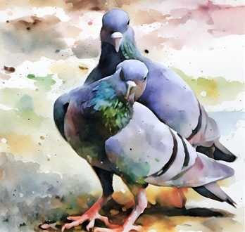
If He Be Poor
The person should bring one lamb and two young pigeons or two young doves.
A lamb will be used as guilt offering.
One of the young pigeons or young dove will be used as sin offering while the other will be used as burnt offering.
The rite is the same as before, except that he will use pigeons or doves for the sin offering and burnt offering this time.
Leviticus 14:21-32

Slide 19
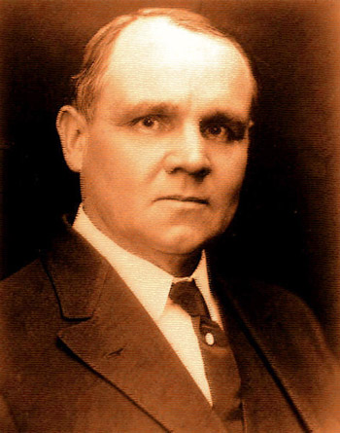
“Leprosy was nothing short of a living death, …a poisoning of the very springs of life; a dissolution, little by little, of the whole body, so that one limb after another actually decayed and fell away.
The disease was incurable
by the art and skill of man…
…The leper, thus fearfully bearing about the body the outward and visible token of sin in the soul, was treated throughout as a sinner.”
They were considered unclean and were shut out from society.
(5)

Slide 20
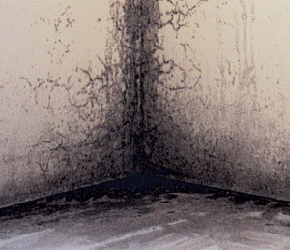
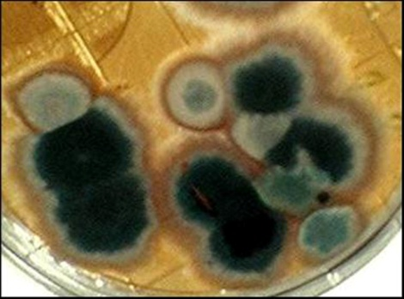
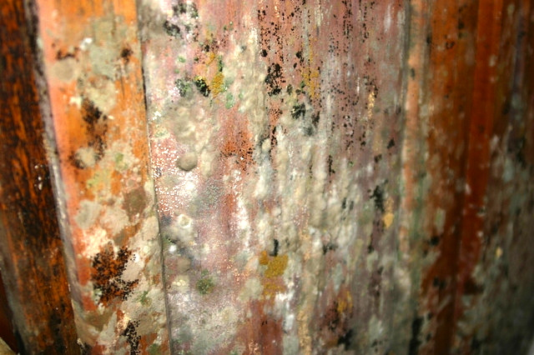
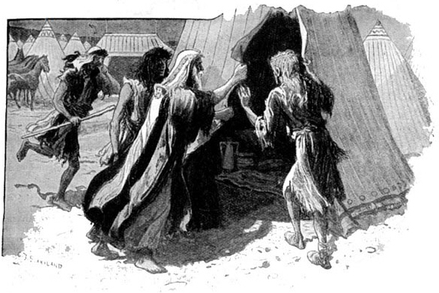
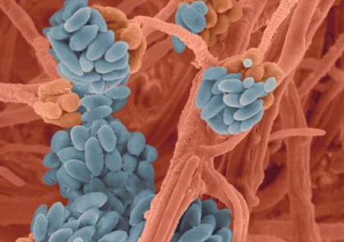
The House of Leprosy
The Lord set forth additional procedures to cleanse houses that contained mildew and mold that could threaten the health of the individuals living there
Leviticus 14:34-53

Slide 21
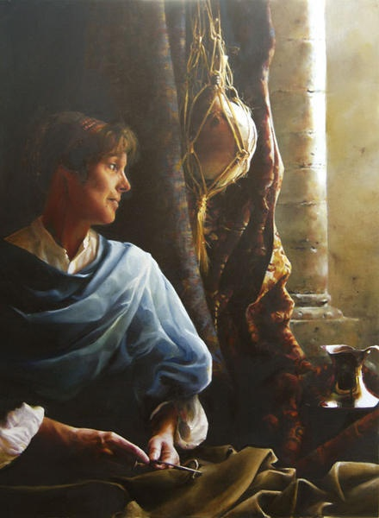
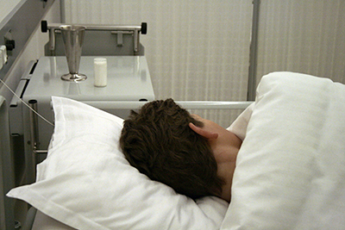
Other Types of Uncleanliness
Additional laws, rites, and sacrifices that were set forth to help priests know how to cleanse other types of uncleanliness.
Unclean in the Mosaic sense did not suggest something disgusting or filthy, nor did it imply that the body or the natural functions of the body, such as childbirth or sexual relations, were inherently evil.
Elspeth C. Young
The physical body and its natural functions remind one that he is of the earth, of the physical.
A discharge from the body—Niddah (menstration) Lev. 15:9
A hemorrhage, pus, bleeding from sores, excretion, etc.
A sickness—cold, fever, chills, etc.
There were certain practical or sanitary aspects of these laws as well. The strict rules about contact with an infected person or objects with which he had come in contact have modern hygienic parallels.
Leviticus 15
(2)

Slide 22
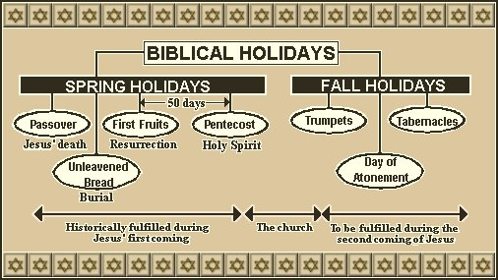
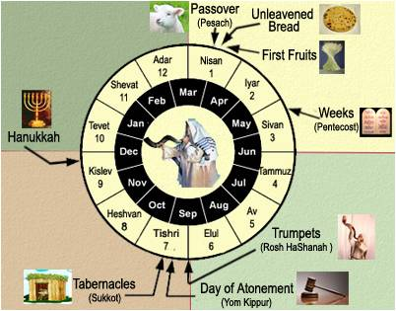
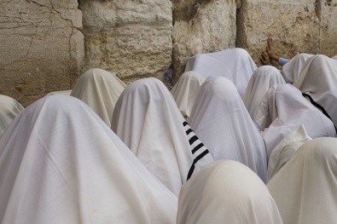
Day of Atonement—Yom Kipper
Took place in the fall of the year, was the most sacred and solemn of all the Israelite festivals.
A day of national fasting and one that signified that the sins of Israel had been atoned for and that the nation and its people were restored to a state of fellowship with God.
Leviticus 16
(2)

Slide 23
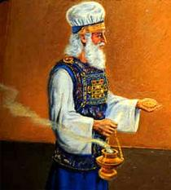
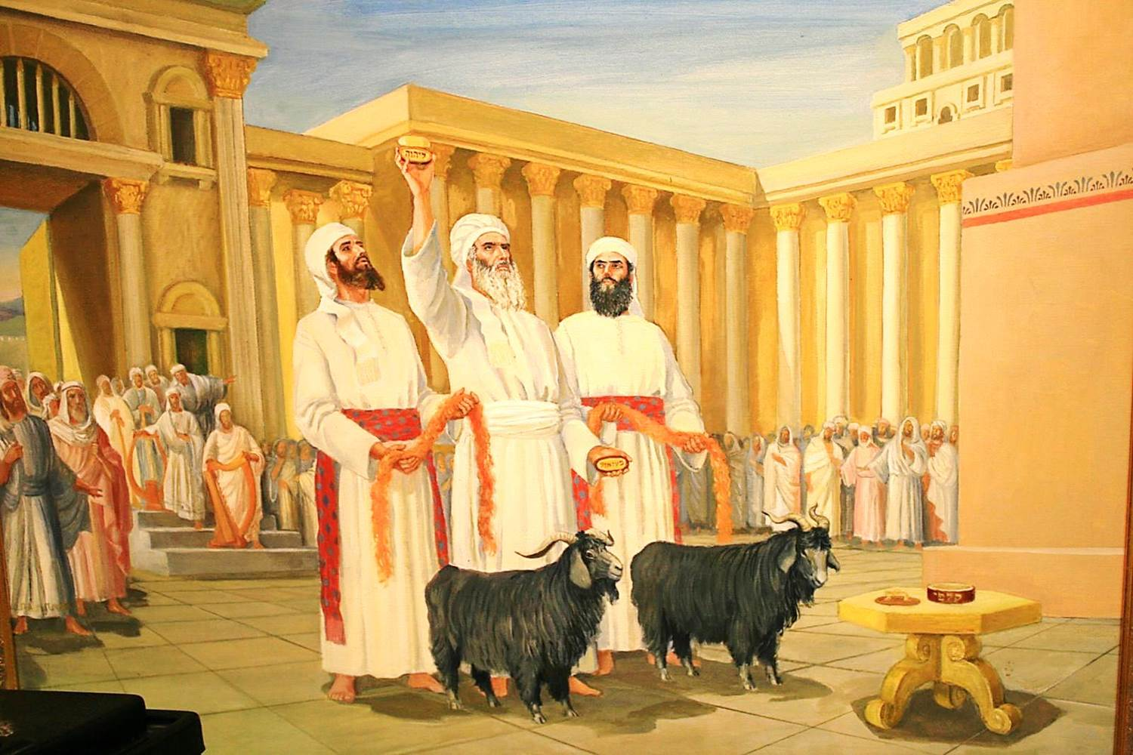
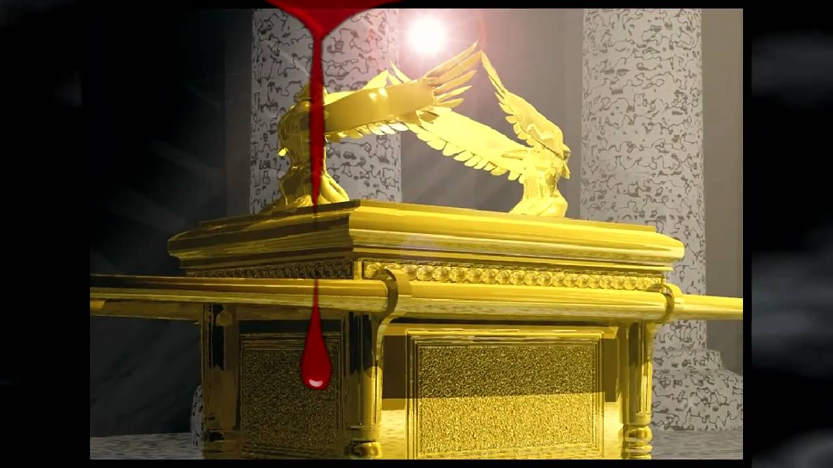
Holy of Holies
Israel’s High priest enters the Holy of Holies to make an atonement for the sins of the people
Sacrificial animals are slain and their blood sprinkles on the mercy seat and before the altar
Incense is burned
Two goats are selected and lots cast.
The name of Jehovah is placed on one goat and then sacrificed and the other is called the “scapegoat” (Azazel) and carried the burden of the sins of the children of Israel into the wilderness
Leviticus 16
(2)

Slide 24
Through the Atonement, Jesus Christ took away the sins of the world by taking them upon Himself. Jesus Christ’s Atonement included His infinite suffering and the shedding of His blood in Gethsemane and on the cross
Leviticus 16

Slide 25
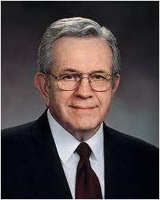
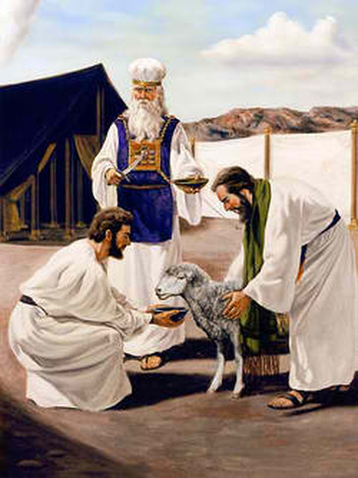
The Sacrifice
“As sacrifice was ever deemed essential to true religion, it was necessary that it should be performed in such a way as to secure the great purpose of its institution.
The Israelites, from their long residence in Egypt, an idolatrous country, had doubtless adopted many of their usages; and many portions of the Pentateuch seem to have been written merely to correct and bring them back to the purity of the Divine worship.
“That no blood should be offered to idols, God commands every animal used for food or sacrifice to be slain at the door of the tabernacle.
While every animal was slain in this sacrificial way, even the daily food of the people must put them in mind of the necessity of a sacrifice for sin.”
When they reached their permanent homes the sacrifices could be done close to home and the then be buried in the dust.
Leviticus 17
(2)

Slide 26
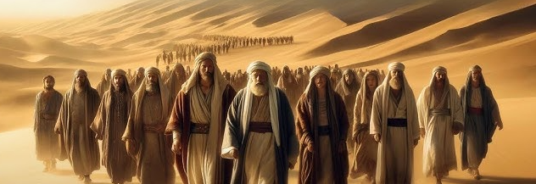
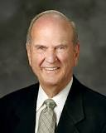
Israel Shall Live Differently
The Lord commanded the people to avoid idolatrous practices, forbade marriages of close relatives, and identified homosexual behavior and other sexual perversions as an abomination. Israel was to keep God’s ordinances and remain undefiled.
“A strong human spirit with control over appetites of the flesh is master over emotions and passions and not a slave to them. That kind of freedom is as vital to the spirit as oxygen is to the body! Freedom from self-slavery is true liberation.”
Leviticus 18
(6)

Slide 27
Sources:
Elder Boyd K. Packer (“Washed Clean,” Ensign, May 1997, 9).
Old Testament Institute Manual
Clarke, Bible Commentary, 1:559). found in Old Testament Institute Manual
Presentation by ©http://fashionsbylynda.com/blog/
Buttrick, Interpreter’s Bible, 2:66–67. found in Old Testament Institute Manual
James E. Talmage “Jesus the Christ” pg 201
6. Russell M. Nelson Decisions for Eternity Oct. 2013 Gen. Conf.
7. Wilson, Old Testament Word Studies, s.v. “leper,” pp. 248–49.

Slide 28
The Book of Leviticus
Bible Dictionary
Chapters 1-7 | Chapters 8-10 | Chapter 11 | Chapters 12 | Chapters 13-15 | Chapter 16 | Chapter 17-26 | Chapter 27
Explains the sacrificial ordinances—the offerings | Describes the ritual observed in the consecration of priests | Explains what may or may not be eaten and what is clean or unclean | Discusses women after childbirth | Are laws relating to ceremonial uncleanness | Contains the ritual to be observed on the Day of Atonement | Contains a code of laws dealing with religious and social observances | Explains that the Lord commanded Israel to consecrate their crops, flocks, and herds to the Lord
Leviticus 12 | Leviticus 13 | Leviticus 14 | Leviticus 15 | Leviticus 16 | Leviticus 17 | Leviticus 18
The Laws Concerning Childbirth | The Laws Concerning Leprosy | Cleansing of Leprosy | Laws Concerning Discharge | The Day of the Atonement | Laws | Laws of Sanctification for the People
1-8 | Examination of People 1-46 Examination of Garments 47-59 | Cleansing the People 1-32 Cleansing the House 33-53 Purpose of the Laws of Leprosy 54-57 | Discharge of the Man 1-18 Discharge of the Woman 19-30 Purpose of Discharge 31-33 | Preparation of High Priest and Sacrifices 1-5 Atonement for Priest 11-14 Atonement for Tabernacle 15-19 Atonement for the People 20-28 Purpose of Day of Atonement 29-34 | Concerning location of Sacrifices 1-9 Concerning the Use of Blood 10-16 | Sexual Sin 1-30

Slide 29
Male Birth VS Female Birth:
Speculation on why the Lord revealed different requirements for ceremonial purifying after the birth of male and female children is pointless until further revelation is received on the matter. Old Testament Institute Manual
Leprosy Culture Background:
it was repulsive to all who saw the person
it was incurable by human means
it was isolating - lepers were confined outside the city limits - many times to the city dump - probably because they could find food and other things there.
it would cause you to become unclean ceremonially if you touched a leper (even if you didn’t catch the disease).
it was the physical counterpart to the spiritual problem of sin. It was the model disease for sin. That is why when a leper is healed it is called a cleansing instead of a healing.
When a leper was healed he was to go to the priest and be pronounced clean before reentering society.
Not since Elisha healed Naaman the Syrian in 2 Kings 5: had someone been healed of leprosy. Bible.org
Niddah: Unclean for 7 days
The Old Testament stipulates a woman is unclean during menstruation, but the Talmud stipulates her period of uncleanness lasts for an additional week after menstruation has ended. Niddah is the word used to denote the menstruating woman and her period of uncleanness. The niddah defiles everyone and everything she touches. She may not have sexual intercourse with her husband. Talmud Laws of Menstration
According to the Mosaic Law, a woman was considered unclean for seven days during normal menstruation. The bed or any other articles upon which the menstruating woman might lie or sit were also rendered unclean. Anyone touching her or items she had made unclean was required to wash his garments and bathe, and that one remained unclean until the evening. If her menstrual impurity came to be upon a man lying down with her (as when, unwittingly, a husband had sexual relations with his wife at the beginning of menstruation), he was rendered unclean for seven days, and the bed upon which he might lie down was considered unclean.
The woman was also viewed as unclean for the duration of an irregular running discharge of blood or “a flow longer than her menstrual impurity,” at which time she made the articles on which she lay or sat as well as persons touching these items unclean. After the abnormal discharge ceased, she was to count seven days, and she then became clean. On the eighth day the woman brought two turtledoves or two young pigeons to the priest, who made atonement for her, presenting one of these creatures to Jehovah as a sin offering and the other as a burnt offering. If a man and a woman deliberately cohabited during her menstrual impurity, they were cut off in death. Leviticus 15:19-30; 20:18 Watchtower Online Library
Leprosy:
Anyone suspected of having this disease had to go to a priest for examination (Leviticus 13:2-3). If found to be infected, “the leprous person who has the disease shall wear torn clothes and let the hair of his head hang loose, and he shall cover his upper lip and cry out, ‘Unclean, unclean.’ He shall remain unclean as long as he has the disease. He is unclean. He shall live alone. His dwelling shall be outside the camp” (Leviticus 13:45-46). The leper then was considered utterly unclean—physically and spiritually.
Incurable by man, many believed God inflicted the curse of leprosy upon people for the sins they committed. In fact, those with leprosy were so despised and loathed that they were not allowed to live in any community with their own people (Numbers 5:2). Among the sixty-one defilements of ancient Jewish laws, leprosy was second only to a dead body in seriousness. A leper wasn’t allowed to come within six feet of any other human, including his own family. The disease was considered so revolting that the leper wasn’t permitted to come within 150 feet of anyone when the wind was blowing. Lepers lived in a community with other lepers until they either got better or died. This was the only way the people knew to contain the spread of the contagious forms of leprosy. Gotquestions.org
Childbirth: Throughout the scriptures, the word unclean can refer to both physical and spiritual uncleanliness. Additionally, in the law of Moses, “uncleanness referred to being ceremonially or ritually unclean” (Bible Dictionary, “Clean and unclean”). For example, Leviticus 12 teaches that women who underwent childbirth were to be pronounced unclean. This does not mean the mother was unworthy because of sins or misdeeds. Rather, the purification time would allow the mother time to recuperate from childbirth. During this time she would be in seclusion and separated from the rest of the camp. After the designated period of time passed, she would bring the appropriate animal sacrifice to the tabernacle. The priest would then make an offering, after which she would be pronounced clean. She was then able to again participate in the ceremonies and rituals of the law of Moses.

Slide 30
The other goat, Azazel, was brought before the high priest, who laid his hands upon its head and symbolically transferred all of the sins of Israel to it. Then it was taken out into the wilderness and released where it would never be seen again. One commentator explained the significance of Azazel by saying that it represented ‘the devil himself, the head of the fallen angels, who was afterwards called Satan; for no subordinate evil spirit could have been placed in antithesis to Jehovah as Azazel is here, but only the ruler or head of the kingdom of demons.’ (C. F. Keil and F. Delitzsch, Commentary on the Old Testament, bk. 1: The Pentateuch, ‘The Third Book of Moses,’ 10 bks. [n.d.], p. 398.)
Other Forms of Idol Worship: Molech:
The worship of these false gods sometimes involved human sacrifice—as in the case of Molech; more often, the worship of a fertility god or goddess involved immorality committed with “priests” or “priestesses” of a cult….
Molech—meaning “king,” the term comes from the same Hebrew root as Melchizedek, “king of Salem” and “king of righteousness,” and Mulek, “son of King Zedekiah.” Molech was the fire god of the Ammonites. The Baal of Elijah’s contest may have been Molech; we know that he was the same as the Moabite god Chemish, and that his priests were called chemarims. (See Zeph. 1:4 b.)
The worship of Molech was particularly heinous; it required human sacrifice—usually of a small child, often the firstborn son. The brass statue of Molech was hollow, and it was used to burn victims alive. (See Peloubet, Peloubet’s Bible Dictionary, p. 416.) References to giving one’s seed to Molech (see Lev. 20:2–5) or to passing a child through fire (see 2 Kgs. 16:3; 2 Kgs. 21:6; 2 Kgs. 23:10) refer to human sacrifice by fire.
David H. Madsen No Other Gods before Me January 1990 Ensign
“The sacred writings of ancient times, the inspired utterances of latter-day prophets, the traditions of mankind, the rites of sacrifice, and even the sacrileges of heathen idolatries, all involve the idea of vicarious atonement. God has never refused to accept an offering made by one who is authorized on behalf of those who are in any way incapable of doing the required service themselves. The scapegoat and the altar victim of ancient Israel, if offered with repentance and contrition, were accepted by the Lord in mitigation of the sins of the people.” Elder James E. Talmage (Articles of Faith, p. 77

Slide 31
The leper Leviticus 14:2 | Leprosy in its various forms was a disease that involved decay and putrefaction of the living body; also, because of its loathsomeness, it required the person to be ostracized and cut off from any fellowship with the rest of the house of Israel | Sin introduces decay and corruption into the spiritual realm similar to what leprosy does in the physical realm.
The priest Leviticus 14:3-5 | The priest served as the official representative of the Lord, and he was authorized to cleanse the leper and bring him back into full fellowship. | Our bishop holds the priesthood and serves as our official representative of the Lord.
The birds Leviticus 14:4-7 | As the only living objects used in the ritual, the birds symbolized the candidate. Because of the two truths to be taught, two birds were required. The first bird was killed by the shedding of its blood, signifying that the leper (the natural man) had to give up his life. The second bird, after being bound together with other symbols, was released. | The birds signify that the man has been freed from the bondage of sin.
The cedar wood Leviticus 14:4-6 | The wood from cedar trees is still used today because of its ability to preserve surrounding objects from decay and corruption. | The cedar tree symbolizes preservation from decay.
The scarlet wool Leviticus 14:4-6 | The word scarlet really meant a piece of wool dyed a bright red | Red reminds us of blood, which is the symbol of life and also of atonement. Leviticus 17:11
The hyssop Leviticus 14:4-6 | Though we are not sure exactly why, we do know that in the Old Testament times the herb hyssop carried with it the symbolism of purification | A symbol of being clean, pure and righteous “Purge me with hyssop, and I shall be clean: wash me, and I shall be whiter than snow.” Psalms 51:7
The basin of water Leviticus 14:5 | Over the basin of water the first bird was killed, symbolizing the death of the natural man and the eventual rebirth of the spiritually innocent person. Blood and water are the symbols of birth, both physical and spiritual Moses 6:59 | The place of spiritual rebirth, the baptismal font, is a symbol of the place where the natural man is put to death D&C 128:12-13
The washing of the leper Lev. 14:8 | A symbol of washing and cleansing | The sacrament is also a symbol of cleansing, renewing our covenants with the Lord
The shaving of the hair Lev. 14:9 | This process would bring a person into a state of appearance very much like that of a newborn infant, who is typically virtually without hair | Symbolic of rebirth, the candidate graphically demonstrated on his own person that he was newborn spiritually.
The sacrifice of the lamb Lev. 14:10-14 | The lamb offered had to be the firstborn male without spot or blemish. | Offering the Son of God
The smearing of the blood on the parts of the body Lev. 14:17 | The organ of hearing or obedience (the ear), the organ of action (the hand), and the organ of following or walking in the proper way (the foot) | ‘atonement’ literally means ‘to cover. The person’s life was touched and affected by the atonement of Christ.
The oil Leviticus 14:15-18 | The olive tree from the earliest times has been the emblem of peace and purity. Also a symbol of the Holy Ghost. D&C 45:55-57 | The blood of Christ cleansed every aspect of the candidate’s life, and then the process was repeated with the oil to show that the Spirit too affected everything he did

