Slide 1


Organization of Israel
Numbers 1-10
v
“For Israel, an eleven-day journey became a forty-year agony.”
--Bruce Wilkinson and Kenneth Boa
Presentation by ©http://fashionsbylynda.com/blog/

Slide 2
Book of Numbers
4th book in Pentateuch
“Numbers is the book of wanderings. It take its name from the two numberings of the Israelites—the first at Mount Sinai, and the second on the plains of Moab…
Leviticus covered one month but during the 2nd year in the wilderness Israel is counted and organized and Numbers stretches over 38 years.
Numbers starts 21 days before the Israelites leave Mt. Sinai
Genesis
Exodus
Leviticus
Deuteronomy
Numbers
“…Most of the book describes Israel’s experiences as they wander in the wilderness.” (1)
We believe the Bible to be the word of God as far as it is translated correctly…
Article of Faith 8
Scholars believe there have been textual errors in the transmission of numbers down through the centuries and that the total number of Israelites would be closer to half a million. (2)

Slide 3

Head Count
1st Day of 2nd Month
Age 21 and up—soldiers
Counted in Tribes
Tribe of Reuben 46,500
Tribe of Simeon 59,300
Tribe of Gad 45,650
Tribe of Judah 74,600
Tribe of Issachar 54,400
Tribe of Zebulun 57,400
v
Tribe of Ephraim (Joseph) 40,500
Tribe of Manasseh (Joseph) 32,200
Tribe of Benjamin 35, 400
Tribe of Dan 62,700
Tribe of Asher 41,500
Tribe of Naphtali 53,400
Levites---22,000 (Numbers 3:39)
The Lord did not permit Moses to take a census fro the tribe of Levi at this time because the Lord did not intend to use them in war.
The Levites were to have a special calling. (3)
603,550 Men
This also excluded all females, old men, boys under twenty years of age, and men unable to bear arms. (2)
Numbers 1:1-4

Slide 4
Camp of Israel
N
Naphtali
Dan
Asher
Manasseh
Zebulun
Merari--Levites
Tent of meeting
Ephraim
Judah
v
Moses and Aaron--Levites
Benjamin
Gershon--Levites
Issachar
Remember the sun rises in the east
Kohath--Levites
“The priest had the first places about the tabernacle; then the Levites.” (4)
Numbers 2
Simon
Reuben
Gad

Slide 5
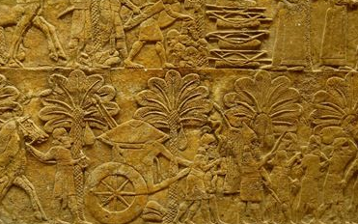
Head of Households/Captains
Reuben
Simeon
Judah
Issachar
Zebulun
Ephraim
Manasseh
Shedeur
Zurishaddai
Amminadab
Zuar
Helon
Ammihud
Pedahzur
Elizur
Shelumiel
Nahshon
Nethaneel
Eliab
Elishama
Gamaliel
Benjamin
Dan
Asher
Gad
Naphtali
Gideoni
Ammishaddai
Ocran
Deuel
Enan
The Lord organizes His people in order to protect and guide them
Abidan
Ahiezer
Pagiel
Eliasaph
Ahira
Numbers 1:5-14; 2

Slide 6
Ministry of The Levites
Died by offering strange fire unto the Lord
Aaron
Nadab
Abihu
Eleazar
Ithamar
Those of the Levitical Priesthood were assigned particularly to care for the house of the Lord: to officiate in it on behalf of the children of Israel and to disassemble and reassemble it in times of movement. They were its protectors, so their tents encircled the sanctuary. (2)
Descendants of Aaron were designated as priests, and they were the ones given the stewardship to preside in the ordinances of the tabernacle.
The other Levites assisted in maintaining the tabernacle and its services, but they could not actually perform the ordinances of sacrifice, burning incense, and so on.
Although all the Levites camped around the tabernacle, Aaron and his sons, along with Moses, were placed in the favored position directly in front of the tabernacle entrance.
Numbers 1:47-54; 3
(3)

Slide 7
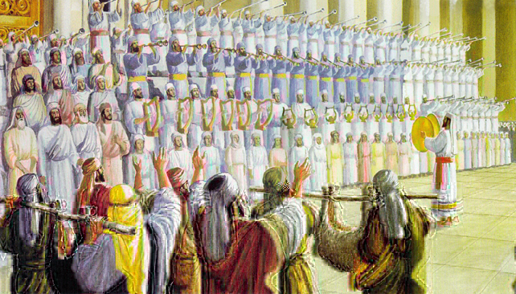
Lord Adopts Tribe of Levi
Number of Levites= 22,000
Number of First Born Levites= 22,273
“The Lord said that since there were 273 more firstborn among the various tribes than the total for the tribe of Levi, He would require the various tribes to redeem this difference of 273 by paying a monetary contribution into the sanctuary of the Tabernacle.”
In order to qualify for the Levitical Priesthood one had to be “without blemish” and between the ages of 30 and 50.
Total qualified= 8,580
Numbers 3:51; 4:47-48
(3)

Slide 8
Gershon, Kohath, Merari
Moses divided the Levites into three groups
N
Descendants of Merari
Levi
Gershon
Kohath
Merari
Descendants of Gershon
Moses and Aaron and Family
Aaron and his sons were set apart to the priesthood and were given the other sons of Levi to assist them in the movement and functions of the tabernacle.
Descendants of Kohath
Kohathites—transported on shoulder all the aritfacts within the Tabernacle--
Numbers 3-4
(3)

Slide 9
Special Duties
The men were washed, shaved, dressed in clean clothes, and consecrated for transporting the Tabernacle
Kohathites—transport on shoulder all the artifacts within the Tabernacle--
Gershonites—transport the curtain
Merarites—transport boards, bars, sockets and pillars.
The Gift
Because these items were so heavy the tribal leaders of Israel came forward with 6 covered wagons and 12 oxen. These wagons carried the tent and frame. The Kohathites were to carry the sacred items on their shoulders.
Before the items were taken out of the Tabernacle only Aaron and priests could enter and then cover the sacred pieces to be transported.
Numbers 3-4, 7
(3)

Slide 10
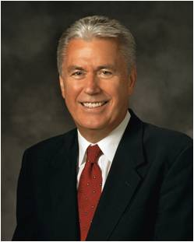
“The Lord organized the Church in a way that offers each member an opportunity for service, which, in turn, leads to personal spiritual growth. …
“You may feel that there are others who are more capable or more experienced who could fulfill your callings and assignments better than you can, but the Lord gave you your responsibilities for a reason.
There may be people and hearts only you can reach and touch. Perhaps no one else could do it in quite the same way” (5)
The Lord assigns specific responsibilities to individuals in His kingdom

Slide 11
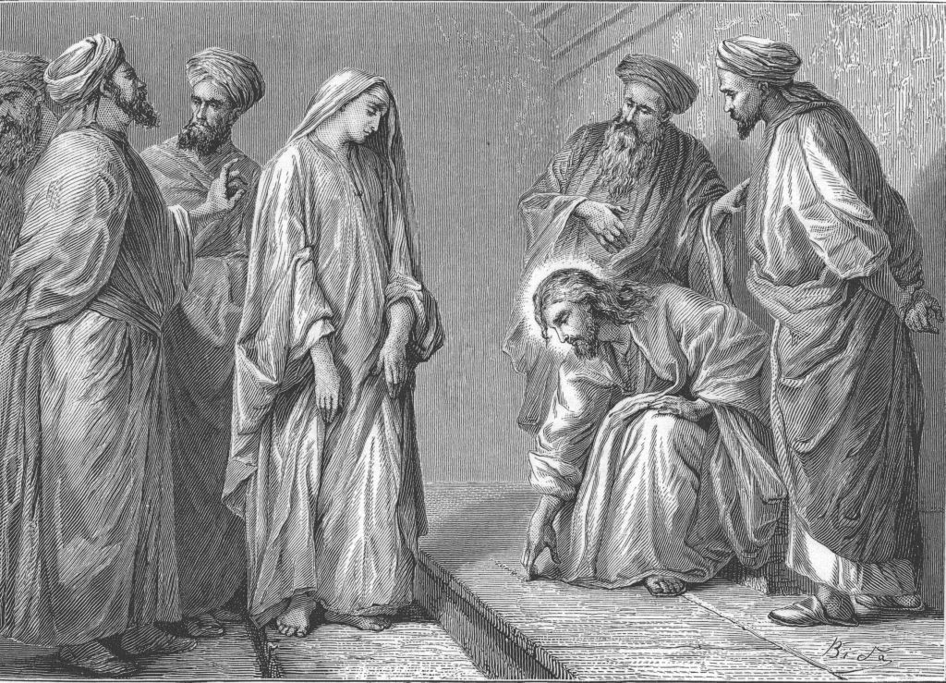
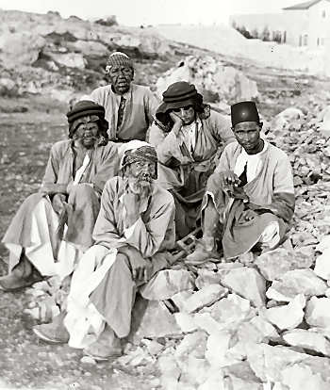
Separation—Defile Not the Camp
Those with leprosy or sunning sores were not allowed to march or camp with the rest of Israel.
They were to be put out of the camp=only separate from the main body, not a total rejection or abandonment.
Men and women were also separated from the main body of the camp if they had issues with adultery or any sin.
Numbers 5
(6)

Slide 12
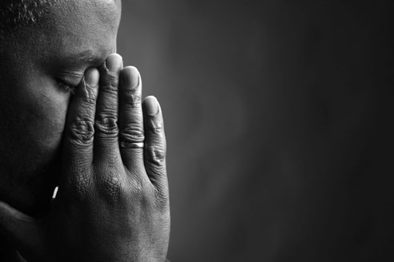
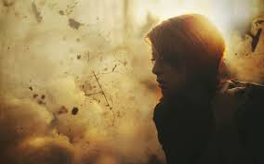
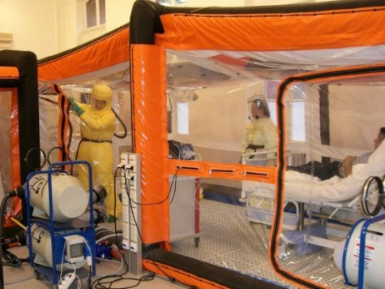
Separation Today
Those with contagious diseases are put in quarantine
Spiritual Separation- Those who have broken their covenants:
Murder=excommunication
The law of chastity = the Church leader may-especially in cases of adultery, fornication, or homosexuality-convene a disciplinary council to help the transgressor through repentance and to protect the integrity of the Church. Depending on the offense and the spiritual maturity of the offender, a disciplinary council may excommunicate, disfellowship, place on probation, or exonerate the person.
Other sins=non participation in church services, depending upon the sin and the bishop’s judgement
Numbers 5
(7)

Slide 13
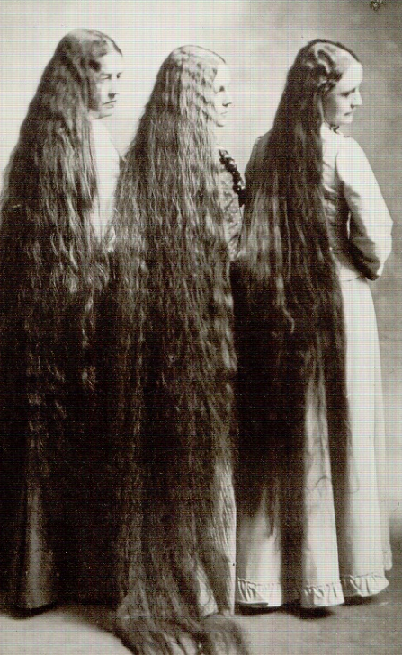
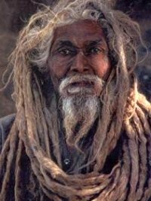
Nazarite Vow
Nothing to do with the town of Nazareth
A Nazarite was a man or woman who took a voluntary vow to separate his life for the service of the Lord, or to live consecrated unto Him. (8)
Nazarite—3 vows (covenant or promise):
Abstain absolutely from wine or strong drink, including any products of the vine in any form.
Would not let a razor touch his head, but would let his hair grow naturally as a crown to God.
Would not allow himself to draw near a dead person, even a member of his own family.
“Speak to the Israelites and say to them: ‘If a man or woman wants to make a special vow, a vow of dedication to the Lord as a Nazirite, … Numbers 6:2
Numbers 6
(7)

Slide 14
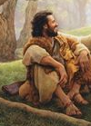
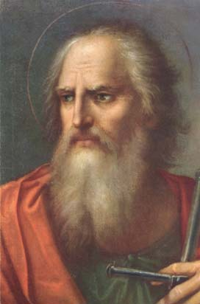
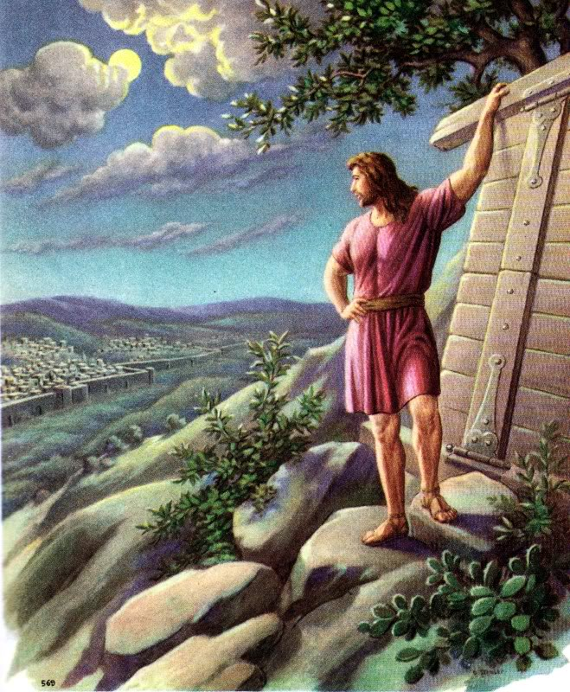

Those Who Took Nazarite Vow
His life and all his efforts were completely and expressly dedicated to the Lord:
Those who seem to have take such vows, or had parents who made the vows for them:
John the Baptist (Luke 1:15)
Paul (Acts 18:18)
Samson (Judges 13:5)
Samuel (1 Samuel 1:11, 28)
(7)
Numbers 6

Slide 15
Prince—Leader of the Tribe
Dedication at the altar:
1 silver charger of 130 shekels (3.25 lbs.)
1 silver bowl of 70 shekels full of flour mingled with oil
1 golden spoon of 10 shekels of incense
1 young bullock
1 ram
1 lamb (1st yearling) for burnt offering
1 kid for sin offering
2 oxen, 5 ram, 5 he goats, and 5 lambs (1st yearling) for a peace offering
Total:
12 silver chargers—weight 2,400 shekels (60 lbs. or 27.22 kilograms)
12 golden spoons—weight 120 shekels
(3 lbs. or 1.361 kilograms)
12 oxen, rams, lambs, goats
Total Offerings:
24 bullocks
60 rams, he goat, lambs all dedicated at the alter
v
Day 1
Tribe of Judah
Nahshon
Day 3
Tribe of Zebulun
Eliab
Day 5
Tribe of Simeon
Shelumiel
Day 7
Tribe of Ephraim
Elishama
Day 10
Tribe of Dan
Ahiezer
Day 11
Tribe of Asher
Pagiel
Day 2
Tribe of Issachar
Nethaneel
Day 4
Tribe of Reuben
Elizar
Day 6
Tribe of Gad
Eliasaph
Day 8
Tribe of Manasseh
Gamaliel
Day 9
Tribe of
Benjamin
Abidan
Day 12
Tribe of Naphtali
Ahira
Numbers 7
(7)

Slide 16
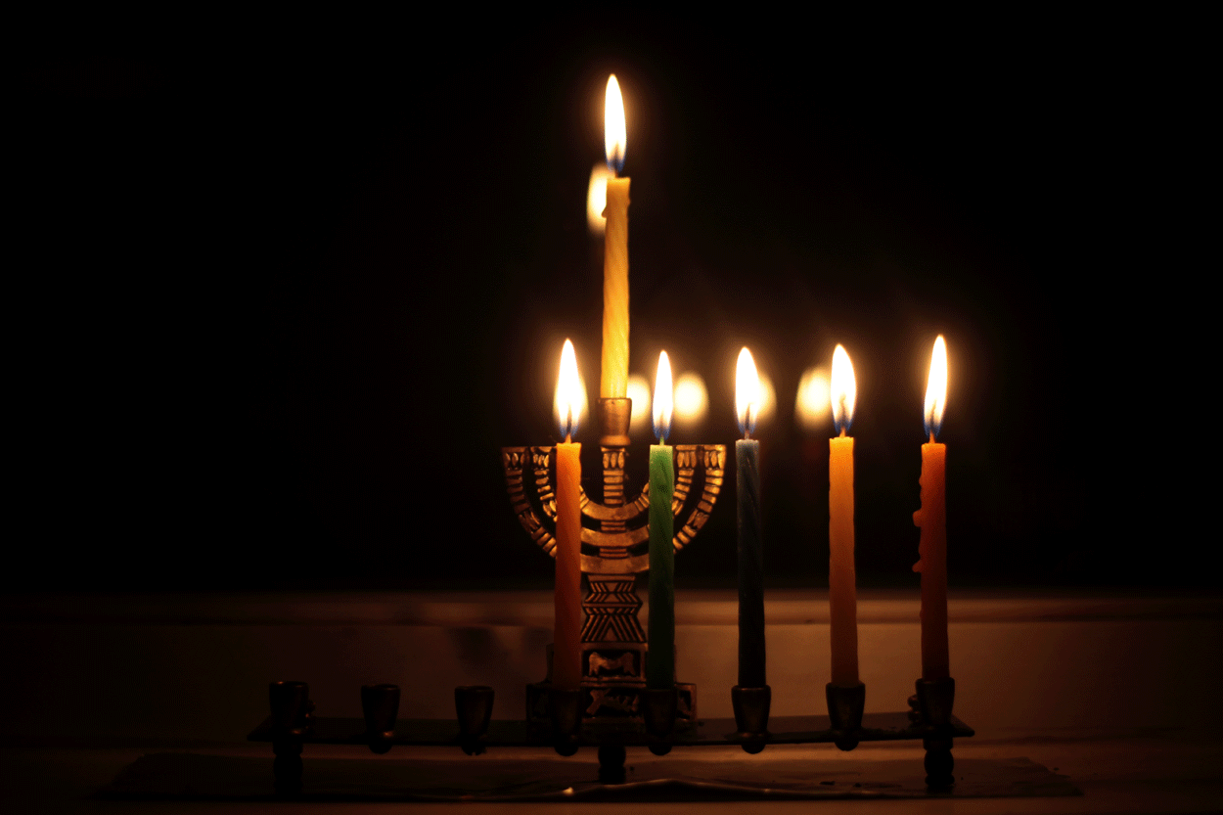
The Levites Are Consecrated
“Over against the Candlestick”
Hebrew: its light illuminated whatever was on the opposite side of the room.
The Levites are washed clean upon entering into their service in the Tabernacle.
People laid hands upon the priest, who were then set apart for his service.
This could mean that they were symbolically sustained to become the representative before the Lord.
Numbers 8
(7)

Slide 17
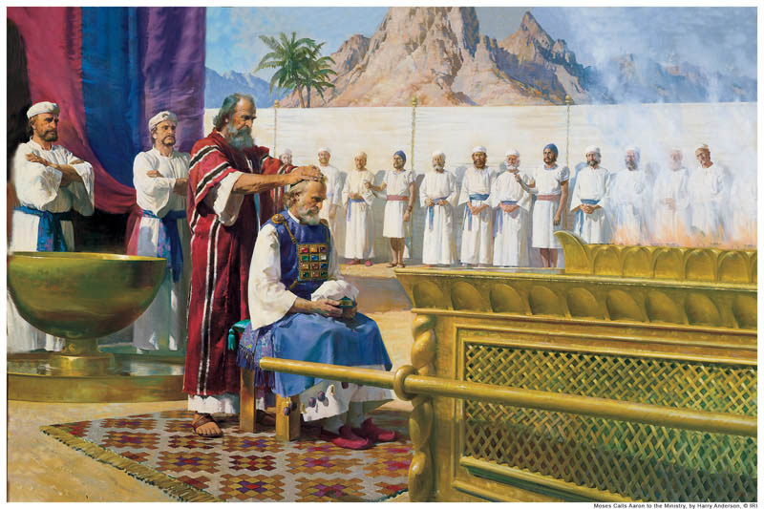
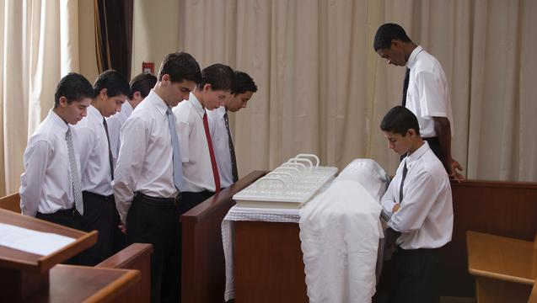
Aaronic VS Levitcal
The Aaronic Priesthood is sometimes called the lesser priesthood.
The fact that it is called the lesser priesthood does not diminish at all the importance of the Aaronic Priesthood.
The Aaronic Priesthood is also called the Levitical Priesthood. The word Levitical comes from the name Levi, one of the twelve sons of Israel. Moses and Aaron, who were brothers, were Levites.
It is a matter of designating duties; it is all one priesthood.
Aaronic-- The Preparatory Priesthood:
Within the tribe, only Aaron and his sons could hold the office of priest. (10)
Today: It prepares young men to hold the higher priesthood, for missions, and for temple marriage.
Levitical--presiding and administrative responsibility.
They were put in charge of the ceremonies of the tabernacle, including the Mosaic law of sacrifice.
Numbers 8
(9)

Slide 18
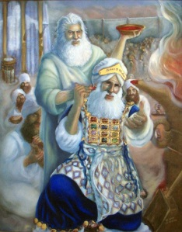
Priests VS Levites
The priests could offer sacrifices for the people, burn incense on the altar, and teach the law
The other Levites were employed in more menial tasks, such as the housekeeping of the tabernacle, keeping oil in the lamps, transporting the Ark of the Covenant, taking down and setting up the tabernacle when moving, and related tasks in assisting the priests
The Aaronic (or Levitical) Priesthood thus functioned only within the tribe of Levi, and the right to have it conferred upon one was determined by lineage and worthiness.
The lineal restrictions of that Aaronic (Levitical) Priesthood were lifted when the law of Moses was fulfilled, and thereafter the offices of the priesthood were conferred upon worthy men without limitation to the tribe of Levi.
Numbers 8
(10)

Slide 19
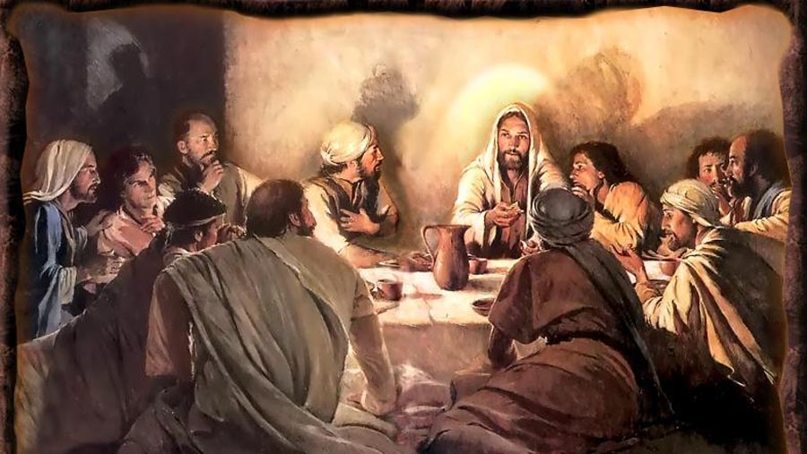
Passover
It is the oldest of the Jewish festivals, celebrating an event in advance of receiving the traditional Mosaic Law.
It reminds every generation of the return of the children of Israel to the promised land and of the great travail in Egypt which preceded it.
It commemorates the passage of a people from subjection and bondage to freedom and deliverance.
The Last Feast:
By that final week of His mortal ministry, Jesus knew clearly what this particular Passover would mean to him.
Jesus sat down with his disciples and, after the eating of the sacrificial lamb and of the bread and wine of this ancient feast, he taught them a newer and holier meaning of that ancient blessing from God.
Numbers 9:1-14
(11)

Slide 20
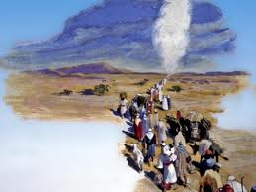
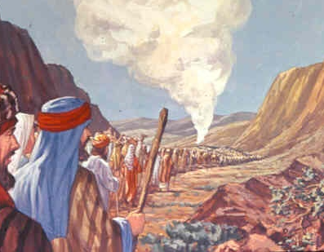
The Cloud—Divine Protection
The Law of the Lord concerning the movement of the camp of Israel
Since the cloud of smoke and fire was a visible sign of God’s presence, Israel learned to literally follow the Lord.
They made camp, broke camp, traveled, and performed their services at the command of the Lord—the Hebrew reads, “at the mouth of Jehovah.”
In very deed they were schooled to follow Jehovah, who has ever directed His church and kingdom, and yet many of them did not transfer the meaning from this miraculous physical demonstration to its more important spiritual corollary.
Numbers 9:15-23
(2)

Slide 21
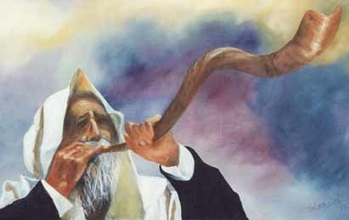
The Trumpet
Beaten or Hammered Silver
To call the general assembly
To assemble the princes or tribal leaders
To sound the signal for breaking camp
To sound an alarm for war
To announce the days of celebration and gladness
To announce solemn feasts days
To announce the start of offering and sacrifices at the beginning of each month
Numbers 10
(2)

Slide 22
Sources:
Video: Dare to Stand Alone (4:20)
Bruce Wilkinson and Kenneth Boa Talk Thru the Bible p.28
Old Testament Institute Manual (Enrichment Section E)
W. Cleon Skousen The Third Thousand Years p. 363
Josephus (Flavius Josephus) Translated by William Whiston. A.M. 3.12.4 p. 116
President Dieter F. Uchtdorf (“Lift Where You Stand,” Ensign or Liahona, Nov. 2008, 56).
Clarke, Bible Commentary, 1:631. Found in Old Testament Institute Manual
Presentation by ©http://fashionsbylynda.com/blog/
Christensen, BRYCE J (BYU.ed) Chastity, Law of…Encyclopedia of Mormonism Harold B. Lee Collections
Keil and Delitzsch, Commentary, 1:3:34. Found in Old Testament Institute Manual
Elder Boyd K. Packer The Aaronic Priesthood Oct. 1981 Gen. Conf.
Bible Dictionary
11. President Howard W. Hunter Christ, Our Passover April 1985 Gen. Conf.

Slide 23
The Book of Numbers
Bible Dictionary
Chapters 1-12 | Chapters 13-20 | Chapter 21-36
Old Generation Organization and Preparation to leave Mt. Sinai | Transition to Kadesh-barnea—drawing back in unbelief—brings God’s discipline Wilderness | New Generation Move to Plains of Moab—east of Promised Land Reorganization of Israel Regulations (offerings and Vows) Conquest and Division of Israel
Numbers 1-2 | Numbers 3-4 | Numbers 5 | Numbers 6 | Numbers 7 | Numbers 8 | Numbers 9 | Numbers 10
Organization of Israel (Tribes) | Organization of Priests | Sanctification of Israel | Nazarite Vow | Worship and Donations | Levites Consecrated | Passover | Guidance of the Cloud and Silver Trumpets
First Census Arrangement of Camp | Census of the Levites The Family of Aaron Ministry of Levites Census of Gershon, Kohath, Merari | Separation of Unclean persons, sinful persons, and infidelity | Consecration of oneself. Three vows Separation from vow | Princes of Israel make offerings. Moses and the mercy seat. | Washing and anointing. First-born of family. Spiritual gifts to Aaron and sons | Reminder keep the Passover A cloud rests upon the tabernacle by day and by night, plus a fire by night. When the cloud rests, Israel camps; when it lifts, they journey. | Call to assemble Cloud taken and Israel marches forth in order of tribes. The ark leads the way. (goes before them)

Slide 24
Numbers 5: Leprosy: “The expulsion mentioned here was founded, 1. On a pure physical reason, viz., the diseases were contagious, and therefore there was a necessity of putting those afflicted by them apart, that the infection might not be communicated. 2. There was also a spiritual reason; the camp was the habitation of God, and nothing impure should be permitted to remain where he dwelt.”
The Aaronic Priesthood:
Although the Aaronic Priesthood is conferred in the Church today without restriction to the lineage of Aaron, the keys of this priesthood rightly belong to the firstborn of the seed of Aaron, and in the restoration of all things the office of bishop (president of the priests) will once again be conferred on one of that lineage, as it is designated by revelation to the president of the Church (D&C 84:14–21; 107:13–17) Bible Dictionary
Sexual Sin:
The eternal consequences of moral sin are tragic. Anyone choosing to embrace immoral thoughts and deeds instead of hearkening to the Savior’s commandments is to be barred from his kingdom.
“Because sexual intimacy is so sacred, the Lord requires self-control and purity before marriage as well as full fidelity after marriage. Never treat your date [or spouse] as an object to be used for your own lustful desires or ego. …
In marriage, infidelity often dooms a relationship and leads to the spiritual destruction of the one who has been unfaithful. Unchastity before marriage naturally undermines the confidence of a potential partner, raising unsettling emotional and physical concerns—such as the possibility of dangerous diseases—along with the basic question of trustworthiness.
Marital fidelity begins not with the making of the vows on the day of the wedding, but in our hearts long before we reach the altar.
Thou Shalt Not Commit Adultery July 1994 Ensign
By W. Jeffrey Marsh
Passover is linked with the Christian observance of Easter which we celebrate this weekend in this great conference of The Church of Jesus Christ of Latter-day Saints. The Passover in the Old Testament and Easter in the New Testament testify of the great gift God has given and of the sacrifice that was involved in its bestowal. Both of these great religious commemorations declare that death would “pass over” us and could have no permanent power upon us, and that the grave would have no victory.
This is the majesty of the Atonement and Resurrection, not just a Passover from death, but a gift of eternal life by an infinite sacrifice. (11)
Nazarite:
The Nazarite vow is always referred to in the scripture as a vow of limited duration, never for life unless commanded by the Lord as with Samson and Samuel. It is obvious that the Lord never intended that groups of people in a state of “separation” or as Nazarites should band together and become a monastic order. Yet this is what happened during the period of Israel’s apostasy.
“From the Nazarites sprang the Rechabites, from the Rechabites the Essenes, from the Essenes, the Anchorites or Hermits, and in imitation of these, the different (Christian) meaning (“the pious one”) which produced the “Dead Sea Scrolls.” (Dr. Adam Clarke Bible Commentary, Vol. 1 p. 634)
The Third Thousand Years by W. Cleon Skousen p. 368
Nazarite Vow Separation:
Some took the Nazarite vows for life, but more often they were for a specific period of time, after which the person returned to a normal life. Two instances: Acts 18:18-19 and 21:23-26.
Once a person is finished, they bring to the priest:
1 he lamb= burnt offering ( 1st year, unblemished)
1 ewe= sin offering (1st year, unblemished)
1 ram=peace offering (unblemished)
Basket of unleavened bread mingled with oil=meat offering and a drink offering.
They shave their hair at the door of the tabernacle and burn it with the peace offering.
The priest takes the sodden shoulder of the Ram, 1 unleavened cake, 1 unleavened wafer and put it in hands of the Nazarite for a wave offering and then they drink wine for their separation.
Numbers 6:13-21

