Slide 1

Travel in the wilderness
Numbers 11-12
I am the living bread which came down from heaven: if any man eat of this bread, he shall live for ever: and the bread that I will give is my flesh, which I will give for the life of the world.
John 6:51
Presentation by ©http://fashionsbylynda.com/blog/

Slide 2
Recap—At Mt. Sinai
Moses tried to prepare the nation by:
Orally giving them the Ten Commandments of the Lord
Giving them the criminal and civil code for a political government
Receiving the fullness of the priesthood (yet they were worshipping idols and lost those blessings and ordinances)
Giving them the instructions on how to build and operate the tabernacle (portable temple)
Giving the Law of Moses (The Mosaic Law)
the law of carnal or temporal order of things
Giving them the Levitical Priesthood and the organization of it along with the rituals pertaining to it
(2)

Slide 3
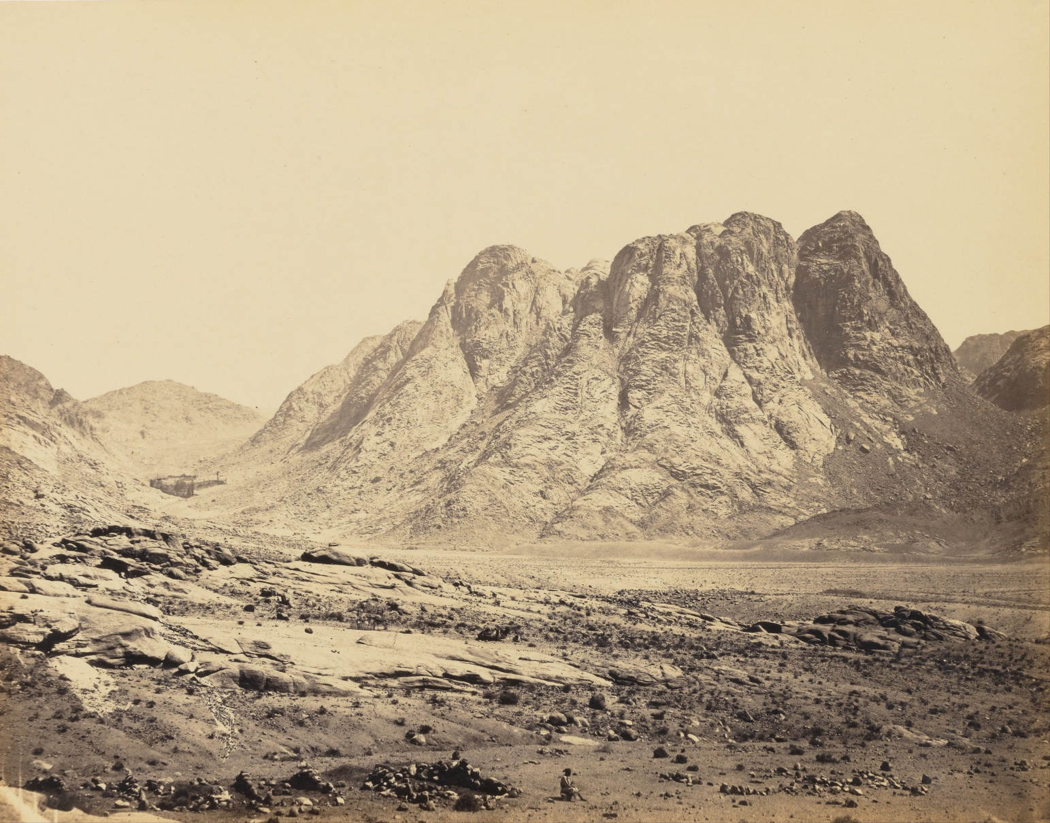
The Move
After 10 months of camping at the foot of Mt. Sinai the Lord told Moses to continue their journey to the Promised land. (Deuteronomy 1:6,8)
Traditionally “Horeb” is believed to be the general range of mountains and Sinai being one of the major peaks.
Thought: It must have taken about 2 months to prepare for the journey
(1)

Slide 4

Taberah
Burning
One of the locations which the Israelites passed through during their Exodus journey.
Taberah is described by the Torah as being a three days' journey from Mount Sinai.
Wikipedia
A fiery judgment consumed those who were complainers.
Numbers 11:1-3

Slide 5
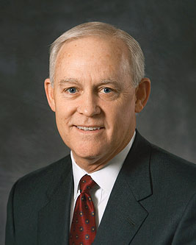

Complaining
Complaining shows an ingratitude for all the Lord had done for the us.
I knew a faithful mother who humbled herself and asked, “What is keeping me from progressing?” In her case, the response from the Spirit came immediately: “Stop complaining.”
This answer surprised her; she had never thought of herself as a complainer. However, the message from the Holy Ghost was very clear. In the days that followed, she became conscious of her habit of complaining. Grateful for the prompting to improve, she determined to count her blessings instead of her challenges…” (3)

Slide 6

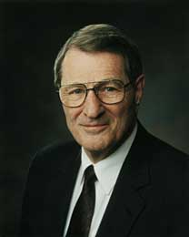
Short Memories—longest Lists of Demands
Murmuring seems to come so naturally to the natural man.
It crosses the scriptural spectrum of recorded complaints.
“A basic cause of murmuring is that too many of us seem to expect that life will flow ever smoothly, featuring an unbroken chain of green lights with empty parking places just in front of our destinations!
...murmurers have short memories. Israel arrived in Sinai, then journeyed on to the Holy Land though they were sometimes hungry and thirsty. But the Lord rescued them, whether by the miraculous appearance by quail or by water struck from a rock.
Strange, isn't it, brothers and sisters, how those with the shortest memories have the longest lists of
demands!
However, with no remembrance
of past blessings, there is no perspective about
what is really going on.”
We need water and bread
Why did we ever leave Egypt
Numbers 21:5; 11:20

Slide 7
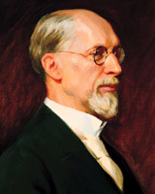
Happiness With the Way Things Are
“Happiness consists not of having, but of being; not of possessing, but of enjoying. It is the warm glow of a heart at peace with itself.” (4)
Happiness is a state of being contented or satisfied. But sometimes it’s hard to be content and satisfied—to have enough.
There will always be a newer watch, a more powerful computer, a fancier car or closet organizer.
But you can never get enough of what you don’t need, because what you don’t need never satisfies.
Failing to recognize our blessings can lead us to be ungrateful to the Lord
I was impressed with the idea that our Heavenly Father loves us and that his commandments were not intended to deprive us of true pleasure, [but rather,] if observed, would add to our peace and contentment here and prepare us for eternal happiness.” (5)

Slide 8
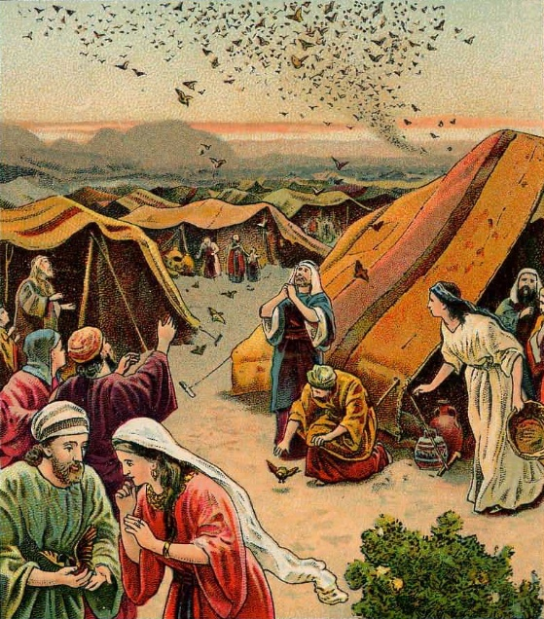
The Lord’s solution…
I am not able to bear all this people alone, because it is too heavy for me
Moses felt overwhelmed trying to lead a large number of people who were selfish and ungrateful, and there was no meat (flesh) for the people to eat.
70 elders—
Met at the temple
Shared the burden with Moses.
The seventy elders of Israel were granted one of the gifts of the Spirit, the gift of prophecy.
The Lord eventually gave Israel their wish and provided the flesh of quail for them, but before doing so He granted Moses his wish for help in the burdens of leadership. (7)
Does only one person run the Church?
Numbers 11:11-23

Slide 9
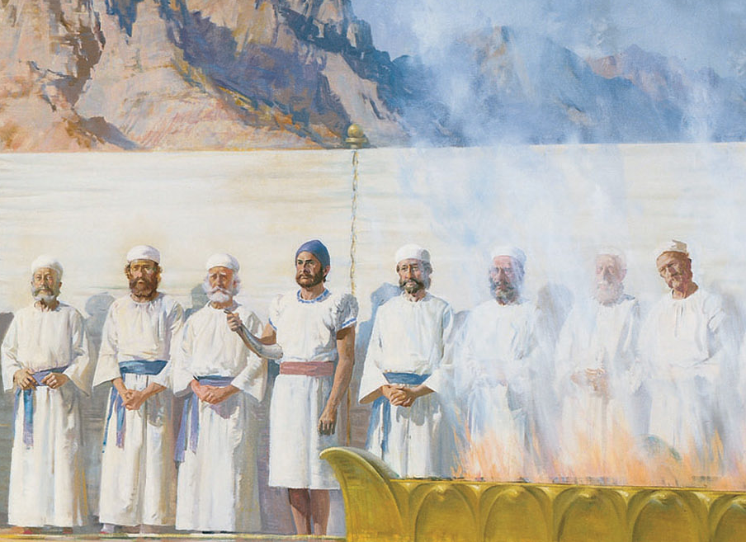
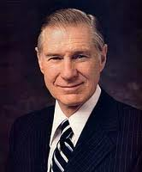
Dispersing Responsibility
“One of the first principles we must keep in mind is that the work of the Lord goes forward through assignments. Leaders receive and give assignments. This is an important part of the necessary principle of delegating.”
“Those who stand faithful to their priesthood are often those who bear some weight of responsibility.”
Most of us who are called to leadership in the Church feel that we are inadequate because of inexperience, lack of ability, or meager learning and education. Of the many descriptions of Moses is the following: “Now the man Moses was very meek, above all the men which were upon the face of the earth” (Num. 12:3)
“A leader cannot ask of others what he is not willing to do himself. Our safest course is to follow the example of the Savior, and our security is to listen to and follow the direction of his prophet, the President of the Church.”
(8)

Slide 10



Bring it to the lord
Those who stand faithful to their priesthood are often those who bear some weight of responsibility
Our prayers are not always answered immediately and that the Lord can strengthen us to endure as we patiently seek His help to obtain solutions
Should you ever feel distanced from our Father, it could be for many reasons. Whatever the cause, as you continue to plead for help, He will guide you to do that which will restore your confidence that He is near. Pray even when you have no desire to pray. That is when you most need to pray. Never feel you are too unworthy to pray.
(10)

Slide 11
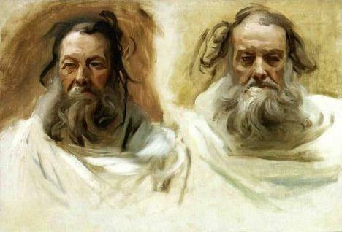
Gift of Prophesy
Eldad and Medad are described as having prophesied among the Israelites, despite the fact that they had remained in the camp, while 70 elders had gone to the tabernacle outside the camp to receive the ability to prophesy from God.
According to the narrative, Joshua asked Moses to forbid Eldad and Medad from prophecy, but Moses argued that it was a good thing that others could prophesy, and that ideally all the Israelites would prophesy.
John Singer Sargent
Moses was not saying that he wanted everyone to be a prophet to lead and receive revelation for the Church. Rather, he likely meant that he would like it if all people lived worthy to receive revelation for their own lives, callings, and responsibilities.
If we are spiritually prepared and worthy, we can receive (personal) revelation
Numbers 11:26-30
(10)

Slide 12
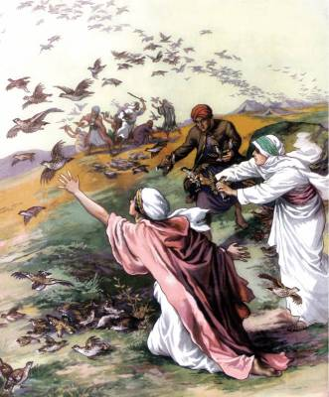
Kibroth-hattaavah
Graves of Lust--Glutten
It was at this place, that the Israelites loudly complained about constantly eating only manna, and that they had had a much more varied diet, of fish, vegetables, fruit, and meat, when they lived in Egypt; who then promised them so much meat that 'they would vomit it through their nostrils'.
A huge number of quails brought by the winds to both sides of the Israelite encampment, which the people gathered, but the Lord sent a plague as they were chewing the meat.
Numbers 11:31-35

Slide 13
Miriam and Aaron
And Miriam the prophetess, the sister of Aaron (Ex. 15:20)
The Lord authorized Moses’s marriage to the Ethiopian woman.
Therefore, Miriam and Aaron had no basis to criticize Moses for the marriage. (D&C 132:1, 38)
v
Their words might suggest that because the Lord had also spoken by them, or given them revelation, they thought they were equal in status to the prophet Moses.
Numbers 12:1-3

Slide 14
Criticism
Who was criticized | The Criticism | Source
Savior | For eating with sinners | Luke 15:2
Savior | Accused of being in league with Beelzebub | Luke 11:14-15
Abinadi | Judged of being insane | Mosiah 13:1
Paul | Judged of being insane | Acts 26:24
Nephi | Mocked by brothers when building the ship | 1 Nephi 17:17-18
Samuel | Cast out of the land of Zarahemla because he was a Lamanite and his prophecies offended the wicked | Helaman 13:2; 14:10
Joseph Smith | Accused of deserting the Saints when, in June 1844, he crossed the river into Iowa to avoid being taken to Carthage | History of the Church 6:549

Slide 15
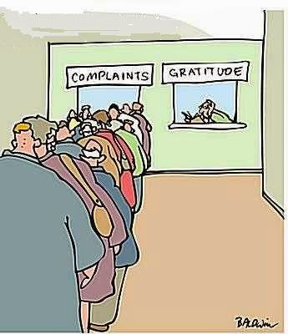
Complaints From Saints
Among Church members rebellion frequently takes the form of criticism of authorities and leaders.
They complain of the programs, belittle the constituted authorities, and generally set themselves up as judges.
After a while they absent themselves from Church meetings for imagined offenses, and fail to pay their tithes and meet their other Church obligations. In a word, they have the spirit of apostasy, which is almost always the harvest of the seeds of criticism.

Slide 16
Meekness is one of those attributes acquired only by experience, some of it painful, for it is developed "according to the flesh."
It is not an attribute achieved overnight, nor is it certified to in only one exam-but, rather, "in process of time."
The Savior said we are to "take up [the] cross daily"-not just once or occasionally. His rigorous requirement places a premium upon our having meekness. (3)
Numbers 12:3

Slide 17
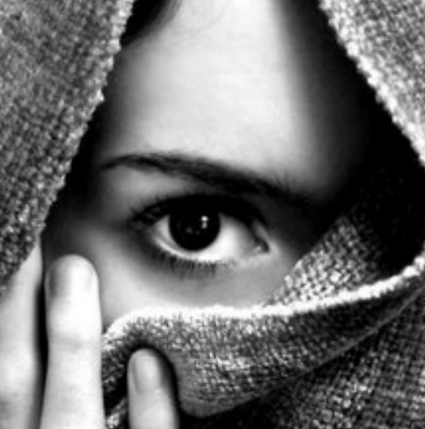
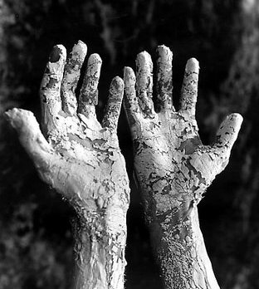
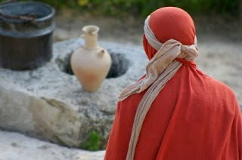
White As Snow
Leprosy
Miriam’s sin was not in seeking to be like Moses in terms of spiritual gifts but rather in seeking to share with him the calling of presiding priesthood officer
And Miriam was shut out from the camp seven days: and the people journeyed not till Miriam was brought in again.
Numbers 12:10-15

Slide 18
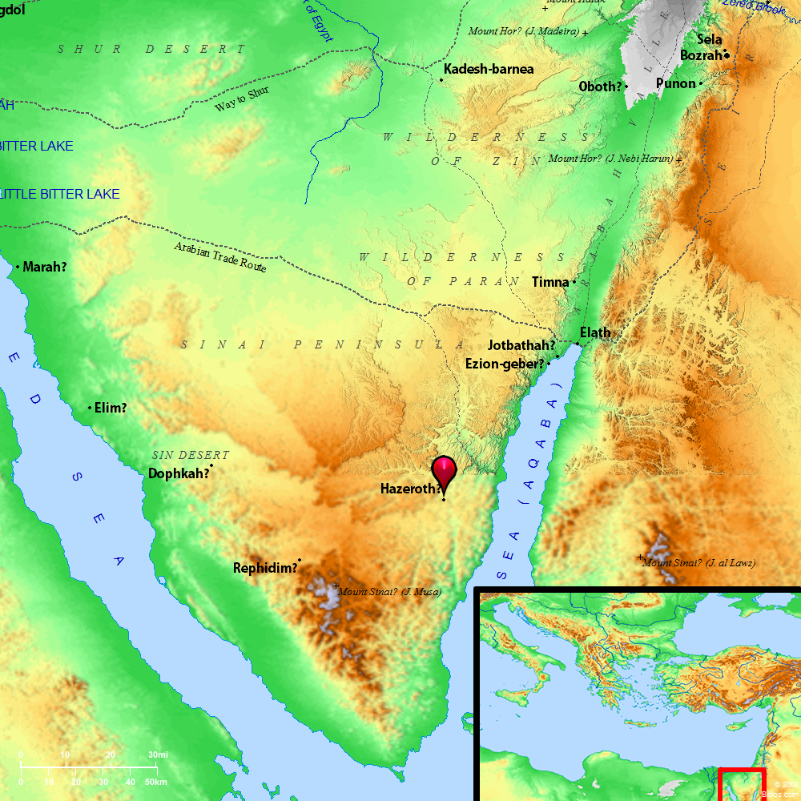
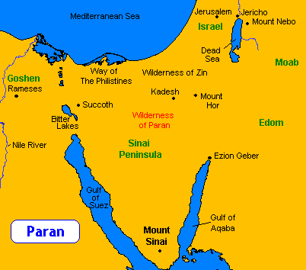
Hazeroth
Wilderness of Paran
Numbers 12:16

Slide 19
Sources:
W. Cleon Skousen The Third Thousand Years p. 369
Edward J. Brandt excerpts from: Journeys and Events in the Life of Moses Oct 1973 Ensign
3. Elder Larry R. Lawrence What Lack I Yet? Oct. 2015 Gen. Conf.
4. William George Jordan: The Royal Road to Happiness, The Majesty of Calmness (Old Tappan, New Jersey: Fleming H. Revell Company, 1900), p. 54; see David O. McKay, CR, October 1955, p. 8]
George Albert Smith [Sharing the Gospel with Others (Salt Lake City: Deseret Book Company, 1948), p. 50]
Presentation by ©http://fashionsbylynda.com/blog/
Neal A. Maxwell Murmur Not Ensign, Nov. 1989, 82-83)
"Meekness-A Dimension of True Discipleship," Ensign, Mar. 1983, 71
7. Old Testament Institute Manual
President James E. Faust These I Will Make My Leaders Oct. 1980 Gen. Conf.
Strength for the Youth (Richard G. Scott)

Slide 20
Time spent at the foot of Mt. Sinai:
In the third month, when the children of Israel were gone forth out of the land of Egypt, the same day came they into the wilderness of Sinai. Exodus 19:1
And
And the Lord spake unto Moses in the wilderness of Sinai, in the tabernacle of the congregation, on the first day of the second month, in the second year after they were come out of the land of Egypt, saying, Numbers 1:1
Lifting the heavy burdens of the leaders:
The strength of the kingdom of God at any time is not to be found alone in the power and strength of its leaders, but more important in the individual testimonies of the members. Members who gain the witness and enjoy the gifts lift heavy burdens from the shoulders of the leaders, for they now perform their labors in the Church with intelligent obedience. They are more converted and more motivated. (gospeldoctrine.com)
President Brigham Young observed: 'I am like Moses when a messenger came to him saying, `The people are prophesying in their tents.` Said Moses, Well, what of that? I would to God that the Lord's people were all prophets! I would to God that they all had revelation! When they receive revelation from heaven the story is told, they know for themselves.'"
(Kent P. Jackson and Robert L. Millet, eds., Studies in Scripture, Vol. 3: Genesis to 2 Samuel [Salt Lake City: Randall Book, 1985], 203 - 204)
70 Elders and their Priesthood:
The seventy elders of Israel were called to perform administrative duties. The Seventy sent by the Master were called to perform missionary duties. Today's quorums of the Seventy are tasked with both administrative and missionary duties.
The Seventy are to act in the name of the Lord, under the direction of the Twelve... in building up the church and regulating all the affairs of the same...
The Seventy are also called to preach the gospel, and to be especial witnesses unto the Gentiles and in all the world... (D&C 107: 34, 25)
The thoughtful student asks, "Did these seventy men hold the priesthood? And if so, was it Aaronic or Melchizedek?" The answer is that they were not all Levites, so they could not hold the Aaronic-besides they were not ministering under Aaron's authority. Secondly, they couldn't possibly minister for Moses without Moses' priesthood. If the Lord took "of the spirit which is upon [Moses], and... put it upon them," they must have had the higher priesthood.
"The Melchizedek Priesthood was never fully taken. The difficulty of untangling the pre-Mosaic ritual from that which was given as a part of the carnal law is further complicated by the fact that the Melchizedek Priesthood, though taken from the people generally, was always had in Old Testament times. Joseph Smith said, 'All the prophets had the Melchizedek Priesthood and were ordained by God himself' (Smith, Joseph. Teachings of the Prophet Joseph Smith. Joseph F. Smith, comp. Salt Lake City: Deseret Book Co., 1976., p. 181). Moses, Aaron, and at least the quorum of the seventy all held that priesthood. Certainly Joshua held the Melchizedek Priesthood when he succeeded Moses as prophet, seer, and revelator." (Joseph Fielding McConkie, Gospel Symbolism [Salt Lake City: Bookcraft, 1999], 79)
"The religious involvement of the seventy is... impressively documented. One must recall initially that the gathering of the seventy on the mountain with Moses and Aaron was specifically done to ratify the covenant made by Israel at Mt. Sinai, this in response to God's invitation (see Exodus 19:5-6). In this extremely important ceremony, the seventy-plus Moses and others-served not only as agents acting on behalf of the larger Israelite nation but also as the guarantors of the covenant by acting as witnesses of the Lord's ratifying presence. In the passage that concerns the appointment of the seventy to assist Moses with the affairs of the camp, the spiritual dimensions were highlighted when the Lord both said to Moses, 'I will take of the spirit which is upon thee, and will put it upon them [the seventy]' (Numbers 11:17) and then instructed the people to sanctify themselves in preparation for receiving this special spiritual endowment (Numbers 11:18). The entire event, of course, was set in its proper spiritual perspective when the spirit of prophecy fell upon them all 'and did not cease' (Numbers 11:25)." (John M. Lundquist and Stephen D. Ricks, eds., By Study and Also by Faith: Essays in Honor of Hugh W. Nibley on the Occasion of His Eightieth Birthday, 27 March 1990, 2 vols. [Salt Lake City and Provo: Deseret Book Co., Foundation for Ancient Research and Mormon Studies, 1990], 1: 36) gospeldoctrine.com (Numbers 11:16)

Slide 21
Receiving Revelation:
“The Lord’s house is a house of order. The Prophet Joseph Smith taught that ‘it is contrary to the economy of God for any member of the Church, or any one [else], to receive instruction for those in authority, higher than themselves’ [Teachings of the Prophet Joseph Smith, p. 21].
“You may receive revelation individually, as a parent for your family, or for those for whom you are responsible as a leader or teacher, having been properly called and set apart.
“If one becomes critical and harbors negative feelings, the Spirit will withdraw. Only when they repent will the Spirit return. My experience is that the channels of inspiration always follow that order. You are safe following your leaders” (“Personal Revelation: The Gift, the Test, and the Promise,” Ensign, Nov. 1994, 61).
The Spirit of Revelation:
“The spirit of revelation is available to every person. … This blessing is not restricted to the presiding authorities of the Church; rather, it belongs to and should be operative in the life of every man, woman, and child who reaches the age of accountability and enters into sacred covenants. Sincere desire and worthiness invite the spirit of revelation into our lives” (“The Spirit of Revelation,” Ensign or Liahona, May 2011, 87).
Meekness:
“Meekness is vital for us to become more Christlike. Without it we won’t be able to develop other important virtues. Being meek does not mean weakness, but it does mean behaving with goodness and kindness, showing strength, serenity, healthy self-worth, and self-control.
“Meekness was one of the most abundant attributes in the Savior’s life. He Himself taught His disciples, ‘Learn of me; for I am meek and lowly in heart’ [Matthew 11:29]” Elder Ulisses Soares of the Seventy taught:
(“Be Meek and Lowly of Heart,” Ensign or Liahona, Nov. 2013, 9).
Punishment for criticism:
"It may seem to some that Jehovah treated Miriam and Aaron harshly by using a temporary case of leprosy in making his point. They were not blatantly wicked or rebellious. They felt justified in their criticism and attempted correction of the prophet. From this episode we see that criticizing the prophets of God, whatever the issue, is no light matter to the Lord-even if one feels right or justified in the criticism. Today some murmur against, criticize, and/or reject living prophets by virtue of some similarly misconceived justification-the obscurity of the prophets' background, their lack of academic credentials or professional training, a familiarity with their failings, or any other supposed deficiency." (Brent L. Top, Larry E. Dahl, and Walter D. Bowen, Follow the Living Prophets [Salt Lake City: Bookcraft, 1993], 166)

Slide 22
The Book of Numbers
Bible Dictionary
Chapters 1-12 | Chapters 13-20 | Chapter 21-36
Old Generation Organization and Preparation to leave Mt. Sinai | Transition to Kadesh-barnea—drawing back in unbelief—brings God’s discipline Wilderness | New Generation Move to Plains of Moab—east of Promised Land Reorganization of Israel Regulations (offerings and Vows) Conquest and Division of Israel
Numbers 11 | Numbers 12
Failure of the People | Failure of Miriam and Aaron
Depart Mt. Sinai People Complain Moses Complains The Lord Provides for Moses and People—quail The Lord sends plagues | Rebellion of Aaron and Miriam Miriam punished Miriam restored

