Slide 1

Tragedy in the Wilderness
Numbers 15-19
“…they (Israelites) were more than unusually angry, both against one another and against their leader.”
--Josephus
Levi
Presentation by ©http://fashionsbylynda.com/blog/

Slide 2
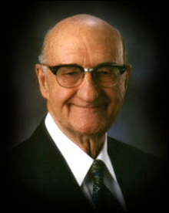
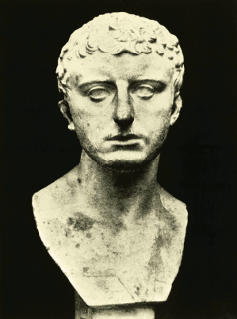
Wander
“For 38 years the Israelite would wander up and down the region of the Arabah—the valley connecting the Dead Sea with the Akaba gulf of the Red Sea.”
(1)
“…they (Israelites) were more than unusually angry, both against one another and against their leader.”
(2)
Numbers 14

Slide 3
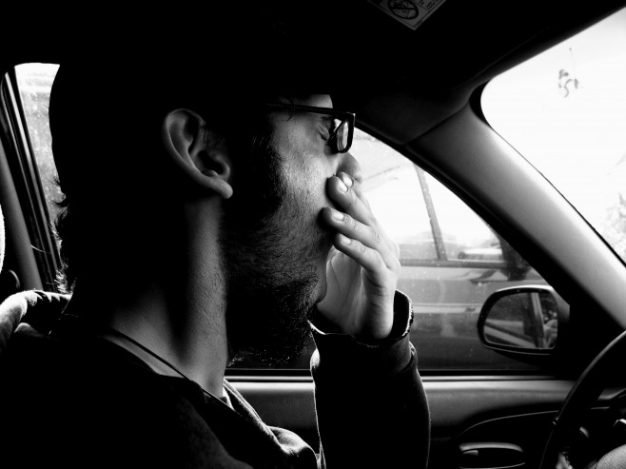

Intentional VS Unintentional Sins
A young man who is a recent convert to the Church is driving his car. He becomes upset at another driver and swears. Although he does not take the name of the Lord in vain, he feels an immediate withdrawal of the Spirit.
Do you think the consequences for these two people should be the same or different?
Why?
Just before a young woman begins her application for missionary service, she decides to spend time with friends who are not making good choices. When they offer her an alcoholic drink, she willfully drinks it, believing she can always repent later if she wants to so she can still serve a mission.

Slide 4
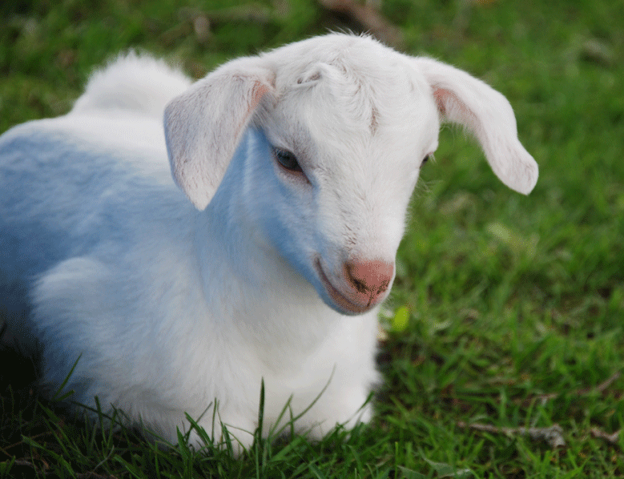
Ignorance
Two different attitudes of a transgressor—one who defiantly and willfully sins versus one who sins ignorantly or makes a mistake unintentionally and feels guilty about offending God
Ignorant (Unintentional)
Sin offering of she goat (1st year)
Priest makes atonement for the soul of that sinner
If we repent, we can be forgiven of our sins, including those we commit in ignorance, through the Atonement of Jesus Christ
Numbers 15:22-26

Slide 5
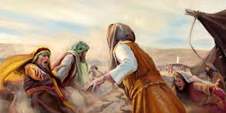
Presumptuously
Readiness to presume in conduct or thought
Willful (intentional)
Cut off from the Lord and the people
If we willfully break God’s commandments and do not repent, then we must stand accountable before God for those sins
Even though we are accountable for our sins, if we repent we can be cleansed through the Atonement of Jesus Christ.
Numbers 15:27-30

Slide 6
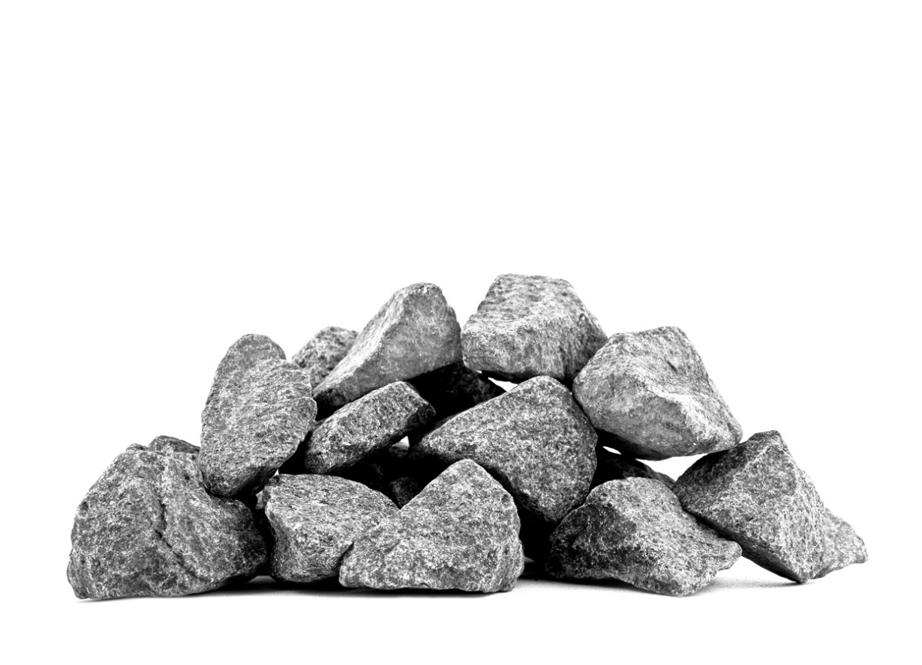
Violation on the Sabbath
To stone a man for violation of the Sabbath seems a harsh punishment.
But in its historical context, two things are significant.
Moses had just given the law for willful rebellion against God.
Did this man know the law of the Sabbath?
Moses had clearly taught earlier that one who violated the Sabbath was to be put to death.
(see Exodus 31:14–15; 35:2).
Obviously, here is an example of one who “despised the word of the Lord.”
Numbers 15:32-36
(3)

Slide 7
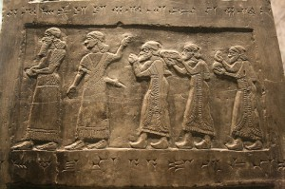
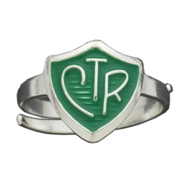
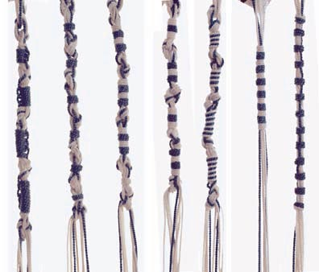
Fringes on the Borders
zizith [tassel]
The ribbon of blue also symbolically suggested concepts of deep importance. Blue signifies the heavens and so symbolizes the spiritual realm or godliness (3)
In Remembrance
Lord told the people to make fringes on the borders of their clothing to remind them to follow the commandments in order to remain holy.
What do we wear to remember to keep the commandments?
Numbers 15:37-41

Slide 8
Korah
He was the son of Izhar, grandson of Kohath, great grandson of Levi
He was first cousin to Aaron and Moses
He and two others, Dathan and Abiram (lineage of Reuben), combined forces with 250 princes of Israel to defy Moses and Aaron in seeking more priestly power
Him and the others were censured by Moses and subsequently swallowed up in the earth…where the name is spelled Core
The later descendants of Korah (Korahites or Korathites) were part of a guild of performing musicians.
Others of this particular Levite lineage were appointed to serve as porters, gatekeepers, bakers, and the like.
Numbers 15:27-30
(4)

Slide 9
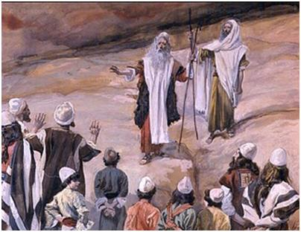
Seeking a Higher Position
“Now those that conspired with Corah (Korah), there were two hundred and fifty, and those of the principal men also, who were eager to have the priesthood taken away from Moses’ brother, and to bring him into disgrace. Nay, the multitude themselves were provoked to be seditious, and attempted to stone Moses, and gathered themselves together after an indecent manner, with confusion and disorder.”
“and seek ye the priesthood also?”
Numbers 16:10
Korah rallied 250 “princes of the assembly”…those that were famous and renowned. They wanted to share in the same privilege of performing ordinances before the Lord in the sanctuary in the Holy of Holies.
“Seek ye the high priesthood also”
JST Numbers 16:10
Numbers 16:1-3
(2)

Slide 10
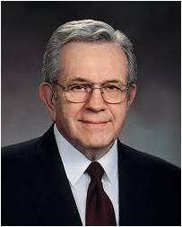
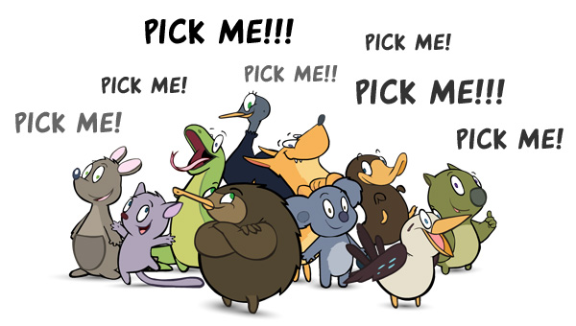
“The priesthood is not divisible. An elder holds as much priesthood as an Apostle.
When a man receives the priesthood, he receives all of it. However, there are offices within the priesthood—divisions of authority and responsibility.
One may exercise his priesthood according to the rights of the office to which he is ordained or set apart. …
“We do not call ourselves to offices in the Church. Rather we respond to the call of those who preside over us.
It is the responsibility of those who preside to prayerfully consult the Lord as to His will concerning a position in the Church.
Then the principle of revelation is at work. The call is then delivered by the presiding officer who is acting for the Lord.”
(5)

Slide 11
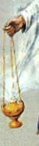
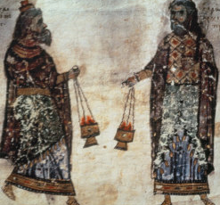
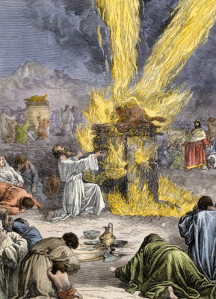
Censers
Any type of vessel made for burning incense
Moses demanded that Aaron and all the rebellious Levites and the princes of the congregation meet him the following day before the Tabernacle. They were to bring their censers, lighted with fire, and they would see who would be accepted by the Lord.
Elijah’s contest with priest of Baal: In that instance, false worshipers were asked to call upon God for a sign that Baal had power. When they failed, the Lord gave a dramatic physical witness that He was God—fire from heaven consumed not just the sacrifice but also the altar. (1 Kings 18:17-40)
Numbers 16:5-7, 16-18
(1)

Slide 12
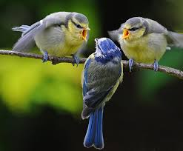
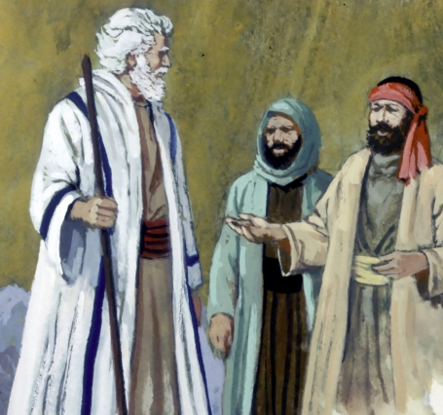
Dathan and Abiram
Two conspirators of the tribe of Reuben were not present when Moses asked the priests to bring their censers.
“They were so bitter in their denunciation of Moses that they even blamed him because Israel had not yet obtained the promised land.”
Numbers 16:12-14
(1)

Slide 13
Separate Yourselves
Illumination of Cloud—immediate presence of God
And Korah gathered all the congregation against them unto the door of the tabernacle of the congregation: and the glory of the Lord appeared unto all the congregation.
If we separate ourselves from evil influences, then we may avoid the Lord’s judgments that come upon the wicked
Numbers 16:19-22
(1)

Slide 14
Separate Ourselves
Separation from the evils of the world needs to be accompanied by holiness.
Is the way we live consistent with what we believe, and would our friends and associates recognize that we have separated ourselves from worldly evils?
In order to serve God and be holy, are we making sacrifices consistent with our covenants?
Are worldly pleasures, profits, and similar pursuits distracting us from following, worshiping, and serving the Savior in our daily lives?
Numbers 16:19-22
(6)

Slide 15
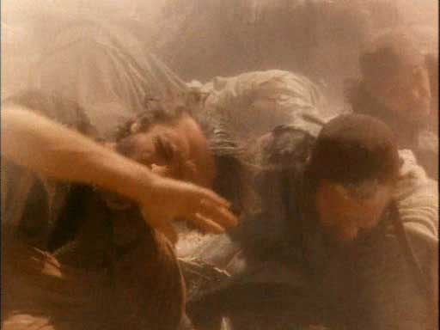
The Warning
“The people immediately began to gather their belongings and flee from the place where God’s wrath was about to strike.
”But Dathan and Abiram stood contemptuously with their families at the door of their tents.
“When Moses had assembled the multitude at a safe distance, he gave the people a warning and a prophecy. He warned them that what was about to happen would be proof that he, Moses, was a true prophet…and prophesied that Korah, Dathan, and Abiram would die.
Numbers 16:27-30
(1)

Slide 16
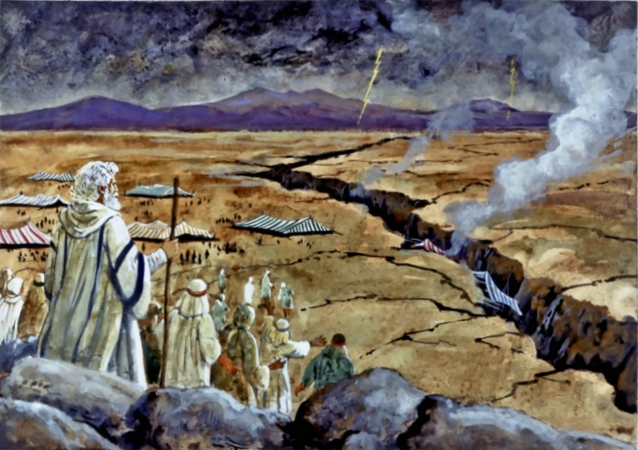
The Fate of Korah, Dathan, and Abiram
In and instant a terrible earthquake shook the camp.
“the earth opened her mouth, and swallowed them up, and all that were with them….that they “go down quick into the pit.”
Numbers 16:31-35
(1)

Slide 17
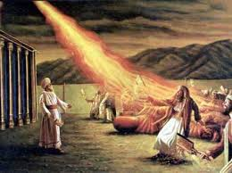
The Fate of the 250
Those who were waiting at the Tabernacle to prove their acceptance by the Lord with their censers found them selves caught in the same vortex of God’s vengeance.
Their death came through a consuming of fire.
Numbers 16:31-35
(1)

Slide 18
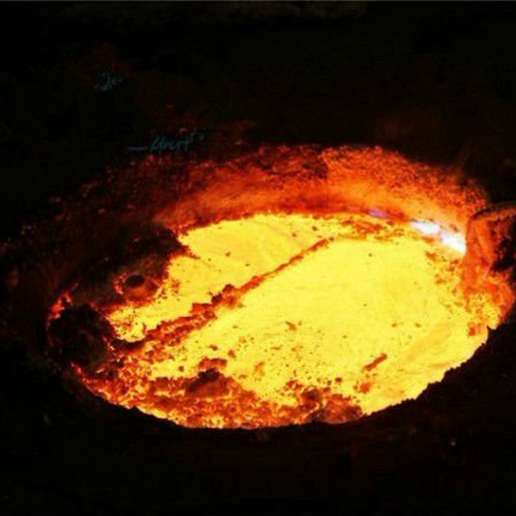
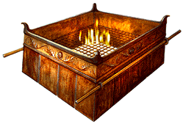
Eleazar
Son of Aaron
The Lord commanded Moses to tell Eleazar to go out among the 250 dead princes and gather up all their bras censers, melt them into flat plates and cover the alar of sacrifice which stood before the Tabernacle
To be a memorial unto the children of Israel,
Numbers 16:31-40
(1)

Slide 19
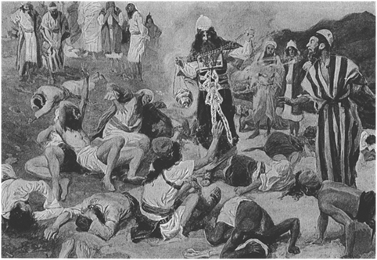
The Wrath—The Plague
On the next day, the Israelites continued to murmur and speak out against Aaron and Moses.
Aaron made an atonement for the congregation.
However the plague had begun and 14,700 died beside those that died about the matter of Korah
Numbers 16:41-50
(1)

Slide 20
Miracle of the Rod
Verifying that Moses was the chosen prophet and that Aaron was the priest over the people, and that he or his sons were to minister at the altar of incense and within the veil.
Naphtali
Issachar
Benjamin
Reuben
Judah
Zebulon
Simeon
Levi
Dan
Gad
Asher
Joseph
“Moses had each tribe write its leader’s name upon a rod and place in the Holy of Holies before the Ark of the Covenant and they remained for a day.
The following morning Moses brought forth the twelve rods. The rod of Aaron which had been inscribed with his insignia for the tribe of Levi, had burst into live growth overnight and produced bud, blossoms and matured almonds. Almonds-- Hebrew word “Awake”.
(1)
Numbers 17

Slide 21
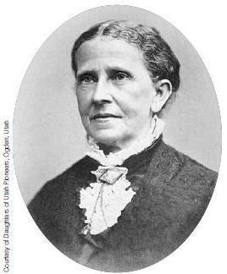
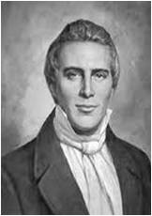
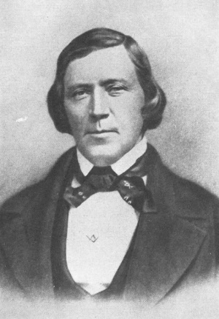
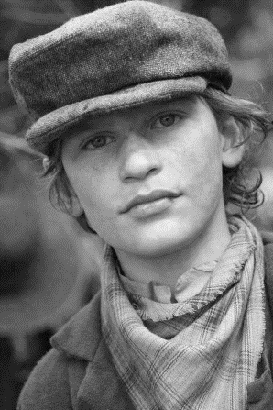
Who Will Lead?
After the death of the Prophet Joseph Smith…there was a question as to who would lead the saints.
Cox, Elias (age 9)
“I heard Brother Brigham speak and that is the first time that I ever saw two men look and sound so much alike in all my life. And after he had sat down, I wondered where Joseph had gone.”
Jane Snyder Richards
After his [Josephs] tragic death I attended the meeting at which President Brigham Young addressed the Saints, and saw his face illuminated and appear as the face of Joseph while the voice of Joseph seemed to address the people through the mouth of Brigham. I can never forget the divine thrill that passed through the audience on that occasion and the impression that the appearance and voice of Joseph produced upon his hearers.
The Lord will help us know whom He has called to lead His people
Unknown boy
(7)

Slide 22
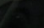













Aaronic and Levitical
Aaronic and Levitical are sometimes used interchangeably
The lesser priesthood was given to those of “the tribe of Levi”, to which Aaron and his sons belonged.
The Levites performed the housekeeping chores of the tabernacle, such as filling and lighting the lamps, carrying the ark of the covenant, assembling and disassembling the tabernacle, and so forth.
The priests, who were chosen from Aaron’s sons alone, were appointed to offer sacrifice, burn incense, instruct in the law, and so forth. Presiding over all the priests, or sons of Aaron, was a firstborn son.
Aaron served as high priest or president of the priests
(3)
Numbers 18

Slide 23
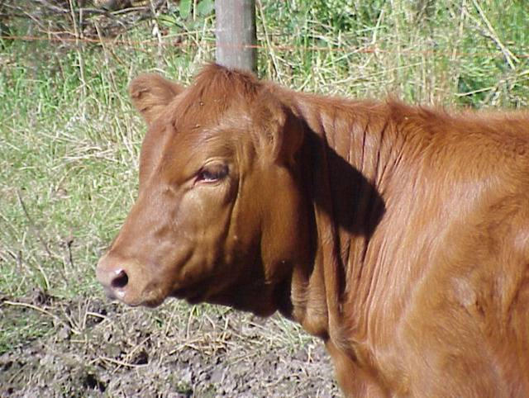
Tabernacle Defiled and Sanctified Again
Dedication meant the cleaning of everything and a sacrifice.
Because of the death of the 250 souls of rebellion Aaron needed to dedicate the Temple again.
The Red Heifer
First, a red heifer was slain, burned, and the ashes laid aside. Then the ashes were placed in pure water and the mixture sprinkled upon those who had been defiled. This was known as “the water of separation,” since by it one was separated, or purified, from sin. Failure to avail oneself of the cleansing power in this way resulted in being “cut off from among the congregation”
(3)
Numbers 19

Slide 24
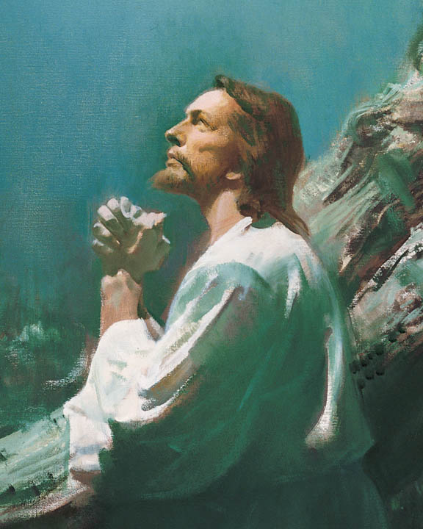
Symbolism
Much vital symbolism can be found in this ordinance. One who defiles himself with sin undergoes a spiritual death and is cut off from God’s presence through the loss of the Holy Spirit.
Recovery from spiritual death is obtained by faith in Christ’s Atonement (symbolized by the death of the red heifer), repentance from sin, baptism in water, receiving the Holy Ghost, and obedience to God’s commandments.
All who thereafter commit certain serious sins and refuse to repent are likewise “cut off from among the congregation,” that is, excommunicated.
(3)
Numbers 19

Slide 25
Sources:
W. Cleon Skousen The Third Thousand Years p. 393-407
Flavius Josephus translated by William Whiston, A.M. Book 4. Chapter 2. Verse 3 p.121
Old Testament Institute Manual
Who’s Who in the Old Testament by Ed J. Pinegar and Richard J. Allen p. 115
Presentation by ©http://fashionsbylynda.com/blog/
5. President Boyd K. Packer The Honor and Order of the Priesthood 2012 June Ensign
6. Elder Quentin L. Cook Are You a Saint? October 2003 Gen. Conf.
7. BYU Studies

Slide 26
The Book of Numbers
Bible Dictionary
Chapters 1-12 | Chapters 13-20 | Chapter 21-36
Old Generation Organization and Preparation to leave Mt. Sinai | Transition to Kadesh-barnea—drawing back in unbelief—brings God’s discipline Wilderness | New Generation Move to Plains of Moab—east of Promised Land Reorganization of Israel Regulations (offerings and Vows) Conquest and Division of Israel
Numbers 15-16 | Numbers 16 | Numbers 17-18 | Numbers 19
Offerings | Rebellions | Role of the Priesthood | Purification
To Thank the Lord Unintentional sins (ignorant) Intentional sins (willful) Tassels on the garment | Rebellion of Korah Rebellion against Moses and Aaron | Aaron and miracle of the Rod Confirmation of Divine Call Remuneration of the Priesthood | Purification of the red heifer

Slide 27
Cut off:
They were to be excommunicated from the camp of Israel (see v. 30).
In some cases the sin also required the death penalty. This extreme action was necessitated because the sinner “despised the word of the Lord” (v. 31).
It was not a sin committed in ignorance or weakness, but a deliberate refusal to obey the word of the Lord. This law thus teaches, on an individual basis, the same lesson taught Israel collectively; that is, when persons or nation despise the word of the Lord and willfully sin, they will be cut off from God and not be counted part of His covenant people. They will suffer spiritual death.
Old Testament Institute Manual
Aaronic and Levitical Priesthood:
Those selected to minister in the offices of priest and Levite were to be supported from the tithes and offerings made by the children of Israel (see Numbers 18:21, 24). The Lord said to Aaron, “All the best of the oil, and all the best of the wine, and of the wheat, the first fruits of them which they shall offer unto the Lord, them have I given thee” (v. 12). These, like everything else in Israel, were to be tithed (see v. 26).
In addition, the Levites had to have a place to live. They were not given land as the other tribes were because their inheritance was the priesthood instead (see v. 20). In order to scatter them among the tribes and provide homes for the Levites, Moses commanded that forty-eight “Levite cities” be established for those who ministered to Israel’s spiritual needs (see Numbers 35:1–8). This Levitical inheritance was provided when the land of Canaan was conquered under Joshua (see Joshua 21).
The Rod:
In the rebellion against the leadership of Moses and Aaron, the Lord gave two miraculous demonstrations that showed Israel without question whom He had chosen to lead His people. First, Korah and those who joined him in the rebellion were killed by being either swallowed in the earth or consumed by fire. Second, those who still continued to sustain his evil leadership, even after Korah’s death, were killed in a plague (see Numbers 16:49). The scriptures state that nearly fifteen thousand people died trying to prove that Moses and Aaron were not the ones who should lead Israel. Then the Lord offered one more miracle to further demonstrate who was chosen to hold the priesthood. Bible scholars have explained the significance of this miracle in this way:
“The miracle which God wrought here as the Creator of nature, was at the same time a significant symbol of the nature and meaning of the priesthood. The choice of the rods had also a bearing upon the object in question. A man’s rod was the sign of his position as ruler in the house and congregation; with a prince the rod becomes a sceptre, the insignia of rule [see Genesis 49:10]. As a severed branch, the rod could not put forth shoots and blossom in a natural way.
It was this which the Lord intended to show to the people, by causing Aaron’s rod to put forth branches, blossom, and fruit, through a miracle of His omnipotence; whereas the rods of the others heads of the tribes remained as barren as before. In this way, therefore, it was not without deep significance that Aaron’s rod not only put forth shoots, by which the divine election might be recognized, but bore even blossom and ripe fruit. This showed that Aaron was not only qualified for his calling, but administered his office in the full power of the Spirit, and bore the fruit expected of him. The almond rod was especially adapted to exhibit this, as an almond-tree flowers and bears fruit the earliest of all the trees, and has received its name [in Hebrew, which means] ‘awake,’ from this very fact [cf. Jeremiah 1:11].” (Keil and Delitzsch, Commentary, 1:3:114).

Slide 28
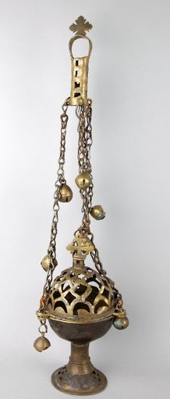
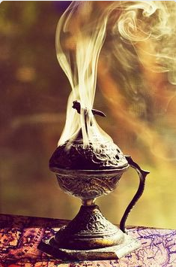
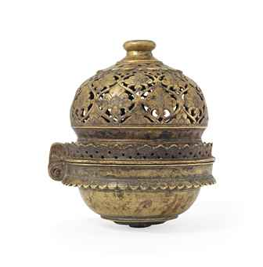
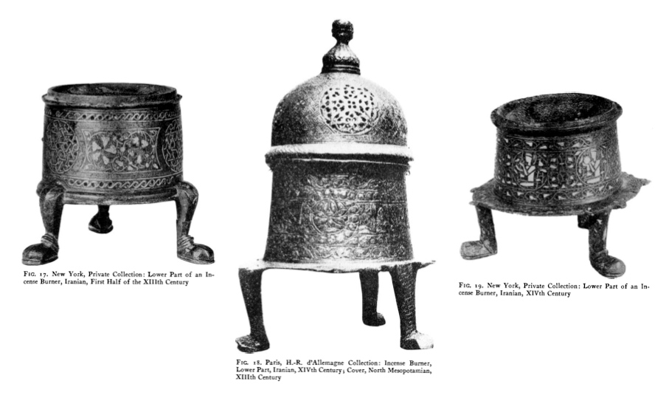
Ethiopian Censer
The censer is rhythmically swung from its long chains to waft the incense during religious services and processions.
Islamic Censer
Approx. 4,000 – 8,000 Dollars
Iranian incense burners
13th and 14th century
A censer was a small metal container made to hold hot coals taken from the altar of the tabernacle. During the tabernacle service, the officiating priest was required to sprinkle incense on the burning coals on the altar of incense, which stood directly in front of the veil of the tabernacle. Other scriptures indicate that the burning of incense was a symbol of prayer suggesting that God can only be approached in holy supplication. Old Testament Institute Manual

Slide 29
Summary of Work done by the Aaronic Priesthood holder in the days of ancient Israel:
Watch over the fire on the altar of burnt offering, day and night.
Make the morning and evening sacrifice of a lab accompanied by a Meat (meal) Offering and a Drink Offering
Perform the ordinance of burning incense on the golden altar of the Tabernacle every night and morning.
Keep the lamps on the golden candlestick trimmed and burning.
Maintain the table of shew-bread in the Tabernacle.
Slaughter and offer up sacrifices brought in by the people.
Receive and distribute offerings brought in by the people
Perform rites of circumcision.
Perform baptisms
Teach the children of Israel the statures of the Lord
Sound the silver trumpets to give the alarm or troop signals in time of war and to announce the festivals of the Lord in times of peace.
They were required to wear certain “holy garments’ designed “for glory and for beauty.”
The priests wore a simpler clothing than the High Priest.
This clothing was not to be worn outside the precincts of the Tabernacle or Temple.
The priests were forbidden to shave their heads or let their hair grow long so as to distinguish them as a separate class.
Each would serve at the Temple in rotation for one week. Individual assignments to members of a group were determined by lot.
While not at the Tabernacle, the priests were busy serving the people in their local communities. They had multiple duties of both a religious and temporal nature. They were teachers, preachers, Baptists, judges, law enforcement officials and supervisors of the Levitical Priesthood which assisted them. (1)

Slide 30
Summary of Work done by the Levitical priesthood:
Assist in the feast days with sacrifices and offering.
(Comparable to Deacon and Teacher of today)
They collected, handled and delivered the various offerings
They had charge of keeping order and seeing that everything was clean and comfortable
They were assigned to preach, teach, exhort, visit the people, detect evil, eliminate quarreling, encourage attendance at Sabbath services, and “watch over the church always”
Restrictions:
They could not perform any of the ordinances
They did not have to actively serve longer than age fifty
Their assignments were often extremely strenuous, particularly those involving the handling of sacrificial animals
After age fifty they merely moved among the congregation serving as watchmen and counsellors.
They would go to the Tabernacle on a rotating basis for one week
When not at the Tabernacle they would assist the priests in teaching and administering to the temporal welfare of the various tribes in the area where they were assigned.
They were not given an inheritance but required to to live in certain cities which were judiciously scattered among all the tribes.
The Levitical priesthood was never considered a separate or independent order. It was always looked upon as simply an “appendage” to the Aaronic Priesthood.
They were excused from military service but deprived of political status and they were awarded tithes, bread, meat, grain, fruits from the offerings of the Tabernacle and had to be eaten on the premises. (1)

