Slide 1


Looking to the Savior in Faith
Numbers 20-21
And as Moses lifted up the serpent in the wilderness, even so must the Son of man be lifted up:
That whosoever believeth in him should not perish, but have eternal life.
John 3:14-15
Presentation by ©http://fashionsbylynda.com/blog/

Slide 2


While preparing a talk for sacrament meeting, you receive impressions about what you should say. After you give the talk, a member of your ward approaches you and says, “Thank you so much for what you said today. You are an amazing speaker, and your words were exactly what I needed to hear. I am so grateful for you.”
A friend who accepted the gospel because of your example says, “You changed my life. Because of you, I am happy and have direction and peace in my life.”
How Do You Respond to Praise?

Slide 3
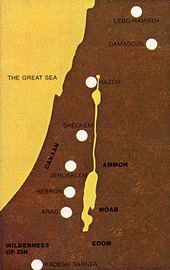

The Wilderness of Zin
The children of Israel lived as a desert people in the area around Kadesh-barnea, until forty years from the time of their departure from Egypt had passed.
Only 3 events are recorded during this time:
The stoning of the Sabbath breaker
The leading by Korah, a Levite and priest officiating at the tabernacle, of a rebellion against Moses
The miracle of the budding of Aaron’s rod
Levi
Kadesh-barnea
Numbers 20

Slide 4
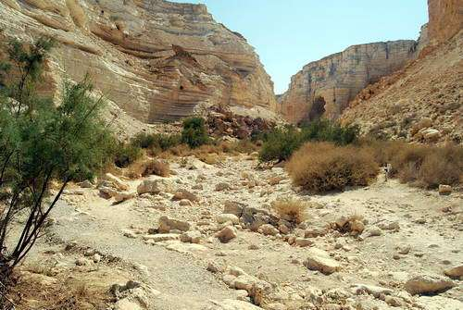
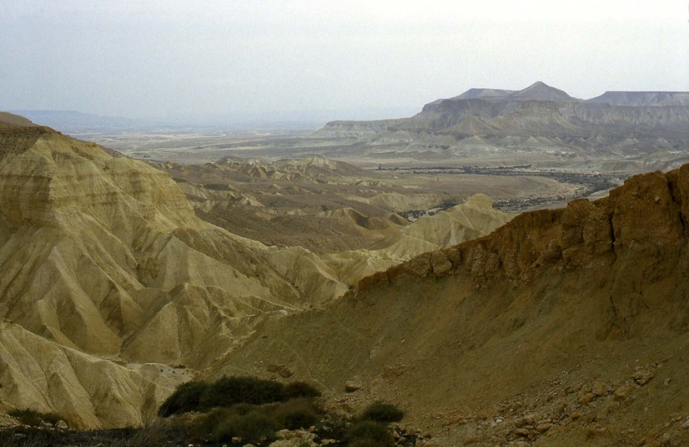
Near Kadesh
“The whole region is inhospitable and uninviting.”
Miriam Died
Wilderness of Zin
Wadi Zin. Photo by Ferrell Jenkins
Israelites once again rebelled against Moses and Aaron and complained that there was no water
Chode—past tense of Chide– Scold, berate, reprimand, rebuke, give someone a piece of one’s mind
Numbers 20:1-5
(1)

Slide 5
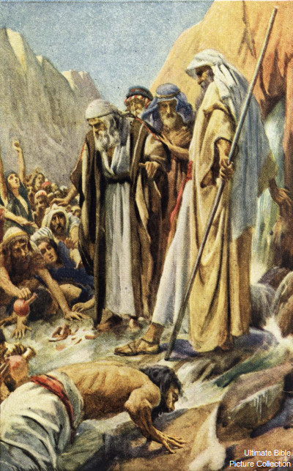
Take The Rod
Aaron’s rod is kept in the Ark of the Covenant
A water crisis arose and was resolved by the miracle of striking a rock, called Meribah, Moses “smote the rock twice” and water gushed forth.
Moses and Aaron did not glorify the Lord for this blessing and consequently were denied the privilege of entering the Promised Land.
And the Lord spake unto Moses and Aaron, Because ye believed me not, to sanctify me in the eyes of the children of Israel, therefore ye shall not bring this congregation into the land which I have given them.
Numbers 20:6-12
(1)

Slide 6
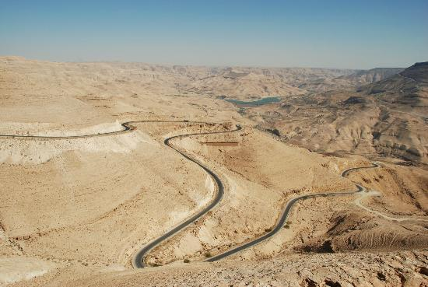
The King’s Highway
Taking the highway would have been the easiest route for the Israelites.
“The ‘king’s way’ is the public high road, which was probably made at the cost of the state, and kept up for the king and his armies to travel upon, and is synonymous with the ‘sultan-road’ (Derb es Sultan) or ‘emperor road,’ as the open, broad, old military roads are still called in the East” (2)
King’s Highway today
The highway ran along the highlands of present-day Jordan from the Red Sea up into Syria. On the east it paralleled the Dead Sea and the River Jordan.
Numbers 20:17
(1)

Slide 7
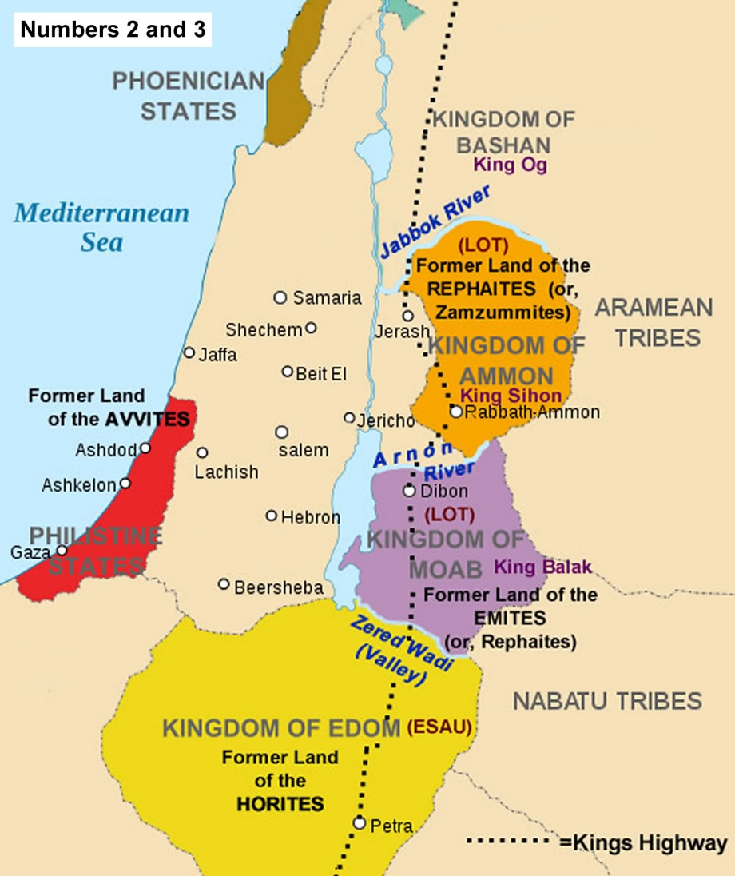
Messengers to Edom
They were travel from Kadesh to the land of Canaan on the east side of the Dead Sea through several well populated areas.
The Edomites lived in a mountainous area also called Mount Seir
Isaac
Sarah
They would be passing in areas that were occupied with distant relatives
Esau
Jacob
Edomites
Israelites
Let us pass, I pray thee, through thy country: we will not pass through the fields, or through the vineyards, neither will we drink of the water of the wells: we will go by the king’s high way, we will not turn to the right hand nor to the left, until we have passed thy borders.
Numbers 20:14-21
(1)

Slide 8
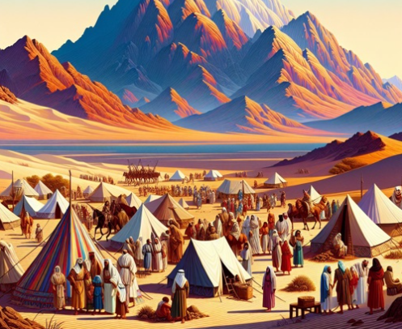
Response of Edom
They refused the passage to the Israelites, and he sent an army to ensure that they did not pass through.
This new generation of Israelites left Kadesh and transported themselves to a place on the border of Edom that they called Mount Hor.
Numbers 20:14-21, 22
(1)

Slide 9
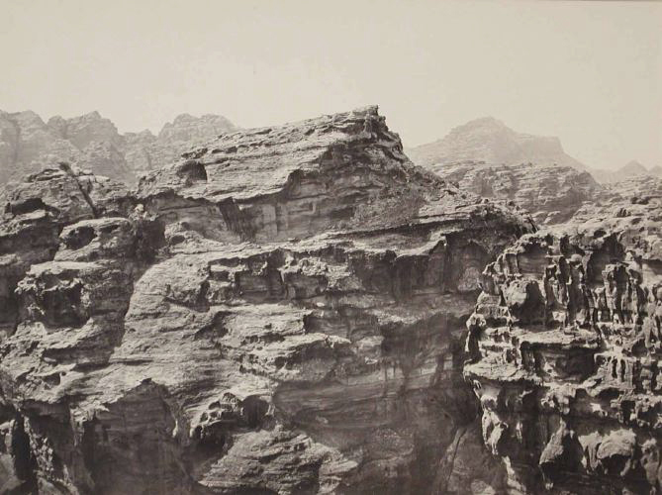
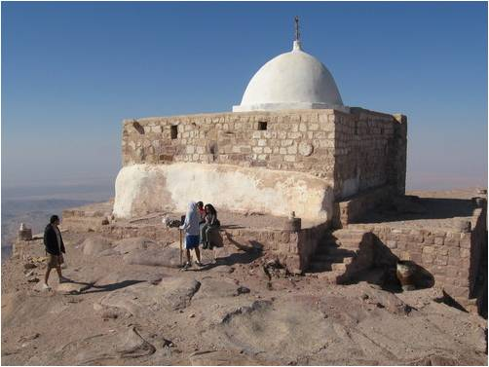
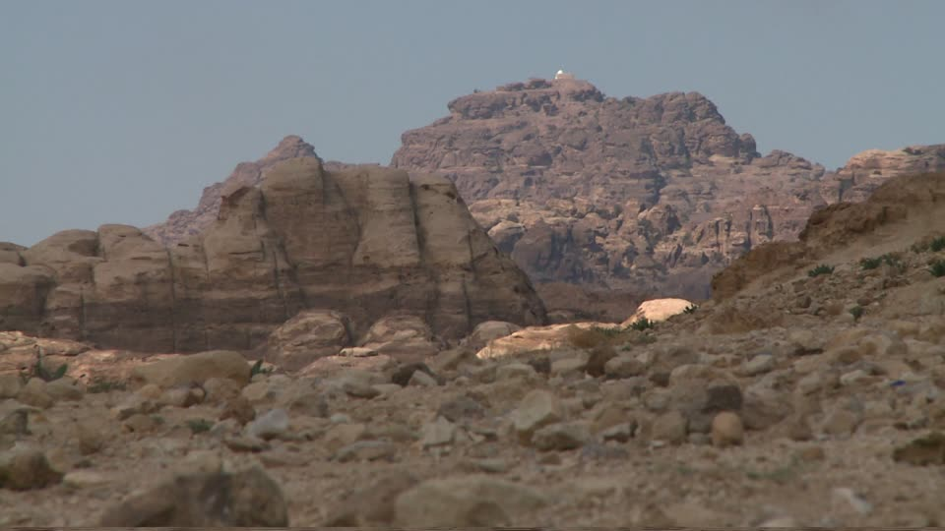
Aaron Confers Priesthood to Son
This new generation of Israelites left Kadesh and transported themselves to a place on the border of Edom that they called Mount Hor.
Aaron’s Tomb
Stripped of His Garments=turning the office over to Aaron’s son
Upon this mount, Eleazar, the son of Aaron, was given the presidency of the Levitical Priesthood in his father’s stead; and here Aaron died.
The people mourned for 30 days.
Numbers 20:22-29
(1)

Slide 10
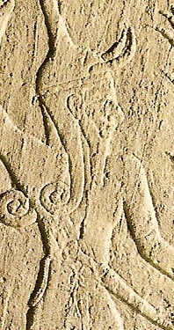
King Arad Captures Some Israelites
The Israelites early encounter with the Canaanite clan proved symbolic and prophetic of what would happen to Israel in Canaan later.
The Canaanite attack:
A raiding party swept down out of the southern monarchy of King Arad and captured an important segment of the people of Israel.
They were not rescued at this time inasmuch as it would have brought Israel into a direct engagement with the powerful Canaanites at the wrong time and place. (6)
Numbers 21:1
(1)

Slide 11
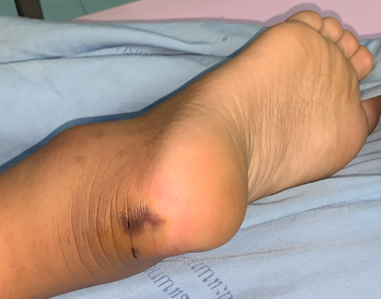
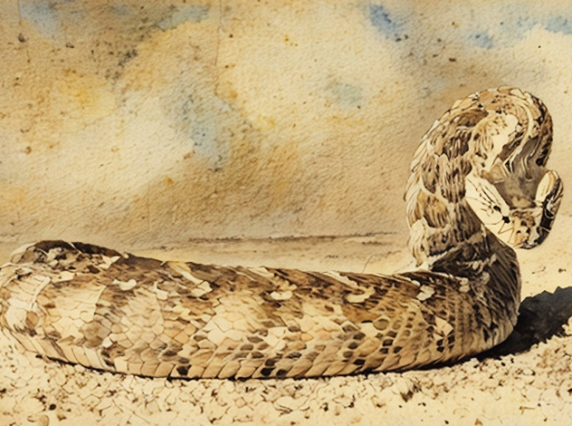
A Reaction After a Snake Bite
Being bitten by a venomous snake can cause swelling, blistering, severe pain, and illness. In extreme cases, it can even be deadly.
What are some of the different ways people may react after being bitten?
Panic
Seek revenge on the snake and kill it Wait to see how their body reacts to the bite
Immediately get help.
(1)

Slide 12





Reacting After Sinning
Rationalizing their actions
Looking to numb their feelings
Hiding their actions because of shame or embarrassment
Waiting to see what further consequences they face
Looking to the Lord for help
(1)

Slide 13
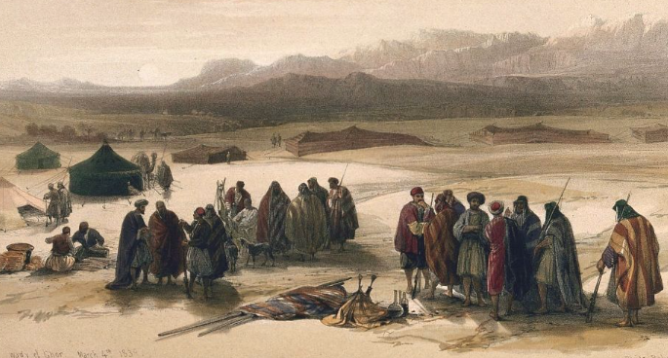
Discouragement
“The long journey, the prospect of death in the wilderness, the frequent lack of water, and even the diet of manna became causes of rebellion. (6)
Numbers 21:4-5

Slide 14
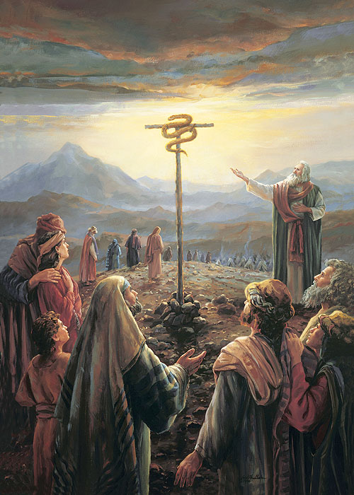
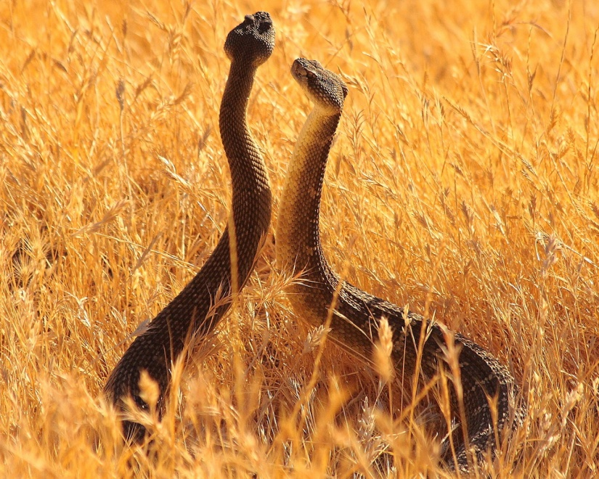
Brass Serpent- Rod of Ascleplius
“Fiery serpents” afflicted them and caused the death of many.
The Jaradites: “And there came forth poisonous serpents also upon the face of the land, and did poison many people…” (Ether 9:31-33)
The Lord sent these upon the children of Israel to “straiten them,” and he prepared a way that those who were bitten might be healed by looking at the serpent of brass that Moses raised up before them, which was a symbol of the Redeemer being lifted upon the cross. (3)
All who was bitten and looked up would be healed
Numbers 21:6-9

Slide 15
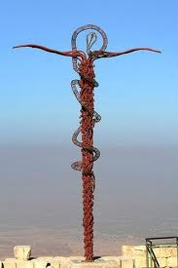
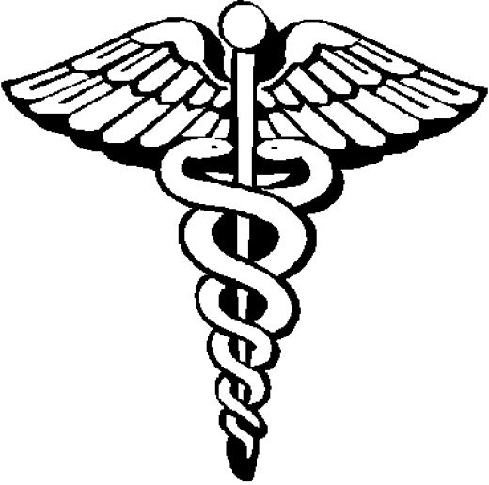
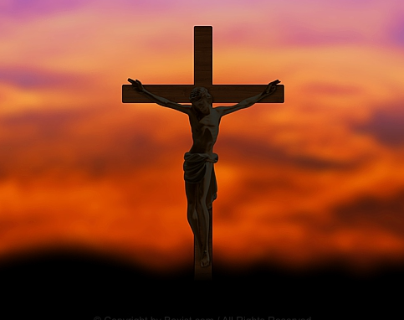
Symbol of Christ
Healer of Nations:
“…and behold a type was raised up in the wilderness…” (Alma 33:19)
As we look to the Savior in faith, He will heal us spiritually
Numbers 21:6-9

Slide 16

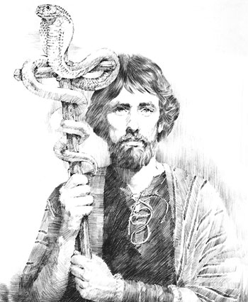
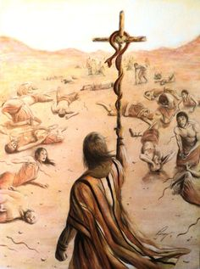
Look To Be Healed
O my brethren, if ye could be healed by merely casting about your eyes that ye might be healed, would ye not behold quickly, or would ye rather harden your hearts in unbelief, and be slothful, that ye would not cast about your eyes, that ye might perish?
Alma 33:21
And as many as should look upon that serpent should live, even so as many as should look upon the Son of God with faith, having a contrite spirit, might live, even unto that life which is eternal. Helaman 8:15
I plead with you to come unto Him so that He can heal you! He will heal you from sin as you repent. He will heal you from sadness and fear. He will heal you from the wounds of this world. (7)
Numbers 21:1-9

Slide 17
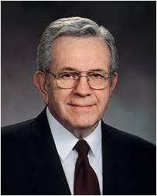
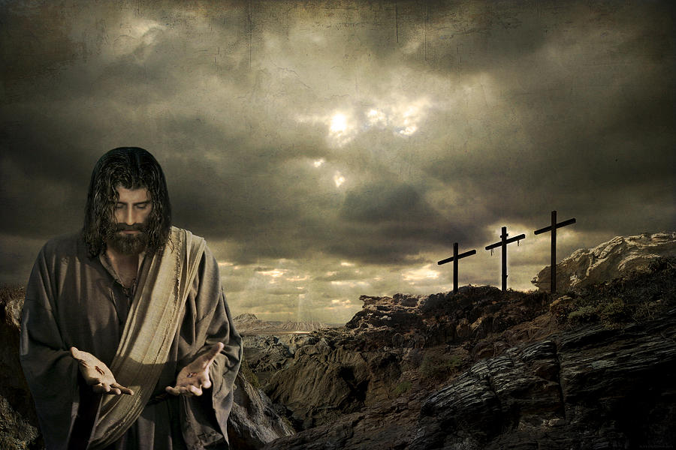
“Jesus Christ has prescribed a very clear method for us to repent and find healing in our lives.
The cure for most mistakes can be found by seeking forgiveness through personal prayer.
However, there are certain spiritual illnesses, particularly those dealing with violations of the moral law, which absolutely require the assistance and treatment of a qualified spiritual physician. …
Acropolis De Versailles
(4)

Slide 18

“If you … wish to return to full spiritual health, see your bishop. He holds the keys and can help you along the pathway of repentance”
(4)

Slide 19
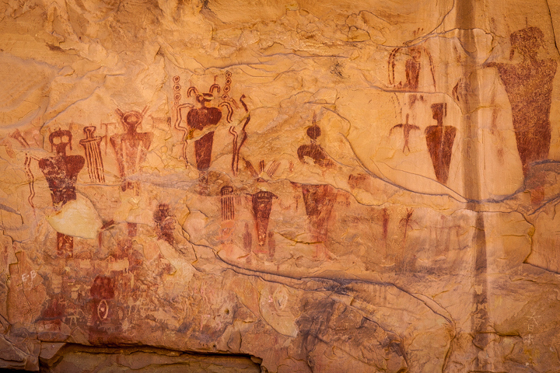
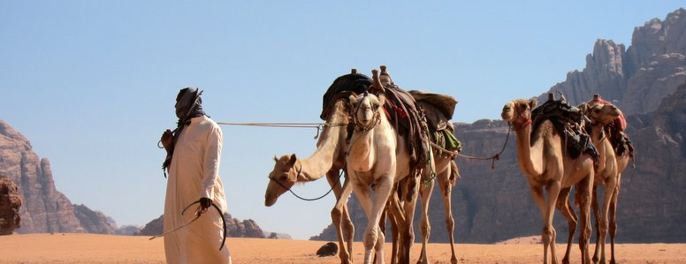
The Journey Continued…
The children of Israel were healed by looking to Christ, they defeated the Amorites and the people of Bashan who fought against them.
Top of Pisgah (looked toward Jeshimon)
Bamoth
Nahaliel
Mattanah
Beer (well dug by princes)
The locales mentioned as stopping places are not definitely known today.
Side of Arnon(border of Moab)
Valley of Zared
Ijeabarim (before Moab)
Obath
Mt. Hor
Numbers 21:10-20

Slide 20
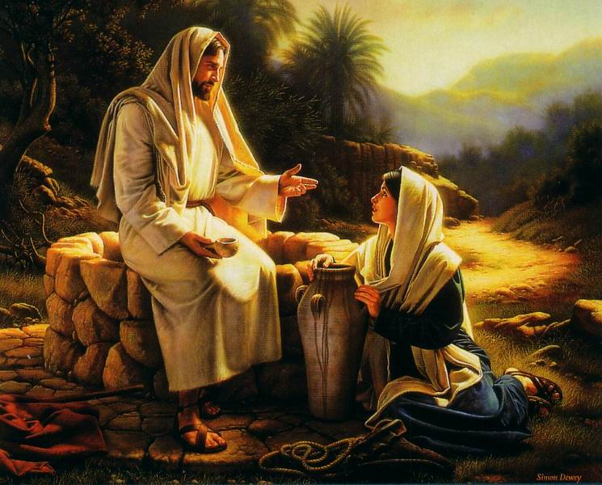
“Spring Up, Oh Well; Sing Ye Unto It”
The princes (leaders of the tribes) dug a well with their staves
Therefore with joy shall ye draw water out of the wells of salvation. Isaiah 12:3
But whosoever drinketh of the water that I shall give him shall never thirst; but the water that I shall give him shall be in him a well of water springing up into everlasting life. John 4:14
As water is essential to sustain physical life, the Savior and his teachings (living water) are essential for eternal life. (3)
Numbers 21:16-18

Slide 21
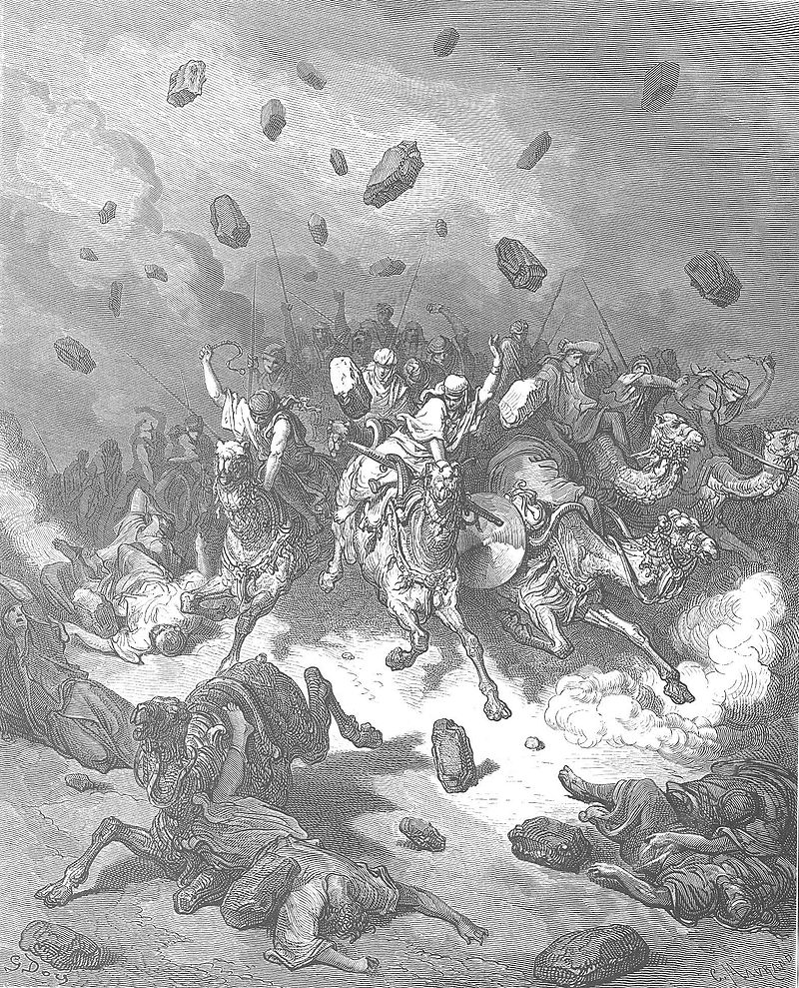
Sihon
King of the Amorites
And Sihon would not suffer Israel to pass through his border:
Amorites is used in the Bible to refer to certain highland mountaineers who inhabited the land of Canaan, described in Genesis 10:16 as descendants of Canaan, son of Ham.
Nave's Topical Bible to refer to the Amorites as "giants.“ Wikipedia
Sihon was defiant. He would not negotiate…and mobilized his armies and came upon the children of Israel.
“…now Israel brought the war to them. As the Israelites overran their walls and pulled down their gates they brought about their complete destruction. Nothing came out alive except the cattle which were taken as spoil. They also stripped each city of the wealth which Sihon’s people had stolen from those who had previously inhabited these towns and cities.” (5)
“The first battle was fought at Jahaz, and then the war spread from the River Arnon to every section where Sihon had built his strongholds…”
Gustave Doré
Numbers 21:21-32; Deuteronomy 2:31-37

Slide 22
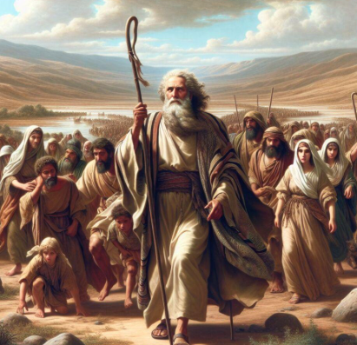
Setting Forward
Kings who refused to allow peaceful passage through their lands were vanquished and their cities possessed for a time;
However…
The Lord deemed the Moabites and Ammonites, descendant of Lot, still the rightful possessors of their lands, and though Israel had strife with them in passing, their lands were not taken from them. (Deut. 2:9, 19)
Numbers 21:27-30
(6)

Slide 23
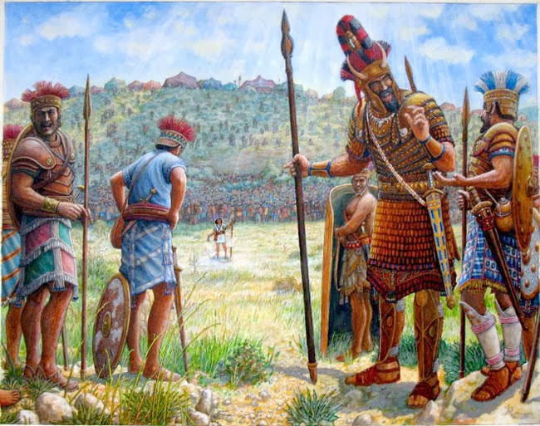
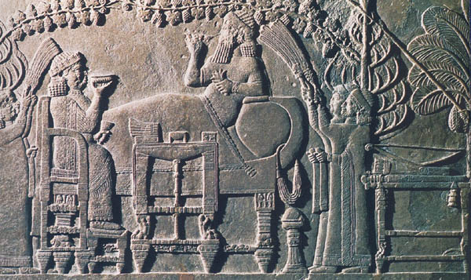
Og
Another Amorite King; King of Bashan
Battle at Edrei
Og ruled everything west of Jordan from the River Jabbock to Mount Hermon. This territory was called “the land of giants” and King Og is referred to by Moses as the only king left of the “remnant of giants.”
“Og was killed and the whole city devastated. Then the armies of Israel swept through the land of Bashan cleansing it as they went.”
"bedstead" (translated in some texts as "sarcophagus") of iron is "nine cubits in length and four cubits in width", which is 13.5 ft by 6 ft according to the standard cubit of a man.
Og may have been around 9 feet 13 inches tall. Wikipedia
And we took at that time out of the hand of the two kings of the Amorites the land that was on this side Jordan, from the river of Arnon unto mount Hermon; Deuteronomy 3:8
Numbers 21:33-35; Deuteronomy 3:2-13
(5)

Slide 24
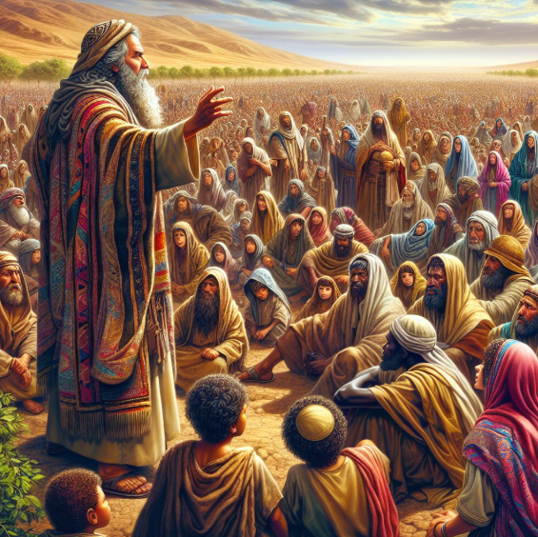
Blessings of Obedience and Healing
The children of Israel were healed by looking to Christ, in conclusion they defeated the Amorites and the people of Bashan who fought against them.
(4)

Slide 25
Sources:
Video: “Atonement: Not a One-Time Thing” (3:00)
“Jesus Christ Has Compassion and Heals the People” from time code 1:43 to 6:19.
Edward J. Brandt Journeys in the Events of the Life of Moses Oct. 1975 Ensign
(Keil and Delitzsch, Commentary, 1:3:134).
Presentation by ©http://fashionsbylynda.com/blog/
3. Bible Dictionary
4. Elder Boyd K. Packer (“The Key to Spiritual Protection,” Ensign or Liahona, Nov. 2013, 28).
5. W. Cleon Skousen The Third Thousand Years p. 424
6. Ellis T. Rasmussen “The Latter-day Commentary on the Old Testament” pg.159-160
7. President Russell M. Nelson (“The Answer Is Always Jesus Christ,” Liahona, May 2023, 127)

Slide 26
The Book of Numbers
Bible Dictionary
Chapters 1-12 | Chapters 13-20 | Chapter 21-36
Old Generation Organization and Preparation to leave Mt. Sinai | Transition to Kadesh-barnea—drawing back in unbelief—brings God’s discipline Wilderness | New Generation Move to Plains of Moab—east of Promised Land Reorganization of Israel Regulations (offerings and Vows) Conquest and Division of Israel
Numbers 20 | Numbers 21
En Route to Moab | The Healing and the Strength
Death of Miriam Moses smites a rock at Meribah and brings forth water The king of Edom refuses to let Israel pass peacefully through his land Aaron dies, and Eleazar becomes the high priest | Victory over Canaanites. Israelites are plagued with fiery serpents Moses lifts up a serpent of brass to save those who look thereon Israel defeats the Amorites, destroys the people of Bashan, and occupies their lands

Slide 27
WHO-DOMITES? Who Are The Edomites Today? Simply put they are the descendants of Esau, the twin brother of the infamous Jacob of the Old Testament. In Genesis 32:28 God changes Jacobs name to Israel and his twelve sons and their descendants became the nation of Israel. Likewise the descendants of Esau formed the nation of Edom from which comes the term Edomites. (Genesis 36:1, 9)
The Edomites were spawned in Edom, which is today Southern Jordan. Although a remnant of Edomites still reside in Southern Jordan, most Edomites migrated in several waves centuries ago into Israel proper and made Hebron their central city. Hebron still exists today in the West Bank and is predominately inhabited by the Palestinians.
Around the time of “Alexander the Great”, (born 356 BC), the Edomites became known in the Greek language as the Idumeans. Presently Edomite descent can be traced into the Palestinian ethnicity as follows: (Edomites-Idumeans-Palestinians). Although the Palestinians are made up of a mish mash of ethnicities, many of them are Esau’s Edomite descendants.
Bill Salus Two End Times Judgments upon Edom blog
Mistakes:
“There have been times when members or leaders in the Church have simply made mistakes. There may have been things said or done that were not in harmony with our values, principles, or doctrine.
“I suppose the Church would be perfect only if it were run by perfect beings. God is perfect, and His doctrine is pure. But He works through us—His imperfect children—and imperfect people make mistakes. …
“It is unfortunate that some have stumbled because of mistakes made by men. But in spite of this, the eternal truth of the restored gospel found in The Church of Jesus Christ of Latter-day Saints is not tarnished, diminished, or destroyed” President Dieter F. Uchtdorf (“Come, Join with Us,” Ensign or Liahona, Nov. 2013, 22).
Even though the Church is led by imperfect people who can make mistakes, the Lord’s prophet will never lead us astray. President Wilford Woodruff explained:
“The Lord will never permit me or any other man who stands as President of this Church to lead you astray. It is not in the program. It is not in the mind of God” (Official Declaration 1, “Excerpts from Three Addresses by President Wilford Woodruff Regarding the Manifesto”).
The Amorite king, Og, was described as the last "of the remnant of the Rephaim" (Deu. 3:11). The terms Amorite and Canaanite seem to be used more or less interchangeably, Canaan being more general and Amorite a specific component among the Canaanites who inhabited the land.
The Biblical Amorites seem to have originally occupied the region stretching from the heights west of the Dead Sea (Gen. 14:7) to Hebron (13:8; Deut. 3:8; 4:46–48), embracing "all Gilead and all Bashan" (Deut. 3:10), with the Jordan valley on the east of the river (4:49), the land of the "two kings of the Amorites," Sihon and Og (Deut. 31:4; Jo. 2:10; 9:10). Both Sihon and Og were independent kings. These Amorites seem to have been linked to the Jerusalem region, and the Jebusites may have been a subgroup of them (Ezek. 16:3). The southern slopes of the mountains of Judea are called the "mount of the Amorites" (Deut. 1:7, 19, 20).
Five kings of the Amorites were first defeated with great slaughter by Joshua (10:10). Then more Amorite kings were defeated at the waters of Merom by Joshua (Josh. 11:8). It is mentioned that in the days of Samuel, there was peace between them and the Israelites (1 Sam. 7:14). The Gibeonites were said to be their descendants, being an offshoot of the Amorites who made a covenant with the Hebrews; when Saul later broke that vow and killed some of the Gibeonites, God sent a famine to Israel.Wikipedia
Stripped of his garments:
This was, in effect, depriving him of his office; and putting the clothes on his son Eleazar implied a transfer of that office to him. A transfer of office, from this circumstance of putting the clothes of the late possessor on the person intended to succeed him, was called investing or investment, (clothing;) as removing a person from an office was termed divesting or unclothing.”(Clarke, Bible Commentary, 1:682.)
The same custom continues to this day in some institutions. When an officer is installed or removed from office, ceremonial clothing is either put on or taken off, symbolizing a transfer of authority. When one departs in dishonor, he is literally stripped of his gown or robes. In the military, the cutting off of one’s epaulets or insignia of rank is the same thing.
Aaron, however, was not retiring in dishonor or disgrace. His death was imminent (see v. 28), and it was time for new and younger leadership.

Slide 28
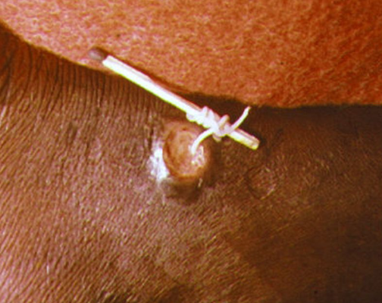
Just a thought—Could Moses be showing the Children of Israel a way to extract the serpent out of the skin? Could this be an obedient example of the future atonement?
Guinea worm (Dracunculus medinensis)
The Guinea worm and its extraction
The parasite: A person becomes infected by drinking water contaminated with tiny copepods (water fleas) that contain Guinea worm larvae. Over the course of about a year, the larvae develop into a mature, pregnant female worm, which can grow to be up to 3 feet (1 meter) long.
The blister: The worm causes a painful, burning blister, typically on the legs or feet, through which it emerges.
The extraction: The only way to remove the worm is to perform a daily, painstaking extraction. A piece of gauze or a small stick is used to wrap and apply gentle traction to the worm as it emerges. The stick is turned just a few centimeters each day, and the process can take weeks.
Preventing breakage: It is critical not to break the worm during extraction. If the worm breaks, it can retract into the body and cause severe inflammation, pain, and potentially life-threatening secondary bacterial infections.
The symbol of medicine: The practice of winding the Guinea worm around a stick is believed by some to be the origin of the Rod of Asclepius, a serpent coiled around a staff that is a symbol of medicine
Ever since Eve’s transgression in the Garden of Eden, snakes in Judeo-Christian tradition have been associated with lies, evil, and temptation. But in other cultures, such as indigenous North America, snakes symbolize fertility, rebirth, renewal, and even immortality
The bronze serpent created by Moses was named Nehushtan. Centuries later, in the time of King Hezekiah, it was destroyed because the Israelites began to worship it as an idol. This act was part of Hezekiah's religious reforms, which aimed to return the people's focus to worshipping God alone. 2 Kings 18:4

