Slide 1

Balak and Balaam
Numbers 22-29
For behold, the Lord doth grant unto all nations, of their own nation and tongue, to teach his word, yea, in wisdom, all that he seeth fit that they should have; therefore we see that the Lord doth counsel in wisdom, according to that which is just and true. Alma 29:2
Presentation by ©http://fashionsbylynda.com/blog/

Slide 2
Moabites
Terah
Son of Lot’s eldest daughter (Gen. 19:37). The land of Moab lay east of the Dead Sea. The Moabites were akin to the Israelites and spoke a language that closely resembled Hebrew, but there was constant warfare between the two nations (1)
Abraham
Haran
Isaac
Lot
Daughter
Jacob
Israelites
Moab
Ben-Ammi
Lot's daughters left Sodom with him, but having grown up in that environment, they retained those wicked ways in their hearts, and in their incredible short-sightedness, committed incest in order to create progeny
(Gen. 19:31-36).
From the children they bore in this wicked manner, came two of the most evil, idolatrous nations of Bible times: The Moabites and the Ammonites.
Moabites
Ammonites

Slide 3
Balak
He was the son of Zippor
His name means “spoiler”
He was the king of the Moabites
He worshipped Baal, a male god in the Phoenician pagan culture, which the Lord forbade all such forms of idolatry with the commandment ‘Thou shalt have no other gods before me’ (Exodus 20:3)
He hired the prophet Balaam to curse the Israelites encamped on the plains of Moab near Jericho three different times—which was in vain
Balak decided to ally with the Midianites to gather their maids in order to lead Israelite’s men astray in adultery
Balak seems to be mentioned by name on a papyrus in the British Museum
Numbers 22
(2), (3)

Slide 4
Balaam
He was a prophet figure who lived in Pethor, a city by the Euphrate. He was the son of Beor
While Israel was encamped on the plains of Moab, they were perceived as a threat to the Moabites and their allies Midianites.
The king of the Moabites, Balak, tried to hire Balaam into cursing the Israelites
He agreed to perform the duty but was intercepted by a messenger of the Lord
The second time he supplicated to the Lord in behalf of Balak to receive permission to carry out the task and again the Lord was angry with Balaam
Balaam received a message through his donkey which proceeded to hold back despite Balaam’s force on the animal
The Lord opened Balaam’s eyes, causing him to repent of his spiritual short-sightedness
Balak tried a third time to get Balaam to perform the cursing that he had been paid for. But Balaam would not and Israel was blessed rather than cursed
However, Balaam counseled Balak to entice the Israelite men to sin (Numbers 31:16)
The Lord commanded Moses to strike out against their enemies and “Balaam also the son of Beor they slew with the sword.” (Numbers 31:8)
Numbers 22 (2)

Slide 5
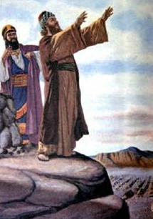
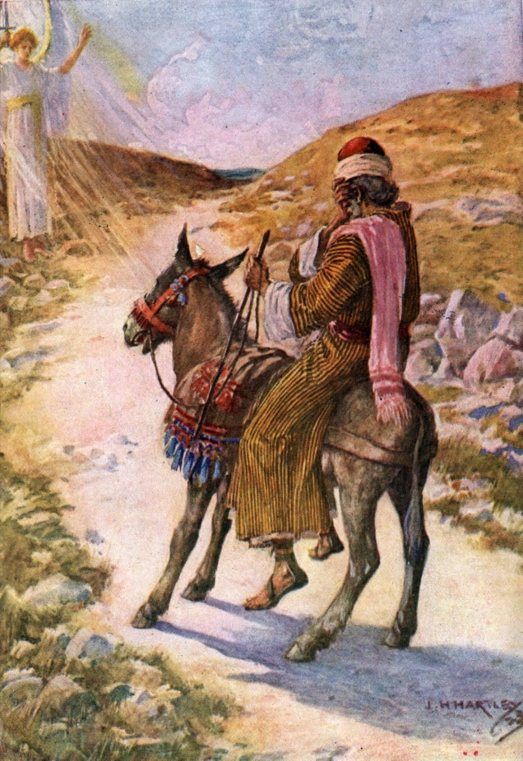
Who Was Balaam?
It is significant that Balaam is referred to as a soothsayer or diviner, somewhat on the order of Simon of the New Testament.
See Acts 8:9-24
Balaam also the son of Beor, the soothsayer, did the children of Israel slay with the sword among them that were slain by them. Joshua 13:22
Although Balaam acknowledged Jehovah and professed his dependence on Him, Balaam was willing to go against the Lord’s counsel and accompany the men of Balak.
Obviously, Balaam had previously accepted money for his prophetic services.
(4)

Slide 6
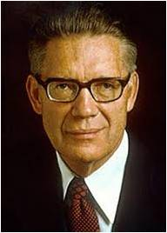
In spite of all this, the record recites that Balaam "taught" Balak "to cast a stumbling block before the children of Israel, to eat things sacrificed unto idols, and to commit fornication," and shortly thereafter, while aligned against Israel in the camps of the Midianites, he was "slain with the sword."
Balaam, the prophet, inspired and mighty as he once was, lost his soul in the end because he set his heart on the things of this world rather than the riches of eternity.
What a wealth of meaning there is in these inspired words of Joseph Smith, words addressed to people who have testimonies but want to mingle the things of this world with them:
"Behold, there are many called, but few are chosen. And why are they not chosen? Because their hearts are set so much upon the things of this world and aspire to the honors of men..." (D&C 121:34-38, 40)
Numbers 22:23; 24; 25; 31:8; 2 Peter 2:15-16; Jude 1:11; and Revelations 2:14.
(5)

Slide 7

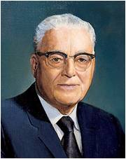
Ignoring
We put ourselves in danger when we ignore the Lord’s instructions and warnings
“From now on, you must not only avoid evil, but also the appearance of evil.”
(6)

Slide 8
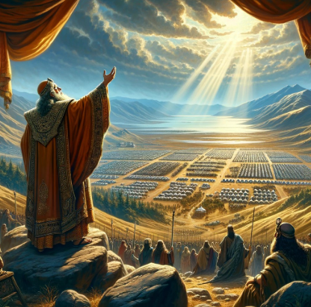
Ready to Curse Israel
And Balaam said unto Balak, Build me here seven altars, and prepare me here seven bullocks and seven rams.
Balaam stands on a ridge, overlooking the massive camp of Hebrews, ready to curse the Israelites.
The king builds 7 altars, complete with animal sacrifices, to enhance the curses.
But when Balaam attempts to call down curses on the unsuspecting Israelites, only the most lovely, poetic, and prophetic blessings come out of his mouth!
Numbers 23
(6)

Slide 9
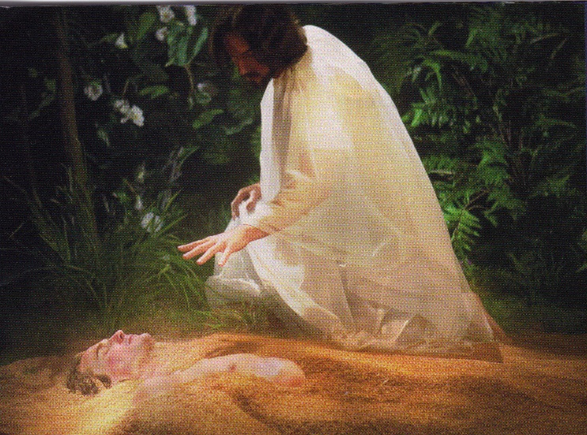
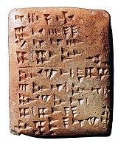
Dust of Jacob
Come, curse me Jacob,
and come, defy Israel.
Who can count the dust of Jacob,
and the number of the fourth part of Israel?
He hath not beheld iniquity in Jacob,
neither hath he seen perverseness in Israel.
Surely there is no enchantment against Jacob,
neither is there any divination against Israel.
How goodly are thy tents, O Jacob,
and thy tabernacles, O Israel!
There shall come a Star out of Jacob,
and a Sceptre shall rise out of Israel.
image of tablet found at Ras Shamra
Numbers 23:7, 10, 21, 23; 24:5, 17
(7)

Slide 10
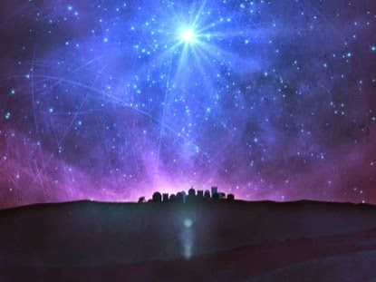
Star Out of Jacob
Balaam prophesied that the children of Israel would eventually rule over the Moabites. He also prophesied that the Savior would one day come from the house of Israel.
One of the remarkable things about Balaam’s blessing of Israel is the Messianic promise of Christ
Sceptre: an ornamented staff carried by rulers on ceremonial occasions as a symbol of sovereignty--authority
Numbers 24:17
(4)

Slide 11
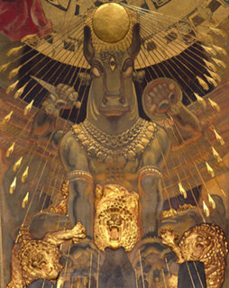
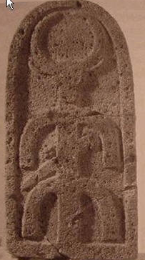
A Serious Sin
Serious Sins
Peor was a place to worship a false god
But I have a few things against thee, because thou hast there them that hold the doctrine of Balaam, who taught Balac to cast a stumbling block before the children of Israel, to eat things sacrificed unto idols, and to commit fornication. Revelation 2:14
The record next describes the whoredoms Israel committed with the daughters of Moab; that is, Israel joined the women of Moab in worshiping Baal-peor, a fertility god, including offering sacrifices to the god and indulging in sexual immorality.
Sin stops us from progressing spiritually and causes us to lose God’s protection and power
King Balak enticed the Israelites to commit sin because he knew that without the Lord’s power they would not be able to successfully conquer his kingdom.
(4)
Numbers 24:17
(4)
Numbers 25

Slide 12
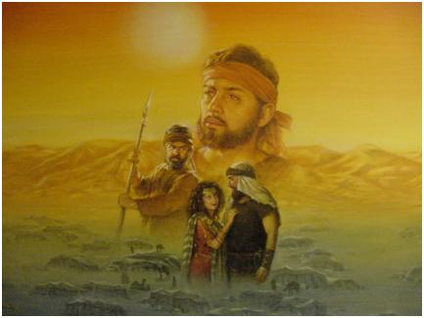
A Serious Sin
Plague Was Stayed
To rid the children of Israel of the sinful influences
Despite the severe action taken by Moses against those who had joined the Moabites in the worship of Baal, one man dared to bring one of the women into camp.
Phinehas slew them both, signifying to all that the priesthood could not tolerate such evil. He knew that the evil of a few could result in suffering and even death for many.
If Israel lost power with God by tolerating evil in their midst, innocent people would die in the wars with the Canaanites when Israel crossed over Jordan.
Phinehas was the son of Eleazar, the son of Aaron the priest
(4)
Numbers 24:17
(4)
Numbers 25

Slide 13

A Serious Sin
Today’s Sin
Modern bishops have a similar responsibility to put away evil in the Church.
While excommunication is the most severe penalty they can invoke, it is nonetheless their responsibility to root out evil from among the Saints.
Failure to do so is to bear responsibility for the people’s sins themselves.
(4)
Numbers 24:17
(4)
Numbers 25

Slide 14

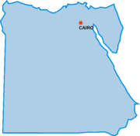
Israel is Recounted
Moses and Eleazar, the priest, counted by their respective tribes the children of Israel aged twenty years and older.
In the process, they discovered that, except for three people, not one living soul over twenty years of age who had been numbered at the beginning of the desert wanderings thirty-eight years earlier was left among the children of Israel.
Only Joshua, Caleb, and Moses himself remained of the original company that came out of Egypt.
Egypt
(4)
Numbers 26
(4)

Slide 15
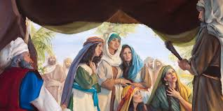
Inheritance
The Daughters of Zeophehad stood before Moses and Eleazar and told them that their father died in the wilderness and that there were no brothers to take care of them…
If a man die who:
Did not have a son—goes to the daughter
Did not have a daughter—goes to his brother
Did not have a brother—goes to his father’s brother (uncle)
Did not have an uncle—next of kin
Joseph
Manasseh
Machir
Gilead
Hepher
Zeophehad
Mahlah
Noah
Hoglah
Milcah
Tirzah
…thou shalt surely give them a possession of an inheritance among their father’s brethren; and thou shalt cause the inheritance of their father to pass unto them.
Numbers 27:1-11
(4,5)

Slide 16
Ordination of Joshua
“Special blessings, anointings, sealing of anointings, confirmations, ordinations, callings, healings, offices, and graces are conferred by the laying on of hands by the Lord’s legal administrators. As with all of the Lord’s prescribed procedural requisites, the proffered blessings come only when the designated formalities are observed.
“‘According to the order of God,’ ordination to offices in the priesthood is performed by the laying on of hands. Setting apart to positions of presidency, administration, or special responsibility comes in the same way.”
Numbers 27:18-23
(4,5)

Slide 17
Specific Sacrifices to the best of my understanding of Numbers 28
Burnt Offering—continually (Every Day) | Sabbath Once a week (along with Burnt Offering) d | Beginning of the months—Burnt offerings/Sin Offering | 14th day of 1st month Passover and 15th day is beginning of 7 day – Feast of Unleavened Bread Last day—no work—holy convocation | Feast of the First Fruits Continually burnt offering
Two lambs of first year—spotless One in the morning and one in the evening | Two lambs of first year—spotless | 2 Young bullocks 1 ram 7 lambs—first year—spotless 1 goat/ sin offering—drink offering | 1st day—no work Burnt offering 2 young bullocks 1 ram 7 lambs (first year-spotless) | 2 young bullocks 1 ram 7 lambs (first year)
Meat offering—with oil 1/10th part burnt by fire | Meat offering—with oil 2/10th flour | Meat offering—with oil 3/10th for 1 ram Several/10th for 1 lamb | Meat offering—with oil 3/10th for bullock 2/10th for ram Several/10th for every lamb 1 goat sin offering | Meat Offering— 3/10th for 1 bullock 2/10th for 1 ram Several/10th for each lamb 1 goat for Atonement for yourselves
Drink offering—1/4 part of hin for one lamb | Drink offering | Drink offering—1/2 for bullock 1/3 for ram 1/4 for lamb |  | Drink offering
Numbers 28:3-6 | Numbers 28:9 | Numbers 28:10-15 | Numbers 28:16-25 | Numbers 28:27-31

Slide 18
Specific Sacrifices to the best of my understanding of Numbers 29
1st day of 7th month Feast of the Trumpets and Feast of Tabernacles * | 10th day of the 7th month No work—holy convocation | 15th day of the 7th month No work—holy convocation | 2nd Day | 3rd Day—7th day 8th day solemn assembly—no work—then same as 1st day of 7th month*
1 young bullock 1 ram 7 lambs (first year) | 1 young bullock 1 ram 7 lambs (first year—spotless) | 13 Young bullocks 2 rams 14 lambs—first year—spotless 1 goat/ sin offering—drink offering | 12 young bullocks 2 rams 14 lambs (first year—spotless) | 11 bullocks 2 rams 14 lambs 9first year—spotless)
Meat offering—with oil 1/10th for 1 bullock 2/10th for 1 ram 1/10 for each lambs one a day 1 goat—sin offering for atonement for yourselves | Meat offering—with oil 3/10th for 1 bullock 2/10th for 1 ram Several/10th for each lamb 1 goat for sin offering, atonement, and continual burnt offering | Meat offering—with oil 3/10th for every bullock (13) 2/10th each ram Several/10th for each lamb (14) 1 goat for sin offering, and continual burnt offering | Meat offering—with oil According to their number after the manner (he must of gotten tired of repeating) 1 goat for sin offering and continual burnt offer | Meat offering—with oil According to their number after the manner 1 goat for sin offering and continual burnt offer
Drink offering | Drink offering | Drink offering | Drink offering | Drink offering
Numbers 29:1-6 | Numbers 29:7-11 | Numbers 29:12-16 | Numbers 28:17-19 | Numbers 29:20-22
Each day the bullocks reduced by one number till the 7th Day Numbers 29:23-34

Slide 19
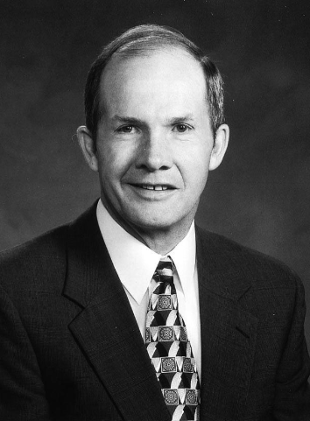
…and your freewill offerings
I asked my two rabbinical friends about Jewish beliefs concerning the doctrine and practice of the law of sacrifice. They explained their understanding of the biblical context of this law and confirmed their deep conviction that it continues to be an important requirement.
Yet, they said, “We are quite certain that our people would reject the notion of bringing back the practice of animal sacrifice. But we confirm that the law is a requirement for all Jews.” (9)
Obedience is a great and important part of the law of sacrifice. The Lord acknowledged the Prophet Joseph Smith’s obedience and sacrifice in these words:
“Behold, I have seen your sacrifices, and will forgive all your sins; I have seen your sacrifices in obedience to that which I have told you” (D&C 132:50).

Slide 20
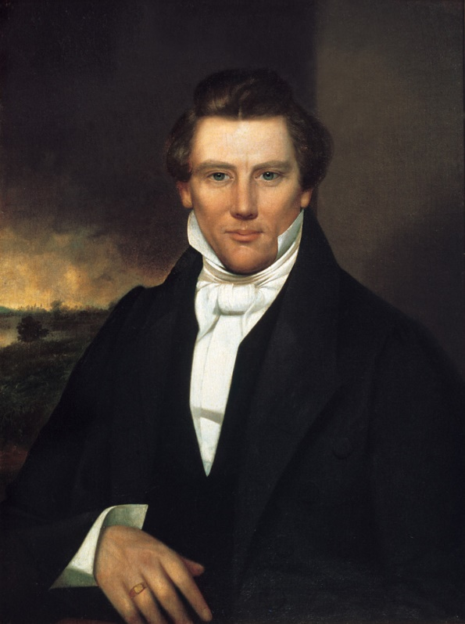
“All the saints of whom we have account, in all the revelations of God which are extant, obtained the knowledge which they had of their acceptance in his sight through the sacrifice which they offered unto him”
“A religion that does not require the sacrifice of all things never has power sufficient to produce the faith necessary unto life and salvation; for, from the first existence of man, the faith necessary unto the enjoyment of life and salvation never could be obtained without the sacrifice of all earthly things. It was through this sacrifice, and this only, that God has ordained that men should enjoy eternal life.”
(10)

Slide 21
Sources:
Bible Dictionary
Who’s Who in the Old Testament by Ed J. Pinegar and Richard J. Allen p. 22, 25
Wikipedia—last two statements
Old Testament Institute Manual
Elder Bruce R. McConkie ("The Story of a Prophet's Madness," New Era, Apr. 1972, 6-7
Mormon Doctrine, p. 438.)
6. James E. Faust Acting for Ourselves and Not Being Acted Upon October 1995 Gen Conf. Quoting Harold B. Lee
7. Kevin L. Barney, "Understanding Old Testament Poetry," Ensign, June 1990, 53-54
8. Joseph Smith (Teachings, pp. 198–199.) …
Presentation by ©http://fashionsbylynda.com/blog/
9. Elder Monte J. Brough Living the Law of Sacrifice April 2000 Ensign
10. Joseph Smith, comp., Lectures on Faith [1985], 70. (Lectures on Faith, 69).
Presentation by ©http://fashionsbylynda.com/blog/

Slide 22
The Book of Numbers
Bible Dictionary
Chapters 1-12 | Chapters 13-20 | Chapter 21-36
Old Generation Organization and Preparation to leave Mt. Sinai | Transition to Kadesh-barnea—drawing back in unbelief—brings God’s discipline Wilderness | New Generation Move to Plains of Moab—east of Promised Land Reorganization of Israel Regulations (offerings and Vows) Conquest and Division of Israel
Numbers 22 | Numbers 23-24 | Numbers 25 | Numbers 26 | Numbers 27 | Numbers 28-29
Balaam | Oracles of Balaam | Sins of Israel with Moabites | Reorganization of Israel | Law of Inheritances | Offerings and Vows
Balak offers money, cattle, and great honors to Balaam to curse Israel The Lord forbids Balaam to do so An angel opposes Balaam on the way. | Balaam blesses Israel and sees vision and prophesies of the destiny of Israel and the Messiah Star out of Jacob | Those worshipping false gods are slain Phinehas slays the adulterers and stays the plague Israel is commanded to vex the Midianites who beguiled them | Moses and Eleazar count the Israelites on the plains of Moab near Jericho Only Caleb and Joshua remain from those numbered at Sinai. | What happens to ones inheritances Joshua is set apart to lead Israel | Sacrifices for Sabbath, first day of each month, Passover, Feast of Unleavened Bread, Feast of Firstfruits 7th month, feast of Trumpets, and Feast of Tabernacles

Slide 23
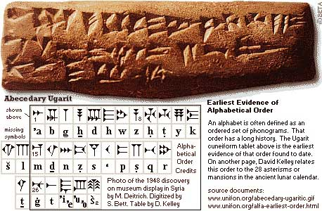
Baal:
A male sun-god worshiped principally in Phoenicia (1 Kgs. 16:31) but also worshiped in different ways in various places: by the Moabites as Baal-peor (Num. 25:1–3), at Shechem as Baal-berith (Judg. 8:33; 9:4), at Ekron as Baal-zebub (2 Kgs. 1:2). Baal may be the same as Bel of Babylon and Zeus of Greece. The word Baal expresses the relationship between a lord and his slave. The usual symbol for Baal was a bull. Ashtoreth was the goddess generally worshiped along with Baal.
Baal was sometimes combined with another name or word to indicate a connection with Baal, such as a place where he was worshiped or a person with attributes like those of Baal. Later, because Baal came to have very evil meanings, the word Bosheth replaced it in those combined names. Bosheth means “shame.”
Bible Dictionary
Dust of Jacob, Numbers 23-24:
This section is a good example of parallelism in Hebrew poetry. These patterns can be seen in the writing of the Hebrew prophets, Isaiah, Jeremiah, and Ezekiel as well as the Book of Mormon and even the Doctrine and Covenants.
"The discovery of the Ras Shamra tablets in 1929 led to a significant refinement of our understanding of parallelism and the way in which ancient poets composed poetry... In order to compose parallel lines rapidly, the Hebrew poet would rely in part on a traditional stock of parallel words that were common to the ancient Near East. The poet could use the same word pairs over and over again as the basic building blocks of different parallel lines.
The High Places of Baal:
A true prophet of the Lord should not spend much time in "the high places of Baal." Baal is one of the most pervasive and damaging idols of the history of Israel.
"Prophets and patriarchs often communed with the Lord in high places (such as Sinai and Beth-el) and Israel had a 'high place' in Gibeon for performing sacrifices. (see 1 Kgs. 3:4.) But idolators soon made high places their sanctuaries of abominations. (See Lev. 26:30; Num. 22:41; Deut. 12:2-3.)
"The idols worshipped in these high places were, for the most part, not of the Israelites' own imagining. Israel 'followed other gods, of the gods of the people that were round about them.' (Judg. 2:12.) The golden calf was probably erected to imitate what the Israelites had seen in Egypt (User-Hapi and Apis-Atum, for example). Baal-peor was a Midianite influence from Moab. (See Num. 25:3.)
"Chemosh was also a Moabite deity, and Molech was brought into Israel from Ammon. (See 1 Kgs. 11:7) In some cases, the children of Israel tried to practice idolatry and worship the true and living God-but, as the Lord states in the first commandment, such a practice is unacceptable to him." (David H. Madsen, "No Other Gods before Me," Ensign, Jan. 1990, 49-50)
Balaam as a Prophet:
It is difficult to determine from the record whether or not Balaam was a true prophet of God holding the powers of the priesthood authority. He lived in an area known as Aram, probably named after the son of Kemuel and grandson of Nahor, a cousin of Abraham. Haran, the place of Abraham’s first settlement after he left Ur, was a seat for the worship of Jehovah and was also in Aram. Therefore, Balaam could have been one of the few scattered people such as Jethro, who held the priesthood and exercised its power. The Bible suggests that he had a true knowledge of God and was susceptible to revelation from Him. Regardless of their origin, the Lord raises up inspired men to all nations (see Alma 29:8).Old Testament Institute Manual
Star out of Jacob:
“‘In figurative language, the spirit hosts in pre-existence are referred to as the stars of heaven.’ (Mormon Doctrine, 2nd ed., pp. 765–66.) The morning stars who joined with all the sons of God when the foundations of the earth were laid were the noble and preeminent spirits. As the Star who came out of Jacob, Christ is thus the most outstanding one of all the hosts of that unnumbered house” Elder Bruce R. McConkie (The Promised Messiah: The First Coming of Christ [1978], 182).

Slide 24
Prophecies of Christ
Jacob | Balaam (Moses) | Isaiah | Micah | Jeremiah
Foresaw that Shiloh would come, to whom people would gather | There shall come a Star out of Jacob, and a Sceptre shall rise out of Israel | A child born, and the government shall be upon his shoulder…peace there shall be no end, upon the throne of David, and upon his kingdom | From Bethlehem shall he come forth…to be ruler in Israel | A King shall reign…and shall execute judgment and justice
Genesis 49:10 | Numbers 24:17 | Isaiah 9:6-7 | Micah 5:2 | Jeremiah 23:5
(Encyclopedia of Mormonism, 1-4 vols., edited by Daniel H. Ludlow (New York: Macmillan)

