Slide 1




Conquest
Numbers 30-36
East of Jordan
We believe the Bible to be the word of God as far as it is translated correctly…”
Article of Faith 8

Slide 2

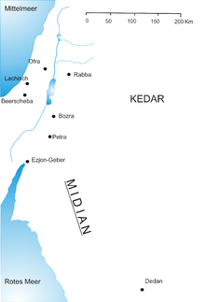
Midianites
The term "Midian“ which seems to be derived from the Arabic root= "place of judgment“ (1)
The Midianites through their apparent religion-political connection with the Moabites are thought to have worshipped a multitude of gods, including Baal-peor. (2)
Sarah
Abraham
Keturah
Rebekah
Isaac
Zimran
Jacob
Jokshan
Medan
Israelites
Midian
Ephah
Ishbak
Epher
Shuah
Hanoch
Abida
A powerful confederation of wandering Arab tribes, akin to the Hebrews, but often in conflict with them.
(3)
Eldaah
Midianites

Slide 3
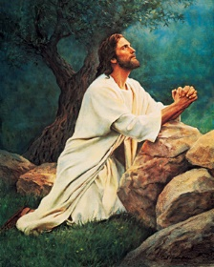




What blessings have you received that are so great, you feel you could never repay Heavenly Father and Jesus Christ?

Slide 4
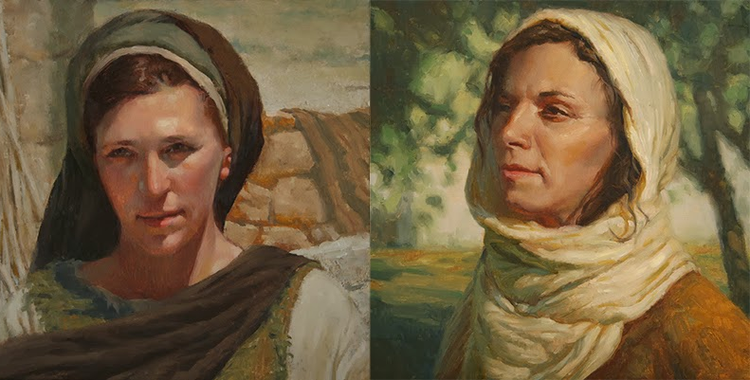
Standards of Vows
Keeping promises, vows, and oaths
This chapter sets forth the relationship between man and woman where a vow or covenant is concerned.
“The third case was that of a vow made by a widow or divorced woman. Such a vow had full force, because the woman was not dependent upon a husband.”
Numbers 30:9
“The fourth case was that of a vow made by a wife in her married state. Such a vow was to remain in force if her husband remained silent when he heard of it, and did not restrain her. On the other hand, it was to have no force if her husband dissolved it at once.”
Numbers 10-12
“The first case is that of a woman in her youth, while still unmarried, and living in her father’s house. If she made a vow of performance or abstinence, and her father heard of it and remained silent, it was to stand, i.e. to remain in force. But if her father held her back when he heard of it, i.e. forbade her fulfilling it, it was not to stand or remain in force, and Jehovah would forgive her because of her father’s refusal. Obedience to a father stood higher than a self-imposed religious service.”
Numbers 30:3-5
“The second case was that of a vow of performance or abstinence, made by a woman before her marriage, and brought along with her (… ‘upon herself’) into her marriage. In such a case the husband had to decide as to its validity, in the same way as the father before her marriage. In the day when he heard of it he could hold back his wife, i.e. dissolve her vow; but if he did not do this at once, he could not hinder its fulfilment afterwards.”
Numbers 30:6-8
These are the statutes, which the Lord commanded Moses, between a man and his wife, between the father and his daughter… Numbers 30:16
(4)

Slide 5
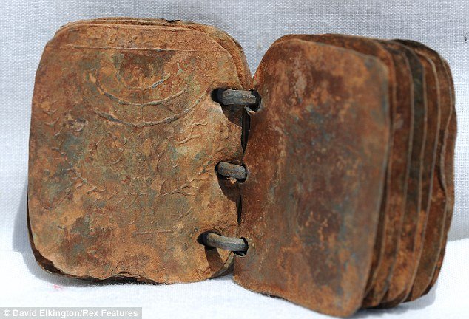
Keep in Mind
“…not fully whole nor pure, but nevertheless of great worth.”
Wherefore, thou seest that after the book hath gone forth through the hands of the great and abominable church, that there are many plain and precious things taken away from the book, which is the book of the Lamb of God.
1 Nephi 13:28
Before you read Numbers 31:
We believe the Bible to be the word of God as far as it is translated correctly…..
“Part of the calling of the patriarch/prophet was to make a record of his days. Thus, in relay form records from earlier patriarchs were handed down, and later prophets synthesized them, incorporated their own records, and passed them on again to yet future generations.” (6)
David Elkington/Rex
The true nature of God has unfortunately become clouded and confused throughout much of the world because of the creeds of men and misinterpretation of the biblical text. (7)
Numbers 31

Slide 6
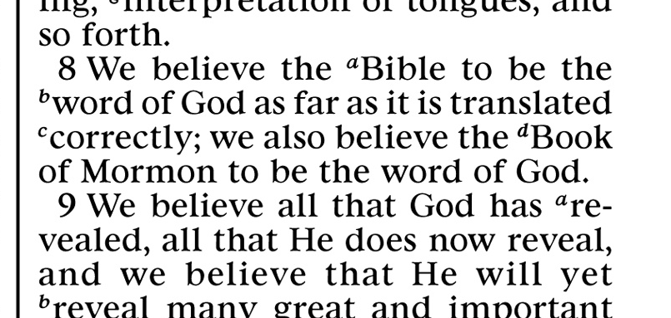
8th Article of Faith
“Our eighth article of faith recognizes this fact, and yet it affirms the record’s divine origin, and that it must be read with an ear tuned to the voice of the Spirit.
Although we look forward to the time when the records will be whole, that which we now have is reverenced and appreciated.”
Numbers 31
(6)

Slide 7
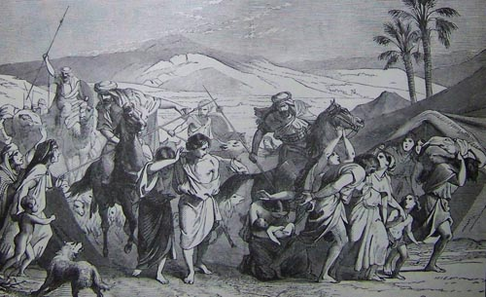
12,000 Soldiers
1,000 Soldiers of Each Tribe
The Moabites and Midianites led many Israelites to worship false gods and engage in sexual immorality. The Israelites who did these things were slain
And the children of Israel took all the women of Midian captives, and their little ones, and took the spoil of all their cattle, and all their flocks, and all their goods.
And they burnt all their cities wherein they dwelt, and all their goodly castles, with fire.
And they took all the spoil, and all the prey, both of men and of beasts.
They killed the 5 kings of Midian:
Evi
Rekem
Zur
Hus
Reba
Also Balaam
Numbers 31:1-12

Slide 8
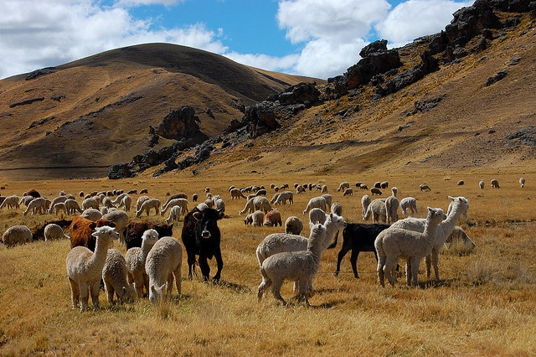
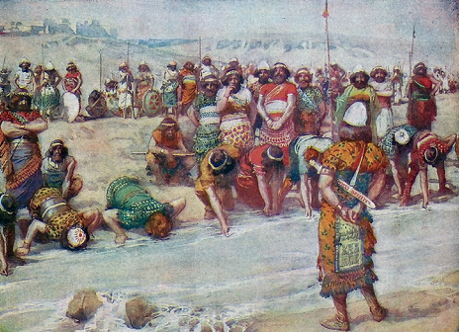
Spoils of War
Divided among Levites (for the offerings) and the soldiers—
Then half to Eleazar for a heave offering
The prisoners…were restricted to female children and young virgins who had not participated in the abominations of Baal.
675,000 Sheep
72,000 head of beef
61,000 donkey
32,000 prisoners
Moses and Eleazar the priest brought the officers’ offerings into the tabernacle as “a memorial for the children of Israel before the Lord
Numbers 31:26-47, 54

Slide 9

“To Make an Atonement for Our Souls”
Not one soldier died during this time
By making their offering, the officers were trying to reconcile the debt they felt they owed the Lord for sparing their lives.
Although no payment could adequately repay the Lord, their offering showed that they acknowledged and were grateful for His blessings of protection.
We can show our gratitude for the Lord’s blessings by making offerings to Him
What are some offerings or gifts we can give to the Lord to show our gratitude for His blessings in our lives?
When have you sought to show your gratitude to the Lord through your actions?
Numbers 31:50

Slide 10
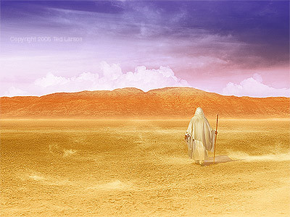
The Last Major Project for Moses
The end of the Midianite war marked the last major project required of the prophet Moses.
The Lord had said that when the affairs of this war were completed Moses could get ready to be “gathered to his people.:
With only a few days of life left to him, Moses still had number of monumental tasks to perform (5)

Slide 11

Receiving an Inheritance
The Tribes of Reuben and Gad desired to settle in the land east of Jordan…and not wait until the west of Jordon had been conquered.
They had acquired many cattle and found the land suitable for grazing.
East of Jordan
If the tribes of Reuben and Gad were given their inheritances at that time, they might not go to battle to help the rest of the tribes obtain their lands.
Moses worried that the rest of the tribes might be discouraged from entering the promised land if they had to battle for their inheritances with a smaller army.
Numbers 32:1-7

Slide 12
Responsibility
The Lord holds us responsible to help others receive His blessings
We will leave our flocks here, build a city with walls and leave our families behind but take our men who are of fighting age and help you win the land west of Jordan
Build you cities for your little ones, and folds for your sheep; and do that which hath proceeded out of your mouth.
Numbers 32:14-15

Slide 13



East of Jordan
Moses gave them the kingdom of Sihon, the
Amorites, and the kingdom of Og king of Bashan, the land, with the cities thereof in the coasts, even the cities of the country round about.
Dibon
Ataroth
Aroer
Atroth
Shophan
Jaazer
Jogbehah
Beth-nimrah
Beth-haran
Heshbon
Elealeh
Kirjathaim
Nebo
Baal-meon
Shibmah
*Baal name represented the idol worship-so they changed the names of the cities to their own names
Half of Tribe of Manasseh
Children of Machir, son of Manasseh took Gilead
Jair, son of Manasseh took small towns—Havoth-jair
Nobah, took Kenath and villages and called it Nobah
Numbers 32:33-42

Slide 14

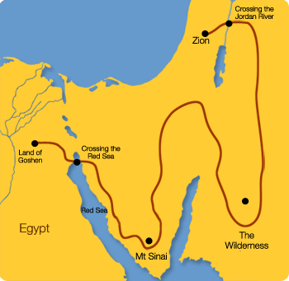

Moses’ Journey
Numbers 33:1-49
Map not accurate
1st month, 15th day
Departing from Egypt
the Passover--Egyptians bury firstborn
Succoth
Etham—edge of wilderness
Pi-hahiroth—midst of sea
Marah—wilderness of Etham
Elim—12 fountains and palm trees
Red Sea
Wilderness of Sin
Dophkah
Alush
Rephidim—wilderness of Sinai
Kibroth-hattaavah
Hazeroth
Rithmah
Rimmon-parez
Libnah
Rissah
Kehelathah
Mt. Shapher
Haradan
Makheloth
Tahath
Tarah
Mithcah
Hashmonah
Moseroth
Bene-jaakan
Hor-hagidgad
Jotbathah
Ebronah
Ezion-gaber
Kadesh-
wilderness of Zin
Mt Hor—Aaron dies at age 123
Zalmonah, Punon, Oboth, Ijeabarim—border of Moab Iim, Dibon-gad, Almon-diblathaim
Mt. of Abarim—before Nebo, Jordon on the plains of Moab

Slide 15
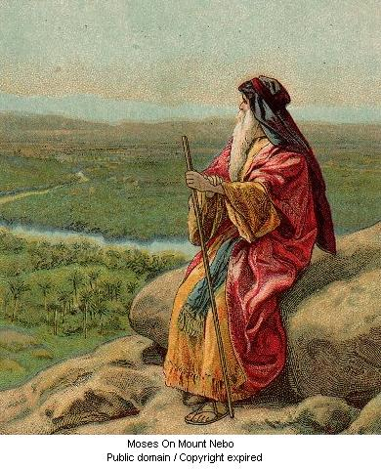
Drive Out Inhabitants of Canaan
And ye shall divide the land by lot for an inheritance among your families: and to the more ye shall give the more inheritance, and to the fewer ye shall give the less inheritance:
every man’s inheritance shall be in the place where his lot falleth; according to the tribes of your fathers ye shall inherit.
Numbers 33:54

Slide 16
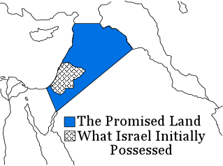
The Borders of Inheritance
And Moses commanded the children of Israel, saying, This is the land which ye shall inherit by lot, which the Lord commanded to give unto the nine tribes, and to the half tribe:
Numbers 34:13

Slide 17
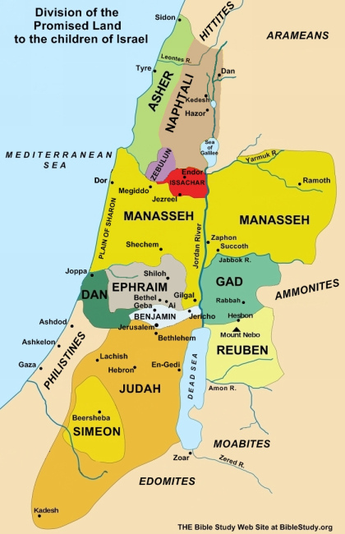
Levites Posses Own Cities
“Six of the forty-eight Levitical cities were appointed to be ‘cities of refuge,’ places where those who had taken human life could find protection until they had been tried and either convicted of murder or released.
These cities were to be located on both sides of the Jordan.
Note the distinction that Moses made between murdering and slaying a human being.
Differentiation was made among what is called today premeditated murder, murder of passion, manslaughter, and self-defense.” (8)
The Lord’s commandment would be that special cities be established throughout Canaan for the Levites.
This would allow the Levites to be among all the tribes and perform ordinances for them.
Numbers 35

Slide 18

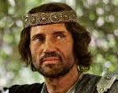
Potential Problems
Here Moses dealt with a practical problem that would face Israel when they began to conquer the land.
Once the tribal divisions were determined, individual families within each tribe were given a land inheritance.
If a portion of land was given to a single woman and she married into another tribe, which was probably quite common, then the woman’s land would become the joint property of her husband.
Thus, another tribe would get a portion of the land assigned by the Lord and Moses to the original tribe.
Moses and the elders foresaw the potential problems and ruled that land inheritances could not move from tribe to tribe. (4)
Numbers 36

Slide 19
Sources:
Jewish encyclopedia by Isidore Singer, M. Seligsohn
Wikipedia
Bible Dictionary
Old Testament Institute Manual
(Keil and Delitzsch, Commentary, 1:3:224).
5. W. Cleon Skousen The Third Thousand Years p. 440
6. Lenet H. Read How the Bible Came to Be: Part 1 and 2, The Word Is Preserved January 1982 Ensign and February 1982 Ensign
Presentation by ©http://fashionsbylynda.com/blog/
7. Todd B. Parker and Robert Norman Moses: Witness of Jesus Christ April 1998 Ensign
8. (Clarke, Bible Commentary, 1:730.)” (Old Testament Student Manual: Genesis–2 Samuel, 3rd ed. [Church Educational System manual, 2003], 211).

Slide 20
The Book of Numbers
Bible Dictionary
Chapters 1-12 | Chapters 13-20 | Chapter 21-36
Old Generation Organization and Preparation to leave Mt. Sinai | Transition to Kadesh-barnea—drawing back in unbelief—brings God’s discipline Wilderness | New Generation Move to Plains of Moab—east of Promised Land Reorganization of Israel Conquest of Land of Canaan Regulations (offerings and Vows) Conquest and Division of Israel
Numbers 30 | Numbers 31 | Numbers 32 | Numbers 33 | Numbers 34 | Numbers 35 | Numbers 36
Regulation of Vows | Conquest of Israel | Division of Land (East of Jordan) | Summary of Israel’s journeys And Division of Land (West of Jordan) | Boundaries of Canaan | Special Cities in Canaan | Special Problems of Inheritance in Canaan
Vows and oaths must be kept | 12,000 soldiers sent Victory over the Midianites Purification of Israel Distribution of Spoils | Reuben, Gad, and half the tribe of Manasseh receive inheritance | From Egypt to Sinai From Sinai to Kadesh Wanderings From Kadesh to Moab | South, West North East Officials for dividing Canaan | For the Levites For the Refuge Murderers are dealt with | Some daughters in Israel are directed to marry within their own tribe Inheritances are not to move from tribe to tribe

Slide 21
Midianites:
Their geographical situation is indicated as having been to the east of Palestine; Abraham sends the sons of his concubines, including Midian, eastward (Gen. 25: 6). But from the statement that Moses led the flocks of Jethro, the priest of Midian, to Mount Horeb (Ex. 3:1), it would appear that the Midianites dwelt in the Sinaitic Peninsula. Later, in the period of the Kings, Midian seems to have occupied a tract of land between Edom and Paran, on the way to Egypt (I Kings 11:18). Midian is likewise described as in the vicinity of Moab: the Midianites were beaten by the Edomite king Hadad "in the field of Moab" (Gen. 36:35), and in the account of Balaam it is said that the elders of both Moab and Midian called upon him to curse Israel (Num. 22:4, 7). Further evidences of the geographical position of the Midianites appear in a survey of their history.
In the time of Moses the Midianites are first mentioned as having had a priest by the name of Reuel or Jethro, who became afterward Moses' father-in-law. Toward the close of the forty years' wandering of the children of Israel in the wilderness, the Midianites were allied with the Moabites in the attempt to exterminate the Israelites. For this reason Moses was ordered by God to punish the Midianites. Moses, accordingly, despatched against them an army of 12,000 men, under Phinehas the priest; this force defeated the Midianites and slew all their males, including their five kings, Evi, Rekem, Zur, Hur, and Reba. It may be noted that these five princes of Midian are called by Joshua (xiii. 21) the vassals of Sihon, the king of the Amorites. It is possible that Sihon had previously conquered Midian and made it a dependency, and that after his death the Midianites recovered their independence. The Israelitish soldiers set on fire all the cities and fortresses of the Midianites, carried the women and children into captivity, and seized their cattle and goods. The Israelites were afterward ordered by Moses to slay every Midianite male child and every woman, sparing only the female children (Num. xxxi. 2-18). It appears from the same account that the Midianites were rich in cattle and gold. The narrative shows that each of the five Midianite tribes was governed by its ownking, but that all acted together against a common enemy; that while a part of each tribe dwelt in cities and fortresses in the vicinity of Moab, another part led a nomadic life, living in tents and apparently remote from the seat of the war. For, after the Midianites had been "exterminated" by the army of Phinehas, they reappear some hundreds of years later, in the time of Gideon.
Jewish Bible By: Isidore Singer, M. Seligsohn
http://www.jewishencyclopedia.com/articles/10804-midian-and-midianites
The War with Midianites:
The Israelites Soldiers were under orders from the Lord to cleanse the land of this society. Only female children and young virgins were spared because it was felt they could be integrated into the culture of Israel without corrupting it. The soldiers, however, violated this commandment and brought back large numbers of captives who should have been destroyed. Moses was under the revolting necessity of requiring them to fulfill their order before they could return to the camps of Israel.
“‘Cities of refuge among the Hebrews were necessary, because the old patriarchal law still remained in force, viz., that the nearest akin had a right to avenge the death of his relation by slaying the murderer; for the original law enacted that whosoever shed man’s blood, by man should his blood be shed, Genesis 9:6, and none was judged so proper to execute this law as the man who was nearest akin to the deceased.
As many rash executions of this law might take place, from the very nature of the thing, it was deemed necessary to qualify its claims, and prevent injustice; and the cities of refuge were judged proper for this purpose. Nor do we ever read that they were ever found inefficient, or that they were ever abused.’
(Clarke, Bible Commentary, 1:730.)” (Old Testament Student Manual: Genesis–2 Samuel, 3rd ed. [Church Educational System manual, 2003], 211).

Slide 22
Some excerpts from How the Bible Came to Be: Part 1 and 2 By Lenet H. Read January and February 1982 Ensign Articles
The Bible:
Precisely how and when did the “record of the Jews” begin? Most scholars say we don’t know, that the stories were passed down orally, that “other than oral” communication began with hieroglyphics and evolved into writing. They say that the records we have of the Creation and the first patriarch came from several unknown sources at much later dates and were somehow untidily interwoven into the Genesis account.
Among some of the most interesting manuscript finds of recent years are works bearing the names of ancient patriarchs. We must remember that these manuscripts are generally not the original writings, but they form a tradition that witnesses that original documents once existed.
These recent finds are of keen interest to Latter-day Saints because in spite of their corruptions they all contain a basic pattern which coincides with the experiences of the prophets whose records came into the hands of Joseph Smith. To summarize this pattern, each prophet separately testifies that he, deeply distressed by the sinfulness of his day, and desiring to serve God, was moved to seek the Lord earnestly.
Man’s scientific pursuit of knowledge of his origins surely will eventually lead him to some truths. But in the meantime, he is susceptible to many false conclusions…. Their discovery made it popular for a time to suggest that Israel had borrowed its “history” from myths of surrounding cultures.
With the fragments of truth which they borrowed or inherited, other ancient cultures built wild fantasies as they separated themselves further from the doctrines sustaining the stories. In the case of the Egyptians, their records became a grab bag full of unsorted and unclear beliefs and ideas. While their collection contained fragments of truth, those fragments were lost in a maze of confusion.
…if to Israel God did not always appear merciful, he at least operated with reasoned justice, and there was always the promise of God’s prophesied redemption.
Thus while neighboring cultures had bits and pieces of truth, their records and therefore their understanding were corrupted.
Much of Israel’s story revolves around the people’s failure to remember their beginnings and the message of the Law and to adhere to its recorded covenants—even though the Law had been written and placed in the most sacred of all places, the ark of the covenant.
Ezra’s reading is believed to have been the first time interpreters were needed to turn the writings into the spoken language of the people: the book was written in Hebrew, but after the captivity the people spoke Aramaic…Evidently Ezra’s work was to begin to gather some of the records of his people. It was an extremely important and demanding task to collect, sort, rewrite, and finally compile many records into one.
New scribes were carefully instructed about the sacredness of their task: “My son, be careful in thy work, for it is heavenly work, lest thou err in omitting or in adding one jot [the smallest letter in the Hebrew alphabet] and so cause the destruction of the whole world.” (See Geddes MacGregor, The Bible in the Making,Philadelphia: J. B. Lippincott Co., 1959, p. 48.)

Slide 23
Some excerpts from How the Bible Came to Be: Part 1 and 2 By Lenet H. Read January and February 1982 Ensign Articles
Translations of the Bible:
Aramaic is generally thought to have been the general tongue of the Hebrews after their Babylonian captivity. Since it was also the language used in trade and diplomatic relations over a wide area, it became entrenched as the everyday speech of the inhabitants of Judah. Therefore, from the fourth century B.C., the Hebrew scriptures were an enigma for most Jews unless translated for them. Yet at that point, according to Jewish tradition, written translations were forbidden, as if the language and the concepts were inseparable. Oral translations were permitted, but only by official synagogue translators. Even then, the translation had to be done verse by verse in the Torah and at least after every third verse in the “Prophets.”
The oral translations, or Targums, were more than just translations. They were interpretation and explanation, sometimes even extending into sermons. The religious leaders found these methods actually useful in overcoming what they felt were easily misunderstood passages. An example used by one scholar of explanatory translation is that given for Exodus 24:10 [Ex. 24:10] which states, “And they saw the God of Israel.” In Aramaic it would be translated and interpreted, “And they saw the glory of the God of Israel.”
Eventually, written Targums were also allowed, but the translations had to be written between the lines of the Hebrew on the scrolls. Translation into Aramaic became quite extensive: remnants of Targums of almost all the books of the Old Testament have been discovered.
Most Jews living in lands other than Judah became Greek-speaking.
And so around 250 B.C. a translation was made of the Hebrew scriptures into Greek
The basic scripture of the earliest Christians was the Septuagint, the Hebrew record translated into Greek.
“Letter of Aristeas.” According to this story, King Ptolemy of Egypt heard of the excellent Jewish records and desired a copy in Greek for his growing library. To obtain them, he sent a group, including Aristeas, to the high priest in Jerusalem, loaded with presents. The Jews agreed to his offer and sent scholars back to Egypt to carry out the translative work. According to the legend, each of these seventy-two elders worked upon the translations separately, but when they compared the results of their progress, their renderings were identical. The work was accomplished within a period of seventy-two days. Because of these elements of seventy—seventy-two elders and seventy-two days—the work came to be known as the Septuagint, Latin for seventy. (See Josiah H. Penniman, A Book about the English Bible (Philadelphia: University of Pennsylvania Press, 1931), pp. 10–11; also Frederick C. Grant, Translating the Bible (Greenwich, Conn.: The Seabury Press, 1961), pp. 20–22.)
Just as there emerged vast differences in the way Jew and Christian interpreted the ancient writings, so there were some differences in the actual manuscripts they used. There are differences in the wording found in Greek and Hebrew scrolls. The Septuagint’s “a virgin shall conceive” was “a young woman” in the later Masoretic version. Exactly how and at what point such differences emerged is uncertain. See MacIntosh, p. 148.
In addition, early Christian Apostles made reference to teachings found in writings attributed to Moses and Enoch but which are not found in scriptures possessed by traditional Judaism. Various manuscripts discovered in modern times claim that after his resurrection Christ himself gave his Apostles certain ancient writings the Jews didn’t possess. See Hugh Nibley, “A Strange Thing in the Land: The Return of the Book of Enoch.” Ensign, July 1976, p. 65.

Slide 24
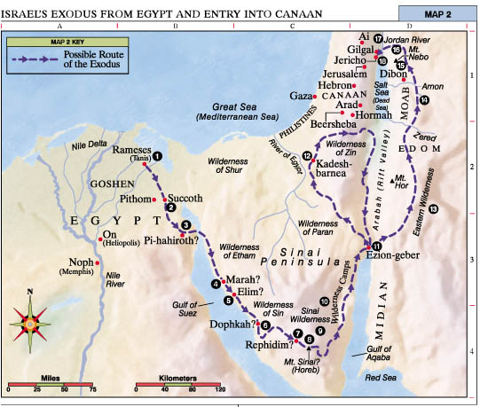
1. Rameses Israel was thrust out of Egypt (Ex. 12; Num. 33:5).
2. Succoth After the Hebrews left this first campsite, the Lord attended them in a cloud by day and in a pillar of fire by night (Ex. 13:20-22).
3. Pi-hahiroth Israel passed through the Red Sea (Ex. 14; Num. 33:8).
4. Marah The Lord healed the waters of Marah (Ex. 15:23-26).
5. Elim Israel camped by 12 springs (Ex. 15:27).
6. Wilderness of Sin The Lord sent manna and quail to feed Israel (Ex. 16).
7. Rephidim Israel fought with Amalek (Ex. 17:8-16).
8. Mount Sinai (Mount Horeb or Jebel Musa) The Lord revealed the Ten Commandments (Ex. 19-20).
9. Sinai Wilderness Israel constructed the tabernacle (Ex. 25-30).
10. Wilderness Camps Seventy elders were called to help Moses govern the people (Num. 11:16-17).
11. Ezion-geber Israel passed through the lands of Esau and Ammon in peace (Deut. 2).
12. Kadesh-barnea Moses sent spies into the promised land; Israel rebelled and failed to enter the land; Kadesh served as the main camp of Israel for many years (Num. 13:1-3, 17-33; 14; 32:8; Deut. 2:14).
13. Eastern Wilderness Israel avoided conflict with Edom and Moab (Num. 20:14-21; 22-24).
14. Arnon River Israel destroyed the Canaanites who fought against them (Deut. 2:24-37).
15. Mount Nebo Moses viewed the promised land (Deut. 34:1-4). Moses delivered his last three sermons (Deut. 1-32).
16. Plains of Moab The Lord told Israel to divide the land and dispossess the inhabitants (Num. 33:50-56).
17. Jordan River Israel crossed the Jordan River on dry ground. Near Gilgal, stones from the bottom of the Jordan River were placed as a monument of Jordan’s waters being divided (Josh. 3-5).
18. Jericho The children of Israel possessed and destroyed the city (Josh. 6).
Bible Maps lds.org

