Slide 1


Crossing the Jordan River
Joshua 2-5
Every place that the sole of your foot shall tread upon, that have I given unto you...
Joshua 1:2
Presentation by ©http://fashionsbylynda.com/blog/

Slide 2
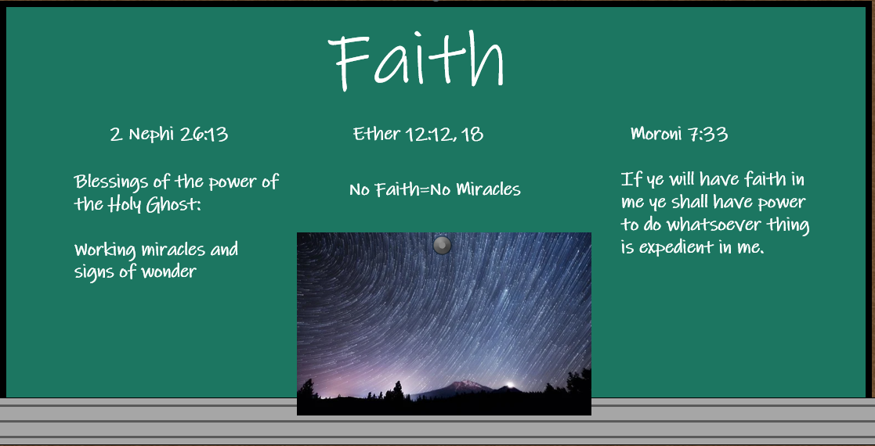

Slide 3

Elements of Faith
Now faith is the substance of things hoped for, the evidence of things not seen. Hebrews 11:1
…faith is not to have a perfect knowledge of things; therefore if ye have faith ye hope for things which are not seen, which are true. Alma 32:21
…the principle of action in all intelligent beings. Lectures on Faith-Joseph Smith Jr.
These teachings highlight three basic elements of faith: (1) faith as the assurance of things hoped for that are true, (2) faith as the evidence of things not seen, and (3) faith as the principle of action in all intelligent beings.
I describe these three components of faith in the Savior as simultaneously facing the future, looking to the past, and initiating action in the present. (13)

Slide 4
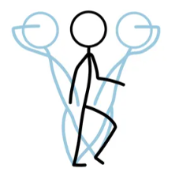
Exercising Faith in the Past, Present, and Future
Act in the Present
Look to the past
Act in the Present
Evidence of things not see
Remembering what God has done
Assurance of things hopes for
Hoping in God’s promises
What has God done in the past that can help you have faith in Him?
How can having hope in God’s promised blessings help you exercise faith in Him?
We exercise faith in Jesus Christ as we face the future, look to the past, and act in the present.

Slide 5


Jericho
Joshua sent two spies across the Jordan River to the city of Jericho.
Jericho was the first city on the west side of the Jordan River that the Israelites were commanded to conquer.
Entering the promised land required them to exercise faith in Jesus Christ.
Joshua 2:1-8

Slide 6
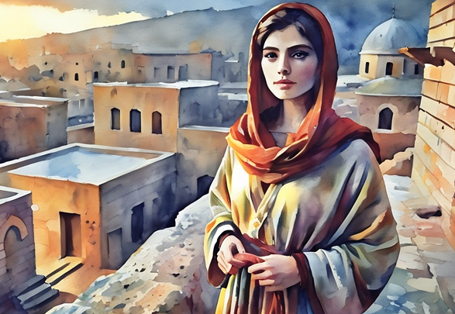
Story of Rahab
The two spies entered into city and made contact with an innkeeper named Rahab
They made their lodgings there.
The spies were followed by a man, and he sent word to the King of Jericho who quickly sent messengers to the inn.
She hid them on the roof of the inn under drying flax.
She told the messengers of the king that the Hebrews were making their way back to the river.
Rahab and her family were saved from death by Joshua and given “certain lands immediately and had her in great esteem ever afterwards.” (6)
Joshua 2:1-8

Slide 7
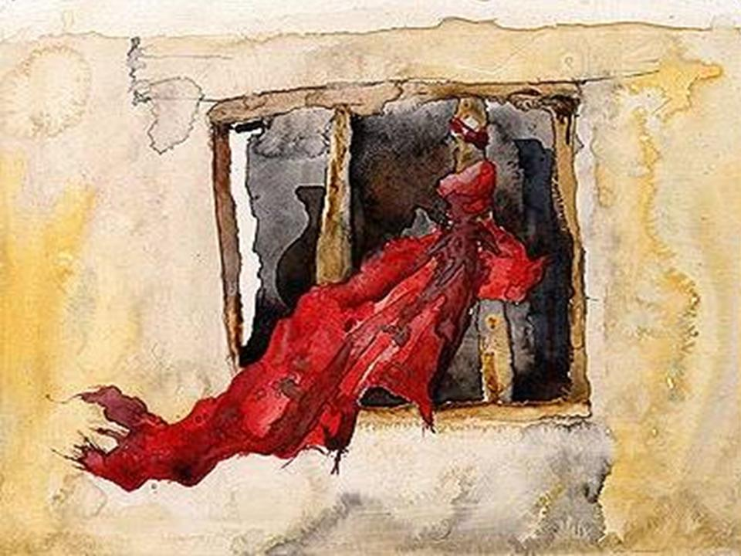
Our Live For Yours
As Rahab offered to shelter the spies and aid them in their escape, she told them she knew of their journeys and their promised to inherit the land of Canaan.
She let down a scarlet rope so the spies could escape
and she received from them the promise that when they returned to her country, along with Joshua and his army, that she and her family would be spared alive.
She awaited her own deliverance. That red token at the window was likewise a signal to the outside world that Rahab believed in the ultimate triumph of Jehovah.
Rahab demonstrated faith in Jesus Christ
Joshua 2:9-14

Slide 8
Jesus—Lineage
Abraham
Isaac
Jacob
Likewise also was not Rahab the harlot justified by works, when she had received the messengers, and had sent them out another way?
James 2:25
See * Rahab in notes
Judas
Zara
Phares
Esrom
Aram
Aminadab
Naasson
And Salmon begat Booz of Rachab; and Booz begat Obed of Ruth; and Obed begat Jesse;
Matthew 1:5
Salmon
Rachab
Booz
Obed
Ruth
Jesse
King David
Matthew 1:1-16

Slide 9
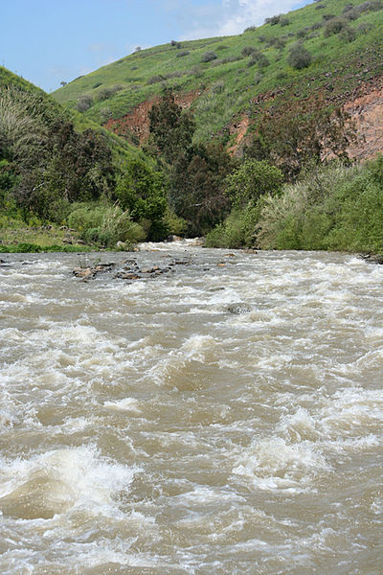
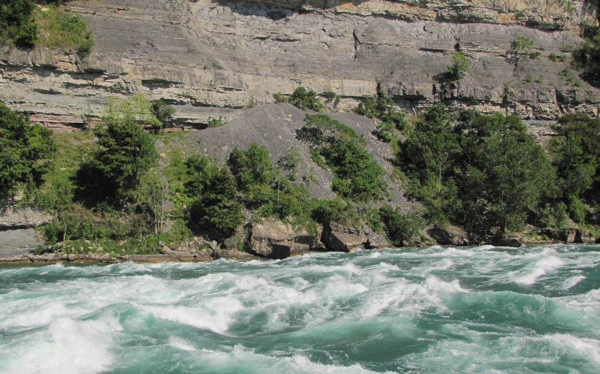
The Current is Strong
Joshua moved the camp by the Jordon River
“Now while Joshua, the commander, was in fear about their passing over Jordan, for the river ran with a strong current…God promised so to dispose of the river, that they might pass over it…” (1)
Jordon River in the Spring
Joshua 3:1

Slide 10
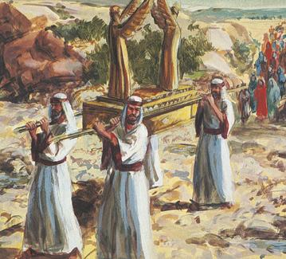
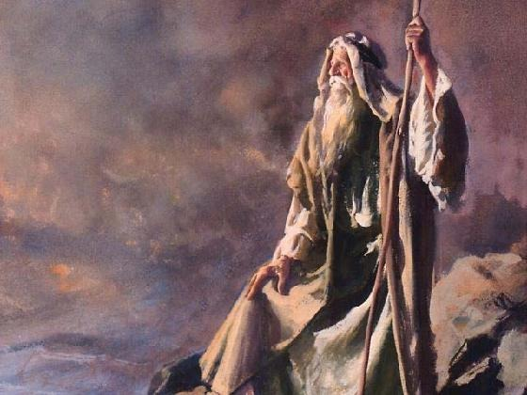
Required Distance
The ark of the covenant represented the presence of the Lord.
On one occasion, when Moses spoke with the Lord on Mount Sinai, the people were to watch from a distance but were not to approach the mountain
(Ex. 19:10-13).
The required distance from the mount suggested they were not holy enough to endure the presence of Jehovah. The distance between the ark and the children in this instance represents the same thing—the children of Israel were to follow the Lord but they were not yet sanctified enough to enter his presence. None of them, save the high priest only, could enter into that part of the tabernacle of Moses which represented the Celestial Kingdom and the presence of God. (2)
Joshua 3:3-4

Slide 11
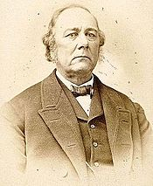
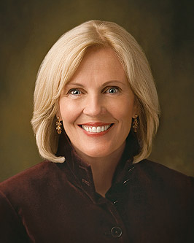
Sanctify Yourselves
Prepare yourselves spiritually
“… in every dispensation those who have been willing to receive the everlasting Gospel have been required to sanctify themselves by living according to its precepts.”
(3)
“This was Joshua’s call for a return to virtue, and it is the same call to us today. We simply cannot do the work we have been reserved and prepared to do unless we can access the strength and confidence that comes by living a virtuous life.” (4)
Joshua 3:5

Slide 12
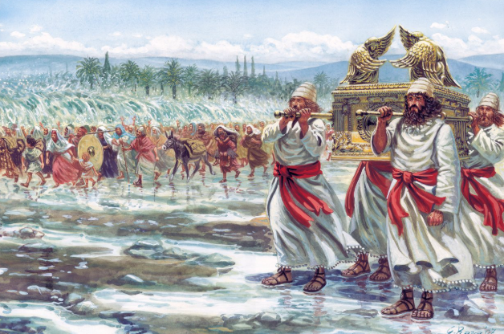
Ark of the Covenant
A sacred container built by the ancient Israelites to hold the stone tablets of the Ten Commandments, a bowl of manna, and Aaron's rod.
The ark was commissioned by God after the exodus from Egypt and held the stone tablets containing the Ten Commandments. It served as a visible reminder of God's covenant with His people.
Joshua 3:6

Slide 13
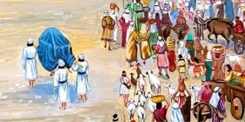
Stand Upon a Heap
The water would stop flowing downstream
The command to cross Jordan was given when all was in readiness. The priests carrying the ark went first, as planned. As their feet entered the river the waters were shut off from above—not just at the site of the crossing but from above—and they stood as in a heap. (6)
The elements find control through faith. The wind, the clouds, the heavens obey the voice of faith. . . . (7)
About 40,000 soldiers crossed and women and children (Josh. 4:13)
Joshua 3:8-17

Slide 14
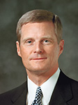
“Recall how the Israelites came to the river Jordan and were promised the waters would part, and they would be able to cross over on dry ground.
Interestingly, the waters did not part as the children of Israel stood on the banks of the river waiting for something to happen; rather, the soles of their feet were wet before the water parted.
The faith of the Israelites was manifested in the fact that they walked into the water before it parted. They walked into the river Jordan with a future-facing assurance of things hoped for” (9)
Moving forward in faith invites God to perform miracles on our behalf

Slide 15
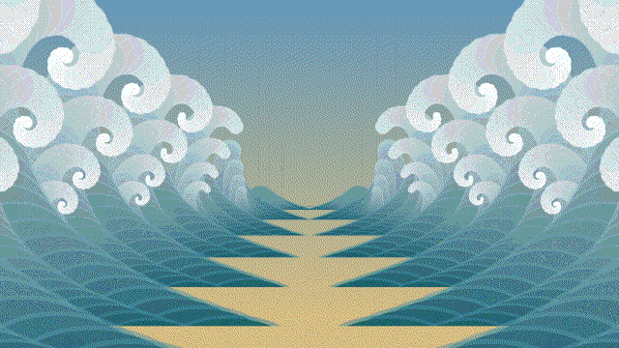
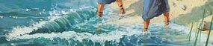
Getting Our Feet Wet
We sometimes must do the hard things we have been asked to do before we will be blessed.
Joshua and his priests, in a little-read replication of the parting and crossing of the Red Sea, crossed the flooded Jordan River in another miracle.
But the miracle did not begin for ancient Israel until after Joshua and his priests got the soles of their feet wet. (5)
Although we may not have flooded rivers to cross in our lives, we will have obstacles and challenges that we may not know how to overcome.
Joshua 3:15-17

Slide 16
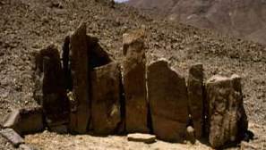
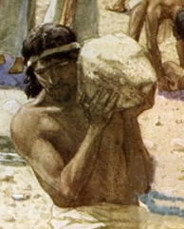
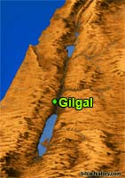
A Memorial of God’s Power
Biblical peoples were very fond of symbolic acts to commemorate great events. In order to memorialize God’s blessing in parting the waters of the Jordan River, Joshua commanded that twelve stones be taken from the riverbed and placed where all the people could see them:
“These stones shall be for a memorial unto the children of Israel for ever” (v. 7).
In later years, when their children would ask the meaning of the stones, Israel could rehearse the story of God’s miracle; thus, the stones would serve as a visible reminder of God’s power.
Joshua 4
(8)

Slide 17
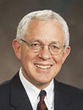
As we remember what the Lord has done for us, our reverence for Him increases and our testimonies are strengthened
“Remembering enables us to see God’s hand in our past, just as prophecy and faith assure us of God’s hand in our future.”
Joshua 4
(10)

Slide 18
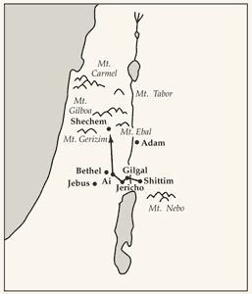
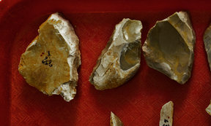
Circumcised
Israelites were in the promised land, the Lord instructed Joshua to have all the men circumcised.
Circumcision was a token of the covenant that the Lord had made with Abraham and his seed.
For some reason this practice had ceased during their 40 years in the wilderness, and the Lord wanted it reinstituted
Flint knives from ancient Israel
Joshua 5:1-9

Slide 19
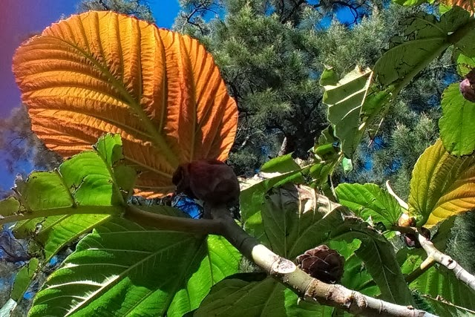
Manna Ceased
The Passover on the fourteenth day of the month at twilight on the plains of Jericho.
But they ate of the fruit of Canaan
Once the Israelites were in the promised land—a fertile land where they could grow and raise their own food—the Lord expected them to provide for themselves.
Joshua 5:12

Slide 20
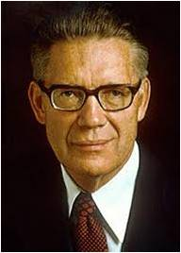
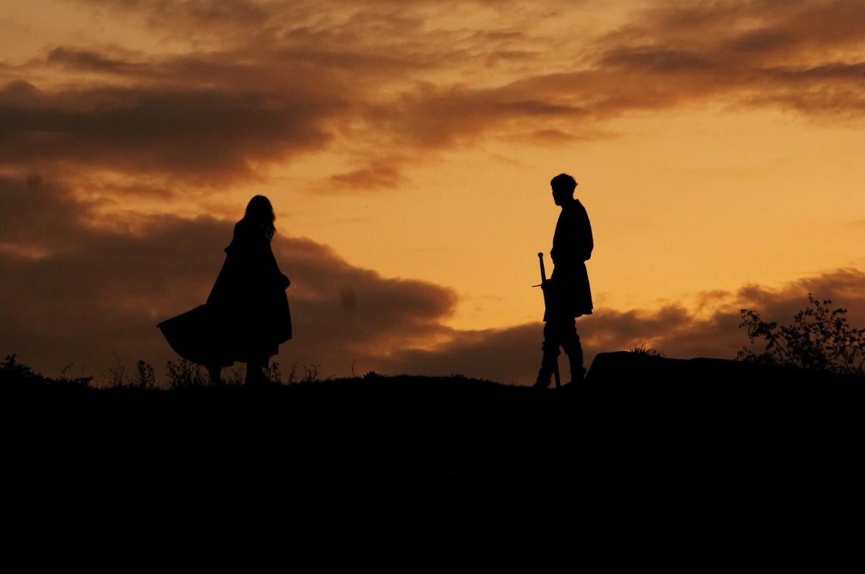
Captain of the Lord
“Christ himself is the chief soldier in his own army; as Commander, he carries the title Captain of the Lord’s Host.
By this name he appeared to Joshua, who seeing ‘him with his sword drawn in his hand,’ and hearing him say, ‘As captain of the host of the Lord am I now come, …
Joshua fell on his face to the earth, and did worship, and said unto him, What saith my lord unto his servant? And the captain of the Lord’s host said unto Joshua, Loose thy shoe from off thy foot; for the place whereon thou standest is holy.’
What further direction was then given has not been preserved for us.”
Joshua 5:13-15
(11)

Slide 21
Sources:
Flavius Josephus translated by William Whiston A.M.
Edward J. Brandt, “Q&A: Questions and Answers,” New Era, May 1973, 50)
Elder Charles C. Rich (remarks by) The Gathering—Knowledge of Salvation Enjoyed By the Latter-Day Saints—Build Up the Kingdom of God. April 6, 1875 Gen. Conf. (found in LDS Scripture Citation Index)
Elaine S. Dalton Remember Who You Are! August 2010 Ensign
Elder Neal A. Maxwell (All These Things Shall Give Thee Experience, pp. 44-45)
Mark E. Peterson (Joshua: Man of Faith [Salt Lake City: Deseret Book Co., 1978], 41)
7. President Spencer W. Kimball (LDS Church News, 1994, 03/26/94)
8. Old Testament Institute Manual
Presentation by ©http://fashionsbylynda.com/blog/
9. Elder David A. Bednar (“Seek Learning by Faith,” Ensign, Sept. 2007, 63).
10. Elder Marlin K. Jensen (“Remember and Perish Not,” Ensign or Liahona, May 2007, 38).
11. Elder Bruce R. McConkie (Mormon Doctrine, 2nd ed. [1966], 111–12).
12. Josephus “The Antiquities of the Jews” page 152 (5.1.7)
13. Elder David A. Bednar (“Seek Learning by Faith,” Ensign, Sept. 2007, 61–62)

Slide 22
Rahab:
While Rahab’s parents, brothers and sisters were alive at the time of her association with the spies Joshua sent out, we are not given any of their names (Joshua 2:13). Some of the ancient Jewish fathers who held her in high reputation reckoned that she was the wife of Joshua himself, but in the royal genealogy of Jesus, Rahab is referred to as being the wife of Salmon, one of the two spies she sheltered. In turn, she became the mother of Boaz, who married Ruth from whose son, Obed, Jesse the father of David came, through whose line Jesus was born (Matthew 1:5, where the asv reads, “Salmon begat Boaz of Rahab”—not Rachab).
Salmon was a prince of the house of Judah, and thus, Rahab, the one-time heathen harlot, married into one of the leading families of Israel and became an ancestress of our Lord, the other foreign ancestresses being Tamar, Ruth and Bathsheba. The gratitude Salmon felt for Rahab ripened into love, and when grace erased her former life of shame, he made her his wife. Jerome’s comment of the inclusion of the four foreign women in Matthew’s genealogy is suggestive—
It has been suggested that the word “harlot” can be translated “innkeeper,” thus making Rahab the landlady of a wayside tavern. Guesses have been made that she had been a concubine, such as Hagar and Zilpah had been, but that in Jericho she was a reputable woman identified with a respectable business. The Bible, however, makes no attempt to smooth over the unpleasant fact that Rahab had been a harlot. Endeavoring to understand her character, we have—
Rahab became an ancestress in the royal line from which Jesus came as the Saviour of lost souls.
Paul highly commends Rahab for her energetic faith and gives her a place on the illustrious roll of the Old Testament of those who triumphed by faith. “By faith the harlot Rahab perished not with them that believed not, when she received the spies with peace” (Hebrews 11:31)
The Apostle James adds to Paul’s record about Rahab being justified by faith by saying that she was likewise justified by works (James 2:25)
Excerpt from Biblegateway
*Dr. Adam Clarke counts the modern Bible translator’s error, “I am fully satisfied that the term zonah in the test, which we translate harlot, should be rendered tavern or inn-keeper or hostess” Dr. Clarke feels there was no excuse for the translators to presume as much just simply because she kept a public house of lodging. Clake’s Bible Commentary Vol. 2 p. 11
Ark of the Covenant Joshua 3:6;
Also known as the Ark of Jehovah and the Ark of the Testimony; an oblong chest of acacia or shittim wood overlaid with gold, 2½ cubits long, 1½ broad and high, made by Moses at God’s command (Ex. 25). It was the oldest and most sacred of the religious symbols of the Israelites, and the Mercy Seat which formed its covering was regarded as the earthly dwelling place of Jehovah (Ex. 25:22). (See Mercy Seat.)
The Ark was fitted with rings and staves, by which it was carried. Prayers were recited before it moved or rested (Num. 10:35–36), and during its progress it was treated with the greatest reverence. According to 1 Kgs. 8:9 it contained only the Tables of the Law, but in Heb. 9:4 it is said to have contained the “pot of manna” and “Aaron’s rod that budded,” which had been ordered to be kept “before the Testimony” (Ex. 16:32–34; 25:16; 40:20; Num. 17:10). The usual resting place of the Ark was in the Holy of Holies (see Tabernacle).
It led the way at the passage of the Jordan (Josh. 3:3–13); it was present at the capture of Jericho (Josh. 6); and during the conquest of Canaan it seems to have been kept at Gilgal (9:6; 10:43). It was present at the solemn service held at Ebal (8:30–33). Later on it was removed to Shiloh (18:1; 1 Sam. 3:3).
In the days of Eli it was captured by the Philistines (1 Sam. 4–7), who sent it back to Beth-shemesh (6:11–20), whence it was taken to Kirjath-jearim or Baale of Judah (6:21–7:2). Thence it was brought by David to Jerusalem, the journey being interrupted at Perezuzzah (2 Sam. 6; 1 Chr. 13:11). In Jerusalem it was placed in a separate tent, which David pitched for it (2 Sam. 7:2; 1 Chr. 16:1). It accompanied the army in the war against Ammon (2 Sam. 11:11), but David refused to take it with him in his campaign against Absalom (2 Sam. 15:24–25).
On the completion of Solomon’s temple it was placed in the Holy of Holies (1 Kgs. 8:1–8). Apparently it was removed by Manasseh and reinstated by Josiah (2 Chr. 33; 35:3). In 2 Maccabees 2:4 there is an untrustworthy tradition of its preservation by Jeremiah at the destruction of the temple. It had certainly disappeared before the building of the second temple. It was seen by John in his vision of heaven (Rev. 11:19). Bible Dictionary

Slide 23
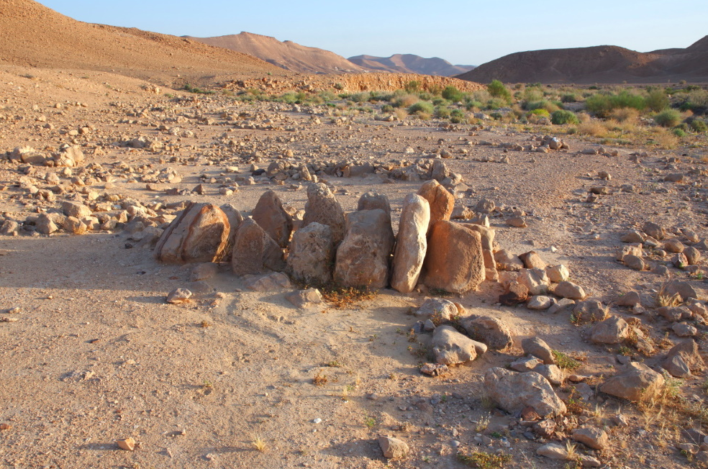
The Ark of the Covenant
“The ark was transported from Sinai to the land of promise. The miraculous crossing of the Jordan River (Josh. 3:3–17) and the fall of the city of Jericho (Josh. 6:1–21) evidence the importance of the ark of the Lord to the Israelites.
Once in the land of promise the ark was cared for in various places until its place of permanent rest, the temple, was constructed. During the reign of the Judges, the ark was found at the town of Bethel. (Judg. 20:27.)
While Samuel was the prophet and until the war with the Philistines, the ark was located at Shiloh (1 Sam. 1:9, 3:3); during the war it was taken to the battlefield called Ebenezer, where it was captured.
For seven months the Philistines were plagued and severely smitten because of their unauthorized possession of the ark. This caused them to return the ark to the Israelites, which they did at the village of Kirjath-jearim. (1 Sam. 4–6.)
Here it remained some twenty years, ignored by King Saul except for one battle when its presence had been requested.
Finally King David brought the ark to Jerusalem, and after some years his son Solomon constructed the long-awaited temple.” (Edward J. Brandt, “Q&A: Questions and Answers,” New Era, May 1973, 50)
Removing shoes:
Although there is a noticeable lack of detail in this account, what is recorded suggests a miraculous vision shown to Joshua. Most commentators assume either a mortal servant of God or an angel came to strengthen Joshua and Israel as they prepared for their first battle.
Two things, however, suggest that Joshua may actually have seen Jehovah, the premortal Jesus Christ. First, when Joshua fell down to worship him, no attempt was made to stop him. Yet the mortal servants of God are quick to prevent others from worshiping them, even when they have demonstrated great power (see Acts 10:25–26; 14:8–18; Alma 18:15–17). The same thing is true of angels, for twice, when he was awed at the presence of angels and fell at their feet to worship them, John the Revelator was told the same thing, “See thou do it not: for I am thy fellow servant, and of thy brethren the prophets” (Revelation 22:9; see also 19:10). The angel who appeared to Samson’s parents clearly taught them that any offerings were to be to the Lord (see Judges 13:16). But no attempt was made to prevent Joshua from falling down to worship this being.
Second, the personage commanded Joshua to remove his shoes because he was standing on holy ground—the same instructions Jehovah gave to Moses on Mount Sinai (see Exodus 3:5). But, since this account in Deuteronomy is very scant on details, it can only be surmised that the being may have been the Lord. Old Testament Institute Manual
President Henry B. Eyring O Remember, Remember
2007 November Ensign https://www.lds.org/ensign/2007/11/o-remember-remember.p1?lang=eng
Double row of 12 standing stones at Har Karkom, in southern Israel. Photo by A.D. Riddle

Slide 24
Joshua 1-6 | Joshua 7-12 | Joshua 13-21 | Joshua 22-24
The children of Israel miraculously cross the Jordan River and enter the promised land. They begin their conquest of the land by destroying the city of Jericho. | Israel loses a battle against the people of Ai because of disobedience. After repenting of their disobedience, the Israelites prosper in battle as the Lord fights for them. They gain control of the promised land. | The promised land is divided among the tribes of Israel. However, not all of the wicked inhabitants are driven out of the land. The Israelites set up the tabernacle in a place called Shiloh. Certain cities are designated as cities of refuge. | Prior to his death, Joshua exhorts the people to have courage, keep the Lord’s commandments, and love the Lord. He and the people covenant to choose the Lord and serve only Him. Joshua and Eleazar, the third son of Aaron, die.
One Month (March-April) 1405 B.C. | 7 years (April) 1405-1398 B.C. | 8 years 1398/7-1390 B.C. | Joshua dies at 110 1390 B.C.
Approximate Dates taken from Talk thru the Bible by Bruce Wilkinson and Kenneth Boa

