Slide 1

The Walls of Jericho
Joshua 6-10
“Now while the Israelites did this, and the Canaanites did not attack them, but kept themselves quiet within their own walls, Joshua resolved to besiege them…” Josephus

Slide 2


Standards That Might Be Hard to Keep
“You should not date until you are at least 16 years old. … Avoid going on frequent dates with the same person.”
“Do not disfigure yourself with tattoos or body piercings. Young women, if you desire to have your ears pierced, wear only one pair of earrings.”
What other commandments or standards has the Lord given that some may question the importance of?
“Honoring the Sabbath day includes attending all your Church meetings. … Sunday is not a day for shopping, recreation, or athletic events.”
(1)

Slide 3
Unusual Tactics For Battle
As the Israelites entered the land of Canaan, the Lord gave them unusual commandments or instructions for how they were to attack the well-fortified city of Jericho.
To some of the Israelites, these commandments may have seemed strange or unreasonable.
Joshua 6:1-5

Slide 4


Compass the City
First came the army of Israel.
Then 7 priests blowing trumpets.
Then the Ark of the Covenant.
Last a special guard bring up the rear
Jericho
They marched everyday, once around the wall for 6 days
Only the sound of the trumpets could be heard
Joshua 6:3-14

Slide 5
The 7th Day
They marched around 7 times
…only Rahab the harlot shall live, she and all that are with her in the house, because she hid the messengers that we sent.
The people shouted and the wall “fell flat”
Joshua 6:15-17

Slide 6
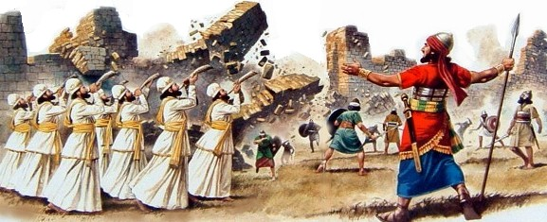
Utterly Destroy
The Lord had previously commanded Israel to “utterly destroy” the inhabitants of the promised land to prevent their sins from spreading to the children of Israel
But thou shalt utterly destroy them; namely, the Hittites, and the Amorites, the Canaanites, and the Perizzites, the Hivites, and the Jebusites; as the Lord thy God hath commanded thee: Deut: 20:17
We
can
show
faith in
the Lord
by
choosing
to obey
His
commandments
even
when
we do
not
understand
the
purpose
for
them
and as
we act
in faith
to obey
the Lord
with
exactness,
He
will
be with
us and
help us
do things
we
could not
do
by
ourselves

Slide 7

What are some examples of how people might only partially obey the standards and commandments?
How have you felt blessed as you have sought to obey the Lord with exactness?
When have you shown faith in the Lord by choosing to obey His commandments even when you did not understand the purposes for them?

Slide 8
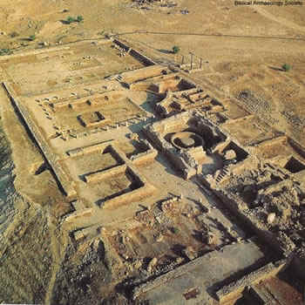
Everything Was Accursed
All things associated with wickedness and disobedience
Except for Rahab and her kindred
All the objects in Jericho were considered accursed.
The Israelites were not to keep anything in the city for themselves but were to turn the wealth of the city over to Joshua to be consecrated to the Lord.
And ye, in any wise keep yourselves from the accursed thing, lest ye make yourselves accursed, when ye take of the accursed thing, and make the camp of Israel a curse, and trouble it.
Joshua 6:17-19

Slide 9
Trespass Against
If you had been in the position of an Israelite soldier, what might you have wanted to do if you saw some valuable items in Jericho?
Achan, the son of Carmi, the son of Zabdi, the son of Zerah, of the tribe of Judah, took of the accursed thing: and the anger of the Lord was kindled against the children of Israel.
What was the effect of Achan’s choice?
Joshua 7:1-5

Slide 10
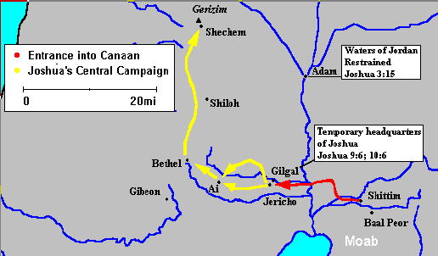
Israel Loses Battle at Ai
“Consider the defeat of Israel by the men of Ai; a law of righteousness had been violated, and things that were accursed had been introduced into the camp of the covenant people; this transgression interposed resistance to the current of divine help, and until the people had sanctified themselves the power was not renewed unto them” (2)
Joshua 7:1-5

Slide 11
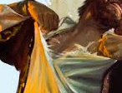
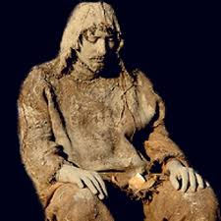
Joshua’s Grief
And Joshua rent his clothes, and fell to the earth upon his face before the ark of the Lord until the eventide, he and the elders of Israel, and put dust upon their heads.
Rent his clothes: The tearing of one’s clothes is an ancient tradition among the Jews, and it is associated with mourning, grief, and loss.
The act of placing dust upon one’s head had the same symbolic meaning as dressing in sackcloth and sitting in ashes. It was a token of great remorse, true humility, and deep repentance.
And they had viewed themselves in their own carnal state, even less than the dust of the earth. Mosiah 4:2
This sense of unworthiness seems to be the meaning of King Benjamin’s comment that the people considered themselves as less than the dust of the earth
Joshua 7:6-9
(3)

Slide 12
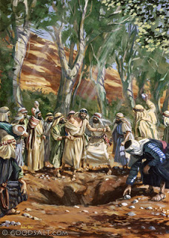
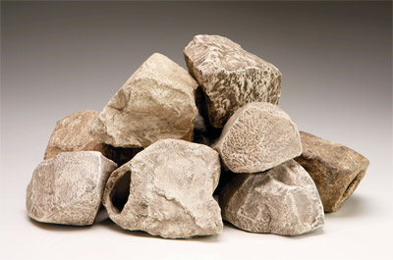
Valley of Achor
Sanctify Yourselves: “there is an accursed thing in the midst of thee, O Israel.”
And on the morrow the sanctified themselves by stoning to death Achan, the son of Carmi, who stole the wedge of gold and the Babylonish (fine linen) garment.
The deaths of Achan’s children suggest that they were guilty of the same sin as their father; otherwise, they would have been spared.
Achan was held accountable for his sins. He and his children were put to death by stoning, also his livestock, and burnt them with fire, together with his tent, the silver, the gold, and the garment, in the valley of Achor.
Thus, all Israel put to death the transgressor and sanctified themselves before the Lord.
Behold the Lord slayeth the wicked to bring forth his righteous purposes. It is better that one man should perish than that a nation should dwindle and perish in unbelief.
1 Nephi 4:13
Joshua 7:16-26

Slide 13
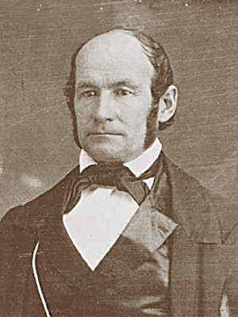
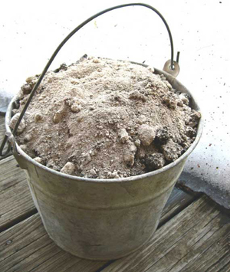
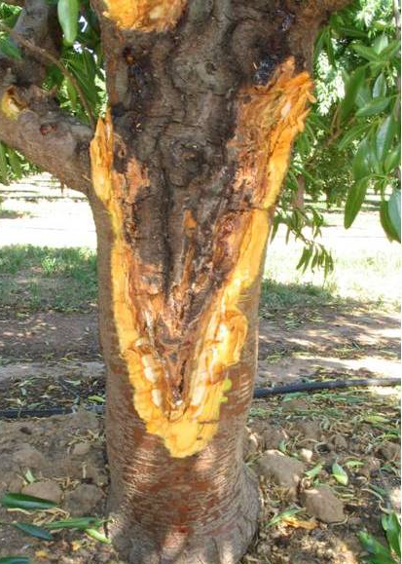
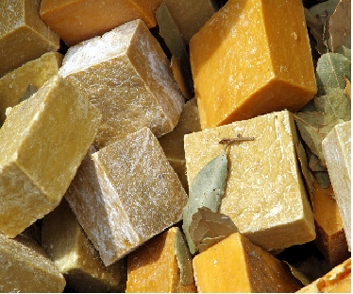
Sanctification
When you undertake to prune a diseased tree, you commence your operations at the root of the evil, and continue to trim it out to the top of the tree, or as far as it extends…
and throw the diseased branches into the brush heap and burn them…
… and then take the ashes and make potash and soap with them, and then cleanse away filthiness with it.
This is what I call sanctification. (4)
Joshua 7:13

Slide 14
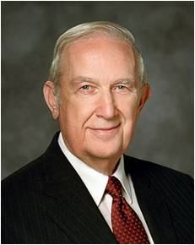
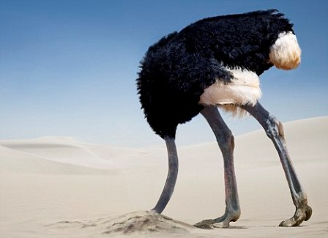
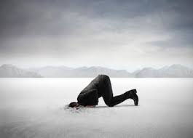
We Cannot Hide Our Sins
“Do not take comfort in the fact that your transgressions are not known by others.
That is like an ostrich with his head buried in the sand.
He sees only darkness and feels comfortably hidden. In reality he is ridiculously conspicuous.
Likewise, our every act is seen by our Father in Heaven and His Beloved Son.” (5)
Joshua 7:19

Slide 15
The Defeat of Ai
30,000 Soldiers
Ai
Joshua 8

Slide 16
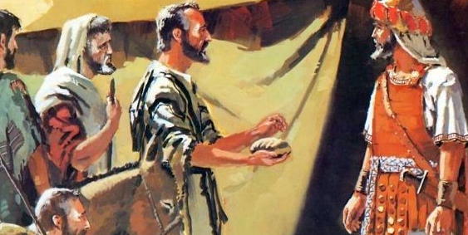
Deceitful Become Slaves
Although the subtle alliance manufactured through deceitful means saved their lives, the people of Gibeon became the perpetual slaves of Israel.
Moses had warned Israel not to make any covenants with the Canaanites (see Deuteronomy 7:2), and this warning may explain why Joshua was so upset when he discovered the deception.
Since the oath had been made, however, he honored it, placing the people of Gibeon in slavery instead of having them killed.
Joshua 9
(3)

Slide 17
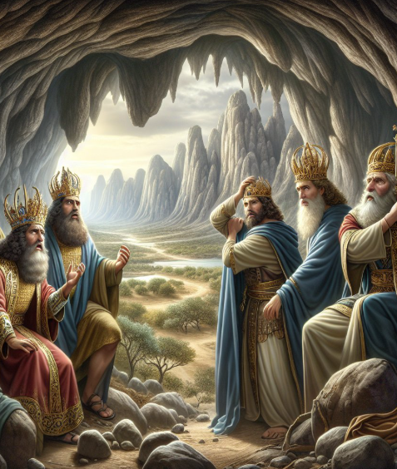
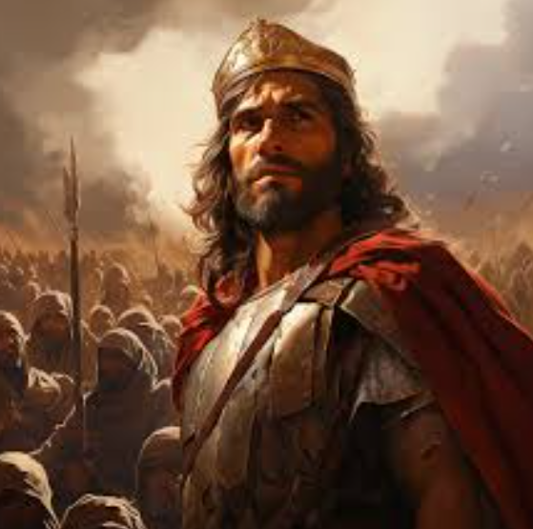
Adoni-Zedek
Adoni-zedek (a Hebrew word meaning “lord of justice”) is an example of many other civil leaders who chose titles for themselves or had titles bestowed upon them by greater rulers whose vassals they were.
Perhaps he, like other Canaanite kings, assumed this name in imitation of the ancient patriarchal king of Salem, Melchizedek, “king of righteousness.”
He was the chief of the confederacy of five kings that made war against Gibeon.
Joshua 10
(3)

Slide 18
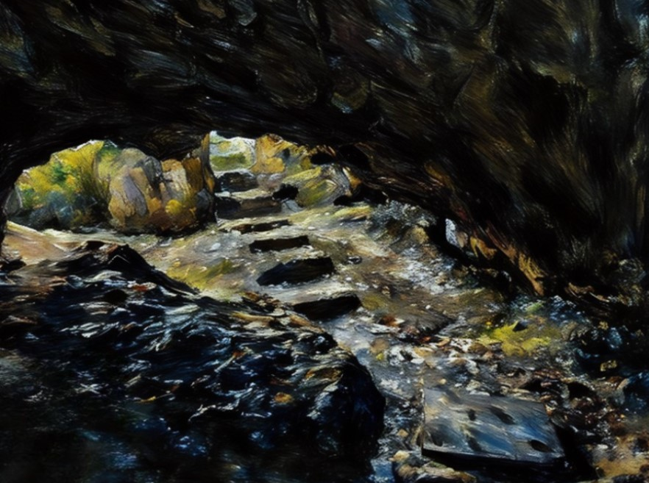
All the Kings of Amorites
Adoni-Zedek king of Jerusalem
Hoham king of Hebron
Piram king of Jarmuth
Japhia king of Lachish,
Debir king of Eglon
The Lord discomfited them. (unnerved, upset, distressed, confuse, discomfort, embarrassed)
The Israelites chased and smote them.
The Lord cast down great stones from heaven (hailstones).
Those who did not die the Israelites killed them by the sword
The five kings were hung on a tree, then cast into a cave and buried by boulders.
The destruction of the five nations of the Canaanites was accomplished over a period of days rather than on the same day as the battle at Gibeon.
Joshua 10
(3)

Slide 19
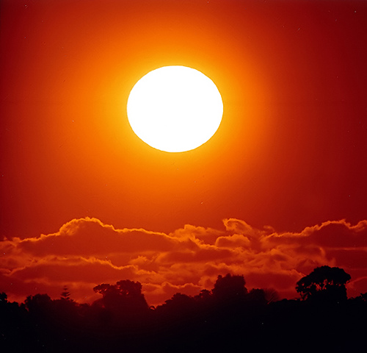
The Sun Stood Still
And the sun stood still, and the moon stayed, until the people had avenged themselves upon their enemies. Is not this written in the book of Jasher? So the sun stood still in the midst of heaven, and hasted not to go down about a whole day.
The Book of Mormon makes it clear that it was the earth, not the sun, that was involved in Joshua’s miracle. Mormon, discoursing on the might and power of God, wrote:
Read Helaman 12:13-17
Joshua 10:13
(3)

Slide 20
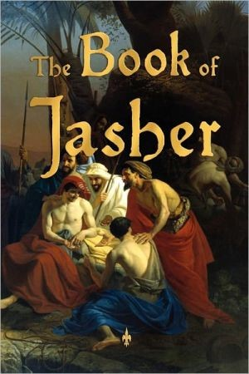
The Book of Jasher
Sefer Hayashar, which means the “book of the upright one” or “the book of the righteous”;
And the sun stood still, and the moon stayed, until the people had avenged themselves upon their enemies. Is not this written in the book of Jasher? So the sun stood still in the midst of heaven, and hasted not to go down about a whole day.
Like numerous other books mentioned in the Old and New Testament but not contained within their pages, the book of Jasher appears to have been a source that contained accounts of heroic deeds in ancient Israel.
It is thought by many to have been written in verse, but it likely contained some prose as well.
A book with this title is currently available, but it is of doubtful origin, according to most scholars, and probably is not the one mentioned in the Old Testament.
Joshua 10:13
(3)

Slide 21
Sources:
Suggested Hymn: 285 God Moves in a Mysterious Ways
For the Strength of Youth [booklet, 2011], 4, 7, 30–31)
Talmage, Articles of Faith, p. 105
Old Testament Institute Manual
4. President H. C. Kimball Sanctification…A Discourse delivered in the Tabernacle, Great Salt Lake City, July 16, 1854. Journal of Discourse Volume 7 p. 17 column b
Presentation by ©http://fashionsbylynda.com/blog/
5. Elder Richard G. Scott (“Finding Forgiveness,” Ensign, May 1995, 77).
6. (Fallows, Bible Encyclopedia, s.v. “Adonizedek,” 1:56). Found in Old Testament Institute Manual
Book of Jasher article by Edward J. Brandt, college curriculum writer, Church Educational System.
https://abn.churchofjesuschrist.org/study/ensign/1981/06/i-have-a-question/can-you-tell-me-if-the-book-of-jasher-is-authentic?lang=eng&abVersion=V00&abName=GLOB88

Slide 22
The Walls Fell:
Jehovah has a better plan. Jericho would fall, but in the Lord’s way. Instead of being armed with swords and spears, they were armed with rams’ horns. Instead of taking a battering ram, they were to take the sacred ark. They were led not by generals, but by priests; they wore not armor, but priestly garments. And in place of a battle cry, there was perhaps a hosanna shout. Instead of setting them to a long, devastating military siege, the Lord promised that after only seven days “the wall of the city shall fall down flat, and the people shall ascend up every man straight before him.” (Josh. 6:5.)
The Apostle Paul, commenting on this rather unusual procedure, explains it all in one simple sentence: “By faith the walls of Jericho fell down.” (Heb. 11:30.)
Howard W. Hunter “Commitment to God,” Ensign, Nov. 1982, 57)
Achan:
How was it on a certain occasion about casting lots to discover the transgressor among all the hosts of Israel? A certain man had taken a gold wedge, and the people had been forbidden to take it. No one knew anything about it, but the transgressor, and he hid it in the earth. Lots were cast and the lot fell upon a certain tribe, it did not designate the man at first; they cast lots again, and it fell upon a certain portion of that tribe; they cast lots again, and it fell on a certain family, and finally it fell on a certain man in that family, and being called up, it proved that he was the very man among all the hundreds of thousands of Israel. Josh. 7:1-26
Elder Orson Pratt Redemption of Discourse by Elder Orson Pratt, delivered in the Twentieth Ward Meetinghouse, on the Evening of Sunday, February 7, 1875.
Books by Other Authors Mentioned in Old Testament:
The "Book of Jasher," referred to by Joshua, is not in the Bible.
The same is true of the "Book of the Acts of Solomon," referred to in First Kings 1 Kgs. 11:41
The books of Nathan and Gad, both of whom were prophets and seers, are missing 1 Chr. 29:29. As inspired men, their writings would be an enlightening guide on the way of truth.
Ahijah and Iddo were prophets and seers likewise 2 Chr. 9:29 Would their works not inspire modern people if they were available? But where are they? Can we say that our Bible is actually complete without them?
The "Book of Jehu" is mentioned in the Old Testament but is not included in it 2 Chr. 20:34 Isaiah wrote a second book known as the "Acts of Uzziah" 2 Chr. 26:22 but where is it? Will anyone say that Isaiah's writings are not inspirational? His second book might prove to be most invaluable if we had it.
"The Sayings of the Seers" 2 Chr. 33:19 another book of sacred writings, is referred to in the Bible. Where is it now? Would it not be good for today's Christians in their spiritual meanderings?
The Christian Reformation
Elder Mark E. Petersen
April 1964 Gen. Conf. ..refer to lds citation index Joshua 10:13
Finding the disobedient:
…as he [Joshua] lay prostrate on his face; whereupon God answered him, That he should rise up, and purify his host from the pollution that had go into it; that “things consecrated to me have been imprudently stolen from me,: and that “this has been the occasion why this defeat had happened to them;” and that when they should search our and punish the offender, he would ever take care they should have the victory over their enemies.”
“This Joshua told the people; and calling for Eleazar the high priest and the men in authority, he cast lots, tribe by tribe; and when the lot shoed that this wicked action was done by one of the tribe of Judah, he then again proposed the lot to the several families thereto belonging so the truth of this wicked action was found to belong to the family of Zachar…Josephus, 5.1.14
Achan’s disobedience:
It may appear that the action taken against Achan for taking the booty of Jericho was too severe, but the death of the mortal body may often be a merciful act both to other people and to the offender (see 1 Nephi 4:13; Leviticus 24:17). Some offenses of men are of such consequence that the payment of the life of the offender is required for the expiation of the sin. Achan’s disobedience cost the lives of thirty-six men (see Joshua 7:5). But even more important, Israel’s spiritual death would be more serious than the physical death of individuals. For Israel to fail to obey the Lord in all things would be tantamount to depriving her of the land of Canaan (see 1 Nephi 17:31–35). It is apparent from his voluntary confession that Achan understood this truth (see Joshua 7:20–21). Old Testament Institute Manual

Slide 23
The Sun Stood Still:
“Yea, and if he say unto the earth—Move—it is moved. Yea, if he say unto the earth—Thou shalt go back, that it lengthen out the day for many hours—it is done; And thus, according to his word the earth goeth back, and it appeareth unto man that the sun standeth still; yea, and behold, this is so; for surely it is the earth that moveth and not the sun. And behold, also, if he say unto the waters of the great deep—Be thou dried up—it is done. Behold, if he say unto this mountain—Be thou raised up, and come over and fall upon that city, that it be buried up—behold it is done.” (Helaman 12:13–17.)
“So here we have the words of a Book of Mormon prophet confirming the fact that God can—and would, when necessary—cause that the earth should stop in its rotation to lengthen a day. And since on the occasion in question he was fighting to bring victory to Israel, this was one of his means of doing so. “If we have doubts about the Lord’s willingness or ability to interrupt the usual movements of heavenly bodies, how shall we explain such phenomena as the following:
“‘But, behold, I say unto you that before this great day shall come the sun shall be darkened, and the moon shall be turned into blood, and the stars shall fall from heaven, and there shall be greater signs in heaven above and in the earth beneath.’ (D&C 29:14.)
“Or: ‘And they shall see signs and wonders, for they shall be shown forth in the heavens above and in the earth beneath. And they shall behold blood, and fire, and vapors of smoke. And before the day of the Lord shall come, the sun shall be darkened, and the moon be turned into blood, and the stars fall from heaven.’ (D&C 45:40–42.)
“‘For not many days hence and the earth shall tremble and reel to and fro as a drunken man; and the sun shall hide his face, and shall refuse to give light; and the moon shall be bathed in blood; and the stars shall become exceedingly angry, and shall cast themselves down as a fig that falleth from off a fig-tree.’ (D&C 88:87.)
“Or: ‘And so great shall be the glory of his presence that the sun shall hide his face in shame, and the moon shall withhold its light, and the stars shall be hurled from their places.’ (D&C 133:49.)
“The episode of Joshua commanding the sun and moon to stand still was insignificant compared to the stellar upsets that will accompany the second advent of the Savior, when stars will be hurled from their places. Some power will darken the sun and make the moon refuse to give its light. (Of course the moon will be darkened as soon as the sun gives no further light, since the moon’s light is merely reflected from the sun.)
“It is appropriate here to quote Sir Charles Marston, a most intelligent ‘critic of the critics,’ who said that it is time we begin ‘to recognize the extravagance of its [criticism by the intellectuals] underlying assumption, that what the critic did not know could not have been!’
(The Bible Comes Alive, New York: Fleming H. Revell Company, 1947, p. 182.)” (Petersen, Joshua, pp. 58–59.) Found in Old Testament Institute Manual
Just for Information only: The Book of Jasher see chapter 89:8 Sun stood still
Not Scriptural or Church Doctrine: Book of Jasher is published in Salt Lake City, and found at http://www.sacred-texts.com/chr/apo/jasher/

Slide 24
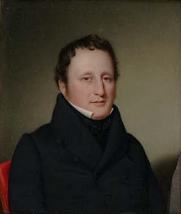
Something of Interest
The first English edition of this book of Jasher was published (as noted above) in 1840 in New York by Mordecai Manuel Noah, a prominent Jewish writer and newspaper editor-publisher of that day. Mr. Noah secured the English translation of this work from an individual who had completed the work but was reluctant to publish it. There was a great stir in England at the time caused by an earlier fictitious book of Jasher that had been published in 1751 in London and again in Bristol in 1829. In 1833, booklets were published to expose the fraudulent claims of the fictitious work, which has since been characterized as Pseudo-Jasher. Because of this unfavorable climate, the translator, choosing to remain anonymous, sold his manuscript to Mr. Noah.
In 1887, the Joseph Hyrum Parry Printing Company of Salt Lake City secured the rights to the New York 1840 edition and republished the work. In 1964 the work was reissued as a photo reprint of the 1887 edition and has experienced a number of printings to date. Edward J. Brandt, college curriculum writer, Church Educational System. June 1981
Noah also shared the belief, among various others, that some Native American "Indians" were from the Lost Tribes of Israel, on which he wrote the Discourse on the Evidences of the American Indians being the Descendants of the Lost Tribes of Israel. In his Discourse on the Restoration of the Jews, Noah proclaimed his faith that the Jews would return and rebuild their ancient homeland and called on America to take the lead in this endeavor.

