Slide 1

The Great Campaign
Joshua 11-22
And all these kings and their land did Joshua take at one time, because the Lord God of Israel fought for Israel.
Joshua 10:42

Slide 2


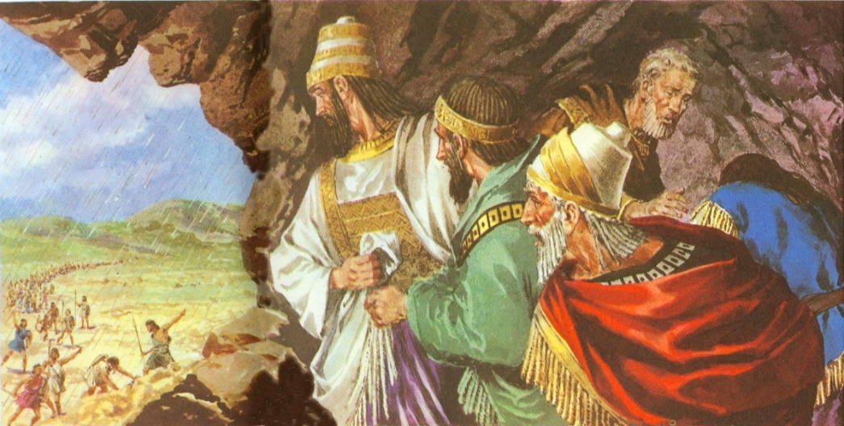
Previously…
The Gibeonites deceived Israel by telling them that they were not Canaanites and wanted to make peace with the Israelites…Upon a promise of Eleazar, the high priest, they were spared…however, when Israel found out that they were really Canaanites they were put into servitude unto the Israelites.
The five kings of the surrounding area found out about the Gibeonites making peace with the Israelites sought out to “make an example” of them and went to battle against them.
The Israelites, duty bound to spare them, went to Gibeon to defend them. They battled and killed many but those who fled were caught in a hailstorm and died. The five kings fled and hid in a cave near Makkedah. Joshua captured them, killed them, hung them on a tree, then entombed them in the cave by placing large boulders over the entrance to seal it up.
Joshua declared that the sun should stand still… the extra hours permitted Joshua to completely consumed the Amorites at Gibeon

Slide 3
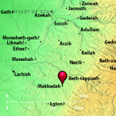
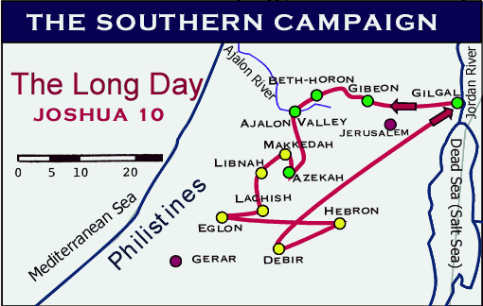
With The Lord’s Help
All these places were destroyed
Makkedah– was the first
Libnah
Bachis
Gezer
Eglon
Hebron
Debir
Kadesh-barnea
Gaze
Goshen
Joshua 10:28-41
Gilgal was the Israelite home base

Slide 4
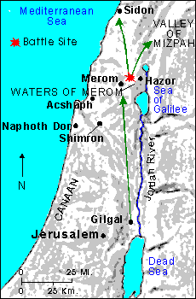
Gathering of the Kings
Gathering of the Kings:
Jaban King of Hazor
Jobab king of Madan
King of Shimron
King of Achshaph
All the Kings North, east and west
Amorites, Hittites, Perizzrite, Jebusites, and Hivites…joined the kings by the waters of Merom to battle against the Israelites
To hough a horse is to cut the leg tendons above and behind the tarsal joint or ankle, thus rendering the horse useless.
The Israelites were foot soldiers rather than charioteers. The fear seems to have been that should the horses and chariots be used as vehicles of war, Israel would turn from faith in God and trust in the arm of flesh. (1)
And the Lord delivered them into the hand of Israel,
Joshua 11

Slide 5
Kings That Were Destroyed
2 kings on the east side of Jordan River and 31 kings on the west of the river were destroyed= 33 kings
King of Jericho
King of Ai
King of Jerusalem
King of Hebron
King of Jarmuth
King of Lachish
King of Eglon
King of Gezer
King of Debir
King of Geder
King of Hormah
King of Arad
King of Libnah
King of Adullam
King of Makkeda
King of Beth-el
King of Tappuah
King of Hepher
King of Aphek
King of Aphek
King of Lasharon
King of Madon
King of Hazor
King of Shimron-meron
King of Achshaph
King of Taanach
King of Megiddo
King of Kedesh
King of Jokneam
King of Dor
King of Tirzah-- all the kings thirty and one.
Sihon king of the Amorites, who dwelt in Heshbon, and ruled from Aroer
Og king of Bashan, which was of the remnant of the giants, that dwelt at Ashtaroth and at Edrei,
Joshua 12

Slide 6
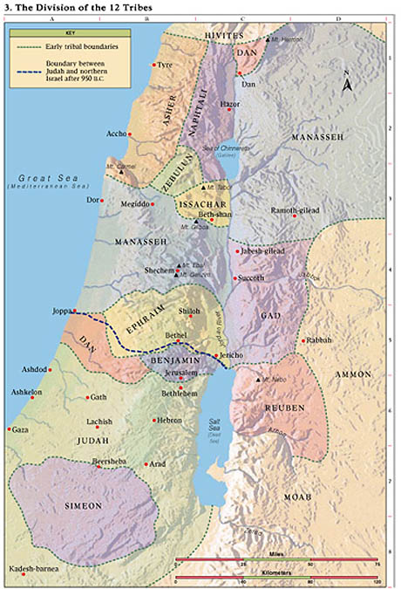
Division of the Land
Joshua gave each tribe an inheritance in the promised land and that the tabernacle was set up at a place called Shiloh
Caleb inherits Hebron as a special reward for his faithfulness
The Levites were not given a specific piece of land but were given 48 cities among each of the other tribes’ inheritances. This would allow the Levites to continue their priesthood service among the Israelites.
The Jebusites were not driven out but dwelt with the tribe of Judah (Josh. 15:36)
Joshua 13-21

Slide 7
6 Cities of Refuge
Golan in Bashan out of the tribe of Manasseh.
And they appointed Kedesh in Galilee in mount Naphtali
and Shechem in mount Ephraim
and Kirjath-arba, which is Hebron, in the mountain of Judah.
Ramoth in Gilead out of the tribe of Gad
Bezer in the wilderness upon the plain out of the tribe of Reuben
Joshua 13-20

Slide 8
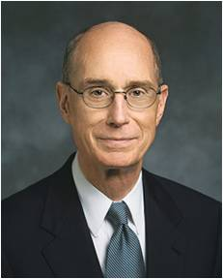
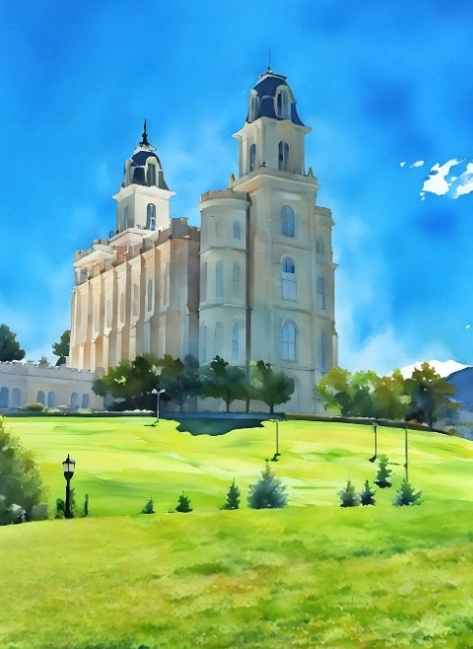
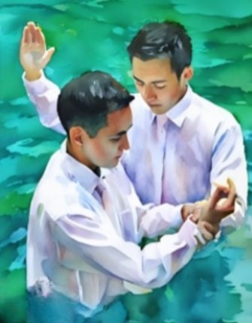
Living Partial Covenants
(The Israelites) at this point were at peace, but the mopping-up operations did not thereafter go as intended, and the Lord could not justly fulfil his part of the covenant if the people did not continue to do their duty; therefore, a different assessment of the state of things was given later in Joshua 23:13 (2)
Qualifying to make sacred covenants is not a one-time effort but a lifetime pattern. The Lord has said it will take our full heart, might, mind, and strength.
Frequent participation in the ordinances of the temple can create a pattern of devotion to the Lord. When you keep your temple covenants and remember them, you invite the companionship of the Holy Ghost to both strengthen and purify you. (3)
Joshua 21

Slide 9
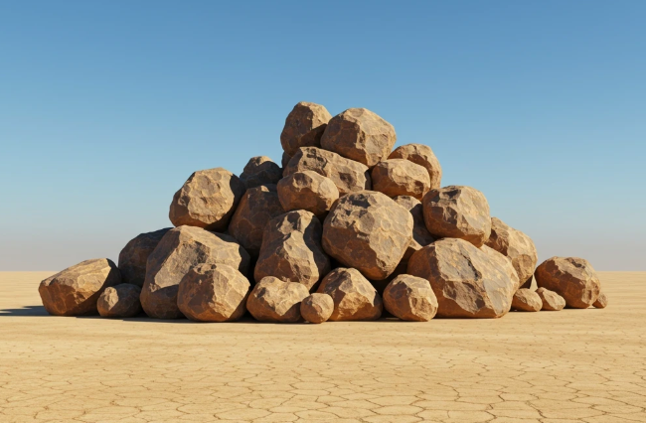
Memorial VS Idol
Joshua summoned representatives of the tribes who were to live east of the Joran in order to bless them and charge them to be faithful to the Lord
He then sent them to their inheritances across the river.
They built a great altar, not for sacrifice, but as a monument, a symbolic witness for the future generations.
Ironically the western tribes, seeing it from afar, thought it was an altar erected to an idol.
A war was averted because the true leaders determined the true purpose of the stone altar-like monument to be a memorial.
(2)
Joshua 22

Slide 10
Sources:
Old Testament Institute Manual
Presentation by ©http://fashionsbylynda.com/blog/
2. The Latter-day Commentary on the Old Testament by Ellis T. Rasmussen (paraphrasing)
3. President Henry B. Eyring “All Will Be Well Because of Temple Covenants” April 2024 General Conference

Slide 11
9 ½ Remaining Tribal Inheritances
Tribe | Location | Number of Cities
Simeon | Extreme south (Negeb) | 17
Judah | South-Between Dead Sea and Mediterranean Sea | Not given
Benjamin | Jordan River, half-way to the Mediterranean Sea | 26
Dan | From Benjamin to Mediterranean Sea | 17
Ephraim | Samaria-from Jordan River to Mediterranean Sea | Not given
Manasseh | Above Ephraim from Jordan River to Mediterranean Sea | Not given
Issachar | From Jordan River half-way to Mediterranean Sea | 16
Zebulon | Landlocked area half-way between Galilee and Mediterranean Sea | 12
Asher | Mt. Carmel north to Mt. Lebanon | 22
Naphtali | Galilee to Mount Hermon | 19
W. Cleon Skousen Third Thousand Years p.517

