Slide 1


Choose You This Day
Joshua 23-24
Be ye therefore very courageous to keep and to do all that is written in the book of the law of Moses… Joshua 23:6

Slide 2
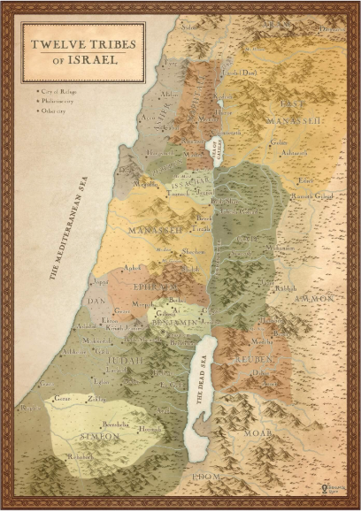
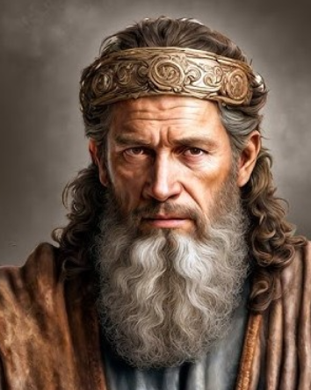
Previously…
After leading the Israelites over the Jordan River on dry ground, the Lord blessed the Israelites in their many battles with the Canaanites.
The Israelites took possession of the land that God had promised them.
The land was divided among the twelve tribes.
Toward the end of his life, Joshua gave one final message to the Israelites in Joshua 23-24.
Joshua 3–4; Joshua 5-12; Joshua 13-22

Slide 3
Parting Advice
What God has done for them:
He fought and will continue to fight for Israel (verses 3, 5, 10)
He gave Israel land for an inheritance (verse 4)
He will expel the other nations from the land (verse 5)
He has kept and will continue to keep His promises to Israel (verses 5, 10)
What Israel is to do:
Be very courageous (verse 6)
Keep the law of Moses (verse 6)
Don’t serve or worship other gods (verse 7)
Cleave (be loyal) unto the Lord (verse 8)
Love the Lord (verse 11)
Remembering what God has done for us strengthens our resolve to love and serve Him
Joshua died at the age of 110
Joshua 23

Slide 4
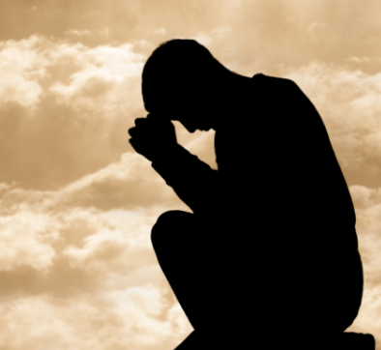
Cleave
To cling, adhere, or be loyal to something or someone.
If we cleave unto the Lord and obey Him, then He will be with us and strengthen us
If we cleave to other gods, we will bring negative consequences upon ourselves and lose the blessings of the Lord
Joshua 23:8

Slide 5

Snares and Traps
A metaphorical term used in scripture and Church teachings to describe spiritual and moral pitfalls that can ensnare individuals.
These traps can include pride, fear, comparison, worldly desires, false teachings, and even seemingly good opportunities that are not from God.
…many individuals become trapped by the adversary. They are beckoned by something that entices them to ignore the safety of proper companionship, to want something without weighing the consequences, and to forget that they really know better. (1)
To overcome these snares, we are taught to rely on Jesus Christ, repent, draw on the power of the Atonement, and follow the guidance of the Holy Spirit.
Outward beauty can serve as a dangerous trap or "snare" that leads people into moral and spiritual ruin.
Joshua 23:12-13

Slide 6
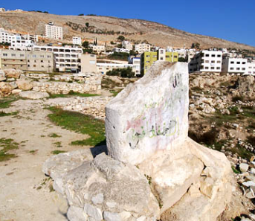
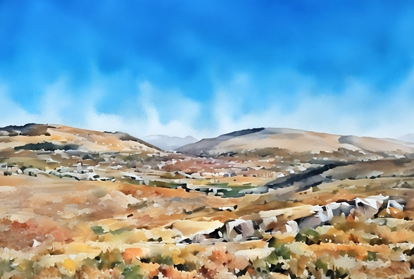
A Gathering at Shechem
The sacred standing stone at Shechem
Joshua gathered all the tribes at Shechem, an important city situated between the mountains of Ebal and Gerizim, known for its central location in the Promised Land and its role as a crossroads of significant biblical events.
Shechem was the first place Abraham entered, where God first appeared to him and promised him the land. Shechem was also the site where Jacob settled, buried his foreign gods, and where Joseph's bones were eventually laid. The city later became the first capital of the northern Kingdom of Israel, marking the division of the nation.
Joshua 24:1-2

Slide 7
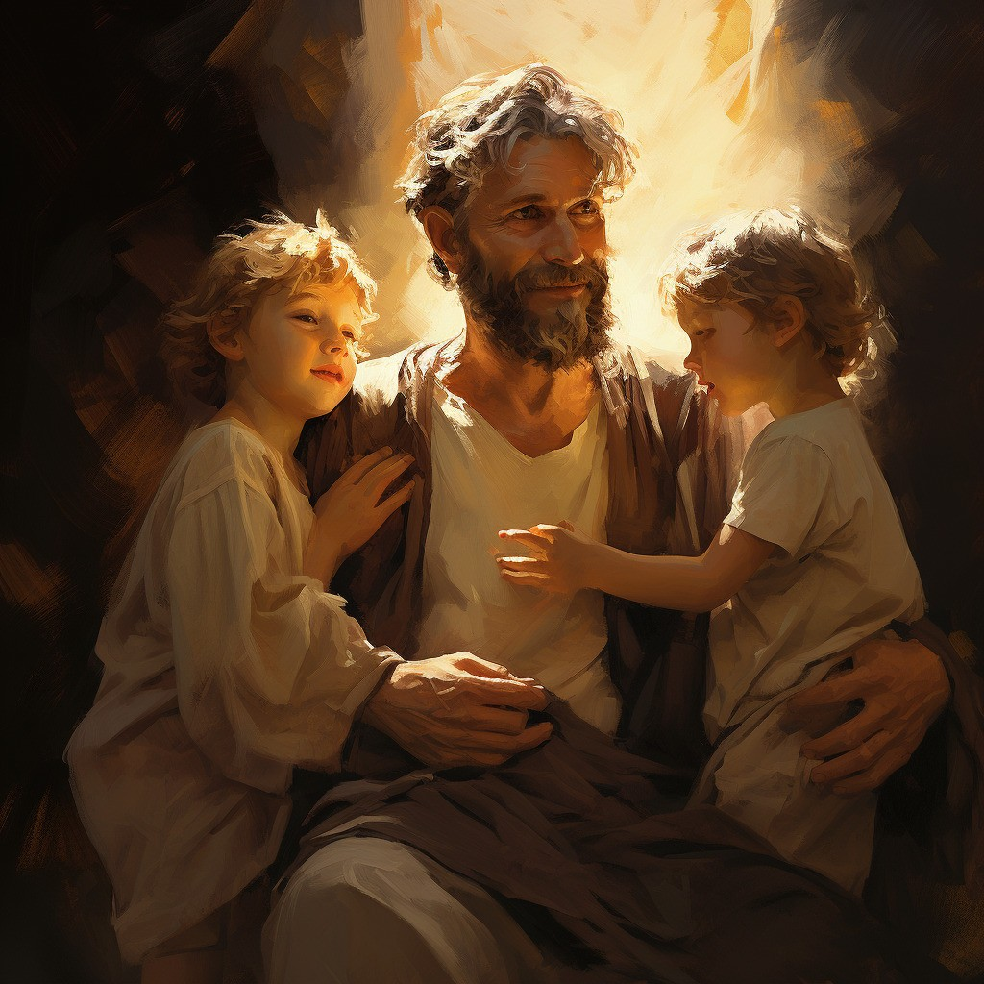
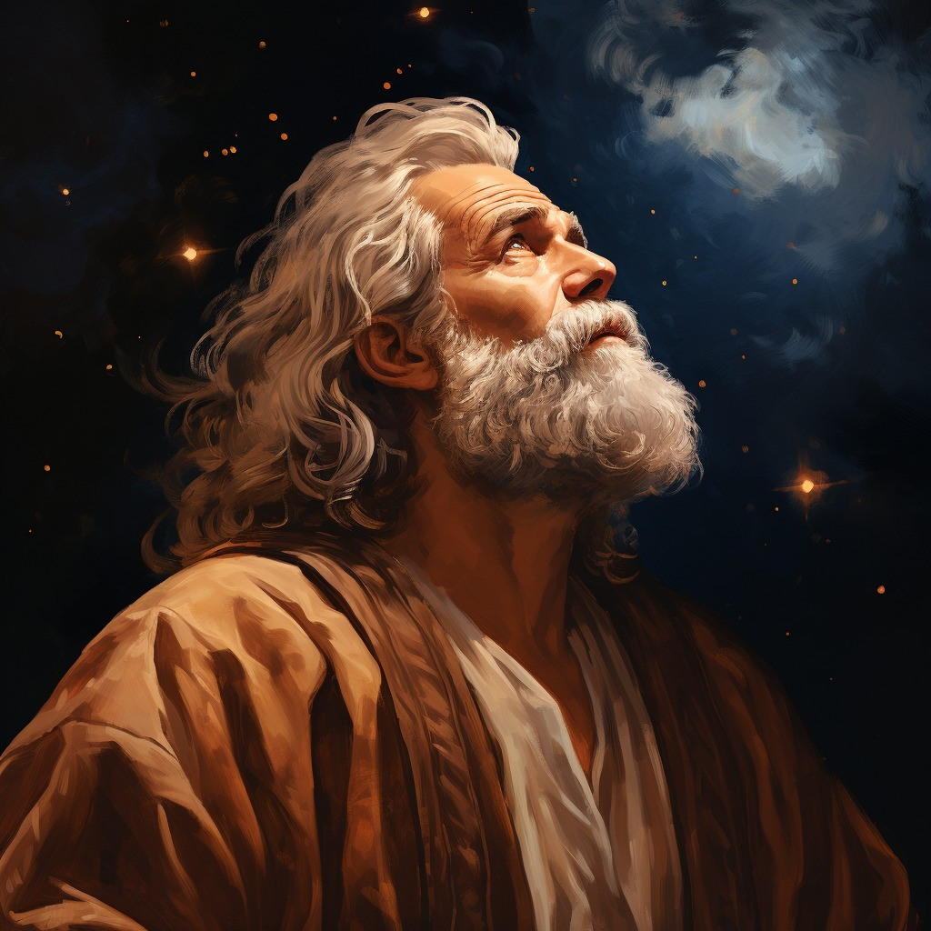
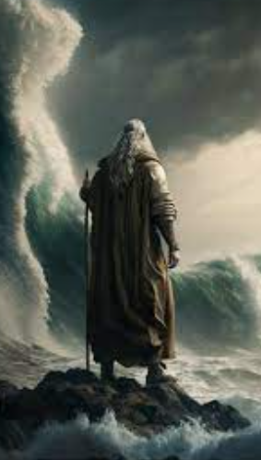
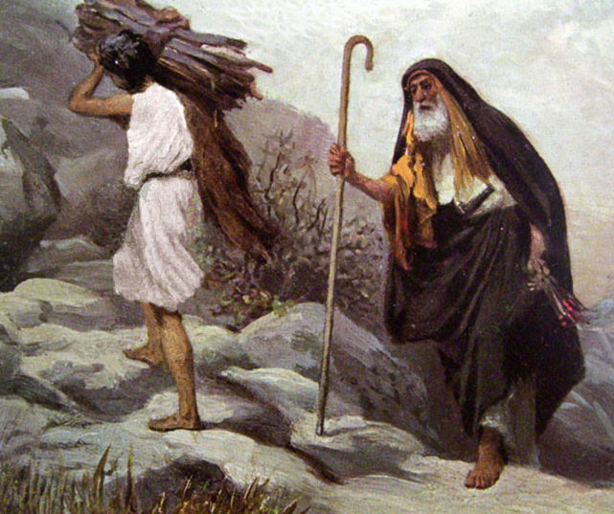
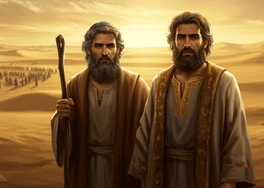
Remember
Joshua 24:3
Joshua 24:4
Joshua 24:6-7
Joshua 24:3
Joshua 24:5
Joshua 24:3-7

Slide 8
Doctrinal Mastery
And if it seem evil unto you to serve the Lord, choose you this day whom ye will serve; whether the gods which your fathers served that were on the other side of the flood, or the gods of the Amorites, in whose land ye dwell: but as for me and my house, we will serve the Lord.
Joshua 24:15

Slide 9
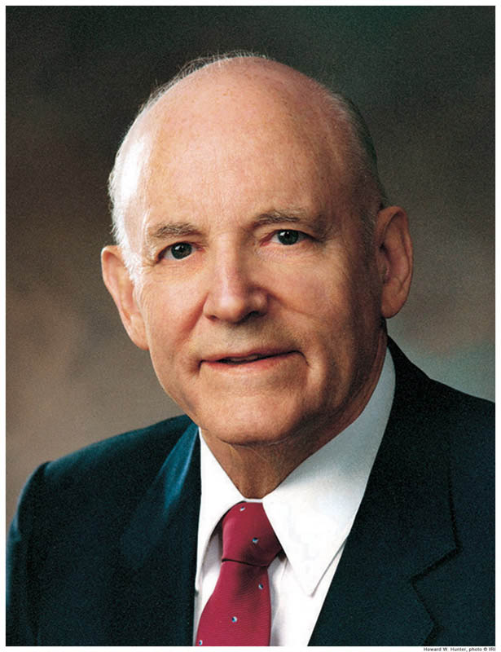
“After Israel had rested from the wars with their enemies, Joshua, who was now very old, called all Israel together.
In his farewell address he reminded them they had been victorious because God had fought for them, but if they now ceased to serve the Lord and keep his law they would be destroyed. …
“This great military and spiritual leader then urged a commitment and made one himself and for his family: ‘Choose you this day whom ye will serve; … but as for me and my house, we will serve the Lord.’ (Josh. 24:15)

Slide 10
“Here was a great statement of full commitment of a man to God. …
He was telling the Israelites that regardless of how they decided, he would do what he knew was right.
He was saying that his decision to serve the Lord was independent of whatever they decided; that their actions would not affect his; that his commitment to do the Lord’s will would not be altered by anything they or anyone else would do.
Joshua was firmly in control of his actions and had his eyes fixed on the commandments of the Lord. He was committed to obedience.
“Surely the Lord loves, more than anything else, an unwavering determination to obey his counsel.
Surely the experiences of the great prophets of the Old Testament have been recorded to help us understand the importance of choosing the path of strict obedience.” (2)

Slide 11
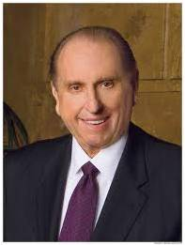
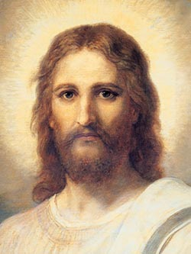
“Joshua of old declared, ‘Choose you this day whom ye will serve; … but as for me and my house, we will serve the Lord’ [Joshua 24:15]. …
“… Positioned on the wall of my office, directly opposite my desk, is a lovely print of the Savior, painted by Heinrich Hofmann.
I love the painting, which I have had since I was a 22-year-old bishop and which I have taken with me wherever I have been assigned to labor. I have tried to pattern my life after the Master.
Whenever I have a difficult decision to make, I have looked at that picture and asked myself, ‘What would He do?’ Then I try to do it.
We can never go wrong when we choose to follow the Savior.” (3, 4)

Slide 12
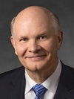
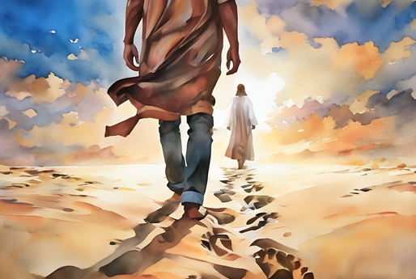
We Will Serve and Obey
We need to choose whom we will serve. The magnitude of our eternal happiness depends on choosing the living God and joining Him in His work. …
Choosing to follow the Father’s plan is the only way we can become inheritors in His kingdom. (4)
Joshua 24:21

Slide 13
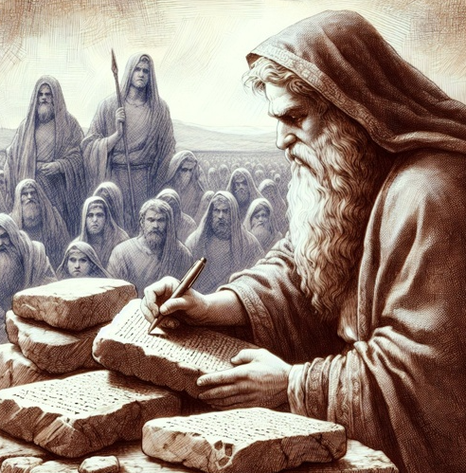
The Book of the Law of God
We do not know for certain who wrote the book of Joshua. The book is named for Joshua—its principal figure and Moses’s successor as the Lord’s prophet to Israel.
Near the end of Joshua’s ministry, after the Israelites had entered into a covenant to not serve false gods in the promised land, the book’s narrator reports that “Joshua wrote these words in the book of the law of God”.
This passage may indicate that Joshua wrote at least a portion of the book that is named for him. (5)
Joshua 24:26; Numbers 27:18-23

Slide 14
Sources:
1. Elder Joseph T. Hicken “Book of Mormon Principles:
Shunning Satan’s Snares” September 2004 Ensign
2. President Howard W. Hunter (“Commitment to God,” Ensign, Nov. 1982, 58; see also Spencer W. Kimball, “The False Gods We Worship,” Ensign, June 1976, 2–6).
Presentation by ©http://fashionsbylynda.com/blog/
3. President Thomas S. Monson (“Choose You This Day,” Ensign or Liahona, Nov. 2004, 67).
[see Jesus Christ, Gospel Art Book [2009], no. 1]. Picture of Jesus
4. Elder Dale G. Renlund (“Choose You This Day,” Ensign or Liahona, Nov. 2018, 106)
5. Old Testament Seminary Teacher Manual 2012

Slide 15
9 ½ Remaining Tribal Inheritances
Tribe | Location | Number of Cities
Simeon | Extreme south (Negeb) | 17
Judah | Between Dead Sea and Mediterranean Sea | Not given
Benjamin | Jordan River, half-way to the Mediterranean Sea | 26
Dan | From Benjamin to Mediterranean Sea | 17
Ephraim | Samaria-from Jordan River to Mediterranean Sea | Not given
Manasseh | Above Ephraim from Jordan River to Mediterranean Sea | Not given
Issachar | From Jordan River half-way to Mediterranean Sea | 16
Zebulon | Landlocked area half-way between Galilee and Mediterranean Sea | 12
Asher | Mt. Carmel north to Mt. Lebanon | 22
Naphtali | Galilee to Mount Hermon | 19
W. Cleon Skousen Third Thousand Years p.517

Slide 16
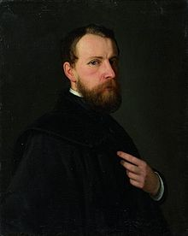
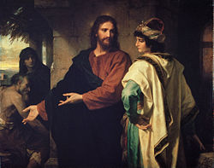
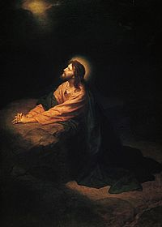
Johann Michael Ferdinand Heinrich Hofmann (March 19, 1824 - June 23, 1911) was a German painter of the late 19th to early 20th century. He was the uncle of the German painter Ludwig von Hofmann. He was born in Darmstadt and died in Dresden. He is best known for his many paintings depicting the life of Jesus Christ.
Heinrich Hofmann grew up in a family that harbored a deep interest in art. His father, advocate Heinrich Karl Hofmann (1795–1845) painted in watercolors, his mother Sophie Hofmann, née Volhard (1798–1854) gave lessons in art before she married, and his four brothers all showed artistic talent. Heinrich, however, was the only one for whom art was not only a profession but the center of his life.
Hofmann received his first lessons in art from the copper engraver Ernst Rauch in Darmstadt. Then, in 1842, he entered the Academy of Art in Düsseldorf and attended the classes given in painting by Theodor Hildebrandt. Later, he was accepted into the studio of Wilhelm von Schadow and there he created his first large painting: A scene from the life of Alboin, King of the Langobards.
Thereafter, he traveled to the Netherlands and France to intensify his studies of art. In 1846, Hofmann visited the Academy of Art in Antwerp. After passing a longer period of time in Munich he returned to Darmstadt in 1848, and at that time, he began an intensive phase of painting portraits. The young artist found that the political activities of his family opened many doors to influential persons of the time. This afforded him the opportunity to create two portraits of Heinrich von Gagern and one of Justus von Liebig (this portrait is now in the possession of Queen of the United Kingdom). In 1851, Hofmann went to Dresden to visit the art gallery there. In 1853, he traveled to Prague to paint the portrait of Dr. Beer, Great Grand Master of the Brotherhood of the Knights of the Cross.
In 1853, Hofmann returned to Darmstadt, and in the beginning of 1854, his beloved mother died. He was deeply moved by her death and it inspired him to paint his first large religious work: Burial of Christ.
In fall of 1854, he started on a journey to Italy. His first longer stop was in Venice and he used the time there to study Giorgione, Bellini and Giotto (in nearby Padua). After having proceeded to Florence – where Hofmann stayed for two months – he then went to Rome in January 1855. The comprehensive correspondence with his family and his detailed diary reports convey an impression of his way of painting at that time. He was deeply impressed by artwork of Antiquity, Christianity and the Renaissance.
Not long after his arrival in Rome, he was introduced to Peter von Cornelius (1783–1867) and frequently paid him a visit. When he began his masterpiece The Arrest of Jesus in 1854, this work awakened the interest of Cornelius and for 4 years he accompanied Hofmann with his counsel and his constructive criticism. In 1858 the painting was finished and acquired by the Grand Duchy Art Gallery in Darmstadt. (It is still there – not on exhibition but in the archives of the Hessisches Landesmuseum.)
In 1858, Hofmann returned to Darmstadt and in the following year he married Elisabeth Werner. The couple had no children.
Now another period of painting portraits began. In addition Hofmann created a large altarpiece for the church in Obermörlen (Hesse): “Madonna with Christ Child and apostles Paul and Peter”. Some time later an altarpiece for Væggerløse Church (Denmark) was painted: “The Resurrected Christ”.
In 1862, Hofmann and his wife moved to Dresden. More and more he devoted himself to the genre of religious paintings. In 1870, Heinrich Hofmann was appointed successor of Professor Johann Carl Baehr of the Academy of Art in Dresden whose honorable member he already was. In 1872, King Johann bestowed on him the Great Golden Medal and later he received the Albrecht-Medal from King Albert. In 1891, Hofmann’s wife died and soon after that he withdrew from the Academy of Art in Dresden. Even though he stopped working for the Academy it is obvious from his letters that in private life he continued to create many works of art until his death on June 23, 1911.
Wikipedia

Slide 17
Shechem Stone:
The earlier discovery of the sacred standing stone that still stands in the courtyard of the temple of Baal-Berith at Shechem.
The broken sacred standing stone (massebah) stands in the courtyard in front of the entrance to the Temple of Baal-Berith. The near-barren Mount Ebal, where the curses of the law were read (Deuteronomy 27); Joshua 8:30-33), is visible to the north.
Ferrell’s Travel log; https://ferrelljenkins.blog/2010/03/11/the-sacred-standing-stone-at-shechem/

