Slide 1

The Lord’s Deliverance
Judges 1-5
…for I will deliver the inhabitants of the land into your hand; and thou shalt drive them out before thee.
Exodus 23:31

Slide 2

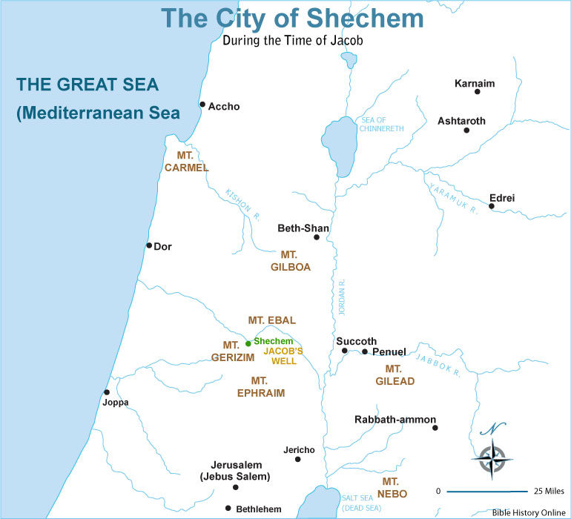
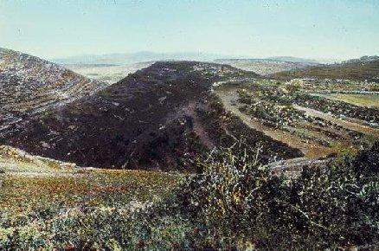
Previously…
Joshua was 110 years old and buried on the border of his inheritance in Timnath-serah, which is in Mount Ephraim, on the north side of the hill of Gaash…
Eleazar—Aaron’s son also died and buried in Mount Ephraim
The bones of Joseph were brought out of Egypt were buried in Shechem.
Joshua 24:29-33
(1)

Slide 3
The Book of Judges
The book of Judges is named for the various rulers, called “judges”
These judges were generally military leaders and fighters more than preachers of righteousness
2 Chronicles
Judges
1 Chronicles
Joshua
Ruth
1 Kings
2 Kings
2 Samuel
1 Samuel
Nehemiah
Ezra
Ester
We do not know who wrote the book of Judges. One Jewish tradition states that Samuel wrote or compiled the book.
However, the book reflects the perspective of a much later time, after the northern tribes of Israel had been conquered by Assyria around 721 B.C.
This perspective suggests that the author or authors lived long after the time of Samuel.
(1)

Slide 4

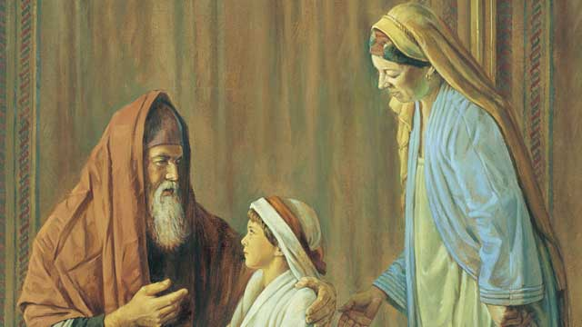
The Book of Judges
Recounts the history of the children of Israel from the time they settled in the land of Canaan after Joshua’s death to the birth of Samuel (approximately 1400–1000 B.C.).
Besides the short narrative of the book of Ruth, Judges provides the only biblical account of this time period.
The book of Judges describes a cycle that repeated itself multiple time during the reign of the judges.
Because the Israelites failed to remove wicked influences from the promised land, they became entangled in sin and were conquered and afflicted by their enemies.
After the Israelites cried unto the Lord for help, He sent judges to deliver them from their enemies. However, the Israelites soon returned to their sins, and this cycle was repeated.
(1)

Slide 5
The Judges—To Govern
The book mentions the names of 12 judges who ruled with various degrees of effectiveness.
The so-called judges, according to the record, appear to be more military heroes rather than officers of the judiciary.
“The English word ‘judge’ doesn’t well describe these leaders. Though the root of the Hebrew word used means primarily ‘to judge,’ it is used secondarily also in the extended meaning ‘to govern.’
Most of the ‘judging’ done in this period was a matter of giving advice and rendering decisions.
Regular court procedures are nowhere described for the times of the Judges in Israel. In fact, the most common function they are seen to perform is that of military leadership.”
The judges did not reign over all of unified Israel during their period of leadership. The chronicler of these stories likely took the choicest of the heroes from each of the tribes during this generally apostate period and combined into one book their righteous achievements and their moral lessons for Israel.
(1)

Slide 6
After Joshua’s Death
The crusade into Canaan had dwindled.
Some of the tribes failed to drive out all the inhabitants.
Instead they put the Canaanites under tribute
The sea coast population:
Philistines, Cannanites, and Phoenicians.
They maintained professional armies.
They lived in walled cities.
They had vast material wealth to protect.
The Phoenicians purchased their security from Egypt and given a monopoly in Egyptian trade.
Judges 1

Slide 7
Conquests and Failures of The Tribes
Tribe of Judah
Brother
Joseph
Caleb
Kenaz
Judah
Simeon
Achsah
Othniel
Judge
Continued to conquer Canaanites
v
Benjamin
Manasseh
Ephriam
Zebulun
Asher
Naphtali
And it came to pass, when Israel was strong, that they put the Canaanites to tribute, and did not utterly drive them out
The tribe of Dan was forced into the mountains by the Amorites
Judges 1

Slide 8
Spiritual Patterns or Cycles
Find the next two numbers in each of the following sequences:
The Pattern
2, 4, 6, 8, 10, 12,___ ,___
B. 1, 3, 7, 13, 21, 31,___ ,___
C. 1, 4, 3, 6, 5, 8, 7,___ ,___
D. 10, 11, 6, 8, 4, 7, 4,___ ,___
14
16
A: +2
B: +2, +4, +6, and so on
C: +3, −1, +3, −1
D: +1, −5, +2, −4, +3, −3, and so on
43
57
10
9
How can we recognize patterns in our spiritual lives?
8
6

Slide 9
Forgetting the Lord (vs. 10)
Judge dies--they would revert back to apostasy
(vs. 19)
They forsake the Lord through idolatry
(vs.11-13)
Cycle of Israel
The Lord delivers them into the hands of their enemies
(vs. 14-15)
Repentance and a restored peace
(vs. 18)
The Lord raises up Judges to deliver them from their enemies (vs. 16)
Judges 2

Slide 10
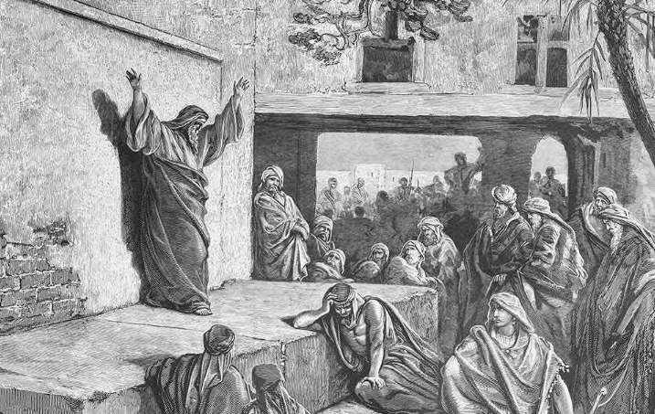
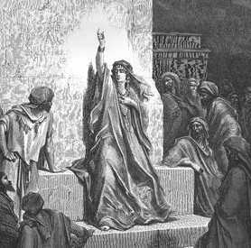
Apostasy Among the Israelites
None of this apostasy needed to happen. The Lord had directed Israel into the promised land and had provided them with a political covenant.
He was to be their divine sovereign.
Their temporal leaders were to be ruling judges, under whom the people retained religious and political liberties. (2)
If we choose to reject the Lord, we will lose His guidance and protection in our lives.
Judges 2

Slide 11
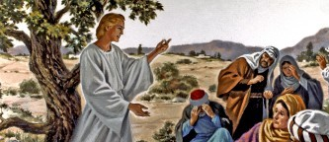
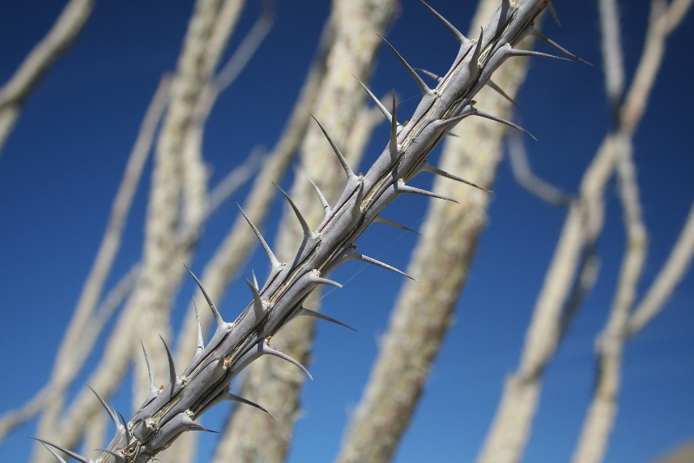
Consequences of Disobedience
The Israelites had failed to obey the Lord’s instructions to drive out the wicked people from the promised land.
The Lord sent an angel to the Israelites to teach them about the consequences of their disobedience.
Bochim—place of weeping…
Eventually all the Israelites who had entered the promised land with Joshua died, and a new generation of Israelites arose who “knew not the Lord, nor … the works which he had done for Israel”
“as thorns in [the Israelites’] sides”
Judges 2

Slide 12
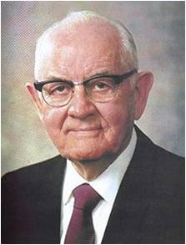



Choosing to Linger
“One man who had been a slave to alcohol most of his adult life became convinced … that he must give up the habit and prepare himself for the temple. … With great effort he quit drinking.
He moved many miles away from the area where his drinking friends lived and, though his body craved and ached and gnawed for [alcohol], he finally conquered. He was at all his Church meetings and was paying his tithing. His new friends in the Church seemed to fortify him and his married life.
He felt good in the new activity, and life was glorious. His wife was beaming, because now the whole family were always together.
This is what she had dreamed about all their married life.
(4)

Slide 13
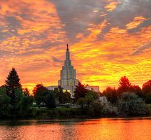


“They got their temple recommends and the happy day arrived, and they drove to the temple city for this great event. They arrived early and each had some errands to do. As it happened, the husband ran into some old friends.
They urged him to go with them to the tavern [where alcohol was served]. No, he would not, he said, he had other important things to do. Well, he could just take a soft drink [soda], they urged.”
“With the best of intentions he finally relented [and went to the tavern with his old friends]. But by the time he was to meet his wife at the temple he was so incapacitated [or drunk with alcohol] that the family went home in disgrace and sorrow and disappointment.”
(4)

Slide 14
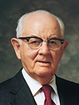
“In abandoning sin one cannot merely wish for better conditions. He must make them. … He must be certain not only that he has abandoned the sin but that he has changed the situations surrounding the sin.
He should avoid the places and conditions and circumstances where the sin occurred, for these could most readily breed it again.”
As we choose to turn to the Lord and call upon His name, He will deliver us.
(4)

Slide 15
They dwelt with the:
Canaanites, Hittites,
Amorites, Perizzites,
Hivites, and Jebusites
Othniel
Othniel died
They took their daughters to be their wives, and daughters to their sons
Cycle 1
Judges 3:5-11
Othniel led them into war with the Spirit of the Lord and the Lord delivered the enemies into their hands
They worshipped Baalim
They cried unto the Lord and He delivered them Othniel, son of Kenaz—the judge of Israel
The Lord sold them into the hand of Chushan-rishathaim (king of Mesopotamia) for 8 years

Slide 16
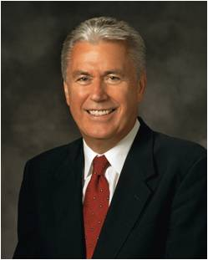
The book of Judges records that after Joshua died, “there arose another generation … which knew not the Lord, nor yet the works which he had done for Israel” [Judges 2:10].
Despite the astonishing heavenly interventions, visitations, rescues, and miraculous victories the children of Israel witnessed during the lifetimes of Moses and Joshua, within a generation the people had abandoned the Way and began walking according to their own desires.
And, of course, it did not take long before they paid the price for that behavior.
Sometimes this falling away takes generations. Sometimes it happens in a matter of years or even months. But we are all susceptible. No matter how strong our spiritual experiences have been in the past, as human beings we tend to wander. (6)
(4)

Slide 17
The Israelite did evil again in the site of the Lord
The land rested for 80 years and Ehud died—Shamgar also delivered them from the Philistines
Ehud
Cycle 2
Judges 3:12-30
Ammon and the Amulekes possessed the city of palms (Jericho)
Through the guidance of the Lord, Ehud stuck a dagger in the king’s belly—Moab was delivered into the hands of the Israelites
They served under king Eglon for 18 years
They cried unto the Lord and He delivered them Ehud, son of Gera, a Benjaminite—the judge of Israel
The people presented a gift to the king

Slide 18
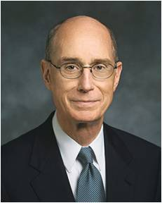
The Lord always wants to lead us to deliverance through our becoming more righteous.
That requires repentance.
And that takes humility.
So the way to deliverance always requires humility in order for the Lord to be able to lead us by the hand where He wants to take us through our troubles and on to sanctification. (5)
(4)

Slide 19
They started to evil again
The land rested 40 years
The Lord put them in the hand of the Canaanite King, Jabin
Cycle 3
Judges 4:1-29
Jael—wife of Heber killed Sisera (chieftain) opening a way for the Israelites to prevail once again
Barak and tribes of Naphtali and Zebulun joined in the battle against Jabin
The Israelites were oppressed 20 years
Deborah—a prophetess and judge sent Barak to deliver the Israelites

Slide 20
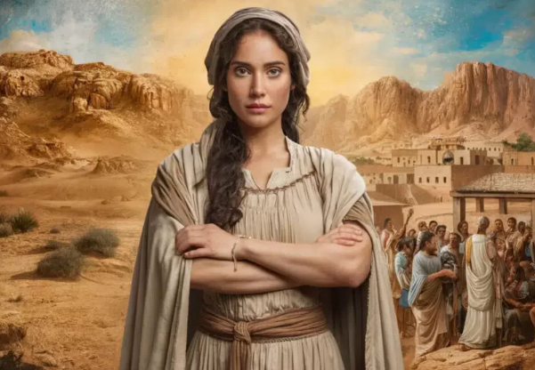
Deborah-Prophetess
The Lord call a woman to judge Israel. From the tribe of Ephraim. She was the wife of Lapidoth.
Israel was sorely lacking in leadership at this time. The regular priesthood leadership was not in effect because the covenant had been broken.
Deborah did not direct Israel in any official sense; she was a prophetess who possessed the spirit of prophecy, one of the gifts of the Spirit.
She was blessed with spiritual insight and leadership qualities that were not being put to use by any man.
Barak (from the tribe of Naphtali) would not lead an army against Jabin until Deborah promised to be present.
Together, she and the military leader Barak delivered Israel from the Canaanites.
…worship God: for the testimony of Jesus is the spirit of prophecy.
Revelation 19:10
Judges 4:4
(2)

Slide 21
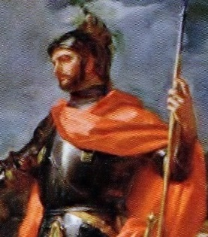
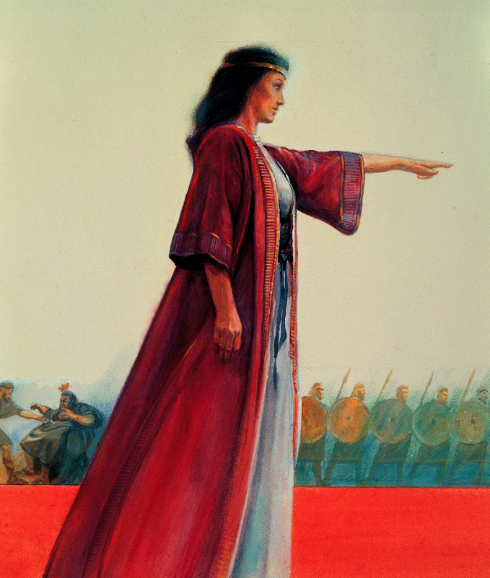
Song of Praise
Praise ye the Lord for the avenging of Israel, when the people willingly offered themselves.
Hear, O ye kings; give ear, O ye princes; I, even I, will sing unto the Lord; I will sing praise to the Lord God of Israel.
Deborah rightly saw in this event the hand of the Lord and gave Him credit for the victory
Judges 5
(2)

Slide 22
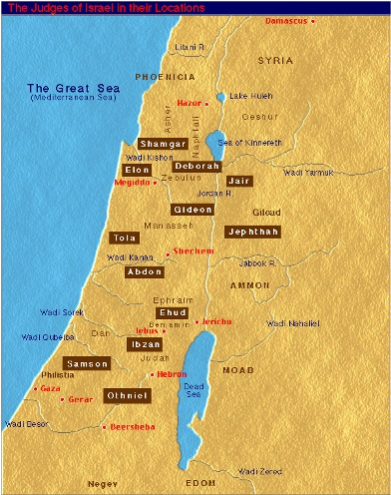
Sources:
Old Testament Student Manual Judges 1-12 (Rasmussen, Introduction to the Old Testament, 1:149.
Old Testament Institute Manual
Presentation by ©http://fashionsbylynda.com/blog/
3. Dictionary.com
4. President Spencer W. Kimball (The Miracle of Forgiveness, 171).
5. President Henry B. Eyring (“The Power of Deliverance” [Brigham Young University devotional, Jan. 15, 2008], 4, speeches.byu.edu)
6. Elder Dieter F. Uchtdorf(“Daily Restoration,” Liahona, Nov. 2021, 78)
Presentation by ©http://fashionsbylynda.com/blog/

Slide 23
7 Cycles (Patterns) In Judges
 | Cycle | Oppressor | Years of Oppression | Deliverer—Judge | Years of Peace
1 | Judges 3:7-11 | Mesopotamians | 8 | Othniel | 40
2 | Judges 3:12-30 Judges 3:31 | Moabites Philistines | 18 | Ehud Shagmar | 80
3 | Judges 4:1-5:31 | Canaanites | 20 | Deborah/Barak | 40
4 | Judges 6:1-8:32 | Midianites | 7 | Gideon | 40
5 | Judges 8:33-10:5 | Abimelech | 3 | Tola/Jair | 45
6 | Judges 10:6-12:15 | Ammonites and Philistines | 18 | Jephthah/Ibzam/ Elon/Abdon | 6,7, 10,8
7 | Judges 13:1-16:31 | Philistines | 40 | Samson | 20
Chart from: Talk thru the Bible by Bruce Wilkinson and Kenneth Boa pg. 62

Slide 24
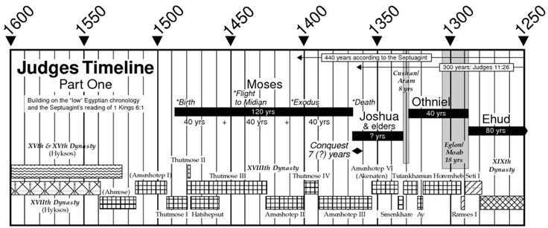

Slide 25
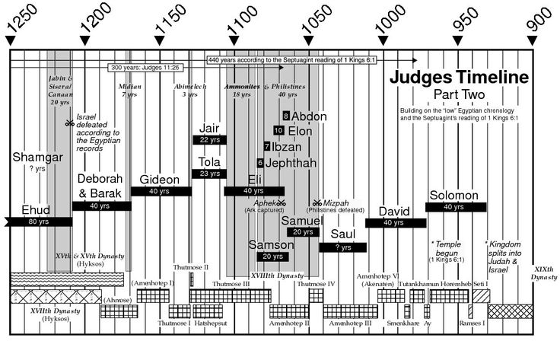
Charts by John C. Lawrenz

Slide 26
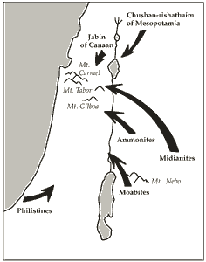
Othniel of Judah (3:9): victory against Chushan-rishathaim.
Ehud of Benjamin (3:15): victory against Eglon of Moab.
Shamgar (3:31): victory against the Philistines (location unknown).
Deborah (Ephraim) and Barak (Naphtali) (4:4–6): victory over Jabin and Sisera.
Gideon of Manasseh (6:11): victory over the Midianites and Amalekites.
Tola of Issachar (10:1).
Jair of Gilead (10:3).
Jephthah of Gilead (11:11): victory over the Ammonites.
Ibzan of Bethlehem (12:8).
Elon of Zebulun (12:11).
Abdon of Ephraim (12:13).
Samson of Dan (15:20): victory against the Philistines.

Slide 27
Idol Worship--Baalim: The word most often associated with idolatry in the Old Testament is Baal. The gods of a people—in the plural—may be referred to as Baalim, as in 1 Kings 18:18. [1 Kgs. 11:1–8] Thus, Baalism refers to the worship of anything or anyone other than the true and living God.
“No Other Gods before Me”
David H. Madsen
January 1990 Ensign
Judah and Benjamin:
It may be helpful to note that Judges 1:8 and 1:21 seem to contradict each other by indicating that two different tribes of Israel (Judah and Benjamin) controlled Jerusalem. In fact, Judah had conquered and was in control of the southern half of the city. The tribe of Benjamin controlled the northern half of Jerusalem, but they did not fully conquer it and drive out the Jebusites until the days of King David (see 2 Samuel 5:6–7).
Background Information On Palestine:
“When discussing the political and religious conditions in Palestine at the time of the Israelite conquest (between 1250 and 1200 B.C.), we should note that the whole Near East had boiled with turmoil during the preceding century. The power of Egypt’s ally in Mesopotamia, Mitanni, had collapsed. Egypt herself first lost and then regained power over much of the eastern Mediterranean area. The Hurrian and Aryan peoples had pressed down from the north almost as far as Palestine, Assyria had begun to rise as a world power, and the old Hittite Empire of Asia Minor and Egypt had reached a standoff for control of the Near East.
“In Palestine, Egypt was nominally in control. The land of Canaan was made up of numerous city-states, each independently governed, which paid tribute to Egypt whenever they were forced to do so. Other Hebrew tribes, distant relatives of the Israelites, comprised a modest part of the population in Canaan. It is also worth noting that prior to Israel’s settlement, the Canaanites had developed a linear alphabet, which later passed from Phoenicia to Greece, thus becoming the ancestor to our own.
“The material culture and international trade of the Canaanites was highly advanced, but their religious ways stood diametrically opposed to Israel’s. Based on the fertility cults led by the god Baal, the Canaanite religion was an extraordinarily immoral form of paganism, including … prostitution, homosexuality, and other orgiastic rites.
“The population of Canaan was mixed. In addition to the Canaanites near the sea and a few Hebrew clans, the Amorites are mentioned often in the Old Testament. Abraham descended from this Semitic people. Many of the other peoples listed in the Bible as inhabitants of the land (Hittites, Hivites, Horites, Jebusites, etc.) represent Canaan’s non-Semitic elements, although their tribal names preserve their distant origins. These people fully adopted the Canaanite religion and way of life by the time of the Israelite invasion.” (S. Kent Brown, “I Have a Question,” Ensign, Oct. 1973, p. 58.)
Baalim: Plural of "Baal"; occurs in the Bible fifteen times, always used with the article; not found in the Pentateuch nor in the poetical books. For a full discussion of the cult, see Ba'al-Worship. The true signification has been a matter of dispute. One of the leading explanations is that the expression is a "plural of majesty," equivalent to "the great god Ba'al," after the analogy of "Elohim" and "Adonim." Apart from other objections, it may be urged against this view that such phrases always become proper names, and, unlike "Baalim," are often used without the article.
Hence other explanations are more plausible; for example, that Baalim are images of the god Baal, or that they are the various forms in which Baal is worshiped. Since, however, there is no evidence of the formal worship in Israel of any Ba'al at a common center, and as the local Canaanitic deities were known as the "baals" of their respective districts, and as Israel notoriously addicted itself to the cult of such deities, it is altogether probable that the expression designates the local deities to which such worship was paid in various places by the Hebrews in Palestine. Among other passages, Judges viii. 33 is specially instructive on this point. In connection with the lapse of the people of Israel into the worship of the Baalim, it is there said that "they made Baal-berith their god"
By: Morris Jastrow, Jr., J. Frederic McCurdy Jewish Encyclopedia
Deborah—a Prophetess:
“No special ordination in the Priesthood is essential to man’s receiving the gift of prophecy; bearers of the Melchizedek Priesthood, Adam, Noah, Moses, and a multitude of others were prophets, but not more truly so than others who were specifically called to the Aaronic order, as exemplified in the instance of John the Baptist. The ministrations of Miriam and Deborah show that this gift may be possessed by women also.” (Talmage, Articles of Faith, pp. 228–29; see also Smith, Answers to Gospel Questions, 3:66.)
Prophetess: A woman who has received a testimony of Jesus and enjoys the spirit of revelation. A prophetess does not hold the priesthood or its keys. Though only a few women in the scriptures are called prophetesses, many prophesied, such as Rebekah, Hannah, Elisabeth, and Mary. (Guide to the Scriptures, “Prophetess,” Gospel Library)

Slide 28
Deborah
Of all the charismatic shophetim, of Deborah alone is it recorded that “the children of Israel came up … for judgment.” (Judg. 4:5.) Chosen by the elders of her tribe to dispense justice beneath her palm tree headquarters in the hill-country of Ephraim, she was also the charismatic leader called by the Lord to deliver the northern Israelite tribes from Canaanite tyranny.
Although they didn’t hold the priesthood and did not have equal authority with the prophets, prophetesses—inspired women with strong testimonies called upon by the Lord to perform various tasks—do not seem to have been unusual in ancient Israel. The writer of the book of Judges shows no astonishment concerning Deborah’s role as prophetess, judge, and deliverer. Indeed, as Daniel H. Ludlow points out, perhaps “the fact that a good woman was recognized as the spokesperson for the Lord is … indication of the failure of priesthood members to honor their responsibilities.”
Whatever the reason for her leadership calling, Deborah certainly followed the pattern of earlier Old Testament women in recognizing a need, heeding the word of the Lord, and acting accordingly. Rebekah ensured that the appropriate birthright blessing would be given to her son Jacob. Shiprah and Pual, the Hebrew midwives, defied Pharaoh and refused to slay infant male Israelites. And Miriam the prophetess, sister of Moses, helped her mother save her baby brother. Stories of these women may in fact have influenced Deborah.
Acting with honesty, integrity, courage, unwavering faith, and unquestioning obedience, Deborah was honored with great responsibilities both by her own people and by the Lord. She judged her people righteously; she heard and acted upon the word of the Lord when it came to her; she accompanied the Israelite army; and she gave glory to the Lord for her people’s deliverance.
Deborah’s War
Deborah’s war against the Canaanites, which took place around 1125 B.C. according to most biblical scholars, was so important to her people’s history that its events are recounted twice in the book of Judges—in chapter 4 and in chapter 5 [Judg. 4–5]. Chapter 4 is a narrative of the war, and chapter 5, the Song of Deborah, is a hymn of jubilant praise composed soon after the victory it celebrates. ⁷
Each chapter emphasizes different aspects of Deborah’s War, a battle that resulted after the Israelites “did evil in the sight of the Lord.” (Judg. 4:1.) They followed the pattern and “chose new gods.” (Judg. 5:8.) Consequently, the Lord allowed the Canaanites to oppress them harshly for twenty years (see Judg. 4:3), and the children of Israel fled from their villages and feared to travel the highroads. (See Judg. 5:6.)
When the word of the Lord came to Deborah, the Old Testament says, “I Deborah arose.” (Judg. 5:7.) She sent a message north to Barak of Kedesh-Naphtali: “Hath not the Lord God of Israel commanded, saying, Go and draw toward mount Tabor, and take with thee ten thousand men?” (Judg. 4:6.)
Barak, fearful and reluctant, agreed to gather an army and attack the Canaanites only if Deborah would accompany him on the mission. But according to Deborah, Barak’s reluctance was unnecessary: “The journey that thou takest shall not be for thine honour; for the Lord shall sell Sisera into the hand of a woman.” (Judg. 4:9.)
Sisera, captain of the Canaanite troops, gave Barak good reason to fear; he awaited the Israelites on the plain by the Wadi Kishon below Mount Tabor with the military might of powerful Canaan. Hundreds of invincible ironclad chariots threatened the ill-trained, poorly armed volunteer Israelite troops who waited on Mount Tabor with Deborah and Barak for the day chosen by the Lord.
Finally, “Deborah said unto Barak, Up; for this is the day in which the Lord hath delivered Sisera into thine hand.” (Judg. 4:14.) And the Lord went out before the Israelites with a terrible storm. Torrents of rain flooded down the mountainside, filling the Wadi Kishon and spilling over the plain: “And the Lord discomfited Sisera, and all his chariots, and all his host. … The river of Kishon swept them away.” (Judg. 4:15; Judg. 5:21.)
Deserting his army, Sisera fled north and sought refuge in the tent of Jael, a woman of the nomadic Kenite tribe, which had a peace agreement with the Canaanites. Jael fed him, concealed him with coverings, waited for him to sleep, and then hammered a tent peg through his temples. She turned the body over to Barak, having fulfilled Deborah’s prophecy that Sisera would be sold into the hands of a woman.
Deborah’s War broke the main Canaanite power in the north, opening the way for territorial expansion that united the Galilee tribes with the territory of Ephraim to the south. Under Deborah’s rallying call, a joint cooperative effort among the Israelite tribes produced victory against a common enemy. After the battle, Barak, according to Josephus, “was the commander of the Israelites for forty years.”
And what of Deborah, who fulfilled her call as Shophet,gathered the tribes to battle, then turned the leadership over to Barak? Nothing more is mentioned of her.
Perhaps, her work in the north finished, Deborah returned to her palm tree in the Ephraim hills and to her role as “a mother in Israel.” (Judg. 5:7.)
January 1990 Ensign Deborah and the Book of Judges by By Kristin E. Litchman

