Slide 1

Gideon, the Deliverer
Judges 6-9
Yea, signs come by faith, not by the will of men, nor as they please, but by the will of God.
D&C 63:10

Slide 2


When Do You Rely on the Lord for Strength ?
Dealing with an injury or sickness
Improving as a person
Education
Marriage
Mission
Employment
Working through challenges with family or friends
Making important decisions
(1)

Slide 3

The Israelites did evil in the sight of the Lord
Gideon
Peace for 40 years. Gideon died after having 70 sons
Cycle 4
Judges 6-7
The Midianites ruined all their crops and land, and the Israelites went to dwell in caves
Gideon led tribes of Manasseh, Asher, Zebulun, and Naphtali into war with the Midianites and defeated them
They were oppressed for 7 years
They cried unto the Lord and He sent an angel of the Lord to Gideon, from the tribe of Manasseh
The Lord tested Gideon and in return Gideon tested the Lord
*Lord—is referred as a title of respected persons,
a messenger of God

Slide 4
Gideon
He was the son of Joash, who was from the tribe of Manasseh and lived in Ophrah
His name means “warrior”
His judgeship commenced around 1263 BC
His first task was to break down the alter of Baal which his father built
He was given the name “Jerrubaal” meaning “let the shameful thing contend”
He led the Israelites to battle the Midianites and defeated them
The people wanted to make Gideon their king, but he refused
He requested the men gather up the ear-rings of the Midianites—the weight of the gold was a 1,700 shekels—he had a priestly garment made out of it to honor the Lord—this was the “snare unto Gideon, and to his house.” (Judges 8:28)
He married several wives and concubines and had 70 sons. After he died one son, Abimelech, killed 68 of his brothers, and only the youngest, Jotham, survived in hiding

Slide 5
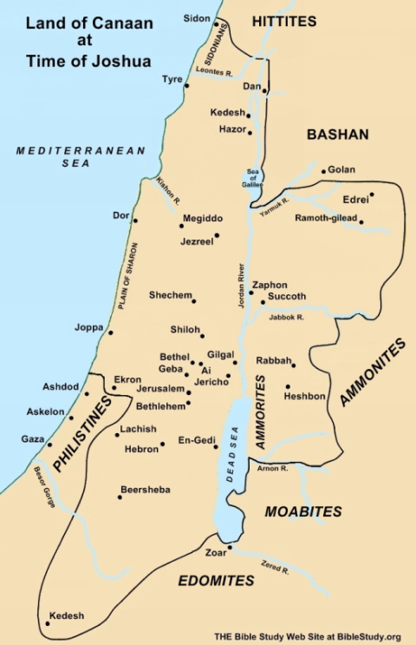
Midianites and Amalekites
200 years had past since the days of Joshua and the original conquest of Canaan.
Midianites were descendants of Abraham and Keturah
Amalekites were descendants of Esau
With them came other Semitic peoples who are referred to as “the children of the eat.”
These Gypsy-like nomads would wait until the Israelites had sown and cultivated their crops and after al the work was done they would swarm across the Jordan and destroy the land.
Judges 6:1-5
(1)

Slide 6
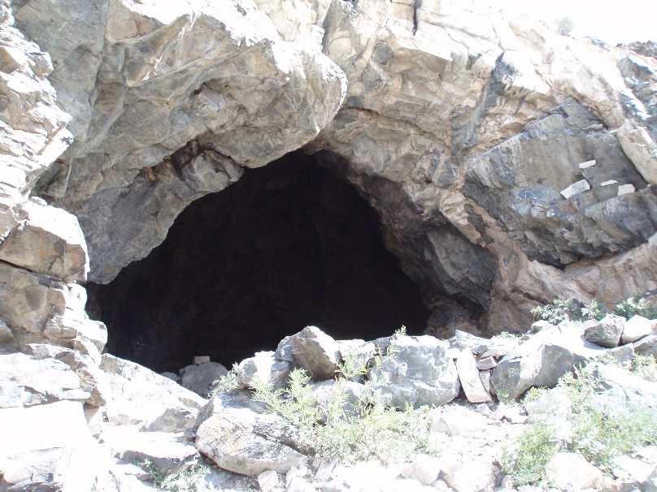
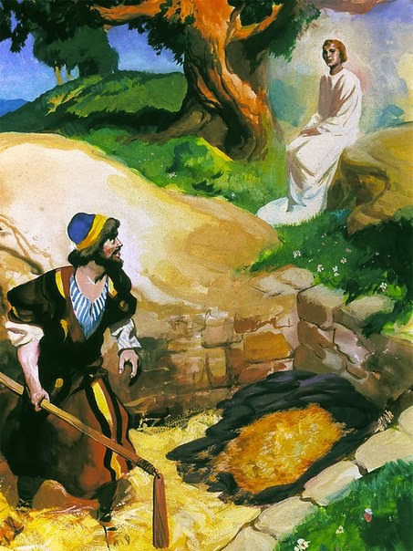
The Land Destroyed
This caused the Israelites to flee into dens in the mountains
And Israel was greatly impoverished because of the Midianites; and the children of Israel cried unto the Lord.
As Gideon hid his wheat from the destruction of the Midianites when his call came from an angel of the Lord.
Judges 6:6-16
(1)

Slide 7
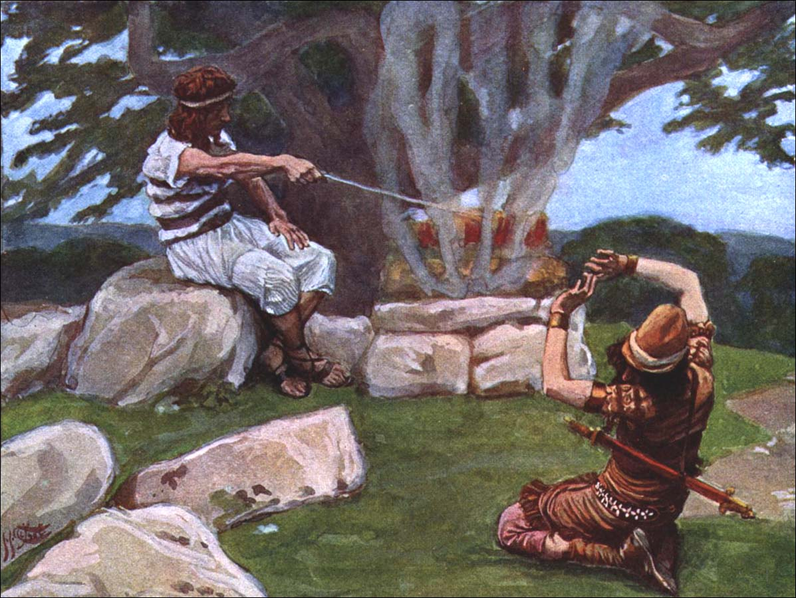
A Sign
“When Gideon asked for a ‘sign’ he seemed only to want a sign that the messenger was a bona fide emissary of the Lord (v. 17).
Signs may be given, based upon man’s faith and the will of God.
“When Gideon made a meal of meat, cakes and broth, and the angel turned it into a miraculous burnt offering, this ‘sign’ quite overwhelmed Gideon.
But the Lord kindly gave him comfort and peace, and Gideon gratefully named the monument he built there ‘Lord of Peace.’” (2)
Tissot
Judges 6:17-24

Slide 8
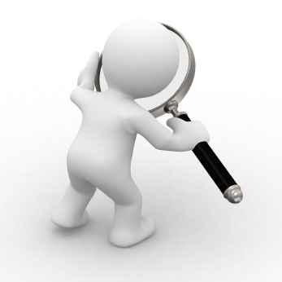
Seeking For Signs of Faith
There is a difference between sincerely seeking confirmation from God with real intent and demanding a sign from God without faith. The motive of the person seeking the sign from God is important.
Some people claim that they would believe in God or His work if they were able to receive a sign.
But faith does not come by signs. … The Lord revealed, ‘Faith cometh not by signs, but signs follow those that believe’.
Such signs are given to those who are faithful and obedient to strengthen them in their faith and to help them carry out the will of God.” (6)

Slide 9
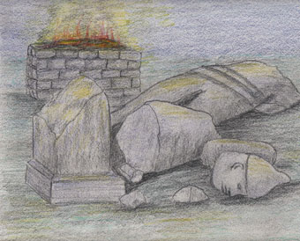
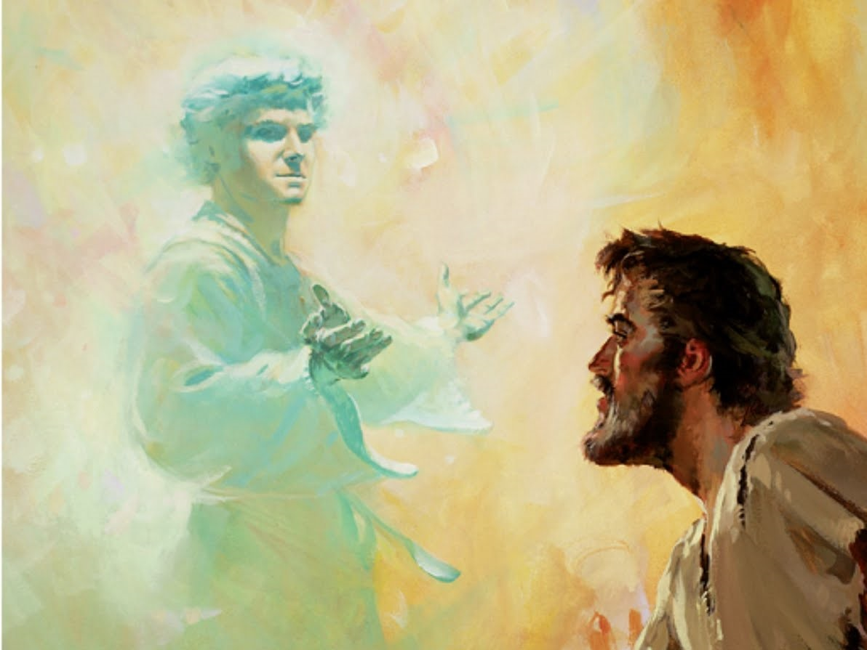
Throw Down the Alter of Baal
Gideon’s first task was to break down his father’s alter and cut down his grove
The men of Ophrah found out and were angry and wanted him killed, however, his father, Joash, defended him and gave Gideon the name of “Jerrubbaal”
If we desire to have the Lord’s help and strength, we must remove spiritually unclean and evil practices from our lives
Grove refers to “a pole or tree representing a fertility goddess,” or an idol
Judges 6:25-34

Slide 10
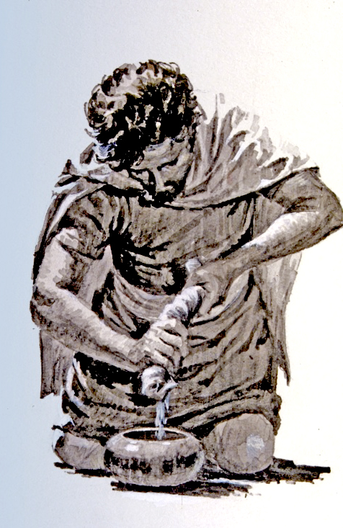
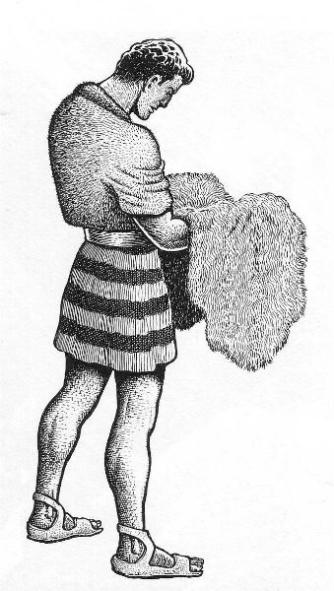
Another Sign
Gideon asked assistance for 4 tribes (Manasseh, Asher, Zebulun, Naphtali)
Gideon also asked for two more signs:
If the fleece in the morning would be wet but the ground dry
2. If the fleece on the next morning would be dry, but the ground wet
Judges 6:35-40

Slide 11
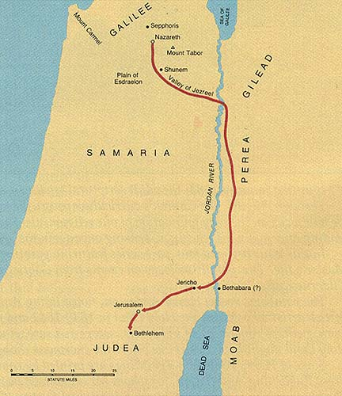
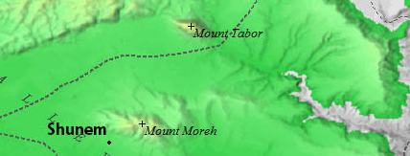
Valley of Jezreel
Hill of Moreh: 900 ft. from the valley floor
The Midianites had not camped in the valley of Jezreel but had passed around Mount Moreh and camped on its northern side in that bay of Esdraelon
The army gathered in the valley of Jezreel
Mount Tabor
Mount Moreh
Gideon
Midianites
Judges 7:1

Slide 12
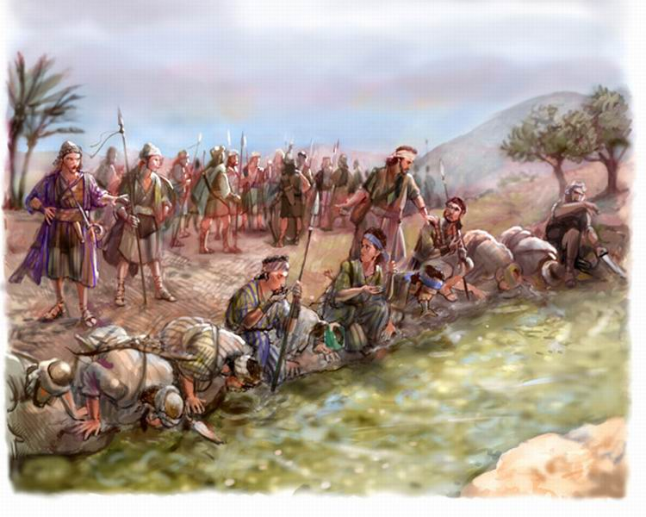
The Lord Chooses the Army
Too many soldiers show up for the battle
Gideon told the warriors to drink from a spring, and he was to pick out any who scooped up the water and drank by “putting their hand to their mouth.”
While nearly all the men lay prone to drink, he chose 300 men from those who drank with their hands cupped.
Judges 7:4-8

Slide 13
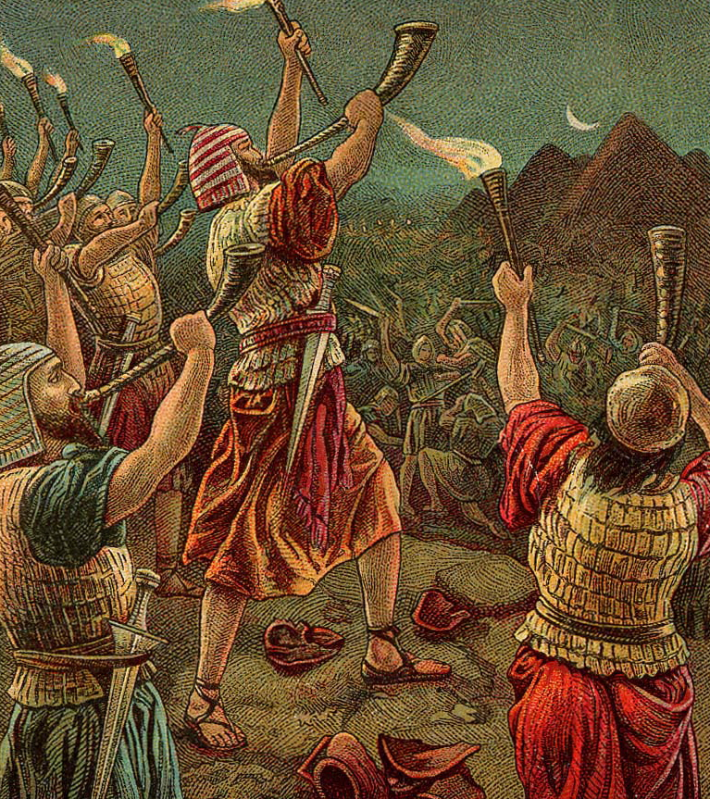
Gideon’s War
The army ascended the heights of Mount Moreh to look at the camp of the Midianites and the Amalekites where they separated into 3 groups of 100 and proceeded to certain strategic positions
They each had a pitcher with a light inside and a trumpet and while the Midianites were sleeping Gideon blew his war trumpet. All the men broke their pitchers and the light shown bright, and they blew their trumpets. The Midianites fled.
Gideon sent word to the Ephraimites. The Ephraimites killed 120,000 men. The Ephraimites took 2 princes of Midian, Oreb (he was slain on a rock) and Zeeb (he was killed near a winepress)
Judges 7:16-25

Slide 14
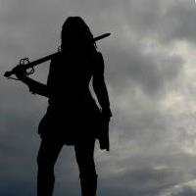
Gideon Pursues the Kings of Midian
Gideon pursued King Zebah and King Zalmunna of Midian who fled. He went through Succoth where the people refused to feed the army and Penuel.
After capturing King Zebah and King Zalmunna Gideon returned to Succoth, seized 70 leaders and flogged them with throne bushes, and in Penuel, Gideon destroyed their watchtower.
The Past in Succoth: And Jacob journeyed to Succoth, and built him an house, and made booths for his cattle: therefore the name of the place is called Succoth. Gen. 33:17
Succoth
Penuel
Judges 8:1-27

Slide 15
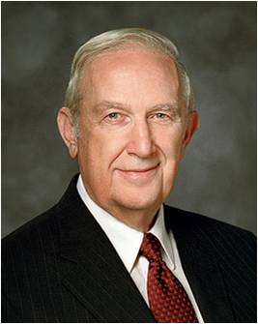
If we follow the Lord’s commands with exactness and always acknowledge our dependence on Him, then He will help us overcome our challenges
Let the Savior be your “lead” in life. He has said, “I am … the Rock of Heaven … ; whoso cometh in at the gate and climbeth up by me shall never fall.”
The Redeemer will safely lead you over the most difficult obstacles of life. His laws are absolutely secure anchors of protection that dispel fear and assure success in an otherwise dangerous world. Such a life will certainly provide you peace and happiness.
The Lord is intent on your personal growth and development. Your progress is accelerated when you willingly allow Him to lead you through every growth experience you encounter, whether you welcome the experience or not.
(3)

Slide 16
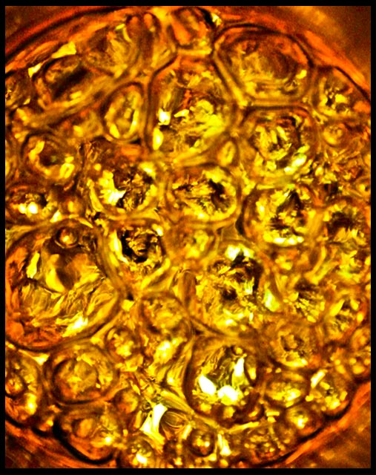
Gideon To Be King?
…Rule thou over us, both thou, and thy son, and thy son’s son also: for thou hast delivered us from the hand of Midian.
I will not rule over you, neither shall my son rule over you: the Lord shall rule over you.
He asked he be allowed to have the ear-rings which they had taken from the people of Midian.
The record is clear that it was not the purpose of Gideon to make himself rich with this gold, but rather to make a gift to the Lord.
However…he made a very rich priestly garment of ephod of gold, which was the procedure followed by heathen in honoring their gods.
This priestly garment was so magnificent that the people came to worship it instead of the Lord… “The Snare.”
Judges 8:22-28
(1)

Slide 17
Abimelech
He was one of the 70 sons of Gideon
His mother was one of the concubines (maid servant) from Shechem
She gave him the name meaning: my father is king”, or “my father hath reigned.”
Following the death of his father, he aspired to and obtained the office of king
He murdered 68 of his brothers to preserve his power and office; the youngest brother, Jotham, hid himself
He ruled with treachery and cunning, generating many enemies
He lost his life when a woman from a tower threw a rock and hit him on the head, but he remained conscious
Thinking he was going to die, he told one of his men to kill him because he did not want the people to know he was really killed by a “woman”
(4, 5)

Slide 18

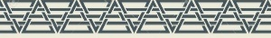
Jotham
He was the youngest son of Gideon
His name means: god is upright or perfect
He escaped the murderous rampage of Abimelech, his brother
and hid from him
From the tops of mount Gerizim, he courageously proclaim a repudiation of Abimelech in the form of a parable about trees going “forth on a time to anoint a king over them.” (Judges 9:8)
He also revealed the key to the parable
Three years from that time Abimelech and the men of Shechem fell victim to internal conflicts among themselves and perished
(4, 5)

Slide 19
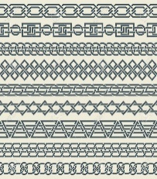
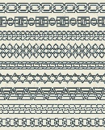
Jotham Climbs Mt Gerzim
Looking West
Valley of Shechem
Mt. Gerzim--blessings
Mt. Ebal--curses
Mt. Gerzim rises 800 ft. above the valley floor and from such a height a strange acoustical phenomenon often occurs. People standing below can clearly distinguish the words of normal conversation
Jotham tells his parable
(4)

Slide 20
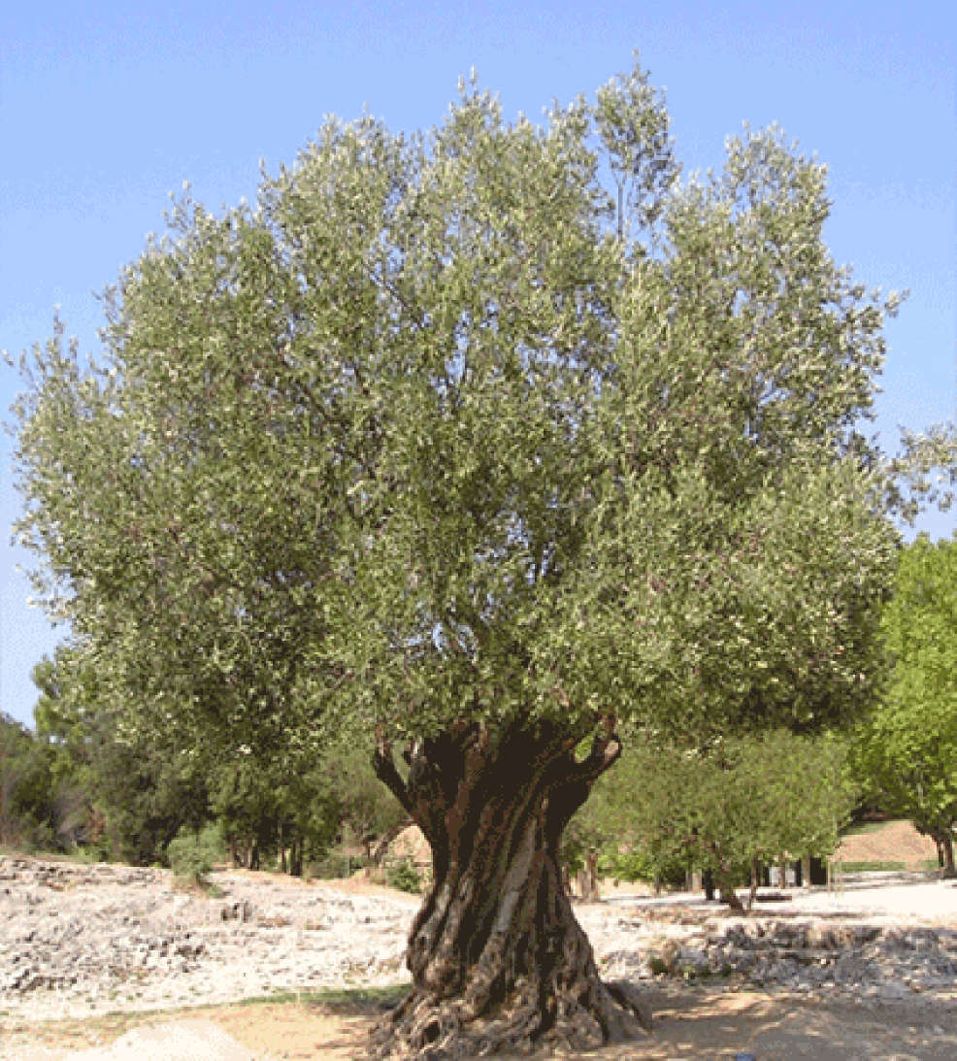
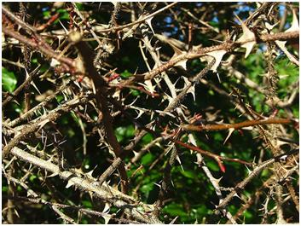
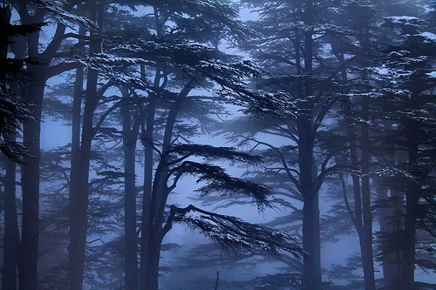
The Parable
“Once upon a time the trees decided to have a king appointed over them.
However, none of the fruitful trees would accept the crown because they felt there should be equality among the trees and not have one ruling over the rest.
Even the vine was invited to rule, but it also refused.
Finally the kingmakers asked the miserable bramble bush to reign over the trees and the bramble consented providing they would put their complete trust in him and obey his every command.
If they did not obey he said he would send out a fire which would consume all the trees, including the magnificent cedars of Lebanon.”
Judges 8-15
(1)

Slide 21
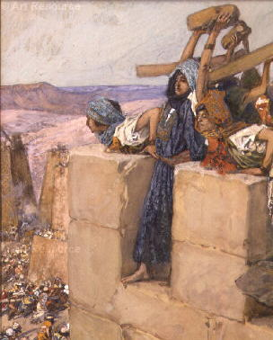
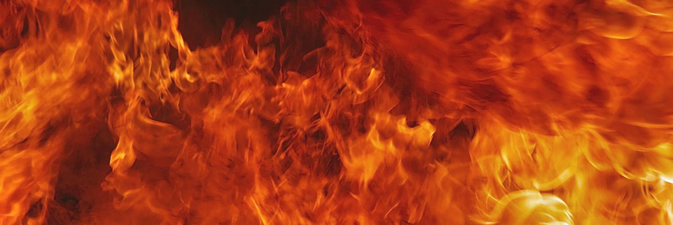
The Last Siege of Abimelech
“During the last stages of the siege he found that a thousand men and women had hidden in the “hold” of the heathen temple.
This was both a shrine and a fortress.
Abimelech was unable to get inside the “hold” …and he built a huge fire all around it and with flames, and fumes killed all who were within it, thereby literally fulfilling Jotham’s prophecy.
He stormed the city of Thebez and the people climbed into a tower…
Abimelech charged up to it ready to put fire to it and a woman took her household millstone (usually weighing around 25 pounds) and cast it down from the tower on Abimelech’s head.
Draw thy sword, and slay me, that men say not of me, A woman slew him
Judges 9:46-56
(1)

Slide 22
How to Rely on the Lord
Trust in the Lord with all thine heart; and lean not unto thine own understanding.
In all thy ways acknowledge him, and he shall direct thy paths.
Phillipians 4:13
I can do all things through Christ which strengtheneth me.
Proverbs 3:5-6
Ether 12:27
Yea, I know that I am nothing; as to my strength I am weak; therefore I will not boast of myself, but I will boast of my God, for in his strength I can do all things; yea, behold, many mighty miracles we have wrought in this land, for which we will praise his name forever.
And if men come unto me I will show unto them their weakness. I give unto men weakness that they may be humble; and my grace is sufficient for all men that humble themselves before me; for if they humble themselves before me, and have faith in me, then will I make weak things become strong unto them.
Alma 26:12

Slide 23
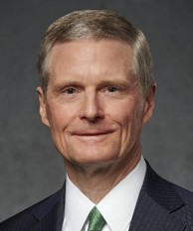
In many of the uncertainties and challenges we encounter in our lives and in this great latter-day work, God requires us to do our best, to trust in Him, to be anxiously engaged and act and not simply wait to be acted upon.
We may not see angels, hear heavenly voices, or receive overwhelming spiritual impressions. We frequently may press forward hoping and praying—but without absolute assurance—that we are acting in accordance with God’s will.
But as we honor our covenants and keep the commandments, we can walk with confidence that God will guide our steps.
(7)

Slide 24
Sources:
Video: “Just Keep Going—with Faith” (ChurchofJesusChrist.org) from time code 6:08 to 9:47.
W. Cleon Skousen The Third Thousand Years pp. 536-555
(Rasmussen, Introduction to the Old Testament, 1:150.) from Old Testament Institute Manual
Elder Richard G. Scott The Atonement Can Secure Your Peace and Happiness Oct 2006 Gen. Conf.
Who’s Who in the Old Testament by Ed J. Pinegar and Richard J. Allen p. 4, 112
Abimelech---Clarke, Bible Commentary Vol. 2. p. 139
Presentation by ©http://fashionsbylynda.com/blog/
6. (Gospel Topics, “Signs”; topics.lds.org). In Gideon’s case, he righteously sought for a sign in faith.
7. Elder Bednar Shares Five Lessons about the Spirit of Revelation with New Mission Leaders,” Church News, July 10, 2018)

Slide 25
7 Cycles In Judges
 | Cycle | Oppressor | Years of Oppression | Deliverer—Judge | Years of Peace
1 | Judges 3:7-11 | Mesopotamians | 8 | Othniel | 40
2 | Judges 3:12-30 Judges 3:31 | Moabites Philistines | 18 | Ehud Shagmar | 80
3 | Judges 4:1-5:31 | Canaanites | 20 | Deborah/Barak | 40
4 | Judges 6:1-8:32 | Midianites | 7 | Gideon | 40
5 | Judges 8:33-10:5 | Abimelech | 3 | Tola/Jair | 45
6 | Judges 10:6-12:15 | Ammonites and Philistines | 18 | Jephthah/Ibzam/ Elon/Abdon | 6,7, 10,8
7 | Judges 13:1-16:31 | Philistines | 40 | Samson | 20
Chart from: Talk thru the Bible by Bruce Wilkinson and Kenneth Boa pg. 62

Slide 26
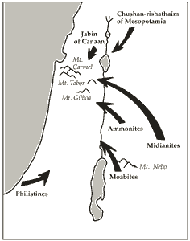
Othniel of Judah (3:9): victory against Chushan-rishathaim.
Ehud of Benjamin (3:15): victory against Eglon of Moab.
Shamgar (3:31): victory against the Philistines (location unknown).
Deborah (Ephraim) and Barak (Naphtali) (4:4–6): victory over Jabin and Sisera.
Gideon of Manasseh (6:11): victory over the Midianites and Amalekites.
Tola of Issachar (10:1).
Jair of Gilead (10:3).
Jephthah of Gilead (11:11): victory over the Ammonites.
Ibzan of Bethlehem (12:8).
Elon of Zebulun (12:11).
Abdon of Ephraim (12:13).
Samson of Dan (15:20): victory against the Philistines.

Slide 27
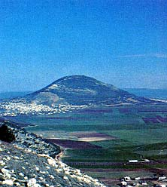
Jezreel:
The name of the first child (of Hosea), Jezreel, is the same as that of the valley of former King Jehu’s bloody purge, and foreshadowed Israel’s overthrow in that strategic valley.
It is a valley overlooked by Megiddo (New Testament “Armageddon”; see Revelation 16:16) and famed for crucial battles past and future.
Jezreel means “God shall sow,” or scatter abroad, since anciently sowing was done by casting handfuls of seed. It undoubtedly alludes to the overthrow and scattering of Israel.
Old Testament Student Manual
Mount Tabor and the Jezreel Valley, photograph by CES.
Valley of Jezreel:
They (Joseph and Mary) would probably have made the journey from Nazareth to Bethlehem by one of two routes. One would have taken them south across the Jezreel Valley, then through the hills of Samaria into Judaea.
This is the more direct route in straight-line distance—but there are two reasons it probably was not the way Joseph and Mary went: It is physically demanding, with constant ups and downs through the hills—and it took the traveler directly through Samaritan country, and “the Jews [had] no dealings with the Samaritans” (John 4:9).
The other possible route is the one Joseph and Mary more likely traveled. It would have taken them southeast across the Jezreel Valley, connecting with the Jordan Valley, then level or slightly down in elevation all the way to Jericho, then up through the Judaean Desert to Jerusalem and Bethlehem.
D. Kelly Ogden The Road to Bethlehem December 1995 Ensign
Elijah and Jezreel:
It is likely that Ahab’s chariot—like those of Sisera a few centuries previous to this, in the same area—had become bogged down in the mud newly formed in the valley by the rainfall. At any rate, Elijah, on foot, beat Ahab to the gates of Jezreel, and the outcome of the footrace plays a role in Elijah’s attack on the worship of Baal. 1 Kings 18
John A Tvedtnes Elijah: Champion of Israel’s God July 1990 Ensign

Slide 28
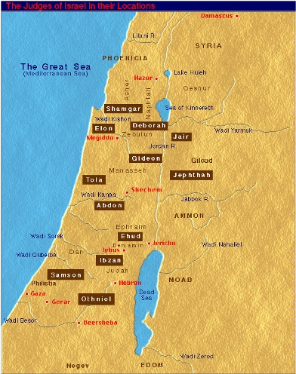
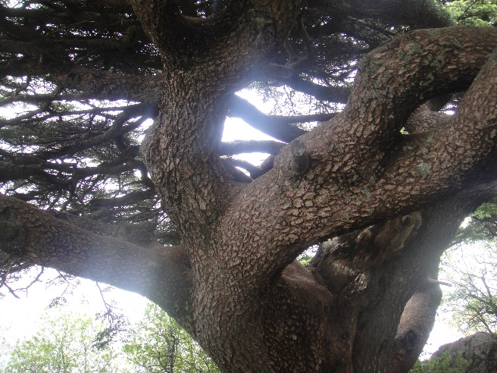
Destroying the Sanctuary of Joash:
Gideon’s father, Joash, owned a grove and an altar dedicated to the false god Baal. Groves of trees played a prominent part in ancient heathen worship. Since it was thought wrong to shut up the gods with walls, groves of trees were often used as natural temples. Within the groves the immoral rites of the heathen religions were performed.
Gideon and ten other men followed the Lord’s commandments to tear down the grove and the altar and in their place erect an altar to Jehovah. The men of the city cried for Gideon’s death, but Joash defended his son’s actions. Joash named Gideon Jerubbaal, “let Baal plead,” meaning that if Baal was upset by Gideon’s actions Baal could defend his own cause. The name Jerubbaal remained with Gideon on some occasions thereafter.
Old Testament Institute Manual
Trees Symbolically:
[The Torah compares humans to trees] because, like humans, trees have the power to grow. And as humans have children, so trees bear fruit.
Humans have been compared to trees from many different points of view. They both draw upon the same elements: earth, water, air and fire (sun); the basic components of the tree – roots, trunk, branches, leaves and fruit – allegorize the complexity of human nature and existence.
http://www.jewishfolksongs.com/en/tree-of-life
The trees of Lebanon:
The mountains of Lebanon were once shaded by thick cedar forests and the tree is the symbol of the country.
The trees of Lebanon is one of the last vestiges of the extensive forests of the Cedars of Lebanon (Cedrus libani ) that thrived across Mount Lebanon in ancient times. Their timber was exploited by the Phoenicians, Israelites, Assyrians, Babylonians and Persians. The wood was prized by Egyptians for shipbuilding; the Ottoman Empire also used the cedars in railway construction. ^{wikipedia}

