Slide 1

The Cycle Continues
Judges 10-21
Tola
Samson
Abdon
Jair
Elon
Jephthah
Ibzam

Slide 2

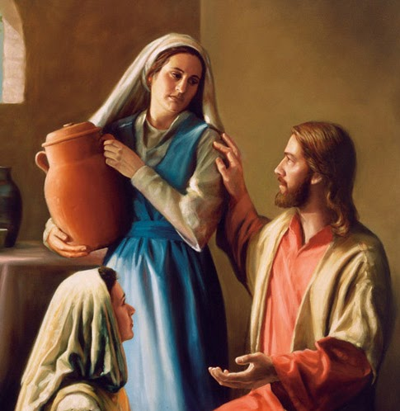

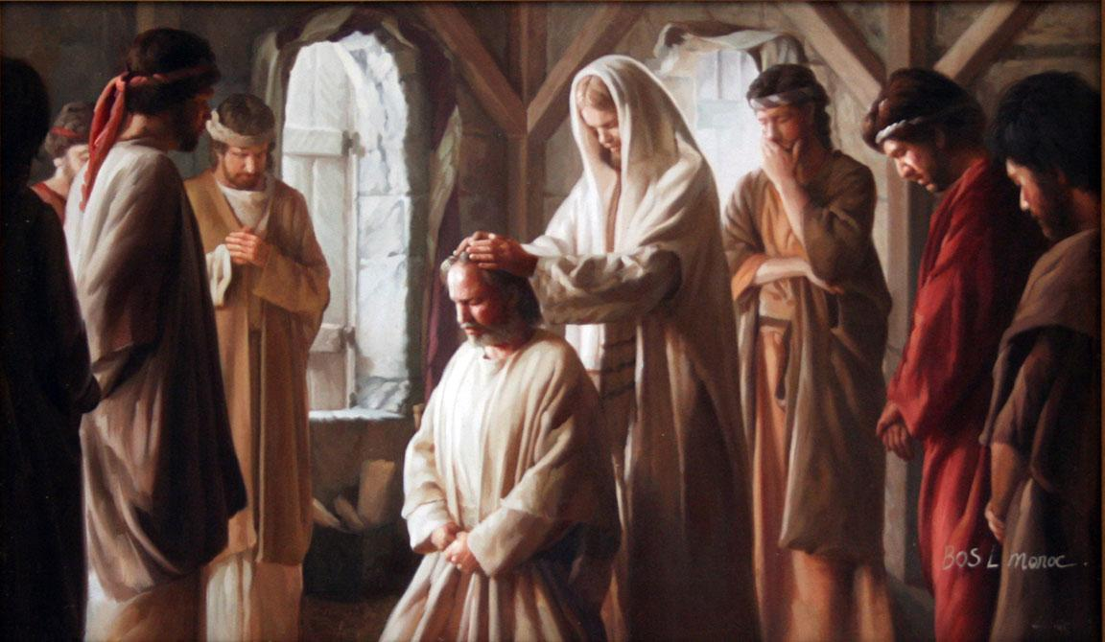

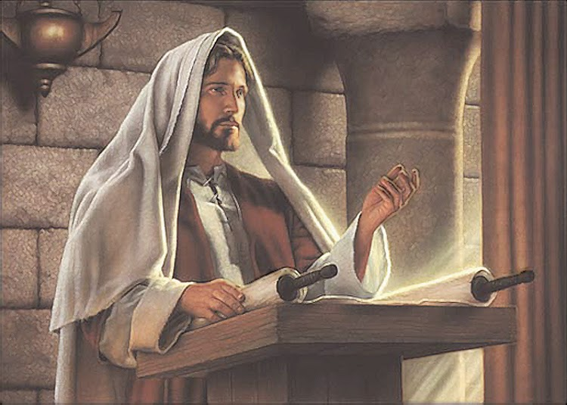
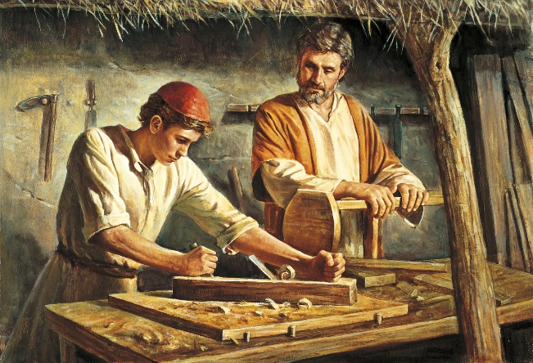
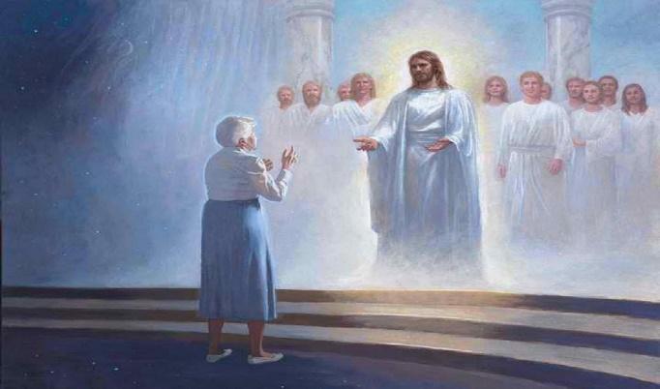
What Would You Like to Accomplish In Your Life?
Serving the Lord
Creating an eternal family
Receiving essential ordinances and covenants
Receiving an education
Developing skills, talent, and divine attributes
Living worthily to return to Heavenly Father’s presence

Slide 3
The Israelites did evil in the sight of the Lord
Tola
Jair
After 45 years of peace the two judges die
Cycle 5
Judges 10
Abimelech is king and oppressed the Israelites for 3 years
Then the Lord sent Jair a Gileadite (from the tribe of Manasseh) judged for 22 years
They cried unto the Lord
The Lord sent Tola (from tribe of Issachar) He judged Israel 23 years.
Judges 11-12

Slide 4
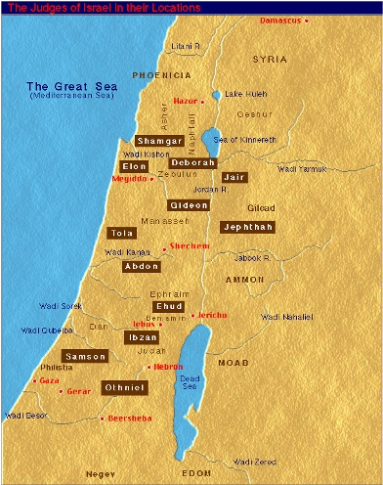
Tola and Jair
Tribe of Issachar
Tribe of Manasseh
Dodo
Jair
A descendant of Gilead (the man)
He had 30 sons and they had 30 cities called Havoth-jair (land of Gilead
He judged for 22 years
He was buried in Camon
Puah
Tola
Dwelt in Shamir in Mount Ephraim
He judged Israel for 23 years
He was buried in Shamir

Slide 5
The Israelites did evil in the sight of the Lord
Elon
Ibsam
Jephthah
Abdon
After 31 years of peace the judges die out one by one
They served the gods of: Baalim, Ashtaroth, Syria, of Zidon, Moab, Ammon, and the Philistines
Cycle 6
Judges 11-12
Then the Lord sends Ibzam, Elon, and Abdon to be judge over Israel
The Lord sold them into the hands of the Philistines and the Ammonites and they were oppressed for 18 years
The Israelites plead for Jephthah to be their leader and judge
Judges 11-12

Slide 6
Jephthah
He was from the tribe of Manasseh and the son of Gilead
He was born of a “harlot” (tavern keeper, a lower class citizen) and ejected from his home by his brothers and dwelt in the land of Tob
He gathered the strength of an army
When the Israelites needed someone to be their leader they went to Jephthah to deliver them and he finally consented
Instead of attacking the Ammonites (descendants of Lot), he confronted the king—through which an argument occurred over who owned the land which caused the Ammonites to bare arms against the Israelites
The Spirit of the Lord came over him, and he made a vow that if the Lord would deliver him he would make an offering unto the Lord (*see notes)
The Israelites were victorious over the Ammonites, however a civil war broke out between the Ephraimites and the army of Jephthah (* see notes)
There was 6 years of peace for the Israelites and he died
(1,2)

Slide 7
Ibzam, Elon, and Abdon
Ibzam
He was from the tribe of Judah
He had 60 children, 30 sons and 30 daughters
He lived in his own country (Bethlehem) and judged 7 years
He died and was buried in Bethlehem
Abdon
He was from the tribe of Ephraim
He was the son of Hilel and born in the city of Pirathon of Ephraim
He had 40 sons and 30 nephews
The sons were skillful riders
He judged for 8 years
He was buried in Pirathon (Pyrathon)
Elon
He was from the tribe of Zebulun
He judged 10 years

Slide 8
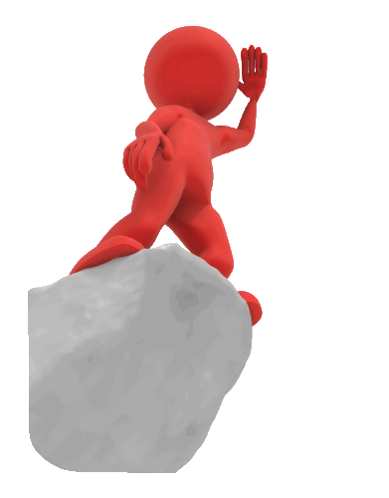

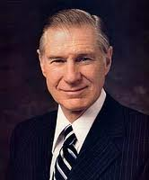
Leaders
What kind of leader did the Israelites need to help them be permanently freed from their enemies?
A righteous spiritual leader who could help them forsake their sins.
“…a leader must cause things to happen and lives to be affected. Something should move and change. He must see that those under him do not fail. But it should be done in the Lord’s way.
He should be the instrument in the hands of the Almighty for changing lives. He needs to know where he is now, where he is going, and how he is going to get there.
A leader must be a good listener. He must be willing to take counsel.” (3)

Slide 9
The Israelites did evil in the sight of the Lord
Samson
After 20 years of peace Samson suffered a tragic death
The Lord delivered the Israelites into the hands of the Philistines for 40 years
Cycle 7
Judges 13
Samson overpowers the Philistines for a short period of time
The Lord provided Samson to deliver the people
Judges 13

Slide 10
Samson
An angel of the Lord came to the wife of Manoah, a member of the Tribe of Dan, and told her that she would conceive (being barren) a son
He was to be a Nazarite—dedicating his life to the Lord– no alcohol consumption, cannot shaving, and no contact with the dead
He slayed a lion with his bare hands during the time he was courting a Philistine woman and sleww 1,000 Philistines with the jawbone of an ass
After a bitter disappointed marriage he had a fatal interaction with a woman from the valley of Sorek, Delilah
Delilah was bribed by the Philistines into finding the secret to his strength
Delilah caused his hair to be cut while he slept, which left him powerless (His power was diminished because he had not turned to the Lord—He was led by his own ambition)
He was blinded by the Philistines and imprisoned
Later after his hair grew out the Philistines assembled to celebrate their victory and to make sport of Samson
He called one last time upon the Lord and pulled down the pillars of the house upon himself and 3,000 of the celebrants who were there. He also died under the rubble and was buried between Zorah and Eshtaol, the burying place of Manoah his father
(1)

Slide 11
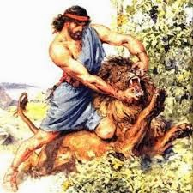
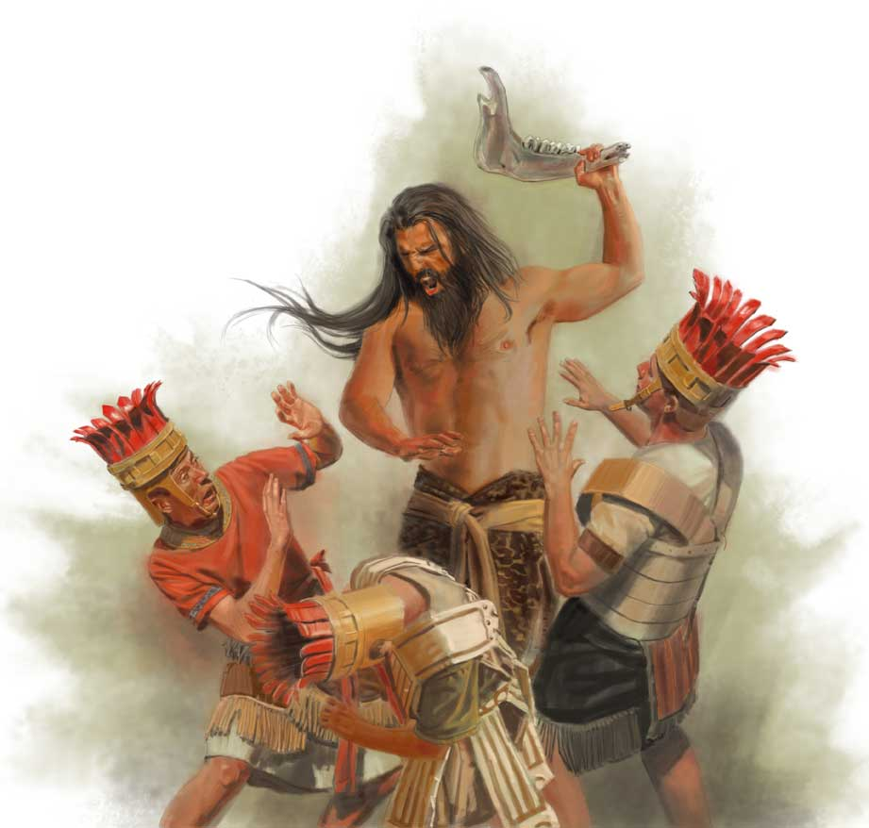
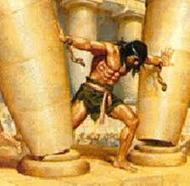
The Spirit of the Lord
Today when we speak of someone having the Spirit of the Lord, we are usually referring to someone who is faithful and obedient and therefore close to God.
However, referring to Samson, the phrase seems to acknowledge Samson’s remarkable physical strength, which came as a gift from God.
The scriptures give credit to the Lord, the true source of Samson’s gift, by saying “the Spirit of the Lord came mightily upon him,” but this does not necessarily mean that the Lord prompted or approved of Samson’s actions.
Sometimes Samson used his gift of strength properly, and sometimes he did not.
Anger and vengeance can lead us to make choices that hurt others and ourselves
Judges 14
(1)

Slide 12
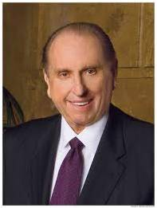
“I ask, is it possible to feel the Spirit of our Heavenly Father when we are angry? I know of no instance where such would be the case. …
“To be angry is to yield to the influence of Satan. No one can make us angry. It is our choice. If we desire to have the proper spirit with us at all times, we must choose to refrain from becoming angry. I testify that such is possible”
(4)

Slide 13

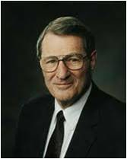
Placing Our Own Desires Before the Lord’s
“…our desires profoundly affect the use of our moral agency. Desires thus become real determinants, even when, with pitiful naivete, we do not really want the consequences of our desires.
For I, the Lord, will judge all men according to their works, according to the desire of their hearts. D&C 137:9
“Desire denotes a real longing or craving. Hence righteous desires are much more than passive preferences or fleeting feelings. Of course our genes, circumstances, and environments matter very much, and they shape us significantly.
Yet there remains an inner zone in which we are sovereign, unless we abdicate. In this zone lies the essence of our individuality and our personal accountability.”
If we place our own desires ahead of the Lord’s will, then we will not reach our divine potential
(4)

Slide 14
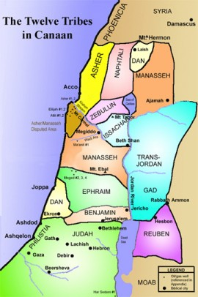
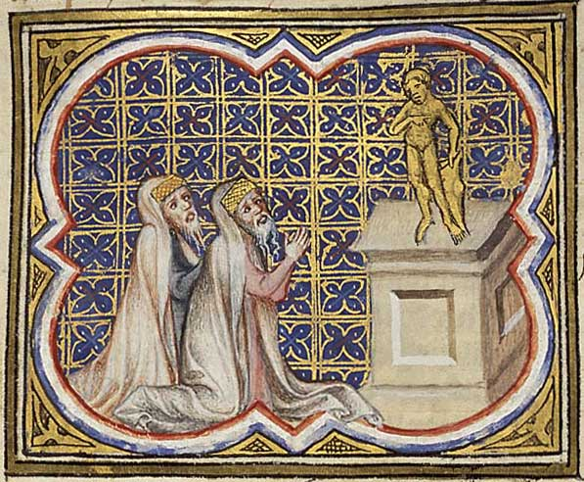
Micah and Jonathan
Micah was an Ephraimite after the days of Samson
He set up a molten image within his own household
He hired Jonathan, the son of Gershom the Levite, to serve as a private priest
The Danites sought to take the image and then burn the city of Laish
When members of the tribe of Dan seized the image, they lured the priest away and took over the city of Laish, renaming it Dan…there they cultivated idol worship for generations, aided by Jonathan and his posterity
Laish name changed to Dan
The City of Dan was in the furthest most Northern territory of Israel and Beer-sheba was the southernmost city
You might find the phrase “Dan to Beer-sheba meaning (going throughout all the land)
(1)

Slide 15
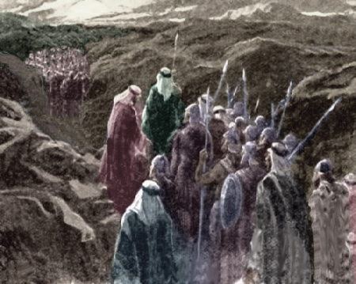
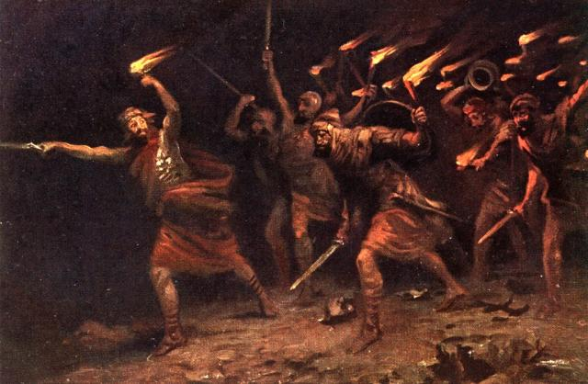
The Israelites During the Time of Judges
Extraordinary courage was required for an Israelite to be devoted to the Lord during this era. Unfortunately, this situation arose not because of pressure from outside of Israel but because of pressure from within.
Indeed, Israel’s problem did not stem from the pagan masses they faced. It lay within their own hearts.
Their greatest enemies were not the power-hungry Midianites or Moabites but inward vacillation, apathy, disobedience, and rebellion.
Their outward enemies raged through them constantly only because the inward weaknesses raged unchecked also.
The Canaanites and Philistines are gone today. But are not the offspring of their gods, metamorphosed into modern form and made intellectually acceptable, still with us? And what of apathy, disobedience, vacillation, and rebellion? Is not our greatest enemy within? If so, then the same kind of courage displayed by the people of whom you have just read is as necessary now as it was then.
(5)

Slide 16
Sources:
Who’s Who in the Old Testament by Ed J. Pinegar and Richard J. Allen p. 90, 106, 126,163
W. Cleon Skousen The Third Thousand Years pg. 558-559
Presentation by ©http://fashionsbylynda.com/blog/
3. President James E. Faust These I Will Make My Leaders Oct. 1980 Gen. Conf.
4. President Thomas S. Monson (“School Thy Feelings, O My Brother,” Ensign or Liahona, Nov. 2009, 67, 68).
5. Old Testament Institute Manual

Slide 17
7 Cycles In Judges
 | Cycle | Oppressor | Years of Oppression | Deliverer—Judge | Years of Peace
1 | Judges 3:7-11 | Mesopotamians | 8 | Othniel | 40
2 | Judges 3:12-30 Judges 3:31 | Moabites Philistines | 18 | Ehud Shagmar | 80
3 | Judges 4:1-5:31 | Canaanites | 20 | Deborah/Barak | 40
4 | Judges 6:1-8:32 | Midianites | 7 | Gideon | 40
5 | Judges 8:33-10:5 | Abimelech | 3 | Tola/Jair | 45
6 | Judges 10:6-12:15, 11-12 | Ammonites and Philistines | 18 | Jephthah/Ibzam/ Elon/Abdon | 6,7, 10,8=31
7 | Judges 13:1-16:31 | Philistines | 40 | Samson | 20
Chart from: Talk thru the Bible by Bruce Wilkinson and Kenneth Boa pg. 62

Slide 18
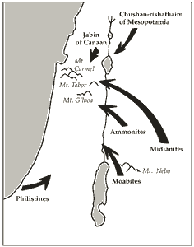
Othniel of Judah (3:9): victory against Chushan-rishathaim.
Ehud of Benjamin (3:15): victory against Eglon of Moab.
Shamgar (3:31): victory against the Philistines (location unknown).
Deborah (Ephraim) and Barak (Naphtali) (4:4–6): victory over Jabin and Sisera.
Gideon of Manasseh (6:11): victory over the Midianites and Amalekites.
Tola of Issachar (10:1).
Jair of Gilead (10:3).
Jephthah of Gilead (11:11): victory over the Ammonites.
Ibzan of Bethlehem (12:8).
Elon of Zebulun (12:11).
Abdon of Ephraim (12:13).
Samson of Dan (15:20): victory against the Philistines.

Slide 19
Jephthah’s Vow Commentary
Many have supposed that Jephthah offered his daughter as a human sacrifice, and a literal reading of the text may support that view. But if that is true, some difficult questions are raised. Jephthah was regarded as a great hero and deliverer of Israel, and even his sacrifice of his daughter is treated in a way that suggests the author of Judges viewed it as a commendable act. In Hebrews 11:32–35 Jephthah is used as one of the examples of great faith. Would this case be true if he had engaged in human sacrifice, an act viewed as one of the greatest of abominations in ancient Israel? Why does Jephthah’s daughter “bewail her virginity” (Judges 11:37) rather than mourn the approaching loss of her life? After Jephthah had fulfilled his vow of sacrificing his daughter, the text states that “she knew no man” (v. 39). Bible scholars have suggested an explanation that adequately answers these questions.
“Jephthah was compelled by his vow to dedicate his daughter to Jehovah in a lifelong virginity. … The entreaty of the daughter, that he would grant her two months’ time, in order that she might lament her virginity upon the mountains with her friends, would have been marvelously out of keeping with the account that she was to be put to death as a sacrifice. To mourn one’s virginity does not mean to mourn because one has to die a virgin, but because one has to live and remain a virgin. But even if we were to assume that mourning her virginity was equivalent to mourning on account of her youth. … ‘it would be impossible to understand why this should take place upon the mountains. It would be altogether opposed to human nature, that a child who had so soon to die should make use of a temporary respite to forsake her father altogether. It would no doubt be a reasonable thing that she should ask permission to enjoy life for two months longer before she was put to death; but that she should only think of bewailing her virginity, when a sacrificial death was in prospect, which would rob her father of his only child, would be contrary to all the ordinary feelings of the human heart. Yet, inasmuch as the history lays special emphasis upon her bewailing her virginity, this must have stood in some peculiar relation to the nature of the vow. …’ (P. Cassel, p. 473).
And this is confirmed by the expression, to bewail her virginity ‘upon the mountains.’‘ If life had been in question, the same tears might have been shed at home. But her lamentations were devoted to her virginity, and such lamentations could not be uttered in the town, and in the presence of men. Modesty required the solitude of the mountains for these. …’ (P. Cassel, p. 476). And so, again, the still further clause in the account of the fulfilment of the vow, ‘and she knew no man,’ is not in harmony with the assumption of a sacrificial death. This clause would add nothing to the description in that case, since it was already known that she was a virgin. The words only gain their proper sense if we connect them with the previous clause, he ‘did with her according to the vow which he had vowed,’ and understand them as describing what the daughter did in fulfilment of the vow. The father fulfilled his vow upon her, and she knew no man; i.e. he fulfilled the vow through the fact that she knew no man, but dedicated her life to the Lord, as a spiritual burnt-offering, in a lifelong chastity. … And the idea of a spiritual sacrifice is supported not only by the words, but also most decisively by the fact that the historian describes the fulfilment of the vow in the words ‘he did to her according to his vow,’ in such a manner as to lead to the conclusion that he regarded the act itself as laudable and good. But a prophetic historian could never have approved of a human sacrifice.” (Keil and Delitzsch, Commentary, 2:1:392–93.)
Compare the wording of Jephthah’s vow (see vv. 30–31) to Hannah’s vow (see 1 Samuel 1:11). Old Testament Institute Manual
Jephthah’s vow:
“Great difficulty has grown out of this passage in its present form Jephthah is vowing to sacrifice “whatsoever” come forth to greet him when he returns. Such a vow is completely illogical. Jephthah would realize that whoever or whatever came out to meet him would in all likelihood be a person rather than a domestic animal and therefore not lawful for a sacrificial offering.
Some leading authorities believe that a single letter was inaccurately copied in the original Hebrew test and, if so, it would change the entire meaning of this passage. It is their belief that the original meaning was as follows: “Whatsoever cometh forth of the doo of my house to meet me -- shall be the Lords: and I will offer HIM (not “it) a burnt offering.” In other words Jephthah is saying that whoever comes to greet him when he returns home will be dedicated to the service of the Tabernacle (as later happened to Samuel), and in addition, Jephthah vowed he would make a burnt offering of thanksgiving to the Lord. (Clark, Bible Commentary, Vol. 2. p. 151)”
W. Cleon Skousen The Third Thousand Years p. 561-562

Slide 20
*Ephraimites (Civil War):
“Barely had Jephthah returned home from his victory over the Ammonites when he found himself confronted by anew king of war.
By conquering the Ammonites Jephthah had been made the leader of all of the Israelites east of the Jordan. Suddenly, however, he found the Ephraimites from west of the Jordan coming up against him with a great force. Their complaint was that Jephthah had taken military action against their common enemy without giving the Ephraimites the privilege of participating.
“And the men of Ephraim gathered themselves together, and went northward, and said unto Jephthah, Wherefore passedst thou over to fight against the children of Ammon, and didst not call us to go with thee? we will burn thine house upon thee with fire.” (Judges 12:1)
The Bible does not give the specific reason but more than likely it was because of the spoils involved. For 18 years the Ammonites had been stealing from all the tribes in southern Israel and now that they had been beaten the matter of dividing the spoils would loom large in the minds of the Ephraimites. They appeared to feel that Jephthah had cheated them by not giving them a chance to participate in the campaign and thereby get their fair share.” W. Cleon Skousen The Third Thousand Years p. 563-564
The Israelites during the time of Judges:
“After this, the Israelites grew effeminate as to fighting any more against their enemies, but applied themselves to the cultivation of the land, which producing them great plenty and riches, they neglected the regular disposition of their settlement, and indulged themselves in luxury and pleasures; nor were they any longer careful to hear the laws that belonged to their political government: whereupon God was provoked to anger, and put them in mind, first, how, contrary to his directions, they had spared the Canaanites: and, after that, how those Canaanites, as opportunity served, used them very barbarously.” Josephus (Antiquities of the Jews, bk. 5, chap. 2, par. 7.)
The Civil War
By conquering the Ammonites Jephthah had been made leader of all the Israelites east of Jordan. The Ephraimites were upset because they had not been asked to partake in the spoils of war. On Jephthah’s part he charged the Ephraimites in neglecting their duty when Jephthah had called for help. The Ephraimites answered with force and violence. The Ephraimites made a proclamation that hereafter all Israelites on the east side of Jordan would be considered “fugitive of Ephraim.” (Judges 12:4)
Jephthah mobilized the Israelites of Trans-Jordan (those called on the east side of Jordon) and met Ephraimites head on…he overwhelmed them so completely that few escaped and those who survived were scattered to the four winds. However, they found all of the Jordon’s crossings guarded and blocked by the soldiers of Jephthah.
They tried to disguise themselves by pretending they were men of Gilead who merely wanted to cross the Jordan on business or to pursue the enemy.
All in a word:
When the disguised Ephraimites would go to the river, the men of Gilead asked of them if they were Ephraimites…and if they said, “no” then the men would ask them to say the word “Shibboleth (burden)
And if the Ephraimite said “Sibboleth” without the “SH”, then the men would take them and kill them.
The Ephraimite dialect did not include the pronunciation of the sound “SH” W. Cleon Skousen p. 564-565 and Wikipedia
Nazarites were those who vowed or covenanted to dedicate themselves to God for a period of time. During the period of their vow, Nazarites promised not to drink wine, touch any dead thing, or cut their hair.
“As Delilah cut Samson's hair, his vow was broken, and the Lord's power departed from him.
“When a Nazarite vow or covenant was broken, it was sometimes possible to renew the vow after a period of repentance. (Num. 6:9-12.) Apparently Samson went through a period of repentance and recommitment because he again received extraordinary strength as he destroyed the Philistine temple and his own life. (Judg. 16:30.)
“Tragedy came upon Samson because as he broke one commandment (morality) he lost the Spirit of the Lord. This led to his breaking other covenants and resulted in weakness, blindness, slavery, and death (both physical and spiritual).” (Victor L. Ludlow,Unlocking the Old Testament [Salt Lake City: Deseret Book Co., 1981], 72)
Judges 14:4 “His father and his mother knew not that [the marriage] was of the Lord”
This statement does not mean that the Lord approved of Samson’s marriage to a Philistine woman. The Lord had expressly forbidden the Israelites from marrying outside the covenant (see Deuteronomy 7:3–4). Nevertheless, the Lord used this marriage, even though it was contrary to His will, to further His purposes in delivering Israel from Philistine bondage.

