Slide 1

A Devoted Woman
Ruth 1-2
‘Entreat me not to leave thee, or to return from following after thee: for whither thou goest, I will go; and where thou lodgest, I will lodge: thy people shall be my people, and thy God my God.’
Ruth 1:16

Slide 2
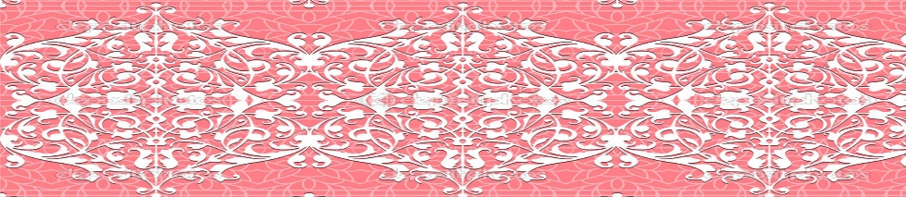
The Book of Ruth
The author of the book is unknown, and it is difficult to determine when and where it was written
2 Chronicles
Judges
1 Chronicles
Joshua
Ruth
1 Kings
2 Kings
2 Samuel
1 Samuel
Nehemiah
Ezra
Esther
The book of Ruth is one of only two books in the Old Testament named after a woman and presents an example of a woman of faith, strength, and kindness.

Slide 3
The Book of Ruth
Terah
Haran
Abraham
Sarah
Rebecca
Issac
Lot
Leah
Jacob
Moab
Ammon
Judah
Tamar
The book of Ruth tells the history of the family of Elimelech, who lived during the time of the judges.
But because the genealogy of David is included, the book of Ruth may have been written after David’s or Solomon’s time, likely following the Babylonian exile.
Moabites
Perez
Hezron
Ram
Amminadab
Nahshon
Salmon
Ruth
Boaz
Obed
Jesse
King David

Slide 4
Elimelech
Elimelech was an Ephrathite from Bethlehem in the territory of Judah
His name, meaning "my God is King," is significant in Jewish culture and reflects devotion to God
He was the husband of Naomi and father of Mahlon and Chilion
He moved his family to the land of Moab during a famine in the days of the Judges
He died shortly after they moved leaving Naomi a widow, to raise her sons
Her sons married Moabite women, Orpha to Chilion and Ruth to Mahlon
Elimelech’s lineage leads to Boaz.
Tradition says Elimelech was the uncle to Boaz.

Slide 5

Famine in the Land
Ephrathites of Beth-lehem-judah
Famine in the land caused Elimelech and his family to the land of Moab
Elimelech
Naomi
Mahon
Ruth
Moabite
Women
Chilion
Orpha
Bethlehem
Moab
Elimelech died shortly after, leaving Naomi a widow and the two sons married Moabite women
Both sons died leaving the women childless
Ruth 1:1-5

Slide 6
Decision to Return Home
Naomi decided that she should return to her home knowing that she should leave the girls behind with their own families
Go, return each to her mother’s house: the Lord deal kindly with you, as ye have dealt with the dead, and with me.
Orpha returned to her family
Bethlehem
Moab
Entreat me not to leave thee, or to return from following after thee: for whither thou goest, I will go; and where thou lodgest, I will lodge: thy people shall be my people, and thy God my God:
The two women returned to Bethlehem
Ruth 1:6-18

Slide 7
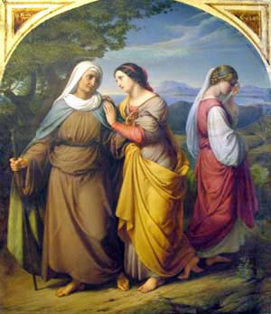
Advantages VS Disadvantages
Stay in Moab
Go to Bethlehem
Advantages
Returning to live with their families and marrying new husbands who would provide for them.
Caring for Naomi and worshipping the Lord with others who believed in Him.
The Moabites worshipped idols, but it appears that they had forsaken the worship of idols and instead worshipped the Lord with their husbands and Naomi
They would not be with Naomi, whom they loved, and they may not be able to worship the Lord with others who shared their faith.
Disadvantages
Needing to provide for themselves and being strangers in a land distant from their homes and families
If we choose to trust in the Lord, then He will reward us for our faith
Ruth 1:8-15

Slide 8
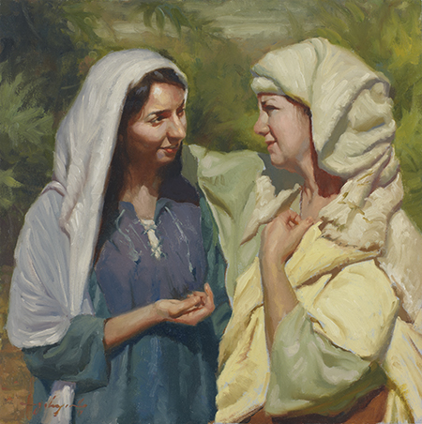
Mara
In Hebrew Naomi means “sweet or pleasant” and Mara means “bitter.”
When, after many years’ absence, the people greeted her in surprise by asking, “Is this Naomi?”, she responded by saying, “Call me not Naomi [pleasant], call me Mara [bitter]: for the Almighty hath dealt very bitterly with me”.
This reply was not an accusation, only Naomi’s way of saying that she had endured much tragedy while in Moab. (2)
Ruth 1:19-20

Slide 9
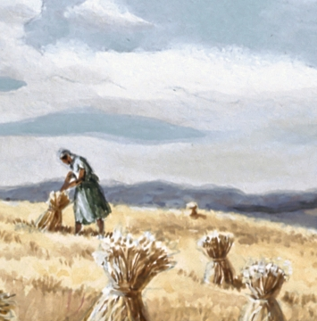
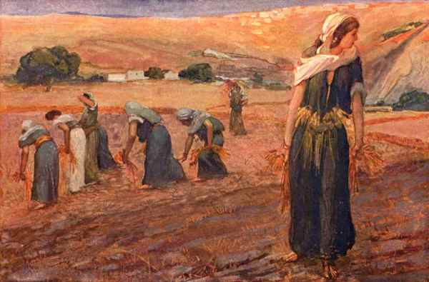
Gleaning
“Harvesting was difficult work and demanded long hours. Young men moved through the fields grasping handfuls of the grain and cutting through the stalks with sickles.
These small bunches of grain were then bound into bundles called sheaves. As the men worked rapidly, a number of stalks fell to the ground. If the men were careful and took the time, these too could be gathered up.
However, any stalks that dropped were allowed to remain where they fell. Poor people, following the reapers, were permitted to ‘glean,’ or gather, the random stalks—possibly all that stood between them and starvation. In addition, the edges of the field, where the sickle was not as easily wielded, were left unharvested. The poor were welcome to that portion, as well.
Ruth 1:19-20
READ: Leviticus 19:9-10

Slide 10
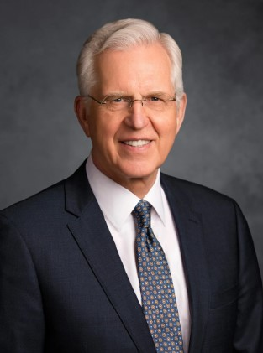
Redeem
Among the most significant of Jesus Christ’s descriptive titles is Redeemer. …
The word redeem means to pay off an obligation or a debt. Redeem can also mean to rescue or set free. (4)
If we come to Jesus Christ, He will redeem us.

Slide 11
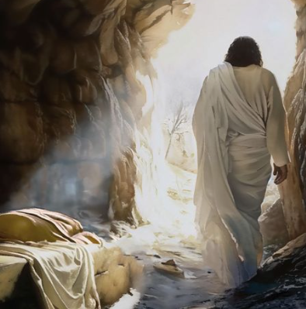
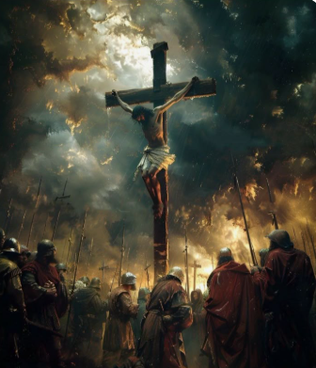
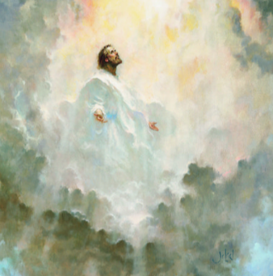
Having Redeemed Them
Having ascended into heaven, having the bowels of mercy; being filled with compassion towards the children of men; standing betwixt them and justice; having broken the bands of death, taken upon himself their iniquity and their transgressions, having redeemed them, and satisfied the demands of justice.
Yea, even so he shall be led, crucified, and slain, the flesh becoming subject even unto death, the will of the Son being swallowed up in the will of the Father.
And thus God breaketh the bands of death, having gained the victory over death; giving the Son power to make intercession for the children of men—
Mosiah 15:7-9

Slide 12
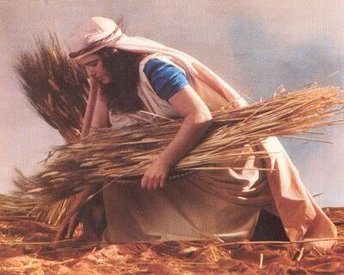
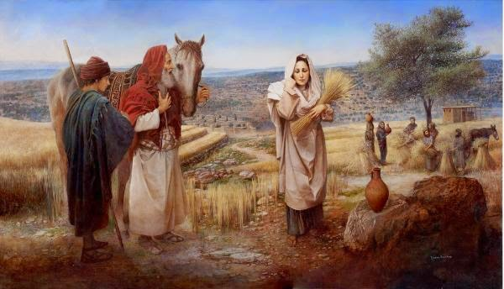
Ruth and Boaz
Naomi wanted to help her faithful daughter-in-law secure a husband and family. To do this, Naomi considered the levirate marriage, a practice that had prevailed for many years in Israel.
The word levirate has nothing to do with the tribe of Levi. Rather, it is taken from the Latin word levir, meaning “husband’s brother.” (2)
Because Naomi and Ruth were widows and without a livelihood, they were eligible to glean in the fields, however Naomi was aged so Ruth volunteered to go out alone.
Boaz was a prosperous farmer in Bethlehem and a relative of the Elimelech family. He admired Ruth’s noble character and was generous and protective of her.
Ruth 2:1-16

Slide 13
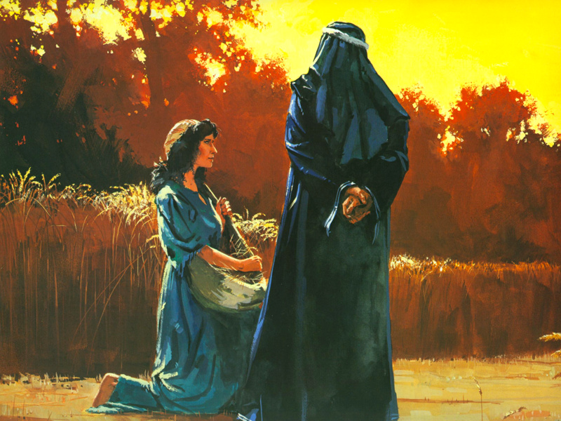
Choosing a Righteous Life
Ruth asks why Boaz is being so kind to her
And Boaz answered and said unto her, It hath fully been shewed me, all that thou hast done unto thy mother-in-law since the death of thine husband: and how thou hast left thy father and thy mother, and the land of thy nativity, and art come unto a people which thou knewest not heretofore.
Boaz showed additional kindness to Ruth by inviting her to eat with him and the reapers, the people he hired to harvest his fields. Boaz also told the reapers to leave extra portions of grain for Ruth to harvest.
When we show love and kindness to others, we invite the Lord’s blessings into our lives
Ruth 2:10-23

Slide 14
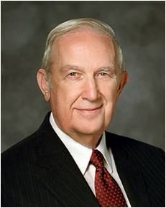
How can we trust in the Lord in times of difficulty?
“At times you may feel lonely and misunderstood … because you don’t fit in with the crowd.
Be grateful that your righteous life molds you so that you don’t fit where you don’t belong.
This is a temporary period of personal testing and growth. It will be replaced in time with true friends and greater happiness.”
(3)

Slide 15
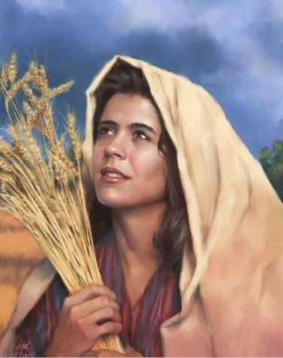
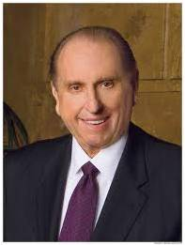
“A model of ideal womanhood is Ruth. Sensing the grief-stricken heart of her mother-in-law Naomi—who suffered the loss of each of her two fine sons—feeling perhaps the pangs of despair and loneliness that plagued the very soul of Naomi, Ruth uttered what has become that classic statement of loyalty: ‘Entreat me not to leave thee, or to return from following after thee: for whither thou goest, I will go; and where thou lodgest, I will lodge: thy people shall be my people, and thy God my God.’ [Ruth 1:16.] Ruth’s actions demonstrated the sincerity of her words.
“Through Ruth’s undeviating loyalty to Naomi, she was to marry Boaz, by which she—the foreigner and Moabite convert—became a great-grandmother of David and, therefore, an ancestor of our Savior Jesus Christ.”
Boaz entered a covenant marriage or relationship with Ruth to always love and care for her.
(1)

Slide 16
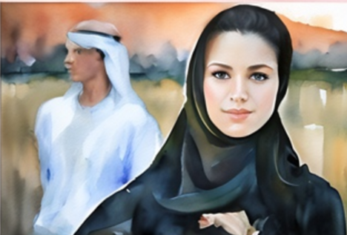
Next Time…
If a mar­ried man died with­out any chil­dren to carry on his name and inher­i­tance, it was his unmar­ried brother’s respon­si­bil­ity to marry the widow so that:
“The first son she bears shall carry on the name of the dead brother so that his name will not be blot­ted out from Israel” (Deuteron­omy 25:6). This is known as a levi­rate mar­riage from the Latin word for brother-in-law, levir.
(1)

Slide 17
Sources:
Videos:
“Finding Your Purpose in Life: Does Faith Matter?” (5:08)
“Moving on from Past Mistakes” (3:43),
President Thomas S. Monson (“Models to Follow,” Ensign, Nov. 2002, 61).
Old Testament Institute Manual
Presentation by ©http://fashionsbylynda.com/blog/
3. Elder Richard G. Scott (“The Power of Righteousness,” Ensign, Nov. 1998, 70).
4. Elder D. Todd Christofferson (“Redemption,” Ensign or Liahona, May 2013, 109)
Presentation by ©http://fashionsbylynda.com/blog/

Slide 18
The levirate law of marriage stated that when a man married and then died before having a male child, his nearest male relative (usually his brother or another near kinsman) was to marry the widow (see Bible Dictionary, “Levirate marriage”).
The first son of that union was considered to be the son and heir of the deceased husband so that the deceased man’s family line could continue. In order to provide an inheritance for the heir, this “kinsman [also] had the right to purchase (redeem) the land of [his] deceased relative” (Ellis T. Rasmussen, A Latter-day Saint Commentary on the Old Testament [1993], 227).
By purchasing this land, providing for the widow’s needs, and ensuring the continuance of the family line, this kinsman essentially became a redeemer or protector to the widow (see Old Testament Student Manual: Genesis–2 Samuel [Church Educational System manual, 2003], 230).
The levirate law is recorded in Deuteronomy 25:5–10. Genesis 38 includes an application of the levirate law that involves the three sons of Judah. Naomi also referred to this law (see Ruth 1:11).
The levirate law of marriage

