Slide 1

Ruth and Boaz
Ruth 3-4
Who can find a virtuous woman? for her price is far above rubies.
Proverbs 31:10

Slide 2

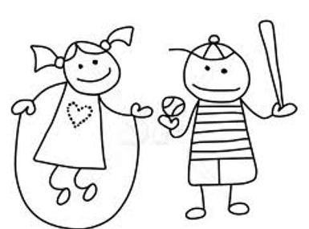
What I Want in a Companion
Good looking, has a good job, and ambitious, nice and funny, does not text other girls, respects me, cuddles with me but not make out, silly and funny, but serious…
…Smart, loves his mother, loves kids, calls me often, strong, loves to cook, and doesn’t watch sports…
Oh and did I mention
Good Looking
Pretty and smart, and loves sports

Slide 3

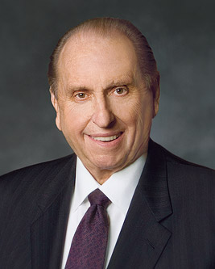

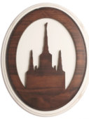
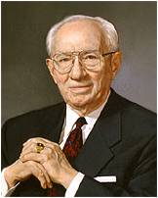
Qualities In An Eternal Companion
“The right person is someone for whom the natural and wholesome and normal affection that should exist does exist.” Then he went on to add: “It is the person who is living so that he or she can go to the temple of God and make the covenants that we there make” (1)
“Choose a companion of your own faith. You are much more likely to be happy. Choose a companion you can always honor, you can always respect, one who will complement you in your own life, one to whom you can give your entire heart, your entire love, your entire allegiance, your entire loyalty.” (2)

Slide 4
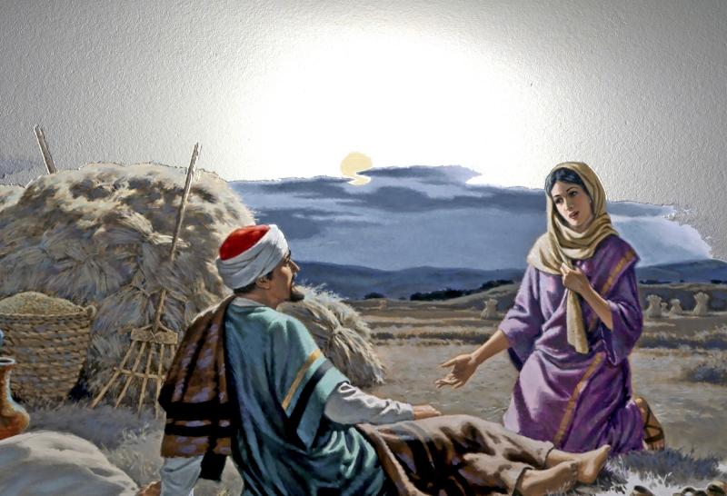
Levirate Marriage
The custom of a widow marrying her deceased husband’s brother or sometimes a near heir. The word has nothing to do with the name Levi or the biblical Levites but is so called because of the Latin levir, meaning “husband’s brother,” connected with the English suffix -ate, thus constituting levirate. (3)
Naomi was suggesting that Ruth marry Boaz.

Slide 5
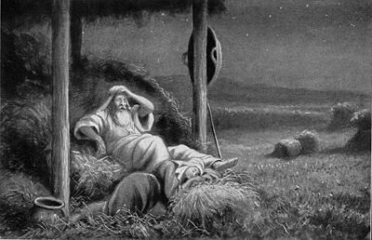
The Plan
Threshing floor= where the workers separated the grain from the rest of the stem and the chaff after the harvest.
Boaz was still working on the harvest and was staying out near the fields
Wash thyself therefore, and anoint thee, and put thy raiment upon thee, and get thee down to the floor: but make not thyself known unto the man, until he shall have done eating and drinking.
And it shall be, when he lieth down, that thou shalt mark the place where he shall lie, and thou shalt go in, and uncover his feet, and lay thee down; and he will tell thee what thou shalt do.
Ruth 3:3-8

Slide 6
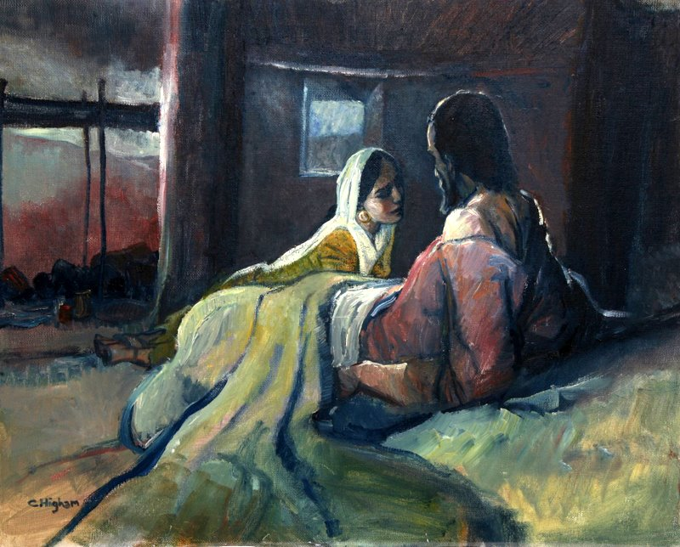
Boaz’s Reply
At midnight Boaz discovered Ruth at his feet
Skirt--wing---take me under your wing…in other words protect me.
Ruth is asking Boaz to marry her
Blessed be thou of the Lord, my daughter: for thou hast shewed more kindness in the latter end than at the beginning, inasmuch as thou followedst not young men, whether poor or rich.
And now, my daughter, fear not; I will do to thee all that thou requirest: for all the city of my people doth know that thou art a virtuous woman.
Chris Higham
Ruth 3:6-9

Slide 7
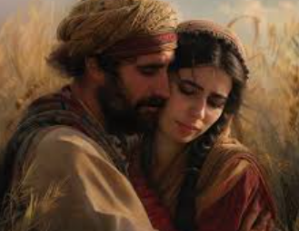
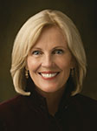
“Virtue ‘is a pattern of thought and behavior based on high moral standards’ (5)
If we live virtuously, then we can have faith that the Lord will bless us
It encompasses chastity and moral purity. Virtue begins in the heart and in the mind. It is nurtured in the home. It is the accumulation of thousands of small decisions and actions.
Virtue is a word we don’t hear often in today’s society, but the Latin root word virtus means strength. Virtuous women and men possess a quiet dignity and inner strength” (6)

Slide 8

What does it mean to live virtuously?
What are some “small decisions” you can make that can help you be virtuous?
Why is it important to look for virtue in the people you date and may one day marry?

Slide 9
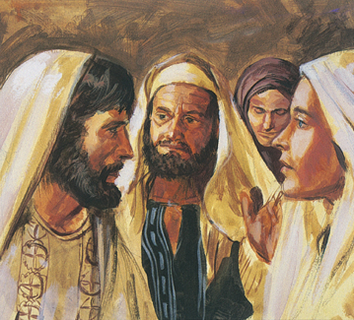
The Next of Kin
According to the law of Moses, Boaz needed to give the nearest kinsman the option of marrying Ruth.
Boaz met the nearest kinsman at the gate of the city, where legal agreements were made.
He employed 10 elders of the city as witnesses.
Boaz knew that according to the custom and levirate marriage rules of their day, the nearest male relative of a deceased man could marry his widow and receive all of his property.
The kinsman mentioned in Ruth 4 was the nearest living relative to Mahlon, Ruth’s deceased husband.
Ruth 4:1-2

Slide 10
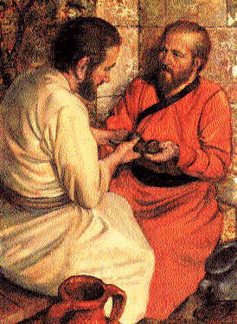
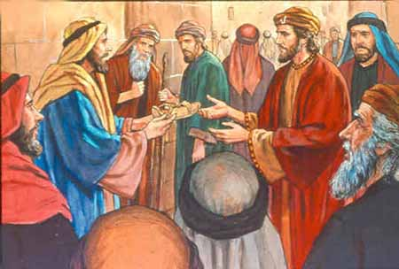
The Offer
The kinsman discovered that if he inherited the land he would also need to raise up children with Ruth
What day thou buyest the field of the hand of Naomi, thou must buy it also of Ruth the Moabitess, the wife of the dead, to raise up the name of the dead upon his inheritance.
The kinsman had no desire to raise another family…with this he gave Boaz his shoe signifying that he would not or could not fulfill his obligation to raise up children to his relative
Ruth 4:3-6

Slide 11
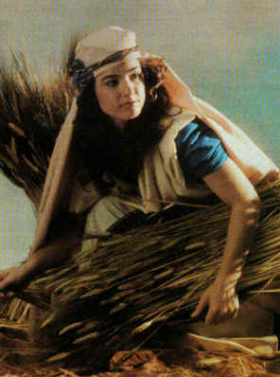
Qualities of Ruth
One of the prominent themes of the account of Ruth is that of redemption, which relates to all of us.
Ruth was a foreigner and a poor and childless widow, which left her in complete poverty with no source of support.
Nevertheless, Ruth faithfully accepted the gospel and joined the Lord’s covenant people.
Though she could not deliver herself from her destitute condition, she was ultimately “redeemed” by her kinsman Boaz.
Because of Ruth’s faith-driven actions and the kindness of her redeemer, Ruth married again, received an inheritance, and was blessed with children. Like Ruth, we cannot save ourselves but must rely on a Redeemer from Bethlehem, one who is able to lift us from our fallen state and secure our happiness as part of His family.
Given this theme of redemption, it is interesting to note that Jesus Christ, the Redeemer of Israel and of all mankind, was one of Ruth’s descendants (see Matthew 1:5–16)

Slide 12
Sources:
Videos:
Return to Virtue (2:34)
Virtue: For Such a Time as This (5:44)
Elder Bruce R. McConkie (CR, October 1955, 13).
President Gordon B.[Hinckley, “Life’s Obligations, 2.
Bible Dictionary
Presentation by ©http://fashionsbylynda.com/blog/
Rasmussen, Introduction to the Old Testament, 1:157.
Preach My Gospel: A Guide to Missionary Service(2004), 118.
Sister Elaine S. Dalton (“A Return to Virtue,” Ensign or Liahona, Nov. 2008, 79).

Slide 13
Ruth lies at Boaz’s feet:
“According to our customs, indeed, this act of Naomi and Ruth appears a very objectionable one from a moral point of view, but it was not so when judged by the customs of the people of Israel at that time. Boaz, who was an honourable man, and, according to [Ruth 3:10], no doubt somewhat advanced in years, praised Ruth for having taken refuge with him, and promised to fulfil her wishes when he had satisfied himself that the nearer redeemer would renounce his right and duty [see vv. 10–11]. As he acknowledged by this very declaration, that under certain circumstances it would be his duty as redeemer to marry Ruth, he took no offence at the manner in which she had approached him and proposed to become his wife. On the contrary, he regarded it as a proof of feminine virtue and modesty, that she had not gone after young men, but offered herself as a wife to an old man like him. This conduct on the part of Boaz is a sufficient proof that women might have confidence in him that he would do nothing unseemly. And he justified such confidence.” (Keil and Delitzsch, Commentary, 2:1:483.) found in Old Testament Institute Manual
Kinsman and Boaz:
“The writer [of the book of Ruth] has not even preserved the name of that kinsman who was willing to redeem the property but not to marry the widow and raise up a son to the name of the dead. The heir of the dead man would get the redeemed property, and thus it would not increase the redeemer’s estate; hence he said selfishly, ‘I cannot redeem it, lest I mar mine own inheritance’ (Ruth 4:6)” (Ellis T. Rasmussen, A Latter-day Saint Commentary on the Old Testament [1993], 228). Boaz, on the other hand, was willing to take the unselfish step of marrying Ruth and ensuring her safety and well-being as well as Naomi’s. In this and other ways, Boaz is a type of the Savior, who redeemed all of mankind without thought for His own benefit.

Slide 14
The Right Person, the Right Place, the Right Time: Guidelines for Wisely... By Tomas B. Holman
The Right Place
The right place is, of course, the temple. “There is no substitute for marrying in the temple,” counsels President Hinckley. “It is the only place under the heavens where marriage can be solemnized for eternity. Don’t cheat yourself. Don’t cheat your companion. Don’t shortchange your lives” (“Life’s Obligations,” 2).
The Right Person
A person committed to temple marriage must then ask: “Whom should I marry?” “How do I identify the right person for me?”
Being the Right Person
Second, one of the most important principles we learn from the scriptures to help us choose an eternal companion is articulated by the Savior in Matthew 7:3–5:
And why beholdest thou the mote that is in thy brother’s eye, but considerest not the beam that is in thine own eye?
Or how wilt thou say to thy brother, Let me pull out the mote out of thine eye; and, behold, a beam is in thine own eye?
Thou hypocrite, first cast out the beam out of thine own eye; and then shalt thou see clearly to cast out the mote out of thy brother’s eye.
Elder Neal A. Maxwell spoke more specifically to those in families, including those in the courtship stage, when he said:
If the choice is between reforming other Church members [including fiancés, fiancées, spouses, children] or ourselves, is there really any question about where we should begin? The key is to have our eyes wide open to our own faults and partially closed to the faults of others—not the other way around! The imperfections of others never release us from the need to work on our own shortcomings. [“A Brother Offended,” Ensign, May 1982, 39]
Thus, as you think about the prophetic counsel and the research I will now discuss on choosing a spouse, you need first to apply the ideas and counsel to yourself. Then you can more appropriately critique another’s rightness for you.
Finding the Right Person
The first quality many young people look for in a potential spouse is someone with whom they can “fall in love,” which often means someone for whom they feel a strong physical attraction. Although love is more than physical attraction, being physically attracted to a potential spouse is not bad. Indeed, Elder Bruce R. McConkie said, “The right person is someone for whom the natural and wholesome and normal affection that should exist does exist.” Then he went on to add: “It is the person who is living so that he or she can go to the temple of God and make the covenants that we there make” (CR, October 1955, 13).
Being “in love” and attracted to a person is a good start, but clearly not enough. President Gordon B. Hinckley suggested several other factors we should keep in mind:
Choose a companion of your own faith. You are much more likely to be happy. Choose a companion you can always honor, you can always respect, one who will complement you in your own life, one to whom you can give your entire heart, your entire love, your entire allegiance, your entire loyalty. [Hinckley, “Life’s Obligations, 2]
Elder Richard G. Scott suggested that in a potential spouse we should look for
essential attributes that bring happiness: a deep love of the Lord and of His commandments, a determination to live them, one that is kindly understanding, forgiving of others, and willing to give of self, with the desire to have a family crowned with beautiful children and a commitment to teach them the principles of truth in the home. [“Receive the Temple Blessings,” Ensign, May 1999, 26]
First, we need to know a lot about the person we are thinking of marrying. As Elder Scott notes, the beliefs the person has about family life matter, and research confirms this. The more the person values marriage and family life, the better the marriage will be. President Hinckley admonishes us to choose a person we can honor, respect, and give our whole heart, love, allegiance, and loyalty to. The research shows that this kind of person will have a healthy sense of self-respect, maturity, self-control, and good mental and emotional health.
President Hinckley suggested you choose a person “who will complement you,” and Elder Scott says our choice should be a person who “is kindly understanding [and] forgiving of others.” Thus, we need to find a person not only of good character, but a person with whom we can have a good relationship.
Two hallmarks of good premarital relationships that Church leaders have stressed are love and communication. These two things help couples solve problems, resolve differences, and increase agreement on important issues. President Spencer W. Kimball helped a young couple on the verge of marriage with this counsel:

Slide 15
The love of which the Lord speaks is not only physical attraction, but also faith, confidence, understanding, and partnership. It is devotion and companionship, parenthood, common ideals, and standards. It is cleanliness of life and sacrifice and unselfishness. This kind of love never tires nor wanes. It lives on through sickness and sorrow, through prosperity and privation, through accomplishment and disappointment, through time and eternity. . . . Today it is a demonstrative love, but in the tomorrows of ten, thirty, fifty years it will be a far greater and more intensified love, grown quieter and more dignified with the years of sacrifice, suffering, joys, and consecration to each other, to your family, and to the kingdom of God. [“An Apostle Speaks About Marriage to John and Mary,” Improvement Era, February 1949, 76; also “John and Mary, Beginning Life Together,” New Era, June 1975, 7–8]
“Soul mates” are fiction and an illusion; and while every young man and young woman will seek with all diligence and prayerfulness to find a mate with whom life can be most compatible and beautiful, yet it is certain that almost any good man and any good woman can have happiness and a successful marriage if both are willing to pay the price. President Spencer W. Kimball [“Marriage and Divorce,” in Speeches of the Year, 1976 (Provo, Utah: Brigham Young University, 1977), 146]
Evidently, seeking for a mate is not a matter of waiting for that “one and only” to walk by and grab you.
The Right Person, the Right Place, the Right Time: Guidelines for Wisely...
Thomas B. Holman (Excerpts From)
https://speeches.byu.edu/talks/thomas-b-holman_right-person-right-place-right-time-guidelines-wisely-choosing-spouse/

Slide 16
Emotional Part of Love
Belief Part of Love
Immature Love | Mature Love
Possessiveness | Lasting Passion
Jealousy | Desire for
Infatuation | Companionship
Preoccupation | Warm Feeling of Contentment
Anxiety
Immature Love | Mature Love
“Love is Blind” | Commitment
External to Us | Trust
Beyond Our Control | Sharing
Behavior Part of Love
Immature Love | Mature Love
Selfish, Thinks only of own needs | Create an Environment for Growth and Development
Lustful | Allows Other Space for Growth
Concerned only with satisfying
Clinging, over dependent, demanding of Obedience
The Right Person, the Right Place, the Right Time: Guidelines for Wisely...
Thomas B. Holman BYU Speeches Aug. 1, 2000

