Slide 1

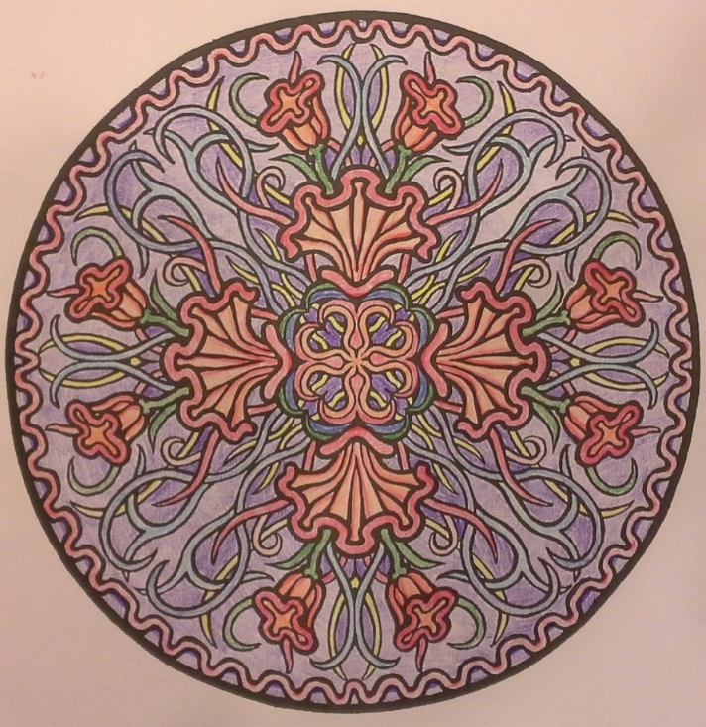
A Peculiar People
Deuteronomy 14-19
And again, I say unto the poor, ye who have not and yet have sufficient, that ye remain from day to day; I mean all you who deny the beggar, because ye have not; I would that ye say in your hearts that: I give not because I havenot, but if I had I would give. Mosiah 4:24

Slide 2

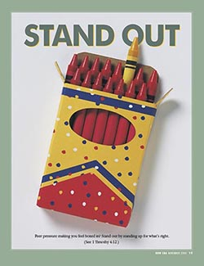


Think about a time when you have either felt approval and joy or felt alone, uncomfortable, or embarrassed because your beliefs made you different from others

Slide 3
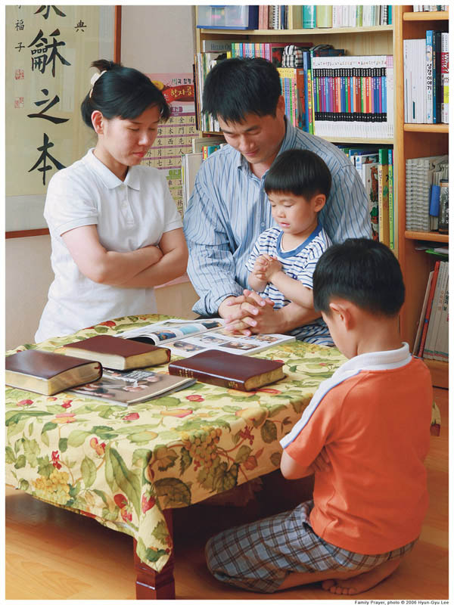
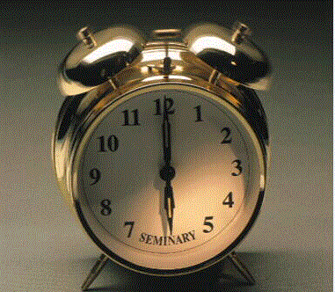



How Do Distinguish Yourselves from Others?
Early Morning Religious Classes
Dressing and Acting appropriately
Family togetherness
Avoiding inappropriate entertainment
Continual service to one another

Slide 4

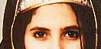
Israel Is To Stand Out
Ye are the children of the Lord your God: ye shall not cut yourselves, nor make any baldness between your eyes for the dead.
Cutting and shaving their foreheads including eyebrows were practices of idolaters during the mourning of a loved one. (1 Kings 18:28 and Jeremiah 16:6)
God placed limits of philosophical inquiry upon his people, indicating that they were not to seek the method of pagan worship because of associated evil practices.
(Deut. 12:30-31) (1)
For thou art an holy people unto the Lord thy God, and the Lord hath chosen thee to be a peculiar people unto himself, above all the nations that are upon the earth.
Holy= sacred and devoted to God
Peculiar=“exclusive, or special” and can refer to a special possession or property
Deuteronomy 14:1-2

Slide 5
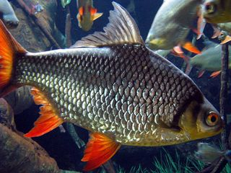
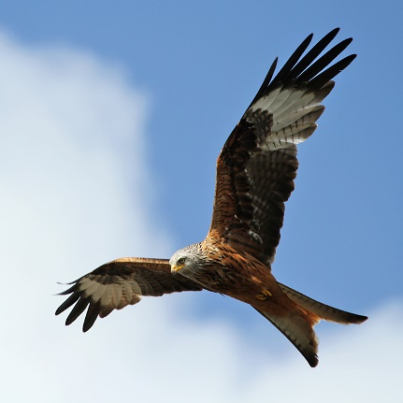
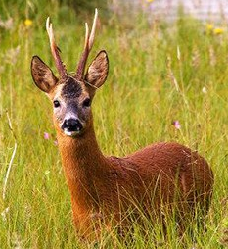
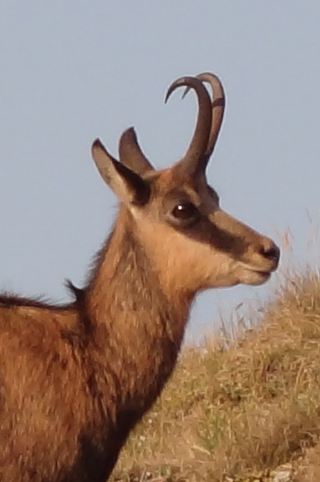
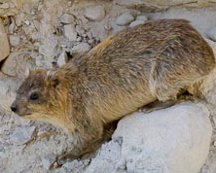
Word of Wisdom Old Testament
Thou shalt not eat any abominable thing
Eagle
Ossifrage
Ospray
Glede
Kite
Vulture
Raven
Owl
Night hawk
Cuckow
Swan
Pelican
Stork
Heron
Lapwin
Bat
Birds of Prey
Camel
Hare
Coney
Swine
Fish with shells
These are the beasts which ye shall eat:
Ox
Sheep
Goat
Hart
Roebuck
Fallow deer
Wild goat
Pygarg
Wild ox
Chamois
Fish that have fins and scales
clean fowls—those that don’t eat other animals
Kite
Chamois
Roebuck
coney
Deuteronomy 14:3-20

Slide 6
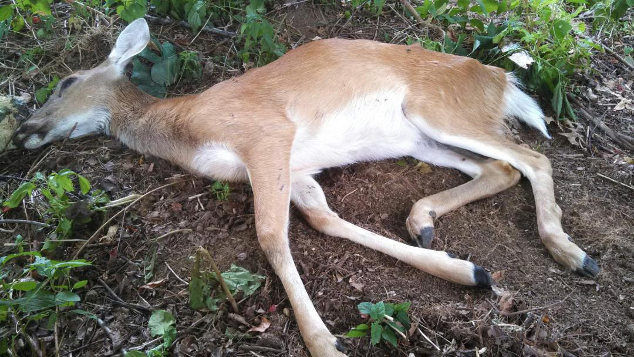
Animals That Die On Their Own
Ye shall not eat of any thing that dieth of itself: thou shalt give it unto the stranger that is in thy gates, that he may eat it; or thou mayest sell it unto an alien: for thou art an holy people unto the Lord thy God. Thou shalt not see the a kid in his mother’s milk.
Do not eat anything you find already dead
JST—That they not give it to a stranger or sell it. It would be contaminated.
Thou shalt not give it unto the stranger
Thou mayest not sell it unto an alien
Deuteronomy 14:21

Slide 7
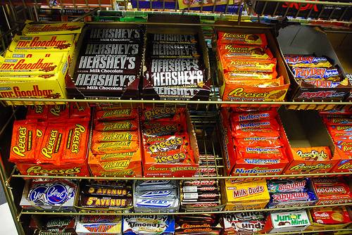
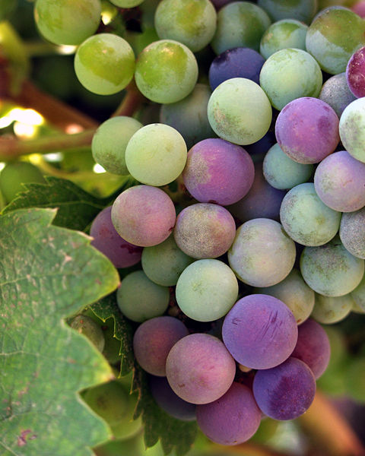
My Own Perspective on Deut. 14:26
And thou shalt bestow that money for whatsoever thy soul lusteth after, for oxen, or for sheep, or for wine, or for strong drink, or for whatsoever thy soul desireth: and thou shalt eat there before the Lord thy God, and thou shalt rejoice, thou, and thine household,
Lusteth=to long or yearn for
Just think about it as if you wanted a candy bar.
What if you took the money you would spend for a candy bar and gave it to the bishop as a fast offering?
Also the use of wine and other fermented fluids (here called ‘strong drink’) may surprise us because we do not use them for any purpose; however, they were then commonly used in ceremonial meals.
Fermented drinks were forbidden to Priests in service, to Nazarites and to some others, according to Leviticus 10 and Numbers 3.)” (2)
Deuteronomy 14:26

Slide 8
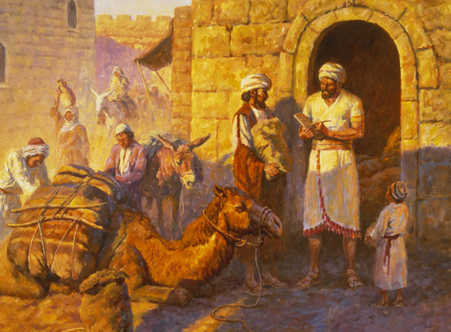
Tithe
“The tithe, or tenth of all increase, was ordinarily contributed ‘in kind’; but if the contributor lived too far from the central place for making the contribution, he could sell the material and carry the money instead, where he could convert it back into whatever kinds of goods he desired to make his contribution and to make the thanksgiving feast which accompanied tithe paying.
The goods would be used by the Levites (who produced none of their own) and by the poor (D&C 119:3–6). (2)
Deuteronomy 14:21-25

Slide 9
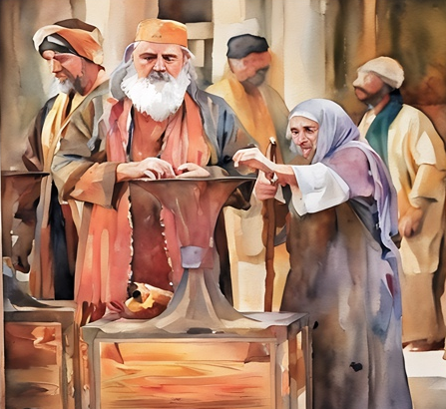
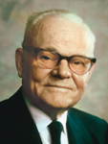
Reasons For Tithing
To care for the Levite priests, strangers, the fatherless, and widows. Tithing also allowed the Lord to bless the tithe payer’s life
And after that, those who have thus been tithed shall pay one-tenth of all their interest annually; and this shall be a standing law unto them forever, for my holy priesthood, saith the Lord. D&C 119:4
“As stated in the revelation, the Lord has prepared all earthly blessings for his children; he has given them the law of tithing, and he has made known the great rewards incident to its payment, and still he gave men their agency. In the exercise of that agency, men themselves decide whether to pay or not to pay tithing—this is their option.
But there is an option they do not have and that is to receive the promised blessings for tithing and also to refuse to pay tithing. If they do not pay tithing, they are not entitled to these blessings and they will never receive them.” (3)
Deuteronomy 14:28-29

Slide 10

Make a Release
The sabbatical year (Shemittah) was a command for the land of Israel to rest every seventh year, with no planting or harvesting allowed, and a debt release in some interpretations
Israelites were not to exact repayment of loans from fellow Israelites beyond any sabbatical year; however, they were not expected to release strangers from their responsibility to repay.
If Israelites would obey God’s commandments, they would be blessed with prosperity and be able to lend to others and have no need of borrowing from them. (8)
Deuteronomy 15:1-6

Slide 11
Every 7 Years—Debts Cancelled
At the end of every seven years thou shalt make are lease.
And this is the manner of the release: Every creditor that lendeth ought unto his neighbour shall release it; he shall not exact it of his neighbour, or of his brother; because it is called the Lord’s release.
Release= the “pardoning or cancellation of debts”
What was the purpose of forgiving debts every seven years?
Save when there shall be no poor among you
To the end that there may be no needy
Year 1 | Year 2 | Year 3 | Year 4 | Year 5 | Year 6 | Year 7
Why might it have been harder for an Israelite to lend to a neighbor in the seventh year?
Deuteronomy 15:1-6

Slide 12
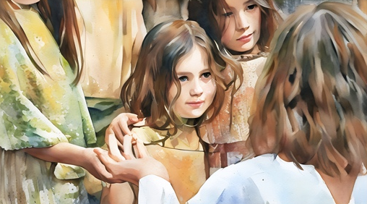
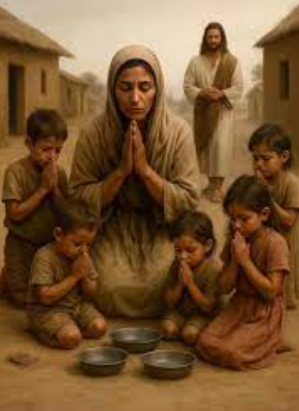

Compassion
The Savior’s commandments to the Israelites in Deuteronomy include forgiving debtors, releasing people in servitude, and relieving the burden of the poor.
As His people, we too have a covenant responsibility to freely share what the Savior has given us to relieve the burden of the poor.
For I was an hungred, and ye gave me meat: I was thirsty, and ye gave me drink: I was a stranger, and ye took me in:
Naked, and ye clothed me: I was sick, and ye visited me: I was in prison, and ye came unto me. Matthew 25:34-35
One of the easiest ways to identify a true follower of Jesus Christ is how compassionately that person treats other people. (7)
Deuteronomy 14:7-11

Slide 13
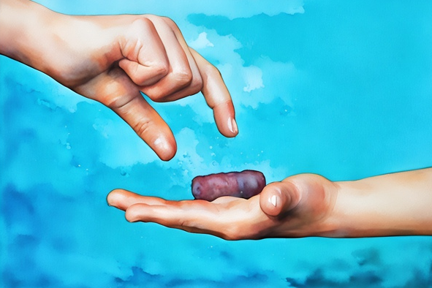
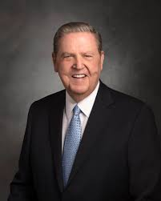
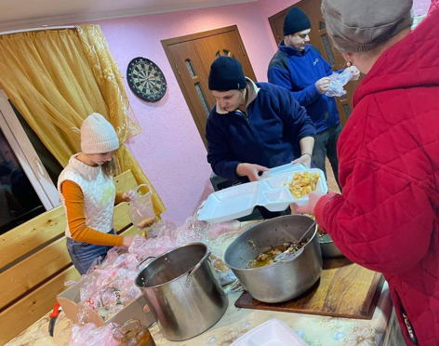
Share the Blessings
The Lord commands us to share the blessings He has given us.
Thou shalt open thine hand wide unto thy brother, to thy poor, and to thy needy, in thy land.
Down through history, poverty has been one of humankind’s greatest and most widespread challenges. Its obvious toll is usually physical, but the spiritual and emotional damage it can bring may be even more debilitating. In any case, the great Redeemer has issued no more persistent call than for us to join Him in lifting this burden from the people. … (9)
Christian Aid in Moldova-feeding the refugees from Ukraine 2022
Deuteronomy 14:7-11

Slide 14
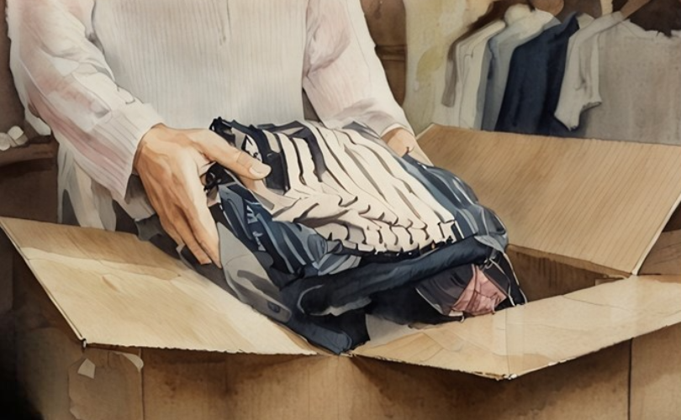
Share the Blessings
In our day, the restored Church of Jesus Christ had not yet seen its first anniversary when the Lord commanded the members to “look to the poor and … needy, and administer to their relief that they shall not suffer”. Note the imperative tone of that passage—“they shall not suffer.” That is language God uses when He means business. …
And they shall look to the poor and the needy, and administer to their relief that they shall not suffer; and send them forth to the place which I have commanded them. D&C 38:35
I bear witness of the miracles, both spiritual and temporal, that come to those who live the law of the fast. … Cherish that sacred privilege at least monthly, and be as generous as circumstances permit in your fast offering and other humanitarian, educational, and missionary contributions. I promise that God will be generous to you, and those who find relief at your hand will call your name blessed forever. …
[A]lthough I may not be my brother’s keeper, I am my brother’s brother, and “because I have been given much, I too must give.” (9)
Deuteronomy 14:7-11

Slide 15
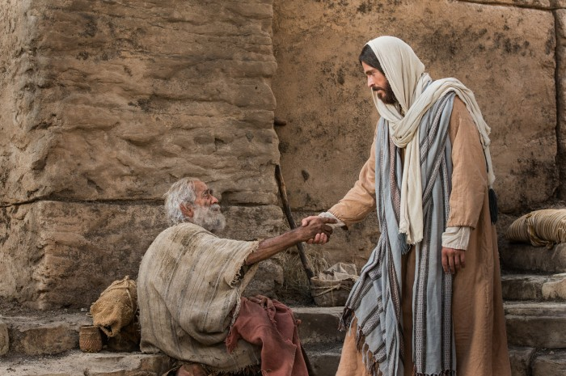
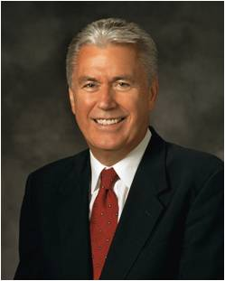
Helping Others in Need
Even if we are not always able to meet others’ needs, we should be able to say in our hearts that we would help if we could
Through His Church, the Lord has provided a way for us to care for those in need. He has asked us to give generously according to what we have received from Him. “The Lord’s way of caring for the needy is different from the world’s way.
The Lord uses our offerings to bless the poor
Deuteronomy 14:22, 28-29;15:9-10

Slide 16
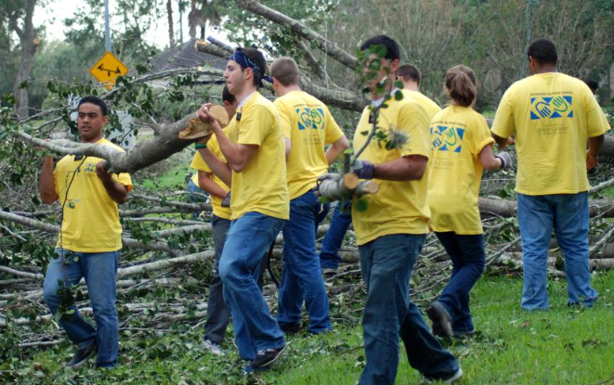
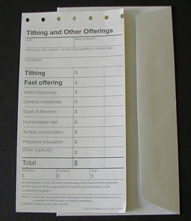



Ways of Giving Generously
Fasting and contributing fast offerings
Ministering assignments
Participating in Church humanitarian efforts
Taking advantage of local opportunities found on the JustServe app, where available
Deuteronomy 14:22, 28-29;15:9-10

Slide 17
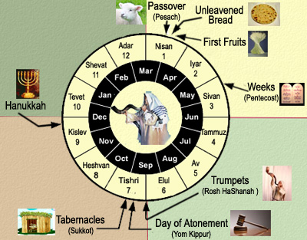
Feasts
The law commanded that three times a year all the males of the covenant people were to appear before the Lord in the place that He should choose; that is, in the Feast of Unleavened Bread, in the Feast of Weeks, and in the Feast of Tabernacles
The Feast of the Passover was instituted to commemorate the passing over the houses of the children of Israel in Egypt when God smote the firstborn of the Egyptians, and more generally the redemption from Egypt. (5)
Shavuot--known as the Feast of Weeks
marks the all-important wheat harvest in the Land of Israel--the grain harvest lasted seven weeks and was a season of gladness.
It began with the harvesting of the barley during Passover and ended with the harvesting of the wheat at Shavuot. wikipedia
The Feast of Tabernacles or Ingathering.
The events celebrated were the sojourning of the children of Israel in the wilderness and the gathering-in of all the fruits of the year. (5)
Deuteronomy 16

Slide 18
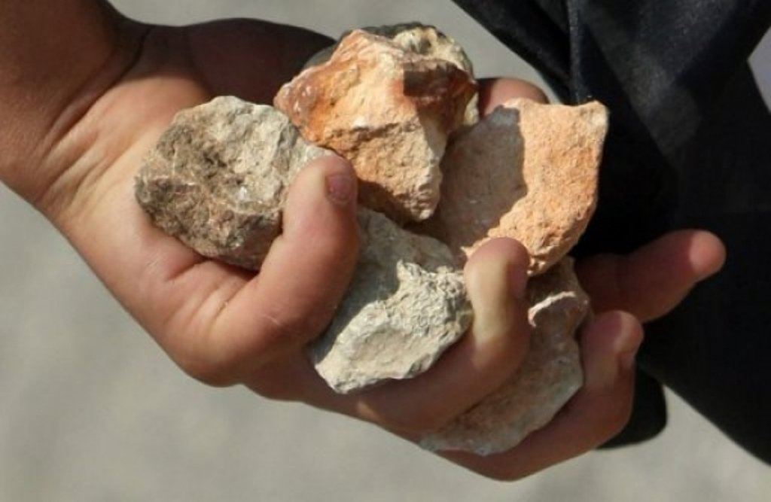
Consequences of Disobedience
The Mosaic Law specified that, before anyone could be put to death by stoning, there had to be a trial, and at least two witnesses had to testify:
Those who testified against the condemned person in court had to cast the first stone. (Verse 7)
Old Testament Stoning For:
Idolatry (Deut. 13:10, Deut. 17:5)
Adultery (Ezekiel 23:47)
Blasphemy (Lev. 24:16)
Breaking the Sabbath (Numbers 15:36)
A son’s rebellion (Deut. 21:18-23)
Taking the spoils of war (Achan—Joshua 7:22, 25)
Wizardry (Lev. 20:27)
Whoring (Deut. 22:21)
Murder (Put to Death…Exodus 21:12)
The strict punishment for sin during the time of the Law helped deter people from adopting the impure practices of their pagan neighbors and rebelling against God.
Israel was given a stern commandment to stay pure: “You must purge the evil from among you” (Deuteronomy 17:7). (6)
For the wages of sin is death; but the gift of God is eternal life through Jesus Christ our Lord. Romans 6:23
Deuteronomy 17:1-13

Slide 19
Israel’s Future Kings
They have to be chosen “Whom the Lord God shall choose” and an Israelite
They cannot multiply (increase) in horses (warfare—see comment, To be a King)
They cannot let the people return to the false beliefs of the Egyptian ways
They cannot multiply (increase) in wives, or expand their wealth (heavy taxes)
They need to read the scriptures that are in the possession of the Levites and be familiar with all the laws and commandments
They need to keep all the commandments and laws
If we study the scriptures daily, they will help us to be humble and live according to God’s commandments
They need to not become prideful
Deuteronomy 17:14-20

Slide 20
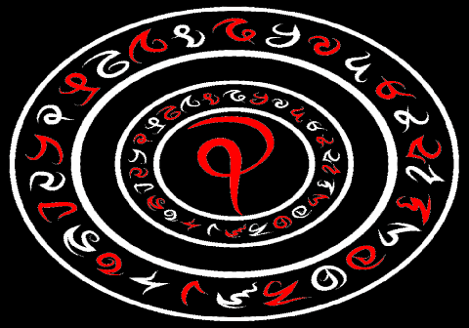
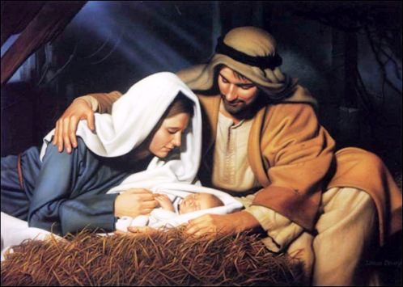
Review
Moses reviewed how to sustain the Levite priests and warned the Israelites to stay away from sorcery…
…And he prophesied of the coming of Jesus Christ and described the legal processes for those who had killed another person, either accidentally or intentionally.
Deuteronomy 18-19

Slide 21
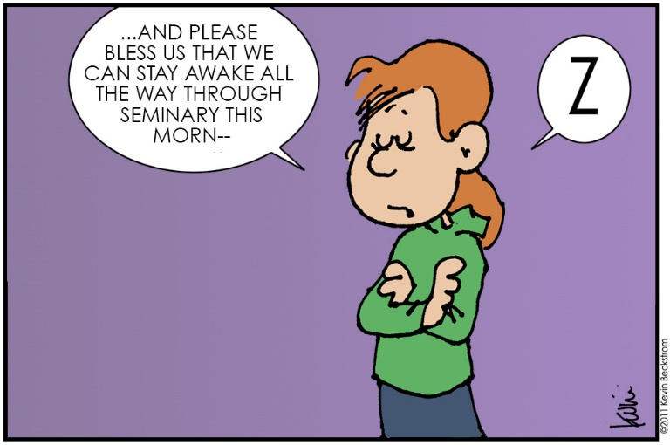
Sources:
Videos:
“Handel’s Messiah: Debtor’s Prison” (3:35).
“Be the Someone” (4:18)
“Joseph Millett Story” (time code 2:36 to 6:08)
“That We Might Be One: The Story of the Dutch Potato Project” (time code 0:00 to 8:57)
Bible Study Tools—dictionary
2. Old Testament Institute Manual
(Rasmussen, Introduction to the Old Testament, 1:131.)
Presentation by ©http://fashionsbylynda.com/blog/
3. President Marion G. Romney The Blessings of an Honest Tithe Jan. 1982 Ensign
4. Dieter F. Uchtdorf, “Providing in the Lord’s Way,” Ensign or Liahona, Nov. 2011, 54.
5. Bible Dictionary
6. gotquestions.org
7. President Russell M. Nelson (“Peacemakers Needed,” Liahona, May 2023, 98)
8. Ellis T. Rasmussen “A Latter-day Saint Commentary on the Old Testament” pg.179
9. President Jeffrey R. Holland (“Are We Not All Beggars?.” Ensign or Liahona, Nov. 2014, 40, 42)
Presentation by ©http://fashionsbylynda.com/blog/

Slide 22
Deuteronomy
Deuteronomy 1-13 | Deuteronomy 14-19 | Deuteronomy 20-26 | Deuteronomy 27-34
Preparing Israel to enter the Promised Land | The Lord’s Laws and Feasts | War and Punishments | Obedience and Disobedience Moses’ Final Sermon
Deuteronomy 14-15 | Deuteronomy 16-18 | Deuteronomy 19
The Israelites are children of the Lord Jehovah Laws on Food, tithes, debts, Slaves, and firstborn | Laws of Feasts Civil Laws: judges, kings, priests and prophets | Cities of Refuge Law of Witnesses

Slide 23
Laws of the Old Testament which demand the death penalty
The Old Testament, includes a surprising number of crimes which merit the death penalty as punishment. These laws were believed to form an integral part of the overall "Covenant" between those who worship Yahweh.
A couple of these demand that the "sinners" be burnt to death rather than stoned — which was the more usual form of capital punishment. One can wonder why these crimes in particular merit this especially horrible fate.
Adultery (Lev 20:10-12, (man and woman).
Lying about virginity. Applies to girls who are still in their fathers' homes, who lie about their virginity, and are presented to their husband as a virgin. The accused is guilty until proved innocent. (Deut 22:20-21).
Making love to a virgin pledged to be married to another. Applies to man who deflowers virgin pledged to be married, and to the virgin if she does not call for help. (Deut 22:23-24).
The daughter of a priest practicing prostitution (death by fire) (Lev 21:9).
Rape of someone who is engaged. If she is not engaged you only have to marry her and give her father 50 shekels. No mention is made of the girl’s opinion. (Deut 22:25).
Men practicing bestiality. (Both man and animal die). (Lev 20:15)
Women practicing bestiality (Both woman and animal die). (Lev 20:16)
Having sex with your father’s wife, as distinct from "your mother", as it was common practice for men at the time to have several wives. (both die). (Lev 20:20).
Having sex with your daughter in law. (Lev 20:30)
Incest. (Lev 20:17)
Male homosexuality. The girls seem to get a free .. errrr ...ride on this one. (Lev 20:13).
Marrying a woman and her daughter. They are all burnt to death (Lev 20:14)
Worshiping idols (Ex 22:20, Lev 20:1-5, Deut 17:2-7).
Blasphemy (Lev 24:14-16,23).
Breaking the Sabbath (Ex 31:14, Numb 15:32-36).
Practicing magic (Ex 22:18).
Being a medium or spiritualist. (stoning) (Lev 20:27).
Trying to convert people to another religion. (stoning) (Deut 13:1-11, 18:20).
Apostasy - If most people in a town come to believe in a different god. (Kill everybody, including animals, and burn the town.) (Deut 13:12-15)
Giving one of your descents to Molech. Probably refers to human sacrifice and is not now commonly practiced in the west. (Lev 20:2)
Non-priests going near the tabernacle when it is being moved. (Numb 1:51)
Being a false prophet. (Deut 132:5, Deut 18:20, Zech 13:2-3)
Striking your parents (Ex 21:15).
Cursing your parents (Ex 21:17, Lev 20:9).

Slide 24
Laws of the Old Testament which demand the death penalty--continued
Being a stubborn and rebellious son. And being a profligate and a drunkard. (stoning) (Quite a few of us might have a problem with this one)(Deut 21:18-21)
Murder. However if a slave is beaten to death the owner is “punished” — not necessarily killed. If the slave survives the beating then there is no punishment. (Gen 9:6, Ex 21:12, Numb 35:16-21). This is part of a wide range of slavery laws in the Old and New Testament.
Kidnapping and selling a man. This is really a law against making an Israelite a slave against his will. (Ex 21:16).
Perjury (in certain cases) (Deut 19:15 - 21). Deut 19:20 explicitly identifies that the purpose of this is deterrence. "The rest of the people will hear of this and be afraid, and never again will such an evil thing (malicious and false testimony by one man against another) be done among you." Presumably all the other death penalties are assumed to be for deterrence as well.
Ignoring the verdict of a judge – (or a priest!) (Deut 17:8-13).
Not penning up a known dangerous bull, if the bull subsequently kills a man or a woman. (Ex 21:29) Both the animal and the reckless owner of the dangerous bull are to be put to death.
Living in a city that failed to surrender to the Israelites. (Kill all the men, make the women and children slaves.) Deut 20:12-14.
The following carry the punishment of being "cut off from his people". Some people seem to feel that this is the same as the death penalty.
A male who is not circumcised. Genesis 17:14
Eating leavened bread during the Feast of Unleavened Bread. Exodus 12:15
Manufacturing anointing oil. Exodus 30:33
Engaging in ritual animal sacrifices other than at the temple. Leviticus 17:1-9
Sexual activity with a woman who is menstruating: Leviticus 20:18
Consuming blood: This would presumably include eating rare meat and black pudding. Also see above. Leviticus 17:10.
Eating peace offerings while ritually unclean: Leviticus 7:20
Waiting too long before consuming sacrifices: Leviticus 19:5-8
Going to the temple in an unclean state: Numbers 19:13
http://gphhawkinsrationalistsociety.weebly.com/laws-of-the-old-testament-which-demand-the-death-penalty.html

Slide 25
To Be a King
He should be a man selected by the Lord (see Deuteronomy 17:15).
He had to be an Israelite (see v. 15).
He should not “multiply horses” (v. 16). In the ancient Middle East, horses were used primarily in warfare. One Bible scholar believed this use was forbidden “lest the people might depend on a well-appointed cavalry as a means of security, and so cease from trusting in the strength and protection of God. And … that they might not be tempted to extend their dominion by means of cavalry, and so get scattered among the surrounding idolatrous nations, and thus cease, in process of time, to be that distinct and separate people which God intended they should be.” (Clarke, Bible Commentary 1:783.)
He should not “multiply wives” (v. 17), for usually a king had multiple wives for political as well as personal reasons. Foreign wives would represent an enticement to false gods; thus, they were forbidden,
“that his heart turn not away” (v. 17). This situation later led to Solomon’s fall from God’s favor (see 1 Kings 11:4).
5. He should not seek to expand his wealth (see v. 17), for this goal often led to oppression and unjust taxation of the people.
6. His basis for rule was to be the law of God (see vv. 18–19). David gave similar words of counsel to Solomon in 1 Kings 2:2–4.
7. He was not to be “lifted up” in pride (v. 20).
Old Testament Institute Manual

