Slide 1

Recognizing the Voice of the Lord
1 Samuel 3
And the Lord appeared again in Shiloh: for the Lord revealed himself to Samuel in Shiloh by the word of the Lord.
1 Samuel 3:21

Slide 2




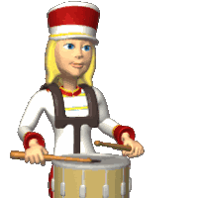


The Sound
Why are some sounds easier to recognize than other sounds?

Slide 3

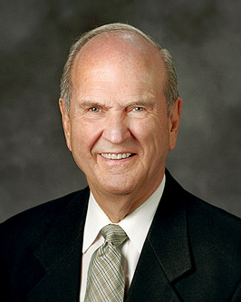
Recognize His Voice-A Personal Revelation
God speaks to us and wants us to recognize His voice
Yea, behold, I will tell you in your mind and in your heart, by the Holy Ghost, which shall come upon you and which shall dwell in your heart. D&C 8:2
One of the things the Spirit has repeatedly impressed upon my mind … is how willing the Lord is to reveal His mind and will. The privilege of receiving revelation is one of the greatest gifts of God to His children. …
Does God really want to speak to you? Yes! (4)

Slide 4


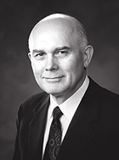
8 Purposes for Revelation
1. The testimony or witness of the Holy Ghost that Jesus is the Christ and that the gospel is true is a revelation from God.
2. Prophecy for personal revelation
3. To give comfort.
4. To uplift.
5. To inform...such as a talk, a blessing, giving a lesson, or communication
6. To restrain us from doing something or saying something wrong.
7. To propose a particular course of action and then to pray for inspiration to confirm it.
8. To impel a person to action.
…revelation or inspiration comes by means of words or thoughts communicated to the mind (see Enos 1:10; D&C 8:2–3), by sudden enlightenment (see D&C 6:14–15),
(5)

Slide 5
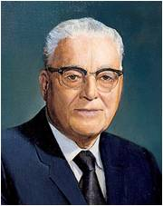
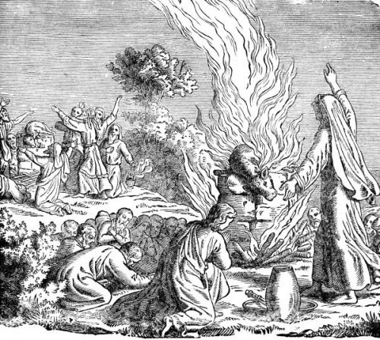
The Word of the Lord Was Precious
At this time: No open visions—Revelations from the Lord were rare
“…there was no prophet upon the earth through whom the Lord could reveal his will, either by personal experience, or by revelation.” (1)
What might this tell us about the spiritual condition of the people at this time?
1 Samuel 3:1

Slide 6
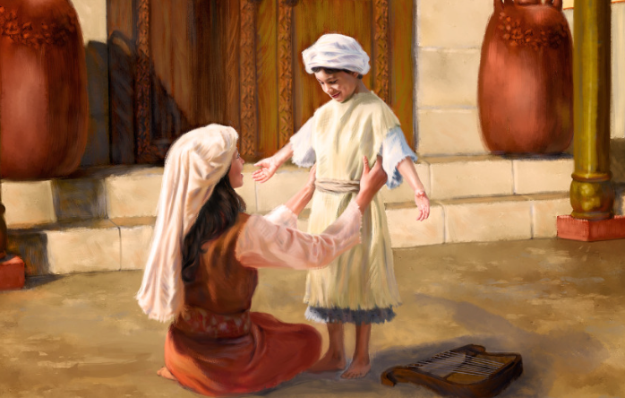
Samuel and the Voice of the Lord
Samuel was born to Hannah as an answer to her prayers.
When Samuel was young, Hannah brought him to the tabernacle where Eli could care for him.
One night, the boy Samuel had an experience hearing the voice of the Lord.
1 Samuel 3:1

Slide 7
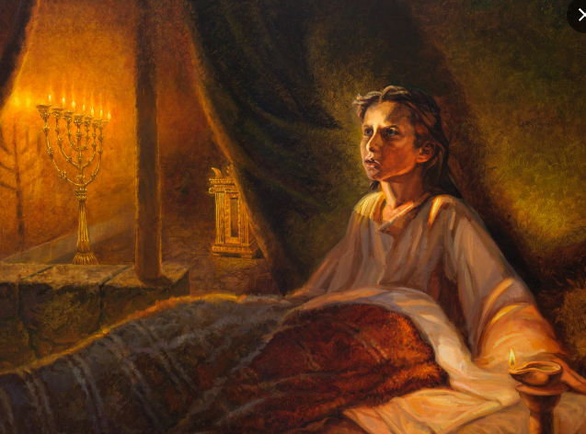
1st Vision— “Samuel”
Why do you think Samuel did not hear the voice as the Lord’s?
And he ran unto Eli, and said, Here am I; for thou calledst me.
And he said, I called not; lie down again.
And he went and lay down.
1 Samuel 3:2-5

Slide 8
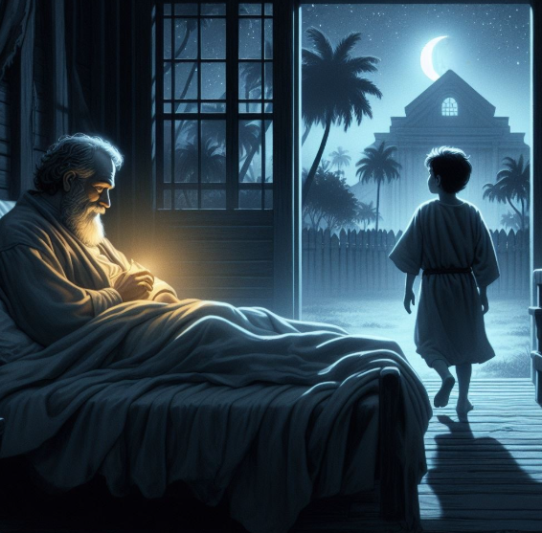
2nd Vision— “Samuel”
And Samuel arose and went to Eli, and said, Here am I; for thou didst call me.
And he answered, I called not, my son; lie down again..
Samuel did not yet know the Lord, neither was the word of the Lord yet revealed unto him.
1 Samuel 3:6

Slide 9
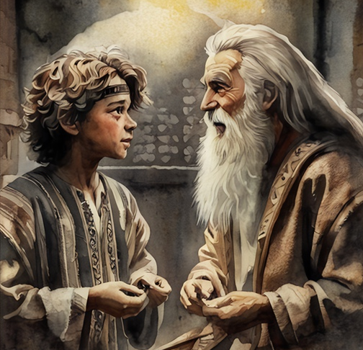
3rd Vision— “Samuel”
Why did Samuel initially not recognize the voice?
And Eli perceived that the Lord had called the child.
Go, lie down: and it shall be, if he call thee, that thou shalt say, Speak, Lord; for thy servant heareth.
And he arose and went to Eli, and said, Here am I; for thou didst call me.
1 Samuel 3:8-9

Slide 10

4th Vision— “Samuel, Samuel”
Speak;
for thy servant heareth.
Behold, I will do a thing in Israel, at which both the ears of every one that heareth it shall tingle.
1 Samuel 3:10-11

Slide 11
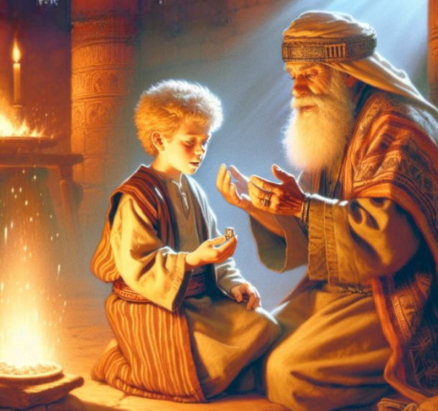
Preparing For A Calling
Why didn’t the Lord go to Eli?
The Lord was displeased with Eli for allowing the iniquity in his household to continue without correction.
The Lord was also giving Samuel guidance and instruction in preparation for his calling as a prophet.
1 Samuel 3:11-14

Slide 12
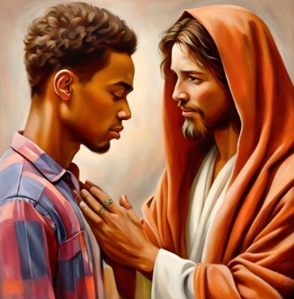
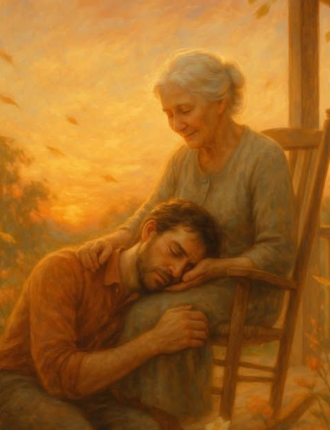
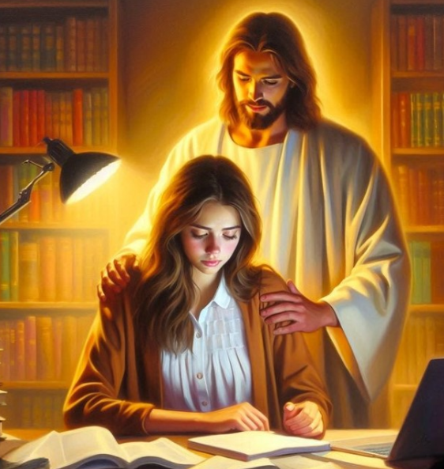
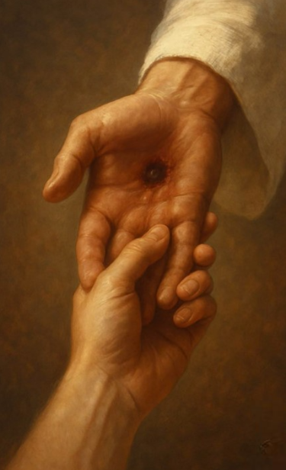

Help in Recognizing His Voice
Verses 4,6,8,10
Verses 4,6,8,10
Verses 7,10,19
Verses 8-9
Verses 10,19
The Lord patiently reaches out to us even when we do not initially recognize His voice
The Lord speaks to youth
It often requires time and practice to become familiar with the Lord’s voice
Others can help us recognize the voice of the Lord
When we demonstrate a willingness to listen and act, the Lord will reveal more.
1 Samuel 3

Slide 13
How Can I Recognize His Voice?
John 14:26–27
Galatian 5:22-23
D&C 8:2
D&C 9:8-9
D&C 11:12-13
The Comforter is the Holy Ghost to bring you Peace
The Spirit is love, joy, peace, longsuffering, gentleness, goodness, faith, meekness, and temperance
The Holy Ghost will let you know in your heart and mind
Study, pray, and feel
Trust in the Spirit and it will enlighten your mind and fill you with joy

Slide 14

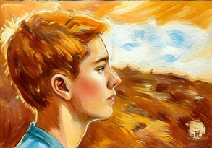
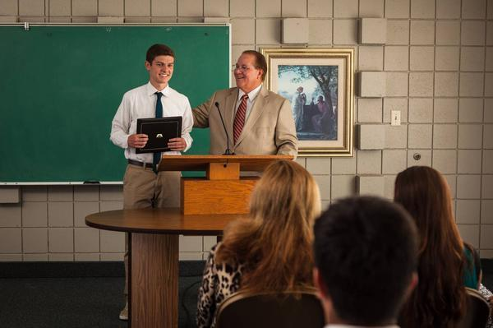
If we are willing and receptive, we can grow in our ability to recognize the voice of the Lord
Trusted leaders and parents can help us learn to recognize the voice of the Lord.
As we increase our ability to receive and understand personal revelation, we will be able to recognize the voice of the Lord more easily and receive His guidance and instruction
1 Samuel 3:11-14

Slide 15
Recognizing
What can prevent us from recognizing the Lord’s voice?
Ye are swift to do iniquity but slow to remember the Lord your God. Ye have seen an angel, and he spake unto you; yea,…
…ye have heard his voice from time to time; and he hath spoken unto you in a still small voice, but ye were past feeling, that ye could not feel his words; wherefore, he has spoken unto you like unto the voice of thunder, which did cause the earth to shake as if it were to divide asunder. 1 Nephi 17:45
What is one thing we need to do if we want to learn to recognize the Lord’s voice?
And now I say unto you, all you that are desirous to follow the voice of the good shepherd, come ye out from the wicked, and be ye separate, and touch not their unclean things… Alma 5:57

Slide 16
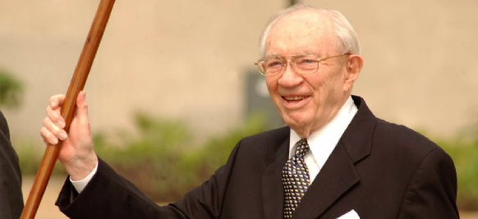
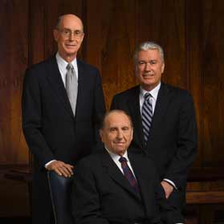
How can you recognize when the Lord speaks to us through the Spirit?
Who may speak for the Lord?
What I the Lord have spoken, I have spoken, and I excuse not myself; and though the heavens and the earth pass away, my word shall not pass away, but shall all be fulfilled, whether by mine own voice or by the voice of my servants, it is the same. D&C 1:38
…I will impart unto you of my Spirit, which shall enlighten your mind, which shall fill your soul with joy; D&C 11:13
What is one way you can hear the voice of the Lord daily?
These words are not of men nor of man, but of me; wherefore, you shall testify they are of me and not of man;
For it is my voice which speaketh them unto you; for they are given by my Spirit unto you, and by my power you can read them one to another; and save it were by my power you could not have them;
Wherefore, you can testify that you have heard my voice, and know my words. D&C 18:34-36
Read, study, have faith, and testify

Slide 17
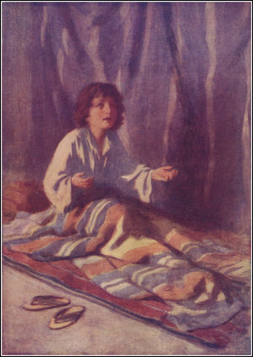
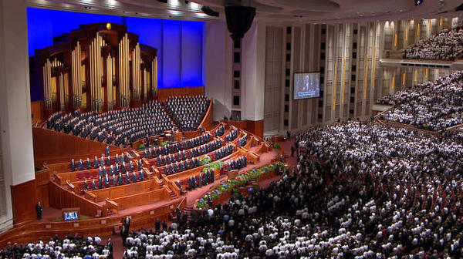
Revelation
The Lord can communicate with us through visions, speech, dreams, and sometimes appearances.
Most often we hear His voice through His prophets, the scriptures, and the Holy Ghost as impressions, thoughts, and ideas
Howbeit when he, the Spirit of truth, is come, he will guide you into all truth: for he shall not speak of himself; but whatsoever he shall hear, that shall he speak: and he will shew you things to come.
He shall glorify me: for he shall receive of mine, and shall shew it unto you.
All things that the Father hath are mine: therefore said I, that he shall take of mine, and shall shew it unto you.
John 16:13-15

Slide 18
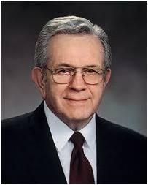
“The Spirit does not get our attention by shouting or shaking us with a heavy hand. Rather it whispers. It caresses so gently that if we are preoccupied we may not feel it at all. …
“Occasionally it will press just firmly enough for us to pay heed. But most of the time, if we do not heed the gentle feeling, the Spirit will withdraw and wait until we come seeking and listening.”
(2)

Slide 19

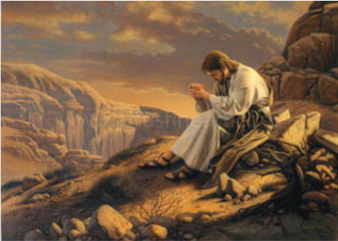
Quiet Spiritual Promptings
Quiet spiritual promptings may not seem as spectacular as visions or angelic visitations, but they can be just as powerful and life-changing.
The witness of the Holy Ghost can make an impression on the soul that is more meaningful than anything we can see or hear.

Slide 20

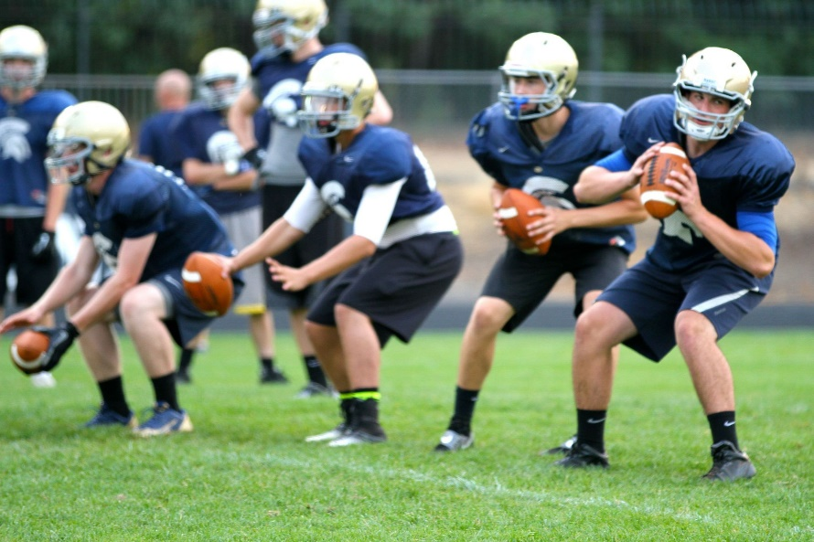
“When I was a young man in high school, one of my passions was American football. I played middle linebacker.
The coach worked the team hard, teaching us the basics. We practiced until the skills became natural and automatic.
(3)

Slide 21

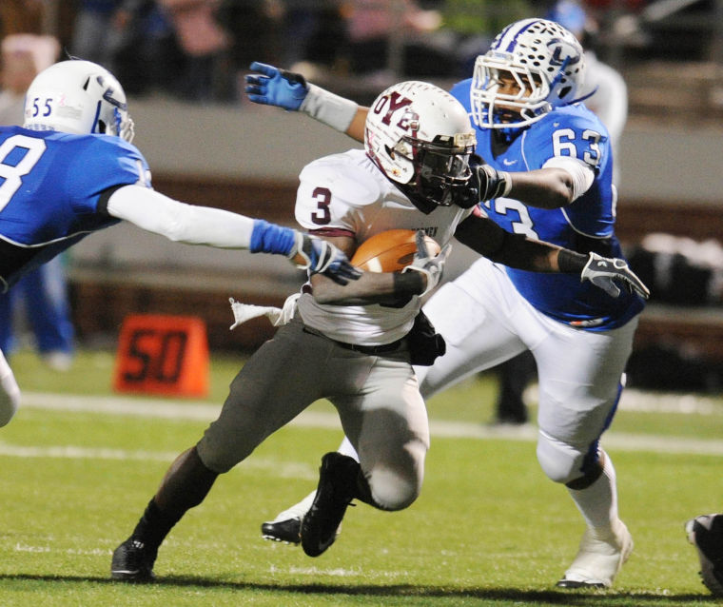
During one play against our biggest rival, I had an experience that has helped me over the years. We were on defense. I knew my assigned opponent, and as the play unfolded, he moved to my right into the line of scrimmage.
There was a lot of noise from players and fans. I reacted as the coach had taught us and followed my man into the line, not knowing if he had the ball.
To my surprise, I felt the ball partially in my hands. I gave it a tug, but my opponent didn’t let go. As we tugged back and forth, amid all the noise I heard a voice yelling, ‘Packer, tackle him!’ That was enough to bring me to my senses, so I dropped him on the spot.
(3)

Slide 22

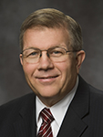
“I have wondered how I heard that voice above all the other noise. I had become acquainted with the voice of the coach during the practices, and I had learned to trust it.
I knew that what he taught worked.
“We need to be acquainted with the promptings of the Holy Ghost, and we need to practice and apply gospel teachings until they become natural and automatic. These promptings become the foundation of our testimonies.”
(3)

Slide 23
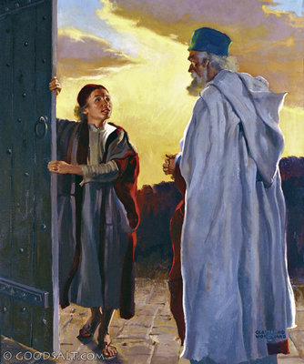
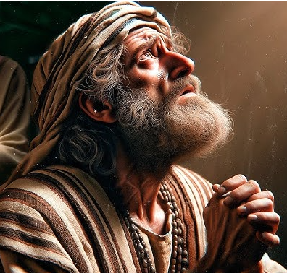
Samuel Tells Eli
For I have told him that I will judge his house for ever for the iniquity which he knoweth; because his sons made themselves vile, and he restrained them not.
And therefore I have sworn unto the house of Eli, that the iniquity of Eli’s house shall not be purged with sacrifice nor offering for ever.
As Samuel grew older, Israel recognized him as a prophet of the Lord
1 Samuel 3:11-18, 20

Slide 24
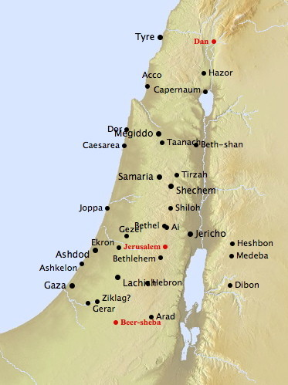
From Dan to Beer-sheba
Dan was a location at the northern extreme of Israel’s boundaries, and Beersheba was located at the furthest south. Thus, the phrase “from Dan even to Beer-sheba” was a way of saying “the whole country.”
The Lord was letting Samuel know that he was the prophet and that He was going to support him throughout the Israelite Nation
All of Samuel’s prophecies were fulfilled, which showed the people that his words came from the Lord
1 Samuel 3:18-21

Slide 25
Sources:
Video: Samuel and Eli (1:38)
Elder Harold B. Lee (“But Arise and Stand upon Thy Feet”—and I Will Speak with Thee, Brigham Young University Speeches of the Year, Provo, 7 Feb. 1956, p. 2.)
President Boyd K. Packer (“The Candle of the Lord,” Ensign, Jan. 1983, 53).
Presentation by ©http://fashionsbylynda.com/blog/
3. Elder Allan F. Packer (“Finding Strength in Challenging Times!” Ensign or Liahona, May 2009, 17).
4. President Russell M. Nelson (“Revelation for the Church, Revelation for Our Lives,” Ensign or Liahona, May 2018, 94–95)
5. Elder Dallin H. Oaks “Eight Ways God Can Speak to You” September 2004 (Ensign) BYU Devotional 29 Sept. 1981

Slide 26
Samuel’s encounter with the Lord:
“‘And the child Samuel ministered unto the Lord before Eli. And the word of the Lord was precious in those days; there was no open vision.’ (I Samuel 3:1) … That means that there was no prophet upon the earth through whom the Lord could reveal his will, either by personal experience, or by revelation. And it came to pass that Eli was laid down in his place and his eyes were dim, and Samuel the boy also lay down to his sleep, and you remember through that night there came a call, ‘Samuel,’ and thinking that Eli had called him he went to Eli’s room to be told that Eli had not called him. And he lay down the second time again to be called, and yet the third time. And by this time Eli, sensing the fact that he was being spoken to by an unseen speaker, said, ‘The next time that you hear, then you shall answer, “Here I am Lord, speak to me.”’ And so the next time when the call came, Samuel answered as he had been directed. Now it says, ‘Samuel (up to this time) did not yet know the Lord, neither was the word of the Lord revealed unto him.’ And after he had recognized the Lord and said, ‘Thy servant heareth,’ then he was told that the Lord was to proceed to ‘do a thing in Israel, at which both the ears of everyone that heareth it, shall tingle.’ And then he explained the reason why Eli could not receive further messages from the Lord. ‘His sons make themselves vile, and he restrained them not,’ or in other words he allowed his sons to curse God and therefore were leading the people of Israel astray.” Elder Harold B. Lee (“But Arise and Stand upon Thy Feet”—and I Will Speak with Thee, Brigham Young University Speeches of the Year, Provo, 7 Feb. 1956, p. 2.)
Increase in ability to Hear the Lord’s Voice:
Pray in the name of Jesus Christ about your concerns, your fears, your weaknesses—yes, the very longings of your heart. And then listen! Write the thoughts that come to your mind. Record your feelings and follow through with actions that you are prompted to take. As you repeat this process day after day, month after month, year after year, you will “grow into the principle of revelation.” President Russel M. Nelson(“Revelation for the Church, Revelation for our Lives,” Ensign or Liahona, May 2018, 95)
Spirit of Revelation:
“God uses a variety of patterns to convey revelations to His sons and daughters, such as thoughts to the mind and feelings to the heart, dreams, … and inspiration. Some revelations are received immediately and intensely; some are recognized gradually and subtly. Receiving, recognizing, and responding to revelations from God are spiritual gifts for which we all should yearn and appropriately seek” (David A. Bednar, “The Spirit of Revelation in the Work,” 2018 mission leadership seminar).
Samuel listens to all the words of the Lord:
“Samuel paid attention to all of the words of the Lord. Samuel as a prophet was now speaking for God. The surrounding verses indicate that the Lord does not let Samuel’s words fall to the ground, because they are His words. Soon all Israel knows that God has established Samuel as His prophet (1 Samuel 3:20).
“As youth of Zion, you have been given wise counsel by prophets, parents, and local priesthood leaders. Do you pay careful attention to that counsel, or do you let it fall to the ground because you don’t understand it or think it isn’t important or doesn’t apply to you? What the Lord said in 1831 applies to the youth today when it comes to For the Strength of Youth and other prophetic counsel you have been given: ‘These words are given unto you, and they are pure before me; wherefore, beware how you hold them’ (D&C 41:12)” Elder Robert D. Hales (Return: Four Phases of Our Mortal Journey Home [2010], 128).

