Slide 1

The Lost Ark of the Covenant
1 Samuel 4-8

Slide 2

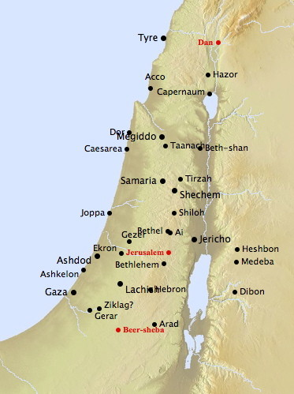
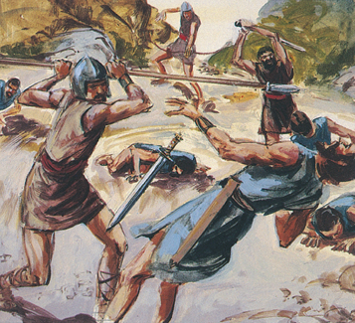
Aphek and Ebenezer
During Samuel’s pursuit of the Philistines the Israelites camped at Ebenezer while the Philistines camped at Aphek
Aphek and Ebenezer
The Philistines overtook the Israelites killing about 4,000
1 Samuel 4:1-2

Slide 3
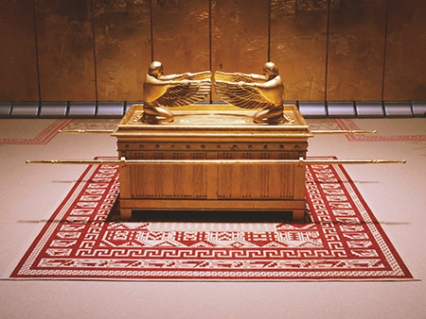
It May Save Us
Without Eli’s permission the Israelites along with Hophni and Phineas (sons of Eli) took the ark from nearby Shiloh to the battlefield.
They were placing their faith in an object [the ark] rather than in the Lord.
A depiction of the ark of the covenant
Their idea was foiled, for the Philistines went into battle and captured the ark killing many including Hophni and Phineas
1 Samuel 4:3-10

Slide 4
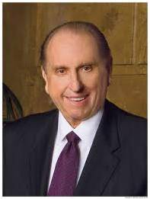
There is a golden thread that runs through every account of faith from the beginning of the world to the present time. Abraham, Noah, the brother of Jared, the Prophet Joseph Smith, and countless others wanted to be obedient to the will of God.
They had ears that could hear, eyes that could see, and hearts that could know and feel.
They never doubted. They trusted.
Through personal prayer, through family prayer, by trusting in God with faith, nothing wavering, we can call down to our rescue His mighty power. His call to us is as it has ever been: “Come unto me.”
In order to receive the Lord’s help, we must place our faith in Him and obey His commandments

Slide 5
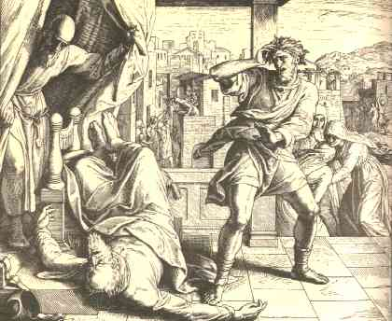
Eli’s Death
News of the capture of the ark and of the death of his sons caused Eli such consternation that he lost his balance on his seat, fell over backwards, and died, thus fulfilling the prophecy that his house would come to a tragic end.
Hophni’s wife also lost her life with the news. A son was born and she named him Ichabod
She said: The glory is departed from Israel: because the ark of God was taken, and because of her father in law and her husband.
1 Samuel 4:12-22
(2)

Slide 6
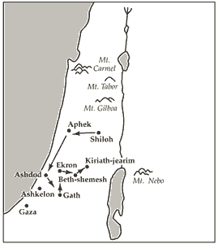
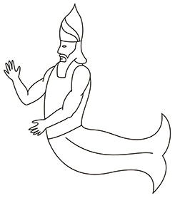
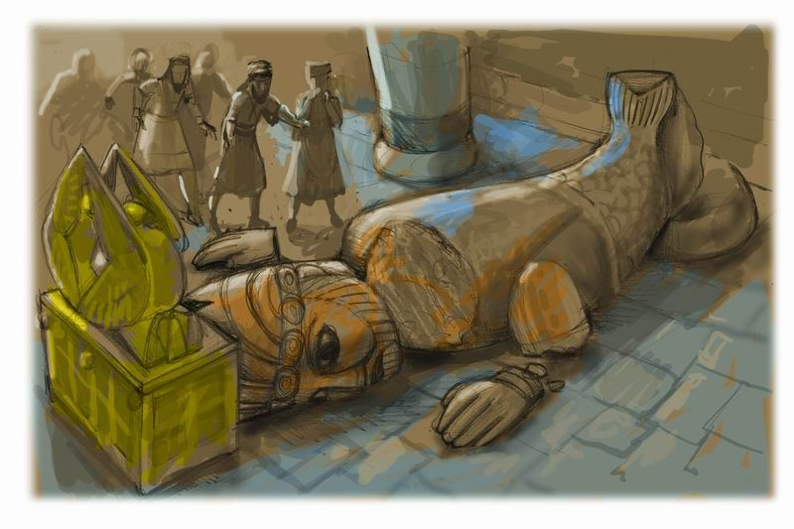
The Ark in the Hands of the Philistines
The House of Dagan--Dagon was one of the gods of the Philistines. Since the Philistines believed that Dagon had given them victory over Israel, the ark was brought into Dagon’s temple and deposited at his feet as a war trophy.
The Ark was taken to Ashdod
Ashdod was plagued with “Emerods”—
Josephus indicated that it was “a very destructive disease” involving dysentery, bleeding, and severe vomiting
We do not know exactly what emerods were, but we do know they were a very destructive disease like tumors or boils
1 Samuel 5:1-5
(2, 3)

Slide 7
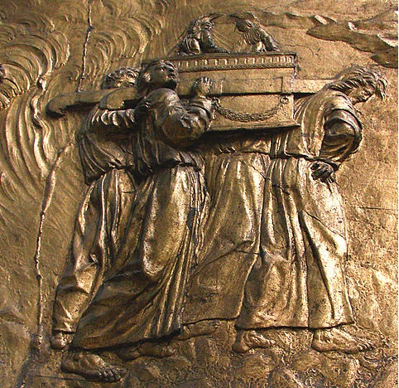
The Curse of the Ark
Other cities who received the ark had the same plague as Ashdod
In Gath the disease immediately broke out, and in Ekron.
The people in Ekron urged the Philistines to take the ark back to the Israelites.
1 Samuel 5:8-12
(2, 3)

Slide 8
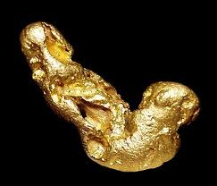
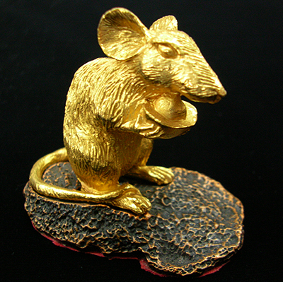
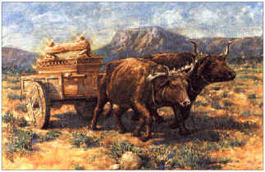
Returning the Ark
The Ark was with the Philistines 7 months
The priests of the Philistines instructed that a new cart should be constructed to carry the Ark and they said it should be drawn by two milk cows which had never before been under the yoke.
They made “five golden emerods, and five golden mice, according to the number of the lords of the Philistines.”
This was for a trespass offering.
They sent two milch kine cows (taking away their calves) on their way without any guidance.
The cows, watched by the Philistines, made their own way to Beth-shemesh into the field of Joshua
1 Samuel 6:1-14

Slide 9
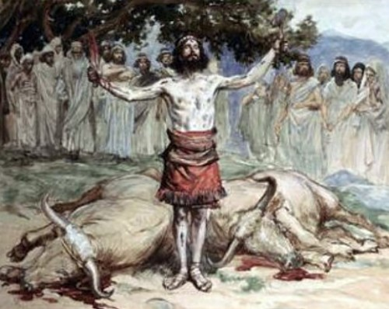
Men of Beth-shemesh
And they of Beth-shemesh were reaping their wheat harvest in the valley: and they lifted up their eyes, and saw the ark, and rejoiced to see it.
The Levites sacrificed the cows for a burnt offering, but somehow desecrated the Ark for the Lord was angry with them…
And he smote the men of Beth-shemesh, because they had looked into the ark of the Lord, even he smote of the people fifty thousand and threescore and ten men: and the people lamented, because the Lord had smitten many of the people with a great slaughter.
The Ark was taken to Kiriath-jearim, and placed in a house of a man named Abinadab, and his son, Eleazar, was assigned the task of safeguarding it… and the Ark rested there for 20 years
1 Samuel 6:10-21, 7:1-2

Slide 10
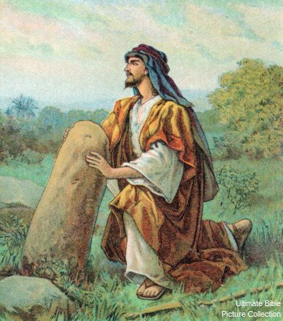
The Stone
Seeing that the Ark had made its way back to the Israelites a violent storm came, and the Philistines returned to Ebenezer.
If ye do return unto the Lord with all your hearts, then put away the strange gods and Ashtaroth from among you, and prepare your hearts unto the Lord, and serve him only: and he will deliver you out of the hand of the Philistines.
After a sacrifice unto the Lord Samuel placed a stone of remembrance between Aphek and Ebenezer
When the Philistines returned the Israelites swept down upon them.
A battle pursued at Ebenezer and the outcome was reversed.
The Philistines were so completely beaten that they evacuated their forces and returned back to Israel all of the territory they had previously held.
1 Samuel 7:3-14

Slide 11
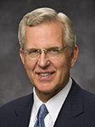
With All Your Hearts
To sincerely repent, we must forsake our sins and confess them to the Lord
“Confessing and forsaking are powerful concepts. They are much more than a casual ‘I admit it; I’m sorry.’ Confession is a deep, sometimes agonizing acknowledgment of error and offense to God and man” (4)

Slide 12
Where Am I?
Jesus Christ
The World
What influences My Decision Making?

Slide 13
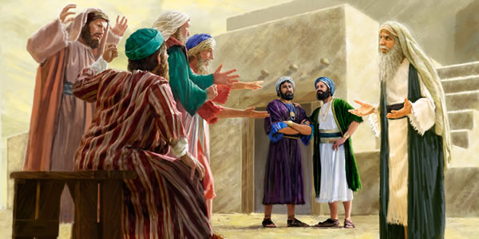
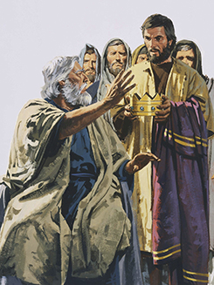
Joel and Abiah: Judges in Beer-sheba
Samuel’s sons set a poor example to the people.
They turned aside from the religious truths they had learned in their youth.
They used their judgeships to seek monetary gain, betraying their sacred trusts by taking bribes and giving perverted judgments.
But, even more than this, the Israelites as a people had become weak and sinful and were envious of surrounding kingdoms, even though their governments were wicked and oppressive. So, they used Samuel’s sons as an excuse to justify their desire to be governed by the same system as the gentile nations.
1 Samuel 8:1-5
(2)

Slide 14
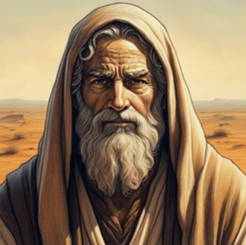

“Like All Nations”
Like many people today, the ancient Israelites struggled with the temptation to fit in with others rather than obeying the Lord.
For many years in the promised land, the Lord guided Israel through judges like Samuel.
Later in Samuel’s life, the Israelites desired to have a king “like all the nations” instead of the Lord to reign over them.

Slide 15
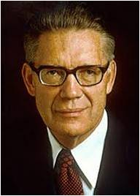
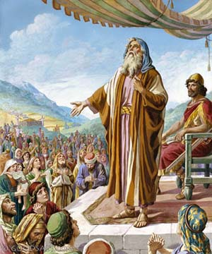
We Want A King
Hearken unto the voiceof the people in all that they say unto thee: for they have not rejected thee, but they have rejected me, that I should not reign over them.
Samuel warned the Israelites of three principal evils of a kingly form of government: excessive taxation, conscription of the labor force, and seizure of private lands
“The system of kingly government itself, no matter how talented or noble an individual occupant of the throne may be, does not make the best form of government, one in which the instinctive and automatic concern of government is to look after the best interests of the body of the people. It is inherent in the nature of even the best and most ideal kingly systems that special privilege and questionable adulation be heaped upon those in the ruling class. …
1 Samuel 8:10-22
(5)

Slide 16
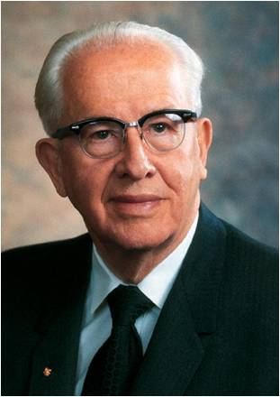
Unwise Requests
“Sometimes [God] temporarily grants to men their unwise requests in order that they might learn from their own sad experiences.
“Sometimes in our attempts to mimic the world, and contrary to the prophet’s counsel, we run after the world’s false educational, political, musical, and dress ideas. New worldly standards take over, a gradual breakdown occurs, and finally, after much suffering, a humble people are ready to be taught once again a higher law.”
And he also unfolded unto them all the disadvantages they labored under, by having an unrighteous king to rule over them; Mosiah 29:35
If a ruler hearken to lies, all his servants are wicked Proverbs 29:12
An angry man stirreth up strife, and a furious man aboundeth in transgression. Proverbs 29:22
Nevertheless, when the wicked rule the people mourn.
Wherefore, honest men and wise men should be sought for diligently, and good men and wise men ye should observe to uphold; otherwise whatsoever is less than these cometh of evil. D&C 98:9-10
An unjust man is an abomination to the just: and he that is upright in the way is abomination to the wicked. Proverbs 29:27
(6)

Slide 17
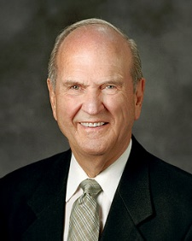




Peer Pressure
The voices and pressures of the world are engaging and numerous.
But too many voices are deceptive, seductive, and can pull us off the covenant path.
To avoid the inevitable heartbreak that follows, I plead with you today to counter the lure of the world by making time for the Lord in your life—each and every day. (7)
(5)

Slide 18
Sources:
Video: “Come, Thou Fount of Every Blessing” (6:04) Tabernacle Choir Singing
Depiction of the Ark of the Covenant by Weldon C. Andersen
Old Testament Institute Manual
Presentation by ©http://fashionsbylynda.com/blog/
3. Josephus The Antiquities of the Jews, translated by William Whiston A.M. p. 180
4. Elder D. Todd Christofferson (“The Divine Gift of Repentance,” Ensign or Liahona, Nov. 2011, 40).
5. Elder Bruce R. McConkie Mormon Doctrine pp. 414-415
6. Ezra T. Benson (“Jesus Christ—Gifts and Expectations,” New Era, May 1975, 17, 18).
7. President Russell M. Nelson (“Make Time for the Lord,” Liahona, Nov. 2021, 120)

Slide 19
The Israelites viewed the ark as the visible symbol of the presence of God, but bringing the ark from Shiloh on this occasion was a demonstration of Israel’s state of spiritual wickedness rather than a demonstration of their faith.
“They vainly supposed that the ark could save them, when the God of it had departed from them because of their wickedness. They knew that in former times their fathers had been beaten by their enemies, when they took not the ark with them to battle; as in the case of their wars with the Canaanites, [see Numbers 14:44–45]; and that they had conquered when they took this with them, as in the case of the destruction of Jericho, [see Joshua 6:4]. From the latter clause they took confidence; but the cause of their miscarriage in the former they laid not to heart.” (Clarke, Bible Commentary, 2:219.)
Idol Worship:
It is very important to understand that the worship of a false god that is intangible is just as evil and just as disastrous to the idolater as the worship of a graven image. Some false god may be associated with nature or be the worship of nature itself, meaning the laws or powers seen in nature. Idolatry of nature-related gods has included the worship of various animals, plants, the weather, volcanoes, the sun, the moon, the stars, the planets, and so on.
Though in the Old Testament idolatry is associated with the worship of actual images, true idolatry goes far beyond the practice of bowing down to images and appeasing angry idols. The Lord has made it clear in all ages that whenever men place their full trust in such things as other men, nations, treaties, treasuries, precious minerals, armies, or armaments, their actions are a form of idolatry because such actions reveal a lack of trust in Jehovah. To be totally free of idolatry one must put complete trust in the true God.
Dagon. “The God of the Philistines (Judg. 16:23; 1 Sam. 5:2; 1 Macc. 10:84; 12:2). There were temples of Dagon at Gaza and Ashdod. … His image was in the form partly of a man and partly of a fish. Some recent writers, however, question whether Dagon was really a fish-god, and connect the name with dagan, ‘grain.’” (Bible Dictionary, s.v. “Dagon”.)
Emerod:
Because the word translated emerod means “an inflamed tumor,” many have assumed that the Philistines were smitten with hemorrhoids and thus were motivated to send the ark back to Israel. The description of the effects of the emerods on the Philistines suggests something far more serious than hemorrhoids, however, although that ailment can be very painful. Many died, and those who did not seem to have endured great suffering (see 1 Samuel 5:10–12).
Josephus indicated that it was “a very destructive disease” involving dysentery, bleeding, and severe vomiting (see Antiquities of the Jews, bk. 6, chap. 1, par. 1). Josephus also mentioned a great plague of mice that accompanied the disease. Although no direct mention is made of the plague of rodents, when the Philistines sought to placate Jehovah’s wrath upon them by returning the ark, they sent five golden emerods and five golden mice as well (see 1 Samuel 6:4).
The severity of the disease and the fact that rodents were involved lead many scholars to conclude that what smote the Philistines was bubonic plague. Bubonic plague gets its name from the buboes, or tumorous swellings, in the lymph glands. These tumors settle particularly in the area of the groin. This fact would explain the “secret parts” mentioned in 1 Samuel 5:9. It is well known that rats and mice are the main carriers of this disease, for the fleas that transmit the disease to man live on rodents. The disease is accompanied by great suffering and pain, and the fatality rate may run as high as 70 percent in a week’s time. (See Hastings, Dictionary of the Bible, s.v., “medicine,” p. 598; Douglas, New Bible Dictionary, s.v. “emerods,” p. 368.) Small wonder that the Philistines were anxious to return the ark to Israel.
The ancient Philistines were very superstitious. They, like many others during the world’s history, believed that an image made to represent an actual object might be used to ward off evil powers. Such appears to have been their thinking in making golden images of the emerods and the mice and sending them as a “trespass offering” (v. 8) with the ark back to Israelite territory.
The men of Beth-shemesh:
“Concerning the men of Beth-shemesh who were smitten for sacrilege, the Hebrew account says, ‘And he smote among the people seventy men, fifty thousand men. …’ It is not a proper Hebrew expression for 50,070. The ‘fifty thousand men’ appears to be an added phrase, or gloss.
The septuagint and Josephus both have merely ‘seventy men.’” (Rasmussen, Introduction to the Old Testament, 1:163.)
Exactly what they did to bring the curse upon them is not clear. If it was merely looking upon the ark, then one wonders why all were not smitten. Bible scholars have indicated that the Hebrew word translated lookedactually means “to look upon or at a thing with lust or malicious pleasure” (Keil and Delitzsch, Commentary, 2:2:69). Remembering that the lid of the ark with the cherubim on it was solid gold and the ark itself was covered with gold plating (see Exodus 25:10–18), it is possible that these residents of Beth-shemesh looked upon the ark with covetous eyes, or at least upon the golden emerods and mice that were sent with it.
But whatever the specific reason for the deaths, the lesson was clear. The ark of the covenant was a physical symbol of the living presence of Jehovah. Any unholiness, whether Philistine or Israelite, was not to be tolerated.

Slide 20
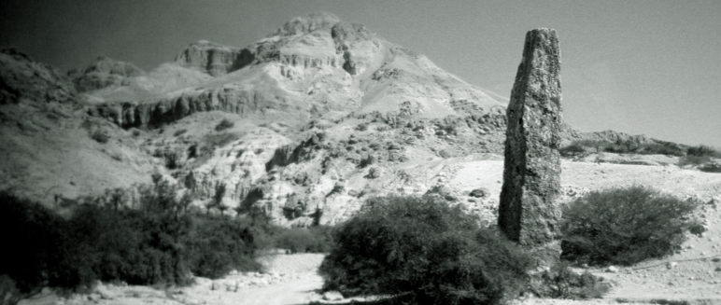
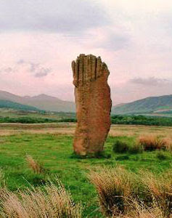
Come Thou Fount of every blessing
Tune my heart to sing Thy grace;
Streams of mercy, never ceasing,
Call for songs of loudest praise
each me some melodious measure,
Sung by flaming tongues above.
O the vast, the boundless treasure
Of my Lord’s unchanging love.
Here I raise my Ebenezer;
Hither by Thy help I'm come;
And I hope, by Thy good pleasure,
Safely to arrive at home.
Jesus sought me when a stranger,
Wandering from the fold of God;
He, to rescue me from danger,
Interposed His precious blood.
O to grace how great a debtor
Daily I'm constrained to be!
Let that grace now like a fetter,
Bind my wandering heart to Thee.
Prone to wander, Lord, I feel it,
Prone to leave the God I love;
Here's my heart, O take and seal it,
Seal it for Thy courts above.
It was written by the 18th century pastor and hymnist Robert Robinson, who was then a Methodist preacher after being converted following a sermon by George Whitfield. He penned the words at age 22 in the year 1757. Later he became a Baptist pastor with a church of over a thousand in Cambridge.
What is Ebenezer & where is it in the Bible?
By Alan Thomas (with input from Irene Tanner)
Eb·en·e·zer –Hebrew word meaning “stone of help”
Ebenezer was located near Aphek, which is in close proximity to Shiloh where the Tabernacle was. For generations to come, as Israelites would be making their regular pilgrimage to Shiloah, they would walk past this giant stone and remember that in that very spot, the Lord helped them. It served as a timeless memorial of what the Lord had done for them. Hitherto, hath the Lord helped us. Ebenezer: A New Years Carol
By Daniel Kolenda

Slide 21
The People Want a King:
“The people of Israel traced the cause of the oppression and distress, from which they had suffered more and more in the time of the judges, to the defects of their own political constitution. They wished to have a king, like all the heathen nations, to conduct their wars and conquer their enemies. Now, although the desire to be ruled by a king, which had existed in the nation even from the time of Gideon, was not in itself at variance with the appointment of Israel as a kingdom of God, yet the motive which led the people to desire it was both wrong and hostile to God, since the source of all the evils and misfortunes from which Israel suffered was to be found in the apostasy of the nation from its God, and its coquetting with the gods of the heathen. Consequently their self-willed obstinacy in demanding a king, notwithstanding the warnings of Samuel, was an actual rejection of the sovereignty of Jehovah, since He had always manifested himself to His people as their king by delivering them out of the power of their foes, as soon as they returned to Him with simple penitence of heart.” (Keil and Delitzsch, Commentary, 2:2:78.)
Monarchy:
“It is true that the Lord on occasions, in the pre-Christian Era, administered righteous and theocratic government through kings, but no such approved kingly government has existed among men for some 2000 years. Such a system, in which the king is the Lord’s representative, is patterned after the true kingdom of God and is proper government, but even then the moment an unrighteous king gains the throne, the blessings and freedoms of such a system die out. As King Mosiah said, ‘Because all men are not just it is not expedient that ye should have a king or kings to rule over you. For behold, how much iniquity doth one wicked king cause to be committed, yea, and what great destruction!’ (Mosiah 29.) Pending the day in which He shall again reign, whose right it is, the saints are obliged to be subject to the powers that be.” Elder Bruce R. McConkie (Mormon Doctrine, pp. 414–15.)
“Samuel’s sons set a poor example to the people. They turned aside from the religious truths they had learned in their youth. They used their judgeships to seek monetary gain, betraying their sacred trusts by taking bribes and giving perverted judgments. But, even more than this, the Israelites as a people had become weak and sinful and were envious of surrounding kingdoms, even though their governments were wicked and oppressive. So they used Samuel’s sons as an excuse to justify their desire to be governed by the same system as the gentile nations.
“‘The people of Israel traced the cause of the oppression and distress, from which they had suffered more and more in the time of the judges, to the defects of their own political constitution. They wished to have a king, like all the heathen nations, to conduct their wars and conquer their enemies’ [C. F. Keil and F. Delitzsch, Commentary on the Old Testament, 10 vols. (n.d.; repr., 1975), 2:2:78]” (Old Testament Student Manual: Genesis–2 Samuel, 3rd ed. [Church Educational System manual], 271).

