Slide 1

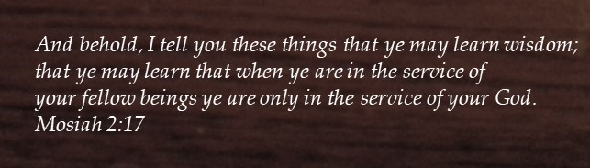
Saul As King
1 Samuel 9-11

Slide 2
Previously…
Samuel is aging and his sons Joel and Abiah are taking bribes and judging unwisely
1 Samuel 8:2
The people are discouraged and asks Samuel to appoint a king
v
Samuel emphasizes the things that could happen under a kingship, especially under an unrighteous king
A whole new era begins for the Israelites

Slide 3
Saul
He was from the tribe of Benjamin and his father, Kish, was a powerful man in Gibiah
He was a big, strong, and righteous Israelite and his history is recorded in Samuel 1
His wife was named Ahinoam, the daughter of Ahimaaz. His sons were: Johnathan, Ishui, and Melchi-shua, and daughters Merab, and Michal (1 Samuel 14:49-50)
The Lord caused the prophet Samul to anoint young Saul to be king of Israel
He began as a humble servant, however, soon after assuming the role of king of Israel, he began to forget the Lord and take upon priestly duties and was rejected of the Lord
He disobeyed the Lord by saving the spoils from the battle of the Amalekites
Samuel told him that the Lord would choose another king
He was an eyewitness to the process of his own dethronement
He was plagued by the spirit of jealousy and continually plotted for the death of David
He lost his life in a battle at Mount Giboa
(1)

Slide 4
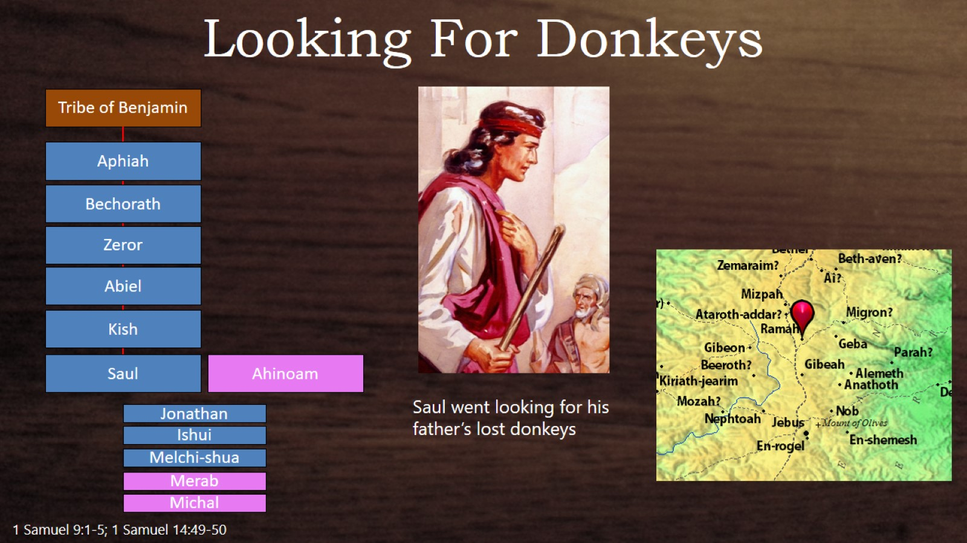

Slide 5
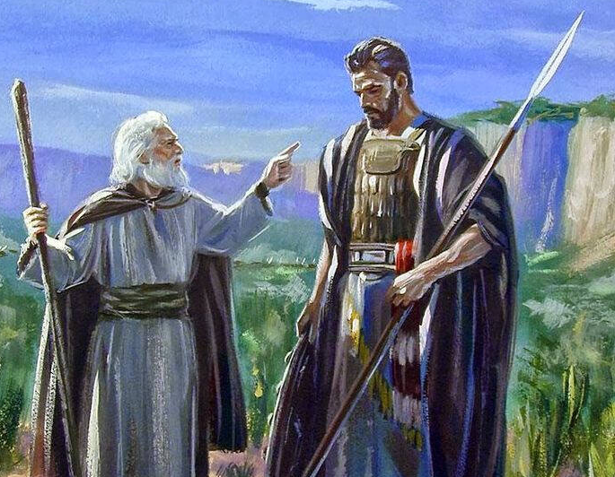
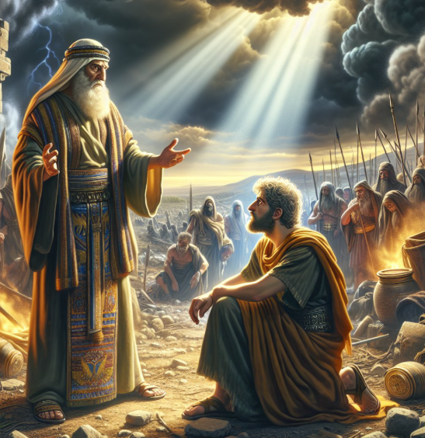
Saul Meets Samuel
Behold now, there is in this city a man of God, and he is an honourable
Seer = a man of God who can see or know of things in the past, present, or future that others may not perceive
The Lord calls people to serve in His kingdom through inspiration to His authorized servants
Upon their arrival in the city, the man of God came toward them as he was going to bless a sacrifice on behalf of the people.
1 Samuel 9:6-17

Slide 6
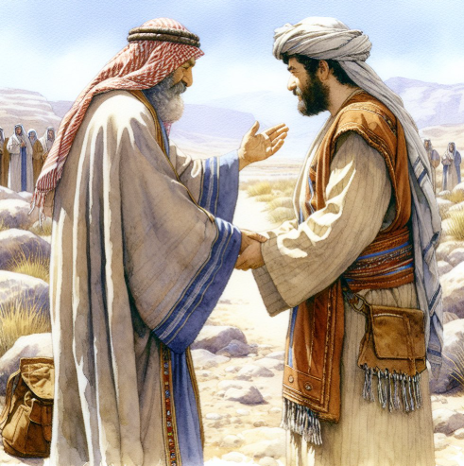
Saul is Treated As A Guest
Saul is worried over the donkeys: Samuel’s instruction regarding the donkeys was likely given to strengthen Saul’s faith in preparation for the call to be king
Samuel was saying that Saul was the man the Lord had chosen to fulfill Israel’s desire to have a king
If we seek the Lord’s direction through His prophets and seers, they will show us the way we should go
1 Samuel 9:18-21

Slide 7
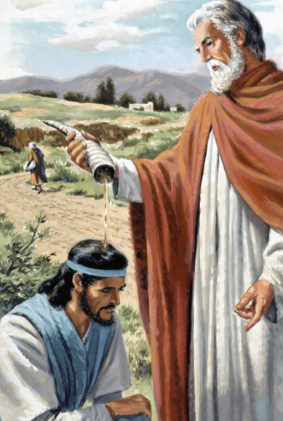
Saul is Anointed
Anointing with oil in a priesthood service is as old as Adam.
Since the Lord set up the kingdom of Israel and revealed the laws that were to govern their kings, it was altogether fitting that these kings be anointed with oil.
“Anointing with oil was a symbol of endowment with the Spirit of God; as the oil itself, by virtue of the strength which it gives to the vital spirits, was a symbol of the Spirit of God as the principle of divine and spiritual power.
Hitherto there had been no other anointing among the people of God than that of the priests and sanctuary. (2)
1 Samuel 10:1

Slide 8
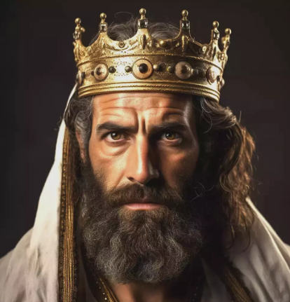
Saul is Selected As King
The people who knew Saul were surprised to see him prophesy with the group of prophets.
After this event, Samuel gathered the Israelites together and reminded them that they had rejected the Lord by seeking to have a king.
He then announced that Saul was the man whom the Lord had chosen to be the earthly leader of Israel.
Not everyone supported Saul’s selection as king.
One group of people questioned Saul’s abilities and despised him, but Saul did not retaliate against them.
“How shall this man save us? And they despised him and brough him no presents. But he held his peace.”
1 Samuel 10:23-27

Slide 9
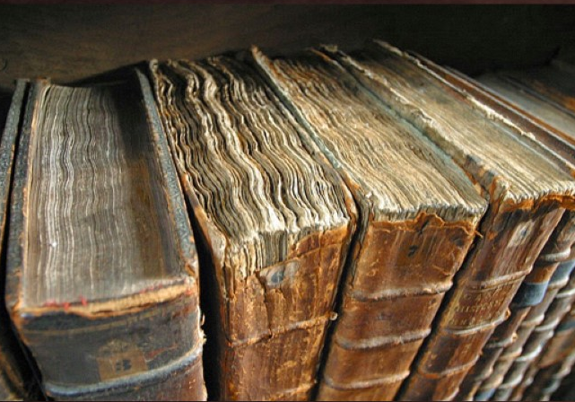
Writing It In A Book
Certainly, the standard works do not contain all that God has ever spoken to His children, and those who say that the Bible is all there is are mistaken.
The Book of Mormon itself does not contain “even a hundredth part” of all that Mormon had at his disposal to make his abridgment. (2)
Several books are mentioned in the Old Testament which are not a part of the present canon of scripture.
“And there had many things transpired which, in the eyes of some, would be great and marvelous: nevertheless, they cannot all be written in this book; yea, this book cannot contain even a hundredth part of what was done among so many people in the space of twenty and five years; 3 Nephi 5:8
1 Samuel 10:25

Slide 10
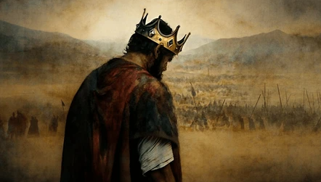
Saul’s Success As King
He slew his oxen and sent the pieces thereof to every tribe to dramatize that this crisis called for a united Israel.
He joined his authority with that of Samuel in the message.
Under this leadership, the armies of Israel dealt a stunning defeat to the Ammonites, and Saul gave all credit to the Lord.
The victory provided the catalyst for uniting the tribes into one nation for the first time. So strong was the support for Saul that some suggested that those who had earlier questioned his right to rule be put to death. Saul rejected this proposal. (2)
Sometime after Saul's appointment as king of Israel, the Ammonites threatened to attack some Israelites living east of the Jordan River.
“And all the people went to Gilgal; and there they made Saul king before the LORD in Gilgal;
1 Samuel 11

Slide 11
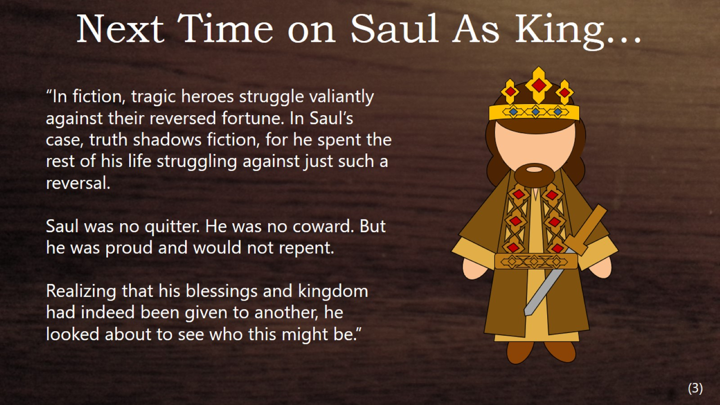

Slide 12
Sources:
Who’s Who in the Old Testament by Ed J. Pinegar and Richard J. Allen pg. 166-167
Presentation by http://fashionsbylynda.com/blog/
2. Old Testament Institute Manual
3. The Tragic Dimensions of Sal by Richard G. Ellsworth June 1990 Ensign

Slide 13
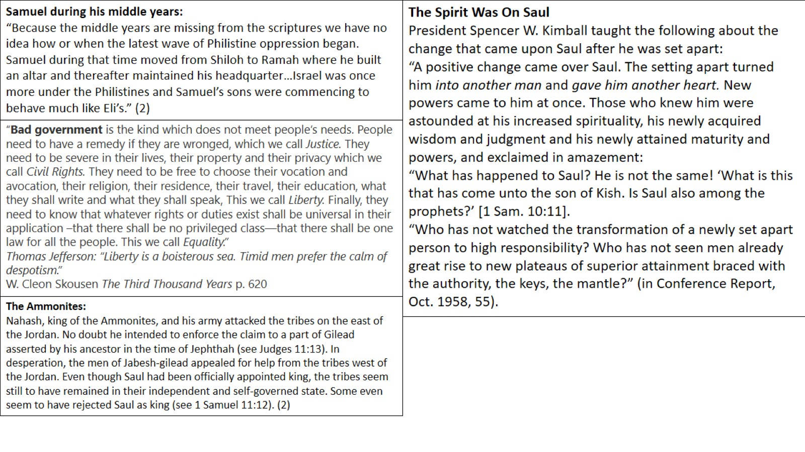

Slide 14
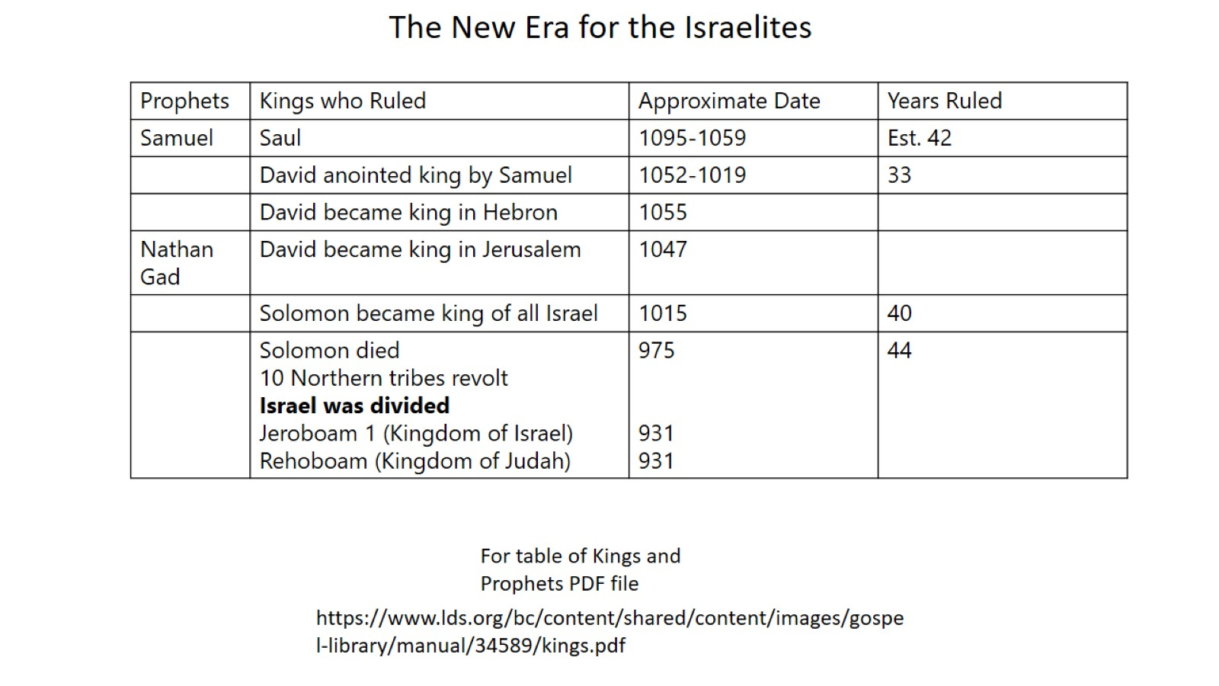

Slide 15
