Slide 1

Justifying Disobedience
1 Samuel 12-15
For if ye will not abide in my covenant ye are not worthy of me.
Doctrine and Covenants 98:15

Slide 2


Samuel’s Conference
Samuel witnesses of his just dealing with the Israelites.
Samuel introduces Saul as their King
Samuel reproved them for ingratitude and exhorted them to follow the Lord.
Samuel reminds them of their heritage and the flight out of their enemies in Egypt.
But if ye will not obey the voice of the Lord, but rebel against the commandment of the Lord, then shall the hand of the Lord be against you, as it was against your fathers.
1 Samuel 12

Slide 3

Justify
To rationalize or excuse
It was ____’s
fault
The others wanted to do it
It wasn’t as bad as what ____did
It wasn’t that big of a deal

Slide 4
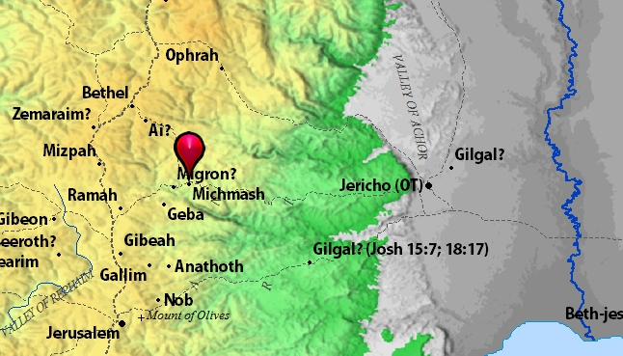
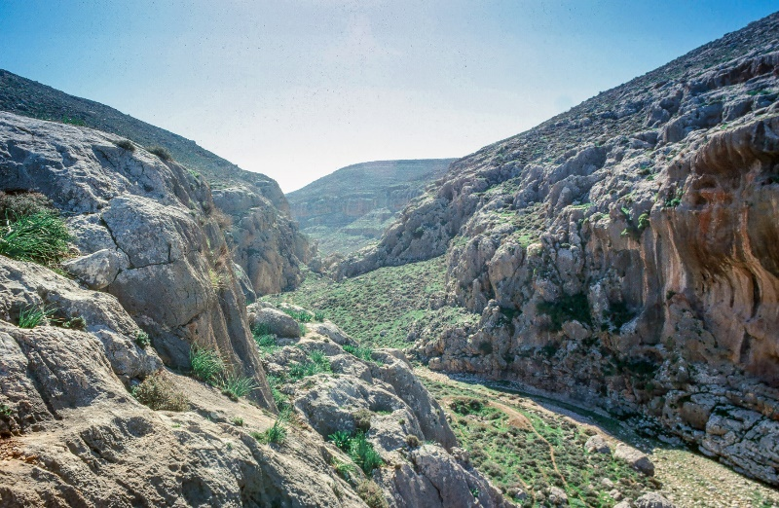
Battle With the Philistines
A group of Israelite soldiers under the command of Saul’s son Jonathan attacked a group of Philistine soldiers stationed in Israelite territory
Knowing this attack would lead to war with the Philistines, Saul gathered additional soldiers.
The Philistines were camped at Michmash
The Israelites were afraid because of the large number of Philistines and hid in caves, pits, high places, etc.
1 Samuel 13:1-8

Slide 5
Jonathan
He was the son of Saul, who was of the tribe of Benjamin
He was known for his military prowess and speed
He excelled in archery
Unbeknownst to him, his father had called for a fast and Jonathan ate of honey and Saul sought to kill him, but the people defended him, and Jonathan’s life was preserved
He had a great friendship with David and defended David before the murderous ambitions of Saul
He fell by the sword along side his father at the battle of Gilbon
David recovered the remains of Saul and Jonathan and buried them “in the country of Benjamin in Zelah, in the sepulcher of Kish
(1)

Slide 6
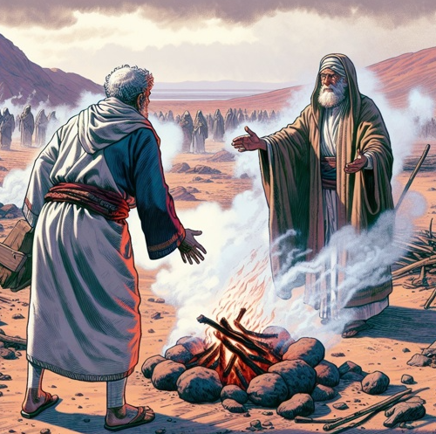
Saul’s Disobedience
The prophet Samuel had previously told Saul that he was to go to Gilgal and wait seven days for Samuel to come and offer sacrifices to the Lord
This sacrifice would be a way to seek the Lord’s blessings before the Israelite army went into battle.
It would also help the soldiers dedicate themselves to the Lord and strengthen their faith.
Saul did not wait and went a performed the sacrifice for which he did not have the authority to do so
1 Samuel 13:9-10

Slide 7
Justifying
What hast thou done?
The kingdom will not continue with a man after his own heart
The people scattered and hid because they were afraid…and you weren’t here…
So I made a supplication for them in the burnt offering
Even though we may try to justify our disobedience to the Lord’s commandments, He will hold us accountable
Thou has done foolishly and not kept the commandments of the Lord
1 Samuel 13:11-14

Slide 8
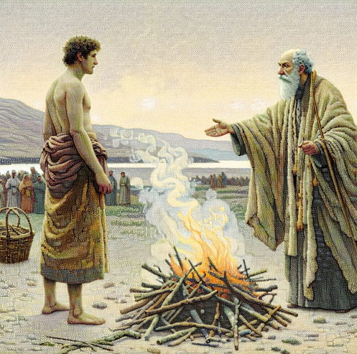
Under All Circumstances
The circumstances were critical, but one of the purposes of mortality is to demonstrate that one will remain faithful and obedient under all circumstances.
Saul failed that test and thereby lost his right to be God’s representative of the people. (2)
Samuel left Saul, and the Philistines sent raiding troops to destroy the land and torment the Israelites.
1 Samuel 13:15-23

Slide 9
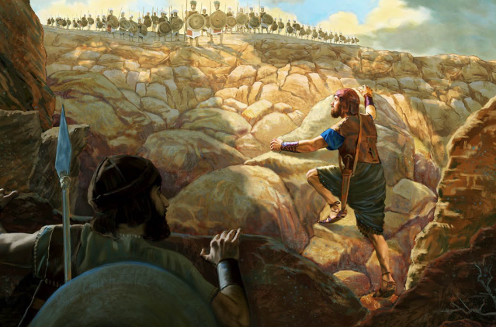
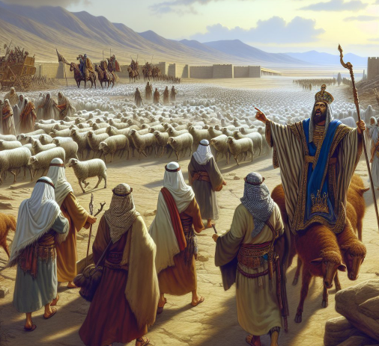
The Attack
Trusting in the Lord, Jonathan and his servant courageously attacked a group of Philistine soldiers.
This act, combined with an earthquake that followed, caused confusion and panic in the Philistine army.
Saul’s army then attacked the panicked Philistines and defeated them.
1 Samuel 14:1-18

Slide 10
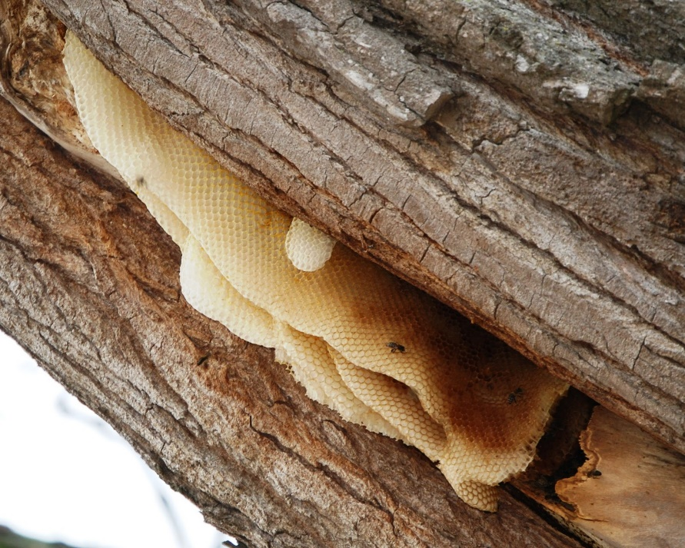
The Required Fast
During this battle, Saul demanded a fast and forbade his soldiers from eating in a misguided effort to get help from the Lord and prevail over his enemies.
Jonathan was unaware of this command and ate some honey while pursuing the Philistines.
1 Samuel 14:24-32

Slide 11
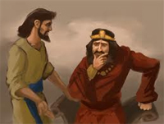
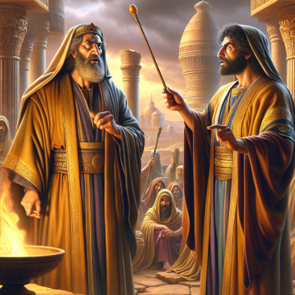
Saul Seeks a Sign from the Lord
Later in the day, when Saul sought revelation from the Lord about whether to attack the Philistines during the night, no answer came.
He gathered the people together and swore an oath that whoever had eaten earlier in the day would be put to death, even if it had been his own son Jonathan.
When he learned that Jonathan had eaten some honey, Saul said Jonathan must die.
Saul concluded that the Lord did not answer because someone in the army had sinned.
1 Samuel 14:24-32

Slide 12
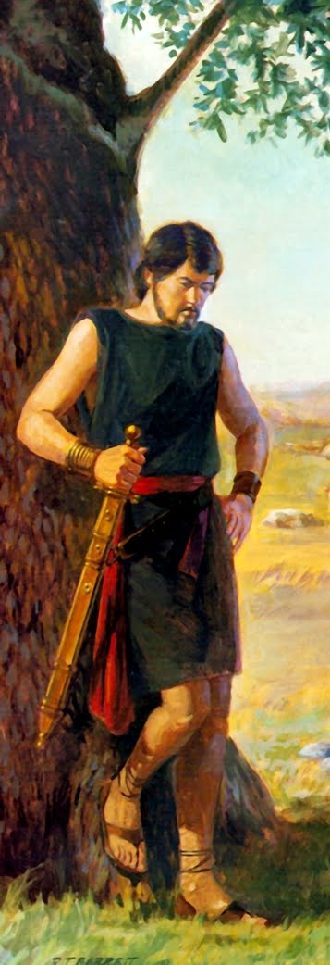
The People’s Response
When told about the oath, Jonathan frankly said that his father had done a foolish thing. Since his own strength had been revived by the food, he wondered aloud how much greater the victory would have been if the people had been allowed to eat instead of fighting in a state of physical exhaustion. (2)
And the people said unto Saul, Shall Jonathan die, who hath wrought this great salvation in Israel? God forbid: as the Lord liveth, there shall not one hair of his head fall to the ground; for he hath wrought with God this day. So the people rescued Jonathan, that he died not.
1 Samuel 14:28-45

Slide 13
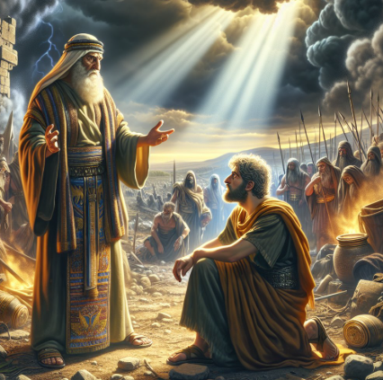
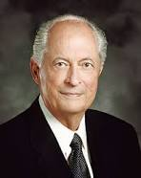
Recognizing One Had Sinned
And Saul could not fail to recognize now, that it was not Jonathan, but he himself, who had sinned, and through his arbitrary and despotic command had brought guilt upon Israel, on account of which God had given him no reply.” (3)
Most of the time it is not total disobedience that gets us into trouble.
It is, rather, that we are selectively obedient. Selective obedience is when we push the limits of what we know to be right.
We may recognize what we must do to be obedient, yet we selectively do only part of what we are commanded to do. (4)
1 Samuel 14:28-45

Slide 14

Justifying Disobedience
Sometimes we might be tempted to try to justify our disobedience to some commandments because we are obedient to others.
Example:
“Because I pray and read my scriptures daily, it is okay if I do not attend my church meetings.”

Slide 15


Pick and Choose
[Have] faith to keep all the commandments of God, knowing that they are given to bless His children and bring them joy.
[You] will encounter people who pick which commandments they will keep and ignore others that they choose to break.
I call this the cafeteria approach to obedience. This practice of picking and choosing will not work.
It will lead to misery. To prepare to meet God, one keeps all of His commandments.
It takes faith to obey them, and keeping His commandments will strengthen that faith. (7)
Obedience to some commandments does not justify disobedience to other commandments

Slide 16
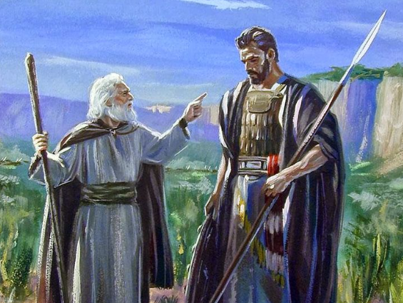
A Second Chance
The Lord gave Saul a second chance to prove his obedience.
He commanded Saul to destroy all the Amalekites and their livestock.
The Amalekites were a murderous people and were enemies of the Lord
Remember what Amalek did unto thee by the way, when ye were come forth out of Egypt; Det. 25:17
1 Samuel 15:1-5

Slide 17
Saul Disobeys the Lord Again
The Lord told Samuel that Saul had turned back from following Him and had disobeyed His commandments.
We have brought the best of the animals and we have destroyed all the rest
You have been anointed King and you have not done what the Lord has asked
Come to Carmel
I have done what the Lord wanted me to do
I have brought the king, Agag with me as a prisoner, and I have destroyed the Amalekites and I have sacrificed the animals unto the Lord
Why do you have the Amalekites flocks?
Behold, to obey is better than sacrifice, and to hearken than the fat of rams.
1 Samuel 15:12-22

Slide 18
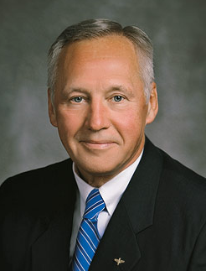
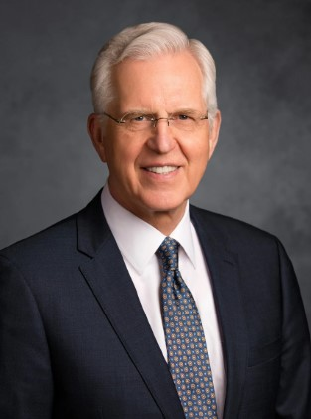
“At times we may rationalize that the Lord will understand our disobedience because our special circumstances make adherence to His laws difficult, embarrassing, or even painful.
However, faithful obedience, regardless of the apparent size of the task, will bring the Lord’s guidance, assistance, and peace” (8)
God sees things in their true perspective, and He shares that perspective with us through His commandments, effectively guiding us around the pitfalls and potholes of mortality toward eternal joy. …
I haven’t met anyone who found the gospel later in life who didn’t wish it could have been earlier. “Oh, the poor choices and mistakes I could have avoided,” they will say.
The Lord’s commandments are our guide to better choices and happier outcomes. How we ought to rejoice and thank Him for showing us this more excellent way. (5)
1 Samuel 15:23

Slide 19
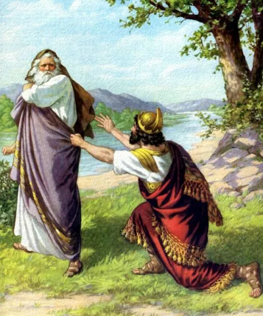
Too Late
Samuel told Saul that the kingdom would be taken from him and given to someone else.
Saul’s repentance was too late and very short-lived. This second violation was essentially the same sin of disobedience he had been guilty of before.
Had Saul’s repentance been deep and sincere, the second incident would never have happened. As the Lord warned in modern times, “But unto that soul who sinneth [after the Lord has forgiven him] shall the former sins return.” (2)
And Samuel came no more to see Saul until the day of his death: nevertheless Samuel mourned for Saul: and the Lord repented that he had made Saul king over Israel.
1 Samuel 15:26-35

Slide 20
Next…
This evil spirit did not depart from Saul during the remainder of his reign. His temper became intolerable, his jealousy unbounded. He was ready to commit murder on the slightest provocation, and at one time he hurled a javelin at his own son, Jonathan.
This was a far cry from the day when God gave Saul a new heart as he commenced his reign, when the spirit of God was his companion, and even when he was given the gift of prophecy. (6)
1 Samuel 15:24-25

Slide 21
Sources:
Video:
“Honesty: You Better Believe It!” (4:46)
“Blessed and Happy Are Those Who Keep the Commandments of God” (5:41)
Who’s Who in the Old Testament by Ed J. Pinegar and Richard J. Allen p. 106-107
Old Testament Institute Manual
(Keil and Delitzsch, Commentary, 2:2:146–47.) Found in Old Testament Institute Manual
Elder Robert D. Hales (“Return with Honor,” Ensign, June 1999, 10)
Presentation by ©http://fashionsbylynda.com/blog/
5. Elder D. Todd Christofferson (“The Joy of the Saints,” Ensign or Liahona, Nov. 2019, 16)
Mark E. Peterson (Three Kings of Israel [Salt Lake City: Deseret Book Co., 1980], 36)
Russell M. Nelson (“Face the Future with Faith,” Ensign or Liahona, May 2011, 34)
Elder Bruce A. Carlson (“When the Lord Commands,” Ensign or Liahona, May 2010, 39).

Slide 22
Saul’s decision:
“…growing impatient at Samuel’s delay, Saul prepared the burnt offering himself, forgetting that though he occupied the throne, wore the crown, and bore the scepter, these insignia of kingly power gave him no right to officiate even as a deacon in the Priesthood of God; and for this and other instances of his unrighteous presumption he was rejected of God and another was made king in his place.” (Talmage, Articles of Faith, pp. 184–85.) Old Testament Institute Manual
Saul’s supplication:
Now to Saul it may have appeared a very simple matter that he should not wait the coming of the prophet. Why could not he, a king, make offering and supplication to the Lord? Why should he wait for the coming of Samuel? Because it was the will and commandment of the Lord, and he did not obey it. In this we have an evidence of the goodness of God in one way and of his strictness in another way. The king was assured by the prophet that if he had obeyed the commandment of God, his kingdom would have been established over Israel forever; but that having departed therefrom, his kingdom should not continue. Rudger Clawson(Conference Report, October 1899, First Day—Morning Session 123-124)
No Smith in the Land:
Scholars believe that at this time the Israelites did not know how to work with iron. The Philistines guarded the secret carefully to maintain superiority in weapons over the softer brass weapons of the Israelites. As a result, the Israelites did not have the superior chariots of iron, nor could they manufacture swords and spears of iron. The other instruments mentioned, “share,” “coulter,” “axe,” “mattock,” and “goad,” had to be taken to the Philistines for sharpening. A share was a metal instrument used to plough the ground, and a coulter was a small garden hoe used to loosen the earth and weed the soil. A mattock was an Egyptian hoe or grubbing axe, and a goad was a sharp rod about eight feet long used to prod stubborn animals
Saul’s Perception: (1 Samuel 15)
You have to love Saul’s perception of his own obedience! He is sure he has done what he was supposed to, declaring “Blessed be thou of the Lord: I have performed the commandment of the Lord.” Had he performed the commandment of the Lord? Had he done exactly as commanded? Had he obeyed perfectly? No, he had not.
Can we make the same mistake? Can we offend God yet convince ourselves that we have honored him with our obedience? It’s a sobering question.
“The story of King Saul stands as a solemn warning to all of us. If the time ever comes that we think we can better serve God by following our own wisdom than we can by following the direction of the Lord through his Holy Spirit and through his holy prophets, we have apostatized. If we thus reject the Lord, we have broken the slender thread of communication. Our prayers cannot then be effective.” (Chauncey C. Riddle, “Obstacles to Prayer,” Ensign, Jan. 1976, 28)
Spoilers:
In the armies of ancient times, certain men were assigned to go out and destroy crops, homes, barns, cattle, and so forth. Their prime purpose was not to take human life, but to make living difficult for the civilian population who supported the military (see Clarke, Bible Commentary, 2:249). Old Testament Institute Manual
The Fasting Decision:
This command of Saul did not proceed from a proper attitude towards the Lord, but was an act of false zeal, in which Saul had more regard to himself and his own kingly power than to the cause of the kingdom of Jehovah, as we may see at once from the expression … ‘till I have avenged myself upon mine enemies.’” (Keil and Delitzsch, Commentary, 2:2:142.)
To obey is better than sacrifice:
When Samuel taught Saul that “to obey is better than sacrifice” (1 Samuel 15:22), the sacrifice Samuel referred to was animal sacrifice and other sacrificial offerings made to the Lord as part of the law of Moses. Samuel was not saying that offering sacrifices was not a correct practice. Offering sacrifices was part of the Israelites’ obedience to the Lord, but these offerings were to be made with a submissive, obedient heart. The Lord requires and delights in complete obedience to Him in heart and action. When an animal was sacrificed to the Lord, the Lord delighted more in the obedience of the person making the offering than in the sacrificed animal. The animals Saul had obtained for the claimed intentions of sacrificing were obtained by his disobedience to the Lord. The Lord would not delight in these offerings if they were to be made. What’s more, the Lord had not required that such a sacrifice be made in this situation. Samuel taught Saul that complete obedience to the Lord is better than performing a singular religious practice and that complying with one religious practice did not justify disobeying the Lord’s other commandments. Saul’s decision to disobey was influenced by his desire to please others rather than the Lord because he feared the judgments of men (see Robert D. Hales, “Agency: Essential to the Plan of Life,” Ensign or Liahona, Nov. 2010, 26). Saul gave in to the temptation to be popular rather than obeying the word of God.

Slide 23
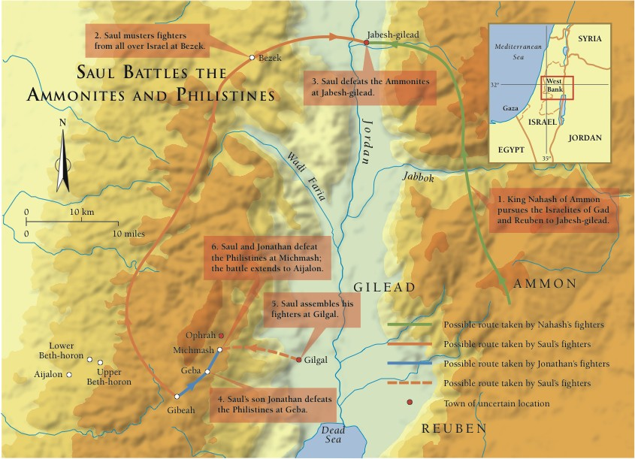

Slide 24
What Saul Did | Scripture
Saul lied about his obedience | 1 Samuel 15:13, 20
Saul tried to justify his disobedience | 1 Samuel 15:15,21
Saul blamed others for his actions | 1 Samuel 15: 15,21
Saul became prideful | 1 Samuel 15:17
Saul didn’t prioritizes what was most important | 1 Samuel 15:22
Saul worried more about the opinions of others than obeying God | 1 Samuel 15:24
What Saul Did | Scripture
Saul lied about his obedience | 1 Samuel 15:13, 20
Saul tried to justify his disobedience | 1 Samuel 15:15,21
Saul blamed others for his actions | 1 Samuel 15: 15,21
Saul became prideful | 1 Samuel 15:17
Saul didn’t prioritizes what was most important | 1 Samuel 15:22
Saul worried more about the opinions of others than obeying God | 1 Samuel 15:24

Slide 25
