Slide 1

David is King
2 Samuel 1-10
So all the elders of Israel came to the king to Hebron; and king David made a league with them in Hebron before the Lord: and they anointed David king over Israel.
2 Samuel 5:3

Slide 2

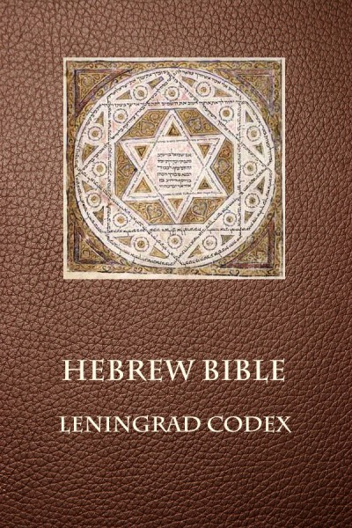
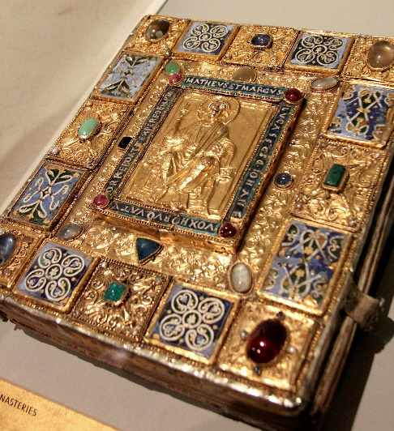
2 Samuel
The books of 1 and 2 Samuel were originally one book of scripture
2 Chronicles
Judges
1 Chronicles
Joshua
Ruth
1 Kings
2 Kings
2 Samuel
1 Samuel
Nehemiah
Ezra
Ester
In the Hebrew Bible these books form one. Our division into two books follows the Greek Bible. The books begin with the birth of Samuel (hence the title) and carry us down nearly to the death of David, a period of about 130 years.
It is uncertain when and where 2 Samuel was written.

Slide 3
David’s History in 2 Samuel
2 Samuel 11-12
2 Samuel 1-10
2 Samuel 13-24
David lusts after Bathsheba and commits adultery with her. Bathsheba conceives a child, and David tries to make it appear as though Bathsheba’s husband, Uriah, is the father. When this plan does not work, David then arranges for Uriah to be killed in battle and takes Bathsheba as a wife. The Lord reveals to Nathan the prophet what David has done, and Nathan exposes David’s sin by means of a parable. Nathan prophesies of the tragedy and misery that will come upon David and his household.
David becomes king, first of the tribe of Judah and then of all of Israel. He takes the ark of the covenant to Jerusalem and offers to build a temple, but the Lord forbids him from doing so. The Lord is with David as he defeats many nations. He exercises wise judgment and governs his kingdom with both justice and mercy.
David’s family is fractured by lust and murder. His son Absalom conspires against him and seeks the throne. David strives to reign uprightly and is able to maintain control of the kingdom.

Slide 4
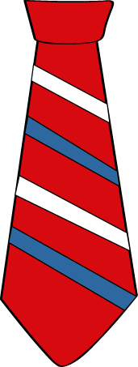
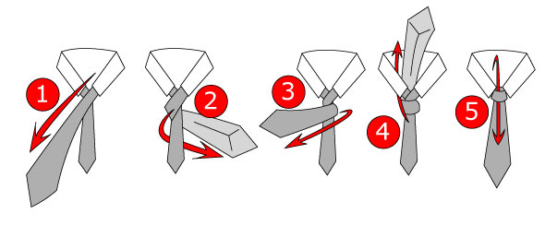
Asking for Guidance
Can you tie a tie?
Is it easier to tie a tie when you can look at instructions or have someone guide you?

Slide 5
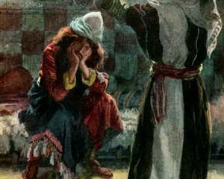
David Learns of the Death of Saul and Johnathan
The practice of ripping one’s clothes and putting soil or ashes on the head “were signs of sorrow and distress among all nations. The clothes rent, signified the rending, dividing, and scattering, of the people; the earth or ashes on the head, signified their humiliation.” (1)
The Lie
The man who came to David and reported that he had killed Saul at Saul’s insistence was not Saul’s armor-bearer.
“The whole account which this young man gives is a fabrication: in many of the particulars it is grossly self-contradictory. There is no fact in the case but the bringing of the crown, or diadem, and bracelets of Saul; which, as he appears to have been a plunderer of the slain, he found on the field of battle; and he brought them to David, and told the lie of having dispatched Saul, merely to ingratiate himself with David.”
When one told me, saying, Behold, Saul is dead, thinking to have brought good tidings, I took hold of him, and slew him in Ziklag, who thought that I would have given him a reward for his tidings:
(1)
2 Samuel 1:3-16

Slide 6
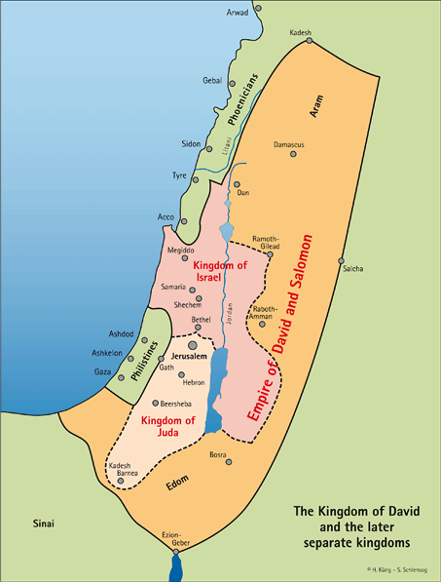
Divided Kingdom
The Northern
Known as Israel
King: Ishbosheth, Saul’s son
Civil war for 7 ½ years
The Southern
Known as Judah
King: David

Slide 7
Abner
He was Saul’s cousin and the son of Ner
He served as Saul’s commander-in-chief
He was chided with by David when Saul was sleeping and David took Saul’s spear and water curse as proof that David was in their camp but did not kill Saul
He wanted to preserve the kingship in the family and manipulated Ishbosheth, Saul’s son, to the throne of the northern kingdom
Ishbosheth was Abner’s puppet while Abner set up a new capital called Mahanaim
He took Rizpah, the daughter of Aiah and concubine of Saul’s, to wife, which caused a dispute between Ishbosheth and him
He enters into peace with David; however, Joab kills him in Hebron as revenge for his brother’s life
(2, 5)

Slide 8
Joab
He was the eldest son of Zeruiah, David’s sister, making him a nephew of David’s
He served as David’s commander-in-chief of Judah and was closely associated with David during David’s reign.
He and Abner met at the pool of Gibeon and each side (north and south) put up 12 men to show off their agilities “play before us”, but blood was spilt and warfare began
Joab’s brother, Asahel, was caught chasing after Abner and Aber put a spear under his 5th rib and Asahel died
Joab blew a trumpet to cease fire and Abner and the men marched all night and crossed the Jordan River
Joab and his brother, Abishai, carried their brother, Ashahel to be buried in Bethlehem
During the siege Joab lost 19 men, while Abner lost 360
Joab and his brother, Abishai, sought revenge at a later time
When Abner joined David and his men in Hebron Joab killed Abner
After David’s death he was in favor of Adonijah’s succession and for that reason was put to death by Solomon
(2,3,)

Slide 9
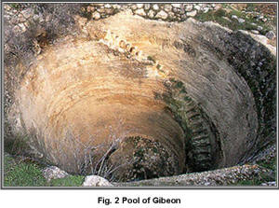
The Pool of Gibeon
The contest between the men of Abner and the men of Joab at the pool of Gibeon was more than a simple grudge match. Abner was the leader of the forces of Ishbosheth, Saul’s son.
Joab was David’s commander. Thus, in the clash between the two kingdoms, champions were chosen to determine the winner. The challenge to let the young men “play before us” (v. 14) meant to let the twelve representatives battle for each side.
Mt. Carmel
Gibeon
Jerusalem
Mt. Nebo
When the twelve from each side had killed each other, no clear winner was shown, so both sides erupted into a furious battle, which David’s men won.
When Asahel, Joab’s brother, gave chase to Abner, Abner yelled back that Asahel should content himself by taking the armor of one of the younger men, but Asahel refused.
2 Samuel 2:9-24
(4)

Slide 10
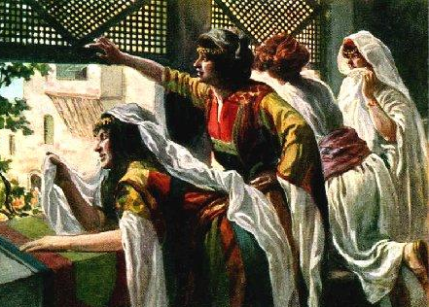
David’s Wives and First Sons
Abinoam
Abigail
Maacha
Haggith
Abital
Eglah
Michal
Amnon
Chileab
Absalom
Adonijah
Shephataih
Ithream
Michal was a bargaining chip between Abner and David.
But once returned to David she did not have children.
2 Samuel 3:2-5

Slide 11
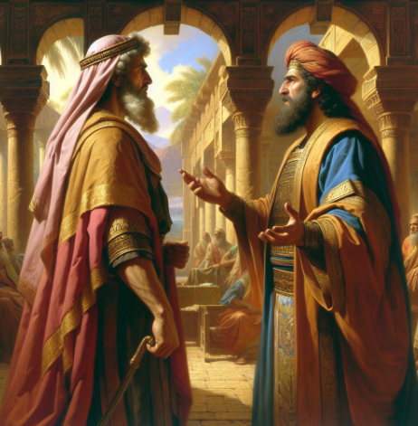
The Long War—7 ½ Years
Frequent battles and skirmishes took place between the followers of David and the followers of Ish-bosheth,
Abner made himself strong - This strengthening of himself, and going in to the late king's concubine, were most evident proofs that he wished to seize upon the government.
2 Samuel 3:1, 6
(1)

Slide 12
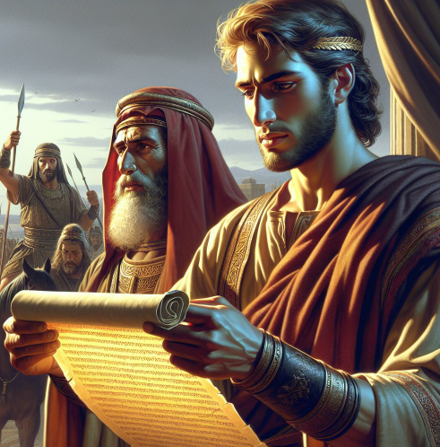
The Bargain
Abner and Ishbosheth had a falling out because Abner married one of Saul’s concubines
Abner sent a message to David to make peace with David
David bargained for the divorcement of Michal to Phaltiel and return her to him, her first husband.
“…yet prudence and policy required that he should strengthen his own interest in the kingdom as much as possible; and that he should not leave a princess in the possession of a man who might, in her right, have made pretensions to the throne. Besides, she was his own lawful wife, and he had a right to demand her when he pleased.”
2 Samuel 3:6-13
(1)

Slide 13
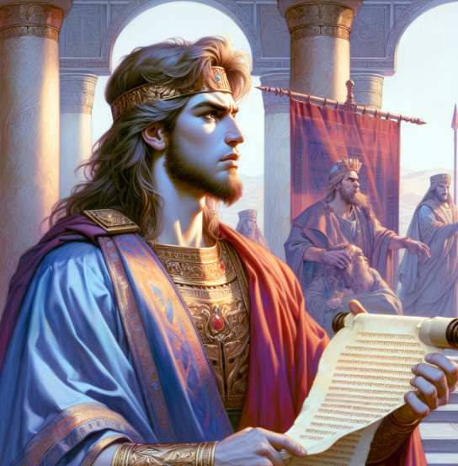
Joab’s Fear and Revenge
Abner came with his followers to join with David in Hebron
Joab feared he might be replaced as captain…
Joab used this opportunity to avenge the death of his brother (4)
Mt. Carmel
David went to great lengths to demonstrate to the people that he had had nothing to do with Abner’s death.
This move was important politically, for those whom Abner had persuaded to change their loyalty to David could easily have gone back to Ishbosheth at the news of Abner’s death.
Jerusalem
Hebron
Mt. Nebo
The people saw that the David's grief was sincere, and that he had no part nor device in the murder of Abner.
2 Samuel 3:19-39
(1)

Slide 14
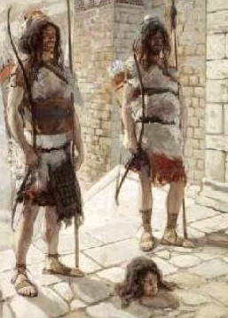
The Death of Ishbosheth
Rechab and Baanah, captains of Ishbosheth, murdered Ish-bosheth, and escape; and brought his head to David.
David is greatly irritated, and commands them to be slain.
How much more, when wicked men have slain a righteous person in his own house upon his bed? shall I not therefore now require his blood of your hand, and take you away from the earth?
2 Samuel 4
(1)

Slide 15
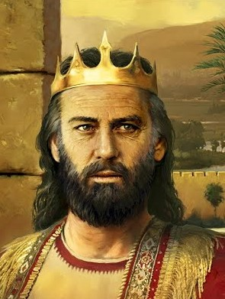
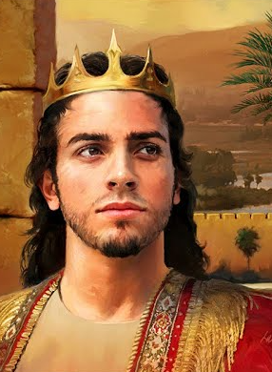
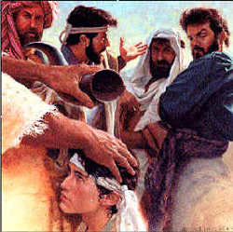
David Is Made King
David was 30 years old when they anointed him king of all Israel
He reigned for 40 years
He was anointed 3 times as king:
By Samuel
By Judah
Now by all of Israel
2 Samuel 5
(1)

Slide 16
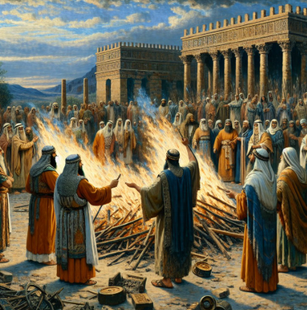
King David Goes to the Lord
Turning to the Lord King David asks the Lord what he should do about the Philistines
The Lord replies, “Go Up”
If we inquire of the Lord and follow His direction, then He can guide us and help us succeed in our righteous endeavors
They went to a place called Baal-perazim and burned all their idols
2 Samuel 5
(1)

Slide 17
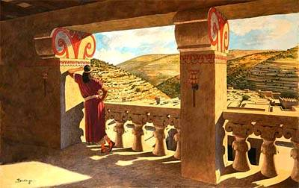
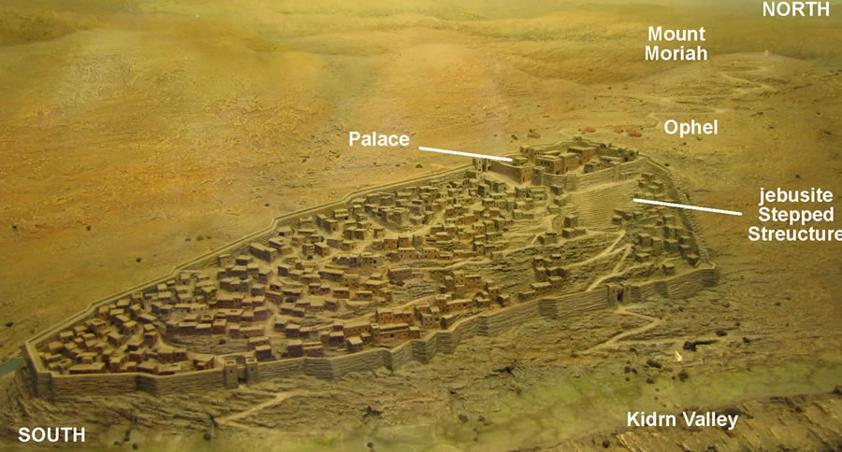
A Cedar Palace
The beautiful cedar palace was built in the “City of David.” This was an ancient center of Jerusalem located on Ophel, the southern spur of Mount Moriah or Mount Zion.
2 Samuel 5
(2)

Slide 18
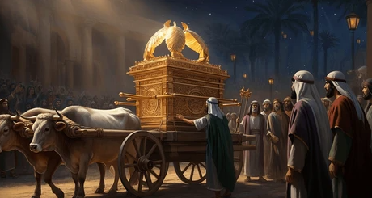
Transporting the Ark of the Covenant
From Baale of Judah - This is supposed to be the same city which, in Joshua 15:60, is called Kirjah-baal or Kirjath-jearim (1)
The Ark was located in Gibeah at the house of Abinadab
This was a sacred occasion. Instead of the priests carrying the ark on their shoulders they made a new cart.
King David had not known an error of ritual had occurred.
They also danced in jubilee as the cart made its way to Jerusalem.
2 Samuel 6:1-8
(2)

Slide 19
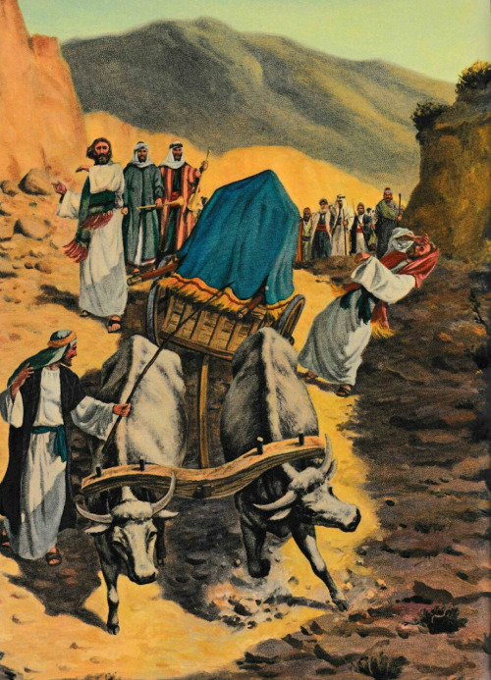
Uzzah’s Mistake
Uzzah and Ahio, the sons of Abinadab, drove the new cart
As the cart was making its way toward Jerusalem, the oxen stumbled and jerk the cart and immediately Uzzah reached forth his hand to steady the Ark and prevent it from falling.
Uzzah was seized instantly by a paroxysm or convulsion and fell to the ground, and died.
2 Samuel 6:7-8
(2)

Slide 20
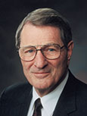
“Some may reason that [Uzzah] was only trying—though mistakenly—to help out.
But given the numerous times the Lord had saved and spared Israel, including the high dramas of the Red Sea and of the manna from heaven, surely He [the Lord] knew how to keep the ark in balance!”
(6)

Slide 21
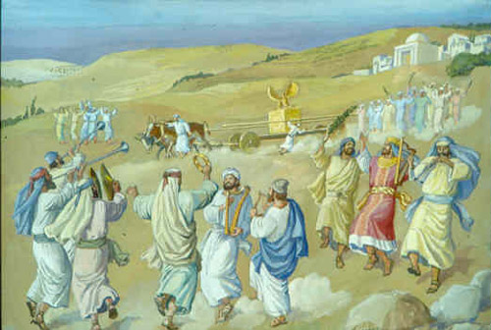
Steadying the Ark
Steadying the ark can be compared to trying to correct something in the Church without having received the authority to do so.
Those who attempt to direct God’s work without His authority bring spiritual death upon themselves
(2)

Slide 22
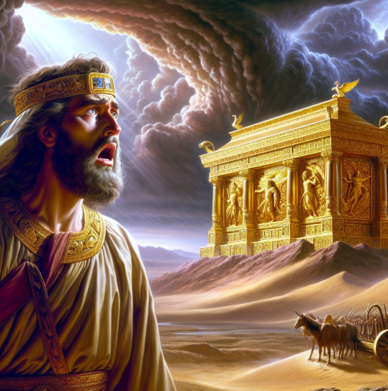
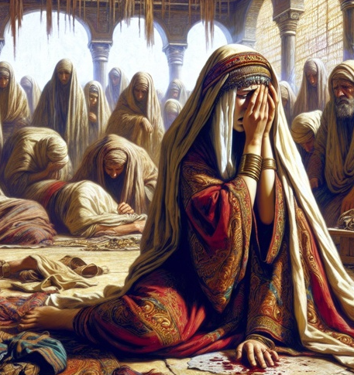
Obed-edom and His Household are Blessed
David was afraid of the Lord that day
And the ark of the Lord continued in the house of Obed-edom the Gittite three months: and the Lord blessed Obed-edom, and all his household.
David finally brought the ark into Jerusalem which was a joyous occasion. David’s wife Michal criticized David’s joyous behavior, which had a negative effect on their relationship.
2 Samuel 6:9-23

Slide 23


Forbidden to Build a Temple
David was concerned that he was living in a nice palace, and the ark was in a tent.
He was prepared to fulfill his ambition to build a sacred and beautiful structure for the Ark of the Covenant.
The Lord told the prophet Nathan that David should not build a temple. However, the Lord said He would establish David’s house (his throne and kingdom) forever. He also said that one of David’s descendants would build the temple.
2 Samuel 7:1-5, 12-13

Slide 24
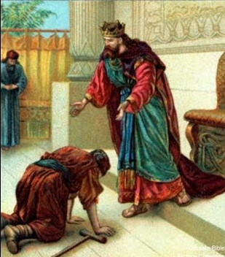
David Honors Covenant Made with Jonathan
David honored the covenant he had made with Jonathan—he received Jonathan’s son, Mephibosheth, into his home and gave him all of the inheritance belonging to the house of Saul.
And Mephibosheth had a young son, whose name was Micha. And all that dwelt in the house of Ziba were servants unto Mephibosheth.
2 Samuel 9

Slide 25
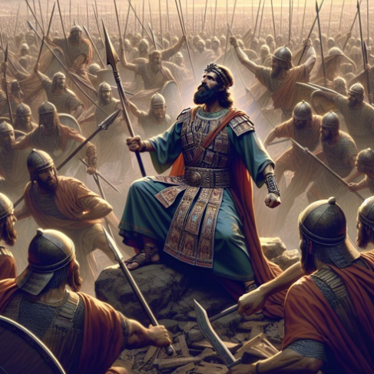
David Conquers
The Lord blessed and preserved David as he reigned in righteousness.
2 Samuel 10

Slide 26
Sources:
Clark, Bible Commentary, Vol. 2, p. 220, 2:308
W. Cleon Skousen The Fourth Thousand Years pp. 81-83
Bible Dictionary
Old Testament Institute Manual
Arthur R. Bassett The King Called David Oct. 1973 Ensign
Presentation by ©http://fashionsbylynda.com/blog/
6. Elder Neal A. Maxwell (Meek and Lowly [1987], 15).

Slide 27
The beauty of Israel is slain
upon thy high places:
How are the mighty fallen!
Tell it not in Gath,
publish it not in the streets of Askelon;
Lest the daughters of the Philistines rejoice,
Lest the daughters of the uncircumcised triumph.
Ye mountains of Gilboa,
Let there be no dew,
neither let there be rain, upon you,
nor fields of offerings:
for there the shield of the mighty
is vilely cast away, the shield of Saul,
as though he had not been anointed with oil.
From the blood of the slain,
from the fat of the mighty,
the bow of Jonathan turned not back,
and the sword of Saul returned not empty.
Saul and Jonathan were lovely
and pleasant in their lives,
and in their death they were not divided:
they were swifter than eagles,
they were stronger than lions.
Ye daughters of Israel,
weep over Saul,
who clothed you in scarlet,
with other delights,
who put on ornaments of gold
upon your apparel.
How are the mighty fallen
in the midst of the battle!
O Jonathan, thou wast slain
in thine high places.
I am distressed for thee,
my brother Jonathan:
very pleasant hast thou been unto me:
thy love to me was wonderful,
passing the love of women.
How are the mighty fallen,
and the weapons of war perished!
David’s Lament for Saul and Johnathan
2 Samuel 19-27 Written in the Book of Jasher

Slide 28
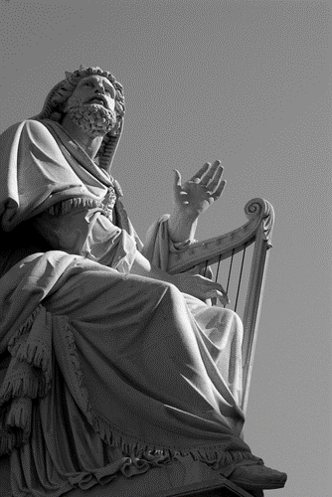
Died Abner as a fool dieth?
Thy hands were not bound,
Nor thy feet put into fetters.
As a man falleth before the wicked.
So hast thou fallen!
This song was a heavy reproof to Joab; and must have galled him extremely, being sung by all the people.
David’s Lament of Abner’s Death
2 Samuel 3:33-34

Slide 29
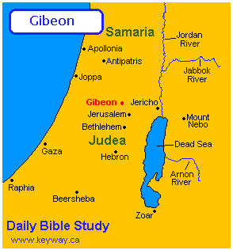
Slaying of Ashahel:
“It seems Asahel wished to get the armour of Abner as a trophy; this also was greatly coveted by ancient heroes. Abner wished to spare him, for fear of exciting Joab’s enmity; but as Asahel was obstinate in the pursuit, and was swifter of foot than Abner, the latter saw that he must either kill or be killed, and therefore he turned his spear and ran it through the body of Asahel. This turning about that he might pierce him is what we translate ‘the hinder end of his spear.’ This slaying of Asahel cost Abner his life.” (Clarke, Bible Commentary, 2:313.)
Those At David’s Anointing 2 Samuel 5:3
Judah 6,800
Simeon 7,100
Levi 4,600
Aaron 3,700
Benjamin 3,000
Ephraim 20,000
Manasseh in Samaria 18,000
Issachar 200 captains and “all their brethren”
Zebulun 50,000
Naphtali 37,000
Danites 28,000
Asher 40,000
Trans-Jordon tribes (Reubenites, Gadites and half the tribe of Manasseh----120,000
1 Chronicles 12:1-23
A pit identified with the pool of Gibeon has been excavated - The shaft is dated to about the 11th or 12th century BC.
- Measuring 37 feet in diameter, by 82 feet deep, it is carved into solid rock and is accessed by a circular staircase of 79 stone steps.
- At the bottom is a 167-foot tunnel leading to the cistern that was fed by a spring outside of the city’s walls, in the eastern slope of the hill.

Slide 30
“It is a little dangerous for us to go out of our own sphere and try unauthoritatively to direct the efforts of a brother. You remember the case of Uzzah who stretched forth his hand to steady the ark. He seemed justified when the oxen stumbled in putting forth his hand to steady that symbol of the covenant.
We today think his punishment was very severe. Be that as it may, the incident conveys a lesson of life.
Let us look around us and see how quickly men who attempt unauthoritatively to steady the ark die spiritually.
Their souls become embittered, their minds distorted, their judgment faulty, and their spirit depressed.
Such is the pitiable condition of men who, neglecting their own responsibilities, spend their time in finding fault with others”
President David O. McKay (in Conference Report, Apr. 1936, 60).
Steadying the Ark
“The ark was the symbol of God’s presence, His glory and majesty. When first given to Israel, the ark was placed in the Holy of Holies in the tabernacle, and not even the priest was allowed to approach it. Only the high priest, a type of Christ, could approach it, and then only after going through an elaborate ritual of personal cleansing and propitiation [regaining God’s favor by repenting] for his sins” (Doctrine and Covenants Student Manual, 2nd ed. [Church Educational System manual, 2001], 188).
When moving the ark, priests were required to use poles running through rings on the sides to carry it. According to Numbers 4:15, the consequence for touching the ark without authorization was death.
President Brigham Young taught the following about steadying the ark: “Let the Kingdom alone, the Lord steadies the ark; and if it does jostle, and appear to need steadying, if the way is a little sideling sometimes, and to all appearance threatens its overthrow, be careful how you stretch forth your hand to steady it; let us not be too officious in meddling with that which does not concern us; let it alone, it is the Lord’s work” (Discourses of Brigham Young, sel. John A. Widtsoe [1954], 66).
“In modern revelation the Lord referred to [Uzzah steadying the ark] to teach the principle that the Lord does not need the help of men to defend his kingdom (see D&C 85:8). Yet even today there are those who fear the ark is tottering and presume to steady its course” (Doctrine and Covenants Student Manual,2nd ed. [Church Educational System manual, 2001], 188). Some members of the Church may see problems and be frustrated with the way they feel their leaders or others are addressing those problems. They may feel that even though they do not have the authority to do so, they need to correct the course of their ward or even of the Church. However, “the best intentions do not justify such interference with the Lord’s plan” (Doctrine and Covenants Student Manual, 188).

Slide 31
Michal:
When the ark came (i.e. was carried) into the city of David, Michal the daughter of Saul looked out of the window, and there she saw king David leaping and dancing before Jehovah, and despised him in her heart. … Michal is intentionally designated the daughter of Saul here, instead of the wife of David, because on this occasion she manifested her father’s disposition rather than her husband’s. In Saul’s time people did not trouble themselves about the ark of the covenant [1 Chronicles 13:3]; public worship was neglected, and the soul for vital religion had died out in the family of the king. Michal possessed teraphim, and in David she only loved the brave hero and exalted king: she here fore took offence at the humility with which the king, in his pious enthusiasm, placed himself on an equality with all the rest of the nation before the Lord. …
“… The proud daughter of Saul was offended at the fact, that the king had let himself down on this occasion to the level of the people. She availed herself of the shortness of the priests’ shoulder dress, to make a contemptuous remark concerning David’s dancing, as an impropriety that was unbecoming in a king. … With the words ‘who chose me before thy father and all his house,’ David humbles the pride of the king’s daughter.
His playing and dancing referred to the Lord, who had chosen him, and had rejected Saul on account of his pride. He would therefore let himself be still further despised before the Lord, i.e. would bear still greater contempt from men than that which he had just received, and be humbled in his own eyes [see Psalm 131:1]: then would he also with the maidens attain to honour before the Lord. For whoso humbleth himself, him will God exalt [Matthew 23:12].” (Keil and Delitzsch, Commentary, 2:2:336–38.) Found in Old Testament Institute Manual
Building a Temple:
David’s motivation for wanting to build a permanent house for the Lord (the tabernacle built by Moses in the wilderness was then about three hundred years old) was proper and good, but the Lord, through Nathan, denied him permission to do so. No specific reason was given here, only a blessing on David’s house. In the account in Chronicles, however, David told Solomon that it was revealed to him that he had seen too much war and bloodshed to build the house of the Lord (see1 Chronicles 22:8). Old Testament Institute Manual

