Slide 1

Consequences of Sinful Actions
2 Samuel 12: 10-24:25
“For if ye forgive men their trespasses, your heavenly Father will also forgive you:
“But if ye forgive not men their trespasses, neither will your Father forgive your trespasses.” (Matt. 6:14–15.)

Slide 2




Consequences
Cheating on a test
Lying
Not forgiving others
Possible failure of a grade
Possible grounding
Loss of a friendship
Loss of respect from others
Loss of respect
Others will be affected
Knowledge lost
Loss of trust from parents
Loss of Eternal Life
Matthew 6:14-15

Slide 3
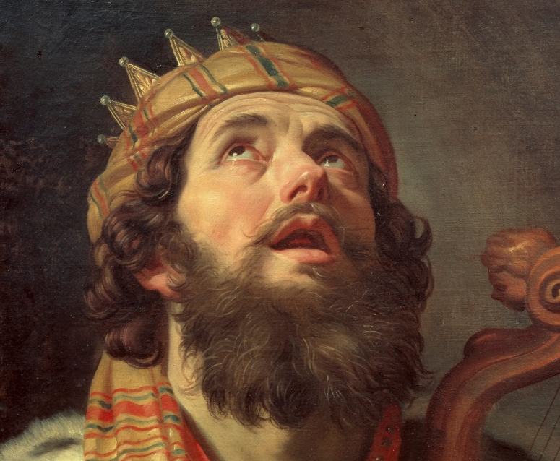
David’s Consequences
During the rest of David’s life there would be plagues of wars with his family and others
The Lord also hath put away thy sin; thou shalt not die.
David, as an adulterer, was condemned to death by the law of God; and he had according to that law passed sentence of death upon himself.
David’s family would also suffer because of his sins
God alone, whose law that was could revoke that sentence, or dispense with its execution; therefore Nathan, who had charged the guilt home upon his conscience, is authorized to give him the assurance that he should not die a temporal death for it:
Loss of his life
However, he lost his son instead
Gerard Van Honthorst
2 Samuel 12:13
(1)

Slide 4
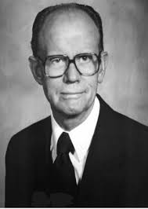
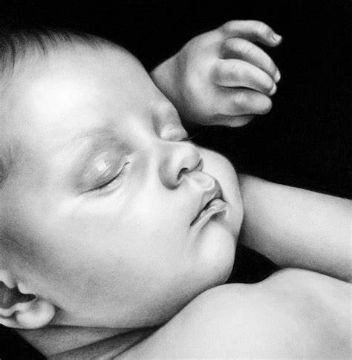
A Child Born…Shall Surely Die
“The child born of [David and Bathsheba’s] illicit union did not live, but there is no reason to look upon that as ‘punishment’ of the child for the sins of the parents. Removal from this earth by the hand of the Lord must come at one time or another and can be a blessing to an individual, brought about for his best interest at whatever time the Lord sees it to be optimum.”
2 Samuel 12:14-18
(9)

Slide 5
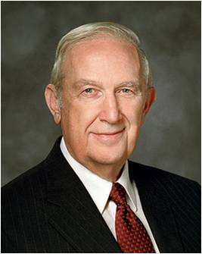

When we choose to sin, we may bring unforeseen and long-term consequences upon ourselves and others
“It is a fundamental truth that through the Atonement of Jesus Christ we can be cleansed.
We can become virtuous and pure. However, sometimes our poor choices leave us with long-term consequences.
One of the vital steps to complete repentance is to bear the short- and long-term consequences of our past sins.”
What are some examples of poor choices that might result in unforeseen and long-term consequences both for us and for others?
(2)

Slide 6
Amnon
He was the oldest son of David through his wife, Abinoam
He was the crown prince and natural heir to David’s throne
He had an overwhelming desire for his half sister, Tamar, daughter of David’s wife Micaah
He lured Tamar into his quarters by pretending to be sick
Ignoring her protests, he raped her, then expelled her from his quarters. Once he had gratified his lust he despised her
King David was angry about the incident, but could not bring himself to punish him
Two years later, to avenge Tamar, Absalom invited all the sons of David and had his servants kill Amnon while he was drunk with wine
(5)

Slide 7
Absalom
He was the third son of David, from his wife Haggith
He kills his brother Amnon and conspires against his father, David
He had his half brother killed by his servants to avenge his sister, Tamar
He lived 3 years away from his family before he saw his “father’s face”
He was caught in a tree, then Joab, an army commander, killed him by thrusting 3 darts through his heart
His body was cast in a pit and covered with stones in the woods
His father remained full of love for his mutinous son to the very end (2 Sam. 18:33)
(3, 4)

Slide 8
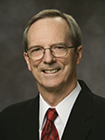


Love or Lust
Why might some people mistake lust for love?
“Satan is the great counterfeiter. He tries to [present] lust as love.
There is a simple test to detect the difference.
On the other hand, lust is motivated by disobedience, self-gratification, and lack of discipline.”
Love is motivated by self-control, obedience to God’s moral laws, respect for others, and unselfishness.
2 Samuel 13
(6)

Slide 9

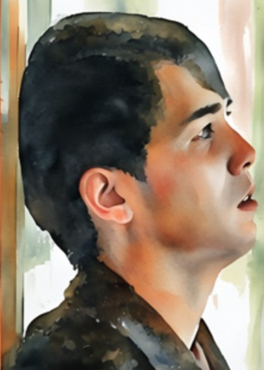
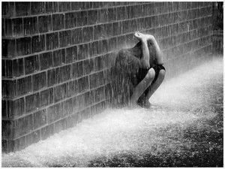
Love or Lust
If we lust, then we lose the Spirit and may dismiss or ignore the consequences of our actions
If we lust, then we lose the Spirit and our love and concern for others may diminish

Slide 10
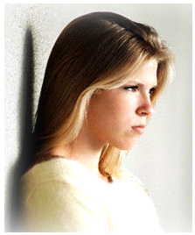



Angry and Prideful
If we prideful, then we lose the Spirit and our love and concern for others may diminish
If we are angry, then we lose the Spirit and may dismiss or ignore the consequences of our actions

Slide 11
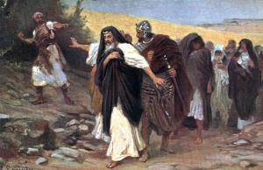
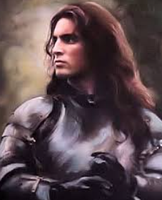
David Flees
Absalom began to capitalize on his return to princely status by developing a careful plan to overthrow his father
David’s immediate call for flight from the city was so out of character that the reader cannot help but wonder what prompted this response.
His words indicate that he wanted to avoid a massacre, but his actions suggest that it was not fear that motivated the flight.
Shimei, of the house of Saul, curses David
2 Samuel 15-16
(7)

Slide 12
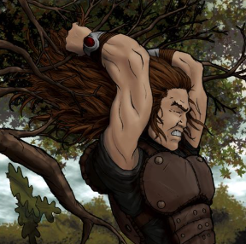
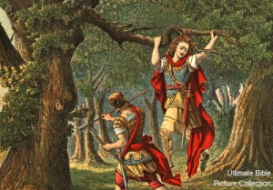
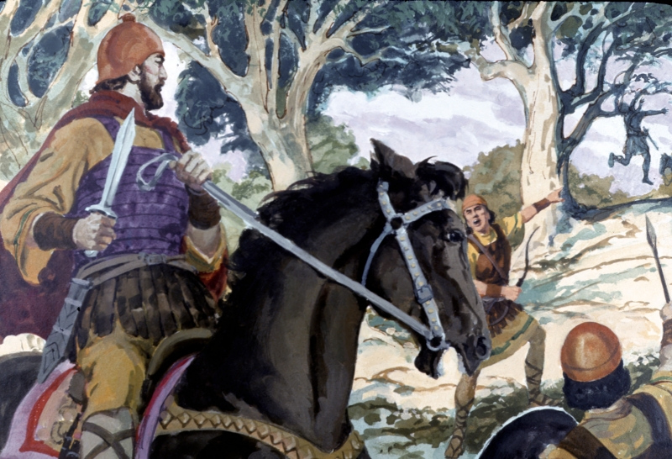
Absalom’s Death
Poll = (2 Sam. 14:26) means “to thin” by means of combing or cutting. Thus, when Absalom’s hair became either too thick or too long, he had it polled.
And Absalom met the servants of David. And Absalom rode upon a mule, and the mule went under the thick boughs of a great oak, and his head caught hold of the oak, and he was taken up between the heaven and the earth; and the mule that was under him went away.
And he [Joab] took three darts in his hand, and thrust them through the heart of Absalom, while he was yet alive in the midst of the oak.
2 Samuel 18:9-17

Slide 13
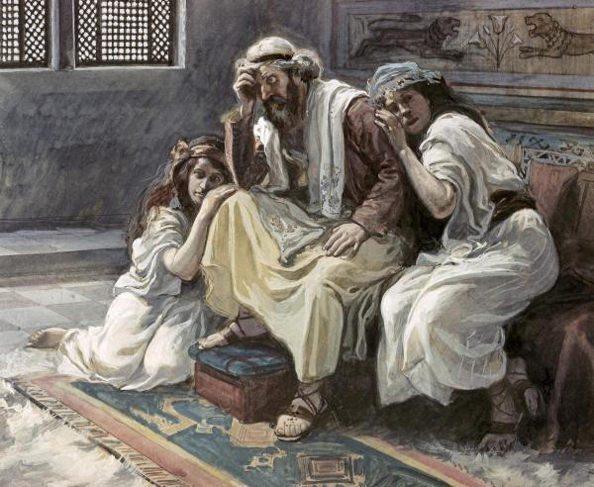
David’s Declining Family
After Absalom’s death, David returned to Jerusalem. Another rebellion among the tribes of Israel was quickly put down by Joab, who led David’s army.
Israel suffered a famine that lasted three years.
King David displeased the Lord by counting the number of men in Judah and Israel who could serve in the military.
The scriptures do not explain why this numbering of the people was offensive, but it might have been representative of David’s trust in the strength of his army rather than in the power of God. (see note*)
To save the people from a plague, David offered sacrifices to the Lord.
2 Samuel 19-24

Slide 14
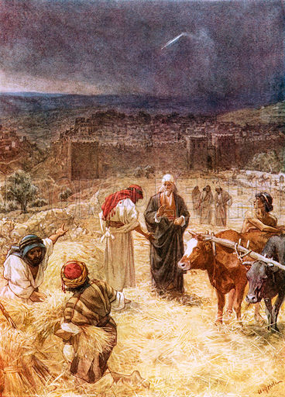
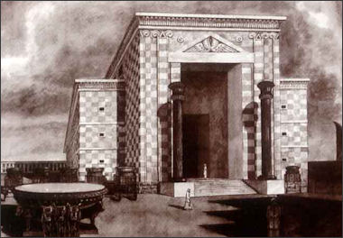
The Threshing Floor of Araunah
In an attempt to appease the Lord and stay the plague that was smiting Israel, David purchased the threshing floor (a large open area where the rock base is flat and the grain could be threshed and winnowed without getting mixed with dirt) from Araunah and there built an altar to the Lord.
This site later became the place where Solomon built his temple (8)
2 Samuel 24:18-25

Slide 15
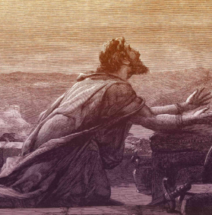
David’s Price
Eventually, David received the assurance that his soul would be “delivered … from the lowest hell” (Psalm 86:12–13). But this assurance could not restore the blessings he had lost. They were gone forever.
David paid another price, too, an earthly one, which haunted him until the day he died.
“The sword shall never depart from thine house,” the prophet Nathan told him, “because thou hast despised me [the Lord], and hast taken the wife of Uriah” (2 Samuel 12:10).
This prophecy was literally fulfilled.

Slide 16
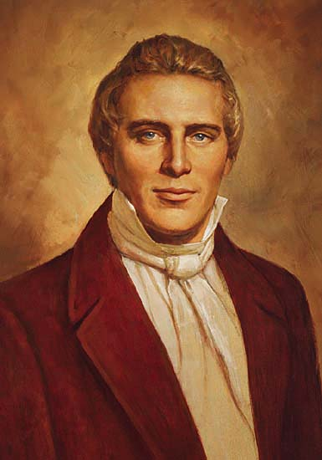
David’s wives and concubines were given unto him of me, by the hand of Nathan, my servant, and others of the prophets who had the keys of this power; and in none of these things did he sin against me save in the case of Uriah and his wife; and, therefore he hath fallen from his exaltation, and received his portion; and he shall not inherit them out of the world, for I gave them unto another, saith the Lord. D&C 132:39

Slide 17
Sources:
Videos:
Watch Your Step (2:39)
1. Adam Clarke Bible Commentary 2 Samuel 12:13
2. Elder Richard G. Scott (“Personal Strength through the Atonement of Jesus Christ,” Ensign or Liahona, Nov. 2013, 82–83).
3. Who’s Who in the Old Testament by Ed J. Pinegar and Richard J. Allen p. 7
4. Bible Dictionary
5. Wikipedia
Presentation by ©http://fashionsbylynda.com/blog/
6. Brother Tad R. Callister (“The Lord’s Standard of Morality,” Ensign, Mar. 2014, 48).
7. Old Testament Institute Manual
8. Fallows, Bible Encyclopedia, s.v. “Araunah,” 1:140. Found in OT Institute Manual
9. Ellis T. Rasmussen, An Introduction to the Old Testament and Its Teachings, 2 vols., 2nd ed. [1972], 1:186
NOTE * So much history went on between 2 Samuel 13-24 I found the OT Institute Manual helpful, which I didn’t include in the presentation

Slide 18
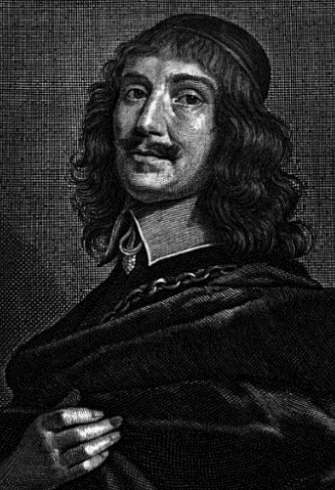
Painter: Gerard Van Honthorst
Gerard Van Honthorst (Gerrit) was a Dutch Golden Age painter. Early in his career he visited Rome, where he had great success painting in a style influenced by Caravaggio. Following his return to the Netherlands he became a leading portrait painter.
Born: November 4, 1592, Utrecht, Netherlands
Died: April 27, 1656, Utrecht, Netherlands
Wikipedia
Why didn’t David punish Amnon for his sin against Tamar? Many reasons have been suggested. One likely reason is that Amnon was David’s son and that David had been guilty of sexual sin himself (in the case of Bathsheba)—therefore, in the case of Amnon and Tamar, he felt inadequate to judge. Another possible reason is that there was no witness to the crime. Amnon’s friend Jonadab had carefully orchestrated the crime to avoid the possibility of witnesses; therefore, there was no way to prove the crime according to Jewish law.
Regardless of the reason, Absalom took matters into his own hands. He avenged Tamar by killing their half-brother Amnon, though it resulted in many problems for himself. Absalom lived away from his family for three years after the murder and then lived for an additional period in Jerusalem before seeing his father’s face. Absalom would also later seek to usurp his father’s throne, resulting in his own death.
The wretched, tragic story of Amnon and Tamar highlights some of the problems associated with sexual sin and its aftermath. No one should experience the treatment Tamar endured, and it is important to respond to such situations with integrity and justice. David neglected justice, and Absalom implemented his own standards, creating additional problems in the process. gotquestions.org
Amnon’s brazen lust:
Afterwards, Amnon was said to hate Tamar more than he had “loved” her before the rape occurred—it was never really “love” at all, but brazen lust. Absalom, Tamar’s full-brother, found out about the deed, and so did David. David’s response was to become “furious” (2 Samuel 13:21), but he took no real action. Absalom cared for Tamar in his own home and would not speak to Amnon. Two years later Absalom commanded his servants to murder Amnon in revenge (2 Samuel 13:28–9). Absalom fled the country for a time and later returned to David.
Controlling Anger: 2 Samuel 13:28-29:
“A cunning part of [Satan’s] strategy is to dissociate anger from agency, making us believe that we are victims of an emotion that we cannot control. We hear, ‘I lost my temper.’ Losing one’s temper is an interesting choice of words that has become a widely used idiom. To ‘lose something’ implies ‘not meaning to,’ ‘accidental,’ ‘involuntary,’ ‘not responsible’﻿—careless perhaps but ‘not responsible.’
“‘He made me mad.’ This is another phrase we hear, also implying lack of control or agency. This is a myth that must be debunked. No one makes us mad. Others don’t make us angry. There is no force involved. Becoming angry is a conscious choice, a decision; therefore, we can make the choice not to become angry. We choose!
“To those who say, ‘But I can’t help myself,’ author William Wilbanks responds: ‘Nonsense.’
“‘Aggression, … suppressing the anger, talking about it, screaming and yelling,’ are all learned strategies in dealing with anger. ‘We choose the one that has proved effective for us in the past. Ever notice how seldom we lose control when frustrated by our boss, but how often we do when annoyed by friends or family?’ (‘The New Obscenity,’ Reader’s Digest, Dec. 1988, 24; emphasis added)” (Lynn G. Robbins, “Agency and Anger” Ensign, May 1998, 80).
Bridle your passions:
“The precise nature of the test of mortality … can be summarized in the following questions: Will my body rule over my spirit, or will my spirit rule over my body? Will I yield to the enticings of the natural man or to the eternal man? That, brothers and sisters, is the test. We are here on the earth to develop godlike qualities and to learn to bridle all of the passions of the flesh (see Alma 38:12)” Elder David R. Bednar (“Ye Are the Temple of God,” Ensign, Sept. 2001, 17).
They exploit women and then despise the women rather than themselves. Amnon would not save Tamar from disgrace by making her a part of his household as a wife or concubine. Knowing that she had been disgraced and would therefore be deprived of a husband, Tamar mourned in the manner of a widow. David was furious because of the way Amnon had treated Tamar, but what could he do or say? His own conduct with Bath-sheba had left him without a basis for condemnation. Here was another result of sin. Because of his own guilt, David did not act to correct this great abomination in his own household. David learned the sad lesson that a man’s sins can often visit him even to the third and fourth generation (see Exodus 34:7). OT Institute

Slide 19
Absalom: 2 Samuel 15
Once restored to his position in David’s court, Absalom began to capitalize on his return to princely status by developing a careful plan to overthrow his father. He began to act like a king, with a full royal procession (see v. 1), but more serious than that, he undertook a deceitful campaign to gain favor with the people. He arose early and sat in judgment at the gates of the city (see v. 2).
A city gate was the normal location for giving judgment in ancient times and was the place where the people came to present grievances. Absalom ingratiated himself by telling the people that their causes and complaints were just, but that no one from the king’s court was willing to hear them. While this assertion may have been a lie, it is more likely that David’s court was not functioning properly and that the people were being neglected. Absalom took advantage of the disgruntlement of the people, but he refused to let them bow down to him. Instead, he raised them up, kissed them, and treated them as equals—highly unusual behavior from royalty (see v. 5). And in this way “Absalom stole the hearts of the men of Israel” (v. 6).
Absalom then lied to his father, telling him that he needed to go to Hebron to fulfill a vow when, in fact, it was his intention to raise an insurrection against David.
Several reasons have been suggested why “the conspiracy was strong” and “the people increased continually with Absalom” (v. 12):
“It is very difficult to account for this general defection of the people. Several reasons are given:
David was old or afflicted, and could not well attend to the administration of justice in the land.
It does appear that the king did not attend to the affairs of state, and that there were no properly appointed judges in the land; [see v. 3].
Joab’s power was overgrown; he was wicked and insolent, oppressive to the people, and David was afraid to execute the laws against him.
There were still some partisans of the house of Saul, who thought the crown not fairly obtained by David.
David was under the displeasure of the Almighty, for his adultery with Bath-sheba, and his murder of Uriah; and God let his enemies loose against him.
There are always troublesome and disaffected men in every state, and under every government; who can never rest, and are ever hoping for something from a change.
Absalom appeared to be the real and was the undisputed heir to the throne; David could not, in the course of nature, live very long; and most people are more disposed to hail the beams of the rising, than exult in those of the setting, sun.
No doubt some of these causes operated, and perhaps most of them exerted less or more influence in this most scandalous business.” (Clarke, Bible Commentary, 2:349–50.)
Curses of Shimei:
“Note the rationale behind David’s humbly choosing to endure the curses of Shimei of the house of Saul:
any dishonor was considered negligible compared to the dishonor of his own son taking his kingship and seeking his life;
if he suffered his afflictions patiently, perhaps the Lord would have mercy upon him and requite him later;
Perhaps the Lord Himself had commanded Shimei to curse him;
Since the sons of Zeruiah (Abishai and Joab) were such men of violence, David countered as usual with more moderate action.” (Rasmussen, Introduction to the Old Testament, 1:187.)
*“God could not be angry with David for numbering the people if he moved him to do it: but in the parallel place [see 1 Chronicles 21:1] it is expressly said, Satan stood up against Israel, and provoked David to number Israel. David, in all probability, slackening in his piety and confidence toward God, and meditating some extension of his dominions without the Divine counsel or command, was naturally curious to know whether the number of fighting men in his empire was sufficient for the work which he had projected. … He therefore orders Joab and the captains to take an exact account of all the effective men in Israel and Judah. God is justly displeased with this conduct, and determines that the props of his vain ambition shall be taken away, either by famine, war, or pestilence.” (Clarke, Bible Commentary, 2:377.) Found in OT Institute Manual

Slide 20
Have mercy upon me, O God, according to thy loving kindness:
according unto the multitude of thy tender mercies
blot out my transgressions.
Wash me thoroughly from mine iniquity,
and cleanse me from my sin.
For I acknowledge my transgressions:
and my sin is ever before me.
Against thee, thee only, have I sinned,
and done this evil in thy sight:
that thou mightest be justified when thou speakest,
and be clear when thou judgest.
Behold, I was shapen in iniquity;
and in sin did my mother conceive me.
Behold, thou desirest truth in the inward parts:
and in the hidden part thou shalt make me to know wisdom.
Purge me with hyssop, and I shall be clean:
wash me, and I shall be whiter than snow.
Make me to hear joy and gladness;
that the bones which thou hast broken may rejoice.
Hide thy face from my sins,
and blot out all mine iniquities.
Create in me a clean heart,
O God; and renew a right spirit within me.
Cast me not away from thy presence;
and take not thy holy spirit from me.
Restore unto me the joy of thy salvation;
and uphold me with thy free spirit.
Then will I teach transgressors thy ways;
and sinners shall be converted unto thee.
Deliver me from blood guiltiness,
O God, thou God of my salvation:
and my tongue shall sing aloud of thy righteousness.
O Lord, open thou my lips;
and my mouth shall shew forth thy praise.
For thou desirest not sacrifice;
else would I give it:
thou delightest not in burnt offering.
The sacrifices of God are a broken spirit:
a broken and a contrite heart,
O God, thou wilt not despise.
Do good in thy good pleasure unto Zion:
build thou the walls of Jerusalem.
Then shalt thou be pleased
with the sacrifices of righteousness,
with burnt offering and whole burnt offering:
then shall they offer bullocks upon thine altar.
To Find Mercy
Psalms 51

Slide 21
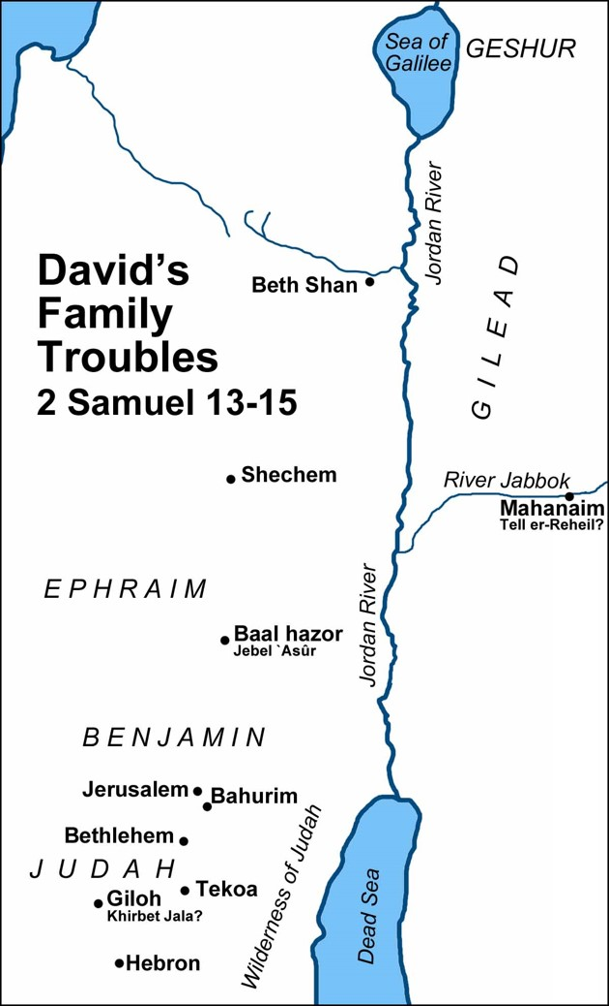
2 Samuel 20: 3
Why Were David’s Ten Concubines Forced into the Status of Widowhood While David Still Lived?
According to the Mosaic law (see Leviticus 18), married women once defiled could not once again enjoy the married state. A Bible scholar explained David’s actions:
“He could not well divorce them; he could not punish them, as they were not in the transgression; he could no more be familiar with them, because they had been defiled by his son; and to have married them to other men might have been dangerous to the state: therefore he shut them up and fed them—made them quite comfortable, and they continued as widows to their death.” (Clarke, Bible Commentary, 2:364.) found in Old Testament Institute Manual
Shimei:
He was the son of Gera, a Benjamite of the house of Saul who actively and aggressively opposed David during the uprising of Absalom. David did not use any power to punish Shimei. Following the defeat and death of Absalom, Shimei came backwith a host of his collegues to demonstrate his subservient contrition before David, who magnanimously pardoned him but warned Solomon of the man’s duplicity. When Shimei violated an oath not to journey away from Jerusalem, King Solomon ordered his execution (1 Kings 2:36-46) (3 in sources p. 173)

