Slide 1

Division of Israel
1 Kings 11-16

Slide 2

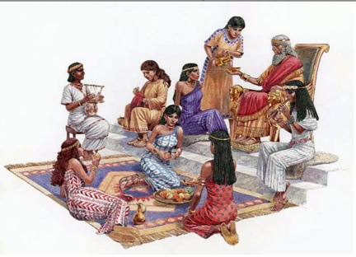
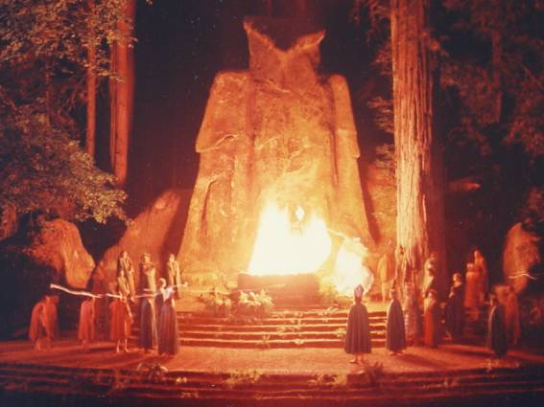
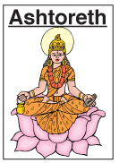
Solomon Loves Many
700 Princesses (of royal lineage) and 300 concubines
Strange women = foreign women, or those not of the covenant.
Solomon’s marriages were for political expediency and perhaps for personal reasons as well.
These women brought to Israel their idols and heathen worship, which corrupted not only Solomon but the people also.
Ashtoreth the goddess of the Zidonians,
Milcom: also known as Molech (Ammorites)
1 Kings 11:1-10

Slide 3
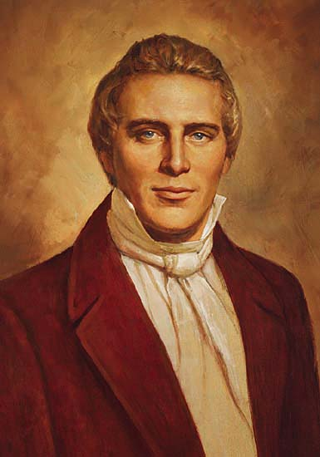
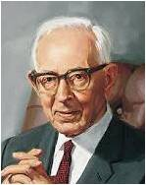
Some Given By the Lord
According to the Doctrine and Covenants, however, some of Solomon’s wives were given to him of the Lord:
“David also received many wives and concubines, and also Solomon and Moses my servants, as also many others of my servants, from the beginning of creation until this time; and in nothing did they sin save in those things which they received not of me” (D&C 132:38).
The Lord “did not condemn Solomon and David for having wives which the Lord gave them.
“Now turn to [2 Samuel] 12:7–8 and you will find that the Lord gave David wives. In your reading of the Old Testament you will also find that Solomon was blessed and the Lord appeared to him and gave him visions and great blessings when he had plural wives, but later in his life, he took wives that the Lord did not give him.” (2)
1 Kings 11:1-10

Slide 4
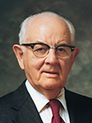
Why Marry Someone of Your Own Faith?
“Marriage is perhaps the most vital of all the decisions and has the most far-reaching effects, for it has to do not only with immediate happiness, but also with eternal joys. It affects not only the two people involved, but also their families and particularly their children and their children’s children down through the many generations.”
(3)

Slide 5


Choices of Dating
“Choose to date only those who have high moral standards and in whose company you can maintain your standards.
Remember that a young man and a young woman on a date are responsible to protect each other’s honor and virtue. …
“As you enter your adult years, make dating and marriage a high priority.
Seek a companion who is worthy to go to the temple to be sealed to you for time and all eternity.
Marrying in the temple and creating an eternal family are essential in God’s plan of happiness.”
1 Kings 11:1-10
(4)

Slide 6
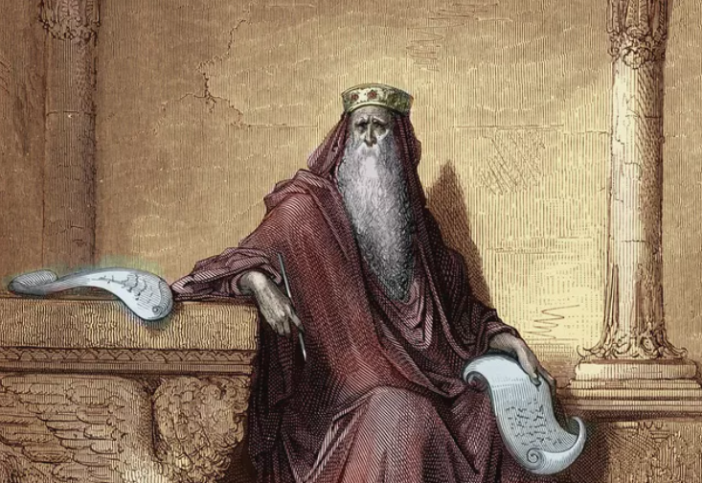
Solomon’s Disobedience
The Lord told him that the kingdom would be taken from him and given to one of his servants
Beth-sheba
David
“The line of the Messiah must be preserved. The prevailing lion must come out of the tribe of Judah: not only the tribe must be preserved, but the regal line and the regal right. All this must be done for the true David's sake: and this was undoubtedly what God had in view by thus miraculously preserving the tribe of Judah and the royal line, in the midst of so general a defection.”
Solomon
Nathan
Rehoboam
Mattatha
Joseph
Mary
Jesus
1 Kings 11:9-11
(5)

Slide 7
Jeroboam
He was the son of Nebat, an Ephrathite (member of the tribe of Ephraim and servant of King Solomon) of Zereda and Zeruah (a widow). (1 Kings 11:26)
While still a young man, King Solomon made him superintendent over his tribesmen in the building of the fortress Millo in Jerusalem and of other public works. He was sent to be over the laborers of Manasseh and Ephraim
He was the first in the long sequence of kings over the northern part of the House of Israel (10 tribes) around 975 BC who rose up against King Solomon largely around the heavy tax burden impose by King Solomon.
He was promised by the prophet Ahijah that if he would walk in the ways of righteousness, his kingdom would be successful.
He set up 2 golden calves…one in Bethel and one in Dan… telling the people to worship there instead of journeying to Jerusalem
He appointed priests from non-Levite ranks
He was rebuked by a prophet of God from Judah for his evil ways
Ahijah pronounced doom upon the house of Jeroboam, and soon his young son, Abijah died. He had another son named Nadab
He reigned for 22 years and died
(6, 7)

Slide 8
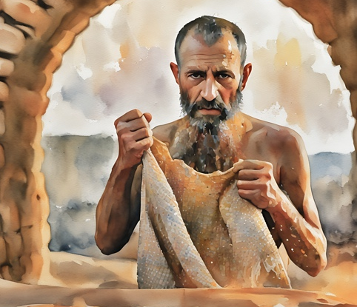
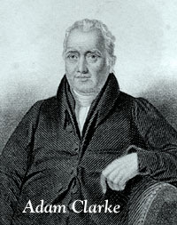
10 Pieces of Fabric
Ahijah the Shilonite (the prophet from the town of Shiloh in the land of Ephraim)
- He was one of those who wrote the history of the reign of Solomon, as we find from 2 Chronicles 9:29, and it is supposed that it was by him God spake twice to Solomon…
And Ahijah caught the new garment that was on him, and rent it in twelve pieces:
The garment was the symbol of the kingdom of Israel; the twelve pieces the symbol of the twelve tribes; the ten pieces given to Jeroboam, of the ten tribes which should be given to him, and afterwards form the kingdom of Israel, ruling in Samaria, to distinguish it from the kingdom of Judah, ruling in Jerusalem.
1 Kings 11:29-31
(5)

Slide 9
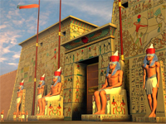
Jeroboam Fleas to Egypt
When Solomon learned Jeroboam was a threat to his kingdom, he sought to kill Jeroboam. Jeroboam fled to Egypt.
Jeroboam stayed with Shishak king of Egypt, and was in Egypt until the death of Solomon.
The book of the acts of Solomon? - These acts were written by Nathan the prophet, Ahijah the Shilonite, and Iddo the seer; as we learn from 2 Chronicles 9:29.
Probably from these were the Books of Kings and Chronicles composed; but the original documents are long since lost.
1 Kings 11:39-43
(5)

Slide 10
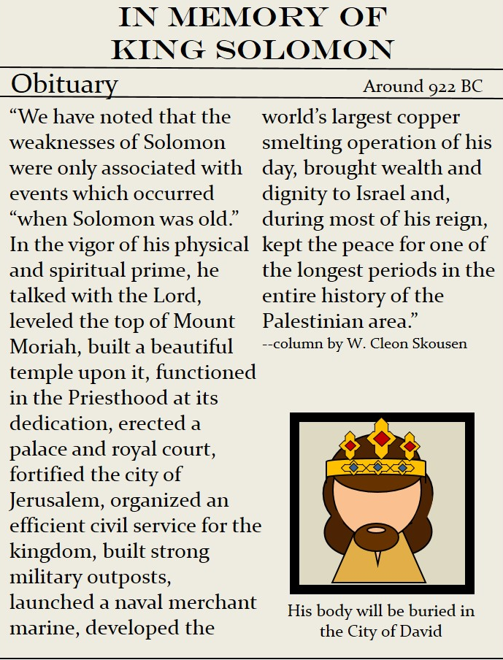
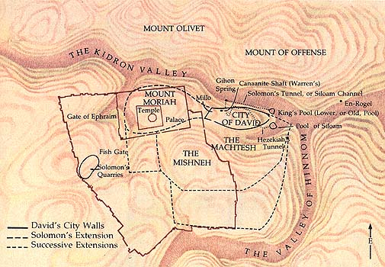
Solomon Dies
Solomon reigned for 40 years and died
1 Kings 11:43
(8)

Slide 11
Rehoboam
Rehoboam was the son and successor of King Solomon and Naamah, an Ammonite woman, whose ancestors were descendants of Lot, Abraham’s nephew.
He was born about the time Solomon was 24 years old. He was 41 when his father died and successor to the throne
Israel became divided, largely because of the revolt of heavy burdens and taxes. Rehoboam attained the throne of the south, or of the tribe of Judah.
Both kingdoms—the northern with Jeroboam (Israel) as king and the southern (Judah) with Rehoboam as king—did not rule in righteousness
He was warned by a man of God, Shemaiah, not to go up to battle against the northern kingdom, however, both kingdoms made war with each other for many years
His power weakened as a result of an invasion by the Egyptians under Shishak, king of Egypt
(6,9)

Slide 12
The Division
After Solomon’s death, his son Rehoboam became king over all of Israel. Jeroboam returned to Israel from Egypt and, along with others, pleaded with Rehoboam to lessen the burdens Solomon had placed on the people to support his many building projects.
Rehoboam chose instead to increase the people’s burdens.
The ten tribes living in the north rebelled against Rehoboam and made Jeroboam their king, which fulfilled the words of the prophet Ahijah.
This revolt divided the kingdom in two: the Northern Kingdom of Israel and the Southern Kingdom of Judah
1 Kings 12:1-24
(8)

Slide 13
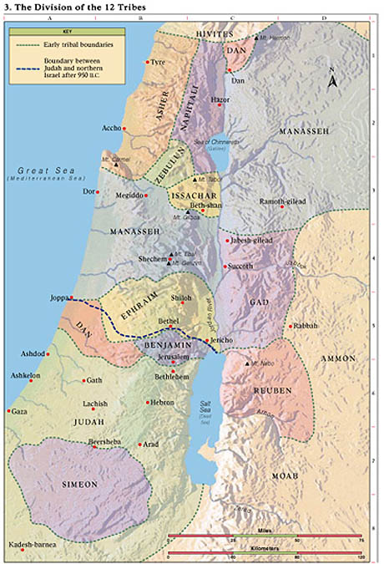
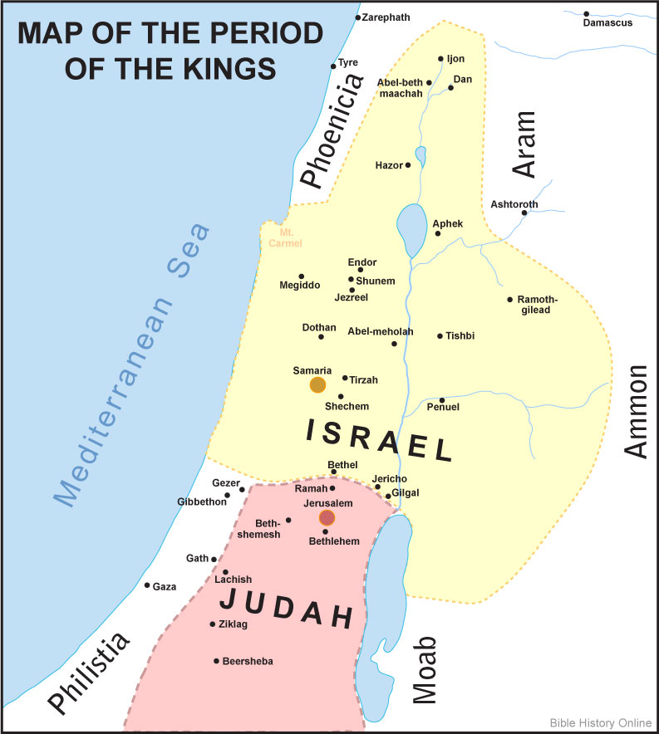
1 Kings 12:1-24

Slide 14

Wisdom in Age
Because of their experience, older people are generally wiser than younger people. But because of their great energy and ability to adapt, youth can be very effective leaders. It is often best to allow the wisdom of the aged to guide the energy of youth.
The reference to scorpions--seems to be an allusion to scourges or whips made of several thongs of leather which had metal barbs embedded in the ends (10).
Rehoboam was simply announcing that he would deal even more sternly with the tribes of Israel than Solomon had.
However, Shemaiah, the man of God, warned Rehoboam not to fight with the Israelites…he heeded and prevented a civil war for a period of time
1 Kings 12:6-11, 22-24

Slide 15
A Prophet’s Warning
Because the temple was located in Judah, Jeroboam feared that his subjects would travel south to worship the Lord and eventually become sympathetic to the Southern Kingdom.
To prevent this, Jeroboam established new places of worship, idols, and feasts in the Northern Kingdom and appointed his own priests.
Jeroboam thus led his people toward apostasy by turning them away from worshipping the Lord at His temple.
The Lord sent a prophet, Ahijah, from Judah to warn Jeroboam about his wickedness and idolatry. Despite seeing miraculous signs of the Lord’s power, Jeroboam did not repent and continued to promote idol worship.
1 Kings 14

Slide 16

If we turn away from the Lord, then we will lose His promised blessings

Slide 17
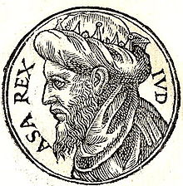
A Series of Wicked Kings
Judah
Rehoboam—Abijam—Asa (begins to rule in righteousness)
Abijam: Reigned three years (abt. 913–910).
Abijam, also called Abijah, was the son of Rehoboam.
He continued the same sins his father had begun.
Asa succeeds him in the kingdom of Judah, and rules in righteousness.
He makes a league with the king of Syria against Baasha king of Israel, who is obliged to desist in his attempts against Judah.
He is diseased in his feet and dies, and is succeeded by his son Jehoshaphat.
1 Kings 15; 2 Chronicles 13

Slide 18
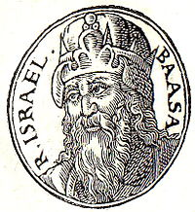
A Series of Wicked Kings
Israel
Jeroboam—Nadab—Baasha—Elah—Zimri—Omri--Ahab
Nadab is slain by Baasha.
Bassha destroys all the house of Jeroboam, the prophecy of Ahijah.
Bassha continues in idolatry.
Jehu, the prophet, denounces the destruction of Baasha.
Elah was killed by Zimri.
Zimri conspires against Baasha, and slays him and his family, and reigns seven days.
The people make Omri king, and besiege Zimri in Tirzah; who, finding no way to escape, sets fire to his palace, and consumes himself in it.
The people are divided, half following Tibni, and half Omri; the latter faction overcomes the former, Tibni is slain, and Omri reigns alone. He founds Samaria. His bad character and death.
Ahab, son of Omri, reigns in his stead; marries Jezebel, restores idolatry, and exceeds his predecessors in wickedness.
Hiel the Beth-elite rebuilds Jericho.
1 Kings 16

Slide 19
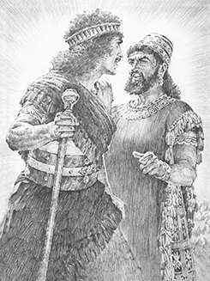
Sources:
Elder Bruce C. Hafen Covenant Marriage Oct. 1996 Gen. Conf.
President Joseph Fielding Smith (Answers to Gospel Questions, 4:214.)
President Spencer W. Kimball (“Oneness in Marriage,” Ensign, Mar. 1977, 3).
For the Strength of Youth [booklet, 2011], 4, 5).
Adam Clark Bible Commentary 1 Kings 11:11
Who’s Who in the Old Testament by Ed J. Pinegar and Richard J. Allen pp. 91-92, 158-159
Presentation by ©http://fashionsbylynda.com/blog/
Wikipedia
W. Cleon Skousen The Fourth Thousand Years p. 280
Old Testament Institute Manual
William Smith, A Dictionary of the Bible,s.v. “scorpion”).

Slide 20
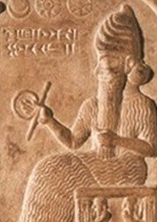
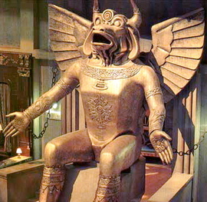
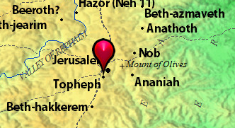
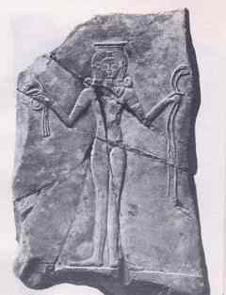
Ashtoreth:
The name given in the Old Testament to the old Semitic mother-goddess, called in Phenicia, Ashtarte; in Babylonia, Ishtar; and in Arabia, Athtar. (For her worship among the Hebrews.) Ashtoreth is derived from Ashtart by a distortion after the analogy of "Bosheth“ Jewish Dictionary
Milcom: or Molech, Moloch:
Milcom was the god of the Ammonites. He was also called Molech (Leviticuas 18:21) and Malcam. His worship demanded the sacrifice of children by fire. Milcom was one of the pagan gods for which King Solomon influenced by his foreign wives, built a shrine in the outskirts of Jerusalem. This shrined called Topheph was destroyed centuries later by King Josiah, who desecrated it with human bones, so that it would no longer be suitable for any worshiper to make his son or daughter pass through fire.

Slide 21
Plural Wives:
Jacob 2:24–31 clearly teaches that plural wives may be taken only when doing so is authorized by the Lord. David’s taking plural wives was authorized by the Lord, for David’s wives “were given unto him of me [the Lord], by the hand of Nathan, my servant, and others of the prophets who had the keys of this power” (D&C 132:39). No plural marriages are authorized by the Lord today, and any attempt to justify them from ancient scripture will result in condemnation from the Lord.
Shechem, the Meeting Place:
From the early years after the settlement of Israel in Canaan, there had been jealousy between the two most powerful tribes, Ephraim and Judah. Solomon’s son Rehoboam was the rightful successor to the throne, but northern Israel did not support him. C. F. Keil and F. Delitzsch explained why:
“Apart from the fact that the tribes had no right to choose at their pleasure a different king from the one who was the lawful heir to the throne of David, the very circumstance that the tribes who were discontented with Solomon’s government did not come to Jerusalem to do homage to Rehoboam, but chose Sichem [Shechem] as the place of meeting, and had also sent for Jeroboam out of Egypt, showed clearly enough that it was their intention to sever themselves from the royal house of David. …
“Rehoboam went to Shechem, because all Israel had come thither to make him king. ‘All Israel,’ according to what follows [compare 1 Kings 12:20–21], was the ten tribes beside Judah and Benjamin. The right of making king the prince whom God has chosen, i.e. of anointing him and doing homage to him … , was an old traditional right in Israel, and the tribes had exercised it not only in the case of Saul and David [see 1 Samuel 11:15;2 Samuel 2:4; 5:3], but in that of Solomon also [see1 Chronicles 29:22]. The ten tribes of Israel made use of this right on Rehoboam’s ascent of the throne; but instead of coming to Jerusalem, the residence of the king and capital of the kingdom, as they ought to have done, and doing homage there to the legitimate successor of Solomon, they had gone to Sichem, the present Nabulus [see Genesis 12:6; 33:18], the place where the ancient national gatherings were held in the tribe of Ephraim [see Joshua 24:1]. …
On the choice of Sichem as the place for doing homage Kimchi has quite correctly observed, that ‘they sought an opportunity for transferring the government to Jeroboam, and therefore were unwilling to come to Jerusalem, but came to Sichem, which belonged to Ephraim, whilst Jeroboam was an Ephraimite.’ If there could be any further doubt on the matter, it would be removed by the fact that they had sent for Jeroboam the son of Nebat to come from Egypt, whither he had fled from Solomon [see 1 Kings 11:40], and attend this meeting, and that Jeroboam took the lead in the meeting, and no doubt suggested to those assembled the demand which they should lay before Rehoboam.” (Commentary on the Old Testament, 3:1:191–93.)
Marrying in the temple:
Elder John A. Widtsoe of the Quorum of the Twelve Apostles explained why marrying in the temple is so vital:
“To create unhappiness is the aim of the adversary of righteousness. Here appears one of the foremost blessings of the temple marriage. Those who have been sealed in the temple have their eyes fixed upon eternity. They dare not forfeit the promised blessings. The family is to them an everlasting possession. They remember the covenants which make possible this eternal association. The temple marriage, with all that it means, becomes a restraining force in the presence of temptation” (Evidences and Reconciliations, arr. G. Homer Durham, 3 vols. in 1 [1960], 299–300).
The Stoning of Adoram: 1 Kings 12:18
Rehoboam must not have thought the people were serious about their rebellion, for he sent Adoram to them. Since Adoram “was the person who was superintendent over the tribute, he was probably sent to collect the ordinary taxes; but the people, indignant at the master who had given them such a brutish answer [to their request for relief from burdens], stoned the servant to death. The sending of Adoram to collect the taxes, when the public mind was in such a state of fermentation [particularly after they had disavowed any allegiance to Rehoboam], was another proof of Rehoboam’s folly and incapacity to govern.” (Clarke, Commentary, 2:436.)
Connection to Book of Mormon:
First Kings 12:17 has particular interest for students of the Book of Mormon. This passage helps to explain why such men as Lehi and Nephi, who were descendants of Manasseh (see Alma 10:3), and the family of Ishmael, who were descendants of Ephraim (see 1 Nephi 7:2; Erastus Snow, in Journal of Discourses, 23:184), were living in the land of Jerusalem several generations after Rehoboam. Laban, a record-keeper for the tribe of Joseph, also lived in Jerusalem at the time of Lehi and Ishmael (see 1 Nephi 3:2–4). This matter is explained more fully in 2 Chronicles 11:13–17 and 15:9 than in 1 Kings.
Old Testament Institute Manual

Slide 22
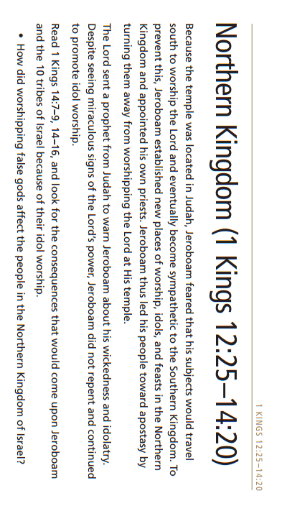

Slide 23
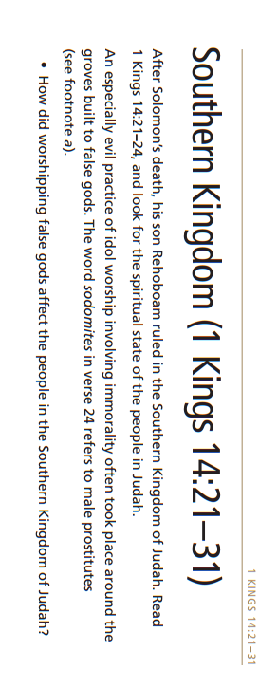

Slide 24
Israel
Judah
Kings | Prophets | Kings | Prophets
Jeroboam | Ahijah | Rehoboam | Shemiah
 | Unnamed
Jeroboam I: Reigned twenty-two years (abt. 930–909 B.C.). The Lord chose him to be king over the ten northern tribes, but Jeroboam would not keep the commandments. Instead, he turned Israel to idolatry and became the pattern for nearly all of Israel’s subsequent kings (see 1 Kings 12:25–14:20).
Rehoboam: Reigned seventeen years (abt. 930–913 B.C.). Rehoboam, a son of Solomon, was sometimes obedient to the Lord and sometimes followed the wickedness of the neighboring countries. As a result, Shishak, pharaoh of Egypt, invaded Judah and plundered the temple (see 1 Kings 12:1–24; 14:21–31; 2 Chronicles 10:1–12:16).
Nadab: Reigned two years (abt. 909–908 B.C.). Nadab, the son of Jeroboam, continued the wickedness begun by his father. He was assassinated by Baasha (see 1 Kings 15:25–31).
Baasha: Reigned twenty-four years (abt. 908–886 B.C.). Baasha gained the throne by murdering Nadab and destroying all of Jeroboam’s descendants. He continued in the wickedness of Jeroboam, and the prophet Jehu predicted that his house would be destroyed as he had destroyed the house of Jeroboam (see 1 Kings 15:32–16:7).
Abijam: Reigned three years (abt. 913–910). Abijam, also called Abijah, was the son of Rehoboam. He continued the same sins his father had begun (see 1 Kings 15:1–8; 2 Chronicles 13).
Elah: Reigned two years (abt. 886–885 B.C.). Elah, the son of Baasha, was killed by Zimri, his chariot captain. Zimri then killed all who belonged to the house of Baasha, fulfilling the prophecy of Jehu (see 1 Kings 16:8–14).
Asa: He was the son of Abijam, grandson of Rehoboam, and great-grandson of Solomon. The Hebrew Bible gives the period of his reign as 41 years. His reign is dated between 913-910 BC to 873-869 BC. He was succeeded by Jehoshaphat, his son (by Azubah). He tried to maintain the traditional worship of God, and in rooting out idolatry
Zimri: Reigned seven days (abt. 885 B.C.). The military revolted against Zimri, who then committed suicide (see 1 Kings 16:9–20).
Omri (abt. 885–874 B.C.) and Tibni (abt. 885–880 B.C.): Omri and Tibni contended for control of the kingdom for four years. Tibni died, and Omri became king. Omri founded the city of Samaria and made it his capital. He reigned twelve more years, more wickedly than his predecessors (see 1 Kings 16:16–28).
Jehoshaphat: Reigned twenty-five years (abt. 872–848 B.C.). Jehoshaphat ruled three years jointly with his father, Asa, and five years with his son Jehoram. He ruled wisely and righteously, except for being too closely allied to Ahab and Ahaziah of Israel. This may have led to his son’s unfortunate marriage to Ahab’s daughter (see 1 Kings 22:41–50; 2 Chronicles 17:1–21:3).
Ahab: Reigned twenty-two years (abt. 874–853 B.C.). Ahab, the son of Omri, is considered to be the northern kingdom’s worst king. He married Jezebel, an idolatrous Sidonian princess who promoted Baal worship and persecuted those who followed Jehovah. She tried to have the prophet Elijah killed. Elijah prophesied the deaths of Ahab and Jezebel (see 1 Kings 16:29–22:40; 2 Chronicles 18).

