Slide 1

Elijah The Prophet
1 Kings 17

Slide 2

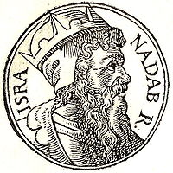
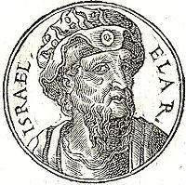
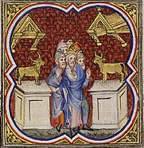
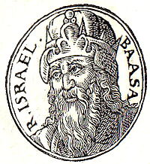
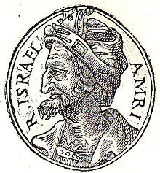
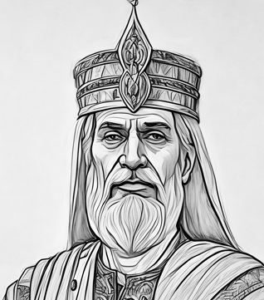
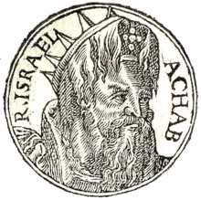
Previously…
Jeroboam—dies after reign of 22 years
Baasha (son of Ahijah of the Tribe of Issachar)--reigned 23 years
Nadab (son of Jeroboam)—reigned only 2 years and killed by Baasha
Elah (son of Baasha)—reigned 2 years then killed by Zimri
Ahab (son of Omri)
Zimri—reigned for 7 days
Omri gained ½ of Israel to support him. Once the people selected Omri as their king, Zimri set fire to the palace and burned therein—Omri builds a new capital in Samaria
1 Kings 14-16, 2 Chronicles 13

Slide 3
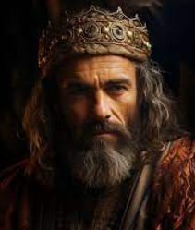
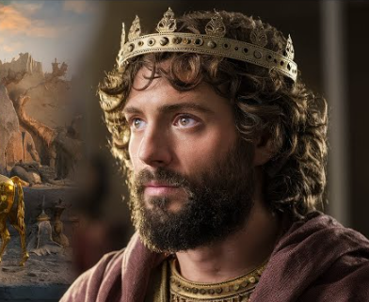
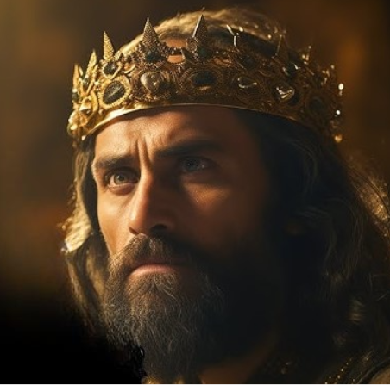
The Divide
Although Solomon began as a righteous follower of the Lord, he eventually chose to disobey the Lord’s commandments. As a result of his disobedience, the Lord told Solomon that the kingdom of Israel would be taken from him and given to his servant Jeroboam.
Jeroboam’s kingdom would become known as the kingdom of Israel, Ephraim, or the northern kingdom. Solomon’s son Rehoboam would become king over the remaining two tribes.
Rehoboam’s kingdom would become known as the kingdom of Judah, or southern kingdom.
1 Kings 11:10–13, 26–40; 12:16–20).

Slide 4
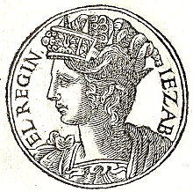
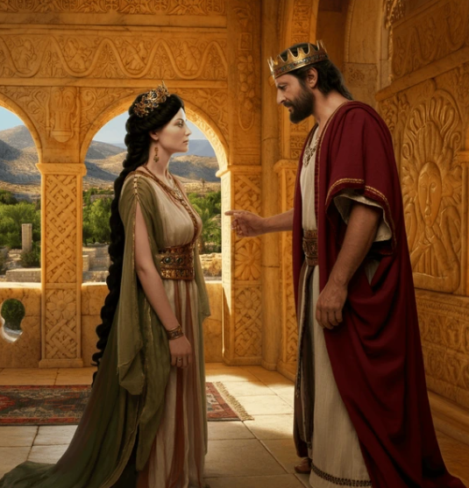
Ahab and Jezebel
Ahab (son of Omri) was the king of northern Israel from about 869-850 BC
He married Jezebel (a Phoenician princess from Sidon (or Zidon, the Mediterranean port city) daughter of King Ethbaal
Jezebel brought with her the worship of the god Baal and Ahab erected a “house of Baal” in the capital city of Samaria
Ahab also made a grove in which people could indulge in immoral practices dedicated to the love goddess, Ashteroth.
Notwithstanding I have a few things against thee, because thou sufferest that woman Jezebel, which calleth herself a prophetess, to teach and to seduce my servants to commit fornication, and to eat things sacrificed unto idols.
Revelation 2:20
1 Kings 16

Slide 5
The Calling of Elijah
Meaning: Jehovah is my God
Elijah the Tishbite came into the scene when Israel was at its worst with Ahab as the King and Jezebel, Ahab’s ruling wife
He commenced his ministry around 926 BC when the Lord told him to hide from the wicked king and his wife
He held the Priesthood keys in his day. These keys included all of the powers delegated to the Melchizedek Priesthood, sometimes called the sealing powers
He had the power to seal up the righteous who accepted the Gospel and had the authority to administer the full temple service with all the higher ordinances and ceremonies and had the power to seal a man to his wife, and children to their parents for time and all eternity
He held the power by which the heavens could be sealed against rain, the power to raise the dead, powers to turn rivers of water back from their courses, call down consuming fire from heaven, move mountains from their foundations, and cause peace to come upon a storm-tossed sea

Slide 6
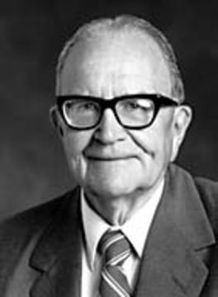
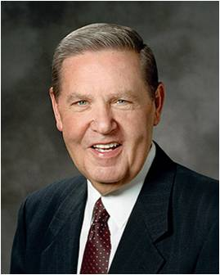
A message to Ahab
The last of the prophets in old Israel who held a fullness of divine authority was Elijah the Tishbite. (1)
The Lord sent a prophet named Elijah to deliver a message to King Ahab.
As the Lord God of Israel liveth, before whom I stand, there shall not be dew nor rain these years, but according to my word.
In response to King Ahab’s great wickedness, the Lord, through the prophet Elijah, sealed the heavens, that neither dew nor rain should fall throughout all the land of Israel. The drought that ensued and the famine that followed affected Elijah himself as well as untold others in the process. (2)
1 Kings 17:1

Slide 7
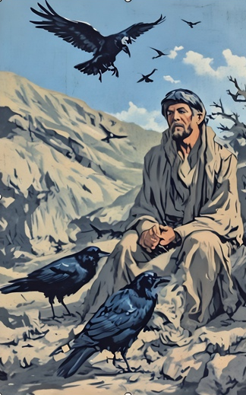
By the Brook
Ravens did bring Elijah bread and meat to eat, but unless ravens carry more than I think they do, this was not a gourmet meal.
And ere long the brook Cherith, near which he hid and from which he drank, ran dry.
And so it went for three years. (2)
1 Kings 17:2-6

Slide 8
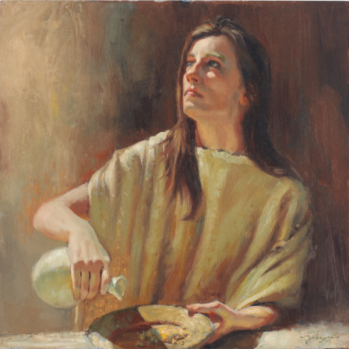
Widow of Faith
As he entered the city in his weary condition he met his benefactress, who was undoubtedly as weak and wasted as he.
Perhaps almost apologetically the thirsty traveler importuned, “Fetch me, I pray thee, a little water in a vessel, that I may drink.”
As she turned to meet his request, Elijah added even more strain to the supplication. “Bring me, I pray thee, a morsel of bread in thine hand [also].”
God commanded Elijah to go to the village of Zarephath where, he said, he had commanded a widow woman to sustain him.
1 Kings 17:7-10
(2)

Slide 9
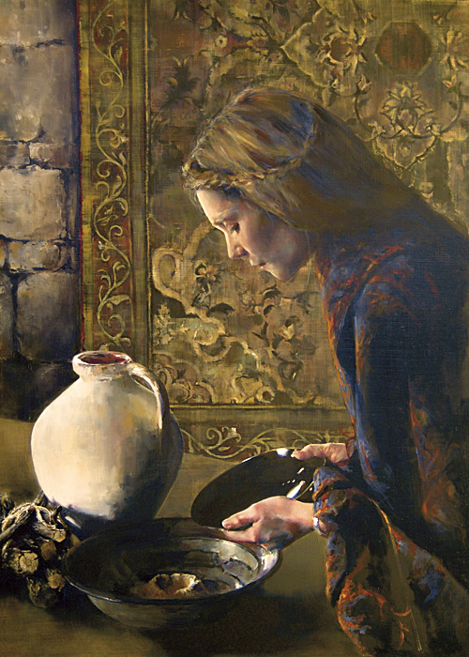
Promises to the Widow
What blessings did the Lord promise to give the woman if she fed Elijah first?
How would it test the woman’s faith to feed Elijah before she fed her son and herself?
Before we can receive the Lord’s promised blessings, we must first act in faith
And she went and did according to the saying of Elijah: and she, and he, and her house, did eat many days.
1 Kings 17:13-16

Slide 10
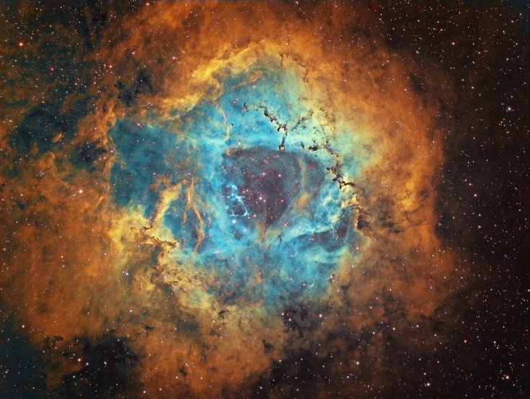


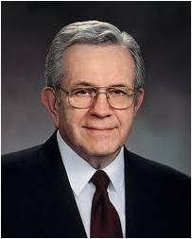
“Faith, to be faith, must center around something that is not known.
Faith, to be faith, must go beyond that for which there is confirming evidence.
Faith, to be faith, must go into the unknown.
Faith, to be faith, must walk to the edge of the light, and then a few steps into the darkness.
If everything has to be known, if everything has to be explained, if everything has to be certified, then there is no need for faith. Indeed, there is no room for it.”
1 Kings 17:13-16
(3)
William Lulow

Slide 11
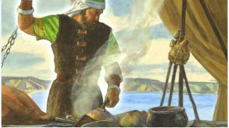
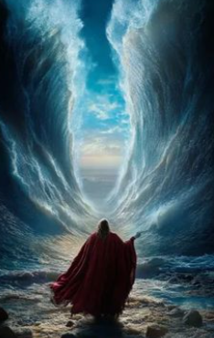
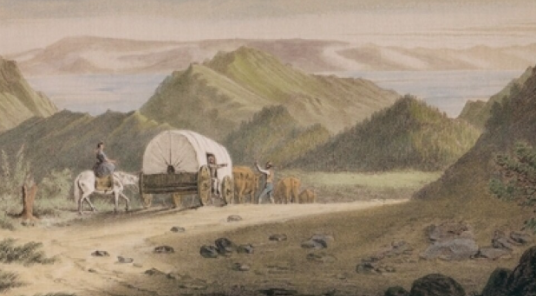
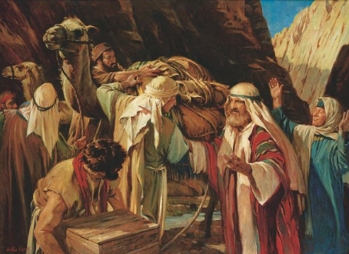
Prophets of Faith
Brother of Jared
Moses
Brigham Young
Ether 2:16; 6:4,11
Lehi
D&C 136:1
Exodus 14:21-22
1 Nephi 2:1-2

Slide 12
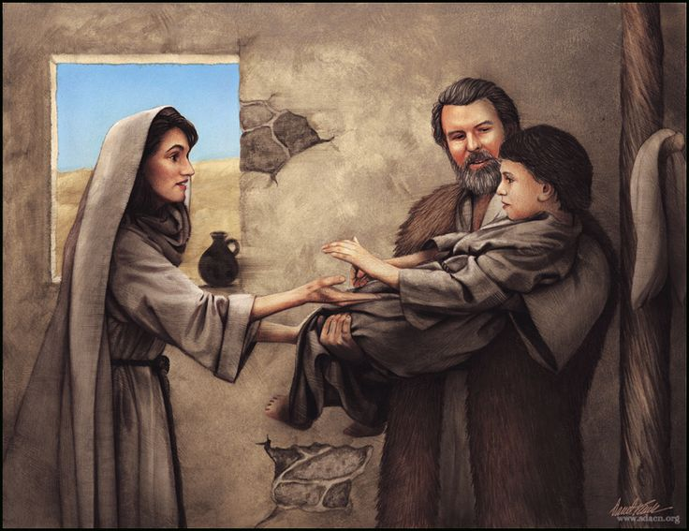
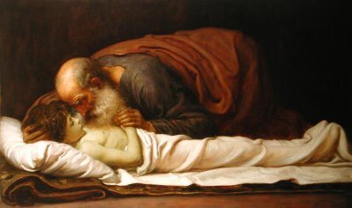
Another Miracle
“For all Elijah knew this boy was permanently dead, and he wanted no witnesses as he earnestly pleaded with the Lord of restoring him to life.
Elijah followed the strange procedure of bending over the child three times as he prayed for his life we do not know. Later, Elisha did something similar in restoring the dead child of the Shunamite (2 Kings 4:34)”
Acting in faith on the Savior’s words brings His promised blessings
1 Kings 17:17-24
(4)

Slide 13
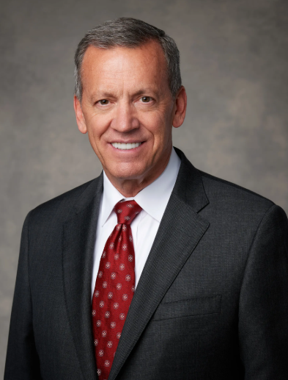

Acting on Faith
I promise that if you will act with faith in your Heavenly Father and His plan—His great plan of happiness—and if you will act with faith in Jesus Christ and His Atonement and follow God’s prophets, you will be given power to do whatever the Lord needs you to do and to become whatever He needs you to become, in spite of your circumstances.(6)

Slide 14
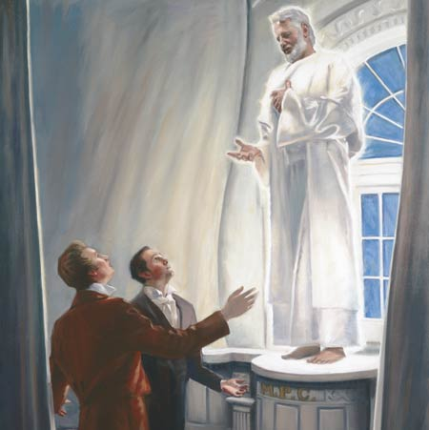
Elijah, The Prophet
Elijah was the last Prophet that held the keys of the Priesthood, and who will, before the last dispensation, restore the authority and deliver the keys of the Priesthood, in order that all the ordinances may be attended to in righteousness.
“The spirit of Elias is first, Elijah second, and Messiah last. Elias is a forerunner to prepare the way, and the spirit and power of Elijah is to come after, holding the keys of power, building the Temple to the capstone, place the seals of the Melchizedek Priesthood upon the house of Israel, and making all things read, then Messiah come to His Temple which is last of all.
Elijah was to come and prepare the way and build up the kingdom before the coming of the great day of the Lord, although the spirit of Elias might begin it.
Documentary History of the Church, Vol. 6 pp. 251-254
(5)

Slide 15
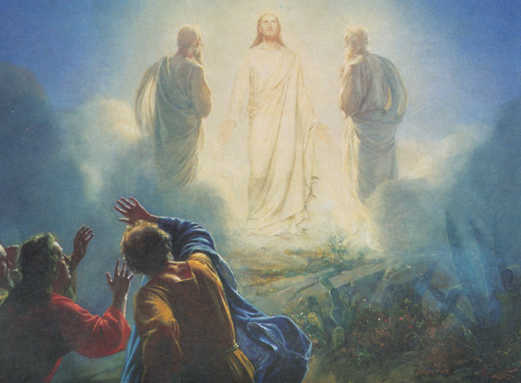
Sources:
Videos:
“Elijah and the Widow of Zarephath” (10:13)
“Fathers and Sons” (5:42)
Theodore M. Burton The Power of Elijah April 1974 Gen. Conf.
Elder Jeffrey R. Holland A Handful of Meal and a Little Oil April 1996 Gen. Conf.
Presentation by ©http://fashionsbylynda.com/blog/
3. President Boyd K. Packer (“What Is Faith?” in Faith [1983], 42–43).
4. W. Cleon Skousen The Fourth Thousand Years p. 339
5. Joseph Smith Documentary History of the Church, Vol. 6 pp. 251-254
6. Elder Randall K. Bennett (“Prophetic Invitations and Promised Blessings,” [Brigham Young University devotional, Mar. 19, 2019], 1, speeches.byu.edu)
On the Mount of Transfiguration, Peter saw the transfigured Savior, as well as Moses and Elias (Elijah) (Matt. 17:1–9).

Slide 16
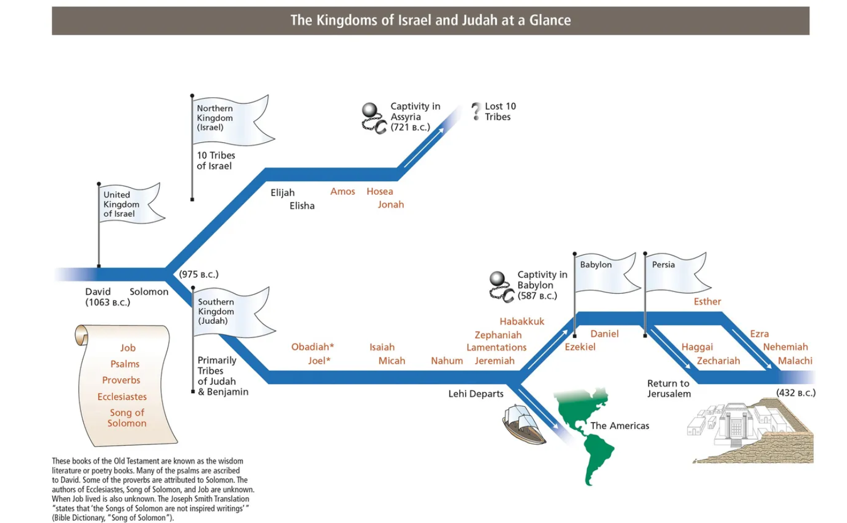

Slide 17
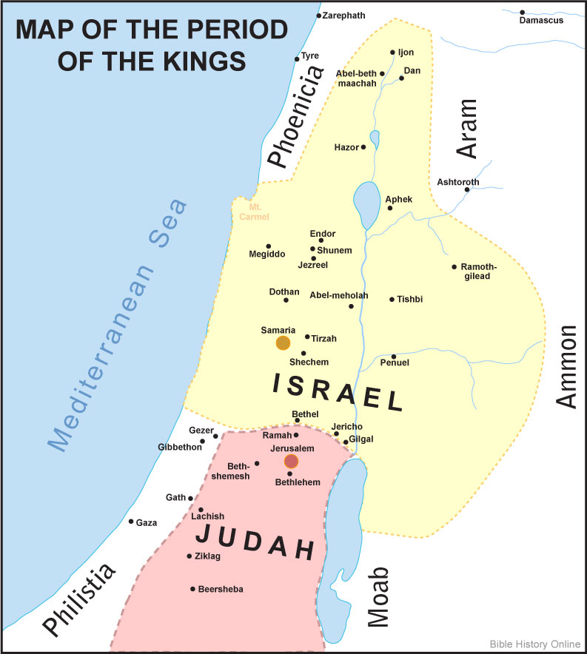
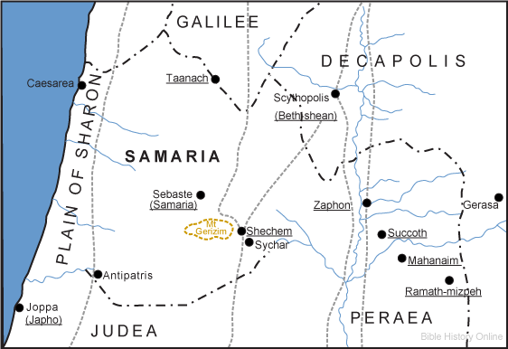
Samaria:
The newest capital was a hill bought by Omri rom a man named Shemar. Joseph points out that the city built on this hill was called by Omri “Semarion, but named by the Greeks Samaria: but he himself called it Semarion, from Semar, who sold him the mountain whereon he built it.” (Josephus, Chapter 12:5) Today the city is called Sebastia, a name given to it by Herod the Great in honor of Augustus Caesar. (Clark, Bible Commentary Vol. 2, p. 450

Slide 18
Elijah
Jehovah is my God. Called “the Tishbite,” but the meaning of this name is quite uncertain, no place being known from which it could be derived. He was “of the inhabitants of Gilead,” the wild and beautiful hill country east of Jordan. The nature of the district and the lonely life that men lived there produced its full effect on the character of the prophet. Nothing is known of his parentage. The northern kingdom was the scene of his work, at a time when, owing to the influence of Ahab and Jezebel, the people had almost entirely forsaken the worship of Jehovah and had become worshippers of the Phoenician god Baal (1 Kgs. 16:32; 18:19). An account of Elijah’s life is found in 1 Kgs. 17–22; 2 Kgs. 1–2 and 2 Chr. 21:12–15.
The deep impression Elijah made upon the life of the Israelites is indicated in the fixed belief that prevails that he will return, as spoken of in Mal. 4:5. The foregoing references from the New Testament show that many mistook Jesus for Elijah returned. Among the Jews he is still an invited guest at the Passover, for whom a vacant seat is reserved and the door is opened.
His recorded words are few but forceful, and his deeds are explicit evidences of his strength of will, force of character, and personal courage. He was an example of solid faith in the Lord. With his ministry are associated such colorful events as his pronouncements upon the life and death of Ahab and Jezebel (and their subsequent fulfillment); calling down fire from heaven; sealing the heavens with no rain for 3½ years; blessing the widow’s meal and oil; and raising a boy from the dead. His life closed dramatically: “there appeared a chariot of fire, … and Elijah went up by a whirlwind into heaven,” (2 Kgs. 2:11–12) and thus was he translated. As a result of Elijah’s ministry, Baal worship was greatly reduced as a threat to Israel. At his translation Elijah’s mantle (shawl) fell on Elisha, his successor; the term “mantle of the prophet” has become a phrase indicative of prophetic succession.
We learn from latter-day revelation that Elijah held the sealing power of the Melchizedek Priesthood. He appeared on the Mount of Transfiguration in company with Moses (also translated) and conferred the keys of the priesthood on Peter, James, and John (Matt. 17:3). He appeared again, in company with Moses and others, on April 3, 1836, in the Kirtland (Ohio) Temple and conferred the same keys upon Joseph Smith and Oliver Cowdery. All of this was in preparation for the coming of the Lord, as spoken of in Mal. 4:5–6 (D&C 110:13–16). As demonstrated by his miraculous deeds, the power of Elijah is the sealing power of the priesthood by which things bound or loosed on earth are bound or loosed in heaven. Thus the keys of this power are once again operative on the earth and are used in performing all the ordinances of the gospel for the living and the dead.
Bible Dictionary
Faith:
Elder David A. Bednar of the Quorum of the Twelve Apostles taught that there are three basic elements of faith. Each of these elements of faith is illustrated in 1 Kings 17:
“(1) faith as the assurance of things hoped for that are true, (2) faith as the evidence of things not seen, and (3) faith as the principle of action in all intelligent beings. I describe these three components of faith in the Savior as simultaneously facing the future, looking to the past, and initiating action in the present.
“Faith as the assurance of things hoped for looks to the future. This assurance is founded upon a correct understanding about, and trust in, God and enables us to ‘press forward’ [2 Nephi 31:20] into uncertain and often challenging situations in the service of the Savior. …
“Faith in Christ is inextricably tied to, and results in, hope in Christ for our redemption and exaltation. And assurance and hope make it possible for us to walk to the edge of the light and take a few steps into the darkness—expecting and trusting the light to move and illuminate the way. The combination of assurance and hope initiates action in the present.
“Faith as the evidence of things not seen looks to the past and confirms our trust in God and our confidence in the truthfulness of things not seen. We stepped into the darkness with assurance and hope, and we received evidence and confirmation as the light in fact moved and provided the illumination we needed. The witness we obtained after the trial of our faith [see Ether 12:6] is evidence that enlarges and strengthens our assurance.
“Assurance, action, and evidence influence each other in an ongoing process. This helix is like a coil, and as it spirals upward it expands and widens. These three elements of faith—assurance, action, and evidence—are not separate and discrete; rather, they are interrelated and continuous and cycle upward. And the faith that fuels this ongoing process develops, evolves, and changes. As we again turn and face forward toward an uncertain future, assurance leads to action and produces evidence, which further increases assurance. Our confidence waxes stronger, line upon line, precept upon precept, here a little and there a little” (“Seek Learning by Faith,” Ensign orLiahona, Sept. 2007, 61–63).

