Slide 1

Sacred Songs, Poems, and Prayers
Psalms Part 1
HYMNS
Psalms 9, 23, 24, 33

Slide 2
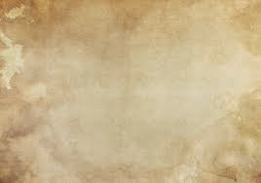
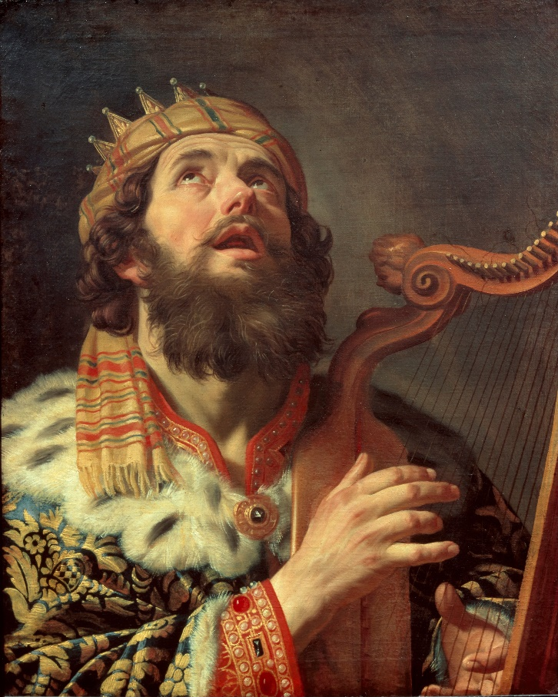
Introduction
It is a collection of ancient Israel’s poetic hymns, petitions, and praises
Psalms has been a source of inspiration for worship since ancient times and continues to be cherished for worship and study by both Jews and Christians
The book of Psalms attributes at least 73 (or about half) of the psalms to David.
Attributes of other psalms:
Asaph (Psalms 50; 73–83)
Heman (Psalm 88).
These attributions, however, appear in titles that “are added to some of the psalms, but it is open to question whether these are as old as the words to which they are attached” (1)

Slide 3
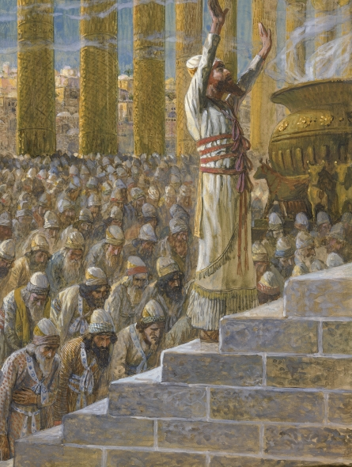
Compiled
The multiple authors who wrote the psalms lived at different times, most of them between about 1000 and 500 B.C.
It is not certain when the book of Psalms was compiled in its current form, but events mentioned in Psalm 137 indicate this process was not completed until after the Jewish exile in Babylon:
“By the rivers of Babylon, there we sat down, yea, we wept, when we remembered Zion. … For there they … carried us away captive” (Psalm 137:1, 3).
Psalms is the Old Testament book most quoted in the New Testament, for “no book of the Old Testament is more Christian in its inner sense or more fully attested as such by the use made of it than the Psalms.” (1)
Many of the psalms contain prophetic references to the Savior and allude to events that would take place during the Savior’s life.

Slide 4
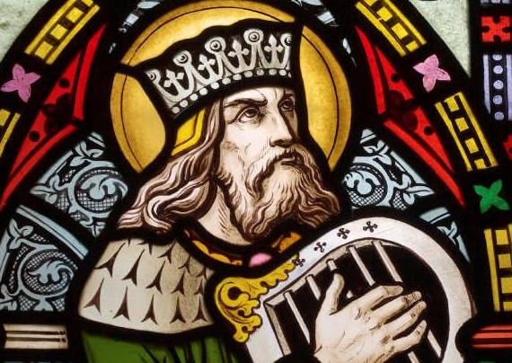
Hymns, Prayers, and Praises
The book of Psalms is divided into five main sections:
Psalms:
Psalms is a collection of sacred songs, poems, and prayers to God. In ancient times, the Israelites would sing or recite the psalms as part of their worship of the Lord.
1-41
107-150
42-72
73-89
90-106
Each of which ends with an expression of praise
These hymns were used for prayer, praises, and meditation, and some of the texts show similarities to Hebrew poetry.
Some titles are “probably names of tunes, well known at the time, to which the psalms were appointed to be sung. (1)

Slide 5
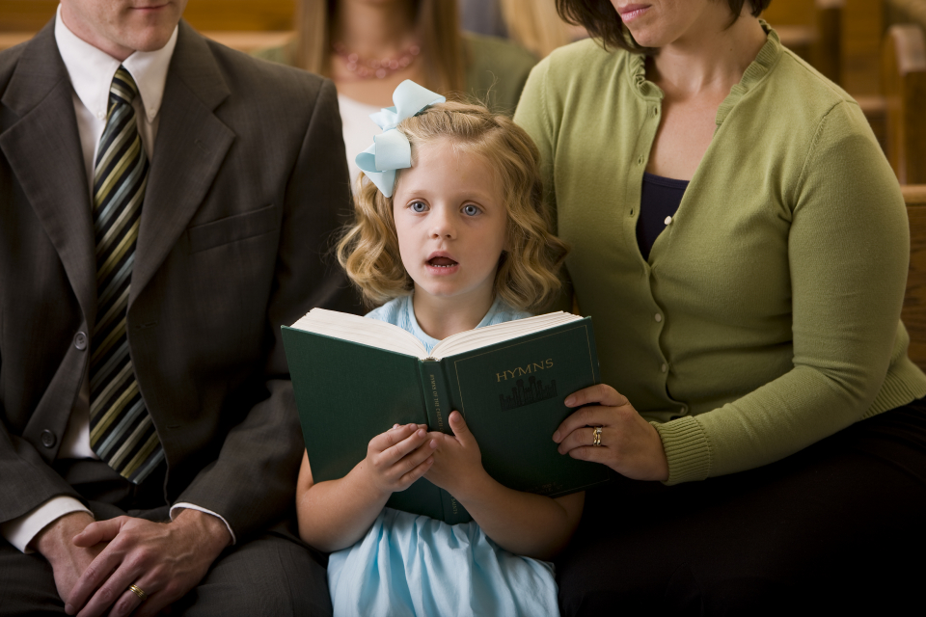
Singing Hymns
The First Presidency has counseled members of the Church to sing the hymns of Zion.
Following that counsel will help us learn and teach the gospel through our sacred hymns and “bring out the spirit of music in the heart and soul of every boy, every girl, every man, and every woman.”
In doing so we will find greater love for the Lord’s doctrine, increased strength to withstand temptation, and a deepened testimony of the Savior and His love for each of us. (2)

Slide 6
The Hymns We Sing
Like the psalms, the lyrics and music of modern hymns can reflect expressions of reverence and love for Heavenly Father and Jesus Christ and can invite the Spirit’s witness of Them.
HYMNS
Psalms 8:3–9; 9:1–2. “How Great Thou Art”
Psalm 26:8. “We Love Thy House, O God”
Psalm 27:1. “The Lord Is My Light”
Psalms 33:1–6; 95:1–6. “For the Beauty of the Earth”
Psalm 37:3–9. “Be Still, My Soul”
Psalm 148. “All Creatures of Our God and King”
Psalm 150. “Praise to the Lord, the Almighty”
Psalm 23 “The Lord Is My Shepherd.”

Slide 7
Acrostic Poem
An acrostic poem is a type of poem where the first letter of each line spells out a specific word, name, or phrase when read vertically.
JESUS
A Hebrew acrostic poem is a poem where the first letters of each line or stanza follow the order of the 22-letter Hebrew alphabet, from Aleph to Tav.
This form is found in biblical texts like Psalms 25, 34, 37, 111, 112, 119, 145, and Proverbs 31
Write one word for each line beginning with the letter.
Write a sentence for each letter

Slide 8
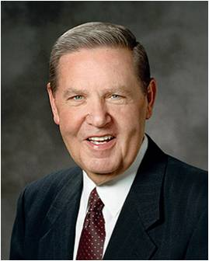
Jesus Christ in Psalms
I will praise thee, O
Lord, with my whole heart;
I will shew forth all thy marvellous works
Have mercy upon me, O Lord; consider my trouble which I suffer of them that hate me, thou that liftest me up from the gates of death:
I will be glad and rejoice in thee: I will sing praise to thy name, O thou most High.
The Lord also will be a refuge for the oppressed, a refuge in times of trouble.
And they that know thy name will put their trust in thee: for thou, Lord, hast not forsaken them that seek thee.
That I may shew forth all thy praise in the gates of the daughter of Zion: I will rejoice in thy salvation.
“Jesus Himself quoted the book of Psalms more than any other Old Testament text. Beyond the Savior’s own use of these writings, the authors of the four Gospels [Matthew, Mark, Luke, and John] drew heavily on the psalms as they strove to document His life and ministry, particularly those excruciating hours of His arrest, trial, and Crucifixion.” (3)
Psalms 9:1-2, 9-10,

Slide 9
Prophecies of Jesus Christ
And he said unto them, These are the words which I spake unto you, while I was yet with you…
…that all things must be fulfilled, which were written in the law of Moses, and in the prophets, and in the psalms, concerning me.
…Then opened he their understanding, that they might understand the scriptures,
…And said unto them, Thus it is written, and thus it behoved Christ to suffer, and to rise from the dead the third day:
Prophecies of Jesus Christ’s suffering and death were given long before He was born on earth. The prophecies of Jesus Christ’s suffering and death were fulfilled
Luke 24:44-46

Slide 10
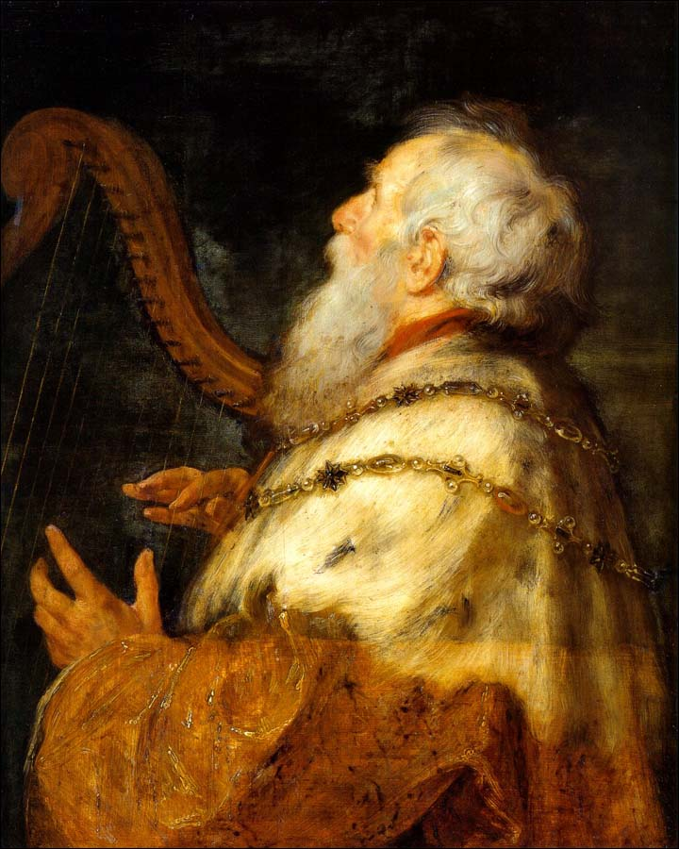
David and Psalms
Seventy-three of the psalms are ascribed to David
Through all of the psalms one theme is constant and dominant: the reliance of man upon God.
This was one lesson David learned early upon the hills of Bethlehem.
The Lord was his Shepherd, and having served part of his own life in the capacity of herdsman, David knew well the full implications of those words of the now famous Twenty-third Psalm. (4)
(1)

Slide 11
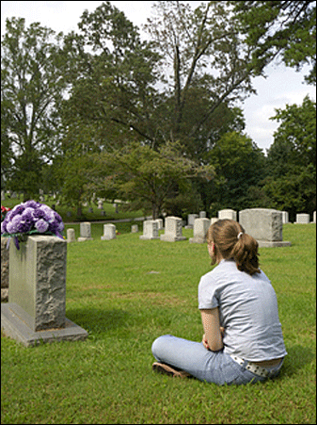

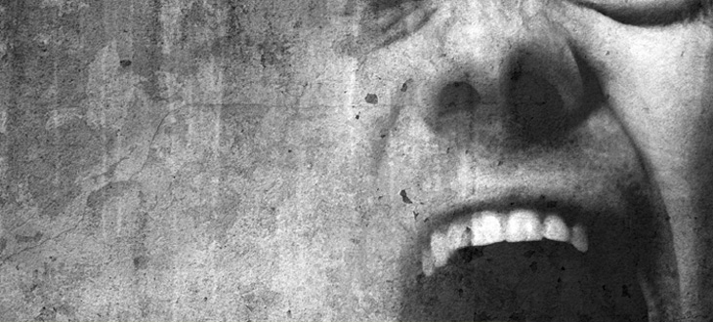

Psalms 23
Death
Confusion
Anger
Heartache
Sickness
Fear
Loneliness
The Lord can help us when we experience difficulties.
This psalm is widely regarded as one of the most beloved scripture passages in the Bible.

Slide 12
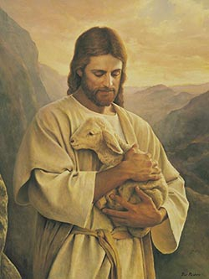
Psalm 23
“We need a shepherd because in innocence or ignorance—but on occasion willfully and against counsel—we turn ‘every one to his own way’ and as a result ‘have gone astray’ [Isaiah 53:6].
We wander here and scamper there, inspect this and nibble at that, until at some point we look up and realize we are either lost or about to be destroyed.
We realize that we, or others who affect us, have done either something stupid or something wrong—which are so very often the same thing.
We realize we desperately need help; we are in trouble and frantically look about for our shepherd, our defender, our savior.”
(3)

Slide 13
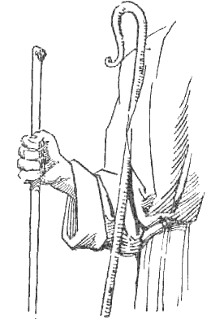
The Shepherd’s Rod and Staff
“In ancient days the only instruments a shepherd carried were a rod and a staff. The rod was a short, stout, club-like weapon used to defend oneself or the flock from an intruder. It was meant to be—and to convey—strength and power in the hand of a strong shepherd who knew how to use it. …
“The staff was a longer, lighter piece, usually with a hook (or crook) on the end used for rescuing a stranded sheep. It, more than the rod, is associated in both art and myth with the shepherd and his vigilant watchcare. …
Everything about the staff speaks of safety and care. It is the great scriptural instrument of rescue and redemption.
(3)

Slide 14
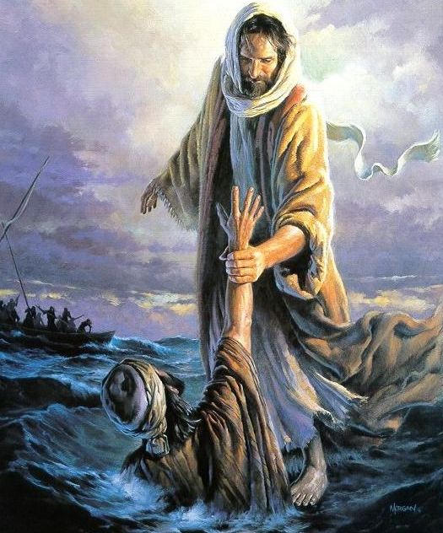
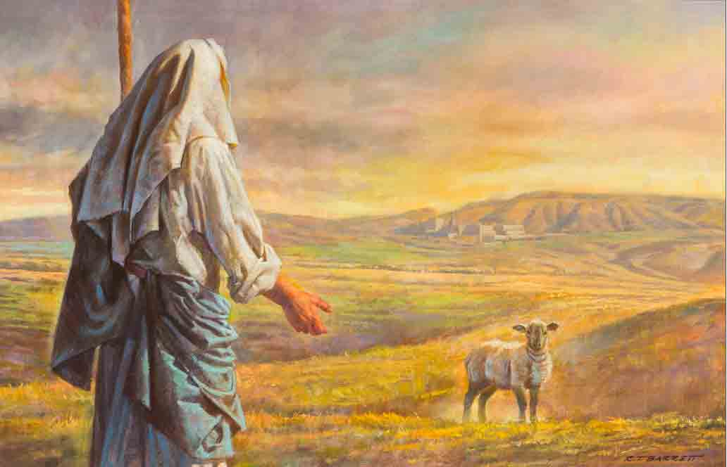
Blessed and Protected
In life we need defending and we need rescue. One way or the other, we are vulnerable.
Whether it be in threatening confrontations or routine wandering, we are blessed and protected by God’s vigilant care.
Thy rod and thy staff they comfort me.”
(3)

Slide 15
Doctrinal Mastery
Psalms
24:3-4
Who shall ascend into the hill of the Lord? or who shall stand in his holy place?
He that hath clean hands, and a pure heart; who hath not lifted up his soul unto vanity, nor sworn deceitfully.

Slide 16
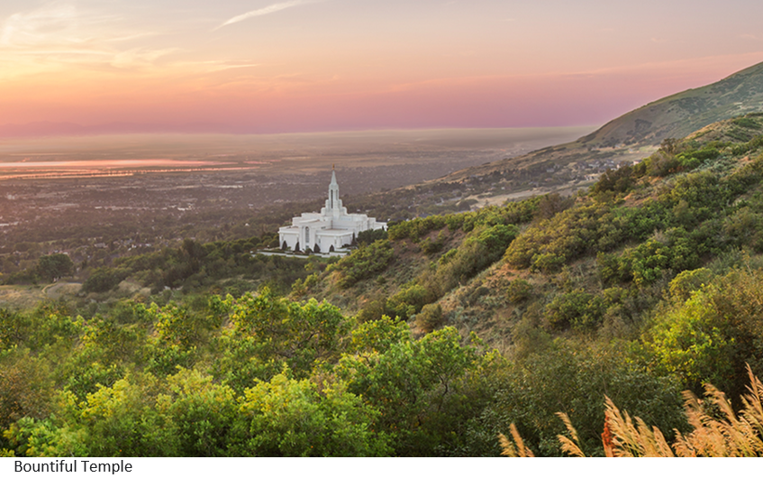
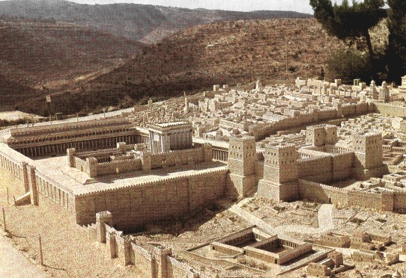
Hill of the Lord/ His Holy Place
The temple or the Lord’s presence.
The temple in Jerusalem was built on top of a hill.
Psalms 24:3-4

Slide 17
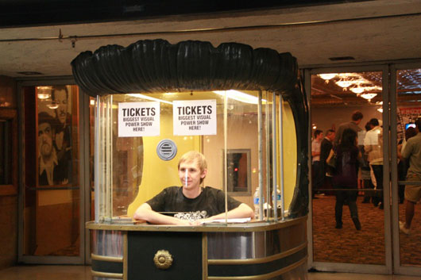
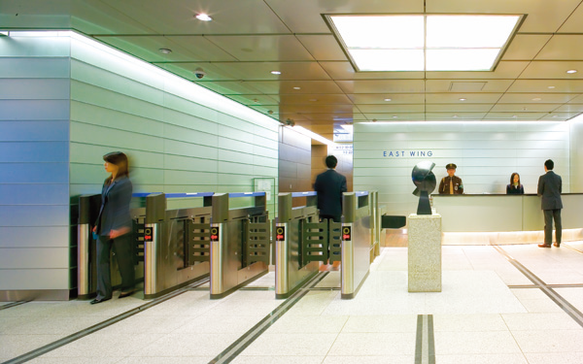
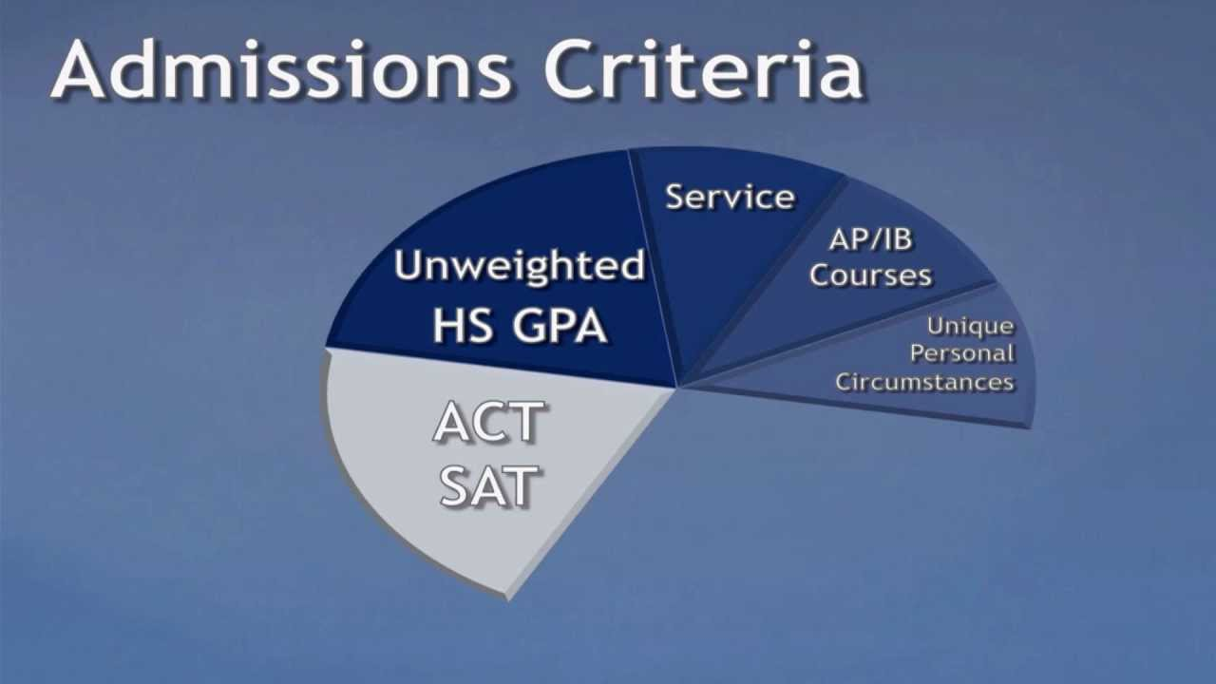
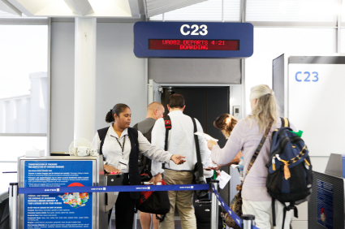
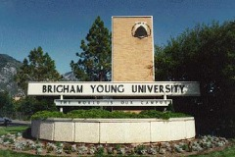
To Gain Entrance
Why are there requirements for entering these or other places?
Psalm 24

Slide 18
Requirements To Enter The Temple
One must be baptized and confirmed by the authority of the priesthood
One must have a testimony of the truthfulness of the gospel
One must be morally clean and have no unresolved sins or issues in keeping the commandments
One must keep the Word of Wisdom
One must keep the Law of Tithing
One must be honest in everything
One must not have any sympathetic feelings toward apostate groups
One must strive to keep the rules, laws, and commandments and attend sacrament meetings (2)
Psalm 24

Slide 19

Clean And Pure
To be worthy to worship in the Lord’s house and to be prepared to dwell in His presence, we must have clean hands and a pure heart
Although it may be difficult for us to keep our hands clean and our hearts pure because of the evil influences that often surround us, it is possible to do so because of our Savior, Jesus Christ.
Psalms 24:5-6

Slide 20
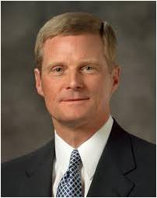
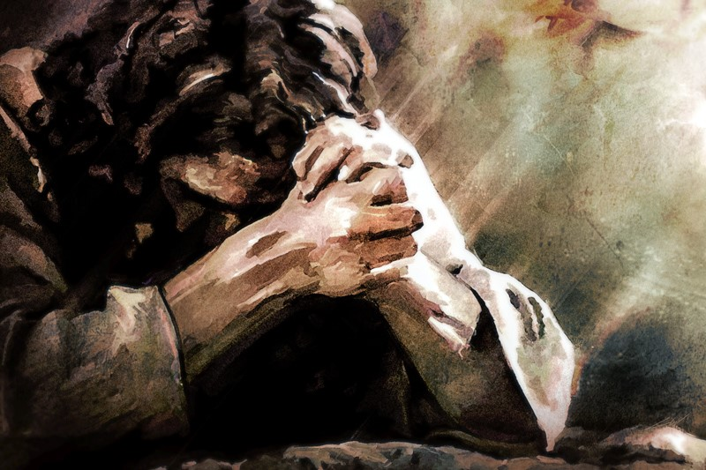
“Let me suggest that hands are made clean through the process of putting off the natural man and by overcoming sin and the evil influences in our lives through the Savior’s Atonement.
Hearts are purified as we receive His strengthening power to do good and become better.
All of our worthy desires and good works, as necessary as they are, can never produce clean hands and a pure heart.
It is the Atonement of Jesus Christ that provides both a cleansing and redeeming power that helps us to overcome sin and a sanctifying and strengthening power that helps us to become better than we ever could by relying only upon our own strength.” (5)
Psalms 24:5-6

Slide 21
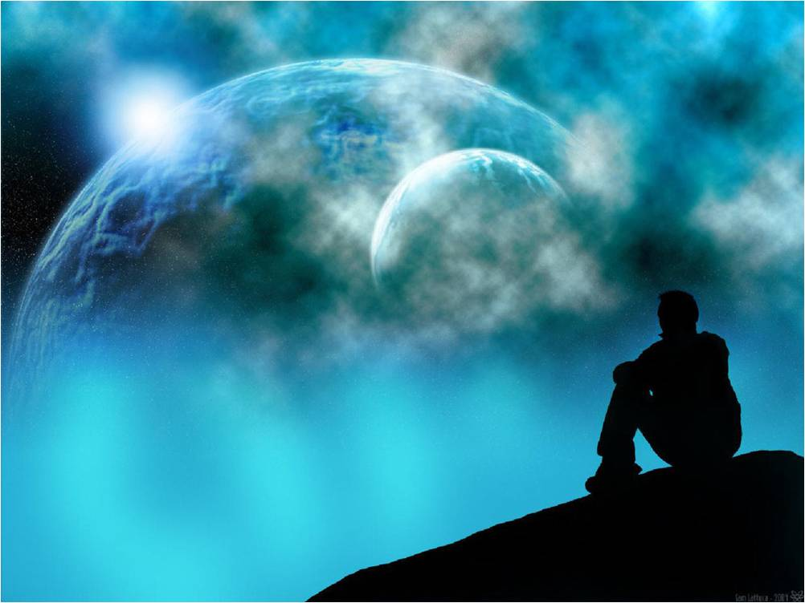
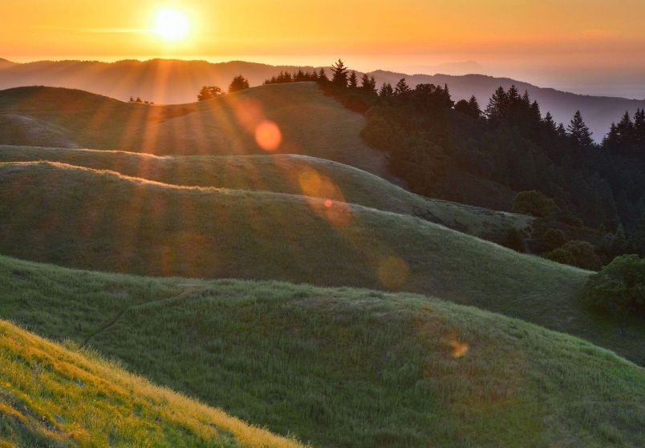
Song of Praise
Who shall ascend into the hill of the Lord? = or who shall stand in his holy place?
He that hath clean hands, and a pure heart; who hath not lifted up his soul unto vanity, nor sworn deceitfully.
A New Song--Do not wear out the old forms: fresh mercies call for new songs of praise and gratitude.
“fear the Lord” = respect or reverence Him and His power.
To “stand in awe of him” = we should praise and admire Him and His creations
Pondering about the Lord and His creations can lead us to praise and revere Him
Psalm 33

Slide 22
Sources:
Suggested Hymn: #108 The Lord is My Shepherd
Videos: The Singing of Hymns (0:57)
Good Shepherd (3:04)
“My Kingdom Is Not of This World” (5:23)
“Nearer, My God, to Thee” (3:30).
Bible Dictionary, “Psalms”
W. Herbert Klopfer Worship the Lord by Singing Hymns January 2012 Ensign
Elder Jeffrey R. Holland (For Times of Trouble [2012], 7–8, 204, 217-218).
Presentation by ©http://fashionsbylynda.com/blog/
Arthur R. Bassett The King Called David Oct. 1973 Ensign
David A. Bednar, “Clean Hands and a Pure Heart,” Ensign or Liahona, Nov. 2007, 82

Slide 23
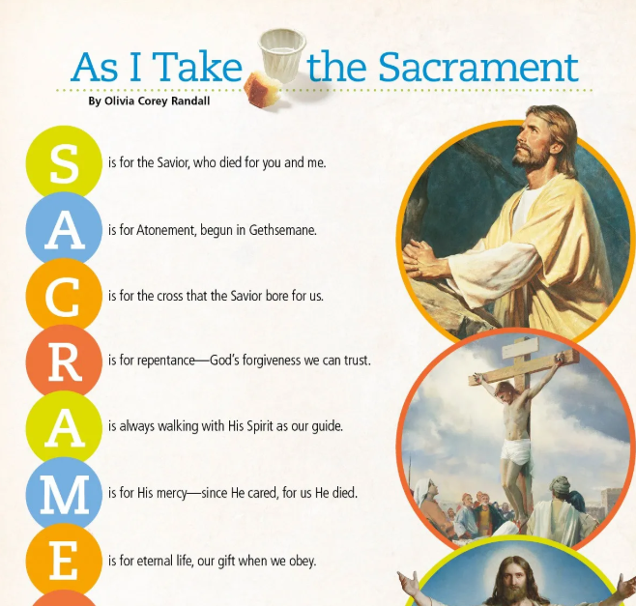
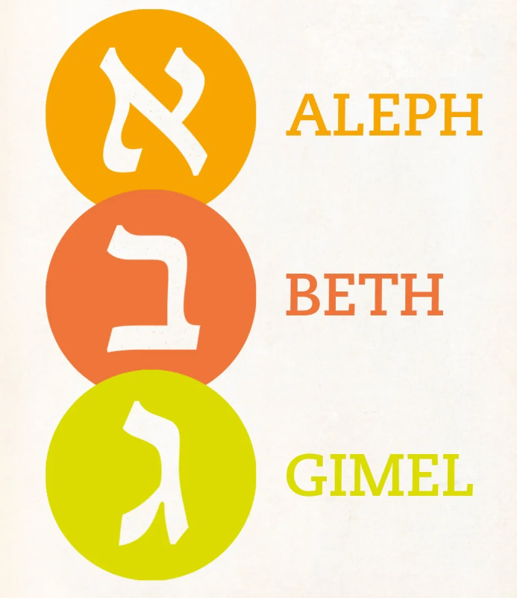
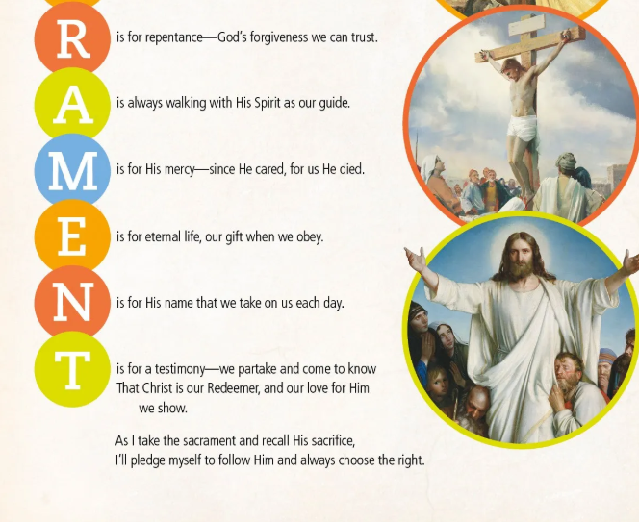
A thought from Psalms 102–150.
Check out Psalm 119! Whoa. It’s the longest chapter in the Bible!
It’s 176 verses long, divided into 22 stanzas of eight verses each. Each stanza is named after a Hebrew letter: aleph, beth, gimel, etc. (What, you don’t have the Hebrew alphabet memorized?)
Here’s the cool part. In the original Hebrew, each verse begins with its “title” letter. That is, in the “aleph” stanza, all eight verses start with the first Hebrew letter. The “beth” verses all start with the second Hebrew letter. And so on. Obviously, this effect gets lost in translation, but the original audience would have noticed it.
This kind of writing—where the first letters of each line spell out a word or phrase or form a pattern—is called an acrostic.
Psalm 119 is the most complete acrostic in the Psalms, but it’s not the only one. There are also these:
Psalms 25, 34, 37, 111, 112, 119, and 145 all have acrostic elements in their original Hebrew.
Lamentations 1, 2, and 4 are all acrostics, each with 22 verses, one for each letter in the Hebrew alphabet.
Why do you think Old Testament writers used acrostic style writing? One reason might be that the structure makes the text easier to remember. Going through the whole alphabet also suggests completeness—it covers everything “from A to Z” (or from aleph to tau).
Gospel Living
Fun With Hebrew Poetry

Slide 24
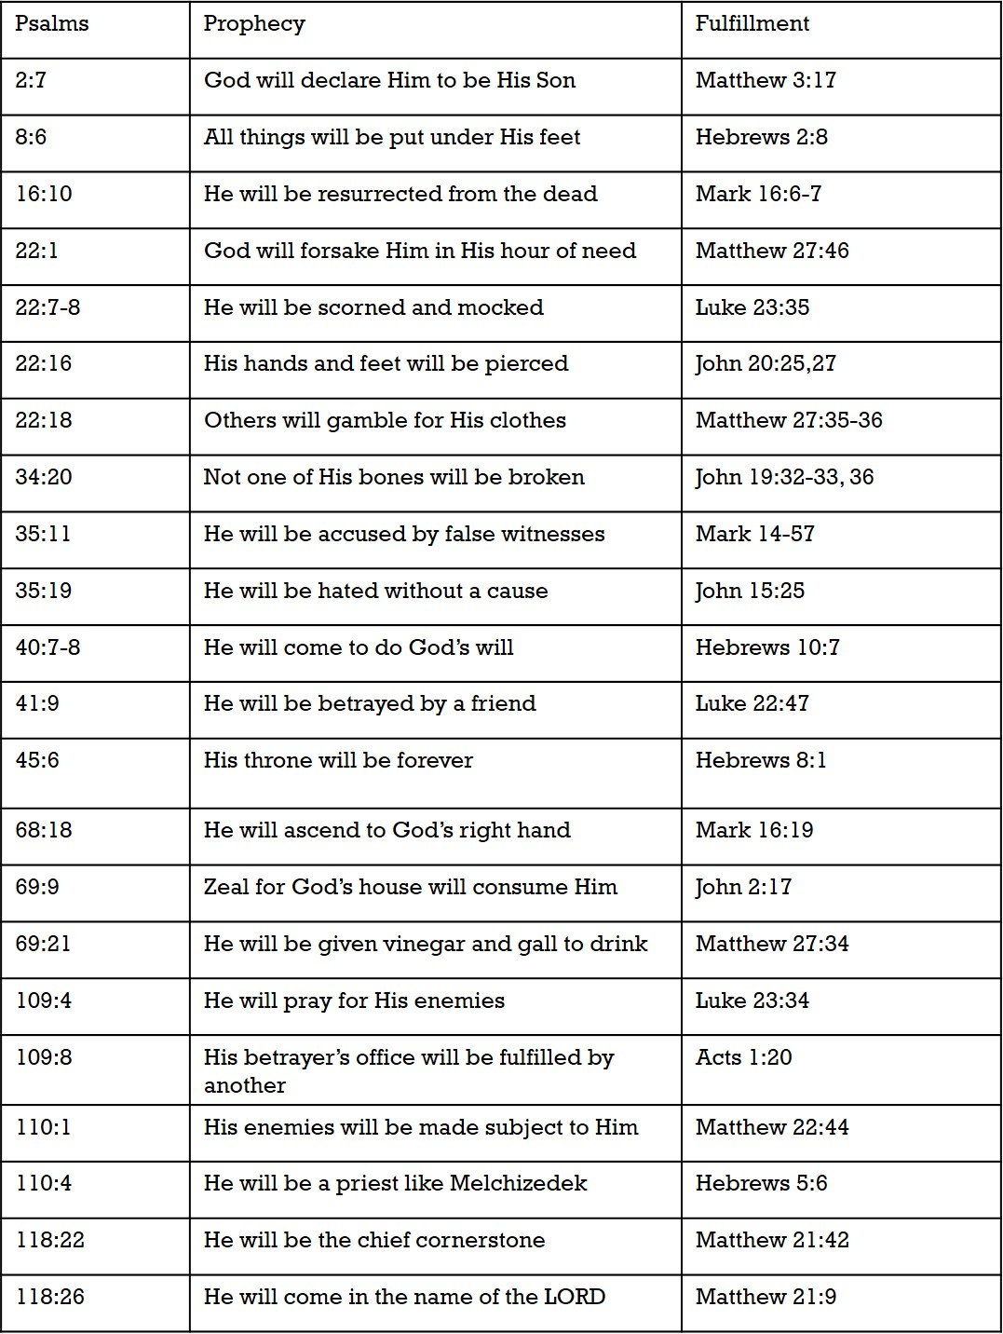
Color Chart
Jesus Christ, The King (portrayed in Matthew)
Jesus Christ, The Servant (portrayed in Mark)
Jesus Christ, the Son of God (portrayed by Luke)
Jesus Christ, the Son of God (portrayed by John)
Jesus Prophesied in Psalms
Chart from: Talk thru the Bible by Bruce Wilkinson and Kenneth Boa

Slide 25
Psalms 1-41
1. Two ways of Life | 2. Coronation of the Lord’s Anointed | 3. Victory in the Face of Defeat | 4. Evening Prayer for Deliverance | 5. Morning Prayer for Guidance | 6.Prayer for God’s Mercy
7. Wickedness Justly Rewarded | 8. God’s Glory and Man’s Dominion | 9. Praise for Victory over Enemies | 10. Petition for God’s Judgment | 11. God Tests the Sons of Men | 12. The Pure Words of the LORD
13. The Prayer for God’s Answer—Now | 14. The Characteristics of the Godless | 15. The Characteristics of the Godly | 16. Eternal Life for One Who Trusts | 17. “Hide Me Under the Shadow of Your Wings” | 18. Thanksgiving for Deliverance by God
19. The Works and Word of God | 20. Trust Not in Chariots and Horses but in God | 21. Triumph of the King | 22. Psalm of the Cross, “The LORD is my Shepherd” | 23. Psalm of the Divine Shepherd | 24. Psalm of the King of Glory
25. Prayer for Instruction | 26. “Examine Me, O Lord, and Prove Me? | 27. Trust in the Lord and Be Not Afraid | 28. Rejoice Because of Answered Prayer | 29. The Powerful Voice of God | 30. Praise for Dramatic Deliverance
31. “Be of Good Courage” | 32. The Blessedness of Forgiveness | 33. God Considers All Man’s Works | 34. Seek the Lord | 35. Petition for God’s Intervention | 36. The Loving Kindness of God
37. “Rest in the Lord” | 38. The Heavy Burden of Sin | 39. Know the Measure of Man’s Day | 40. Delight to Do God’s Will | 41. The Blessedness of Helping the Poor
The book of Psalms begins with a contrast between the godly and the ungodly.
Some of these psalms put great emphasis on trusting God rather than earthly objects or people and remind us that we need not fear because God is with us.
Another psalm reminds us that God will judge our hearts and that we should seek after God’s mercy.

Slide 26
Psalms 42-72
42. Seek After the Lord | 43. “Hope in God” | 44. Prayer for Deliverance by God | 45. The Psalm o the Great King | 46. “God is Our Refuge and Strength” | 47. The LORD Shall Subdue All Nations
48. Praise of Mount Zion | 49. Riches Cannot Redeem | 50. The Lord Shall Judge All people | 51. Confession and Forgiveness of Sin | 52. The LORD Shall Judge the Deceitful | 53. A Portrait of the Godless
54. The LORD Is Our Helper | 55. “Cast Your Burden Upon the LORD | 56. Fears in the Midst of Trials | 57. Prayers in the Midst of Perils | 58. Wicked Judges Will Be Judged | 59. Petition for Deliverance from Violent Men
60. Prayer for Deliverance of the Nation | 61. Prayer When Overwhelmed | 62. Wait for God | 63. Thirst for God | 64. Prayer for God’s Protection | 65. God’s Provision through Nature
66. Remember What God Has Done | 67. God Shall Govern the Earth | 68. God is the Father of the Fatherless | 69. Petition for God to Draw Near | 70. Prayer for the Poor and Needy | 71. Prayer for the Aged
72. The Reign of the Messiah | Psalms 42-72
These psalms could be summarized with the phrase “God is our refuge and strength” (Psalm 46:1).
One psalm reminds us to cast our burdens upon the Lord in every challenge or trial.
Another encourages us to wait patiently upon God in all things.

Slide 27
Psalms 73-89
73. Perspective of Eternity | 74. Request for God to Remember His Covenant | 75. “God Is the Judge” | 76. The Glorious Might of God | 77. When Overwhelmed, Remember God’s Greatness | 78. God’s Continued Guidance in Spite of Unbelief
79. Avenge the Defilement of Jerusalem | 80. Israel’s Plea for God’s Mercy | 81. God’s Plea for Israel’s Obedience | 82. Rebuke of Israel’s Urgent Judges | 83. Plea for God to Destroy Israel’s Enemies | 84. The Joy of Dwelling with God
85. Prayer for Revival | 86. “Teach Me Your Way, O LORD” | 87. Glorious Zion, City of God | 88. Crying from Deepest Affliction | 89. Claiming God’s Promises in Affliction
These psalms encompass several themes and frequently describe God as a judge who can rebuke wicked earthly judges and destroy Israel’s enemies.
In Psalm 86, King David records a plea that God teach us His way so we can walk in truth

Slide 28
Psalms 90-106
90. “Teach Us to Number Our Days” | 91. Abiding in “The Shadow of the Almighty” | 92. It is Good to Praise the LORD | 93. The Majesty of God | 94. Vengeance Belongs only to God | 95. Call to Worship the LORD
96. Declare the Glory of God | 97. Rejoice! The LORD Reigns! | 98. Sing a New Song to the LORD | 99. “Exalt the LORD Our God” | 100. “Serve the LORD with Gladness” | 101. Commitment of a Holy Life
102. Prayer of an Overwhelmed Saint | 103. Bless the LORD, All you People! | 104. Psalm Rehearsing Creation | 105. Remember, God Keeps His Promises | 106. “We Have Sinned”
Many of these psalms encourage us to praise the Lord, remember that vengeance belongs to Him, declare His glory, and serve Him with gladness

Slide 29
Psalms 107-150
107. God Satisfies the Longing Soul | 108. Awake Early and Praise the LORD | 109. Song of the Slandered | 110. The Coming of the Priest-King-Judge | 111. Praise for God’s Tender Care | 112. The Blessings of Those Who Fear God
113. The Condescending Grace of God | 114. In Praise for the Exodus | 115. To God Alone Be the Glory | 116. Love the LORD for What He Has Done | 117. Praise of All | 118. Better to Trust God Than Man
119. Praise of the Scriptures | 120. A Cry in Destress | 121. God is Our Keeper | 122. Pray for the Peace of Jerusalem” | 123. Plea for the Mercy of God | 124. God is on Our Side
125. Trust in the LORD and Abide Forever | 126. “Sow in Tears, Reap in Joy” | 127. Children are God’s Heritage | 128. Blessing on the House of the God-fearing | 129. Plea of the Persecuted | 130. “My Soul Waits for the Lord”
131. A Childlike Faith | 132. Trust in the God of David | 133. Beauty of the Unity of the Brethren | 134. Praise the LORD in the Evening | 135. God Has Done Great Things! | 136. God’s Mercy Endure Forever
137. Tears in Exile | 138. God Answered My Prayer | 139. “Search Me, O God” | 140. Preserve Me form Violence | 141. Set a Guard, O LORD, over My Mouth | 142. “No One Cares for My Soul”
143. “Teach Me to Do Your Will” | 144. “What Is Man?” | 145. Testify to God’s Great Acts | 146. “Do Not Put Your Trust in Prince” | 147. God Heals the Brokenhearted | 148. All Creation Praises the LORD
149. “The Lord Take Pleasure in His People” | 150. “Praise the LORD”
These psalms recognize that “children are an heritage of the Lord” (Psalm 127:3) and that they are an eternal blessing for righteous parents. One psalm near the end of the book offers a heartfelt plea that the Lord will deliver us and keep us from the evil and violent practices of wicked men.

Slide 30
Praising the Lord:
“I think the Lord’s people should rejoice in him and shout praises to his holy name. Cries of hosannah should ascend from our lips continually. When I think of the revealed knowledge we have about him whom it is life eternal to know, and of the great plan of salvation which he ordained for us; when I think about his Beloved Son, who bought us with his blood, and who brought life and immortality to light through his atoning sacrifice; when I think of the life and ministry of the Prophet Joseph Smith, who has done more save Jesus only for the salvation of men in this world, than any other man who ever lived in it, and who crowned his mortal ministry with a martyr’s death—my soul wells up with eternal gratitude and I desire to raise my voice with the choirs above in ceaseless praise to him who dwells on high.
“When I think that the Lord has a living oracle guiding his earthly kingdom, and that there are apostles and prophets who walk the earth again; when I think that the Lord has given us the gift and power of the Holy Ghost so that we have the revelations of heaven and the power to sanctify our souls; when I think of the unnumbered blessings—the gifts, the miracles, the promise that the family unit shall go on everlastingly, all the blessings that are poured out upon us, and offered freely to all men everywhere—my desire to praise the Lord and proclaim his goodness and grace knows no bounds. And so in this spirit of praise and thanksgiving … I shall conclude with these words of my own psalm:.
“Praise ye the Lord:
Praise him for his goodness;
Praise him for his grace;
Exalt his name and seek his face—
O praise ye the Lord.
“Blessed is the Lord:
Bless him for his mercy;
Bless him for his love;
Exalt his name and seek his face—
O blessed is the Lord.
“Praise ye the Lord:
Praise him who all things did create;
Praise him who all things did redeem;
Exalt his name and seek his face—
O praise ye the Lord.
“Seek ye the Lord:
Seek him who rules on high;
Seek him whose will we know;
Exalt his name and seek his face—
O seek ye the Lord”
Elder Bruce R. McConkie (“Think on These Things,” Ensign ,Jan. 1974, 48).

Slide 31
Psalm 22:1 “My God, my God, why hast thou forsaken me?”:
The first line of a hymn identifies the hymn. The first line of a psalm identifies the psalm. When Christ is on the cross, he utters this famous passage. It was an expression of his innermost feelings. It was an honest plea for understanding. But it was also a teaching moment. Those who had derided him saying, "If he be the King of Israel let him now come down from the cross, and we will believe him," (Matt. 27:42) were the chief priests and scribes. They should have known the scriptures better than anyone else. They should have known that the passage, "my God, my God, why hast thou forsaken me" was the first line of the 22nd Psalm. They should have recognized that Jesus was referencing the whole psalm when quoting this line. They should have thought about the content of this psalm. They should have recognized that the Messiah was at that moment on the cross and suffering just as the 22nd psalm had prophesied. They should have then felt remorse and guilt. They should have then understood that their mocking had been prophesied by David a millennia previous. Gospel Doctrine.com
Psalm 23:4 “though I walk through the valley of the shadow of death”
If anyone had reason to worry for his own safety, it was David in the years that Saul persistently sought his life. Walking through the "valley of the shadow of death" was not poetry for David-it was reality. "David abode in the wilderness in strong holds, and remained in a mountain in the wilderness of Ziph. And Saul sought him every Day, but God delivered him not into his hand" (1 Sam. 23:14) What to us may be figurative, was all too real to David.
"David... knew loneliness and estrangement; he knew what it meant to be homeless, without friends; he knew what it meant to be betrayed by those closest to him; he knew what it meant to have his friends suffer. His psalms reflect this. He also was a man of sorrow and acquainted with grief. He, like Jesus after him, knew to an amazing degree the fulness of the dimensions of life. But through all this, David knew best that God knew best-and that the safest course in life is to throw oneself to a great degree upon the wisdom of God. This theme is dominant throughout the psalms. He knew as well as anyone what Christ meant when he told his own disciples ten centuries later, "I am the vine, ye are the branches: He that abideth in me, and I in him, the same bringeth forth much fruit: for without me ye can do nothing." (John 15:5.) This knowledge underlies all of David's poetry-and all of his greatness." (Arthur R. Bassett, "The King Called David," Ensign, Oct. 1973, 69)

Slide 32
Some excerpts from Psalms
Psalm 4:5 | Offer the sacrifices of righteousness | Opportunities to lose oneself for the good of others present themselves daily: the mother who serves her children's needs; the father who gives his time for their instruction; parents who give up worldly pleasure for quality home life; children who care for their aged parents; home teaching service; visiting teaching; time for compassionate service; giving comfort to those who need strength; serving with diligence in Church callings; community and public service in the interest of preserving our freedoms; financial donations for tithes, fast offerings, support of missionaries, welfare, building and temple projects. Truly, the day of sacrifice is not past. Ezra Taft Benson (Conference Report, April 1979, 34)
Psalm 5:3 | In the morning will I direct my prayer unto thee, and will look up | Perhaps what this world needs, as much as anything, is to "look up" as the Psalmist said-to look up in our joys as well as our afflictions, in our abundance as well as in our need. We must continually look up and acknowledge God as the giver of every good thing and the source of our salvation. President Howard W. Hunter Ensign Nov. 1977
Psalm 6:1-2 | O Lord, rebuke me not in thine anger... Have mercy upon me, O Lord; for I am weak | The Lord is justified in punishing us for our sins. If he rebuked us and chastened us immediately after every sin, we would learn our lesson quickly. But do we really want that? Isn't this probationary state a chance for us to learn how to be obedient for reasons other than fear?
Psalm 7:8 | Judge me, O Lord, according to my righteousness, and according to mine integrity | To me the principle of integrity is one of the greatest blessings we can possibly possess. He who proves true to himself or his brethren, to his friends and his God, will have the evidence within him that he is accepted; he will have the confidence of his God and of his friends. The Discourses of Wilford Woodruff, edited by G. Homer Durham [Salt Lake City: Bookcraft, 1969], 260)
Psalm 8:4 | What is man that thou art mindful of him? | I first read the following words 67 years ago in a college English class: "What a piece of work is man! how noble in reason! how infinite in faculty! in form and moving how express and admirable! in action how like an angel! in apprehension how like a god! the beauty of the world! the paragon of animals!" (Hamlet, act 2, scene 2, lines 303-7). Gordon B. Hinckley ("The Quest for Excellence," Ensign, Sept. 1999, 2, 5)
Psalm 9:7 | the Lord... hath prepared his throne for judgment | The ninth psalm may not be the most famous of psalms, but within its few verses is the prophecy of Millennial Judgment-the assurance that the both the wicked and the righteous will receive their due. This judgment will be administered from the millennial throne of Christ. He will share this responsibility with righteous priesthood holders (1 Cor. 6:22; Rev. 20:4).

Slide 33
Some excerpts from Psalms
Psalm 10:1 | Why standest thou afar off, O Lord? Why hidest thou thyself in times of trouble? | At times when the wicked prosper and the righteous suffer, we wonder why God doesn't step in and do something (Alma 14:8-11). Can you think of another prophet who wondered why God seemed so distant? How about the Prophet Joseph in Liberty Jail?
Psalm 14:1 | The fool hath said in his heart, There is no God | What, then, is the meaning of life? What are its central purposes? Can they ever be identified and understood by mortals? These are questions which in one form or another have occupied the time and attention of thoughtful men and women throughout the ages. Alexander B. Morrison ("Life-The Gift Each Is Given," Ensign, Dec. 1998, 15)
Psalm 16:10 | thou wilt not leave my soul in hell | The only souls who are left in hell are the sons of perdition. After their suffering in spirit prison, "all the rest shall be brought forth by the resurrection from the dead through the triumph and glory of the Lamb" to inherit one of three kingdoms of glory (D&C 76:39). David fell from his exaltation, but he was not a son of perdition
Psalm 18:18-20, 24, 96 | Read at the dedication of the Kirtland temple by Sidney Rigdon | At nine o'clock a. m. [March 27, 1836] President Sidney Rigdon commenced the services of the day by reading the 96th and 24th Psalms... President Rigdon then read the 18th, 19th and 20th verses of the 18th chapter of Matthew, and preached more particularly from the 20th verse
Psalm 19:2 | The heavens declare the glory of God; and the firmament sheweth his handywork | (Astronaut Don Lind) "To look down on the earth from space is absolutely incredible. I knew ahead of time just exactly what I was going to see. I was intellectually prepared, but I was not prepared emotionally for what I saw. The world is very large. I knew that. But to see this huge, magnificent sphere slowly rotating beneath me was overwhelming. ("The Heavens Declare the Glory of God," Ensign, Nov. 1985, 38-39)
Psalm 35 | Read at the First Continental Congress | Reverend Duché opened the second session on September 7th, 1774 with prayer. It was not a perfunctory prayer, but one that was a time of profound prayer. Opening the session he read the 35th Psalm, and then broke into extemporaneous prayer.

